Slide 1
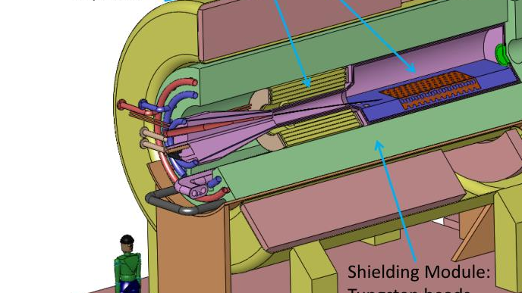



Target Studies for Pion Production
Simulation setup
8/4/2026
Ruaa Alharthy

Slide 2
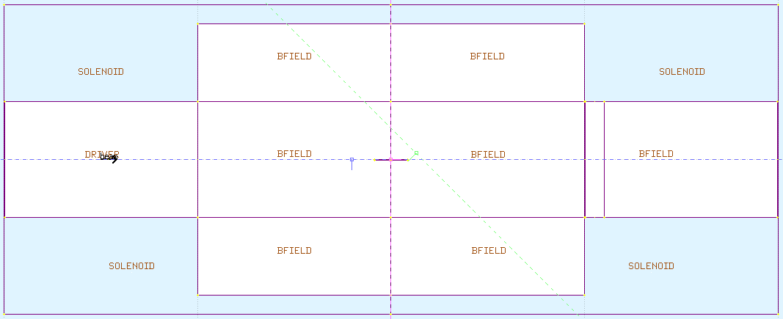
Geometry Setup
The solenoid is 2m wide and has a radius of 70cm.
The target is located at the center of the solenoid.
For now, I chose the transport system to have an aperture that is 60cm wide.
The driver section does not have magnetic field (to ensure the protons move in a straight line)
Used 100,000 8GeV protons.
200 cm
70 cm
80 cm
Invisible detector
No magnetic field here
Target:
Radius = 0.15 cm
Length = 17 cm
Aperture:
60 cm
100 cm
400 cm

Slide 3
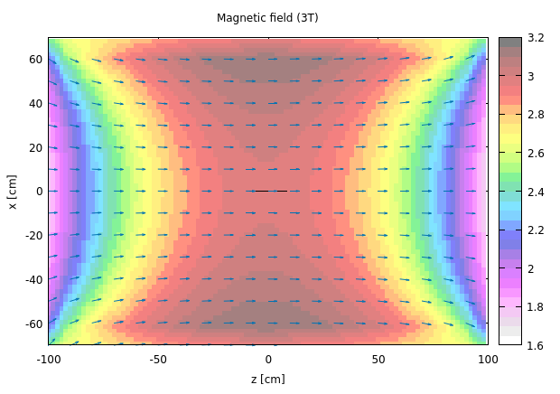
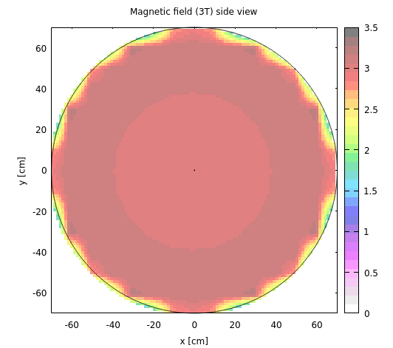
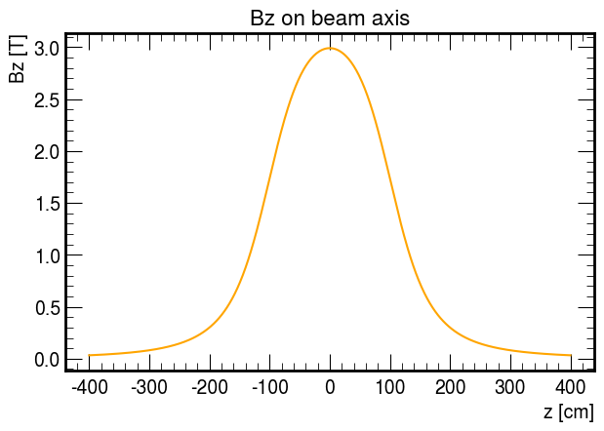
Magnetic field topology
I created magnetic fieldmaps for 3T – 10T.
Initially, I am planning to make a simple comparison of the performance of the different magnetic field strengths.
I also made sure to include fringe fields that span more than 100cm outwards.

Slide 4
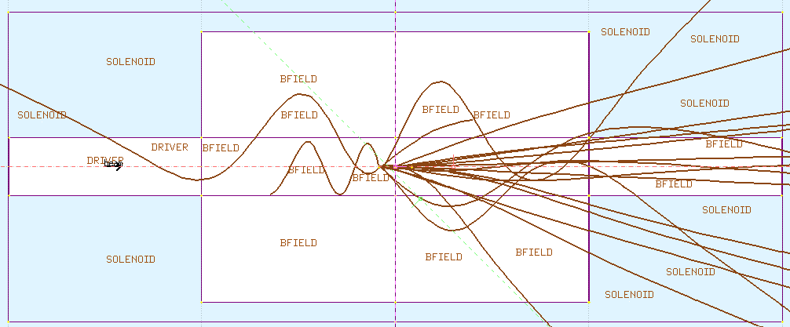
Here are some tracks – 3T

Slide 5
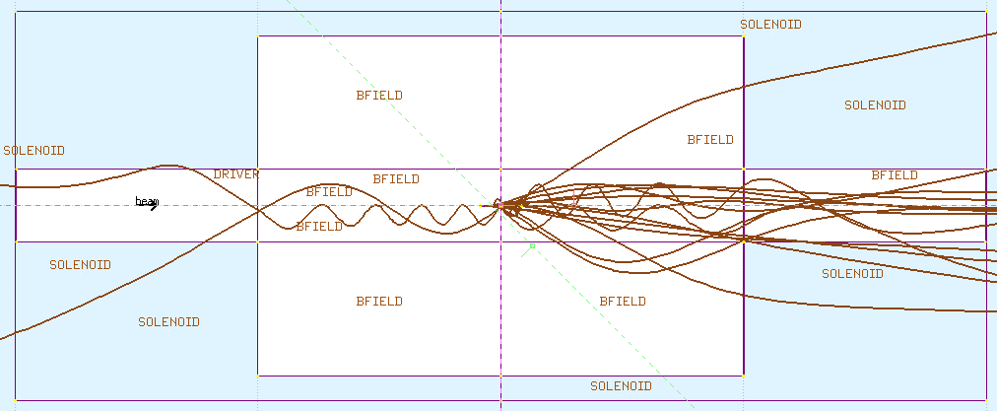
Here are some tracks – 8T

Slide 6
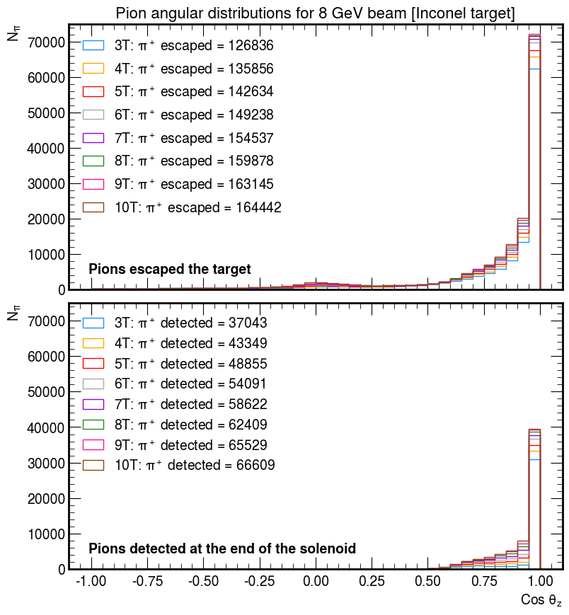
Angular distribution
The following are angular distributions of pions that have escaped the target and those that have been detected by the detector at the end of the solenoid.
Θz is the angle of the momentum of the particle w.r.t the beam axis.
Cos Θz = 1 means that the pion’s momentum is completely along the beam axis.
Cos Θz = 0 means that the pion’s momentum is perpendicular to the beam axis.
So, for an aperture of 60cm, we can capture pions that have Cos Θz > 0.5 .

Slide 7
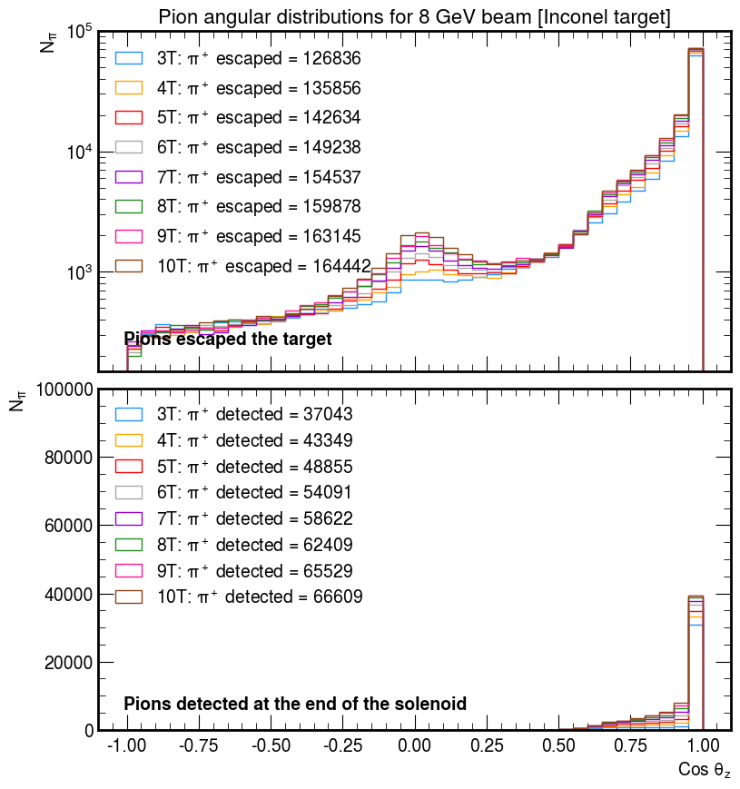
Angular distribution
The following are angular distributions of pions that have escaped the target and those that have been detected by the detector at the end of the solenoid.
Θz is the angle of the momentum of the particle w.r.t the beam axis.
Cos Θz = 1 means that the pion’s momentum is completely along the beam axis.
Cos Θz = 0 means that the pion’s momentum is perpendicular to the beam axis.
So, for an aperture of 60cm, we can capture pions that have Cos Θz > 0.5 .

Slide 8
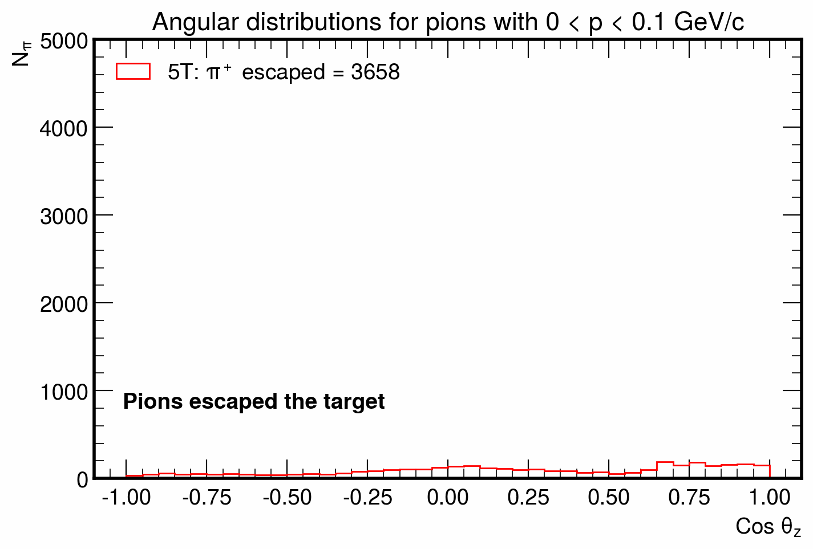
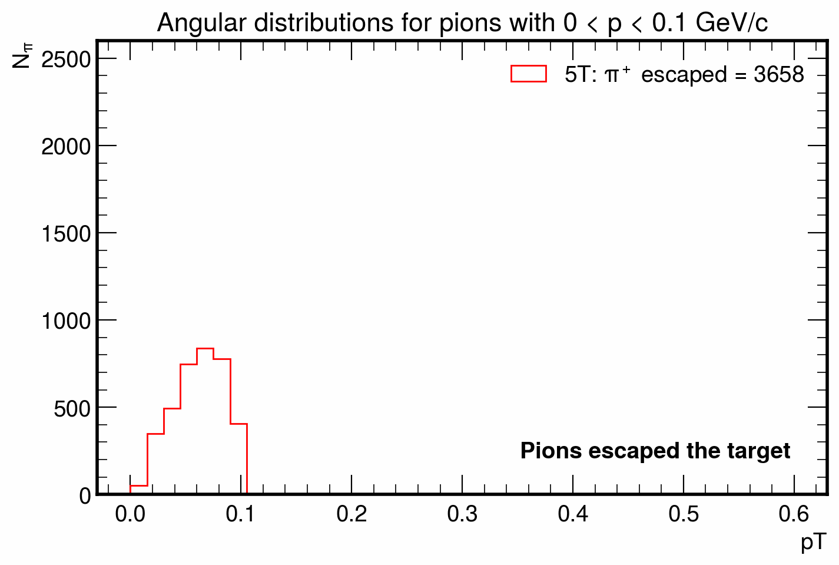
A look at the pT of pions

Slide 9
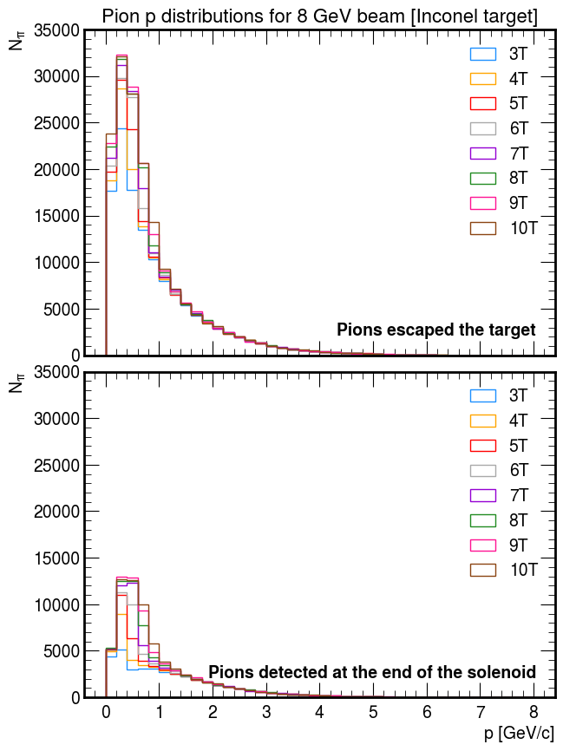
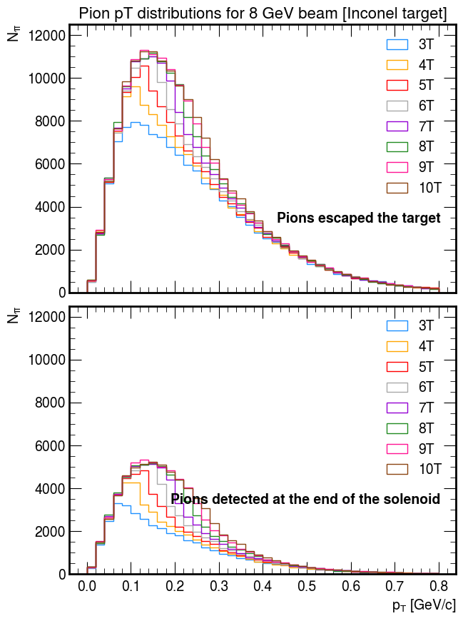
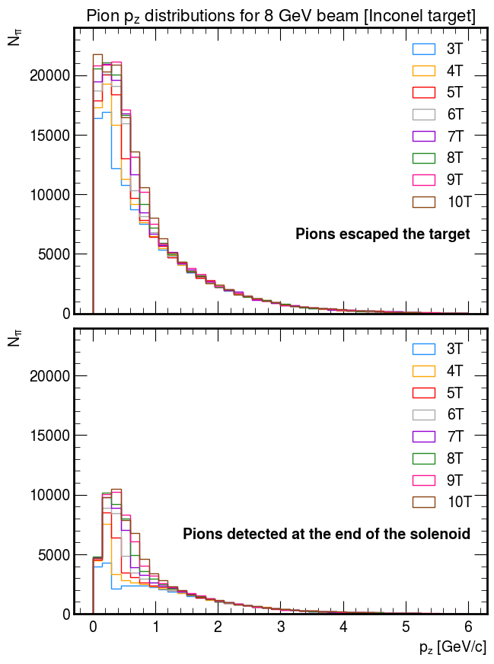
Momentum distribution

Slide 10
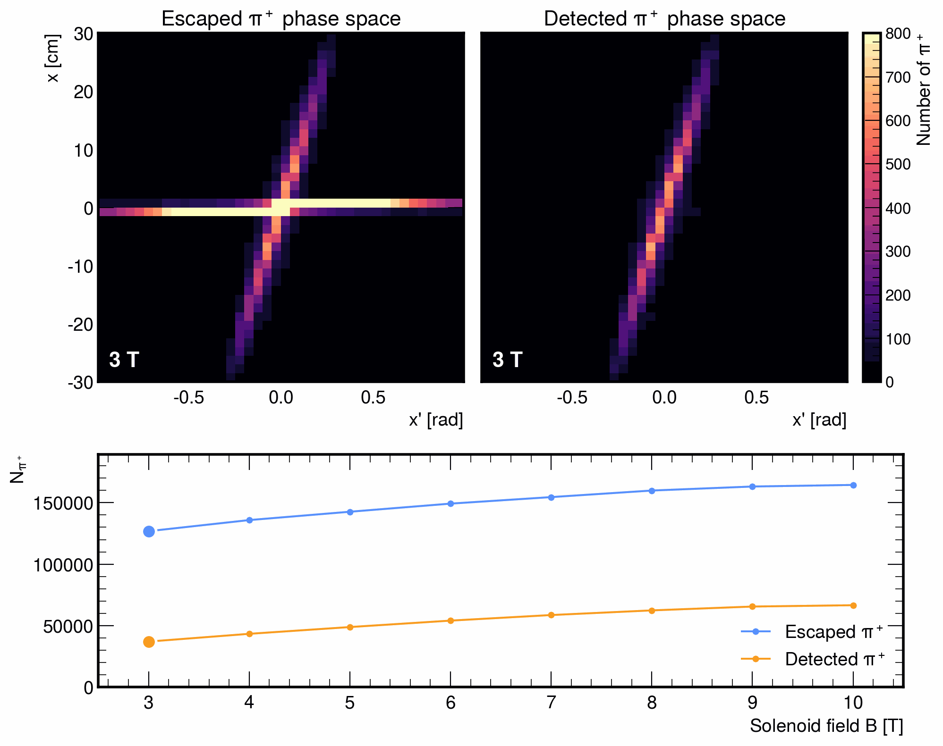
π⁺ phase space

Slide 11
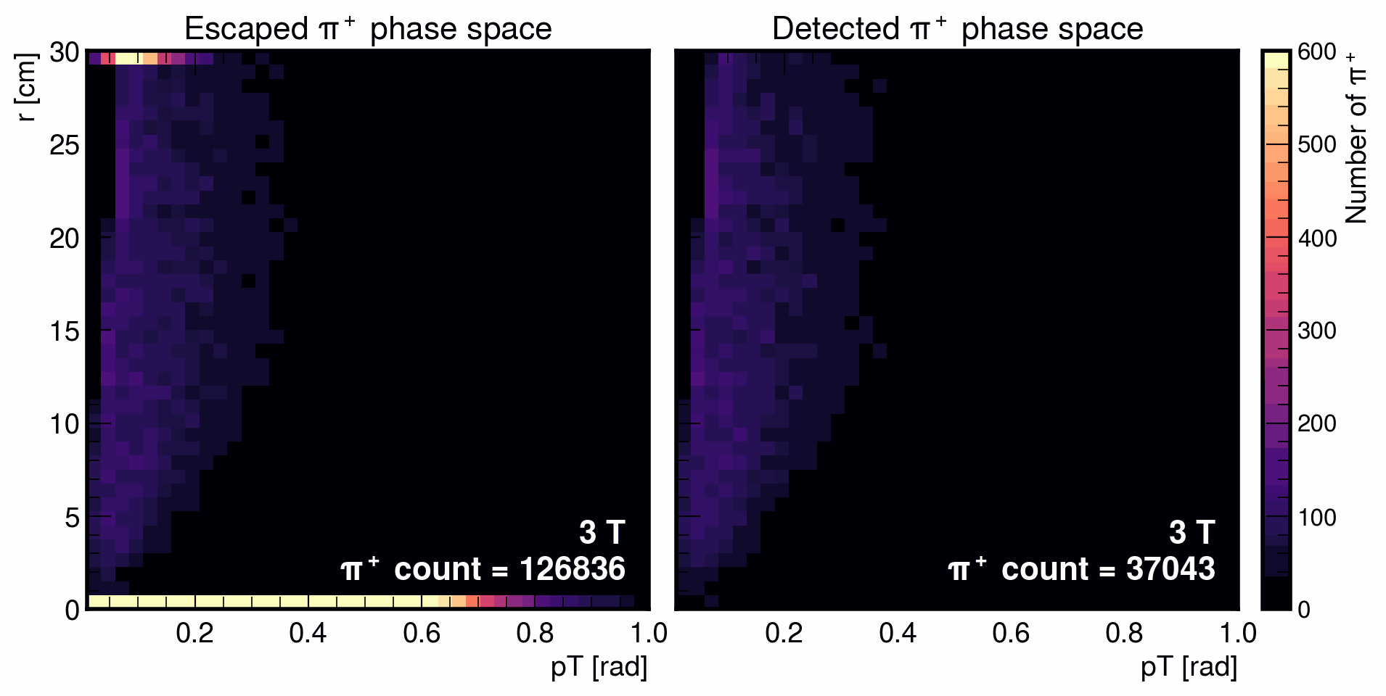
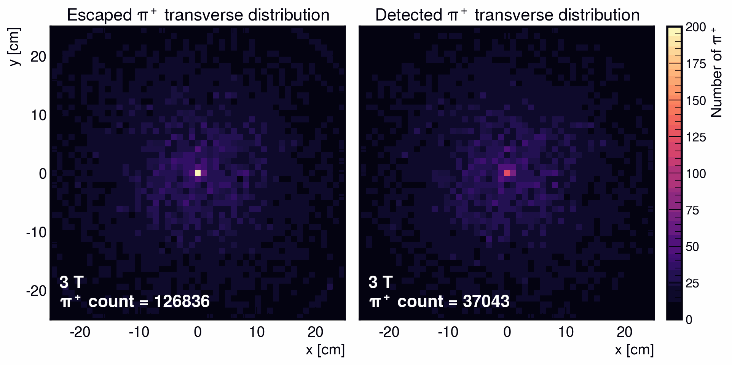
π⁺ phase space
The top row shows r vs pT plots for escaped and detected pi+.
The r vs pT plot suggests that higher pT leads to larger escape radius.
This result is expected as the pions are in a region of significant magnetic field.
As the slope of the r vs pT plot increases the the beam tends to occupy a larger transverse area for the same momentum spread.

Slide 12
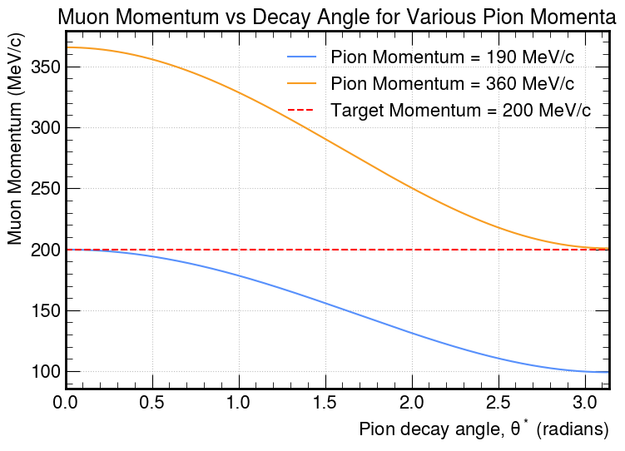
Pion momentum range (from Katsuya)
This plot shows the pion momentum range that would produce 200 MeV muons.
The 190-360 MeV/c momentum interval is used as a first estimate of the pion phase space most relevant for capture.
In practice, the capture channel has a finite momentum acceptance. Muons with momenta near the design value can also be transported efficiently. Consequently, the relevant pion momentum range is broader than the strict 190–360 MeV/c interval.

Slide 13
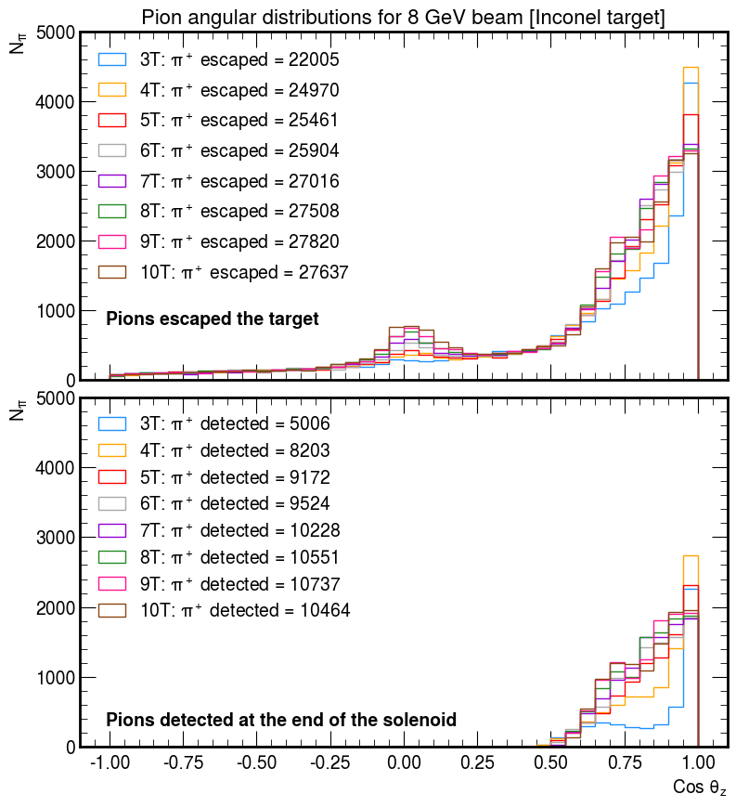
Angular distribution
(select 0.19 < p < 0.36 GeV/c)
Here I applied the momentum selection of 190-360 MeV/c for pions.
Now we see an interesting shift in the pion angular distribution.
Pions produced in 3T, 4T, and 5T solenoid tend to have higher Cos Θz values than those produced in stronger magnetic fields.

Slide 14
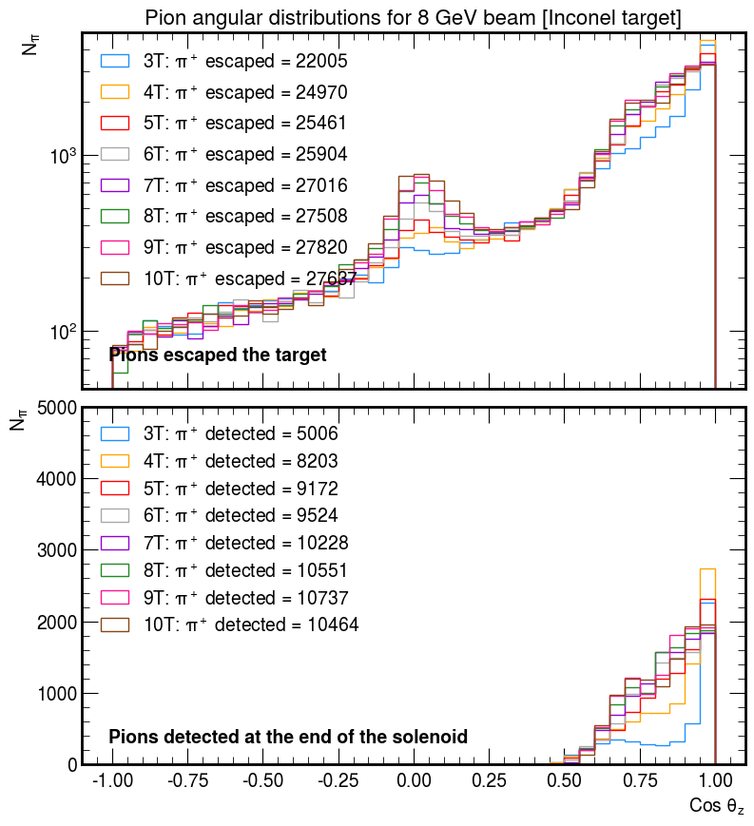
Angular distribution
(select 0.19 < p < 0.36 GeV/c)
Here I applied the momentum selection of 190-360 MeV/c for pions.
Now we see an interesting shift in the pion angular distribution.
Pions produced in 3T, 4T, and 5T solenoid tend to have higher Cos Θz values than those produced in stronger magnetic fields.

Slide 15
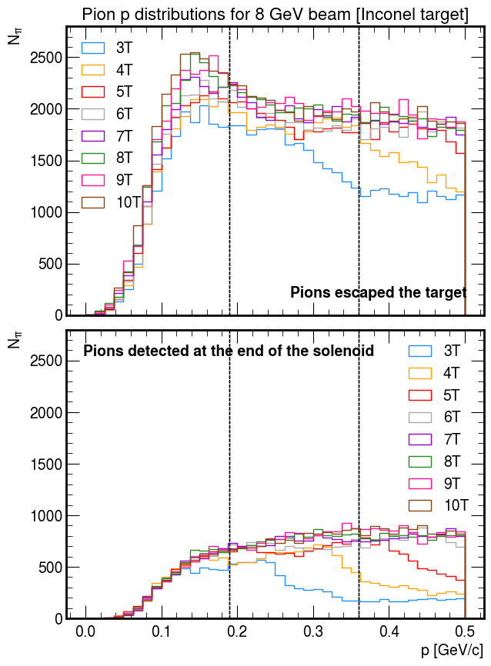
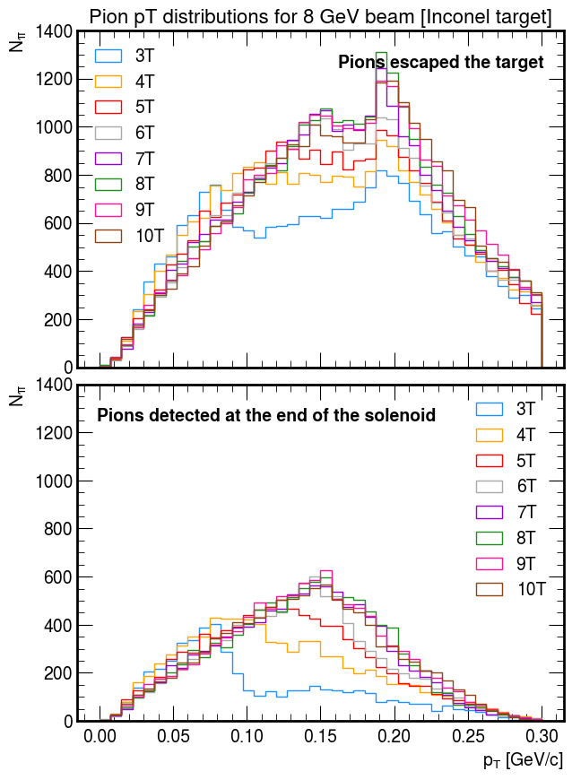
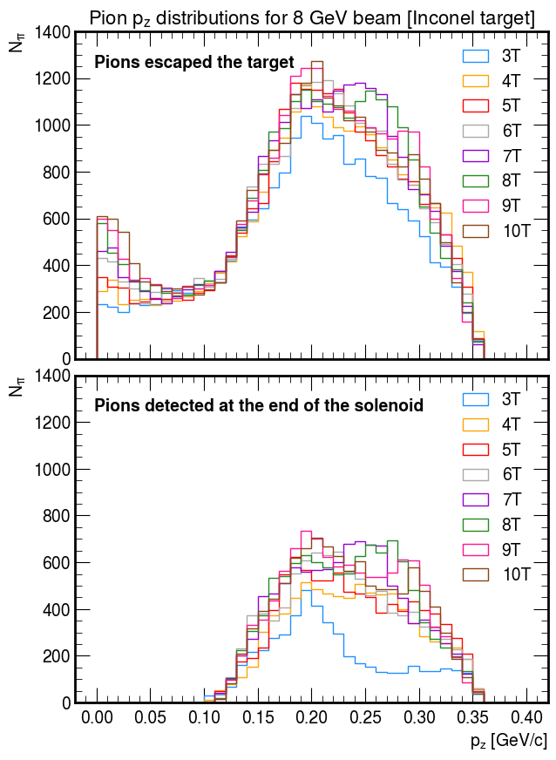
Momentum distribution (select 0.19 < p < 0.36 GeV/c)

Slide 16
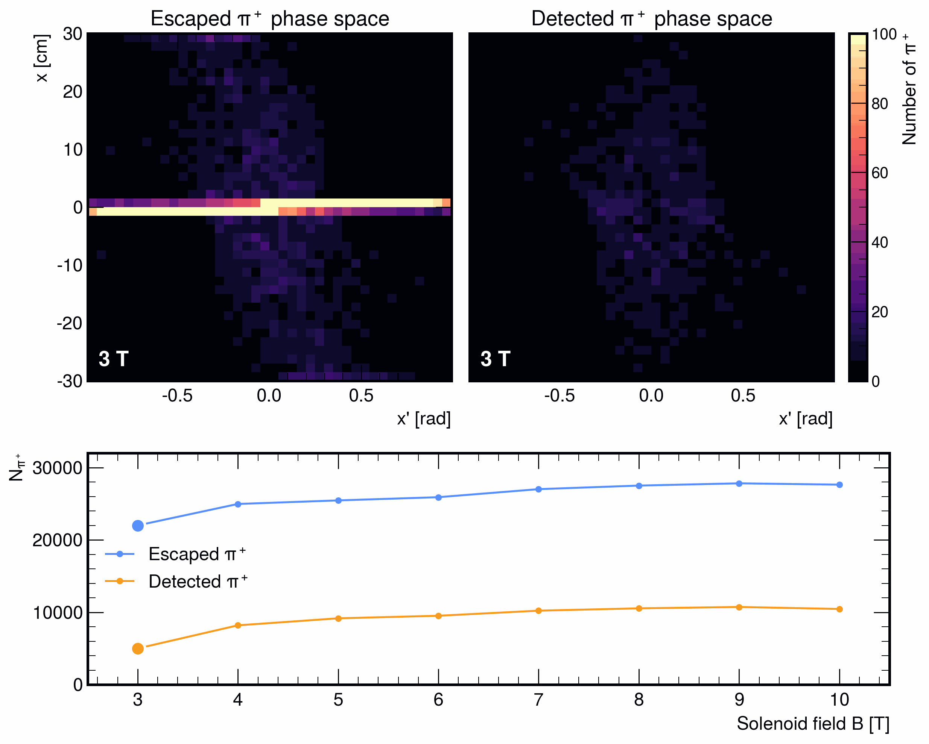
π⁺ phase space
(select 0.19 < p < 0.36 GeV/c)

Slide 17
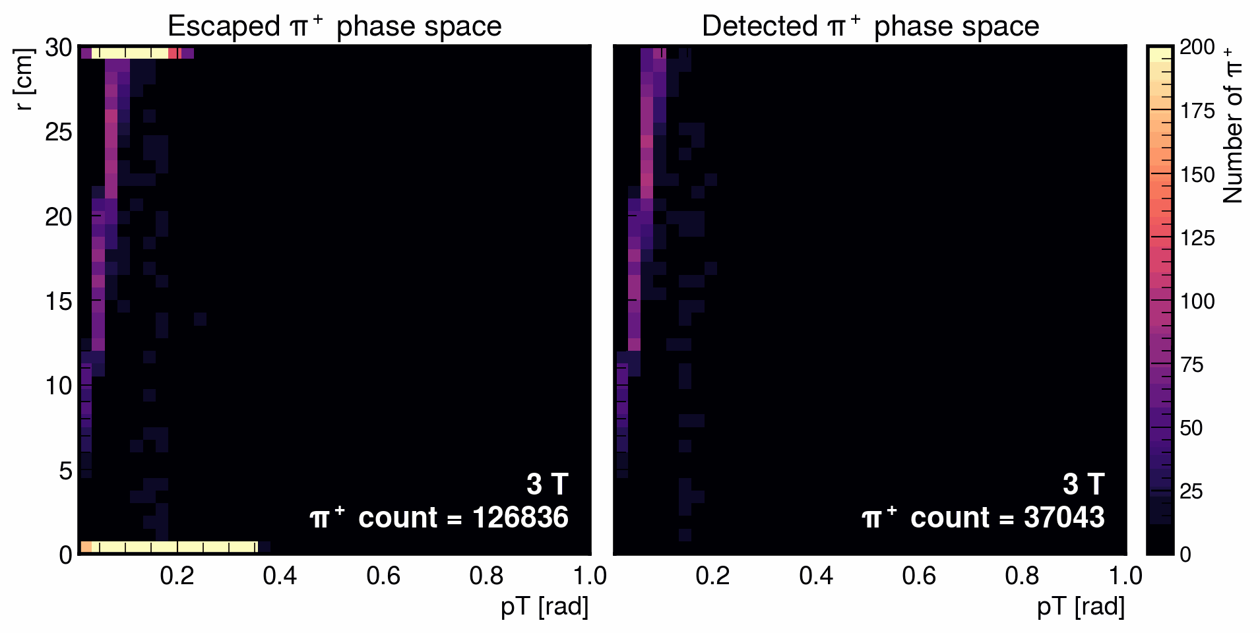
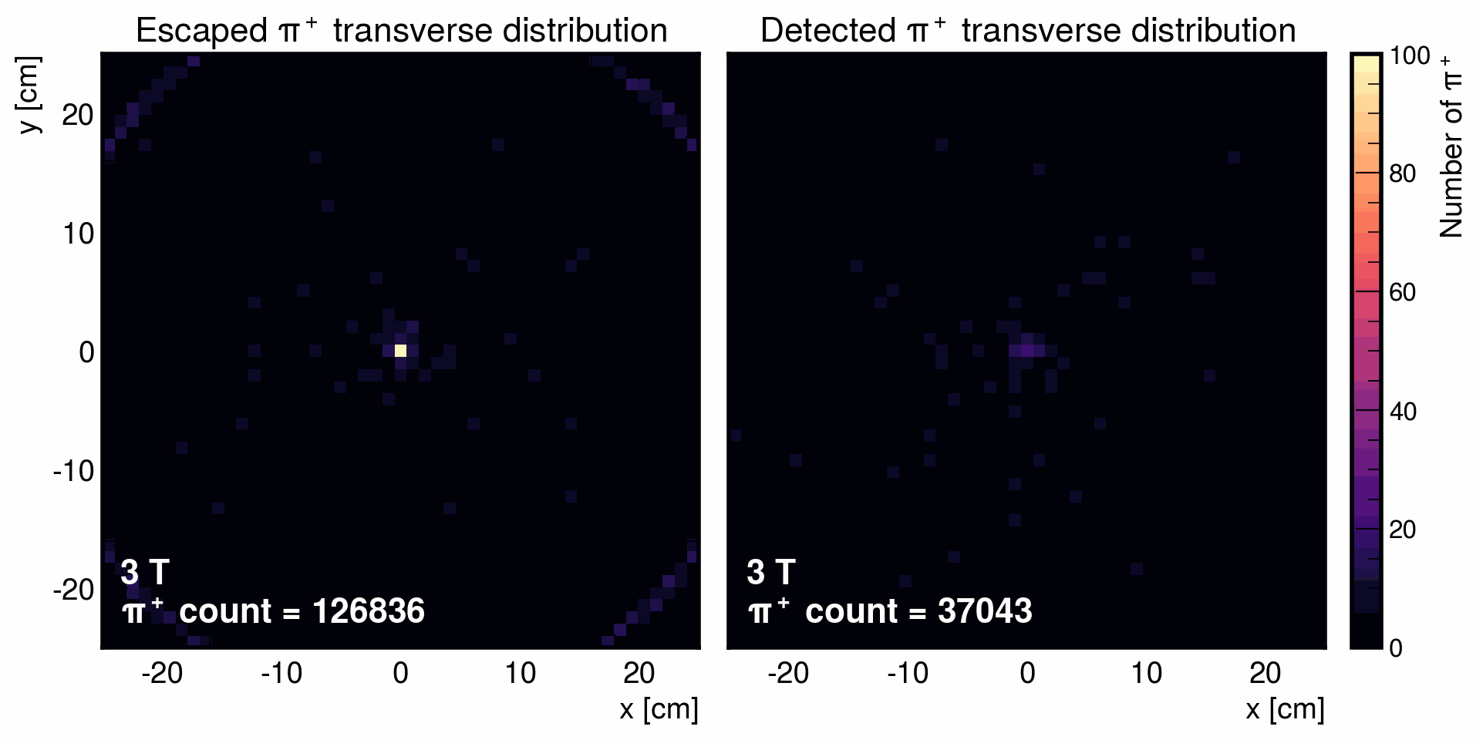
π⁺ phase space
The cloudiness that we start to see with correlation in the r vs pT plot is due to the the transport mixing the phase space.
  From ChatGPT

Slide 18
Next steps
Simulate pion production for 0T ~ no B-field
Simulate 0.8 GeV pions to study pion pT in low energy regime.
Maybe try to find a way to track particles (won’t spend so much time on this)
I am also working on a way to create a source pion beam file to be used for G4bl simulations → working towards a full pion/muon tracking in G4bl.

