Slide 1

MAIA Hackathon Summary
20 August 2026

Slide 2
Overview
Day 1: Looked at PhotonReconstruction, determined useless in default
Day 2: Dug into Federico’s FragmentRemoval optimizations, started producing samples and making comparisons
Day 3: Learned about and implemented KDTree search, made final comparisons

Slide 3
PhotonReconstruction
We had never verified the usefulness of the standalone photon clustering algorithm in the Pandora defaults
Turning it off does not change the efficiency for a photon gun sample
While there may be valid use cases, shouldn’t be in default, as it will not be relevant for particle gun samples

Slide 4
Fragment Removal: Moving Away from N²
Nested hit-to-hit comparison in fragment removal algorithms introduces a huge O(N²) inefficiency
  All hits are compared, even if they are on opposite ends of detector
  At first-order, we should be able to at least discard hits with vast spatial separation
Federico introduced the Bounding Box strategy
  Search layer by layer instead of hit by hit, skip if layer is empty

Slide 5
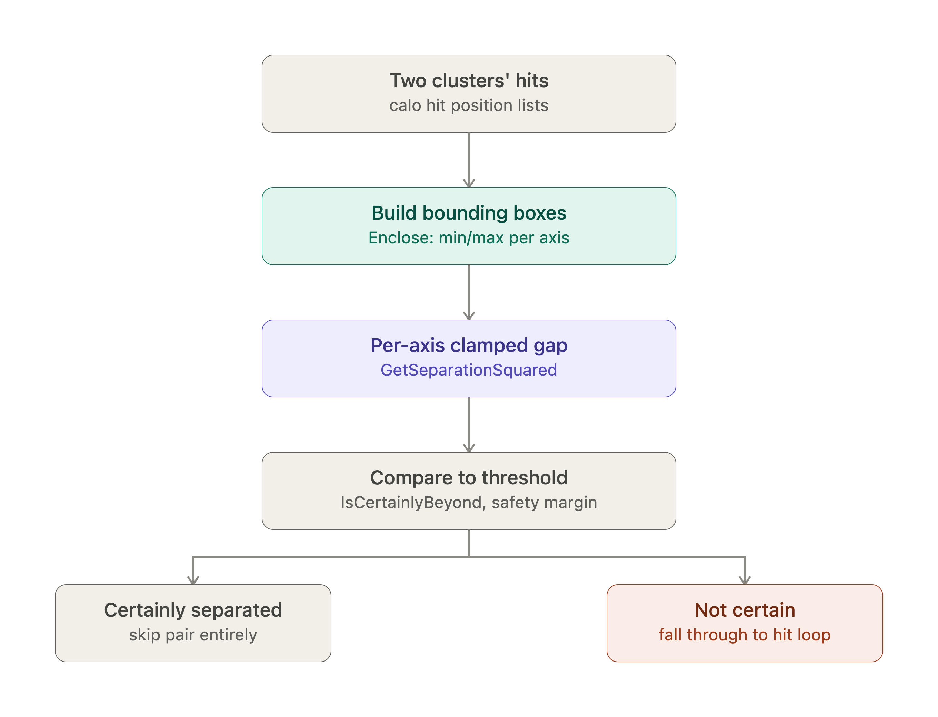
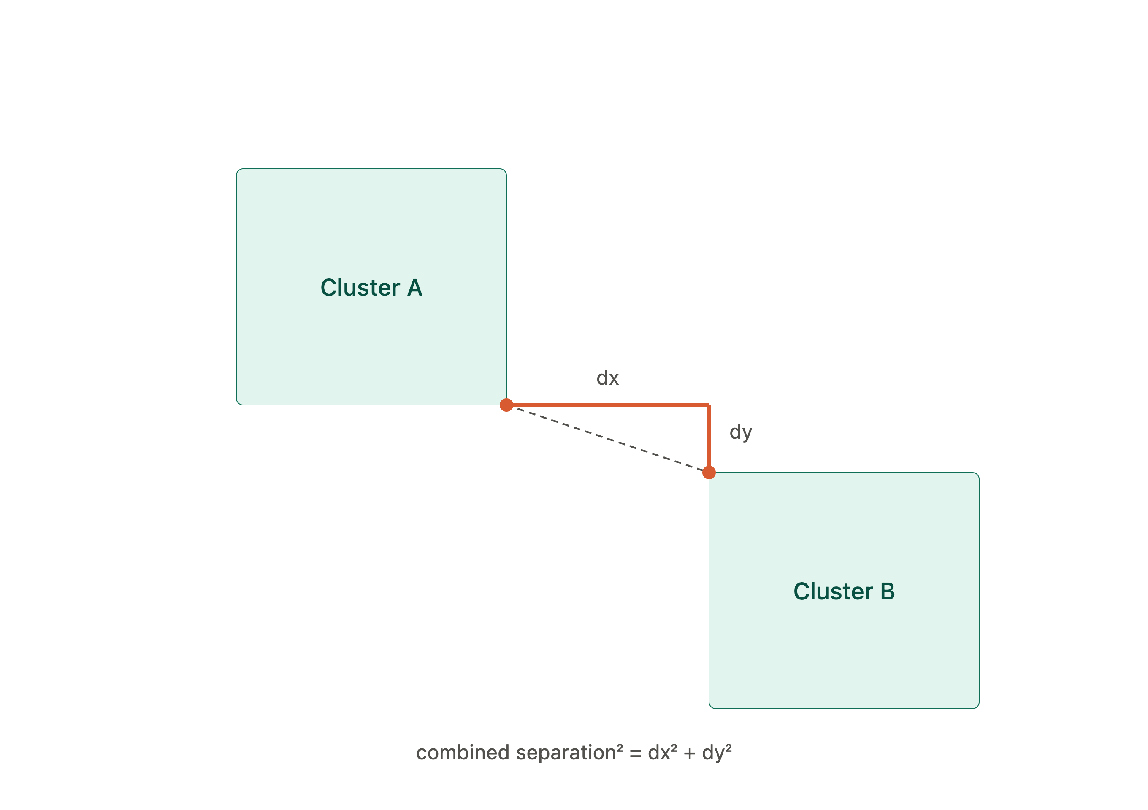
Bounding Box Logic
Rough cluster check: O(N)
Worst case scenario: O(N³)

Slide 6
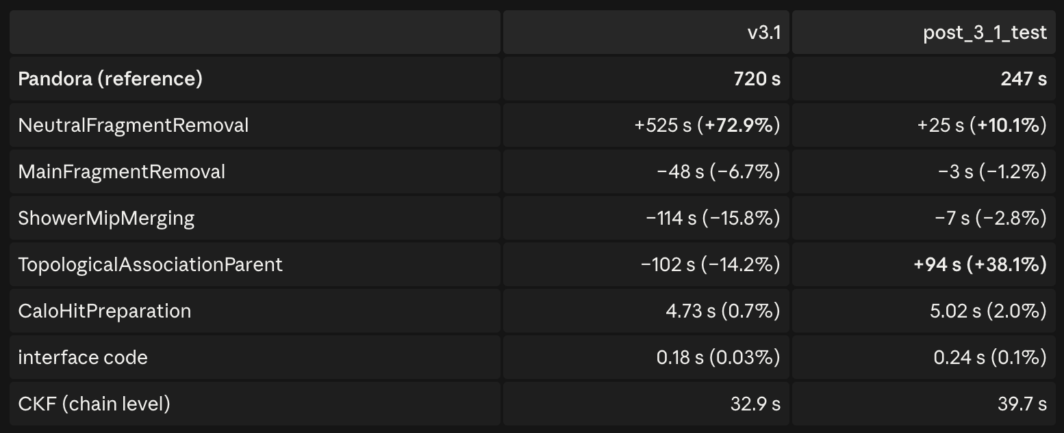
Fragment Removal Sub-Algorithm Timing
Fede’s results showed a timing improvement for the main fragment removal algorithm, but worse timing for the neutral fragment removal algorithm
Tested on a single photon gun event with 25% BIB overlay
This contradictory effect is what I wanted to understand

Slide 7
Tests against Photons
Ran the legacy, Fede’s optimizations (bounding box ON), and a middleground (bounding box ON for main, OFF for neutral/photon) and compared
Used two different photon samples, both with no BIB
  100 evts, 1 photon each, 50-250 GeV (isolated low-noise event proxy)
  100 evts, 10 photons each, 0-50 GeV (multi cluster, lower-E – towards BIB proxy)

Slide 8
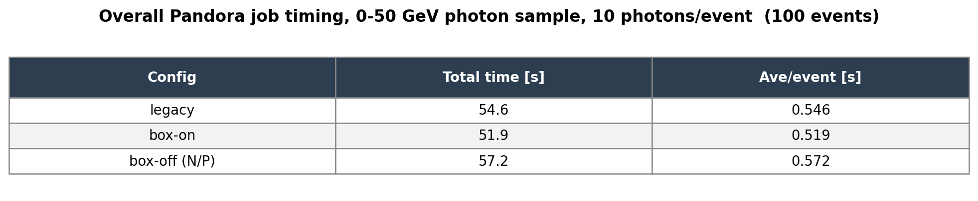
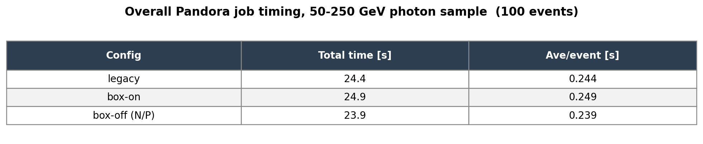
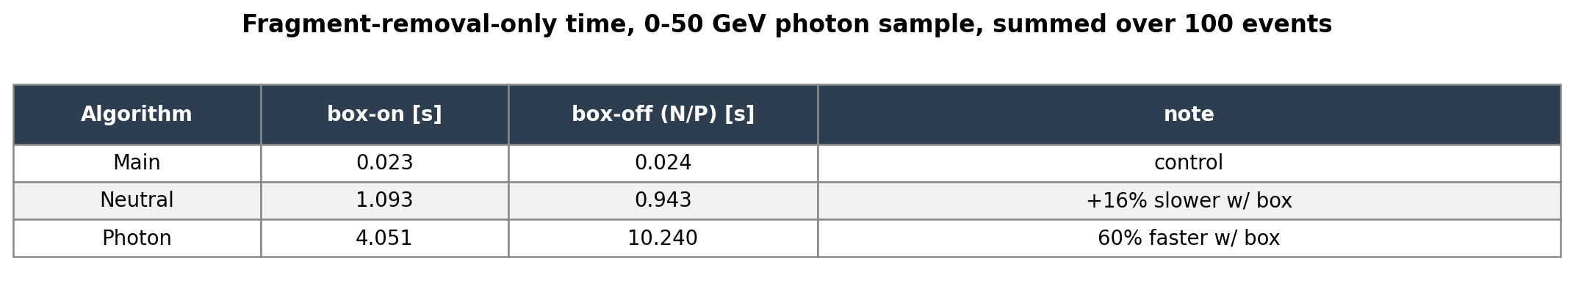
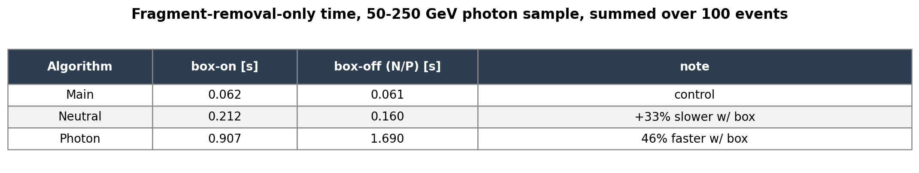
Timing Comparisons
Overall timing better with box on for “noisy” case (closest to what Fede tested)
Worse with box on for “clean” case (1 photon/evt)
  This is where the bounding box overhead kicks in

Slide 9
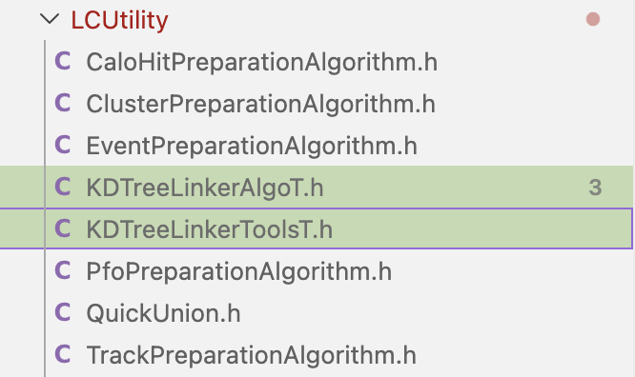
KDTree Implementation
Using a KDTree structure to do a cluster-to-cluster comparison takes us from O(N²) to O(NlogN)
Support already in place in Pandora LCUtility:
The actual algorithm logic is a bit complex…

Slide 10
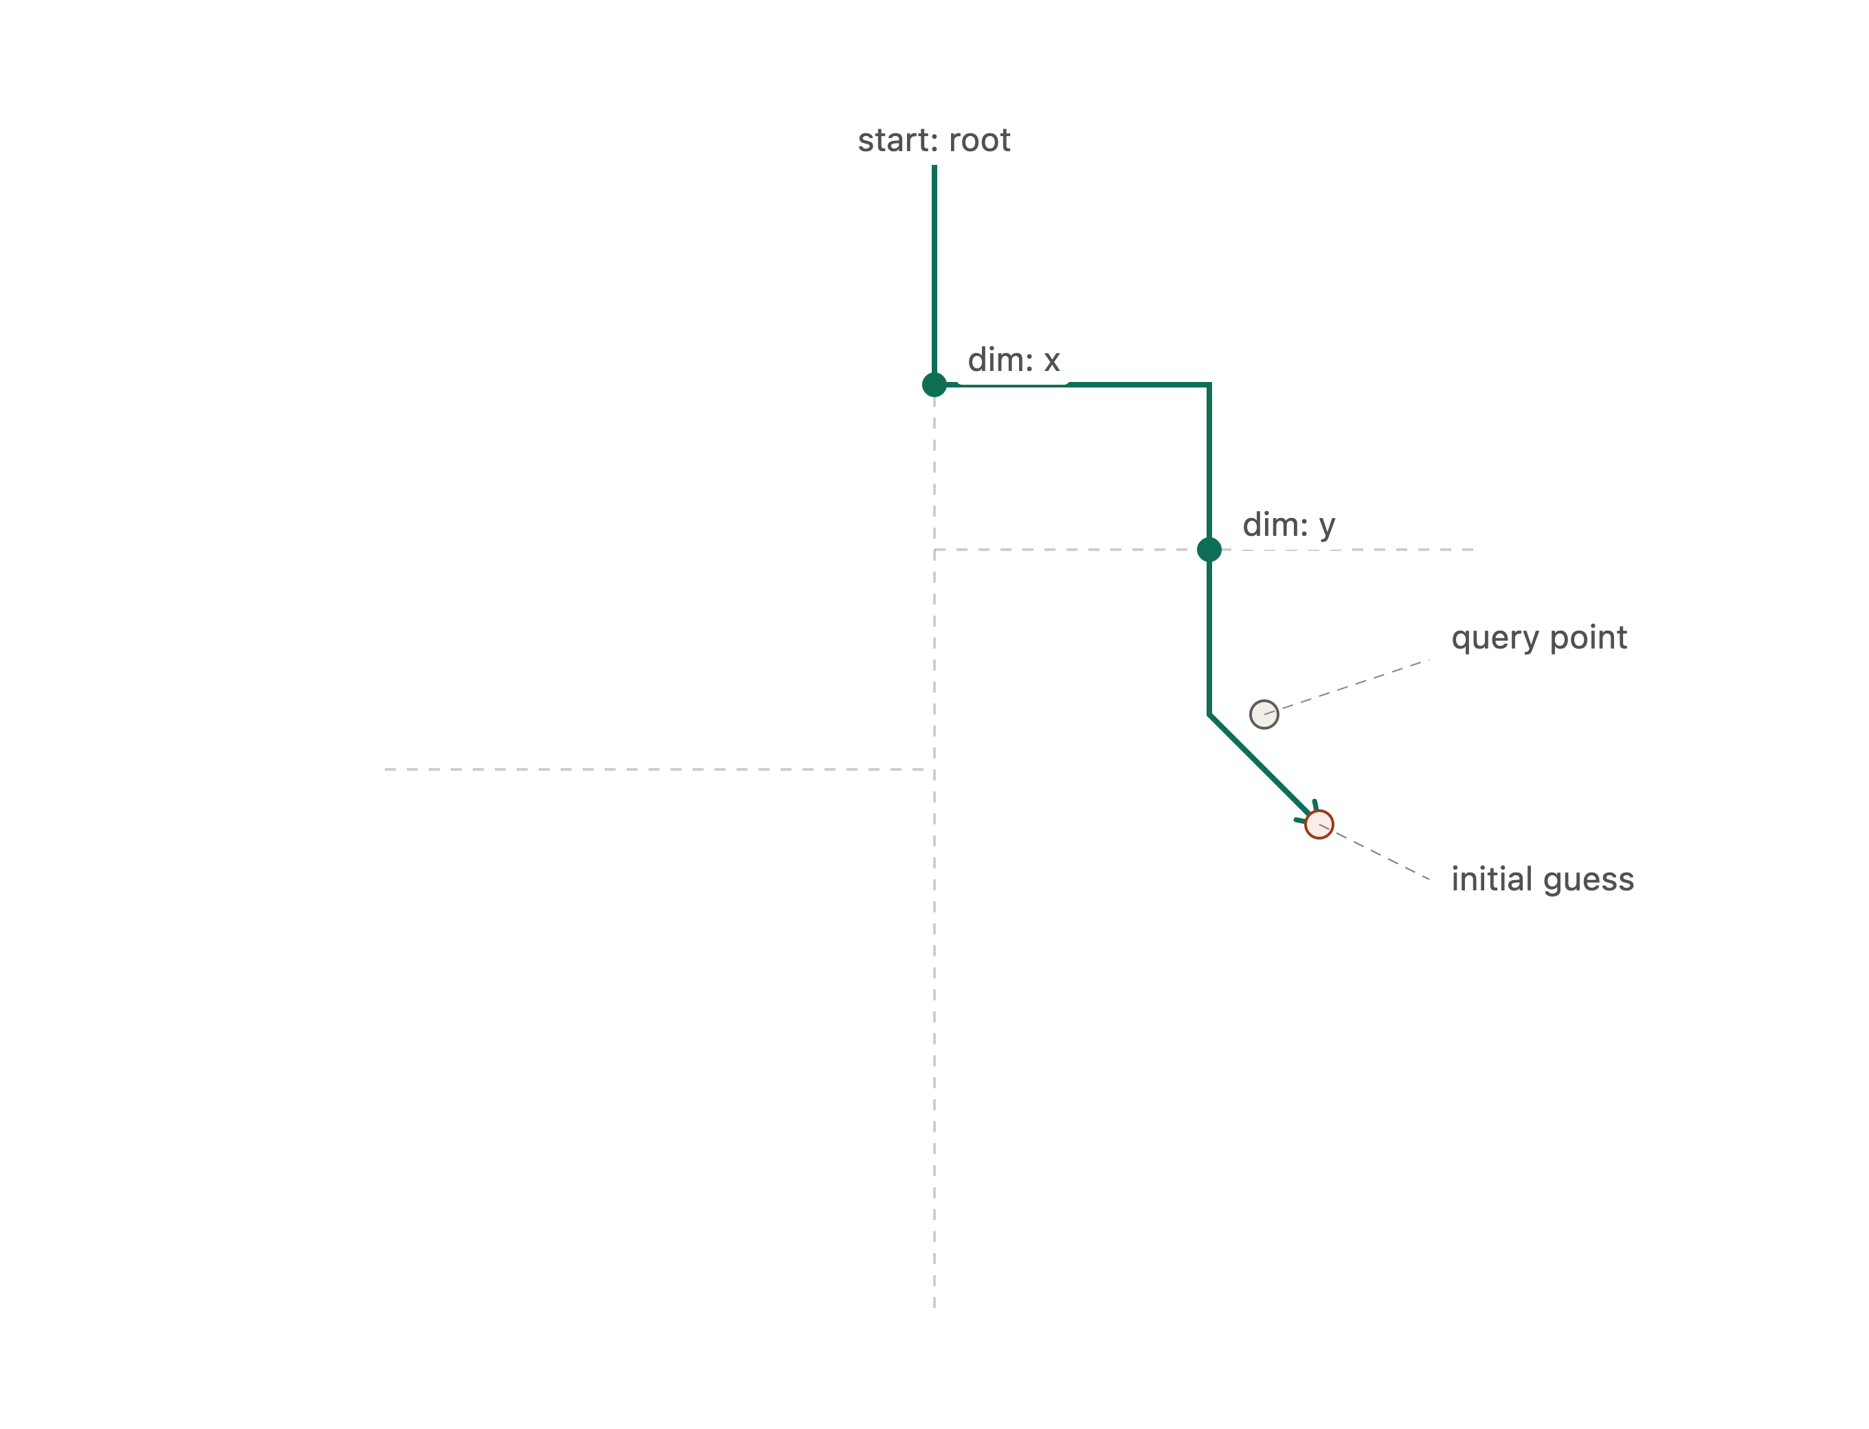
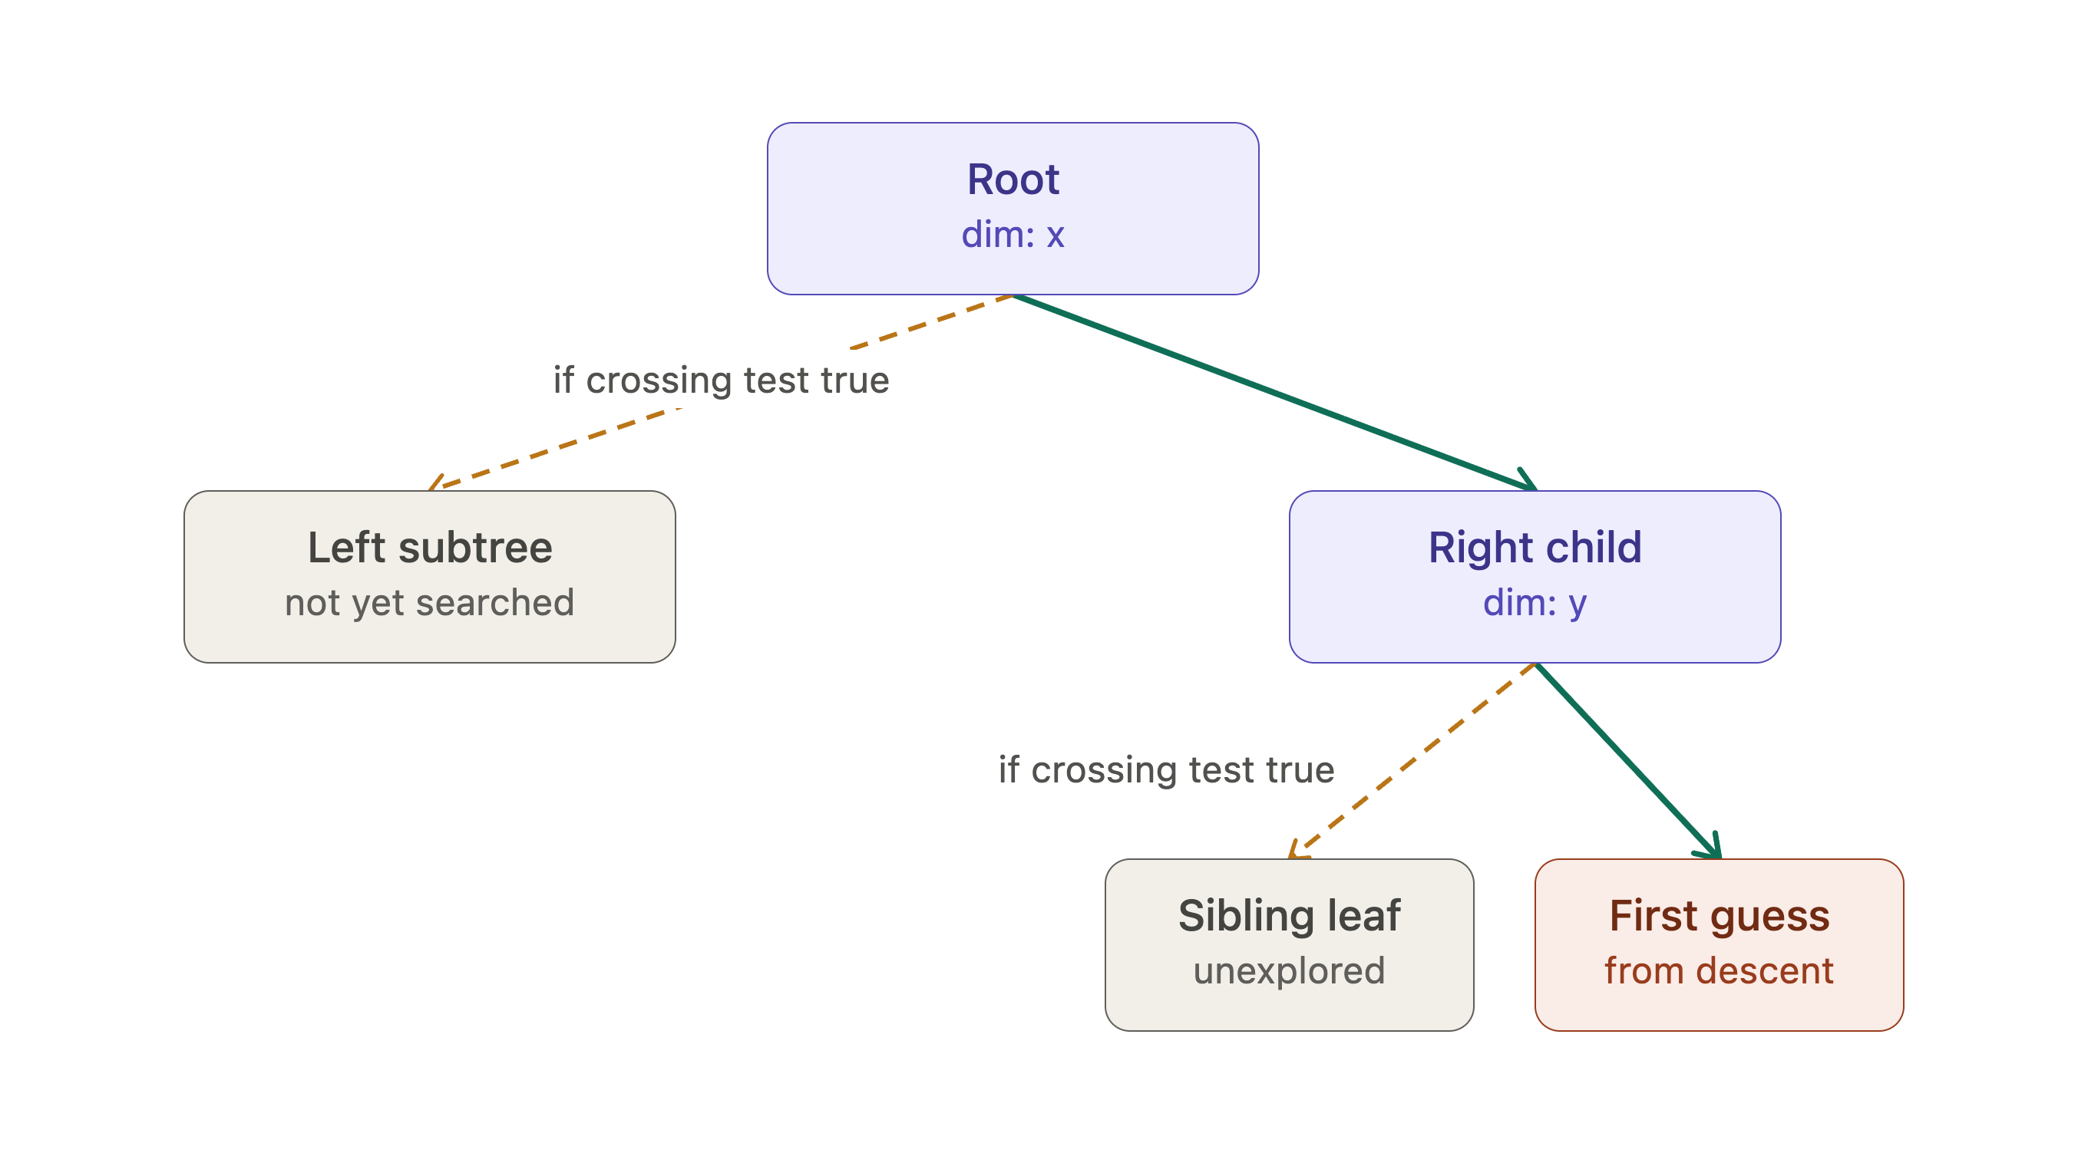
KDTree Searches
Two options: Box Search or Nearest-Neighbor Search
  Former is similar to Fede’s methodology; I tested out the latter
  Build a KDTree of hits (up-front overhead), walk twice over tree

Slide 11
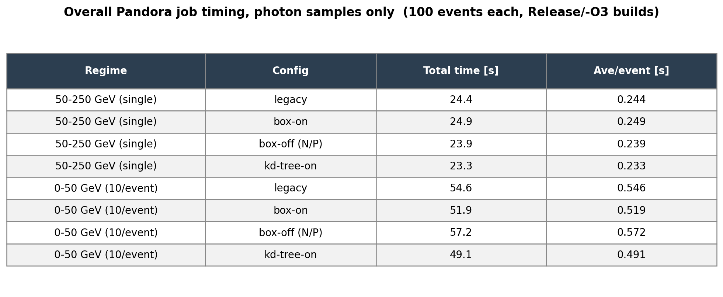
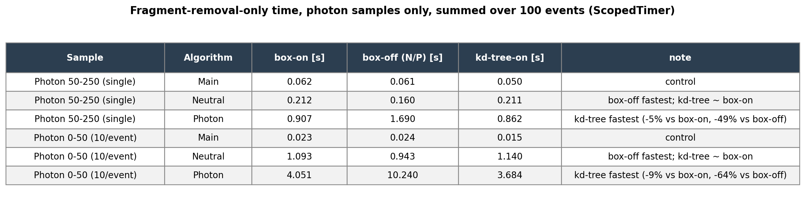
Timing Comparisons (with KDTree)
KDTree is fastest overall job timing across both inputs
For photons, the neutral fragment removal (neutral hadron-targeted) is fastest at default nominal settings

Slide 12
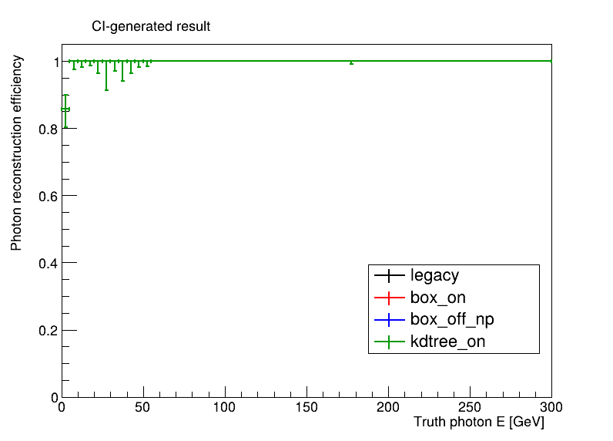
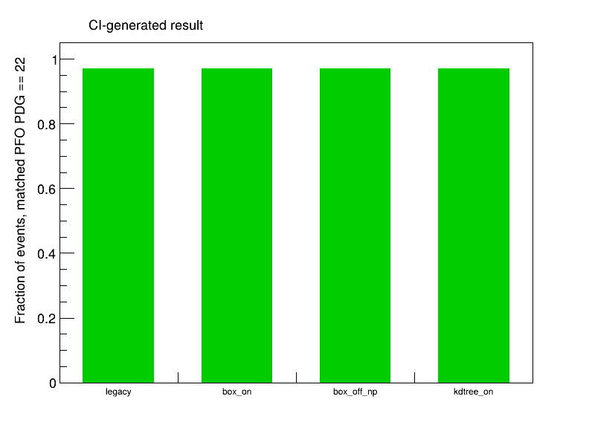
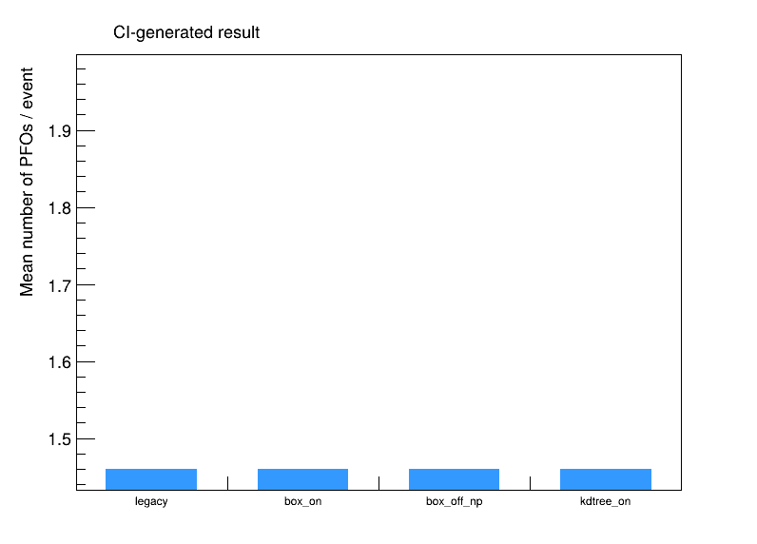
Basic Physics Verification

Slide 13
Next Steps
KDTree implementation is promising but needs further validation
I’ve got larger photon stats cooking
Need to make a BIB-overlaid photon test sample as well
Might be interesting to understand NeutralFragmentRemoval performance for a neutron (or even neutral pion) sample

