Slide 1
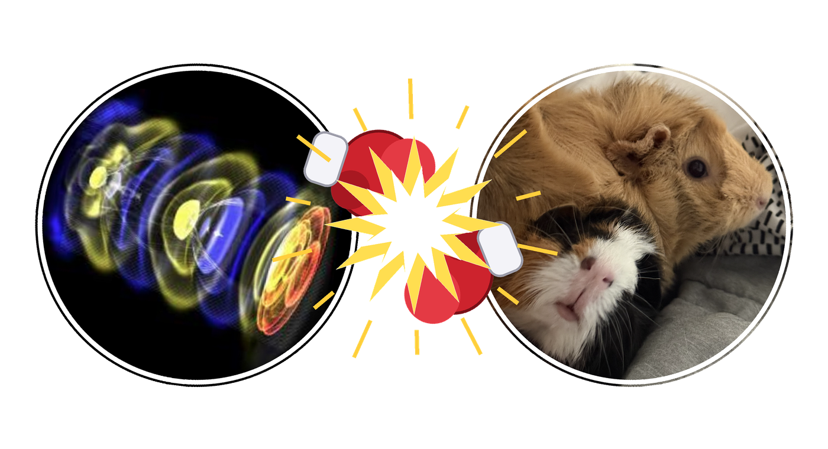
Beam-Beam Interactions in the Muon Collider:
A Comparison of WarpX and GUINEA-PIG

Slide 2
Goals for this Research
Building tools to use WarpX to correctly model muon beams, including
  understanding beam-beam interactions
  quantifying collider performance under different input parameters
  comparing results to a comparable e-e collider
  verifying mass-suppression of quantum effects
Validating WarpX results with the more commonly used GUINEA-PIG
Today, I’ll be focusing on the classical side [beam-beam effects].

Slide 3
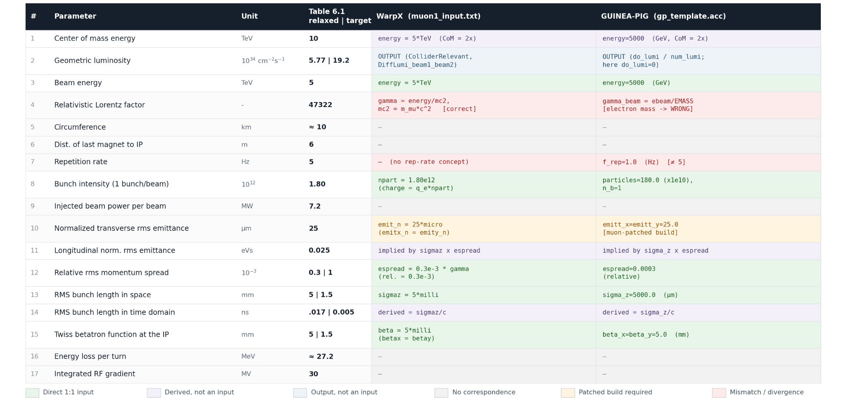
Muon Collider Input Parameters: WarpX & GUINEA-PIG

Slide 4
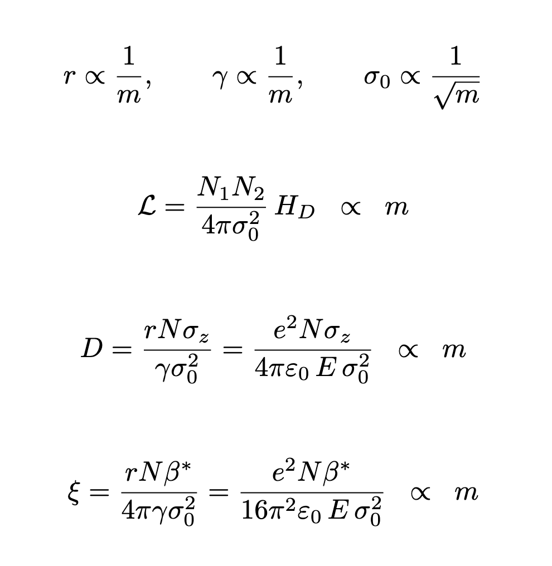
Mass scaling of classical beam parameters
  Holding fixed emittance and beam size, ll of the classical beam parameters scale linearly with the mass of particle.
  Therefore, in order to do a 1-1 comparison of the muon collider vs. e collider, it’s necessary to ‘scale’ at least one of the parameters.
    I think particle number N is probably most physical, to avoid inflating the beam size or changing the enrgy.

Slide 5
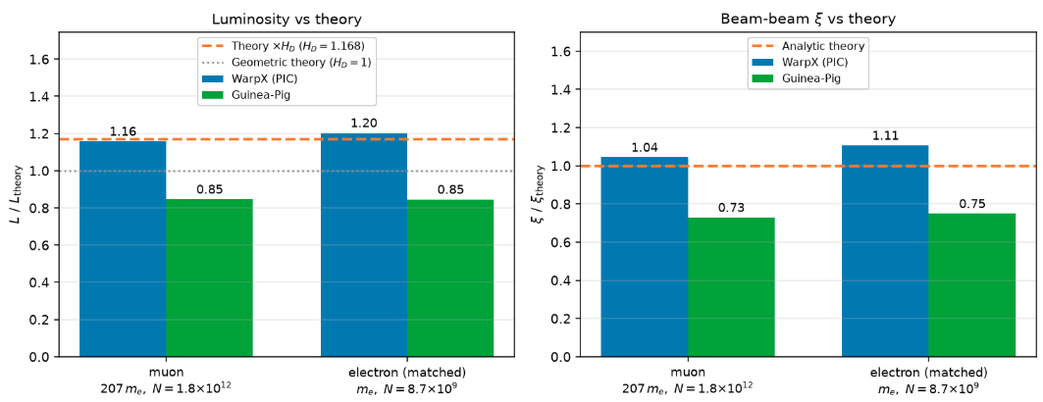
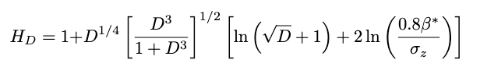
Muon collider v. electron collider with similar input parameters
(Yokoya & Chen 1988)

Slide 6
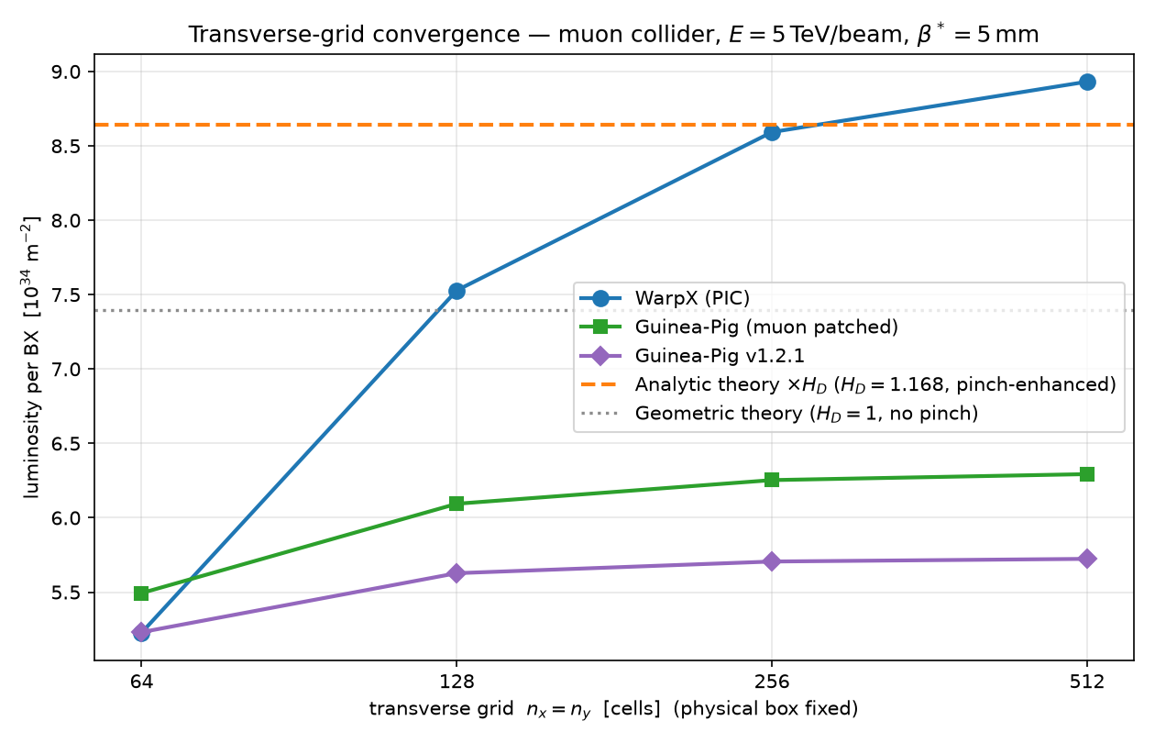
Convergence Test: Luminosity

Slide 7
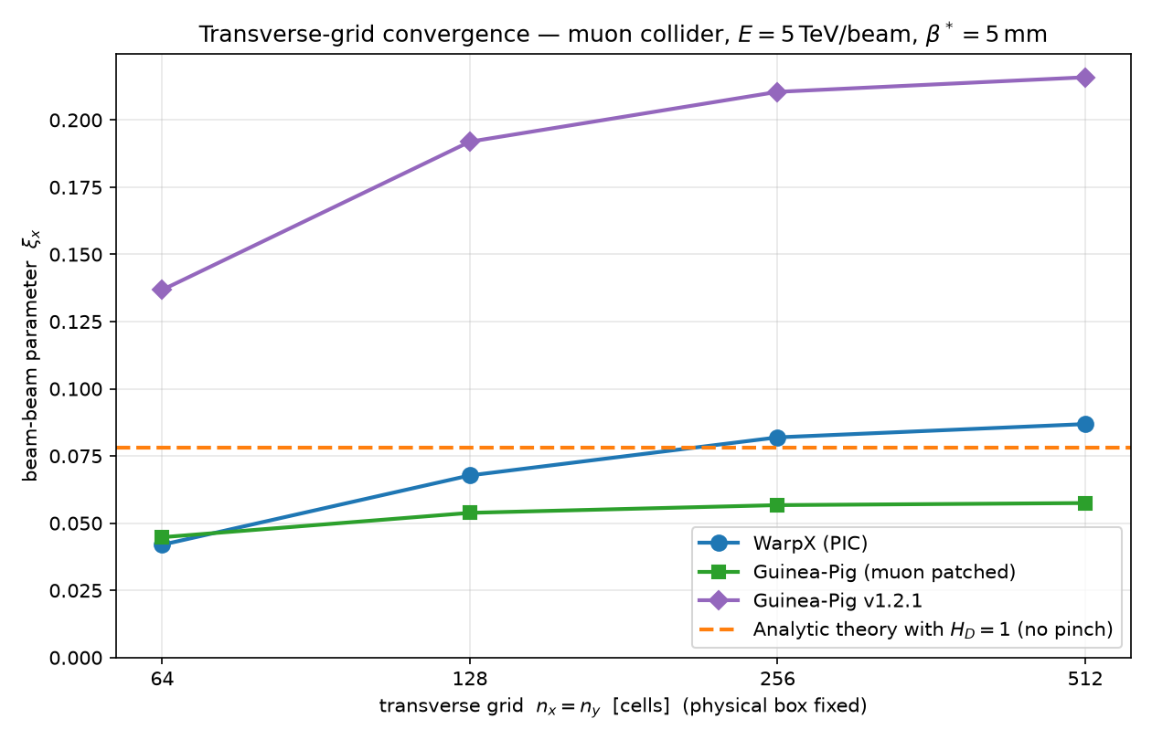
Convergence Test: Beam-Beam Parameter

Slide 8
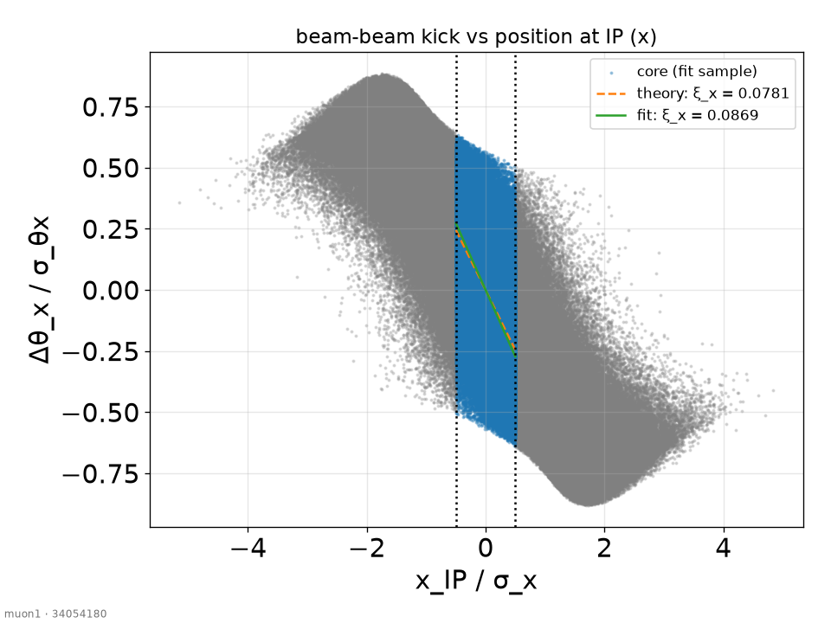

Appendix: Fitting Beam-Beam Parameter in WarpX

Slide 9
Appendix: WarpX muon-patches
File (everything in subdirectory Source/Particles/ElementaryProcess/) | Description of change
QEDInternals/QedChiFunctions.H | Add mass scaling in computation of Schwinger field χ: χ ∝ (m / m_e)^3
QEDInternals/QuantumSyncEngineWrapper.H | Propagate input mass through everything that calls χ
Input file change | Numerical integrals of T(χ) [a modified Bessel function] normally has a pre-computed table; Since χ can now range over orders of magnitude, we have to modify the range over which T(χ) is computed.
QEDPhotonEmission.H | WarpX ‘cleans’ low energy photons by dropping photons under a certain energy, computed using the mass of the electron. This threshold needs to be lowered for heavier lepton.
PICSAR [Particle In Cell Scalable Application Resources] dependency: quantum_sync_engine_core.hpp, gamma_functions.hpp | PICSAR library is used to compute dN/dt [# photons/time] and hard codes the electron mass, so this has to be updated to pass through as well.

Slide 10
Appendix: GP 1.2.1 v. GP muon-patched
2 Major changes
Fixes the classical beam kinematics.
  e.g, sigma_prime = emx*MUMASS/(energy*sigma) (guinea_pig.c:2735, 2992)
  This is the main fix that allows the luminosity and beam-beam parameter to come out correct.
Also appears to patch the rate of production for QED-secondaries to use muon mass (e.g, cutoff energy for producing virtual photons, , beamstrahlung rate)
  I have not tested this yet since I’ve been running GP with QED effects off.
What IS NOT patched for muons:
The classical beam-beam kick is still computed using the electron mass
  RE = ___ * EMASS
  factor = -charge_sign*2*RE/(delta_z*1e9*EMASS)
Fortuitious cancellation means nothing breaks o it seem doesn’t break anything for now when studying electromagnetic interactions.

Slide 11
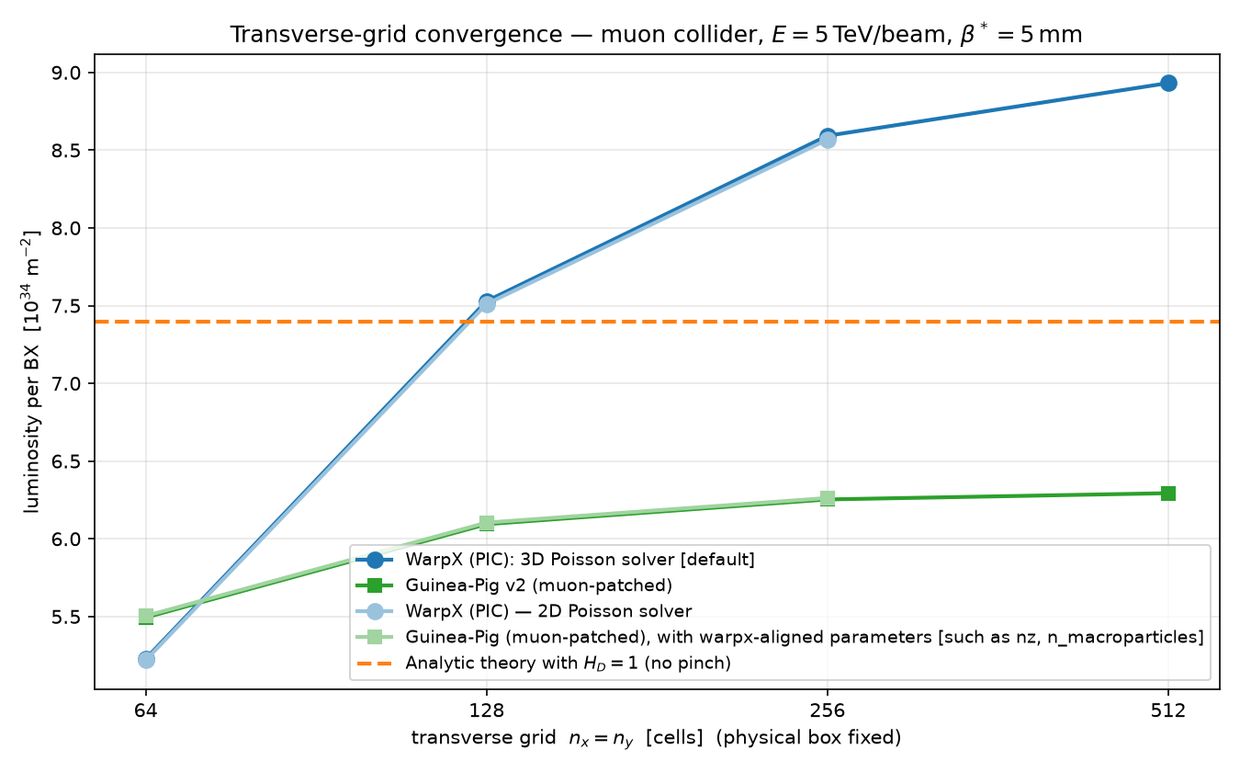
Tweaking WarpX and GP [Pt. 1: luminosity]
  WarpX uses a 3D poisson solver by default
    GP can only solve in 2D slices
  But even if you set Warpx to use the 2D solver (light blue), that doesn’t explain the differences in luminosity and beam-beam parameter.
  Additionally, making sure the GP input file aligns parameter-by parameter with WarpX (light green) doesn’t produce a major change in luminosity.

Slide 12
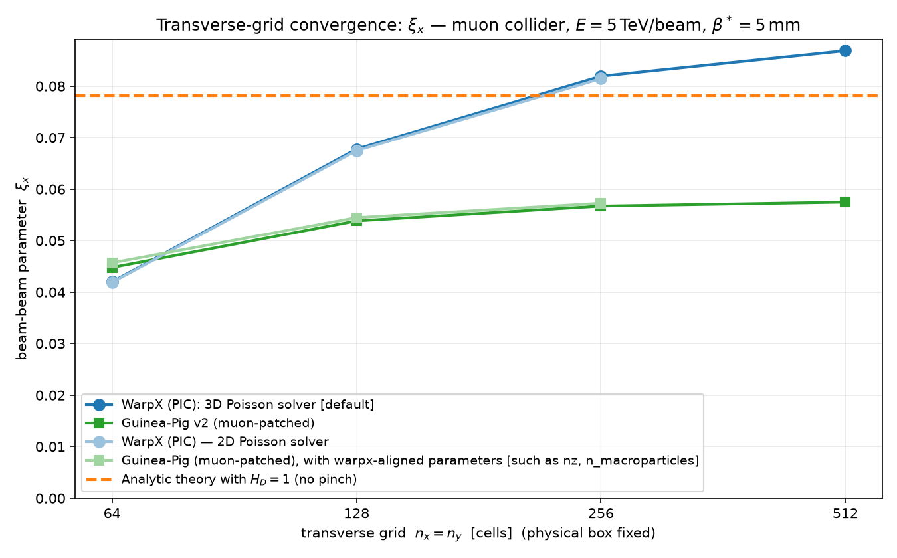
Tweaking WarpX and GP [Pt.2: beam-beam parameter]
  WarpX uses a 3D poisson solver by default
    GP can only solve in 2D slices
  But even if you set Warpx to use the 2D solver (light blue), that doesn’t explain the differences in luminosity and beam-beam parameter.
  Additionally, making sure the GP input file aligns parameter-by parameter with WarpX (light green) doesn’t produce a major change in luminosity.

Slide 13
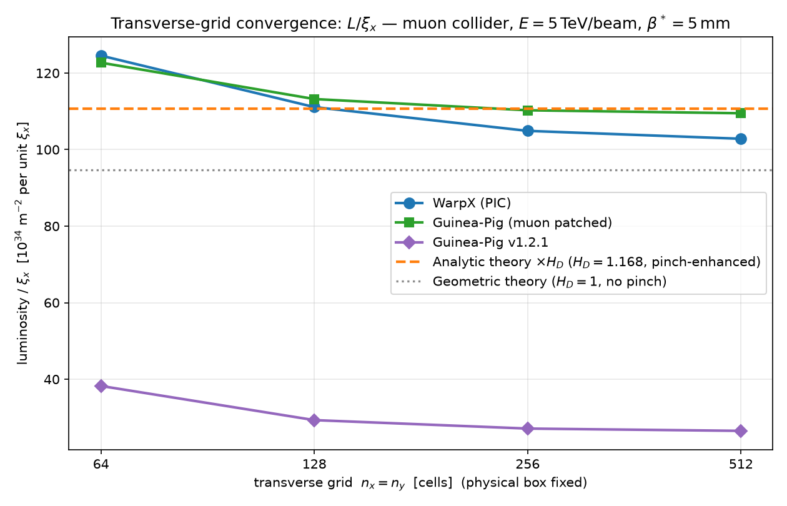
Ratio of luminosity to beam-beam parameter is consistent
  Since these quantities seem to vary together, there is likely something larger that WarpX is picking up that GP isn’t.
    that is, IF you correctly patch for the muon mass [purple line should be discarded]

