Slide 1
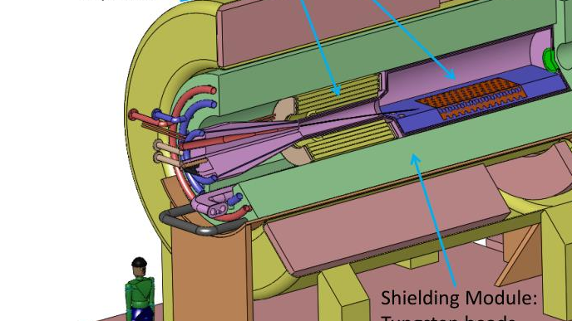



Target Studies for Pion Production
Pion pT distributions
8/10/2026
Ruaa Alharthy

Slide 2
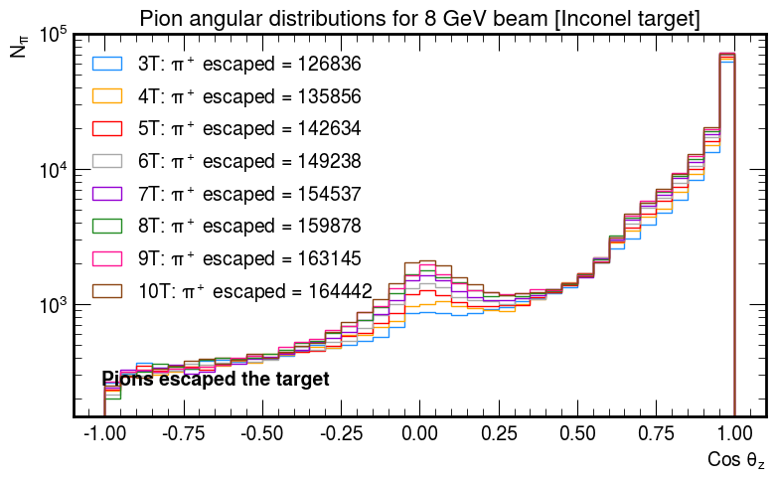
Angular distribution
The following are angular distributions of pions that have escaped the target and those that have been detected by the detector at the end of the solenoid.
θz is defined as the angle between the particle momentum and the beam axis:
  cos θz = 1: pion momentum is completely along the beam axis.
  cos θz = 0: pion momentum is perpendicular to the beam axis.
The first observation made is that the pion yield increases as the magnetic field strength increases. After discussing this with Sridhara, Katsuya, Sergo and Michael, we came up with a theory of why this would happen:
  Maybe in stronger fields the pions re-enter the target more frequently thus producing more pions via secondary or tertiary interactions.
  This still needs to be investigated.

Slide 3
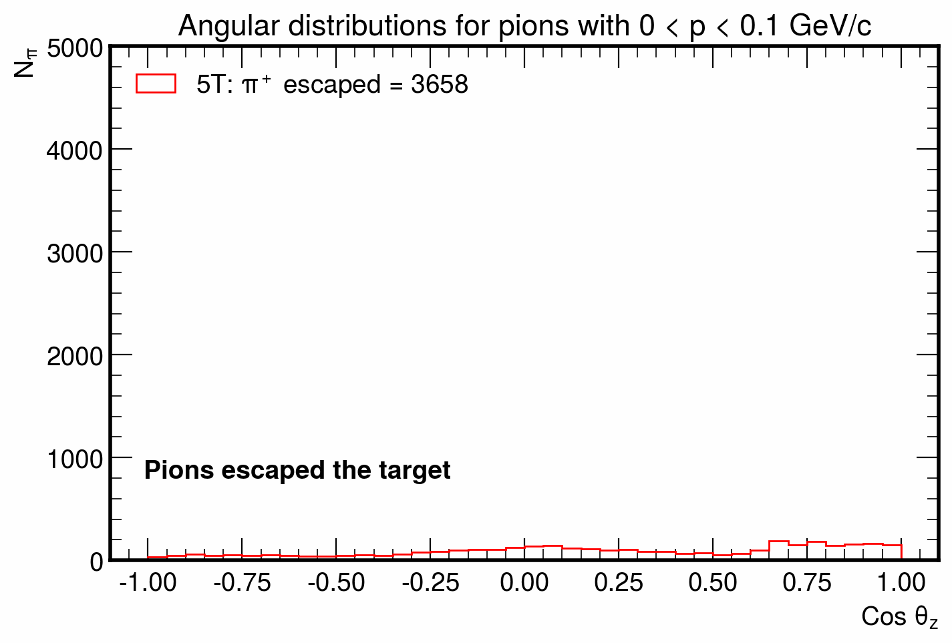
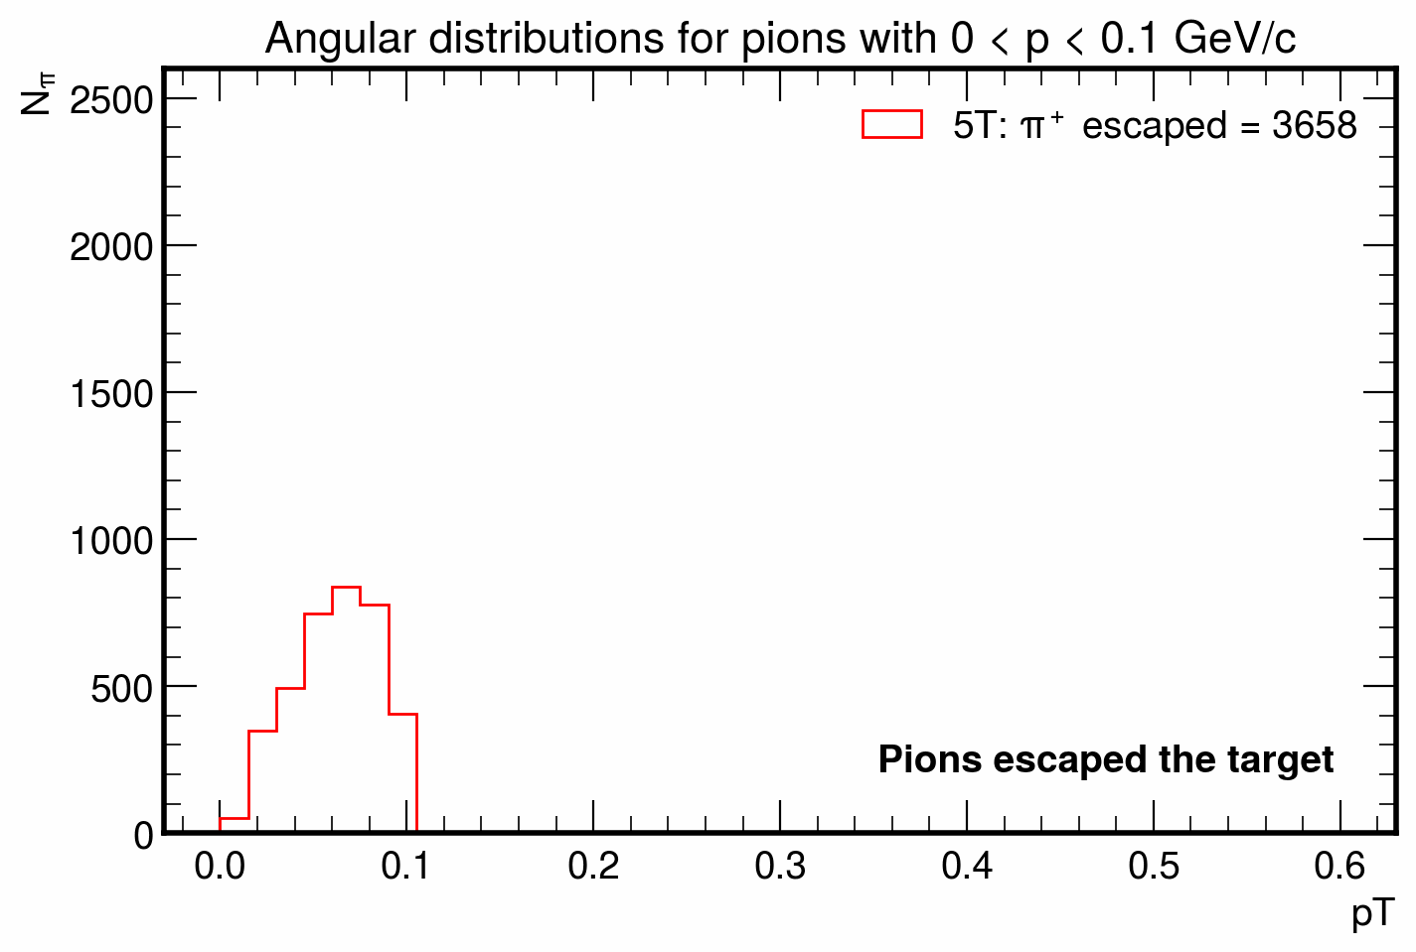
Angular distribution
Another observation made was that there is enhanced number of pions escaping the target with momenta approximately perpendicular to the beam axis (cos θz ≈ 0).
To understand which pions contribute to this effect, examined the angular distributions for pions in different pT ranges.

Slide 4
Next steps
Simulate pion production for 0T ~ no B-field
Simulate 0.8 GeV pions to study pion pT in low energy regime.
Maybe try to find a way to track particles (won’t spend so much time on this)
I am also working on a way to create a source pion beam file to be used for G4bl simulations → working towards a full pion/muon tracking in G4bl.

