Slide 1
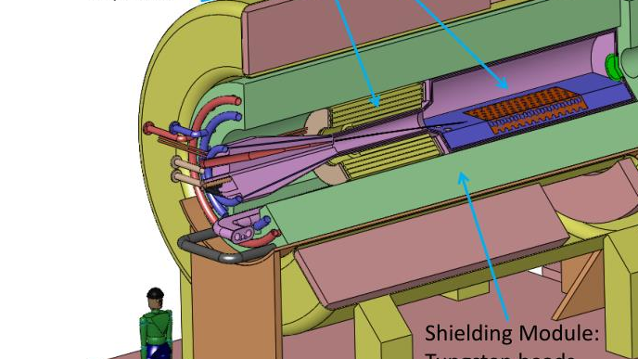


Target Studies for Muon Production
11/10/2025
Ruaa Alharthy

Slide 2
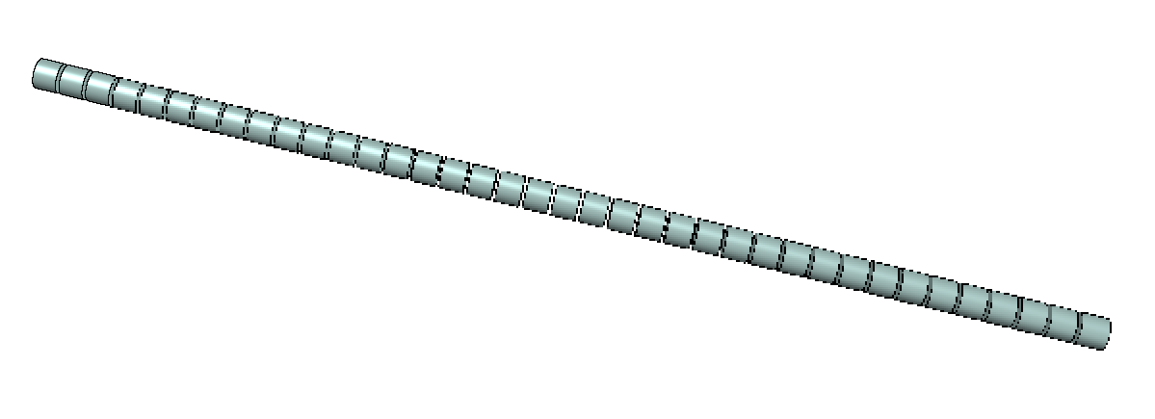
Mu2e target design
Material: Tungsten
The target is 20 cm in length and has radius of 0.315 cm.
The target is divided into 34 sections, each 0.5 cm wide, separated by 0.08 cm gap.

Slide 3
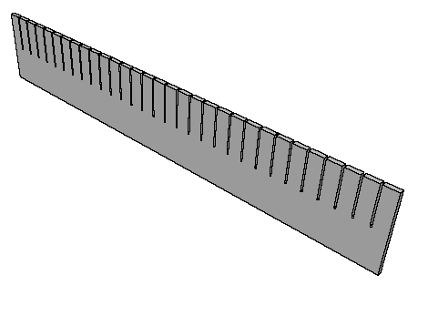
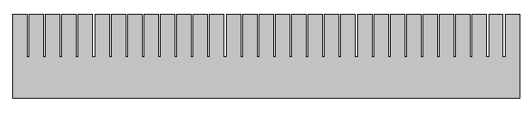
NOvA target design
Material: Graphite
The target is 78 cm in length and 0.74 cm wide.
The target has 31 fins, each measuring 2.4 cm in length along the beam direction, and 6.3 cm in height, spaced by 0.05 cm gaps.

Slide 4
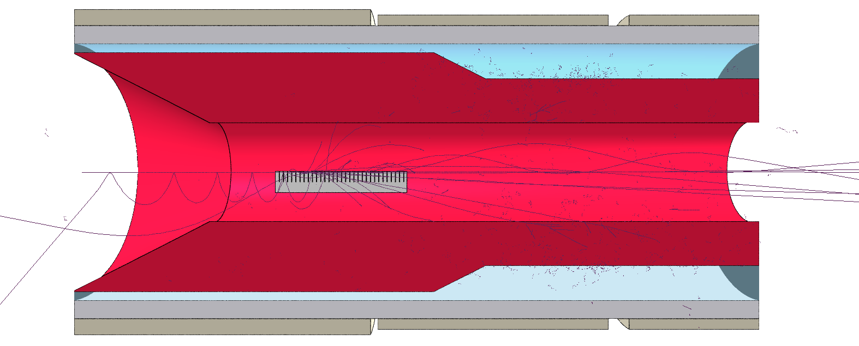
100,000 primary protons were used in all the simulations
Analysis of the proton beams
Beam direction

Slide 5
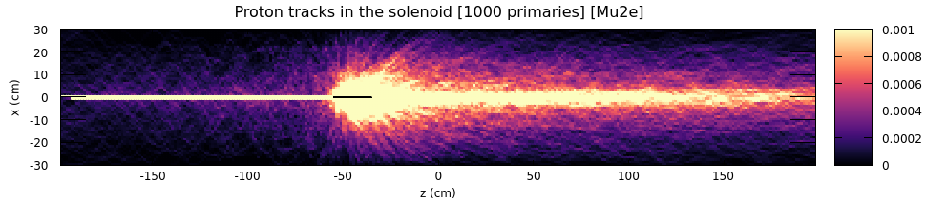
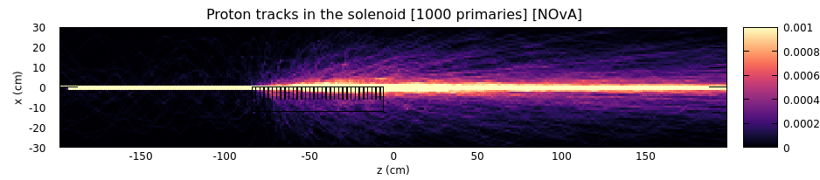
Proton tracks

Slide 6
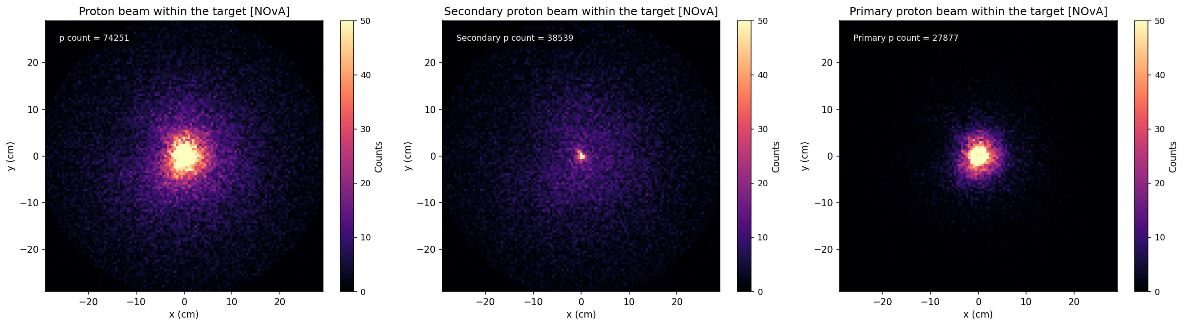
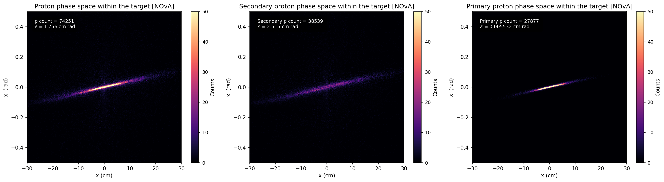
Proton beams detected at the end of the solenoid [NOvA]

Slide 7
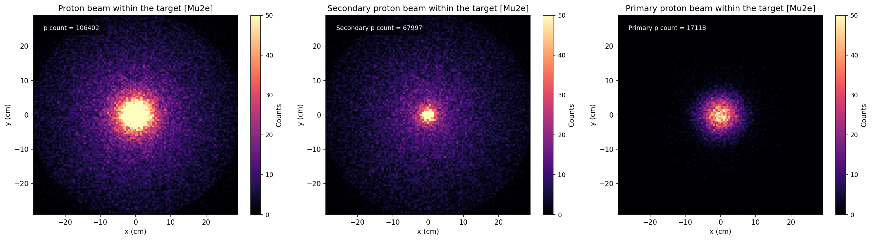
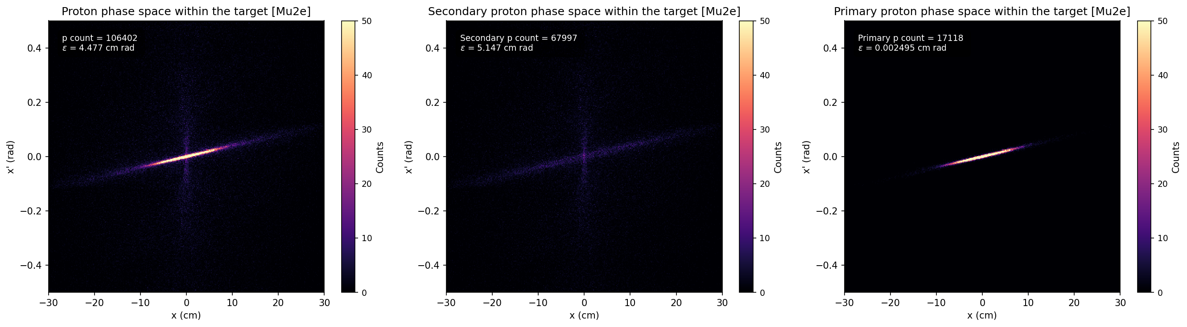
Proton beams detected at the end of the solenoid [Mu2e]

Slide 8
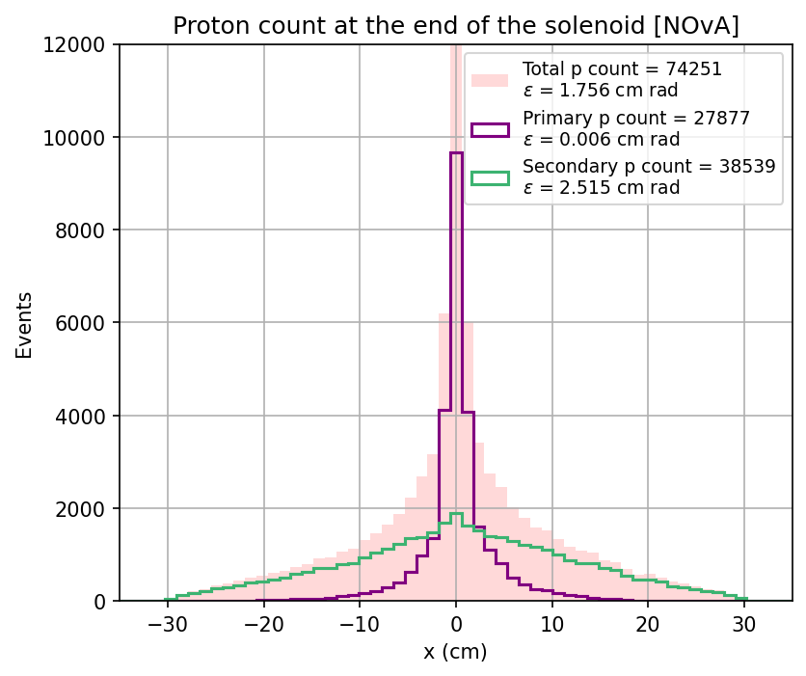
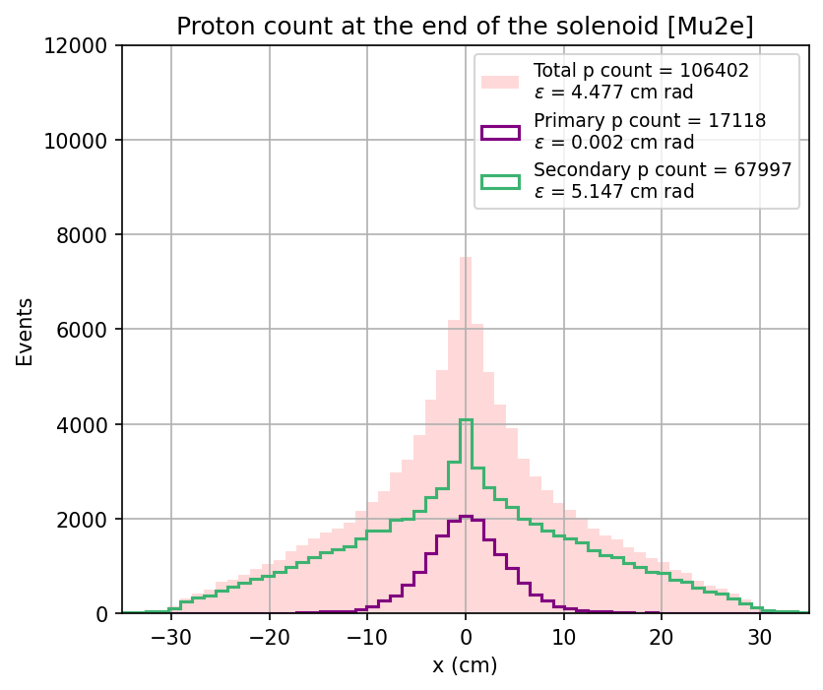
Proton beams transverse distribution at the end of the solenoid

Slide 9
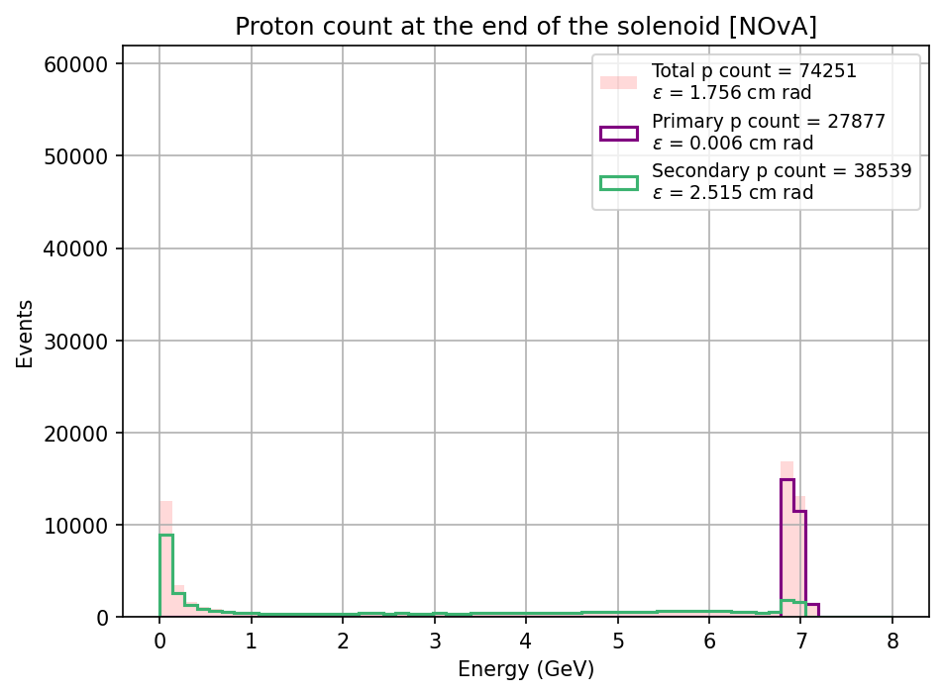
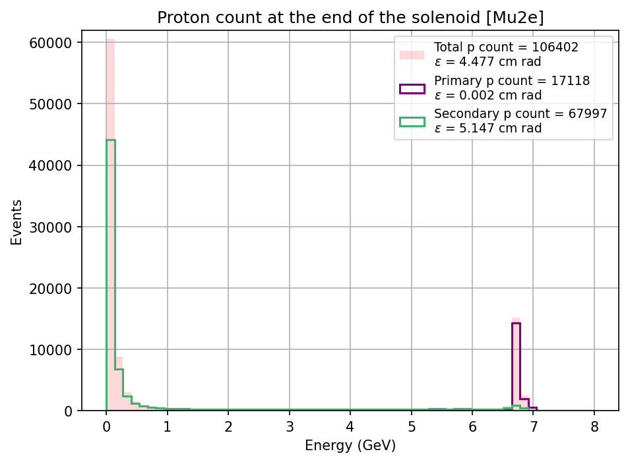
Proton beams energy distribution at the end of the solenoid

Slide 10
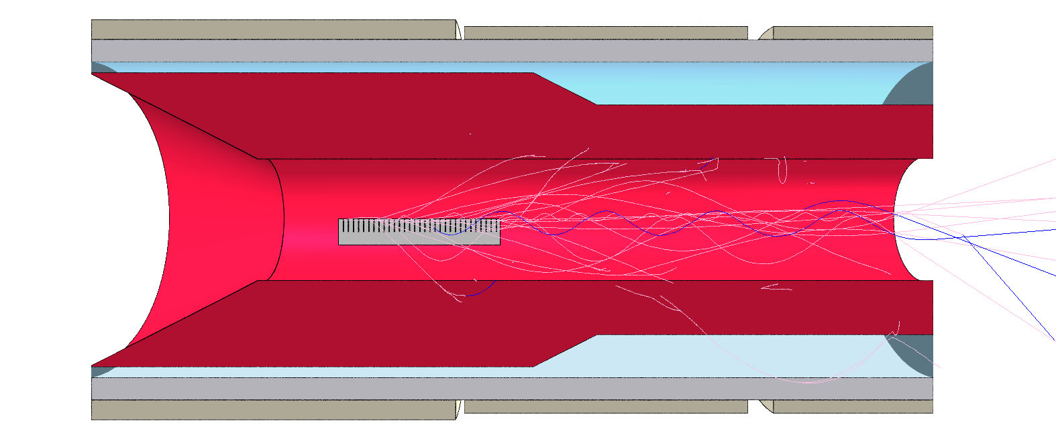
100,000 primary protons were used in all the simulations
Analysis of the π⁺μ⁺ beams

Slide 11
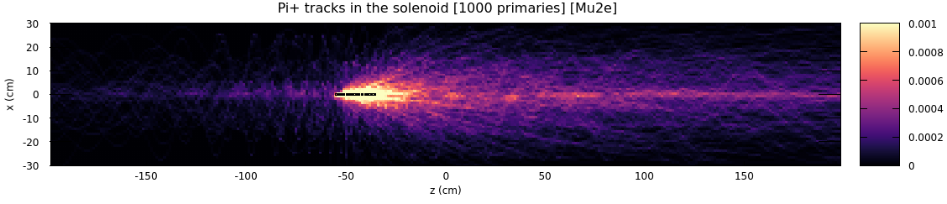
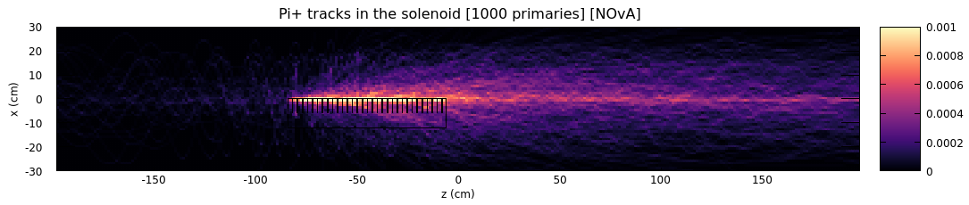
Pion tracks

Slide 12
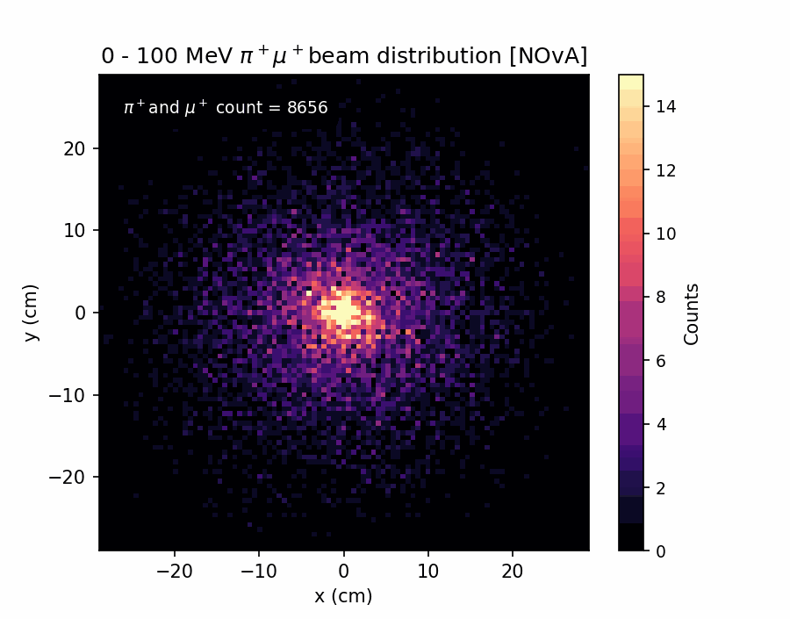
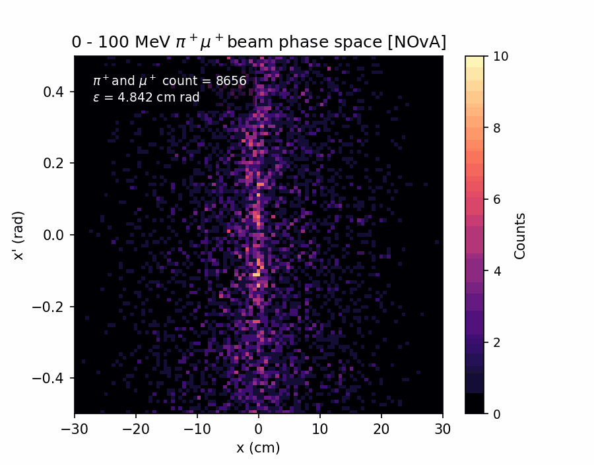
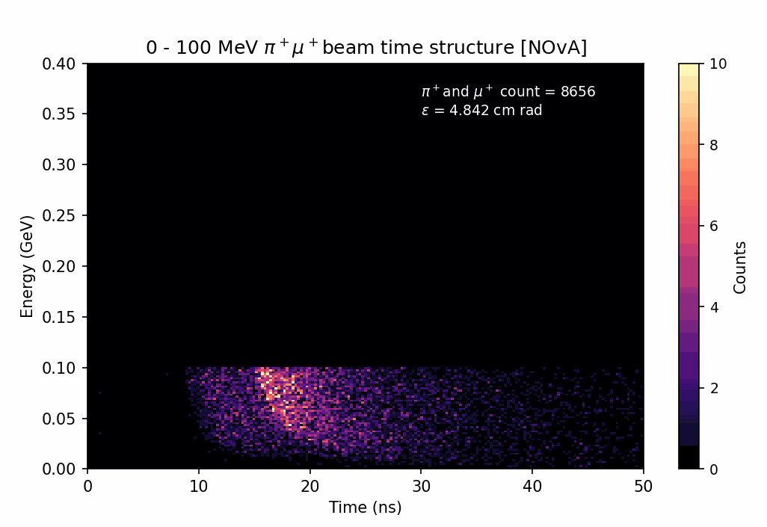
π⁺μ⁺ beams detected at the end of the solenoid [NOvA]

Slide 13
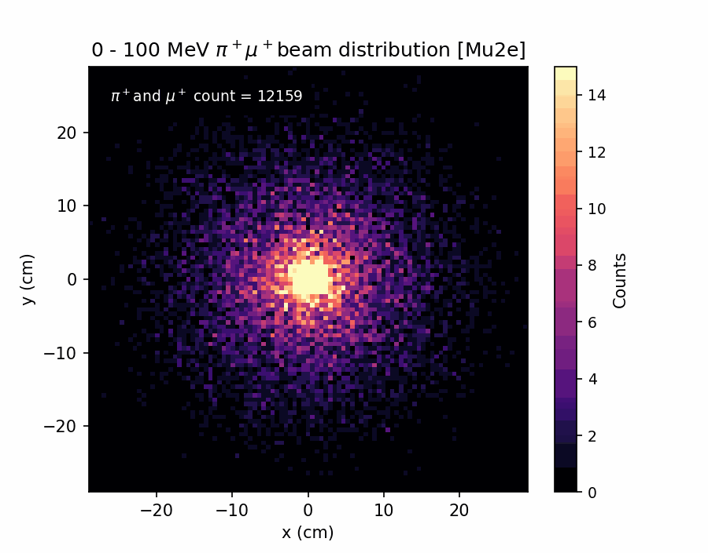
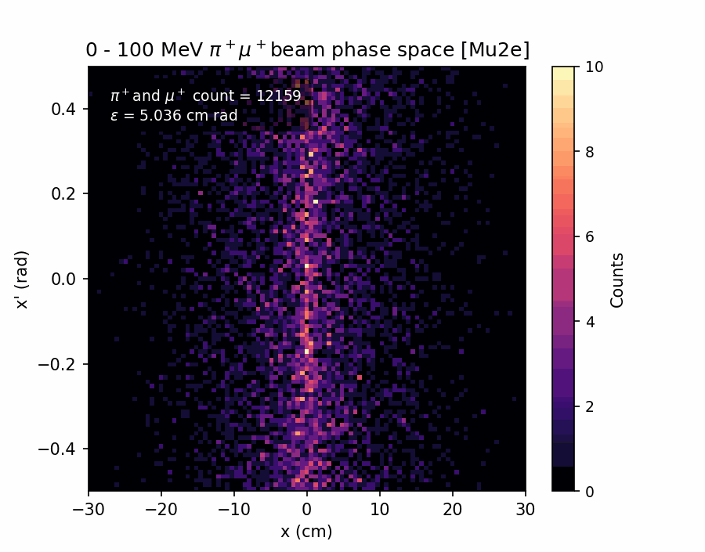
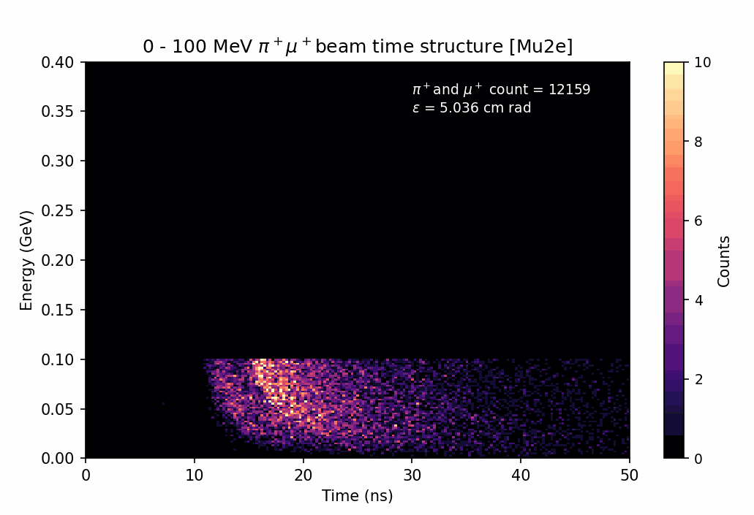
π⁺μ⁺ beams detected at the end of the solenoid [Mu2e]

Slide 14
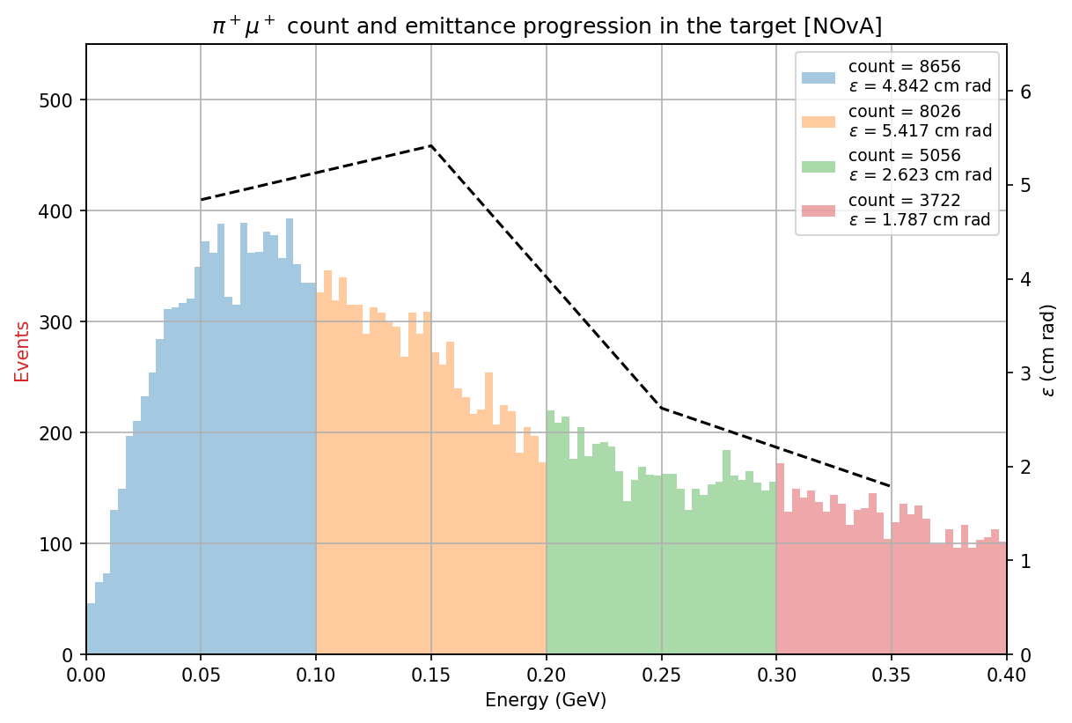
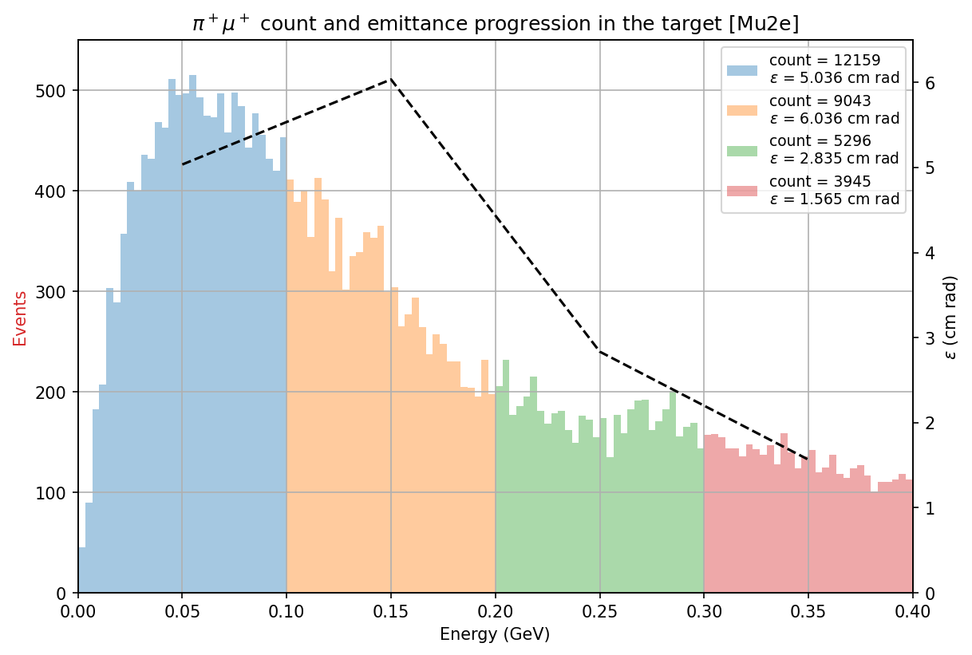
π⁺μ⁺ beams energy distribution and emittance at the end of the solenoid

Slide 15
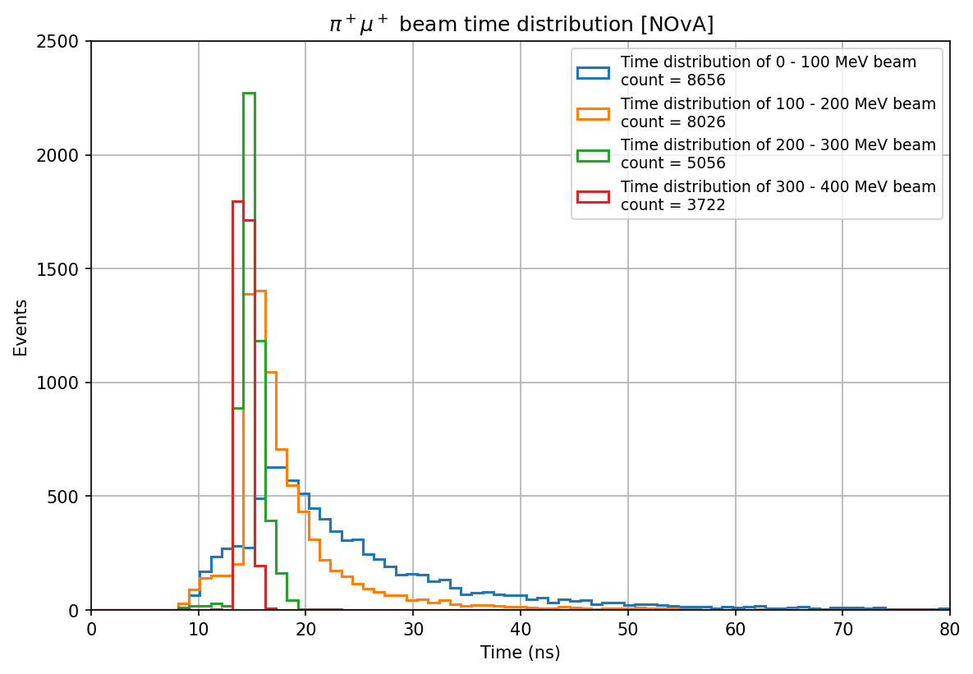
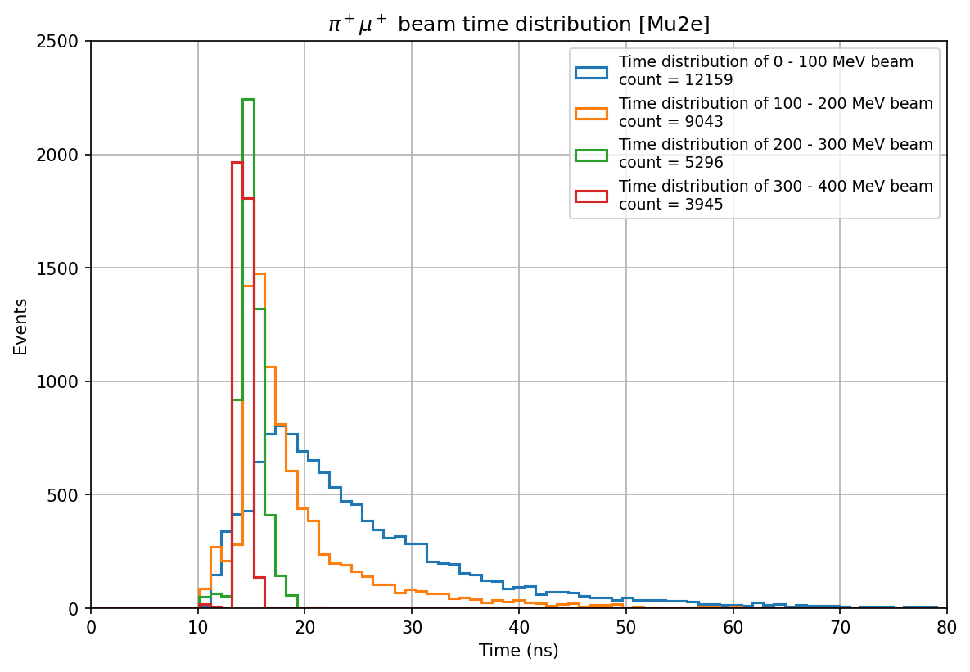
π⁺μ⁺ beams time distribution at the end of the solenoid

Slide 16
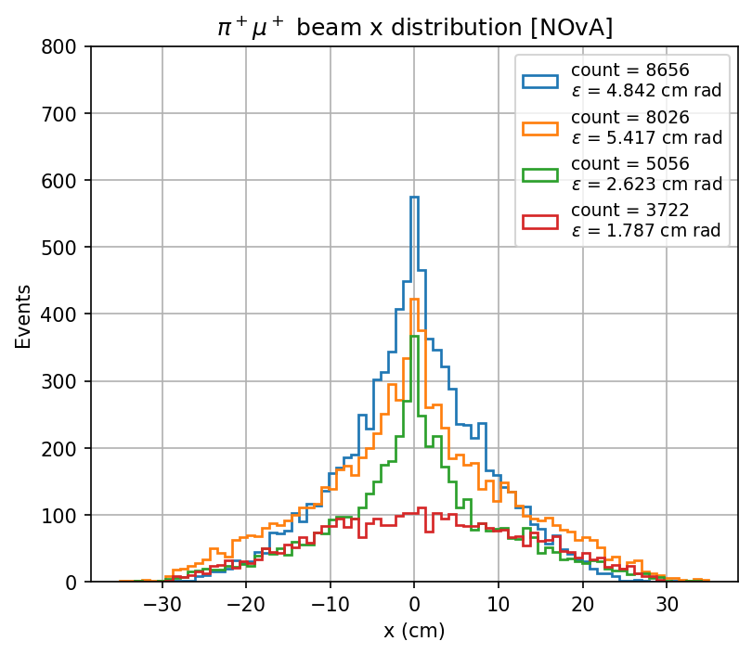
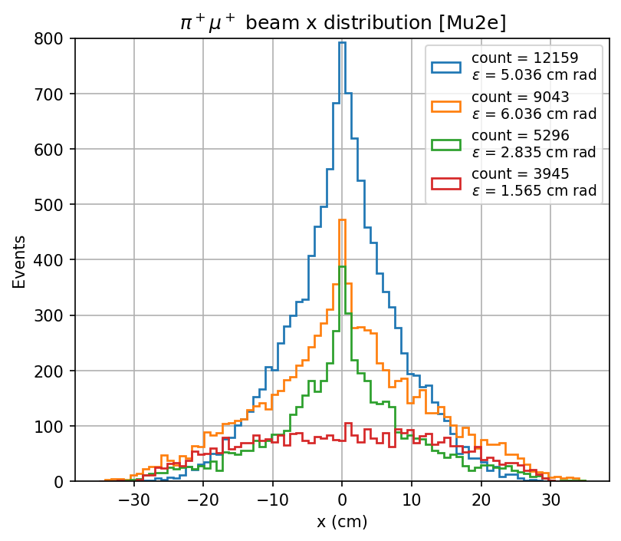
π⁺μ⁺ beams transverse distribution at the end of the solenoid

Slide 17
Here, I sectioned the NOvA target
Section 1
Section 2
Section 3
Section 4

Slide 18
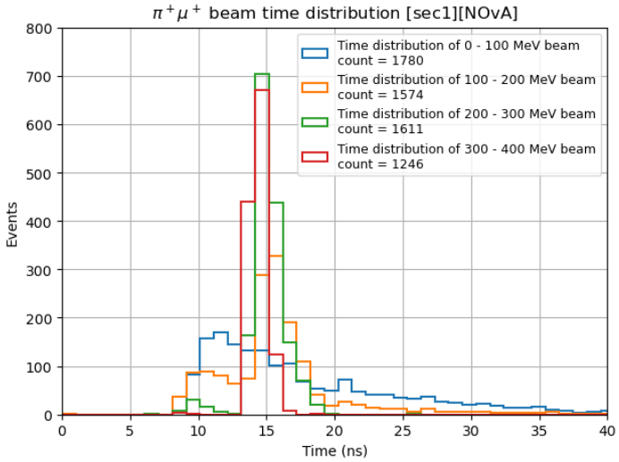
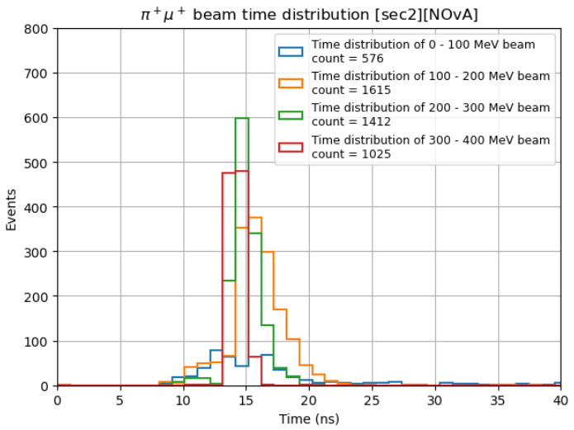
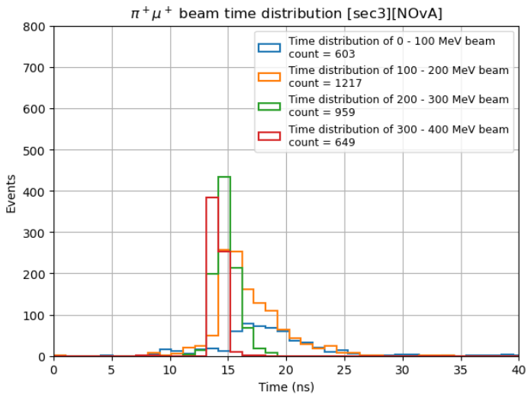
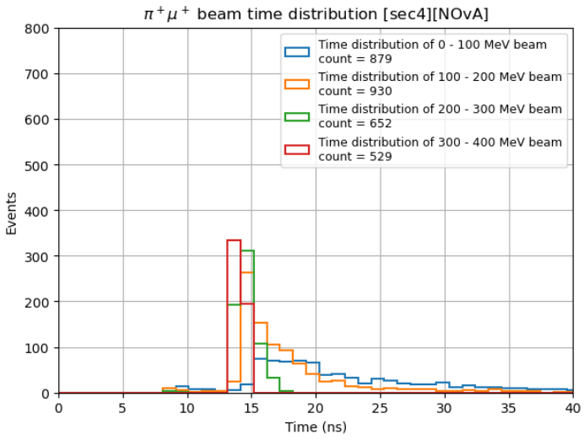
π⁺μ⁺ beams time distribution for different sections [NOvA]

Slide 19
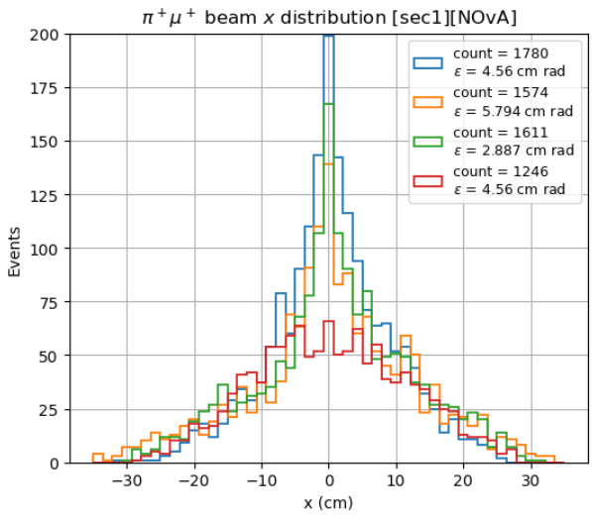
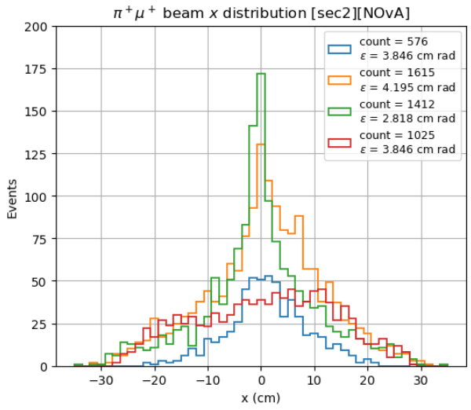
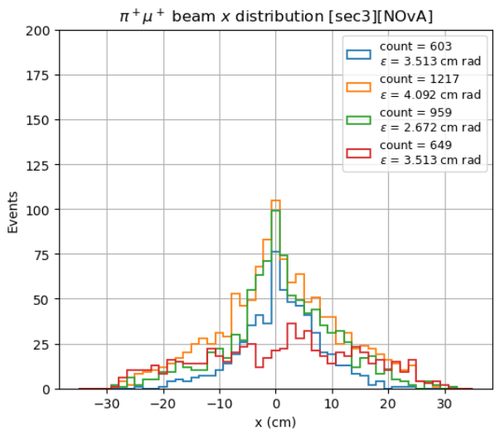
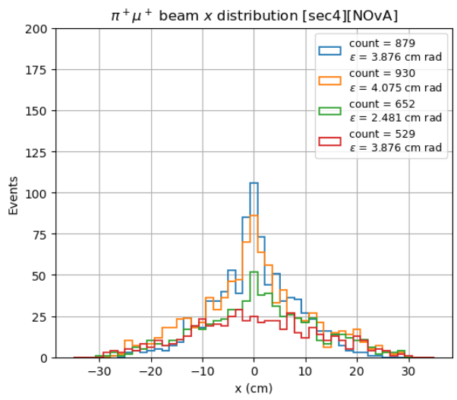
π⁺μ⁺ beams transverse distribution for different sections [NOvA]

Slide 20
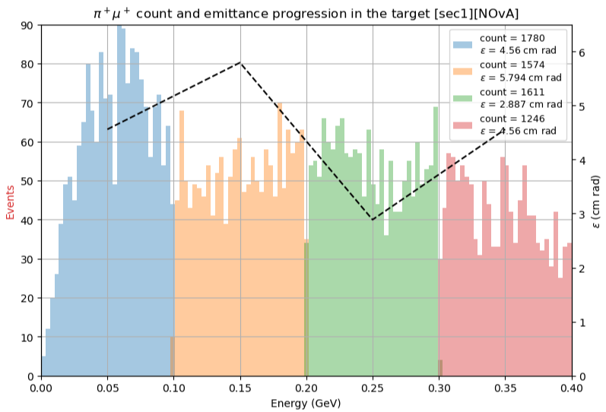
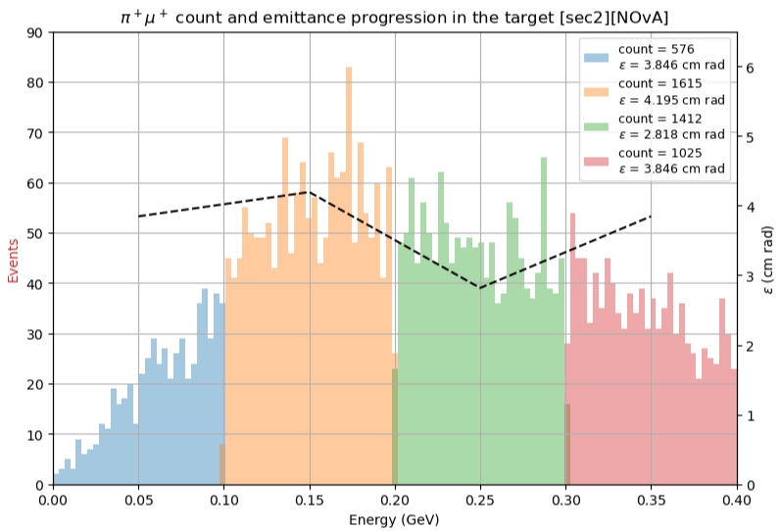
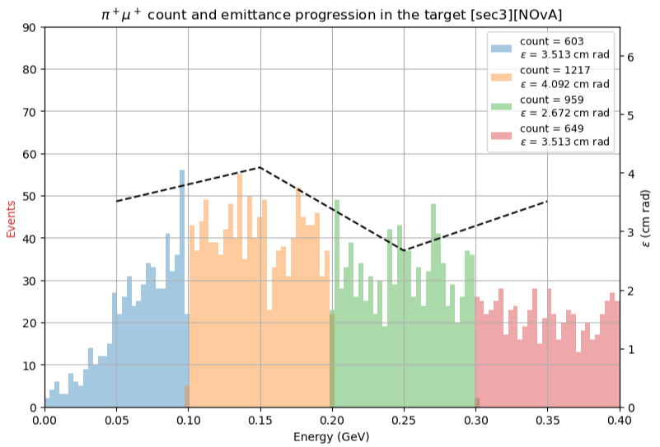
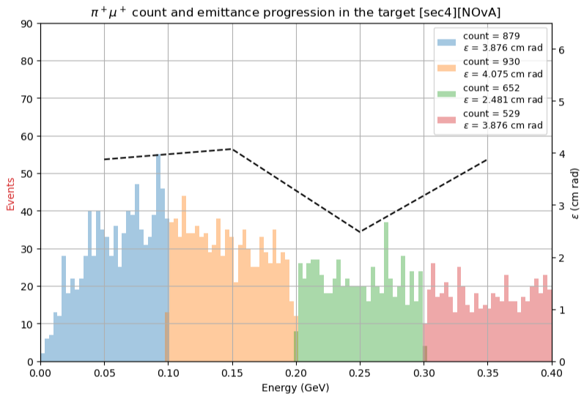
π⁺μ⁺ beams energy distribution for different sections [NOvA]

Slide 21
π⁺μ⁺ beams energy distribution for different sections [NOvA]
From the full simulation:

Slide 22
Summary
The emittance and the time distribution seems to improve for higher energy π⁺μ⁺ beams (300 – 400 MeV), which is expected.
However, we are losing more particles for the beams in that energy range.
The results of this week indicate that the emittance calculated from the fullscale simulation does not agree with the partial simulations of different sections of the NOvA target.
Look at the beam characteristics of π⁺μ⁺ particles produced at different sections of the target.

