Slide 1
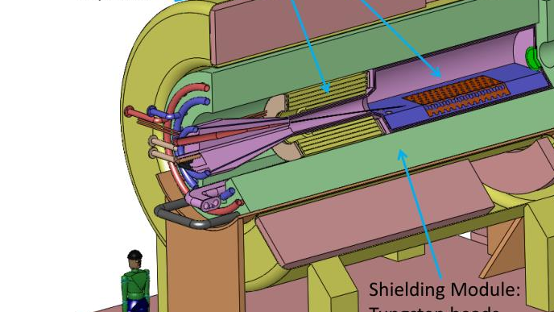


Target Studies for Muon Production
11/17/2025
Ruaa Alharthy

Slide 2
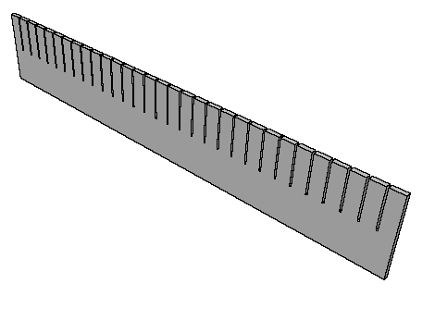
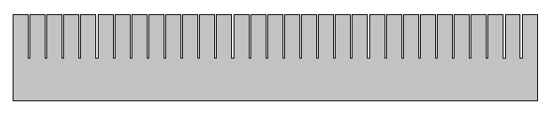
NOvA target design
Material: Graphite
The target is 78 cm in length and 0.74 cm wide.
The target has 31 fins, each measuring 2.4 cm in length along the beam direction, and 6.3 cm in height, spaced by 0.05 cm gaps.

Slide 3
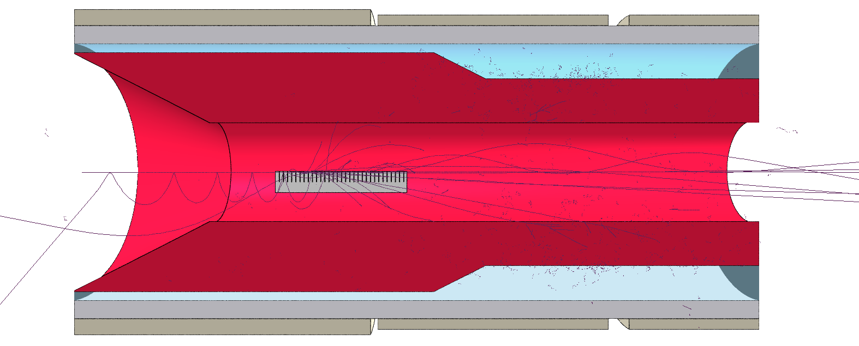
100,000 primary protons were used in all the simulations
Analysis of the proton beams
Beam direction

Slide 4
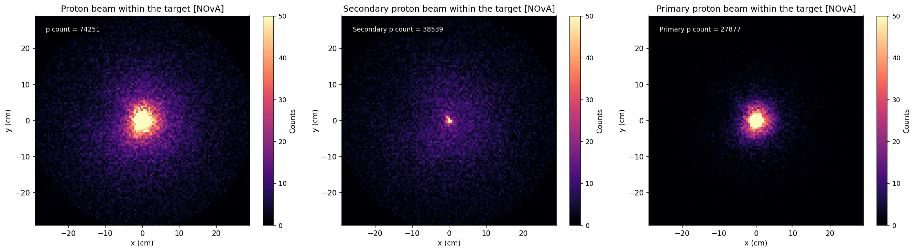
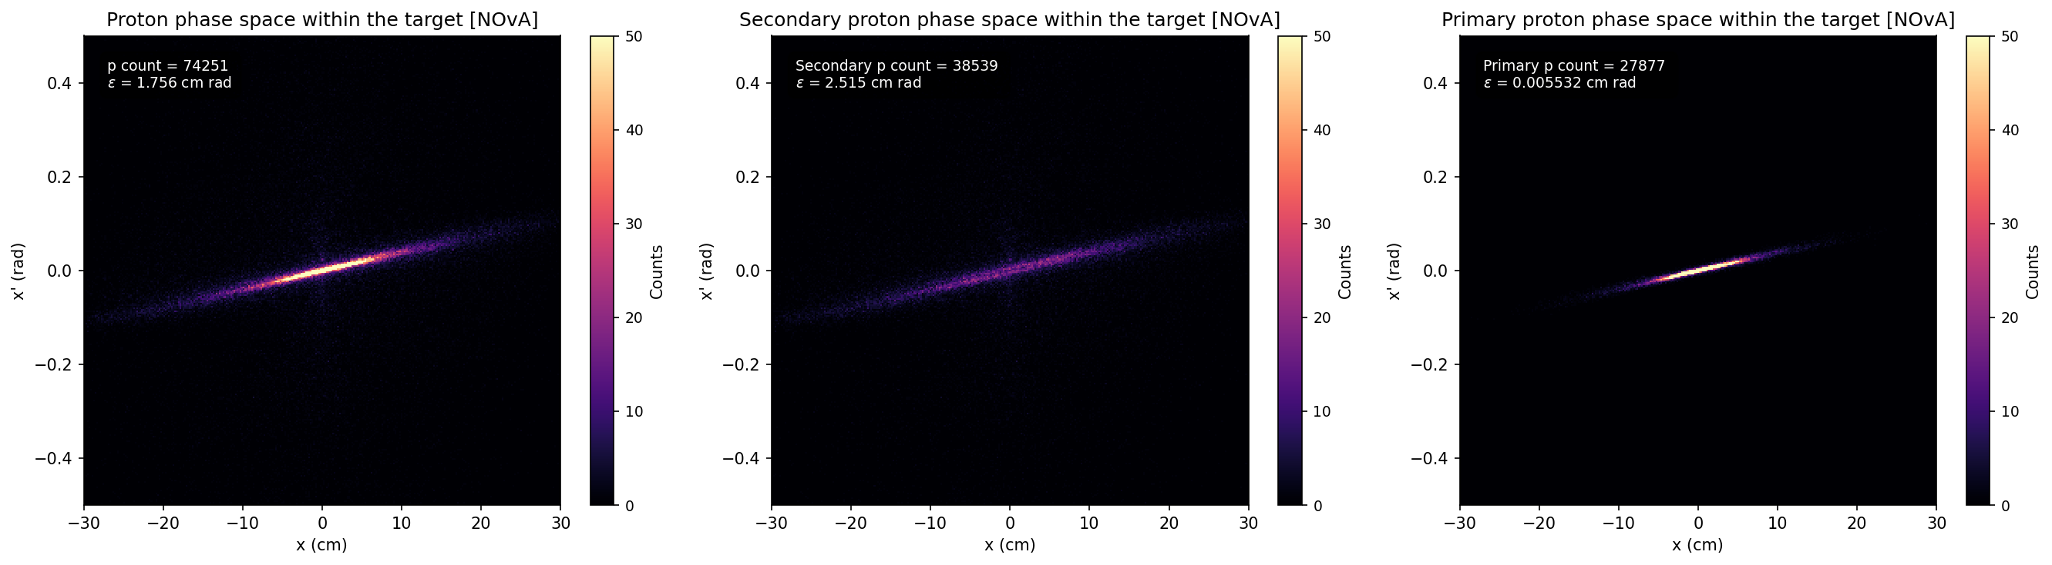
Proton beams detected at the end of the solenoid [NOvA]

Slide 5
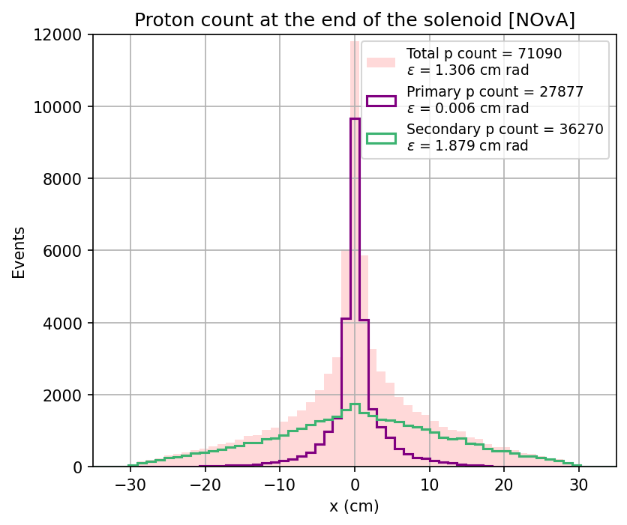
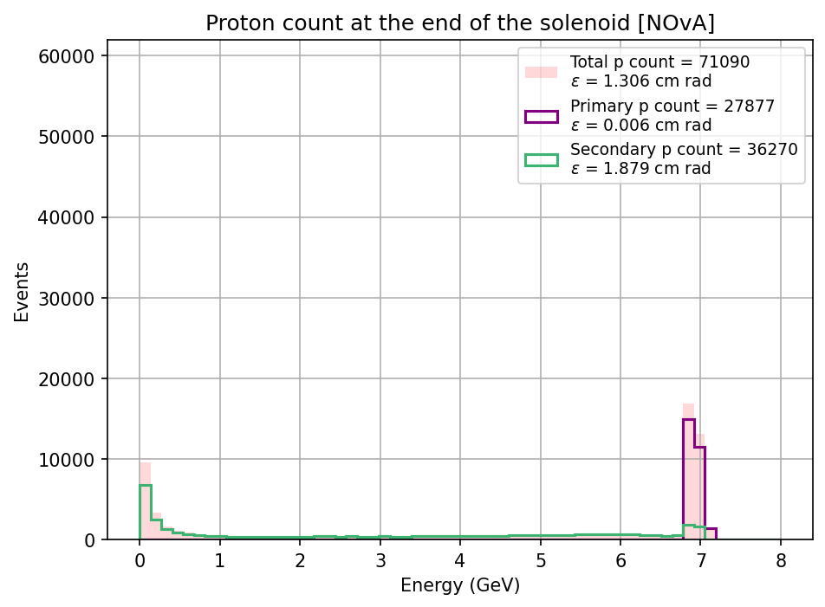
Proton beams transverse and energy distribution at the end of the solenoid [NOvA]

Slide 6
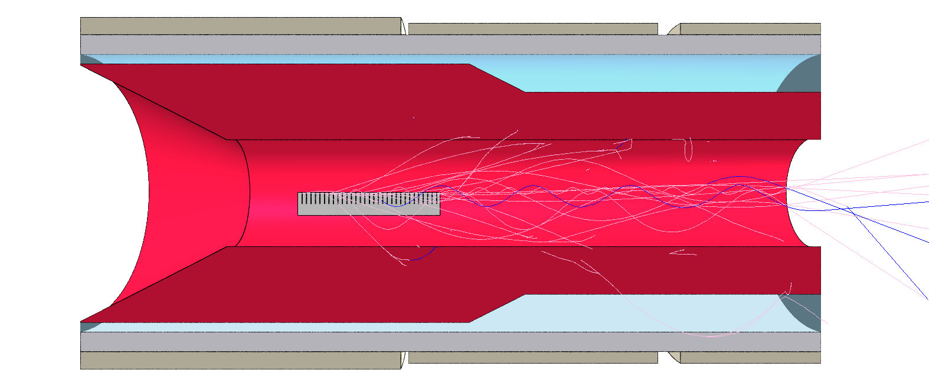
100,000 primary protons were used in all the simulations
Analysis of the π⁺μ⁺ beams

Slide 7
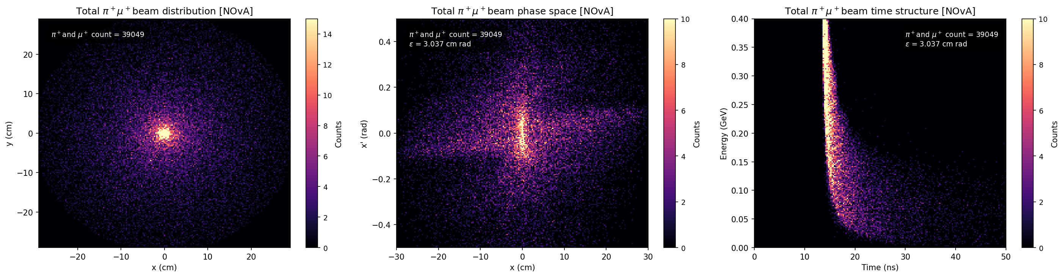
Total π⁺μ⁺ beams detected at the end of the solenoid [NOvA]
Total secondary protons | 36,270
Total π⁺μ⁺ detected at the end of the solenoid | 39,049
I am thinking that it may be a good idea to find how many were produced from secondary protons.

Slide 8
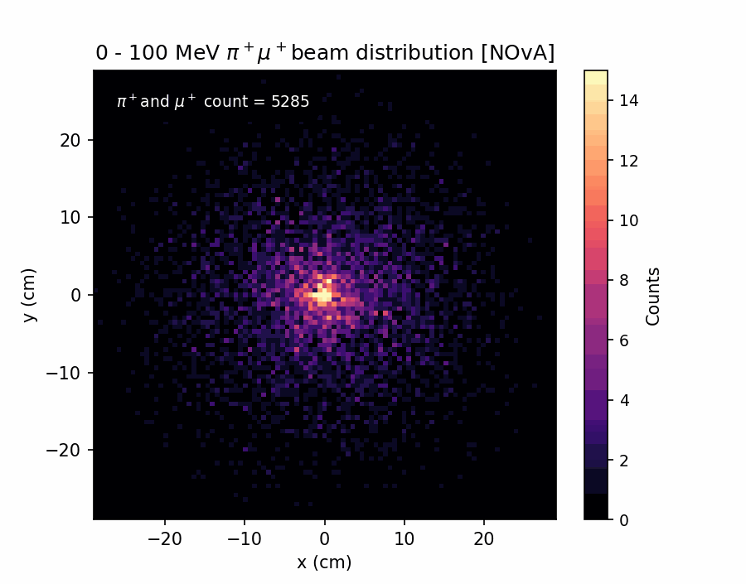
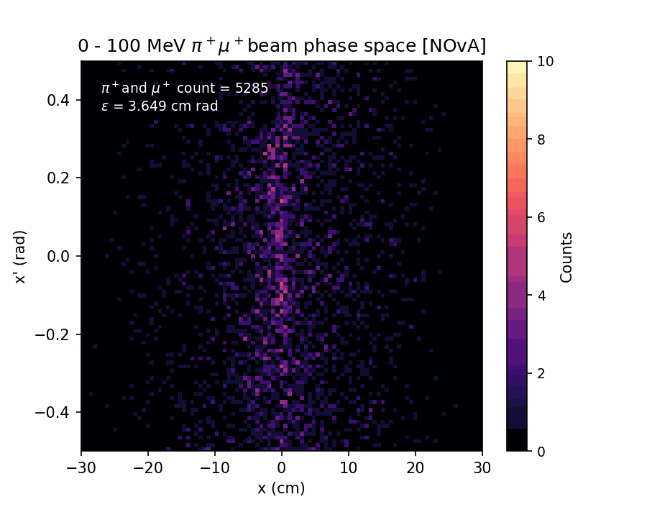
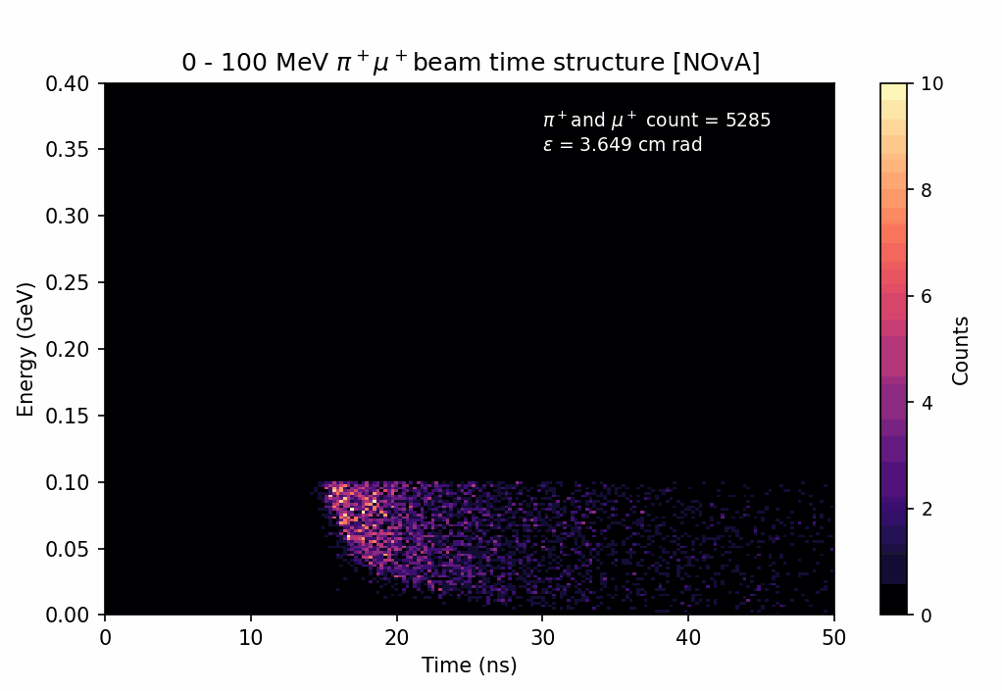
π⁺μ⁺ beams detected at the end of the solenoid [NOvA]

Slide 9
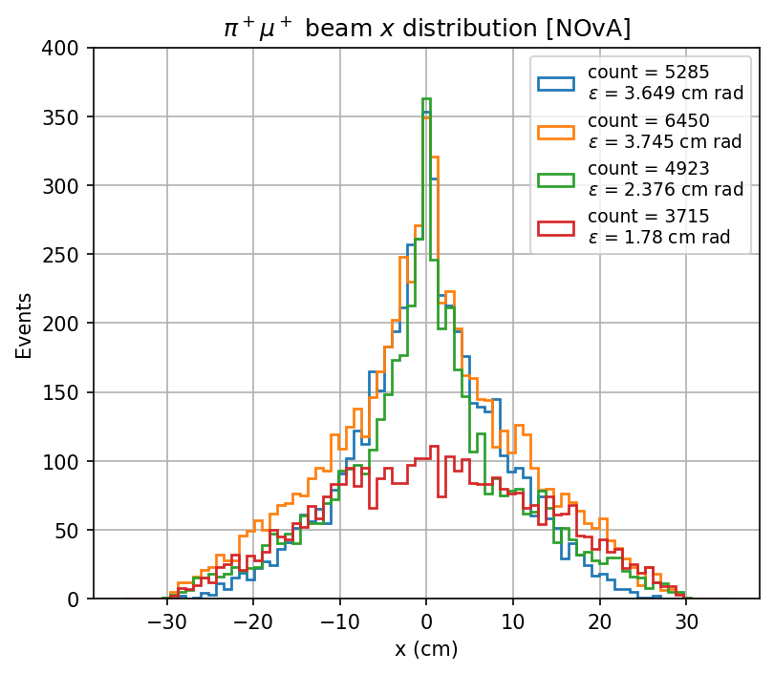
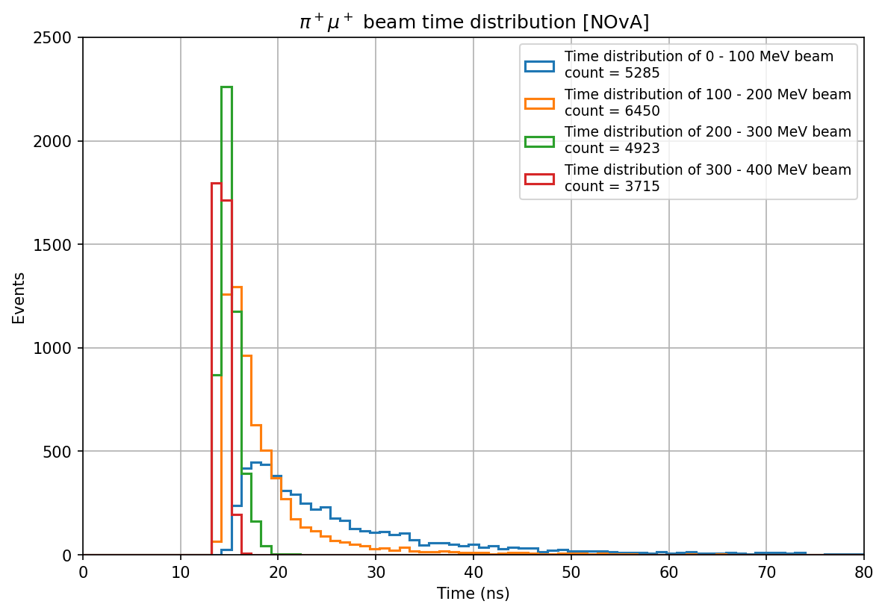
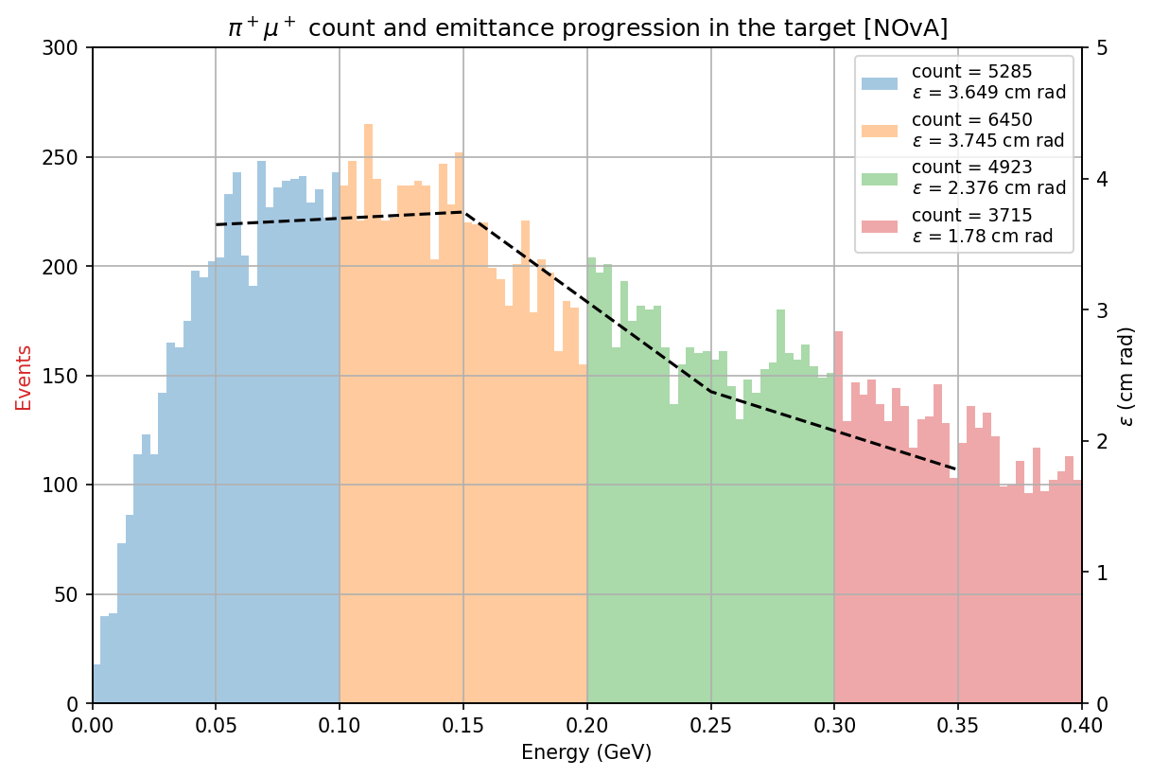
π⁺μ⁺ beams detected at the end of the solenoid [NOvA]

Slide 10
Here, I sectioned the NOvA target
Section 1
Section 2
Section 3
Section 4
New definitions:
  Full simulation: where all the particles that exit the target are recorded.
  Partial simulation: where particles from a particular section are allowed to continue and particles that exit the target from other sections are killed.

Slide 11
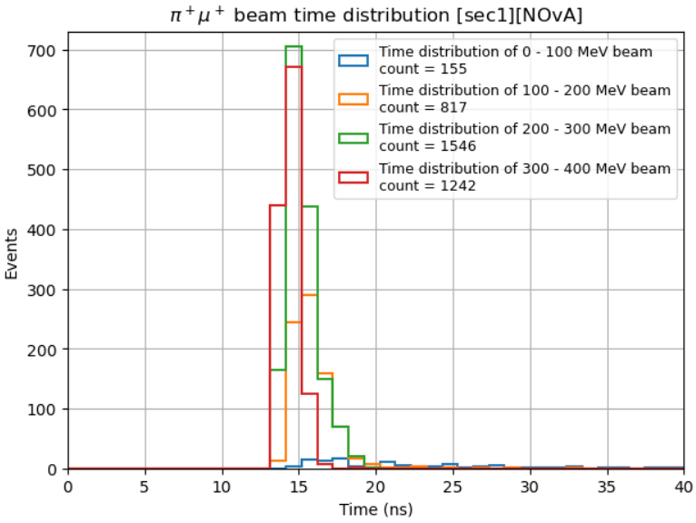
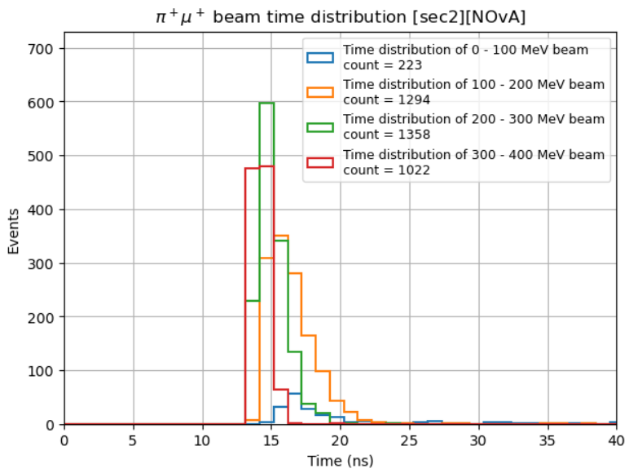
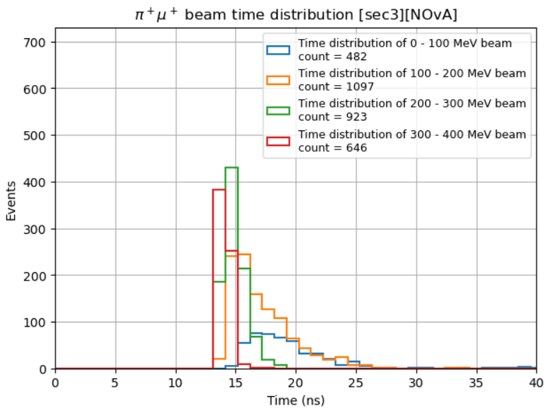
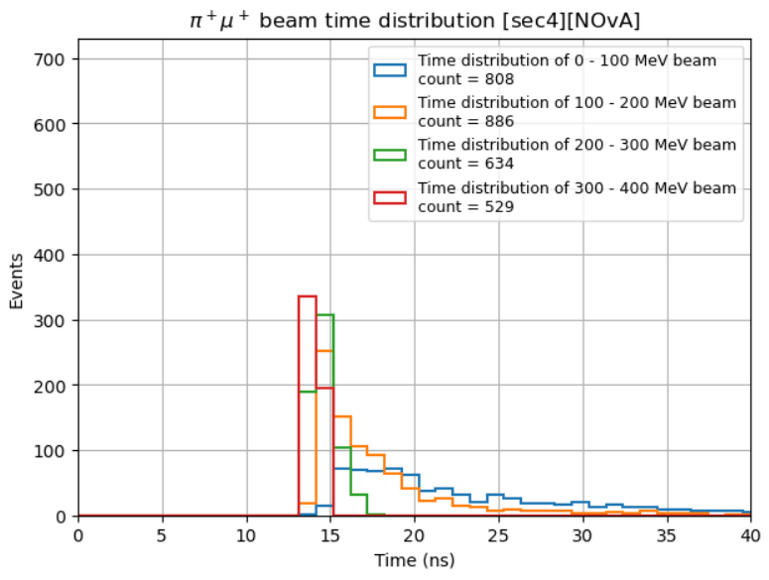
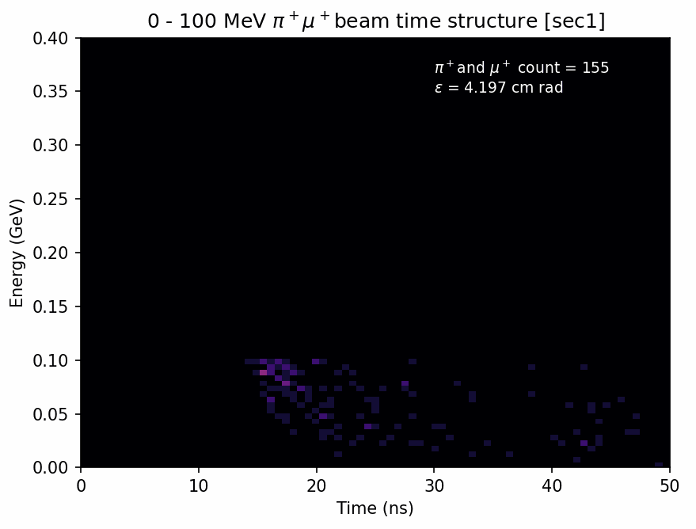
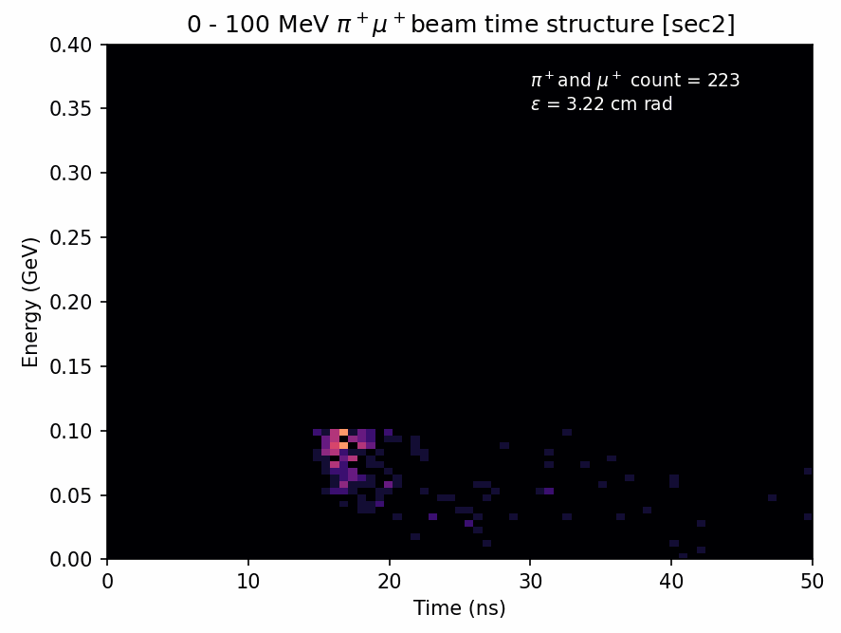
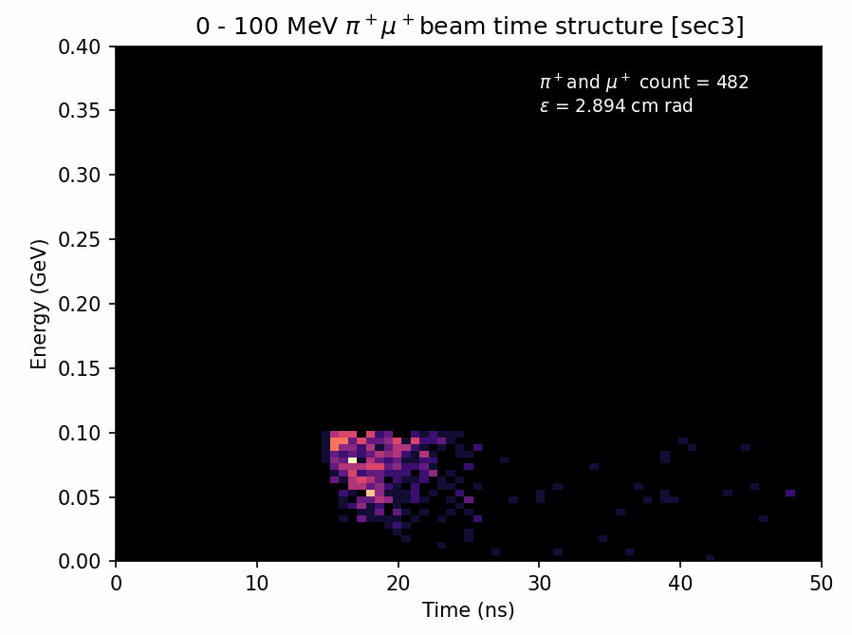
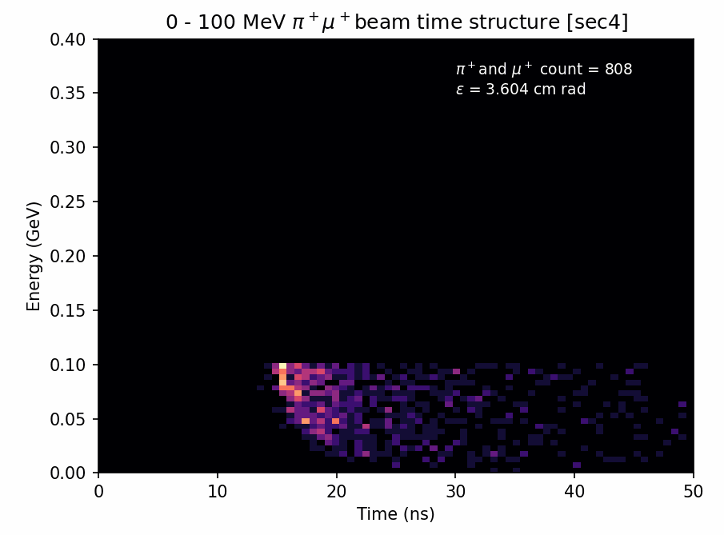
π⁺μ⁺ beams time distribution for different sections [NOvA]

Slide 12
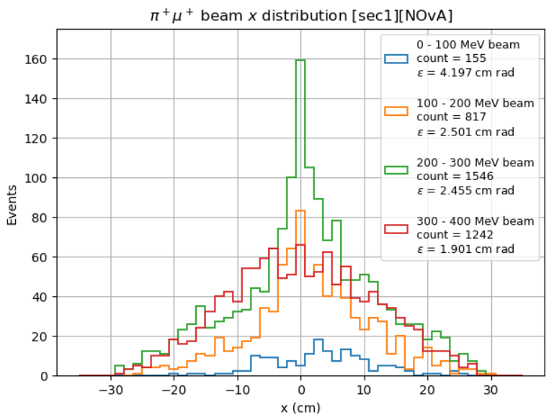
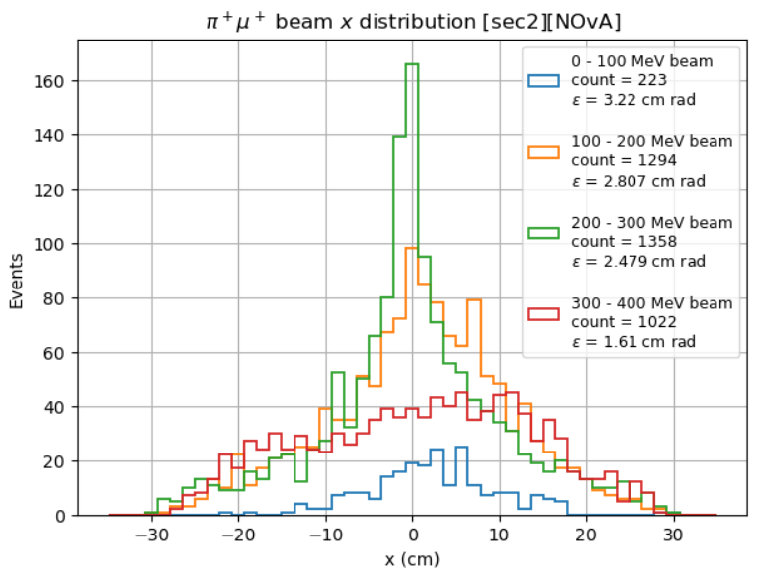
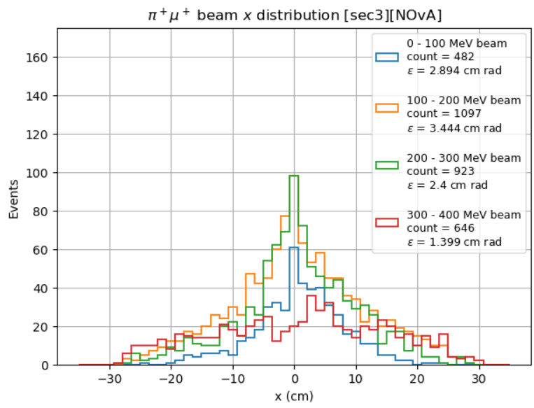
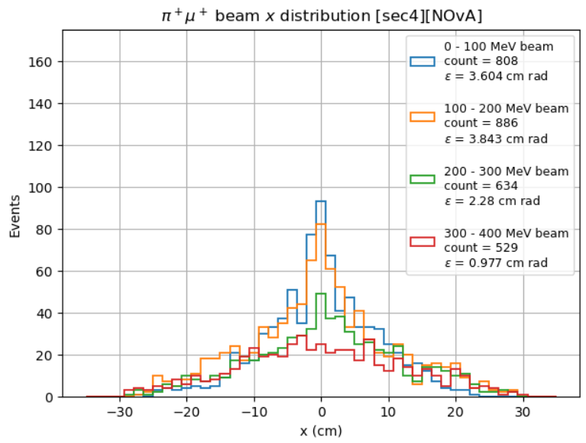
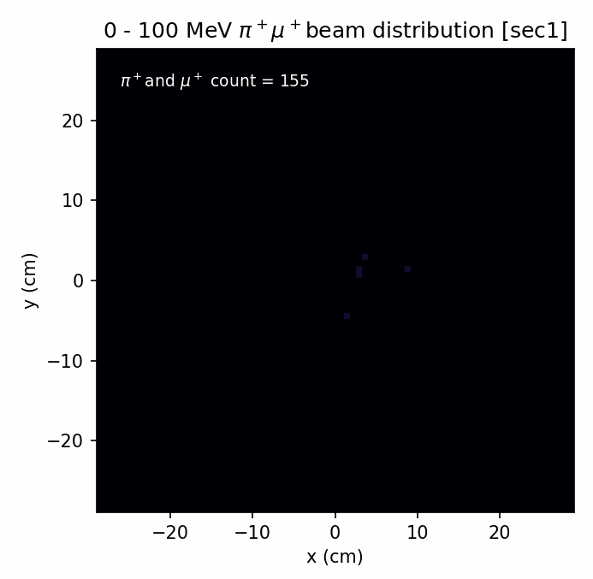

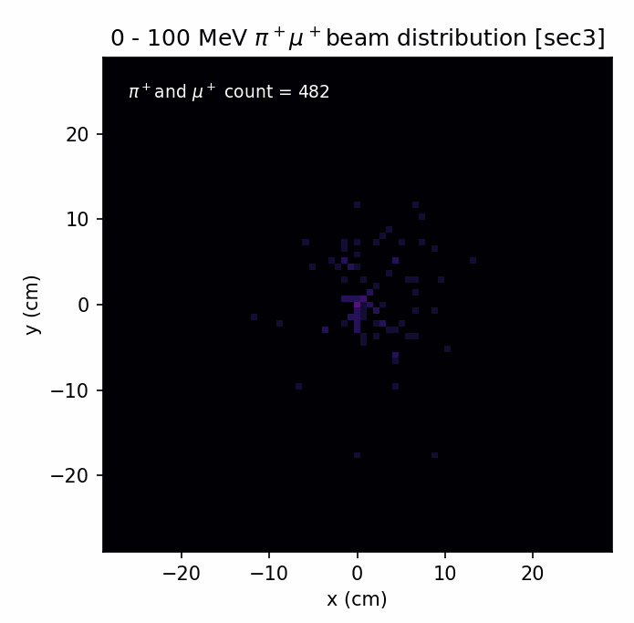
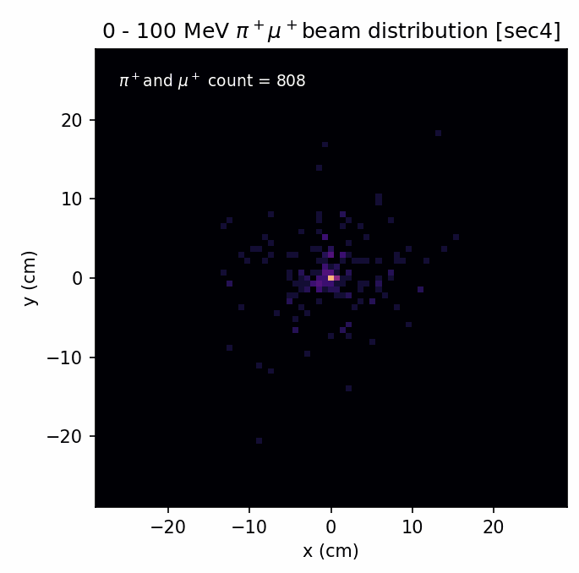
π⁺μ⁺ beams transverse distribution for different sections [NOvA]

Slide 13
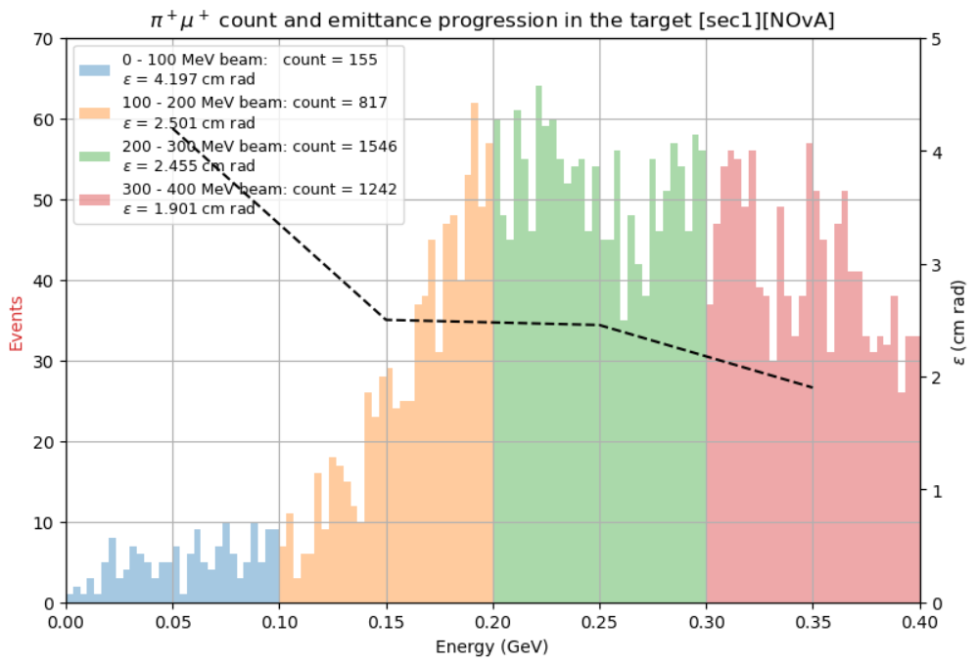
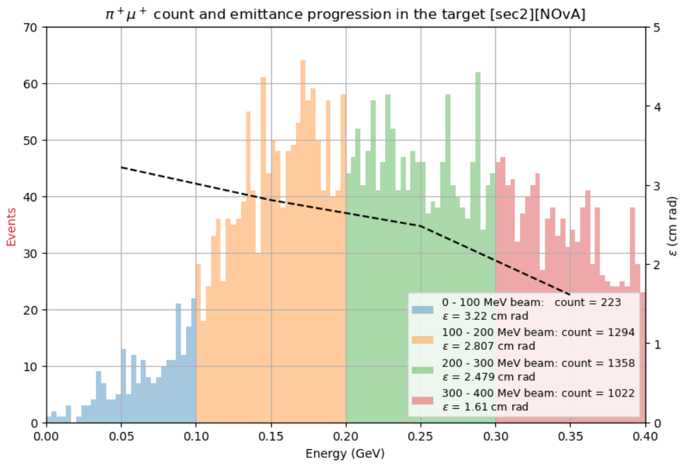
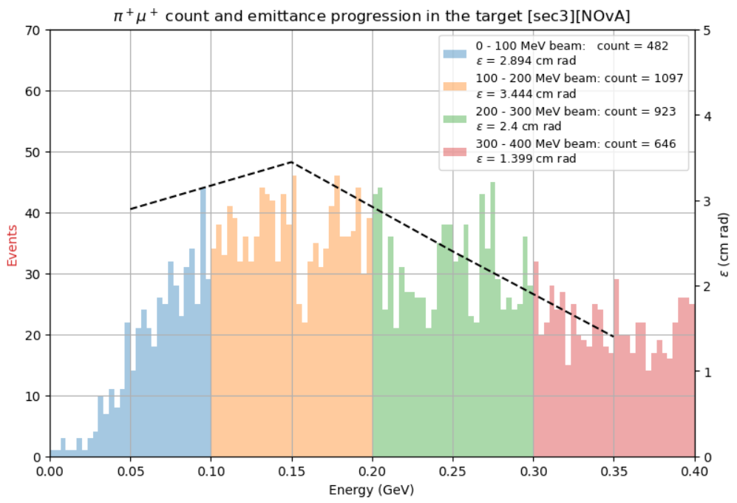
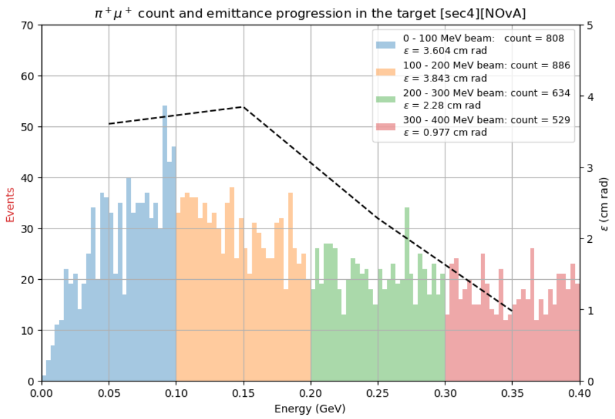
π⁺μ⁺ beams energy distribution for different sections [NOvA]
Full Simulation

Slide 14
π⁺μ⁺ beams energy distribution for different sections [NOvA]
Section | Total π⁺μ⁺ under 400 MeV
1 | 3760
2 | 3907
3 | 3148
4 | 2857
Total | 13,672
From full simulation | 20,373

Slide 15
Notes ☺
There are several questions that came up last time:
  The total number of pions and muons produced in both simulations (partial and full) did not match last time.
  The total pions and muons less than 400 MeV detected in partial simulations is less than the total pions and muons detected in full simulations.
  The energy distribution plots in slide 13 do not add up. The total secondary particles detected within the range 0-100 MeV for partial simulations are drastically lower than those detected in the full simulation.

