Slide 1
High-Power Targetry for a Muon Collider
November 3, 2025
Katsuya Yonehara
National Laboratory Accelerator Study Group Seminar

Slide 2
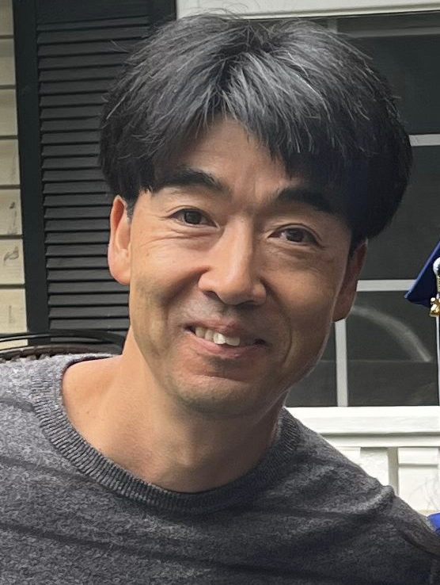
My profile
Katsuya Yonehara
Senior Scientist at Fermilab
Experimental physicist
Accelerator and Particle Physics
Currently working on high-power targetry for neutrino facilities such as NuMI and LBNF
You can reach me via:
During the seminar
Email to yonehara@fnal.gov
USMCC Slack chat

Slide 3
Overview
Conceptual proton-beam parameters for the Muon Collider
Challenges for the Muon Collider Target System
IMCC approach
US strategy
Initiating a Target Design Study with Young Prospects
In collaborating with graduate/undergraduate students and postdocs across USMCC institutions
Summary

Slide 4
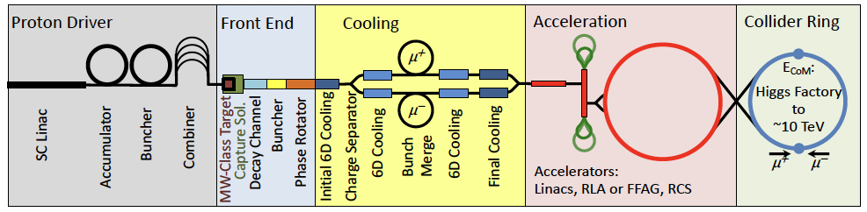
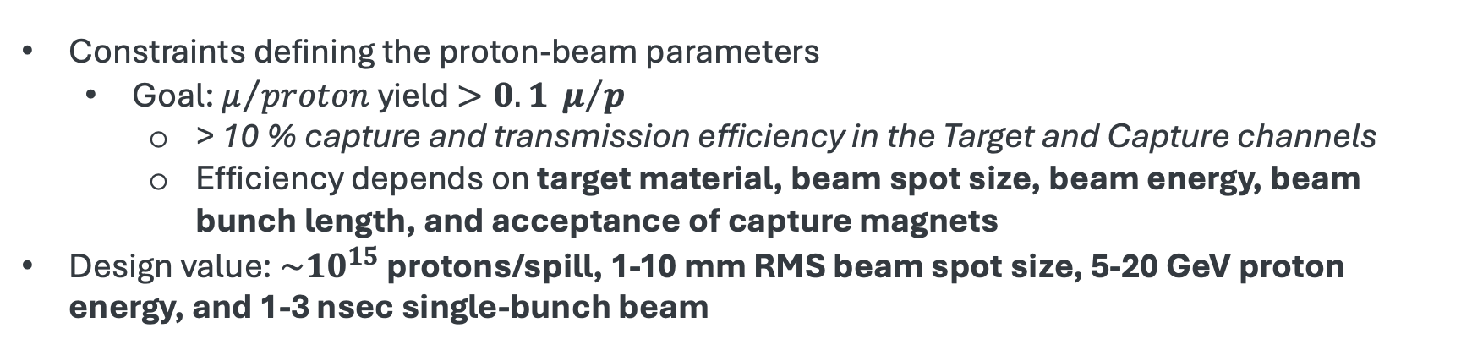
Layout of Muon Collider Accelerator Complex
Proton beam-based muon source and cooling chain
Constraints defining the proton-beam parameters
Goal: $μ/{proton}$yield $>0.1 μ/p$
> 10 % capture and transmission efficiency in the Target and Capture channels
Efficiency depends on target material, beam spot size, beam energy, beam bunch length, and acceptance of capture magnets
Design value: $\sim {10}^{15}$ protons/spill, 1-10 mm RMS beam spot size, 5-20 GeV proton energy, and 1-3 nsec single-bunch beam

Slide 5

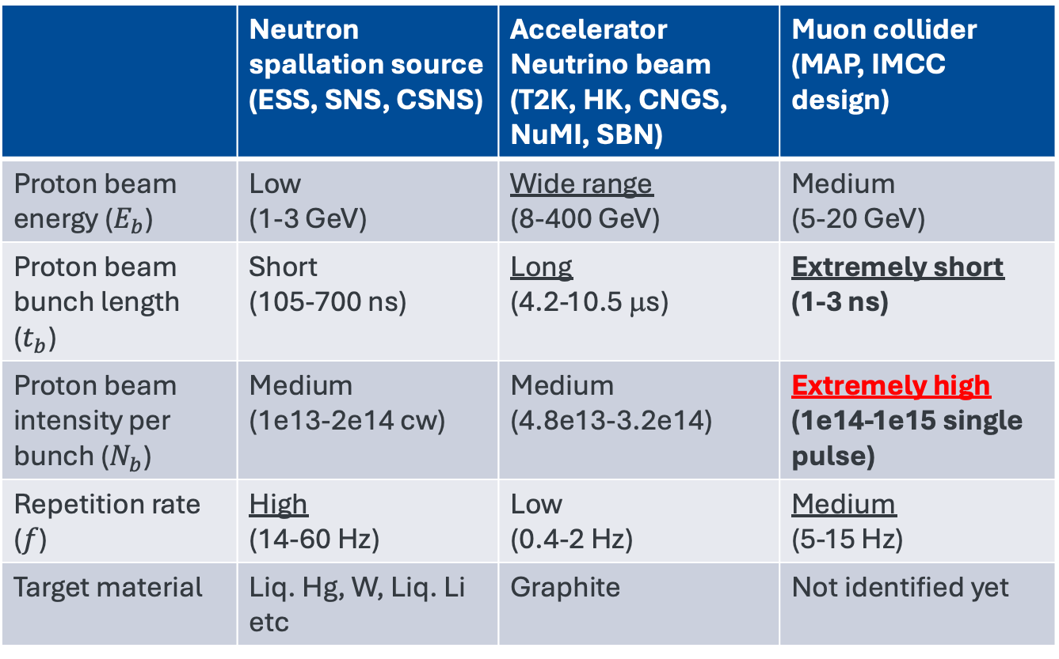
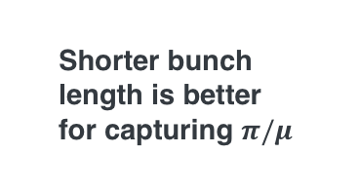
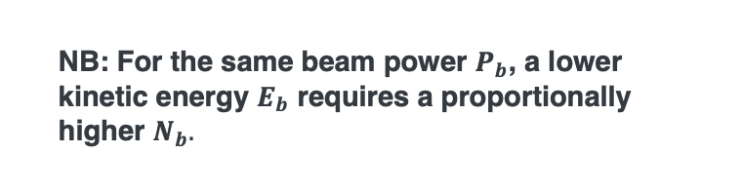
Beam Parameters of MW-class Beam Facilities
 | Neutron spallation source (ESS, SNS, CSNS) | Accelerator Neutrino beam (T2K, HK, CNGS, NuMI, SBN) | Muon collider (MAP, IMCC design)
Proton beam energy ($E_{b}$) | Low (1-3 GeV) | Wide range (8-400 GeV) | Medium (5-20 GeV)
Proton beam bunch length ($t_{b}$) | Short (105-700 ns) | Long (4.2-10.5 μs) | Extremely short (1-3 ns)
Proton beam intensity per bunch ($N_{b}$) | Medium (1e13-2e14 cw) | Medium (4.8e13-3.2e14) | Extremely high (1e14-1e15 single pulse)
Repetition rate ($f$) | High (14-60 Hz) | Low (0.4-2 Hz) | Medium (5-15 Hz)
Target material | Liq. Hg, W, Liq. Li etc | Graphite | Not identified yet
Shorter bunch length is better for capturing $π/μ$
Beam power (Watt):
NB: For the same beam power $P_{b}$, a lower kinetic energy $E_{b}$ requires a proportionally higher $N_{b}.$
$$P_{b}=1.6{∙10}^{−19}×E_{b}∙N_{b}∙f$$

Slide 6
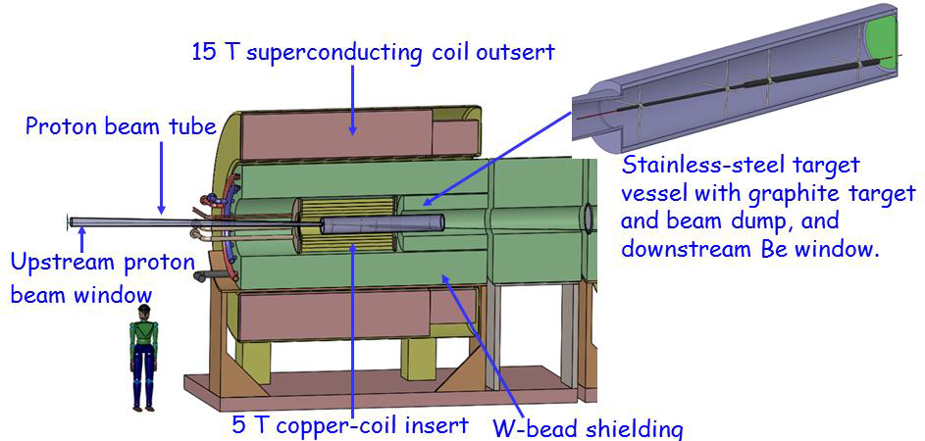
Conceptual design of Target + Capture solenoid magnet
C Target Option
NB: This design is probably outdated.
However, it illustrates several critical challenges

Slide 7
Challenges for MC Target
A multidisciplinary challenge requiring optimization across wide aspects
Physics goal
Achieve μ+π yield efficiency > 10 %
Increase free capture volume to increase acceptance
Remove the exceptional heat load from the target system
Advanced heat transfer technology is needed to reduce the temperature on the target system
Novel target concepts are needed to mitigate instantaneous thermal-shock stress
Ensure accessibility of target system
Long lifetime target system is needed (an operational target system is typically 1 year lifetime)
The lifetime is determined by the degree of mechanical (stress) damage and evaporation (density degradation)
Minimize activity on the target system
Develop instrumentation to monitor target health & remote handling to handle the system
Simple, modular structures are preferred for handling and replacing hot components
Engineering challenge
Engineering challenge
MAP introduced liquid target system to remove critical heat issues
MERIT experiment demonstrated a proof-of-principle for high-power liquid target
Many technological challenges still remain

Slide 8
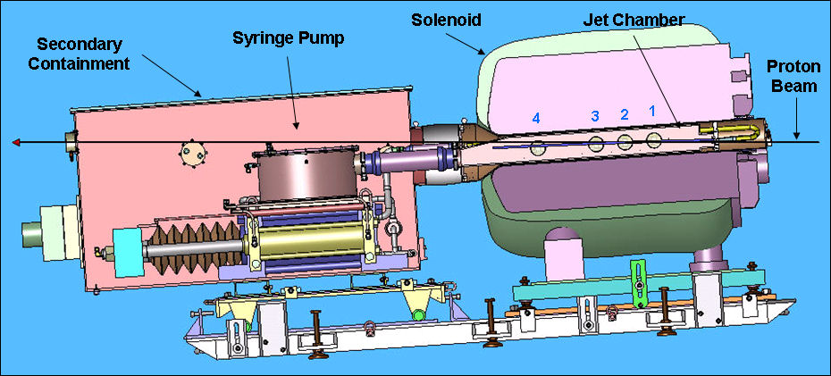
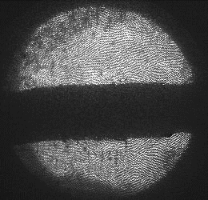
Demonstrate liquid target in MAP
Layout of MERcury Intense Target (MERIT)
1 cm
MERIT was conducted in 2007 at the CERN nTOF11 beamline
A proof-of-principle demonstration of a free liquid-metal (Hg) jet target with intense proton beams, within a 15-T solenoidal field
Used 14 & 24 GeV protons, up to 16 bunches/pulse, with 3.5e12 protons/bunch at a 67 mrad beam angle relative to the solenoid axis
360 beam pulses in total
The mercury jet was magnetically confined as predicted by MHD simulation
Secondary particle flux was observed using diamond detectors (no PID)
Substantial R&D is still required to fully validate technical feasibility

Slide 9
IMCC Progress
Adapted from Rui@CERN

Slide 10

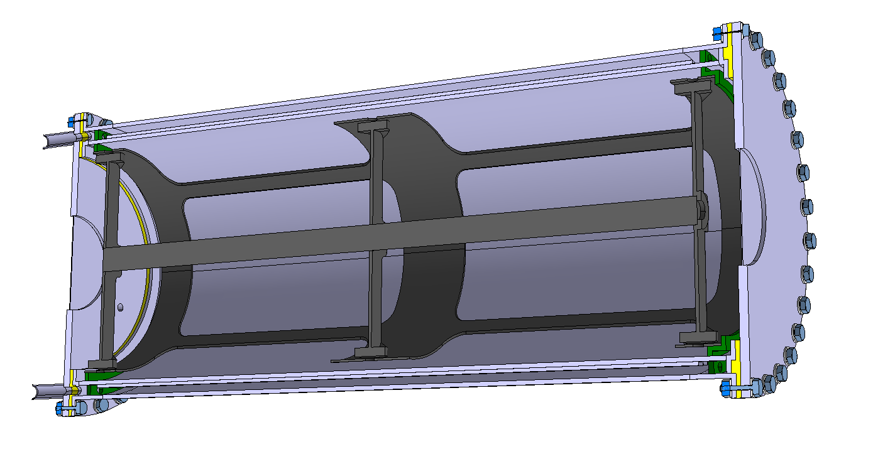
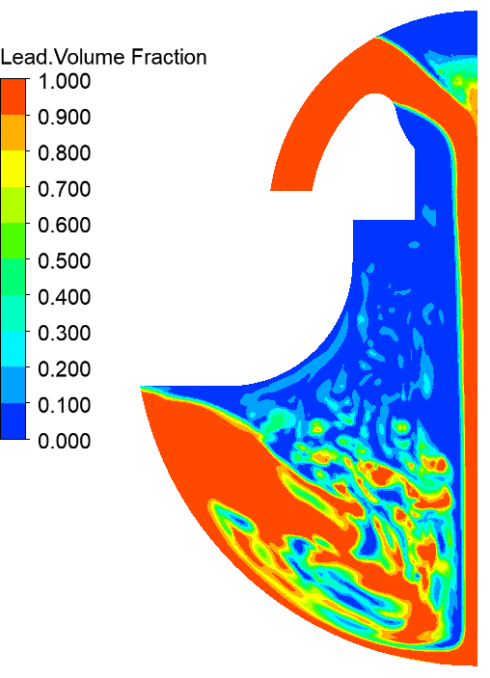
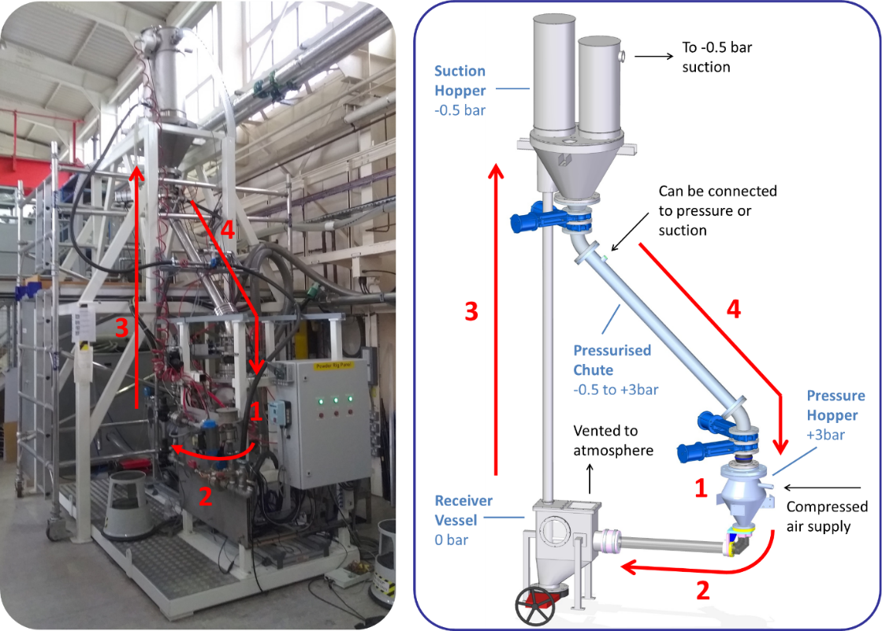
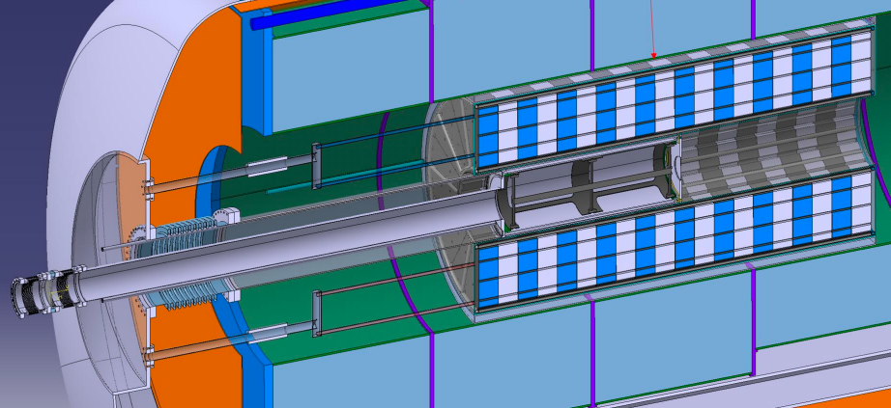
IMCC Targetry options
R. Franqueira, NuFACT‘25
CERN leading C-Target system studies & liquid-Pb option with ENEA. RAL & Warwick University leading fluidized W option.
C-Target & target system
CERN
Liquid Pb Target
ENEA & CERN
Fluidized W-Target
RAL & Warwick Uni.
S. Cândido, R. F. Ximenes, M. Calviani, D. Calzolari, A. Lechner, F. Saura, J. Manczak, G. Lerner, C. Mucher
C. Carrelli, L. Tricarico, M. Tarantino, I.Di Piazza, P.C. Puviani, et al.
B. Suitters, C. Densham, J.J. Back, W. Bishop, D. Wilcox, et al.

Slide 11
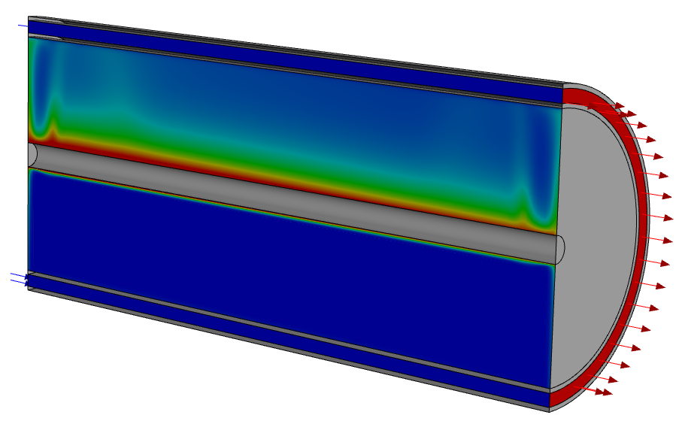
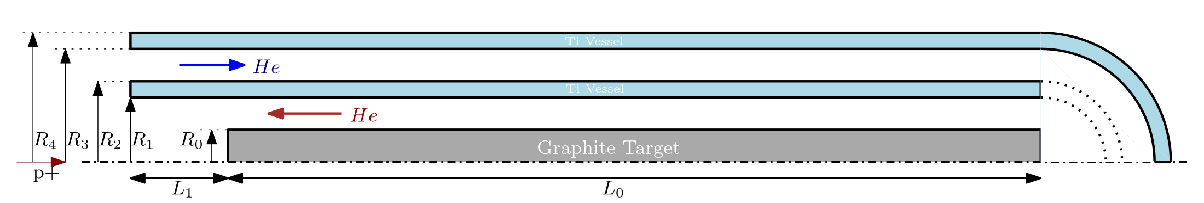
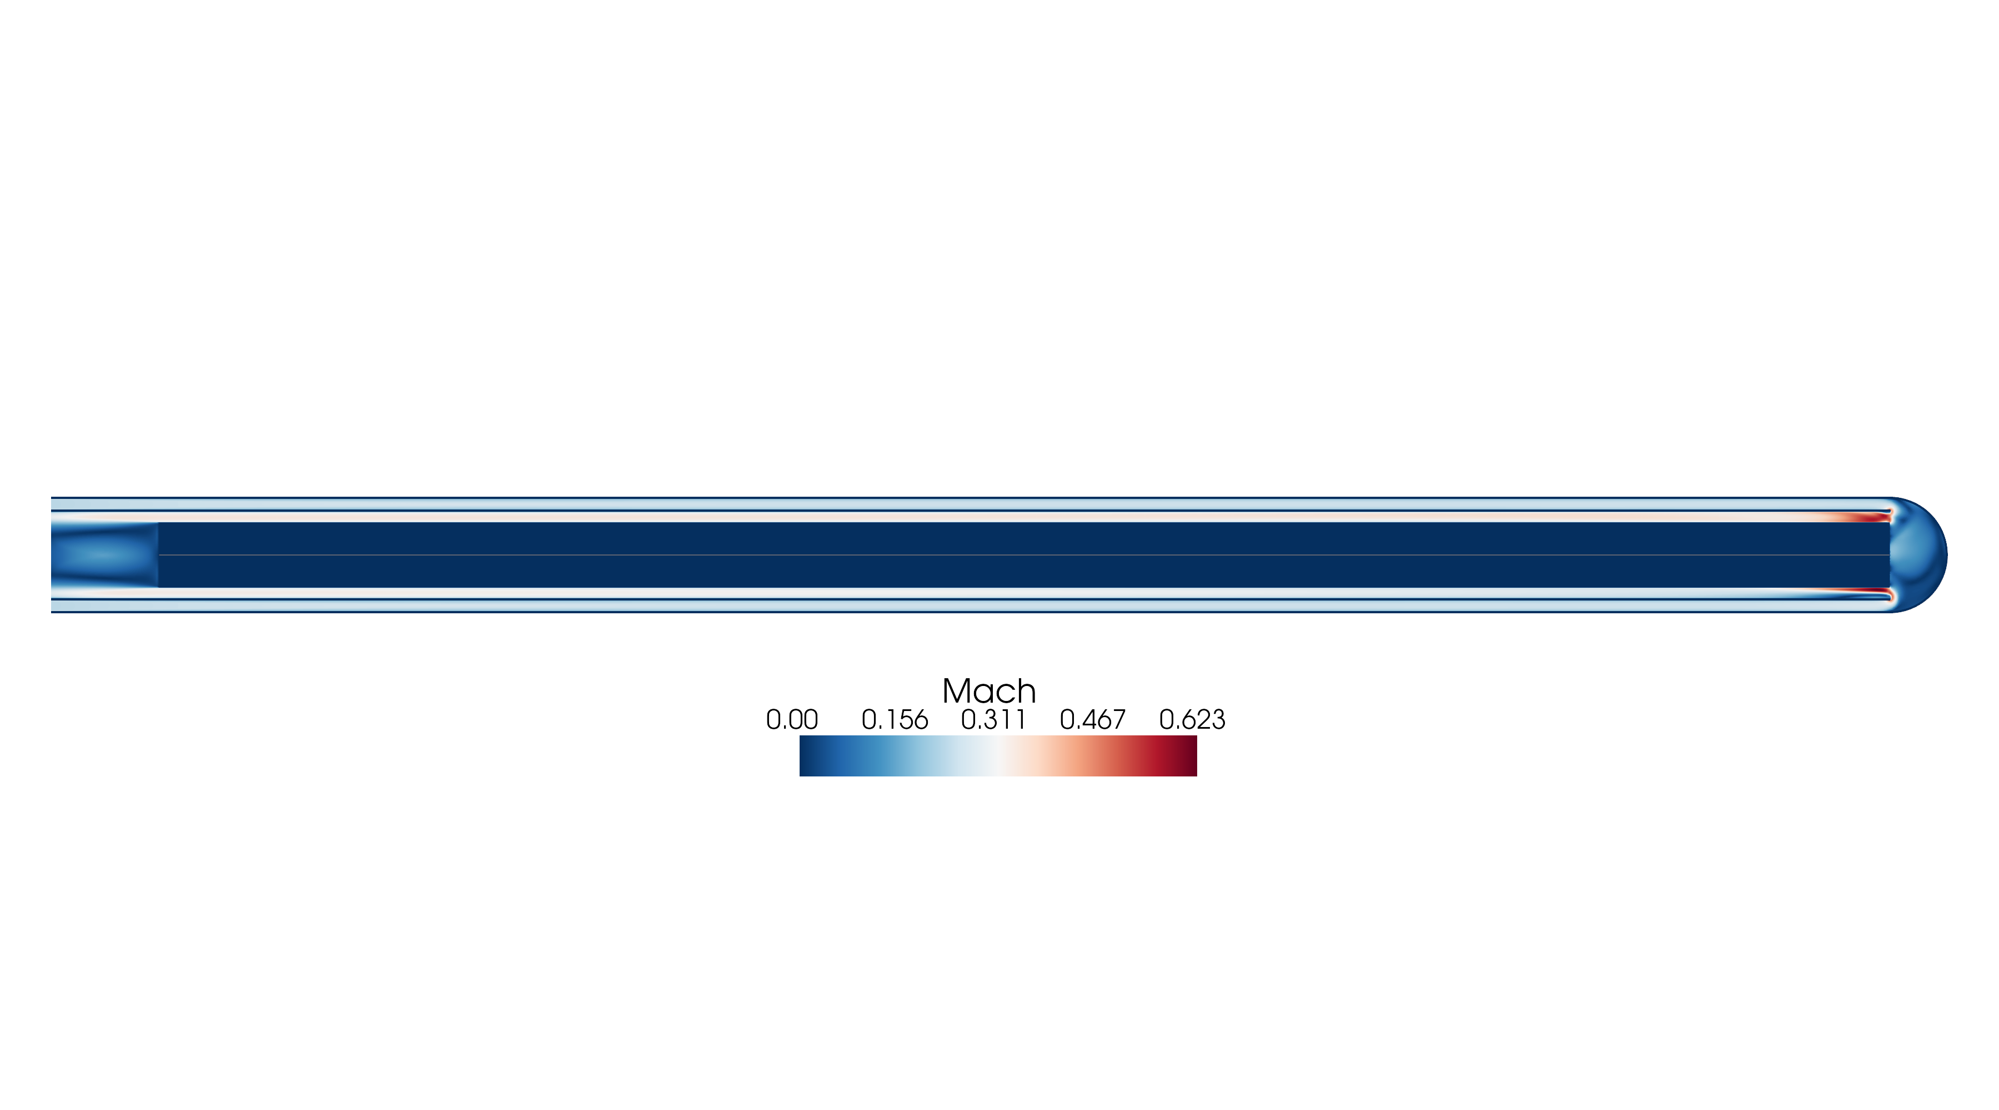
Carbon Target – Cooling
R. Franqueira, NuFACT‘25
Baseline 2 MW (natural convection)
4 MW (option A / B with forced convection)
 | Option A | Option B
(mm) | 10 GeV 5mm | 10 GeV 7.5mm
R0 | 15 | 22.5
R1 | 20 | 27.5
R2 | 21 | 28.5
R3 | 26 | 33.5
R4 | 27 | 34.5
L0 | 800 | 800
L1 | 50 | 50
Natural convection cooling with Helium @ 1 bar
e.g. for 0.25 kg/s
1.1 bar
Pressure loss
# | Energy [GeV] | Power [MW] | Beam sigma [mm] | Target R0 [mm] | Mass flow rate [kg/s] | Mach | He [bar] | HTC [W/m2 ºC] | Tmax [ºC] | Tsurf [ºC] | (SS) Principal stress [MPa]
1 | 5 | 2 | 5 | 15 | Natural Convection | NA | 1 | 33 | 2422 | 2014 | 19.23
2 | 10 | 4 | 5 | 15 | Natural Convection | NA | 1 | 33 | 3315 | 2456 | 28.25
A.1 | 10 | 4 | 5 | 15 | 0.25 | 0.28 | 10 | 4797 | 1448 | 652 | 17.66
A.2 | 10 | 4 | 5 | 15 | 0.20 | 0.22 | 10 | 3898 | 1516 | 763 | 18.74
A.3 | 10 | 4 | 5 | 15 | 0.10 | 0.11 | 10 | 2255 | 2096 | 1240 | 25.69
B.1 | 10 | 4 | 7.5 | 22.5 | 0.36 | 0.28 | 10 | 4792 | 1392 | 548 | 19.52
B.1 | 10 | 4 | 7.5 | 22.5 | 0.30 | 0.23 | 10 | 4135 | 1540 | 640 | 21.35
B.2 | 10 | 4 | 7.5 | 22.5 | 0.25 | 0.20 | 10 | 3420 | 1619 | 683 | 22.42
 | Fs=1.25
 | Physical Limit
Baseline 2 MW
HTC is cross-checked with CHT flow simulation, analitical (Gnielinski correlation) gives <5% difference to numerical
Properties | Value
Density [kg/m3] | 1830
Tensile Yield Strength [MPa] | 29.7
Sublimation T [ºC] | 3330
Best candidate parameters for 4 MW

Slide 12
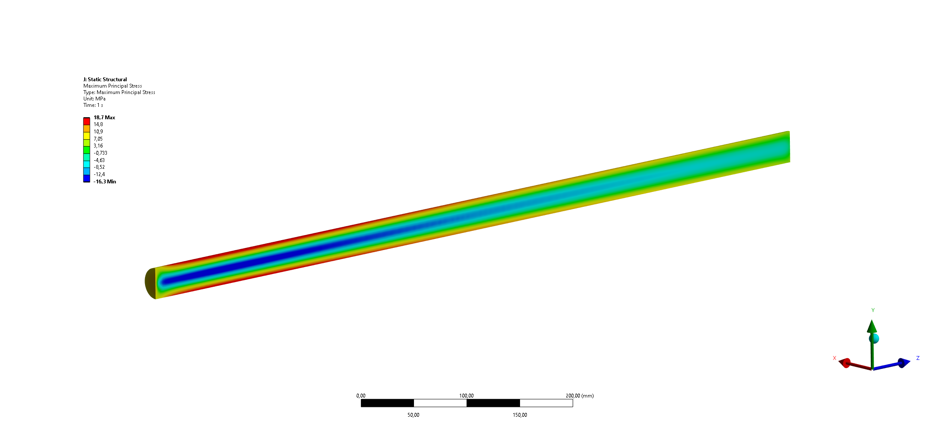
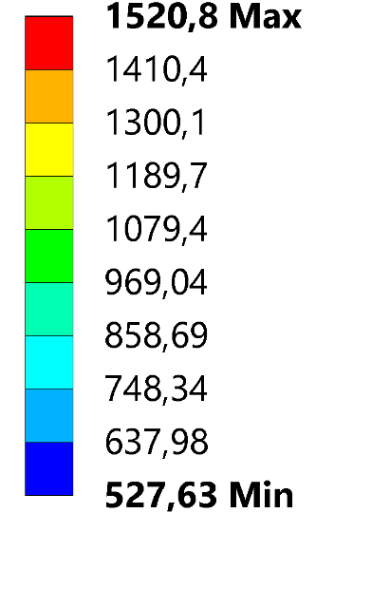
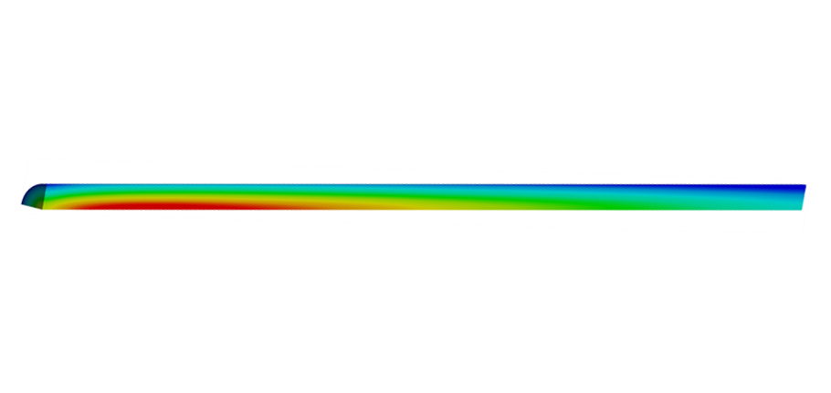
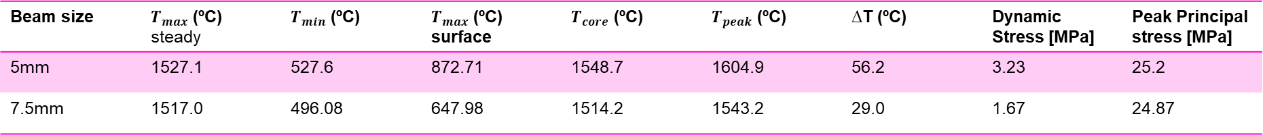

Carbon Target – Thermal shock
R. Franqueira, NuFACT‘25
GRAPHITE R 45550 Polycristalline SGL
Heating is abrupt ⇒ wave launches ⇒ dynamic stress
Elastic‐wave transit time is the radial distance
$E_{d}=11.5$GPa
Grapithe $c_{wave}\sim 2,600$ m/s → elastic wave$τ≈5.8 μ$s > 2 ns (pulse length)
C-Target 2MW
Alternant stress (MPa) | 0.7
Average stress (MPa) | 22.5
From LS Dyna explicit structural simulation of stress waves propagation in graphite for baseline:
Beam size | $T_{max}$ (ºC) steady | $T_{min}$ (ºC) | $T_{max}$ (ºC) surface | $T_{core}$ (ºC) | $T_{peak}$ (ºC) | ∆T (ºC) | Dynamic Stress [MPa] | Peak Principal stress [MPa]
5mm | 1527.1 | 527.6 | 872.71 | 1548.7 | 1604.9 | 56.2 | 3.23 | 25.2
7.5mm | 1517.0 | 496.08 | 647.98 | 1514.2 | 1543.2 | 29.0 | 1.67 | 24.87
Temperature ºC
Stress MPa

Slide 13
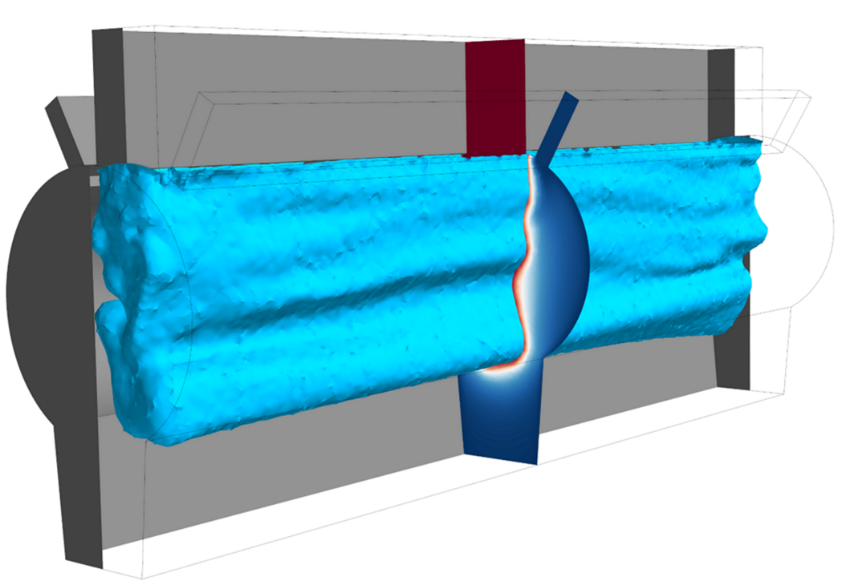
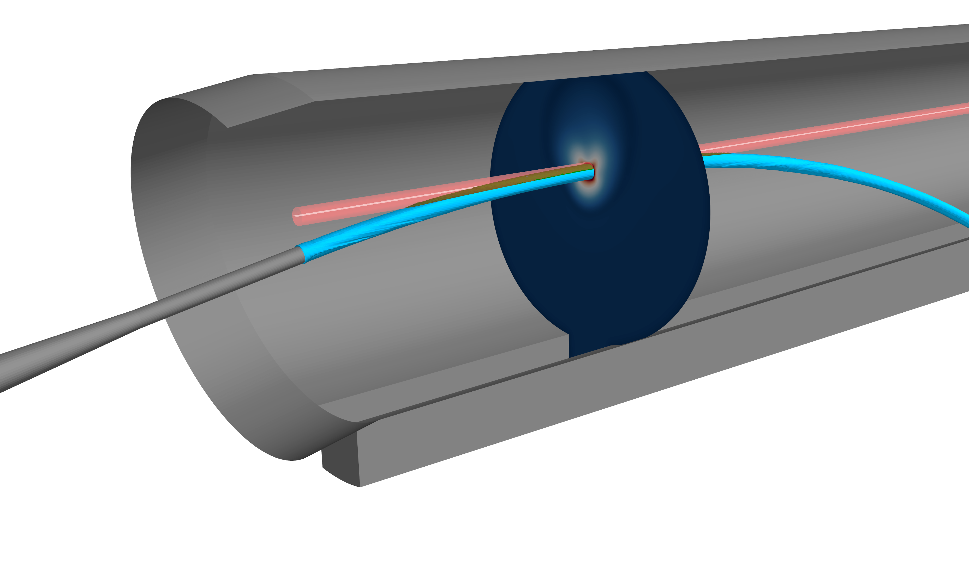


Liquid Pb Target – Pros & Cons
R. Franqueira, NuFACT‘25
Opportunities
Known liquid-Pb / Lead-Bismuth Eutectic thermo-hydraulics
Cooling outside vacuum chamber.
Radioisotopes mostly retained.
No degradation of target material.
Synergies between different projects at CERN such as FCCee.
Challenges
Liquid-Pb containment vessel and windows (material, temperatures, DPA).
MHD interaction.
Cavitation-induced erosion.
Temperature and dynamic effects.
Dynamic multi-phase flow simulation complexity
p+ beam
Conceptual designs
Pipe flow.
Vertical curtain.
Jet stream.
C. Carrelli, L. Tricarico, M. Tarantino, I.Di Piazza, P.C. Puviani, et al.

Slide 14
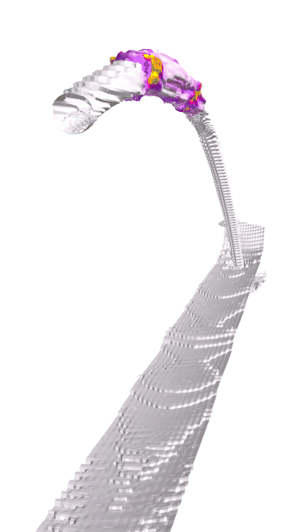
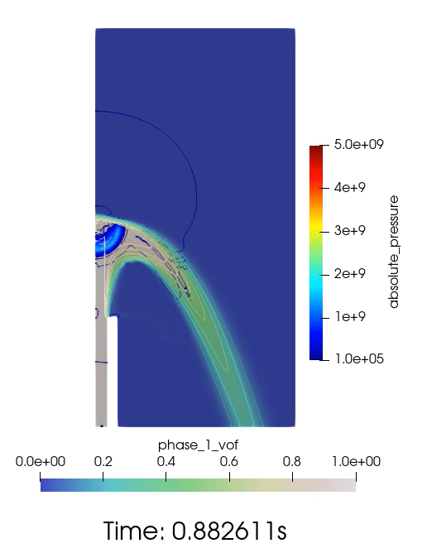
Liquid Pb Target – Jet Concept Shock-wave propagation
R. Franqueira, NuFACT‘25
Shockwave and cavitation: stet up
Over pressure of 5GPa resulting from 1e18 [W m^-3] pick deposition – (starting with 2 MW conditions).
Patch pressure at 5GPa into the interaction zone.
Compressible liquid lead according to Tait EOS.
Cavitation model for liquid lead under 10 Pa.
Incompressible argon and lead vapour.
Isothermal VOF model.
Time step 10ns.
Simulation trials on vertical and horizontal jets

Slide 15
Fluidized W Target – Pros & Cons
R. Franqueira, NuFACT‘25
Advantages
No cavitation, corrosion, radiochemistry damage.
High thermal-shock resistance.
Heat removal.
Challenges
Erosion & powder handling and reliability.
Reduced experience in operational facilities
Offline tests at RAL & HiRadMat beam test
Test rig built and operated at Rutherford Appleton Laboratory from 2009-2018
Response of various size spherical tungsten particles to 2x10¹¹ p+ at HiRadMat (CERN)
B. Suitters, C. Densham, J.J. Back, W. Bishop, D. Wilcox, et al.

Slide 16
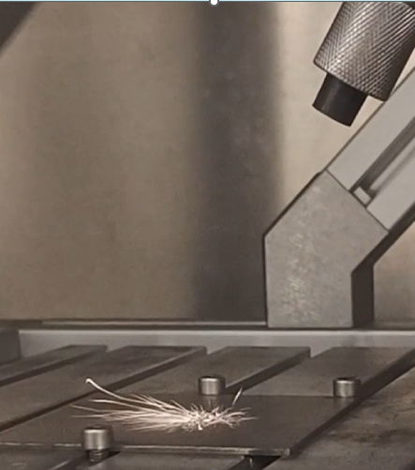
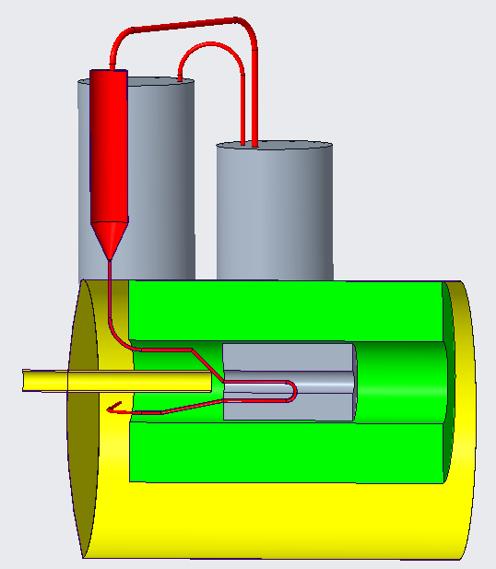
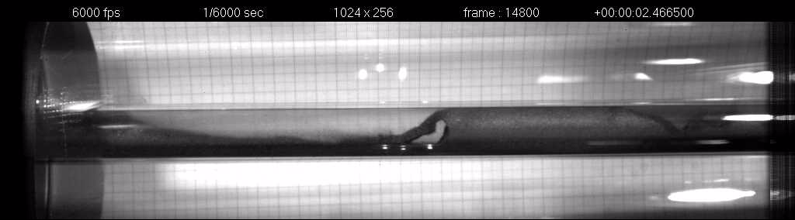
Fluidized W Target – Overview of the studies
R. Franqueira, NuFACT‘25
Focus on R&D
Heat deposition: Design in parallel with Physics optimisation
Pressure: Minimise piping length, test with off-line rig
Erosion: Ongoing work to assess at University of Sheffield
Process design
Use STFC expertise in facility design
Industrial expertise pneumatic conveying and powder handling plant
Offline Testing!

Slide 17
US Approach
Many slides adapted from Frederique@Fermilab

Slide 18
Strategic Plan for High-Power Targetry R&D
Synergistic plan with the major HEP programs
The HPT R&D follows and complements ongoing and future HEP programs
Each HEP program has its own specific target challenges, but none operates with proton beam parameters fully representative of the Muon Collider
Target demonstration strongly depends on the capability of proton accelerators
Because the MC proton beam parameters are extreme, no existing or planned HEP beam facility can fully reproduce the true MC conditions
We therefore need to extrapolate existing irradiation test result and proceed new irradiation test to predict the MC beam effects
This effort requires close collaboration with radiation materials science experts
The RaDIATE collaboration can address this need through ongoing and future material irradiation studies
Indeed, many IMCC target R&D teams include active RaDIATE members
We should leverage and expand US expertise to strengthen national contributions to HEP target R&D
Design Demonstrator Target
First conceptual design provided by 2030(?)
We need to clearly define the goals and success criteria for the demonstrator target design

Slide 19
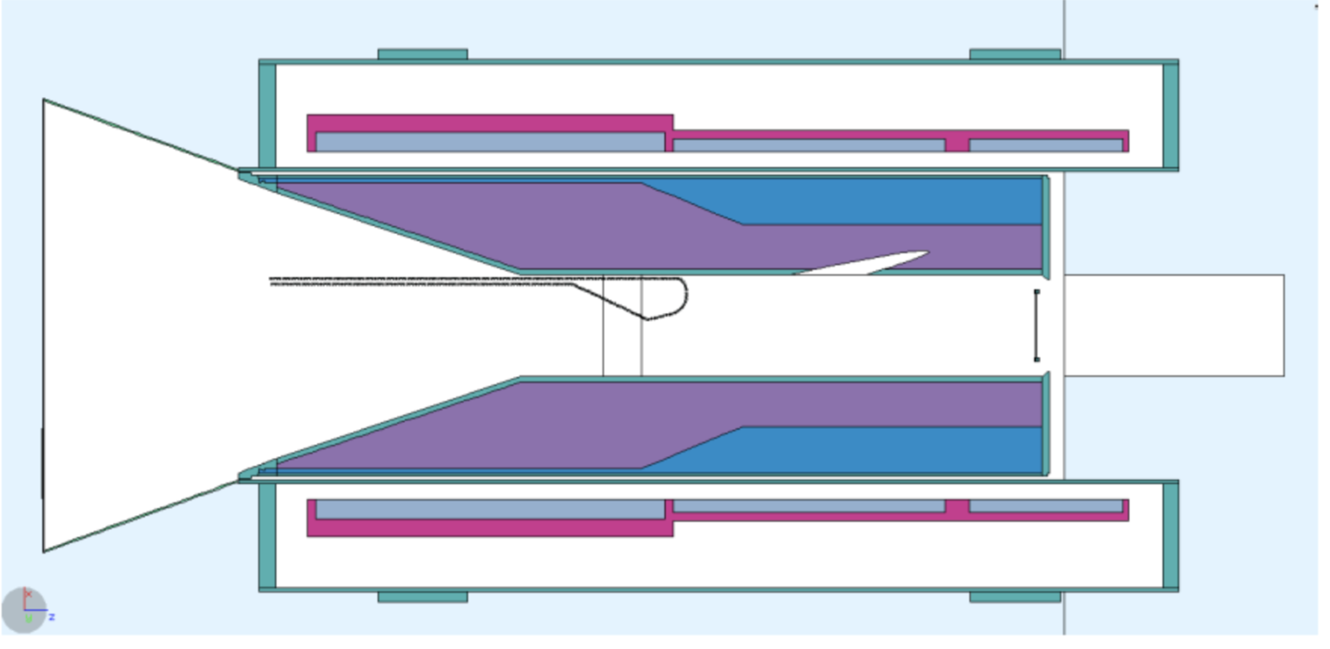
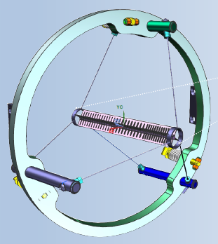
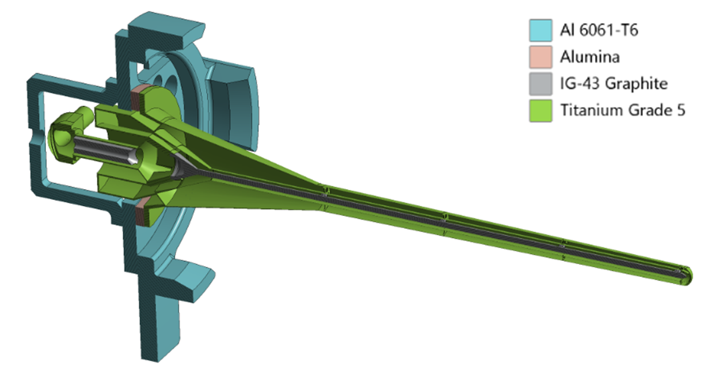
Evolution of High-Power Targetry Challenges
F. Pellemoine, USMCC workshop ‘24
X 2.5
AMF Target core ?
250 kW-1MW in target at 800 MeV
2.4 MW LBNF Target?
X 140
Mu2e-II Target core C, W, WC, SiC,…? ~ 10 mm x 200 mm
100 kW in target at 800 MeV
Mu2e Target core Tungsten 6.3 mm x 220 m
700 W in target at 8 GeV
R&D and
prototyping
are needed!
LBNF Target core Graphite 16 mm x 1.5 m
25kW in target at 120 GeV
Higher power density = Greater engineering and material challenges
p
Conveyor target
Mu2e target
High-Z w/o active cooling
Target in Solenoid magnet
LBNF graphite target
MW operations
Mu2e-II target system
High power operations
Notes:
Generation after generation, the beam power increase and the energy decrease, leading to more and more power density deposited in material.
The different targets are presented with the same scale so you can compare the size from one to another design.

Slide 20

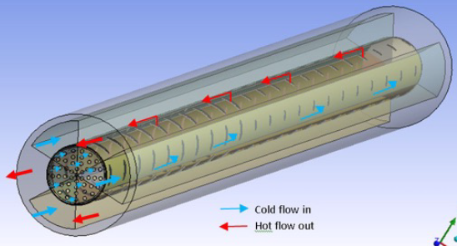
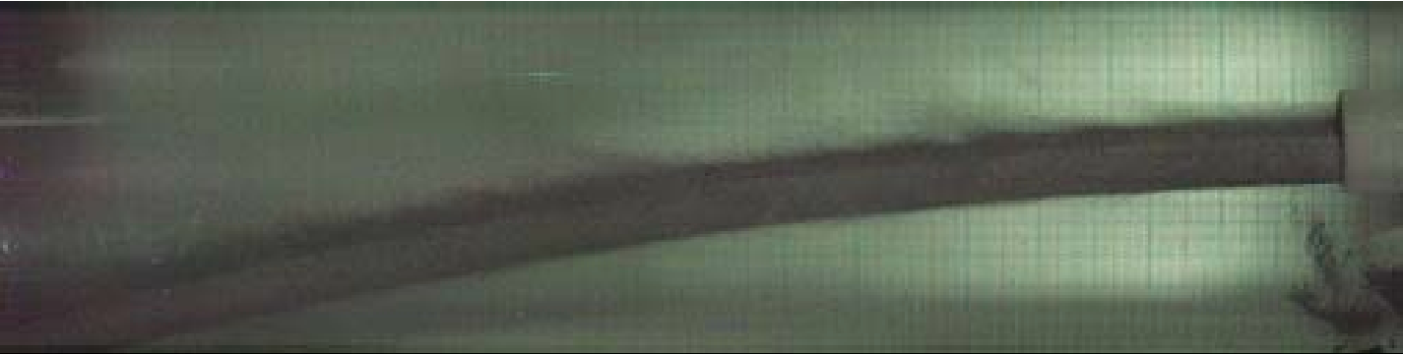




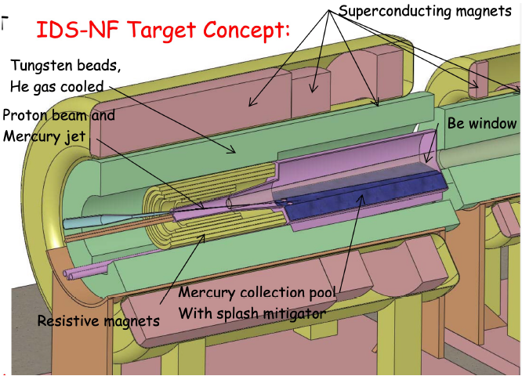
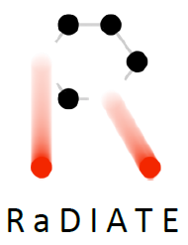
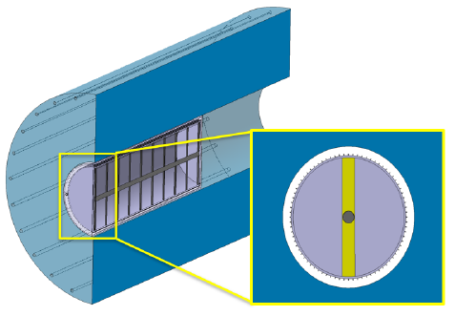
R&D Plan
First: feasible study of each concept : pro and con
DESIGN
FEA simulations
MATERIAL
Material Sciences
Radiation Damage
Thermal shock
Packed bed or Fluidized powder target
PHYSICS
Mu2e-II-like target (conveyer)
Liq. Target
Evaluate physics performance
Neutrino-like target (solid C)
Mu2e-like target
R&D Phase (6-7 years)
F. Pellemoine, USMCC workshop ‘24
Demonstration Phase (~10 years)
Selected Target Design
Prototype

Slide 21
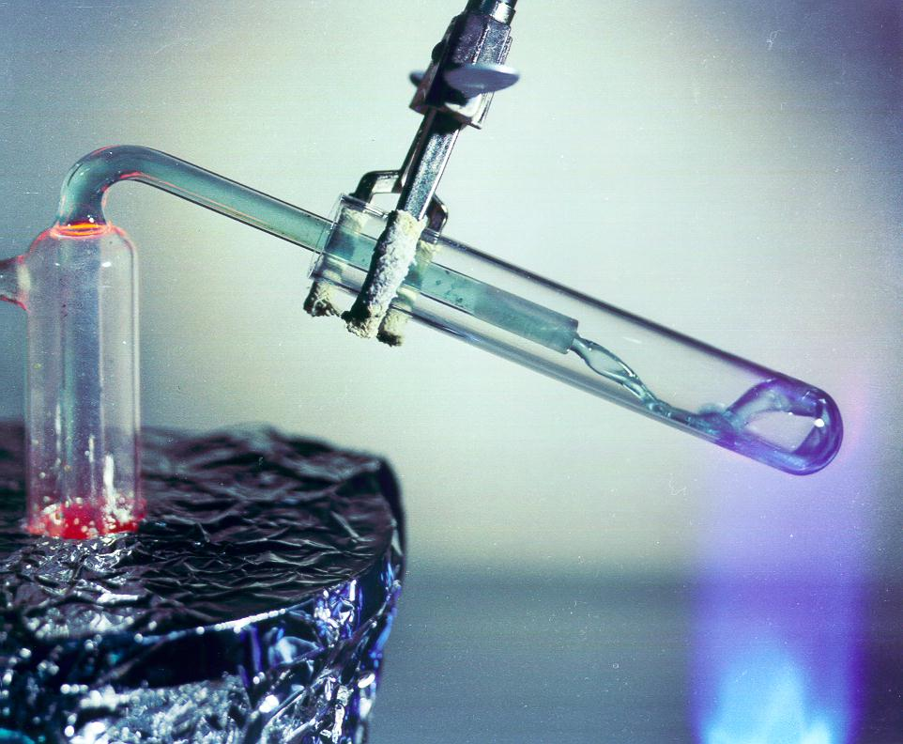
Molten Salt as a Target Material?
J. Williams, DAMSA workshop ‘25
Benefits:
Convenient melting point, good thermophysical properties
Dilution of activation products in total salt inventory
Heat removed with the flowing salt
It isn’t liquid mercury!
Composite high-Z material
Low DPA
Drawbacks:
Tight control of salt chemistry required
Chemical compatibility with container materials
Beam windows still limit life
Difficult, expensive remote handling and disposal for highly-activated materials
Activation on par with existing targets
FLiBe salt, ORNL
Commercial parallels with Molten Salt Reactor
Spallation sources solve this with replaceable primary beam windows
Spallation sources (ESS and SNS STS) have similar facilities to what we would need

Slide 22
Initiating Muon Collider Target System Study with Young Prospects
Engaging and training the next generation of accelerator physicists and engineers

Slide 23


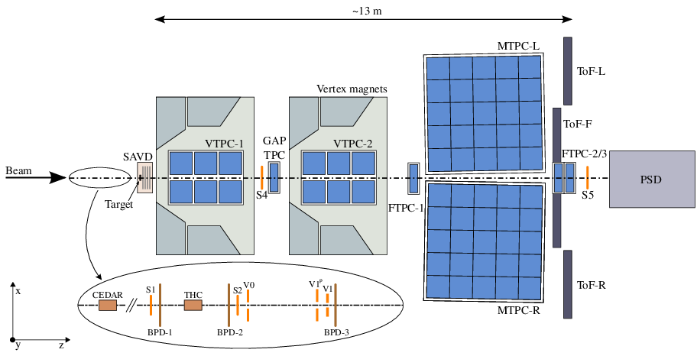
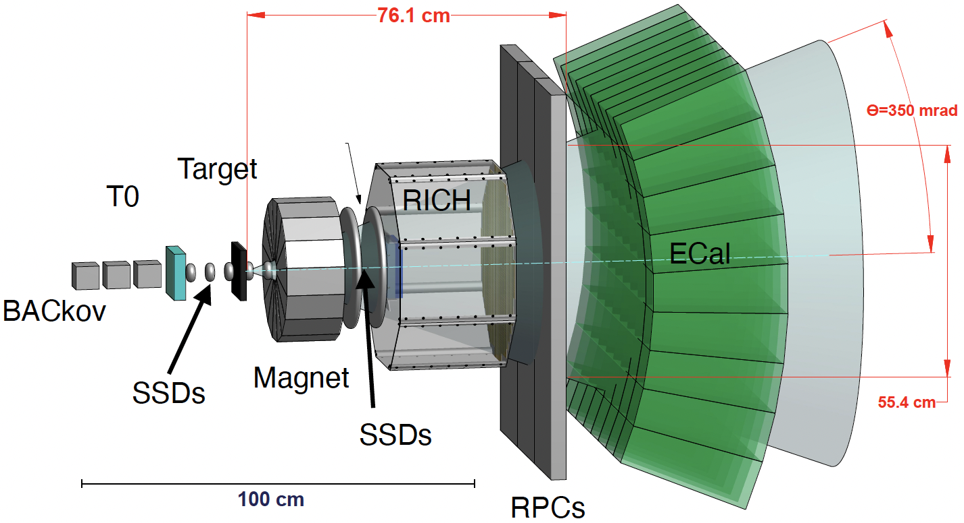
Study of Pion Production Mechanism
Pion event generators in Monte Carlo simulations rely on hadronic interaction models. The associated uncertainties grow significantly for thick materials, where multiple hadronic interactions occur.
Neutrino physics groups have conducted several beam experiments using replica target systems to benchmark and calibrate the models
MARS
NA61/Shine@CERN
EMPHATIC@Fermilab

Slide 24
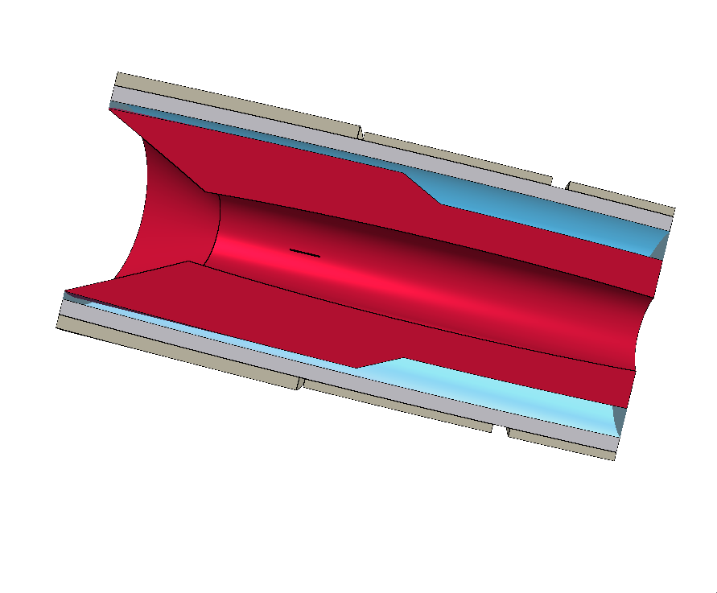
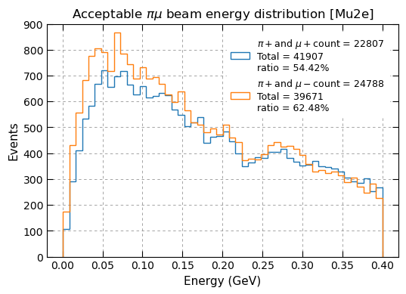
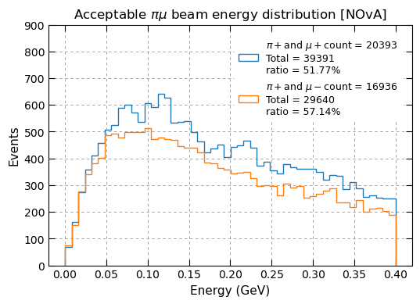
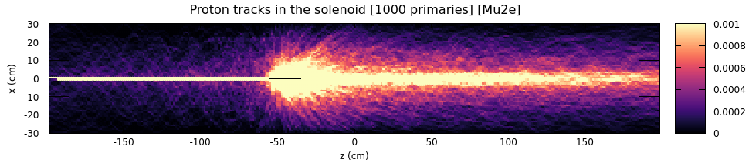
Pion Event Study in Simulations
R. Alharthy, C. Nee, UW-Madison
Can we reuse the Mu2e Target Solenoid?
Steel wall
Titanium solenoids
Water
Tungsten
Beam direction
Bronze
FLUKA
Graphite

Slide 25
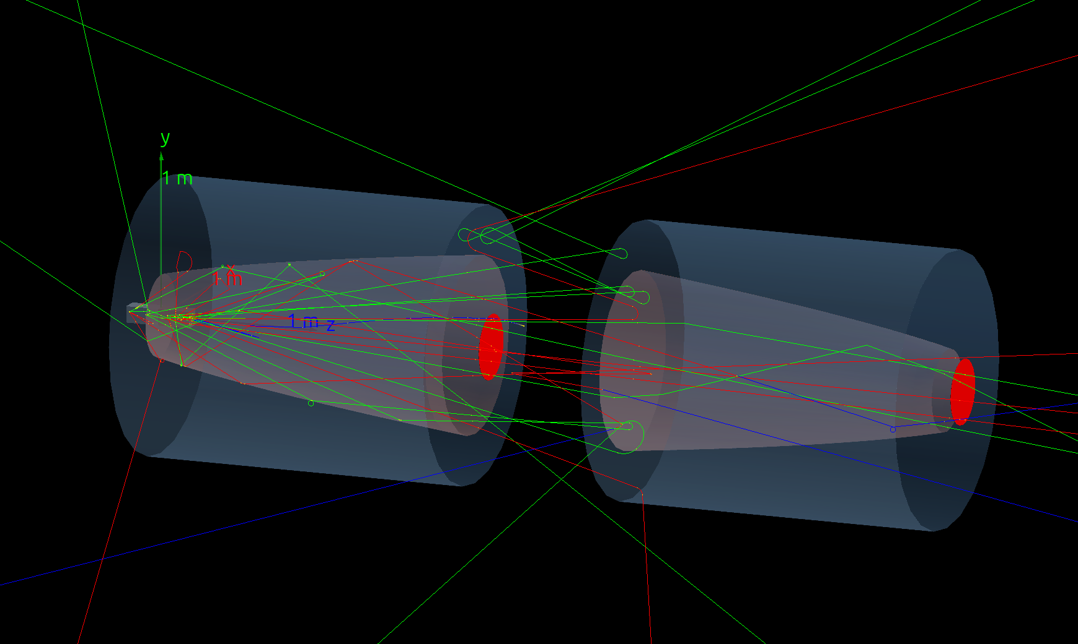
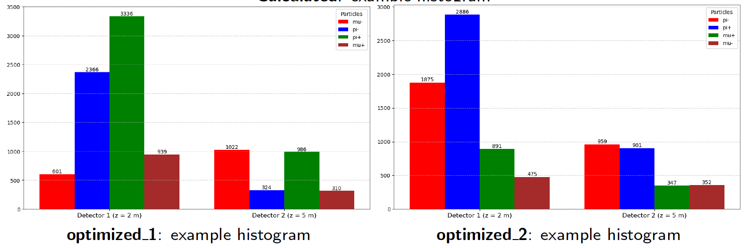
Double Horn Magnet to Capture Both Signs
P. Rao, UW-Madison
Magnetic horn is widely used in neutrino beamlines because they can focus pions over a broad momentum range
However, a conventional horn focuses pions of only one charge sign
We have developed a double-horn configuration that form a FODO-like focusing cell, capable of focusing both positive and negative pions simultaneously

Slide 26


Developing Software Interface
K. Havryshchuk, Amherst University
M. Bloomer, Emory University
General workflow:
Use energy deposition results to compute the temperature profile of the target and the resultant structural load
Calculate the energy deposited by the Mu2e beam to a target of choice

Slide 27

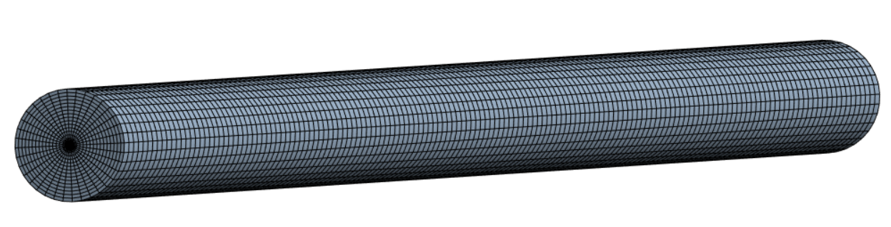
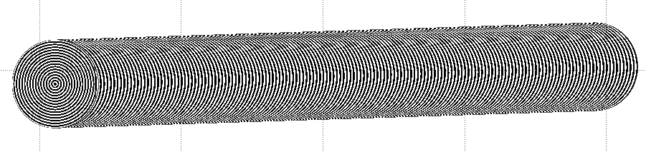
Exercising Mu2e target design
K. Havryshchuk, Amherst University
Characteristics of the Model
Beam parameters:
8 GeV energy
1e13 protons
1.4 s full cycle
0.38 s active beam-on time
8 spills substructure
Target properties:
cylindrical shape
3.14 mm radius
160 mm length
ANSYS model:
2D rectangle 3.14*160 mm
axial symmetry along a longer side
the target is fixed at the front
ANSYS mesh:
2544 elements
16 radial and 160 axial divisions
FLUKA binning:
32 radial and 320 axial divisions

Slide 28
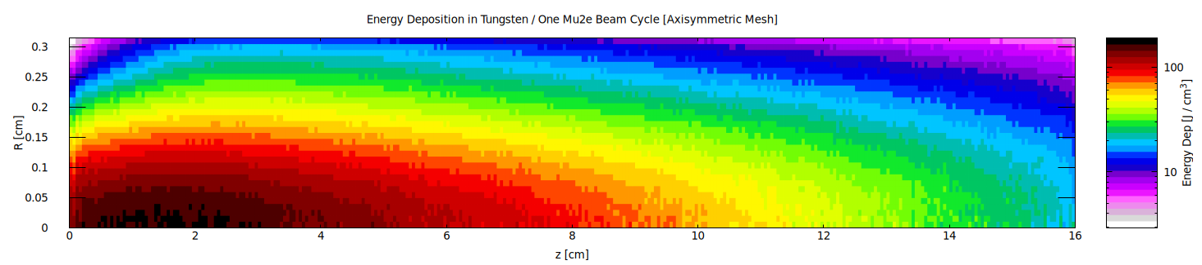
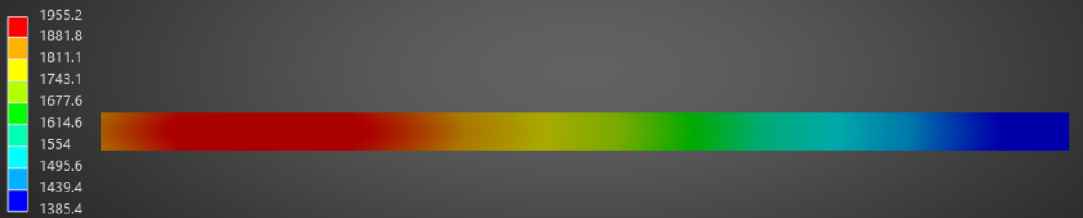
Results
K. Havryshchuk, Amherst University
FLUKA
ANSYS
Smooth transition from FLUKA output file to ANSYS input file

Slide 29
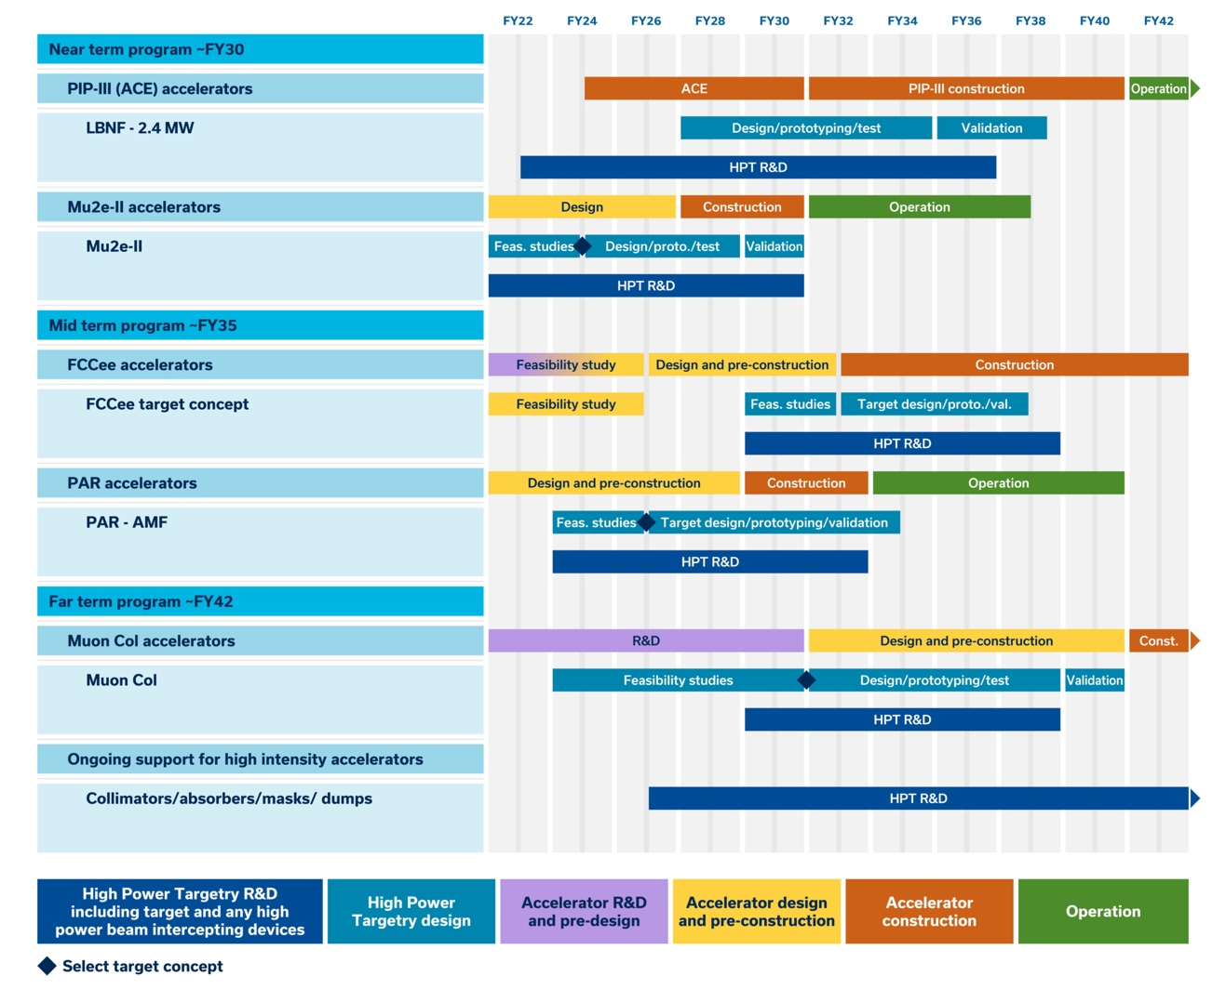
Resources for MC Target System Design R&D
We have advanced the MC Target Design R&D using the following resources
University collaborations
LDRD support for demonstrator channel design
Synergistic studies with Mu2e and LBNF programs
Radiation material science under RaDIATE and GARD framework
We look forward to expanded support and collaborations for future activities!
F. Pellemoine, USMCC workshop ‘24

Slide 30
Summary
Specify required target performance with the MC proton driver parameter
Protons on Target: ~10¹⁵ per pulse, bunch length 1-3 ns, beam energy 5-20 GeV, RMS spot size 1-10 mm
Muon yield efficiency in the target and capture channels: > 10 % μ/p
Design goal of target lifetime: > 1 year
Recognized IMCC design study
Substantial target design studies have been carried out through IMCC
We continue to collaborate actively with IMCC partners
Propose US strategy
Global HPT efforts are needed, aligned with ongoing and future US HEP programs
RaDIATE provides a strong foundation for advancing radiation materials science; We plan to engage US RaDIATE groups in support of muon collider target development
Initiated collaboration with young researchers to foster the next generation of experts
Set a clear definition and scope for the demonstrator target within 2 years

Slide 31
Extra slide

Slide 32

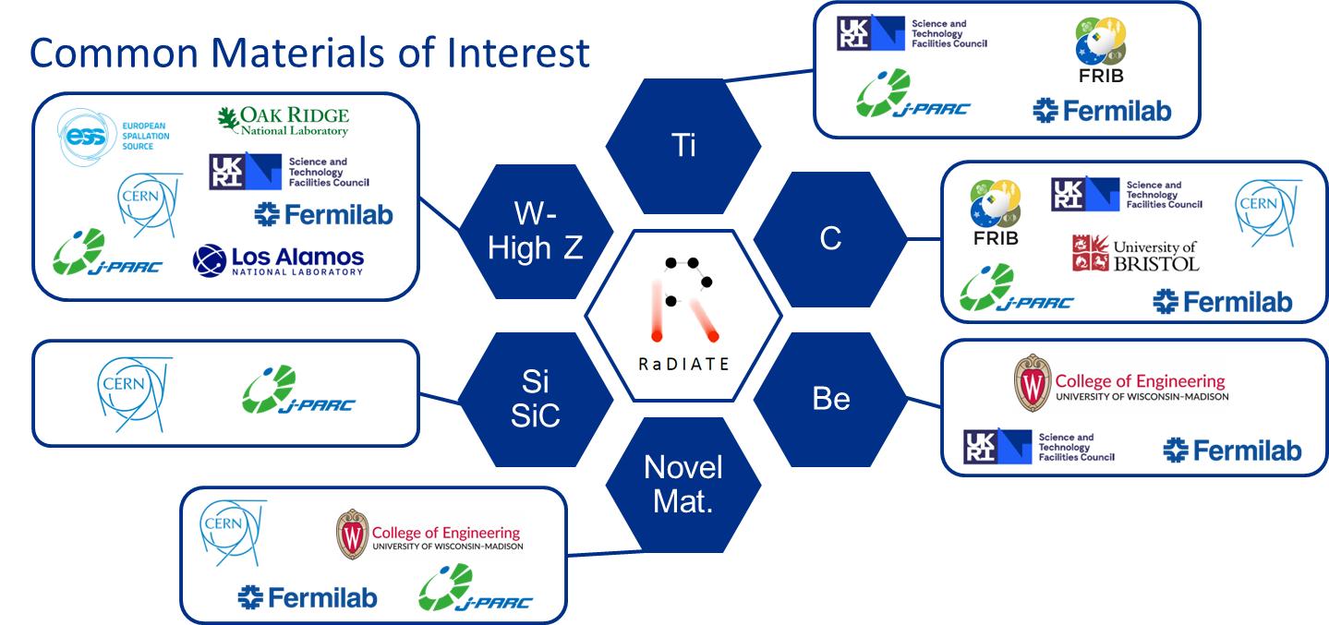
R a D I A T E Collaboration
Radiation Damage In Accelerator Target Environments
RaDIATE collaboration created in 2012, with Fermilab as the leading institution. The collaboration has grown up to 20 institutions over the years.
Objective:
Harness existing expertise in nuclear materials and accelerator targets
Generate new and useful materials data for application within the accelerator and fission/fusion communities
Activities include:
Analysis of materials taken from existing beamline as well as new irradiations of candidate target materials at low and high energy beam facilities
In-beam thermal shock experiments
Notes:
To address these material challenges, the HPT community formed the RaDIATE collaboration in 2012, with Fermilab as the leading institution. The goal was to bring experts from the accelerator and fission/fusion communities together to generate new data for accelerator materials. The collaboration has grown up to 14 institutions over the years.

