Slide 1
Studies on Muon Collider’s Target with G4Beamline(02/24/2026)
Cheng-Hsu (Bryan) Nee
Notes:
Good afternoon, everyone. I’m excited to present our latest research for a light pseudo-scalar Higgs boson at the e+e- Collider. This collaboration involves me, Cheng-Hsu Nee, or you could call me Bryan, I’m a graduate student from the University of Wisconsin Madison, along with Prof. Abdollah Mohammadi, and Prof. Sridhara Dasu. I’m excited to share our findings with you today.

Slide 2
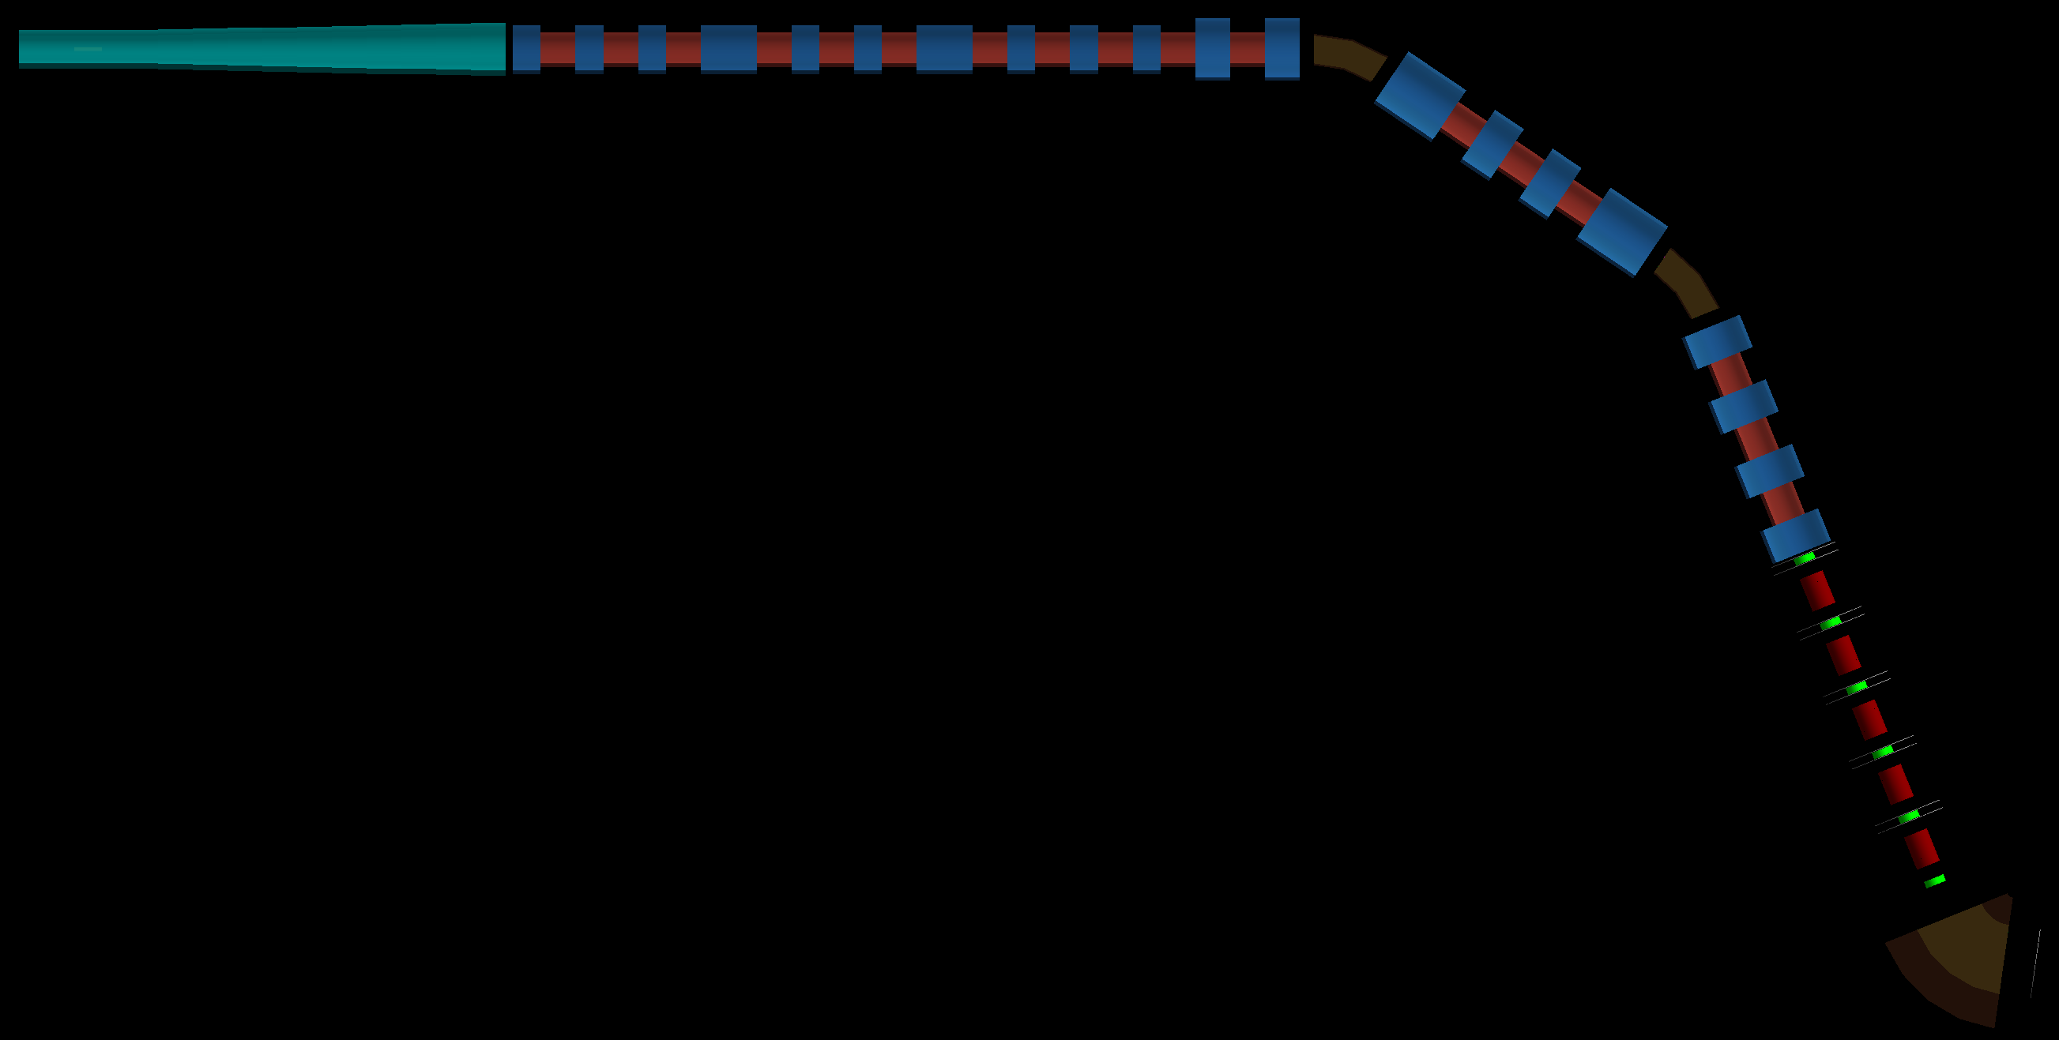

Slide 3
Graphite Target Solenoid with Adiabatic Taper
Efficiently capture pions/muons produced at the graphite target and smoothly match them into the downstream decay channel (APER_PIPE = 300 mm) and quadrupole triplet.
1. High-Field Capture Region:
Target location: centered inside a large-bore solenoid
Capture solenoid:
  Inner radius: 700 mm
  Length: 2 m
  High current (160 A) → strong axial field
Purpose:
  Maximize transverse acceptance
  Capture low-momentum pions immediately after production
2. Adiabatic Solenoid Taper:
Solenoid is split into 10 short segments
Over 5 m total length:
  Field strength decreases smoothly (current → 0 A)
  Warm bore radius shrinks:
    200 mm → 300 mm (inner radius increases from 210, 220, …, 290, → 300 mm)
  Avoids sudden optical mismatch
  Preserves transverse emittance
  Converts transverse momentum into longitudinal motion
3. Matching to Decay Channel:
Final solenoid radius matches:
  Decay channel aperture (APER_PIPE = 300 mm)
Solenoid field smoothly goes to ~0 before:
  Quadrupole triplet (QF1–QD–QF2)

Slide 4
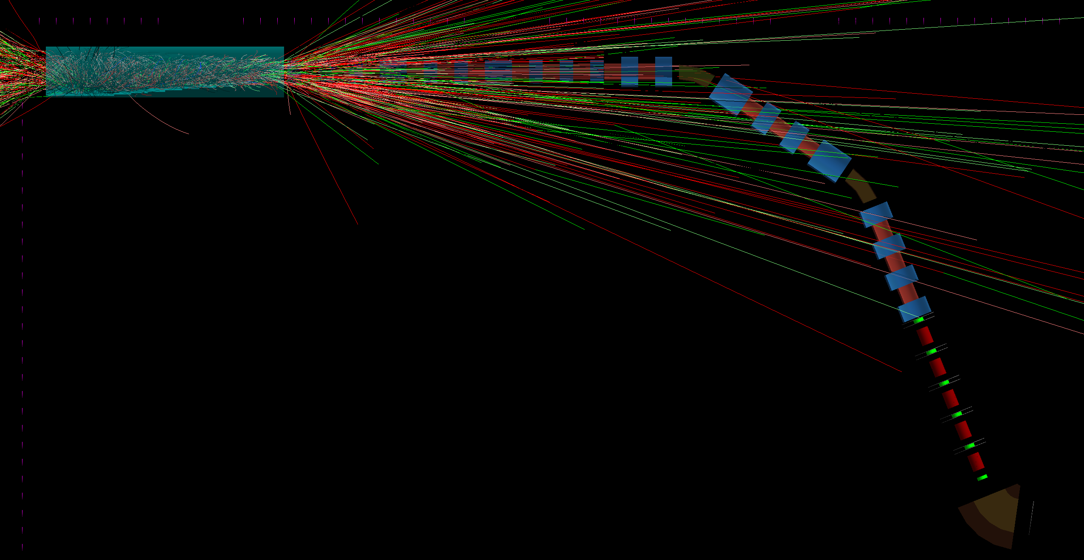
1000 Events
Proton Beam
  8 GeV
  Sigma x = 1mm; Sigma y = 1mm
  Sigma T = 1 ns

Slide 5
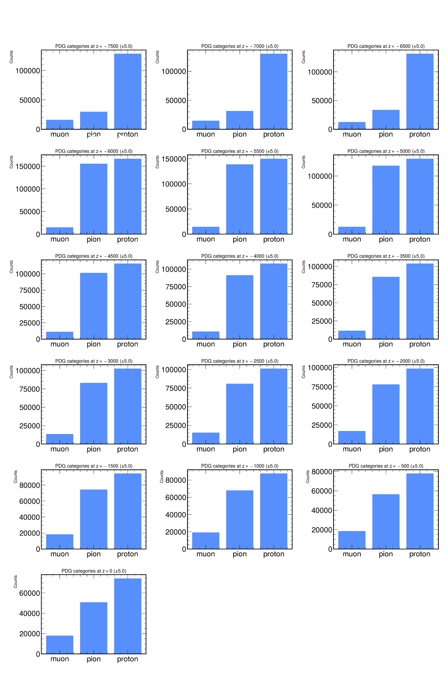
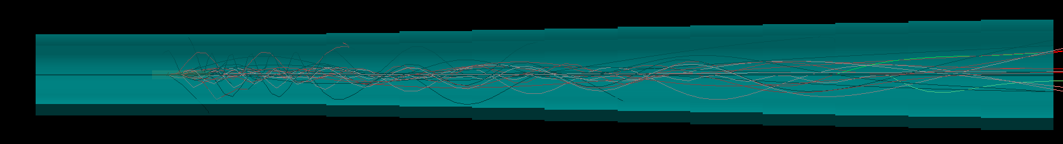
Capture & Taper Solenoids

Slide 6
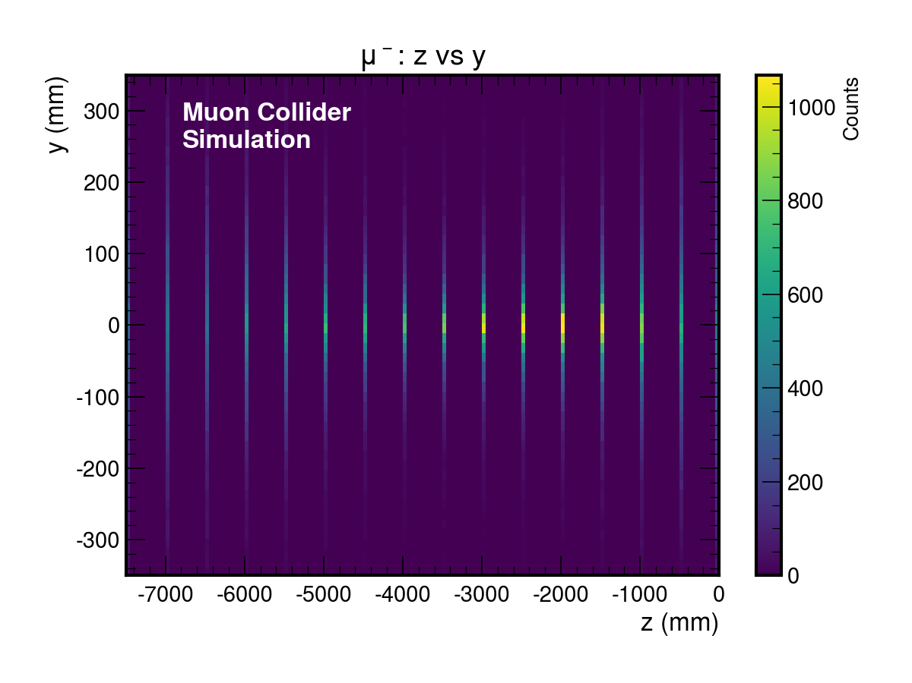
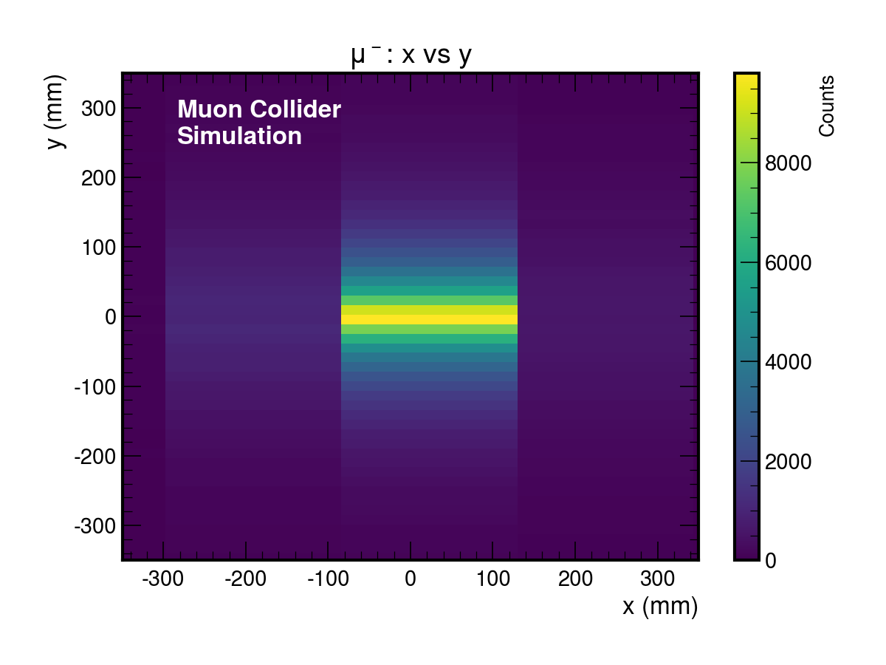
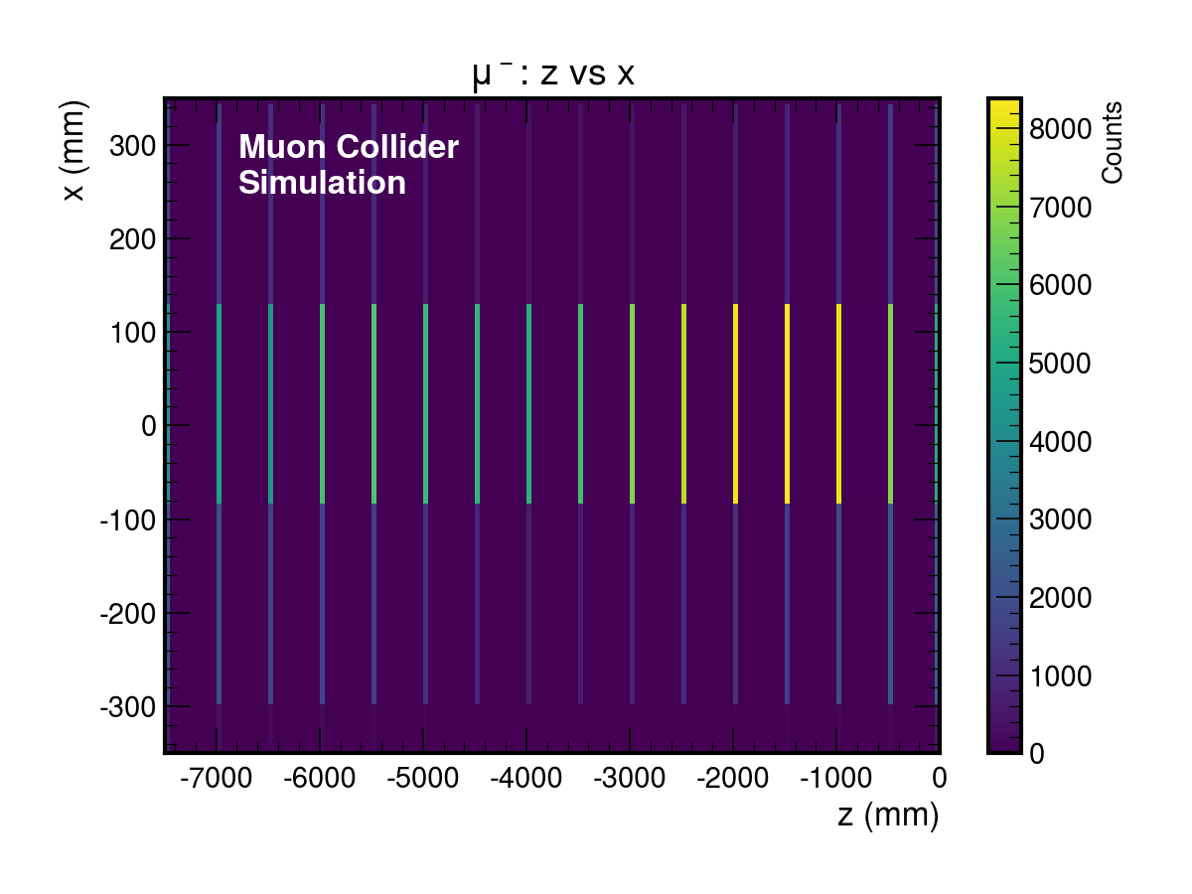
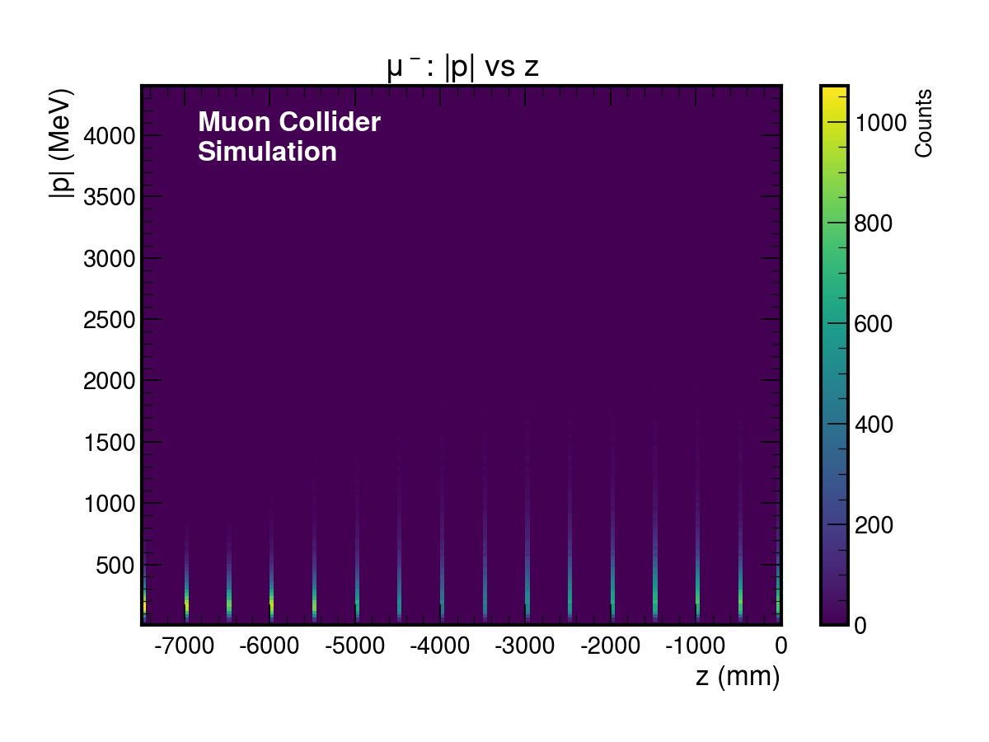

Slide 7
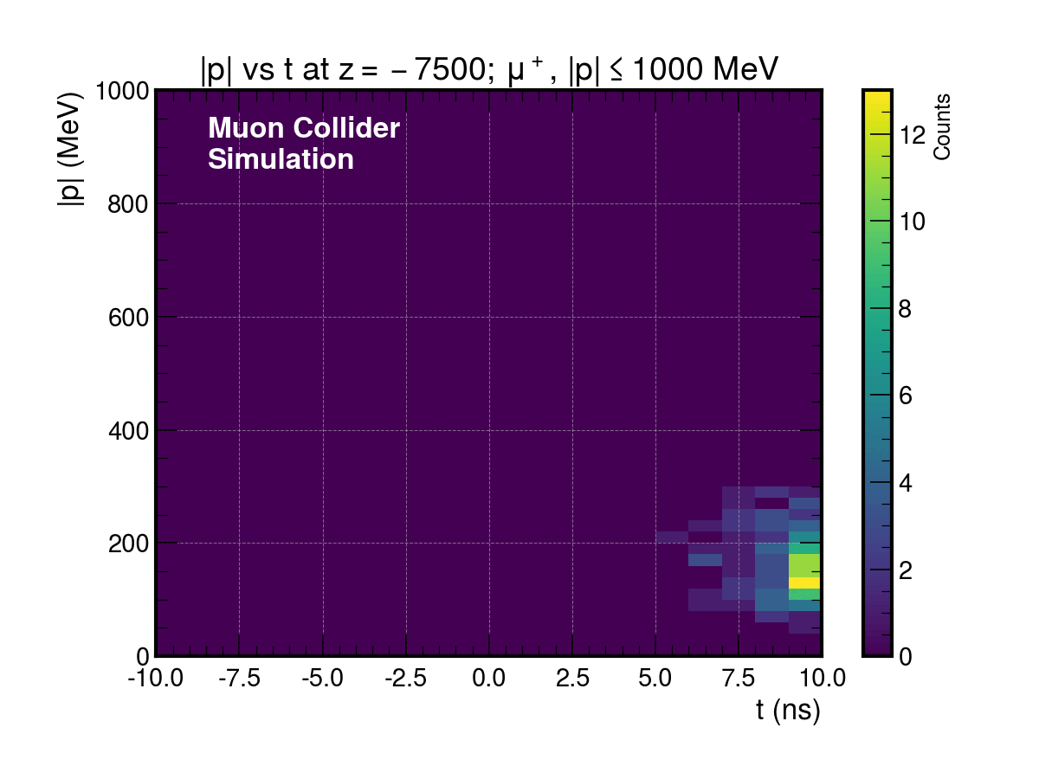

Slide 8
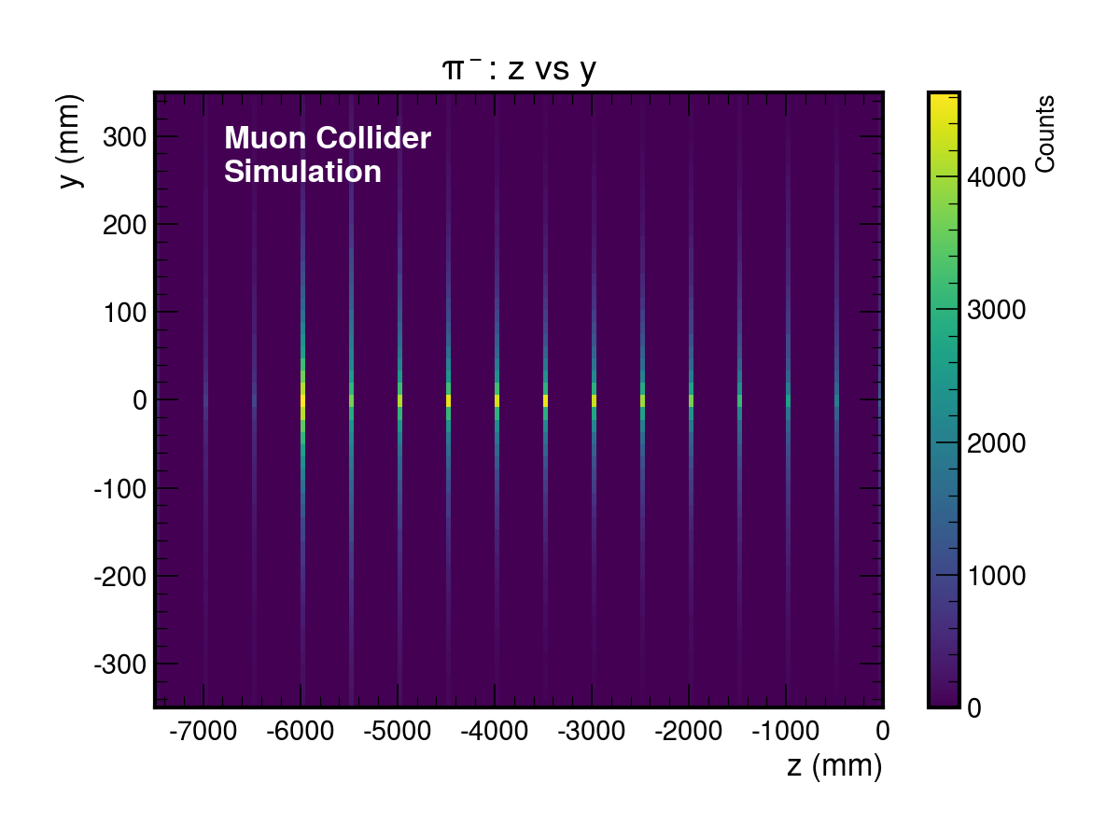
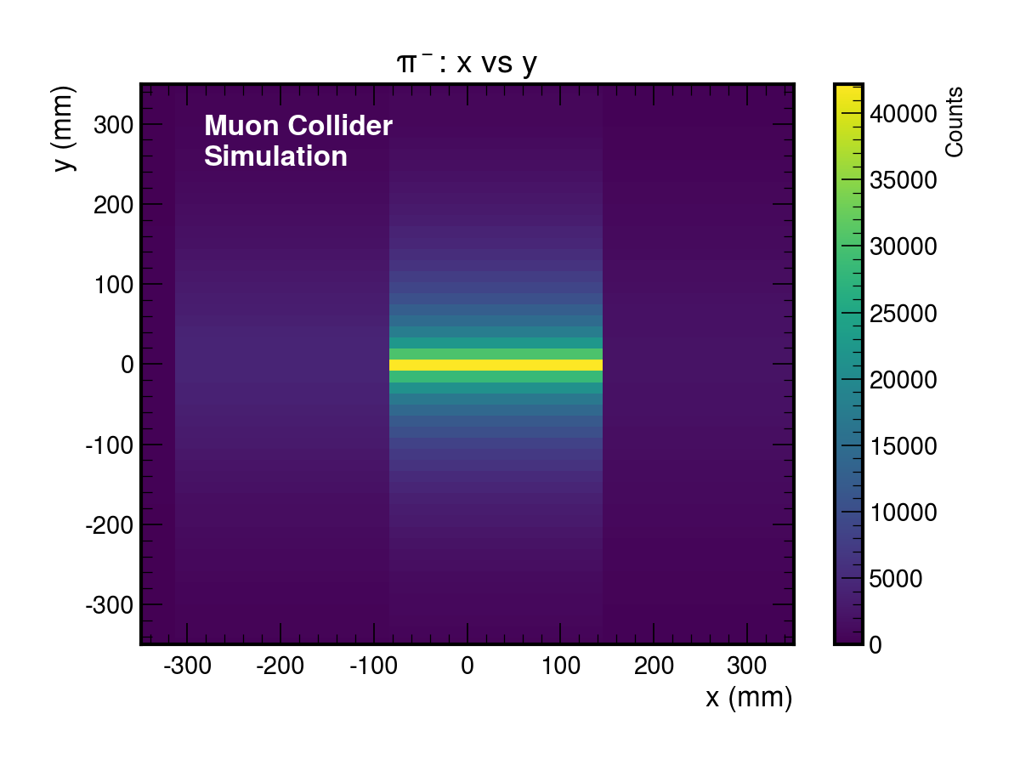
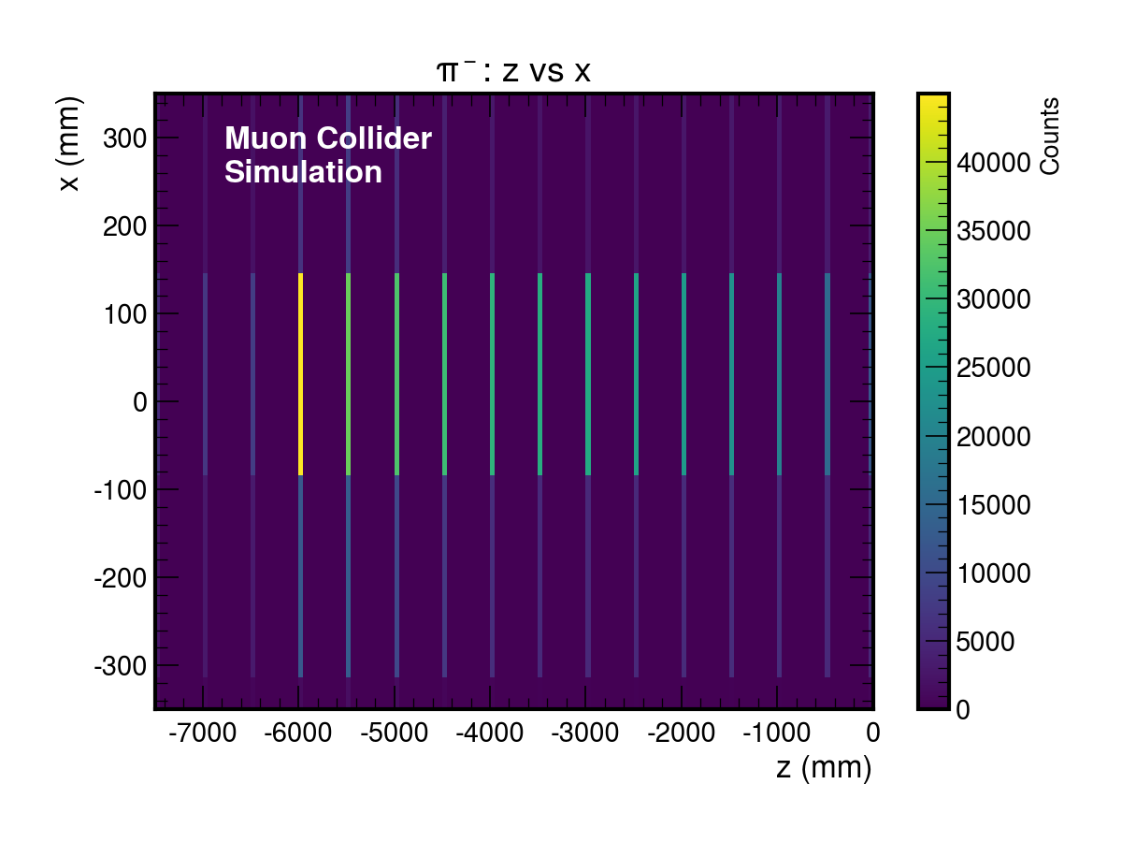
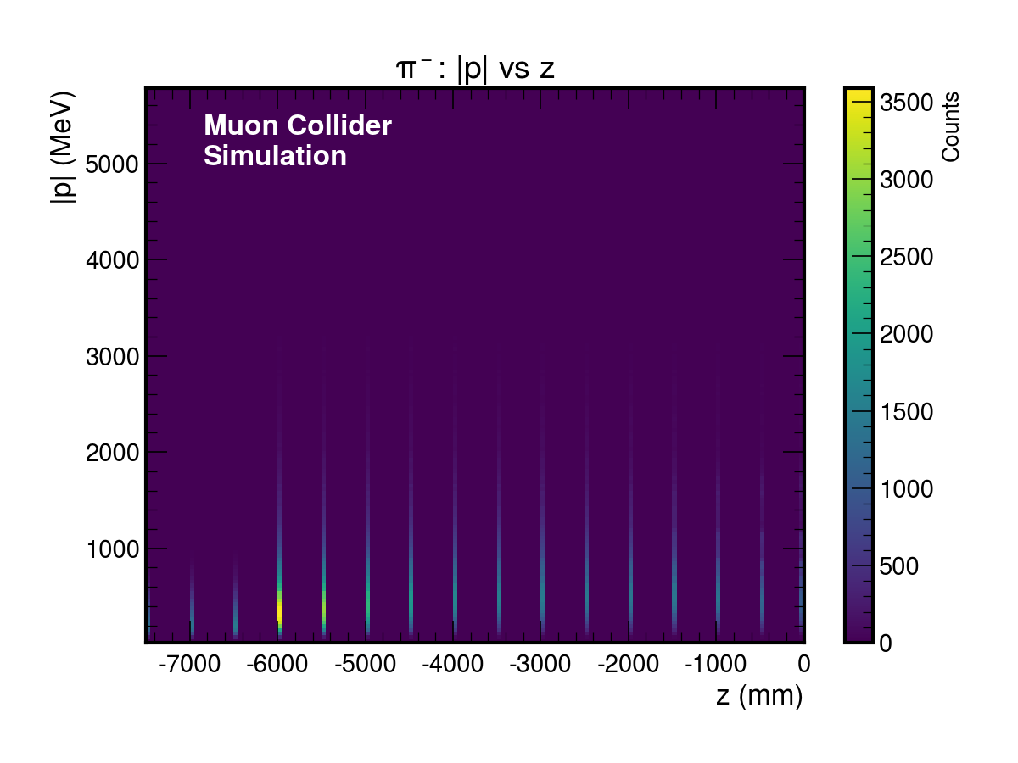

Slide 9
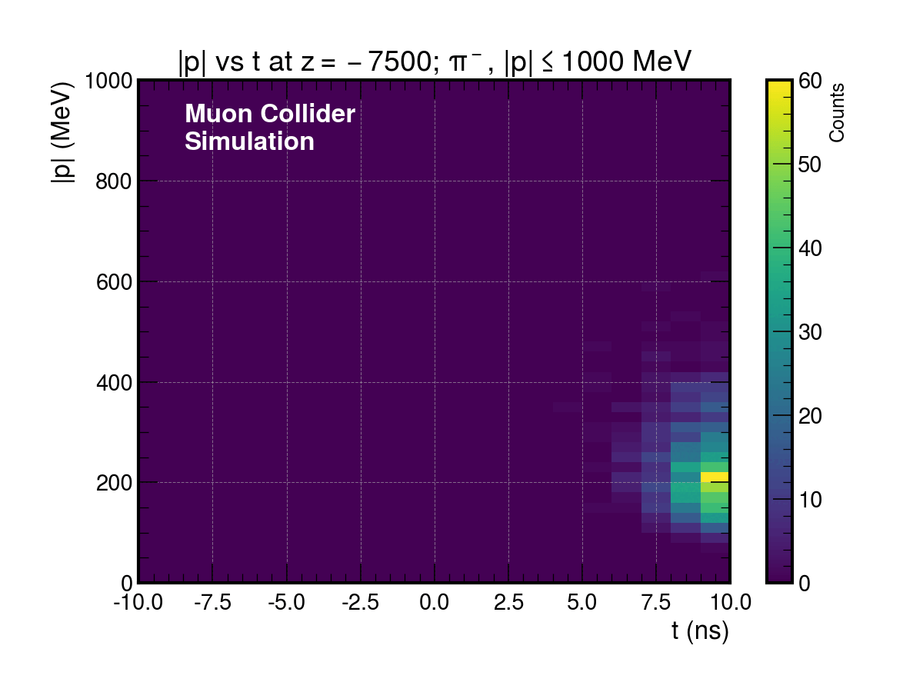

Slide 10
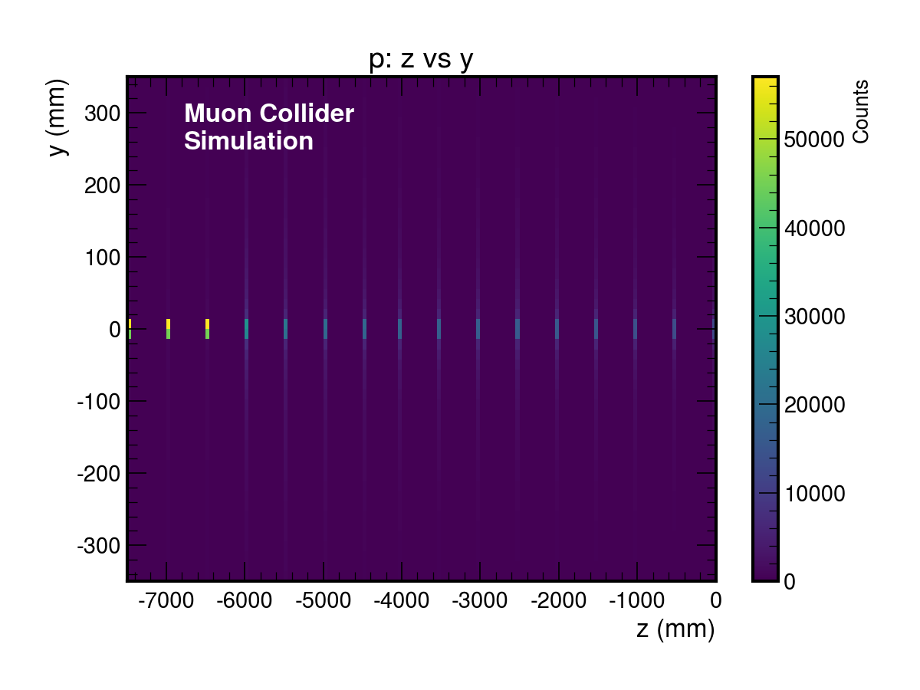
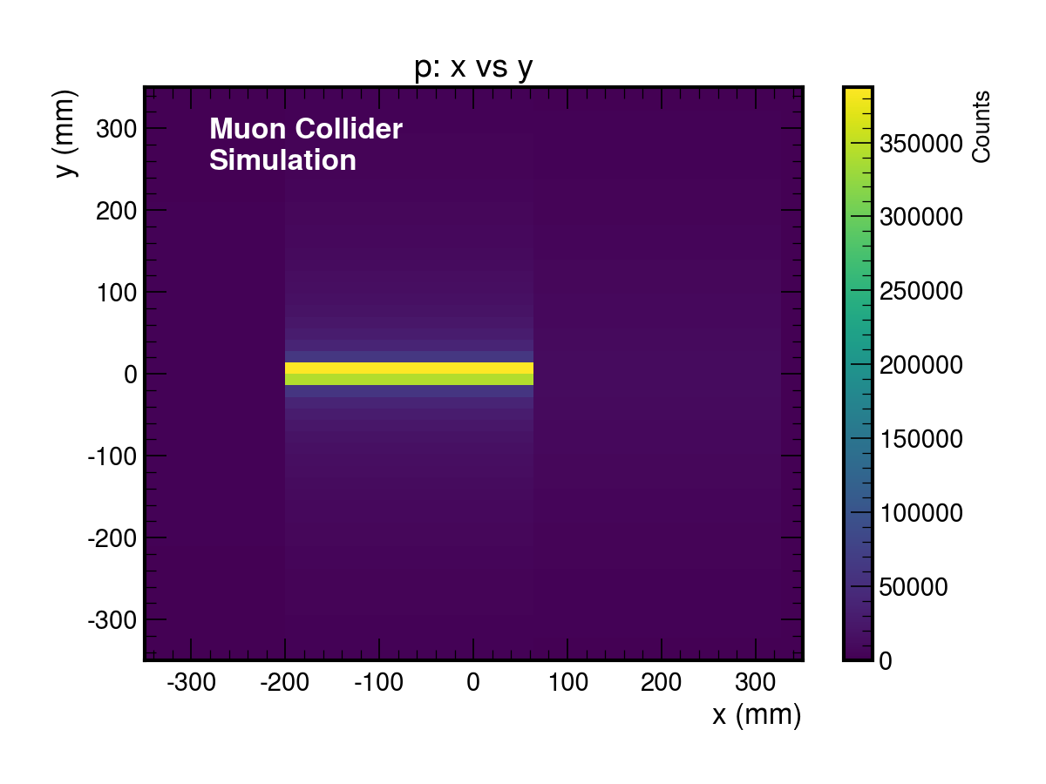
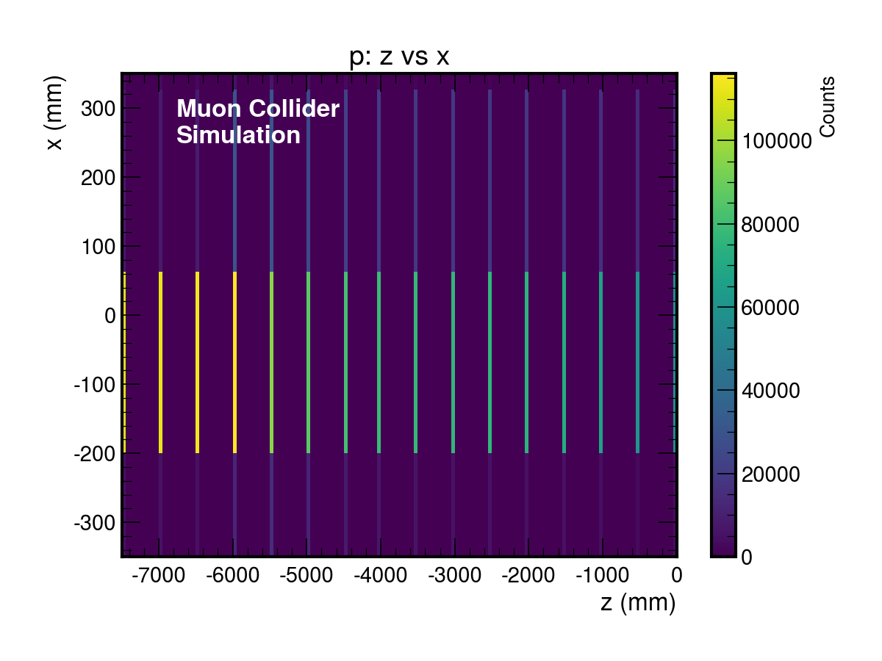
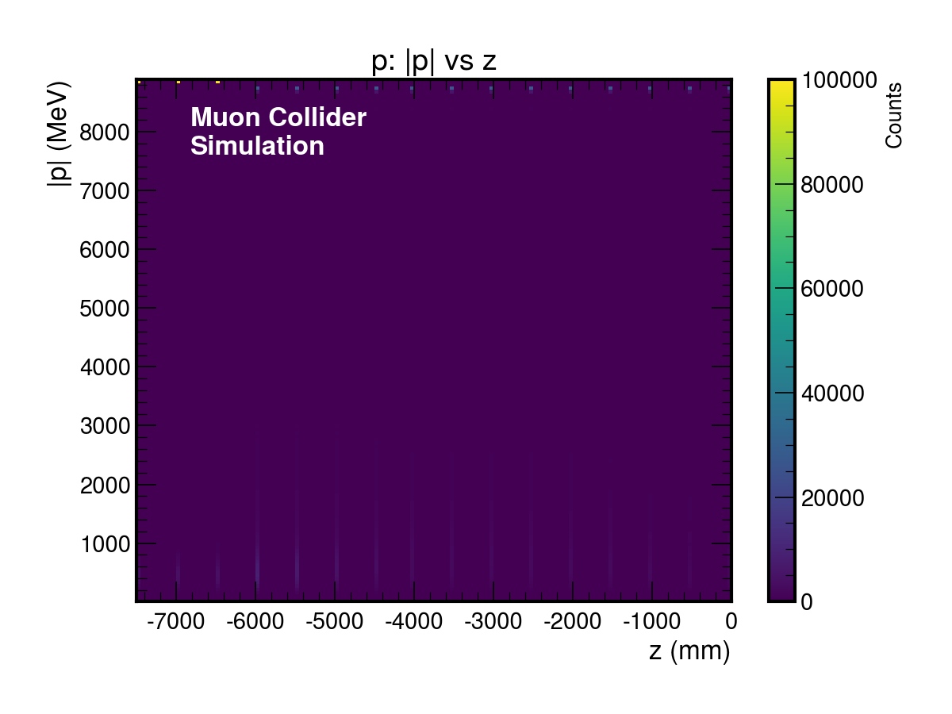

Slide 11
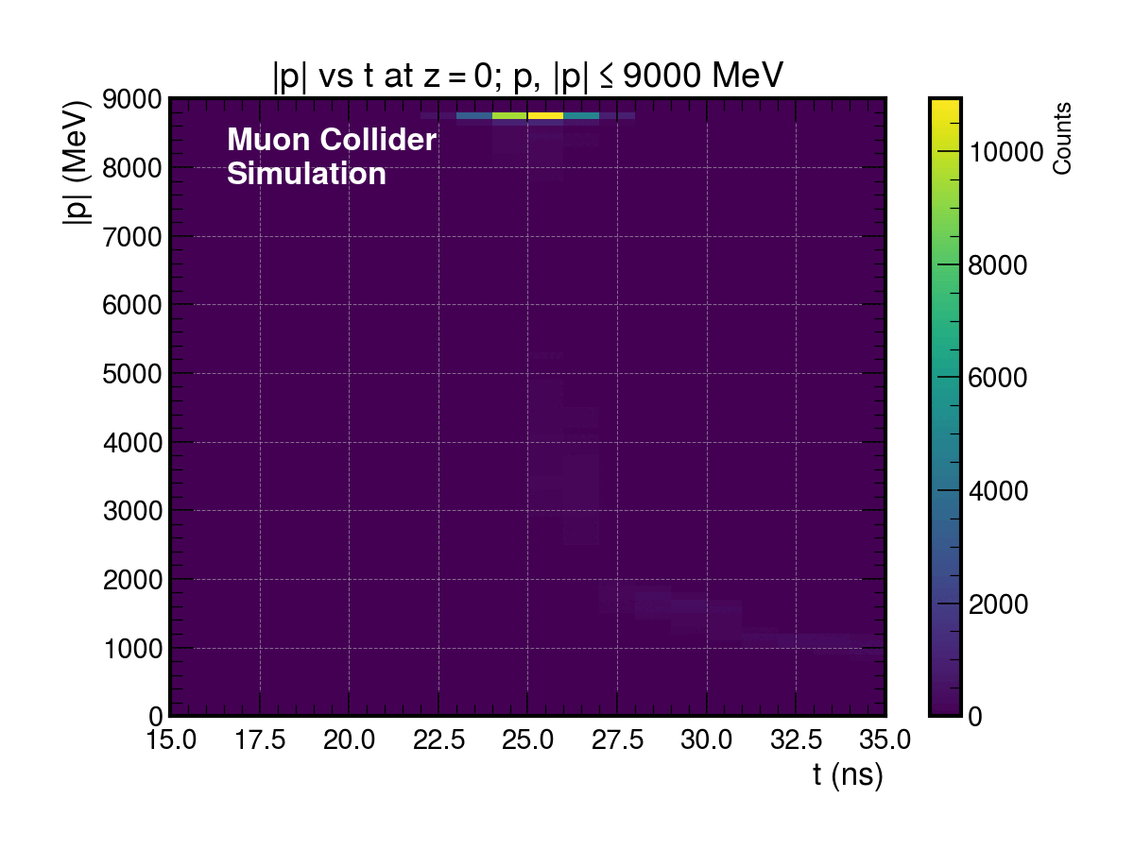

Slide 12
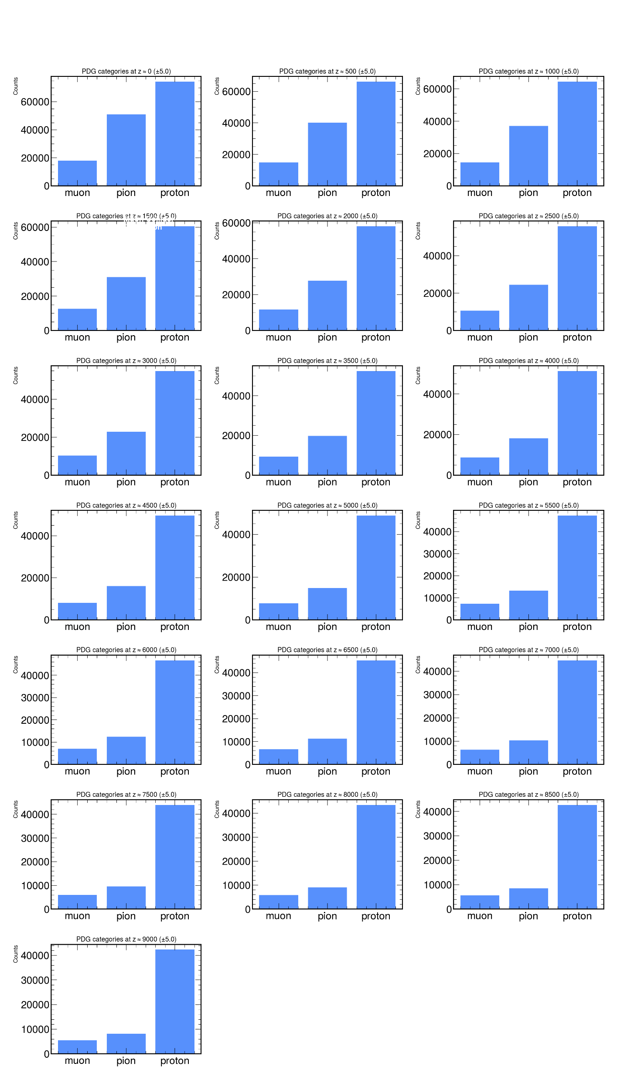
Pion Decay Channel Triplet

Slide 13
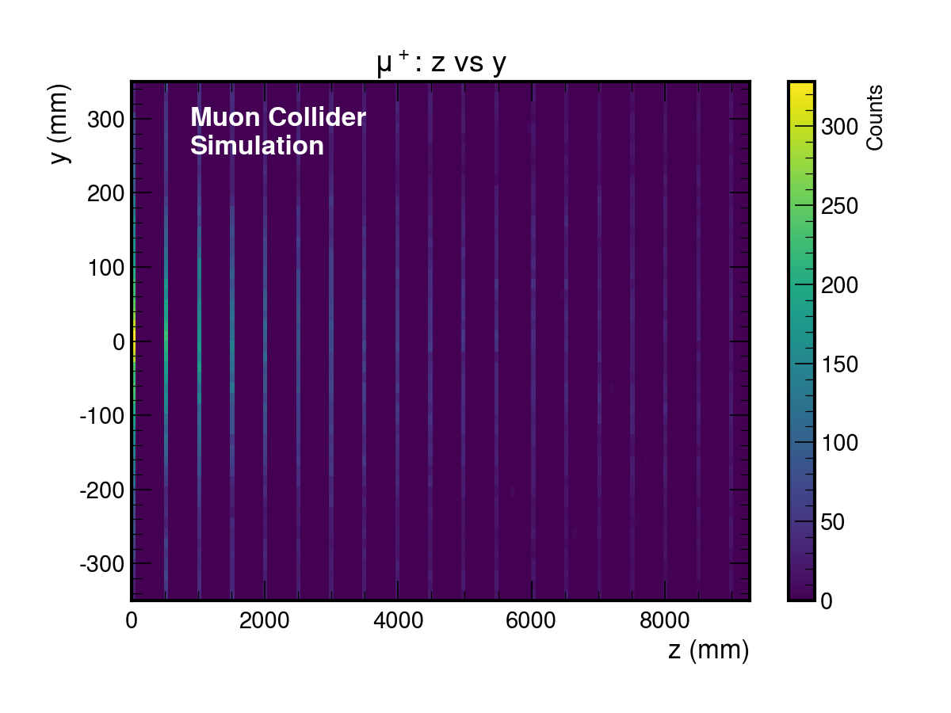
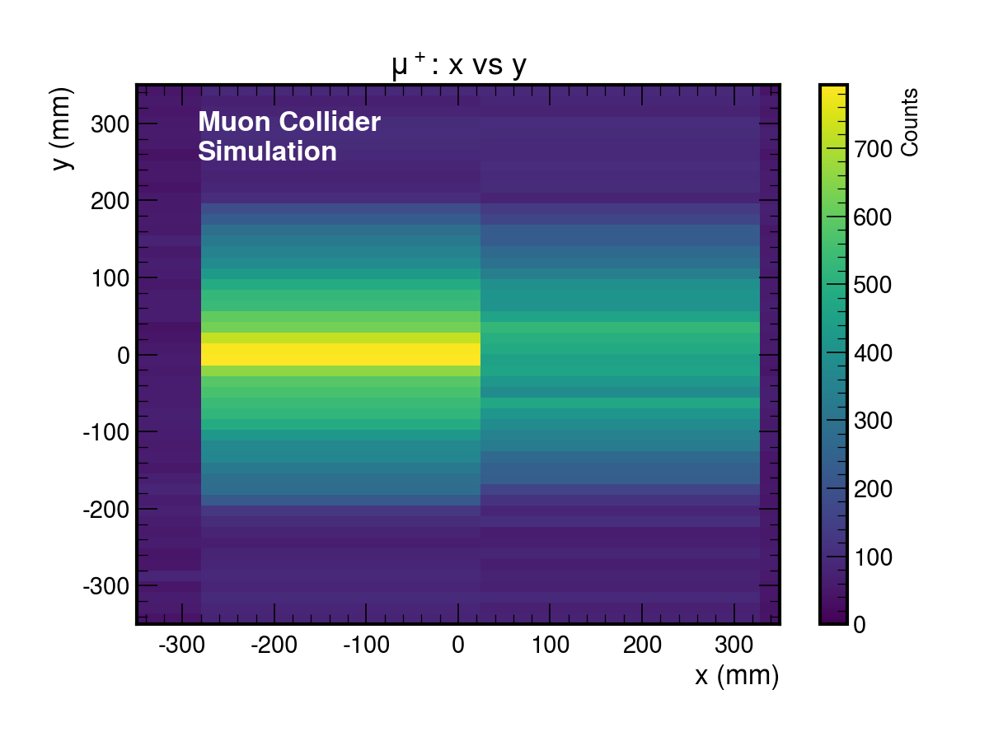
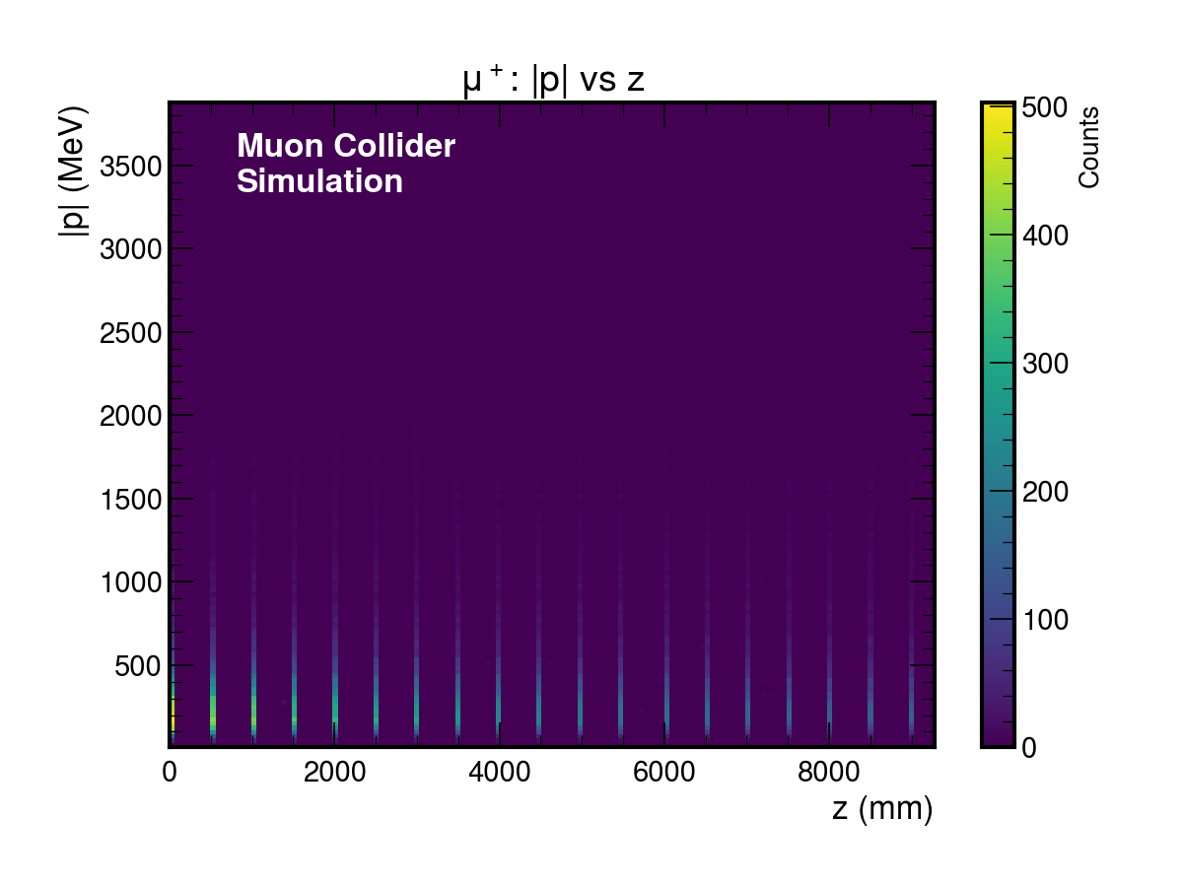

Slide 14
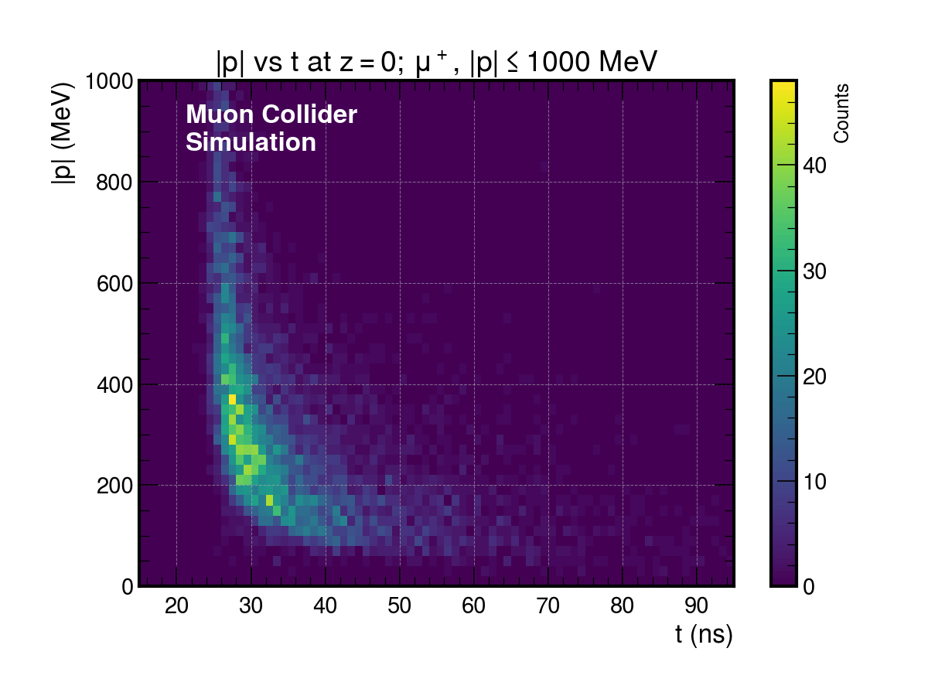

Slide 15
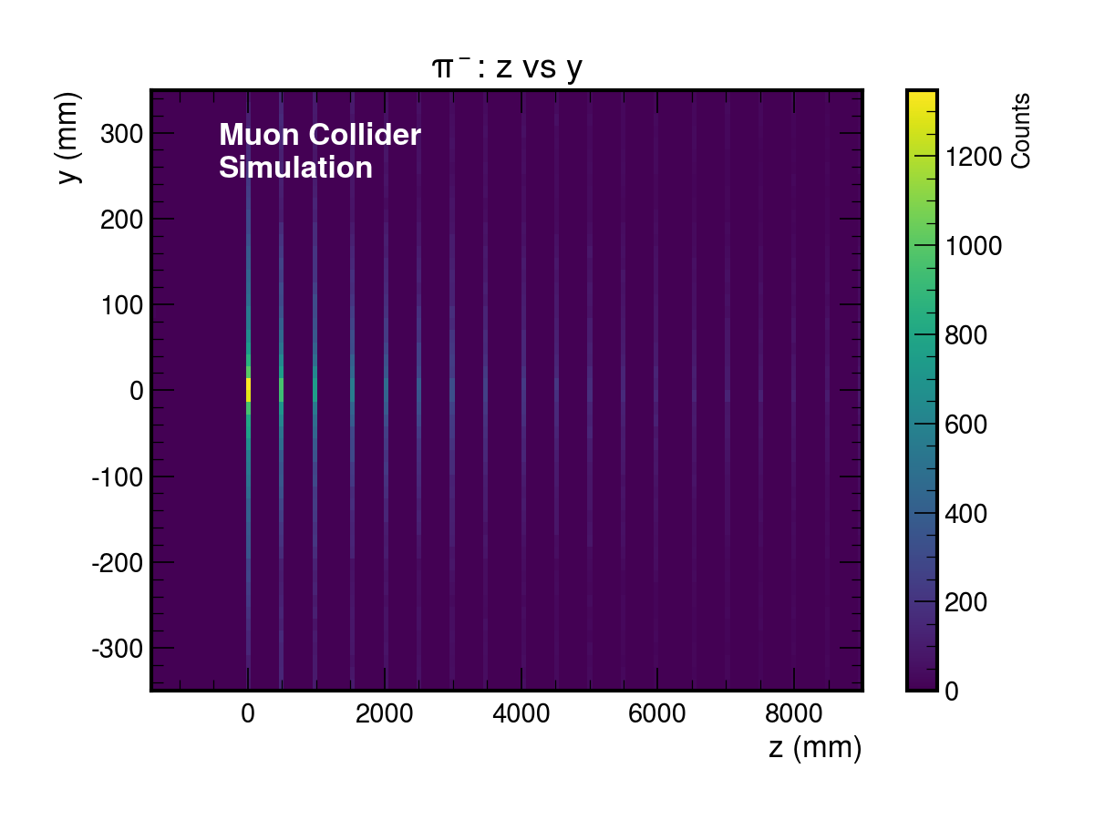
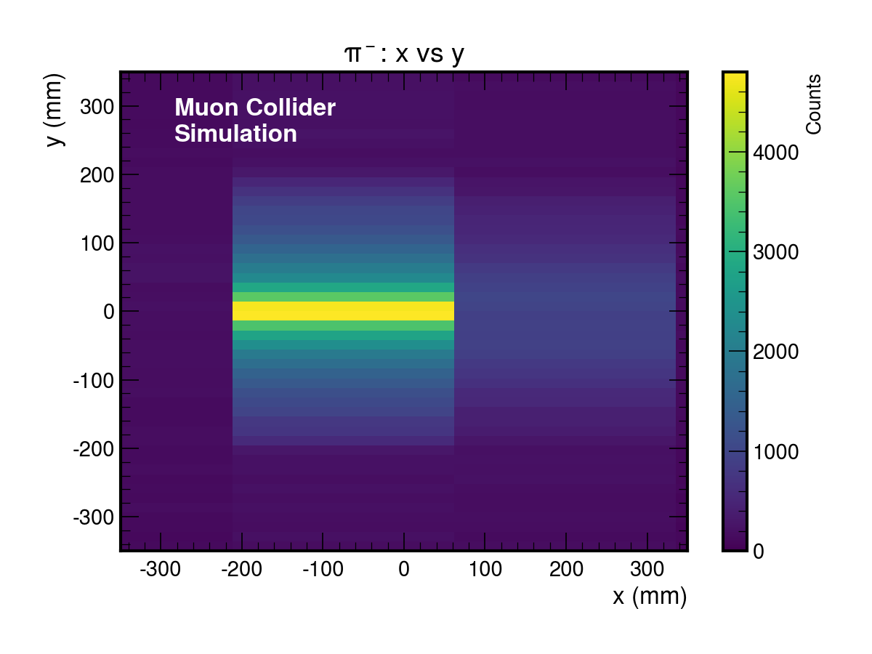
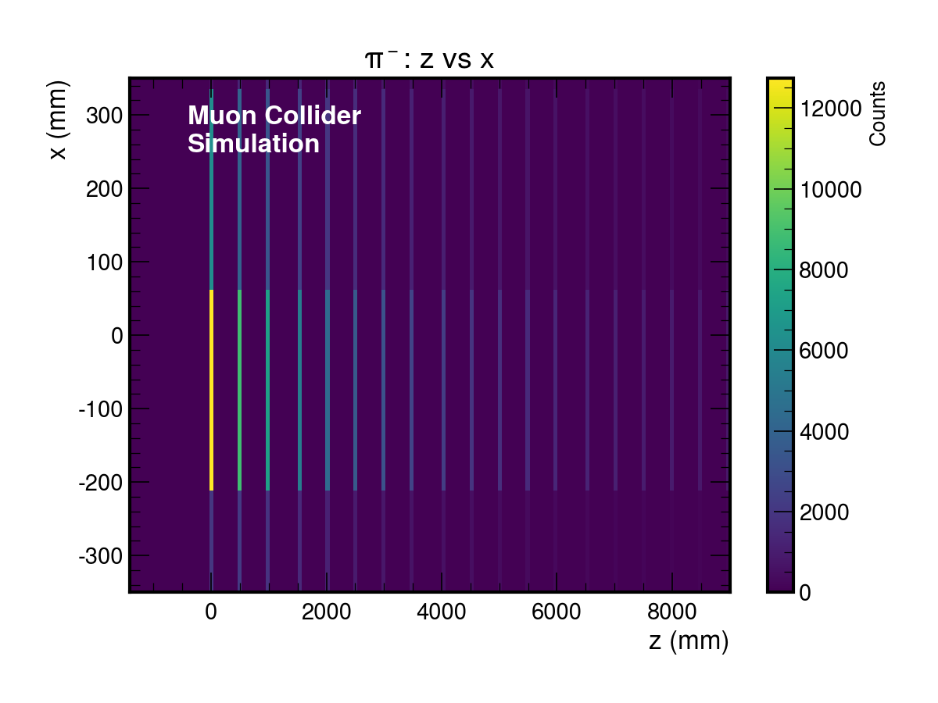
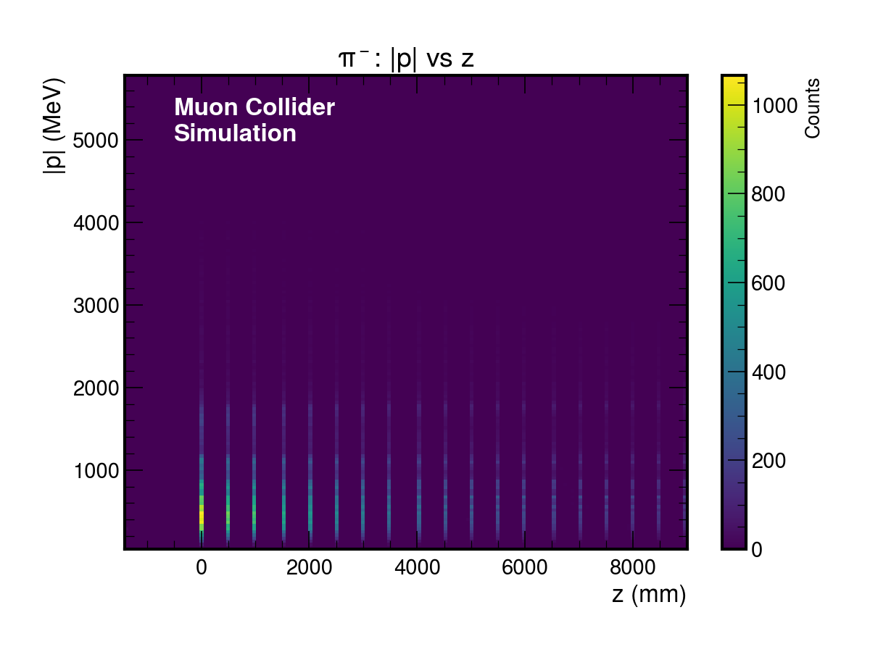

Slide 16
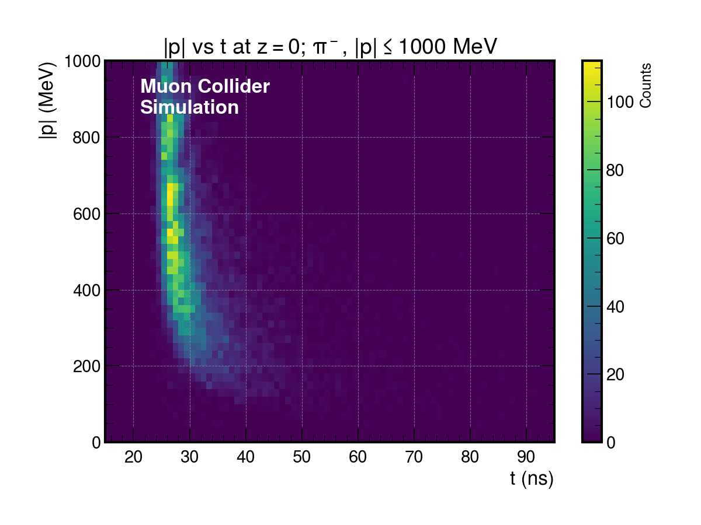

Slide 17
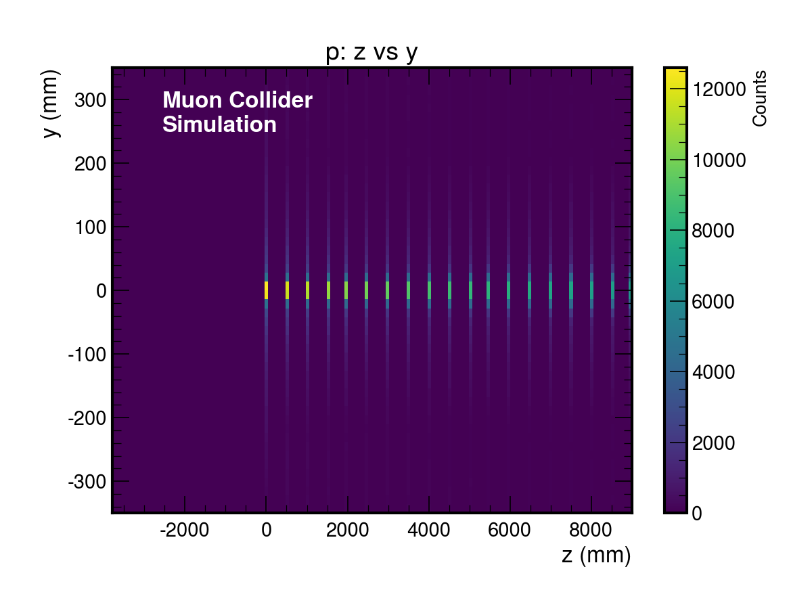
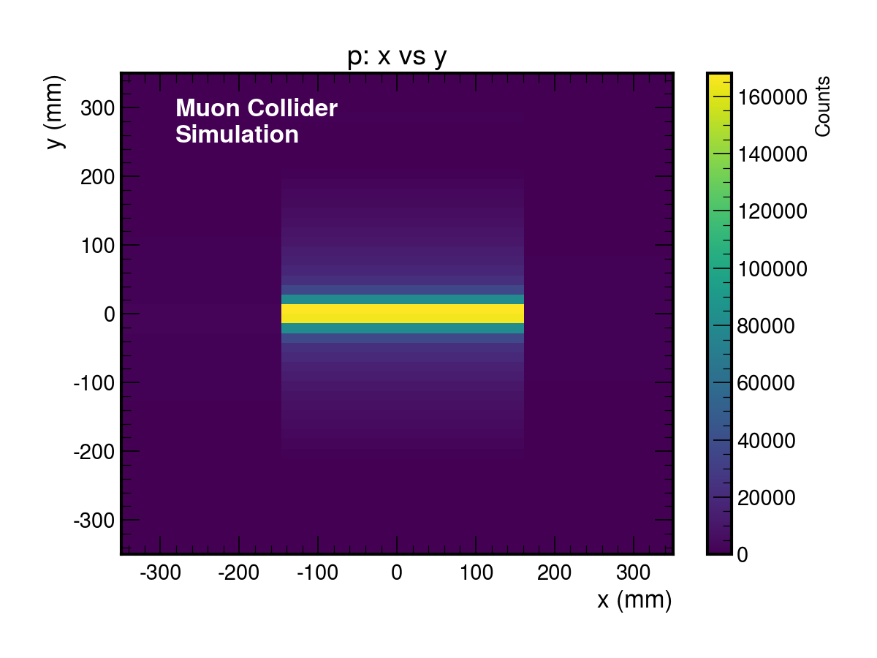
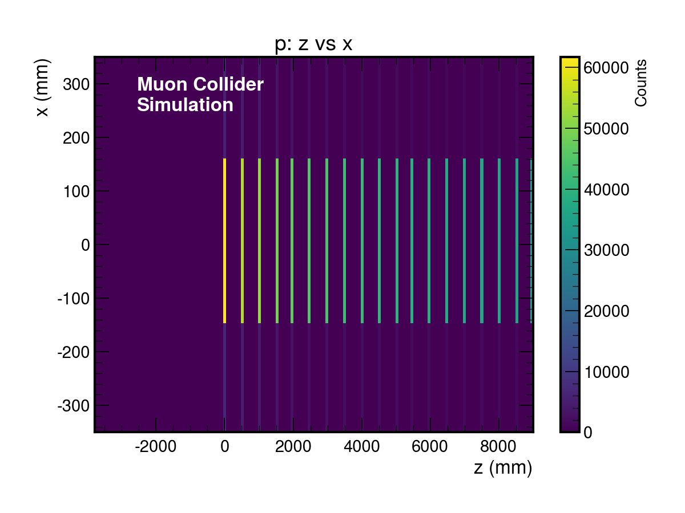


Slide 18
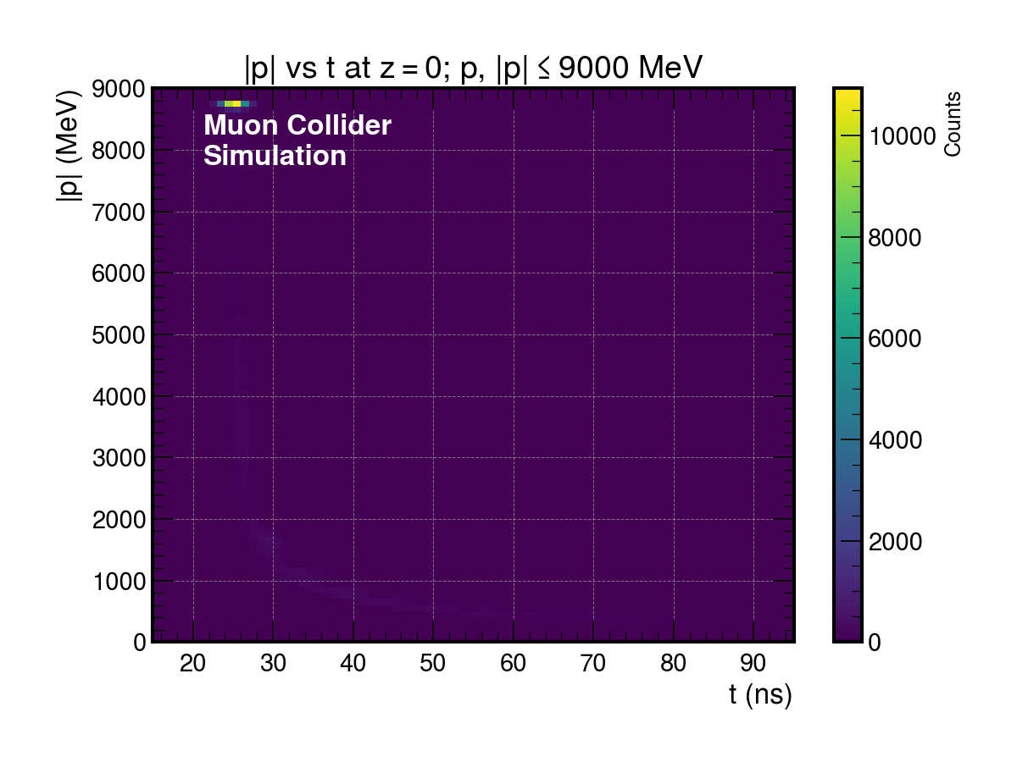

Slide 19
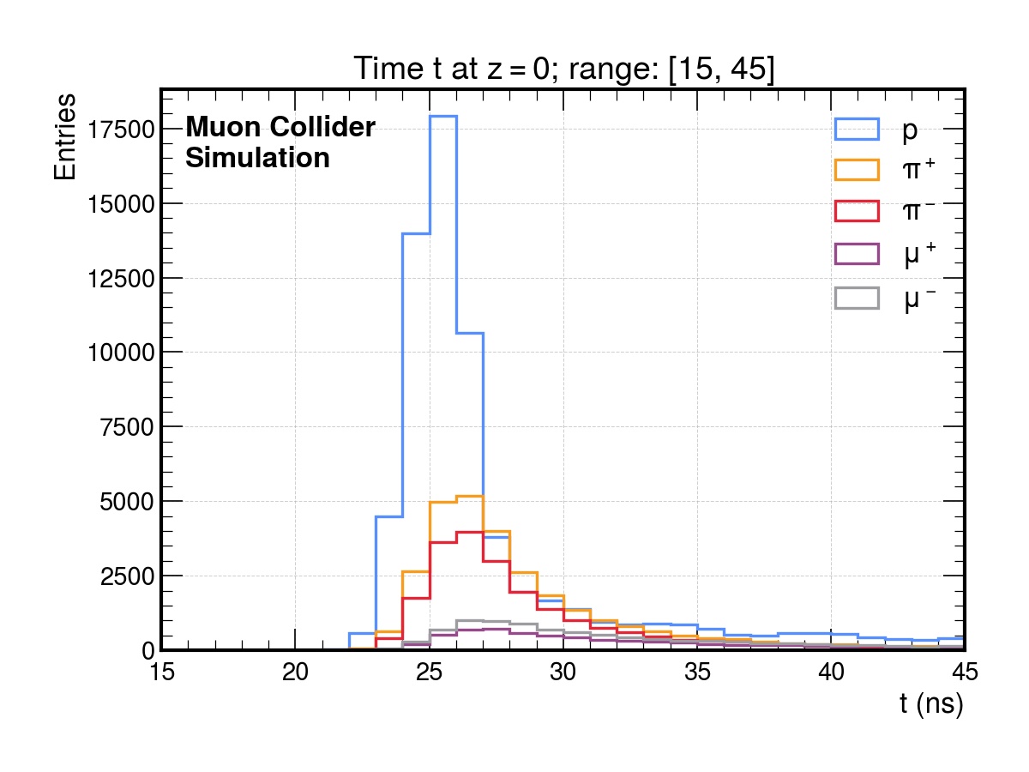

Slide 20
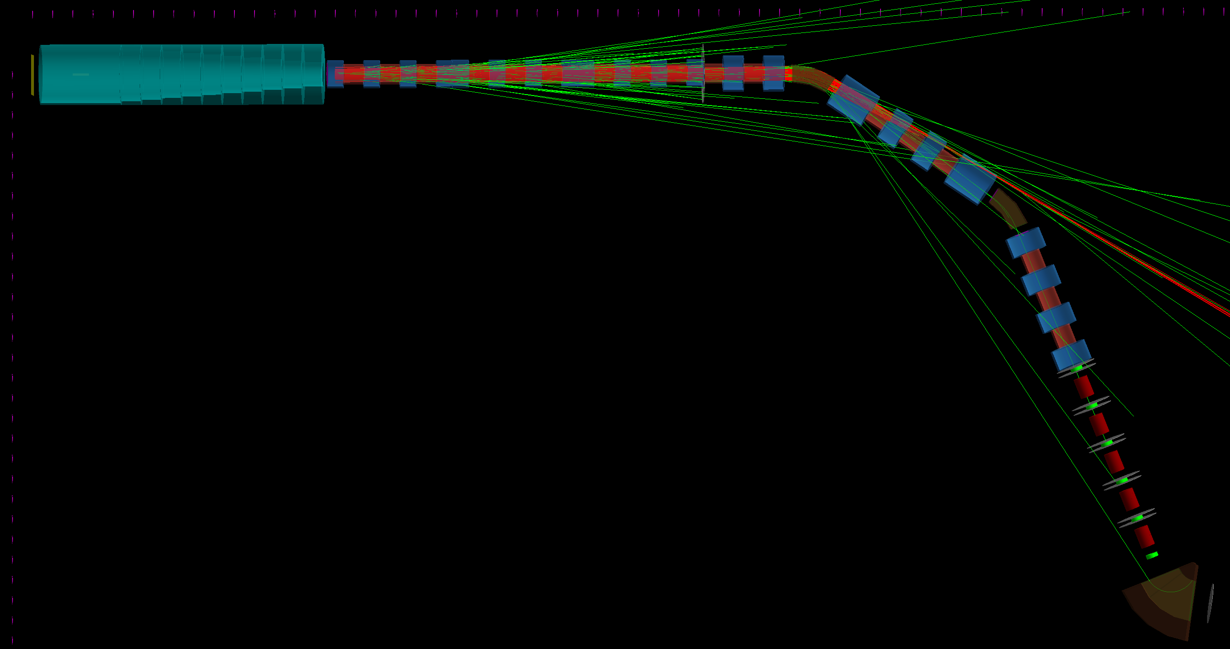

1000 Events
$π^{+}$ Beam
  270/1.15 MeV
  Sigma x = 50 mm; Sigma y = 50 mm
  Sigma T = 1 ns
  Sigma P = 0.05 MeV

Slide 21
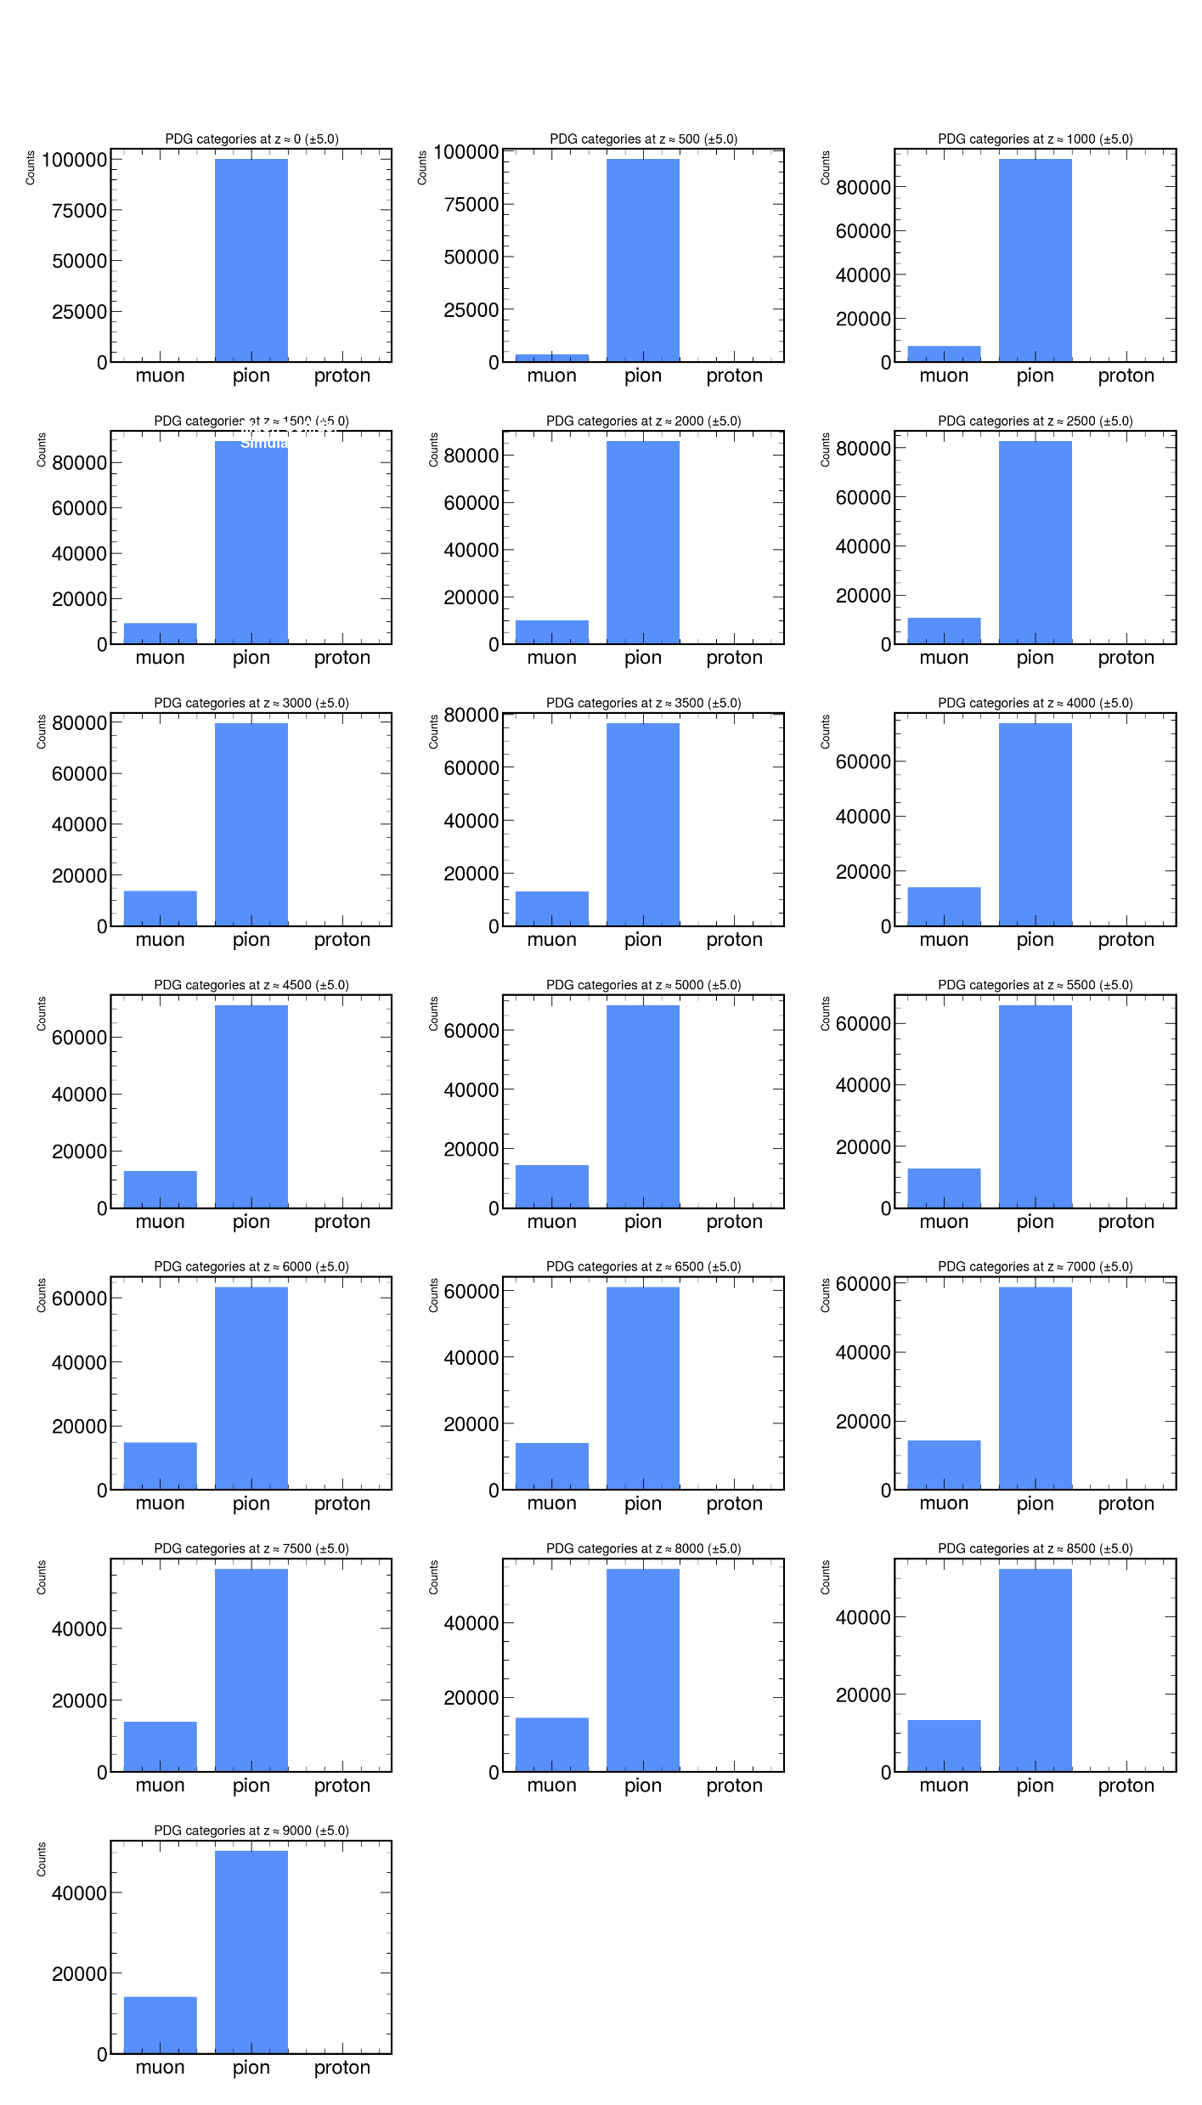
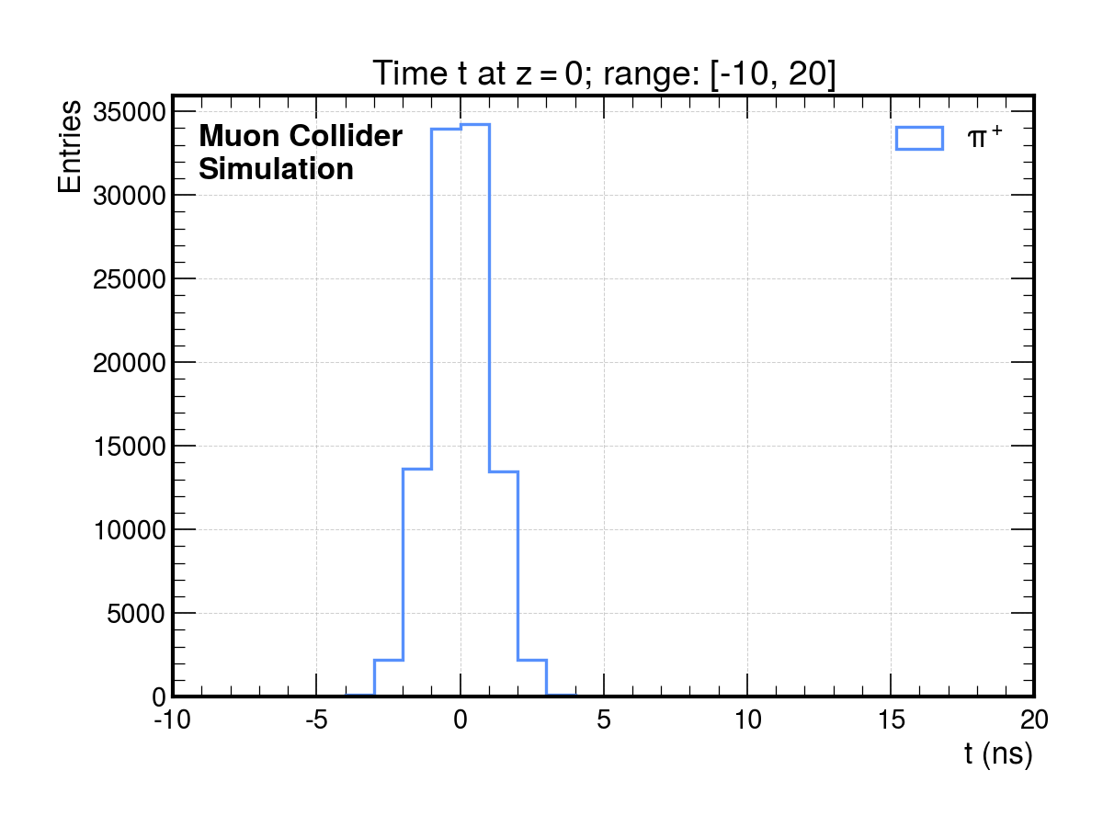
Pion Decay Channel

Slide 22
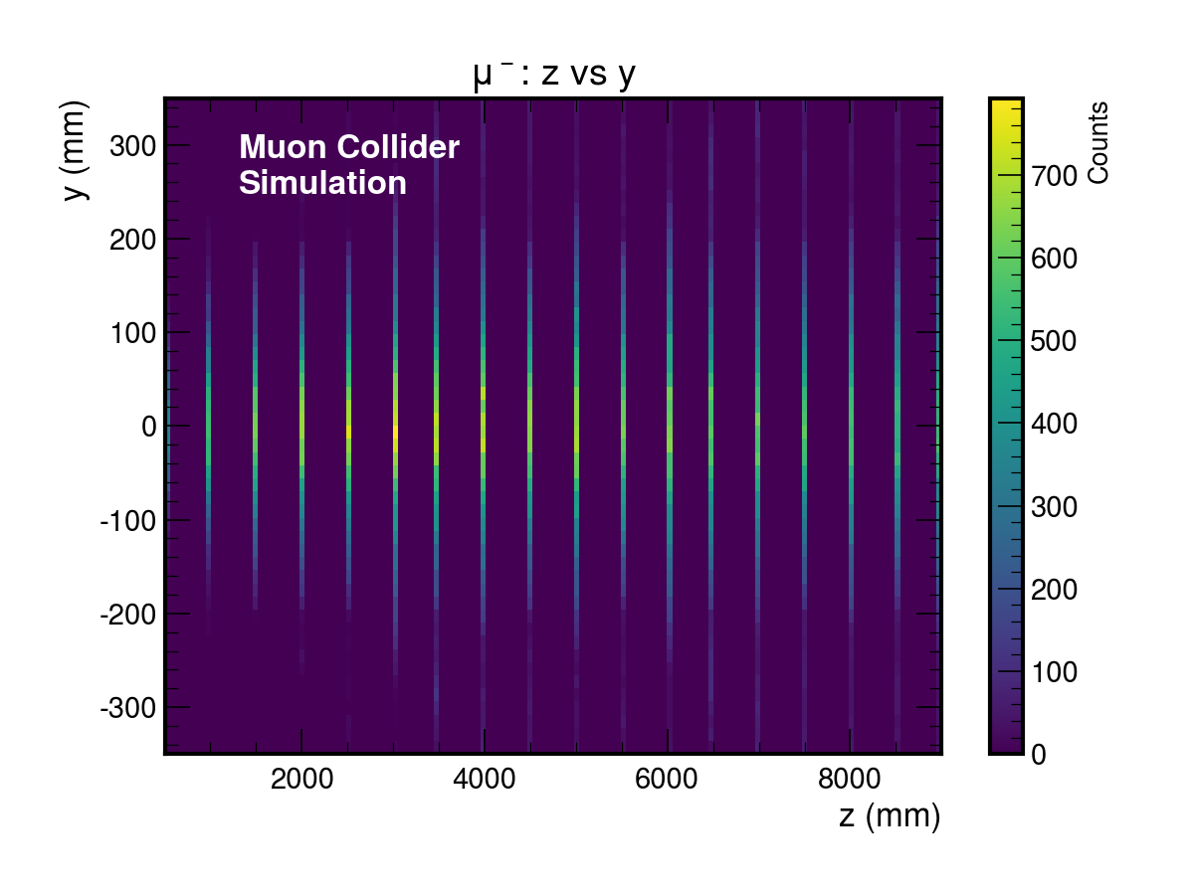
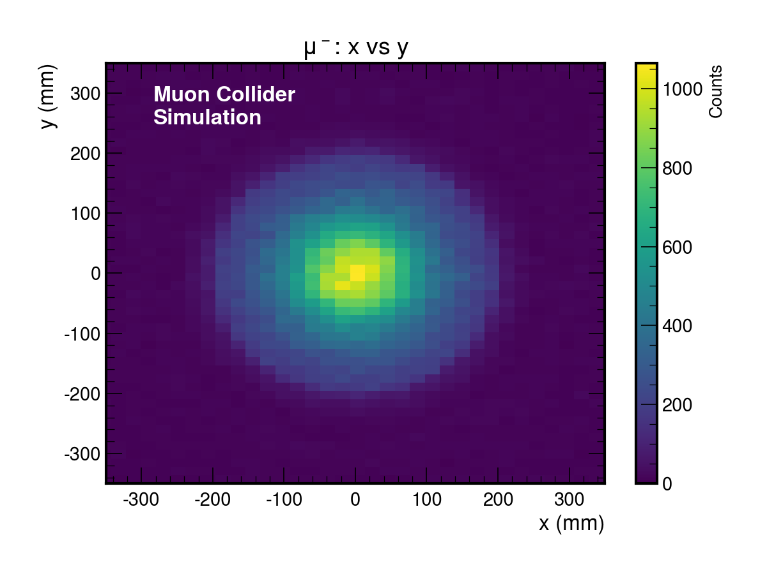
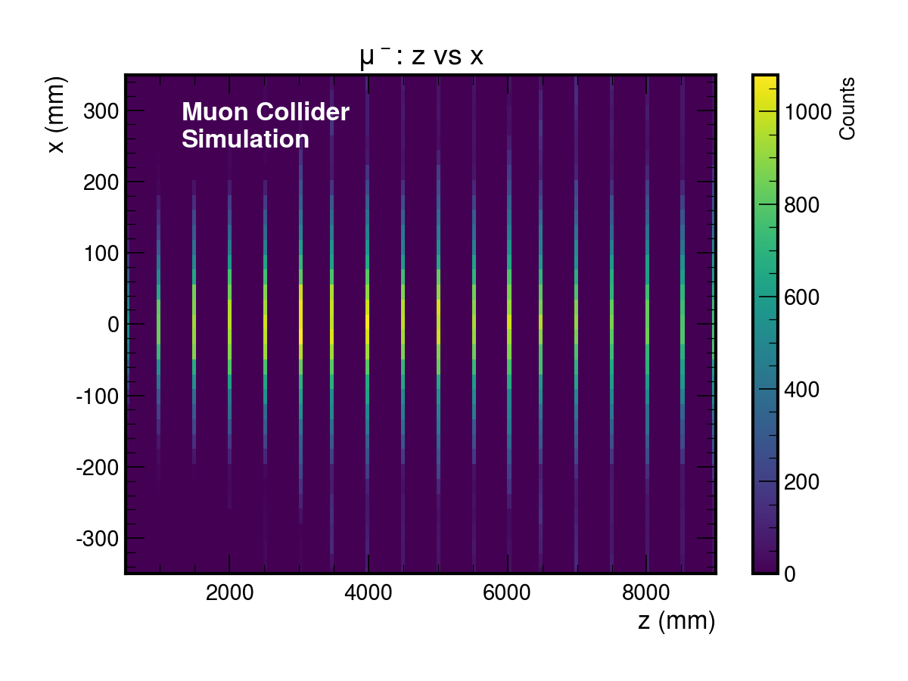
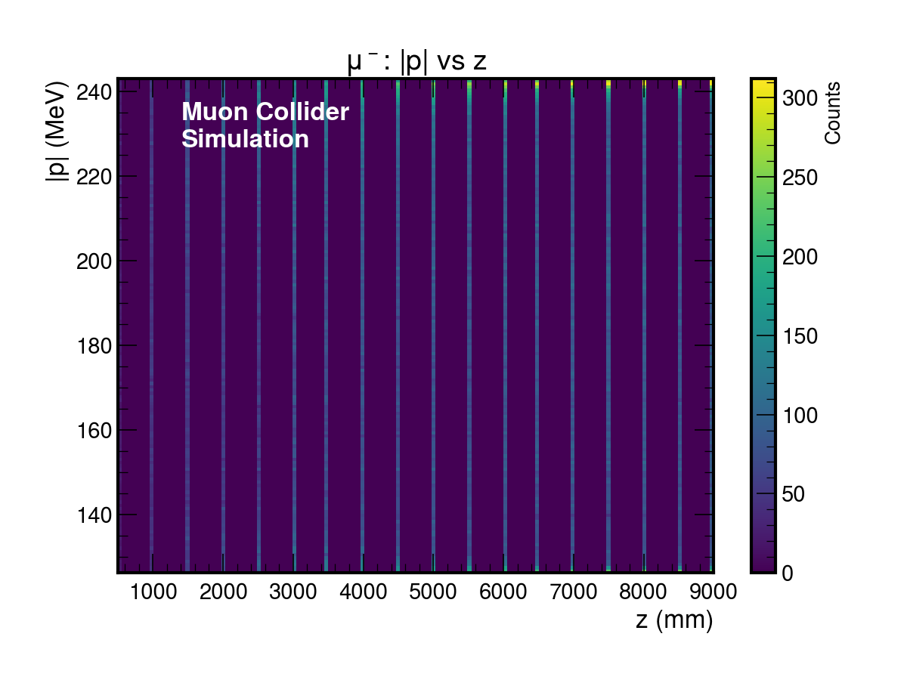
Pion Decay Channel

Slide 23
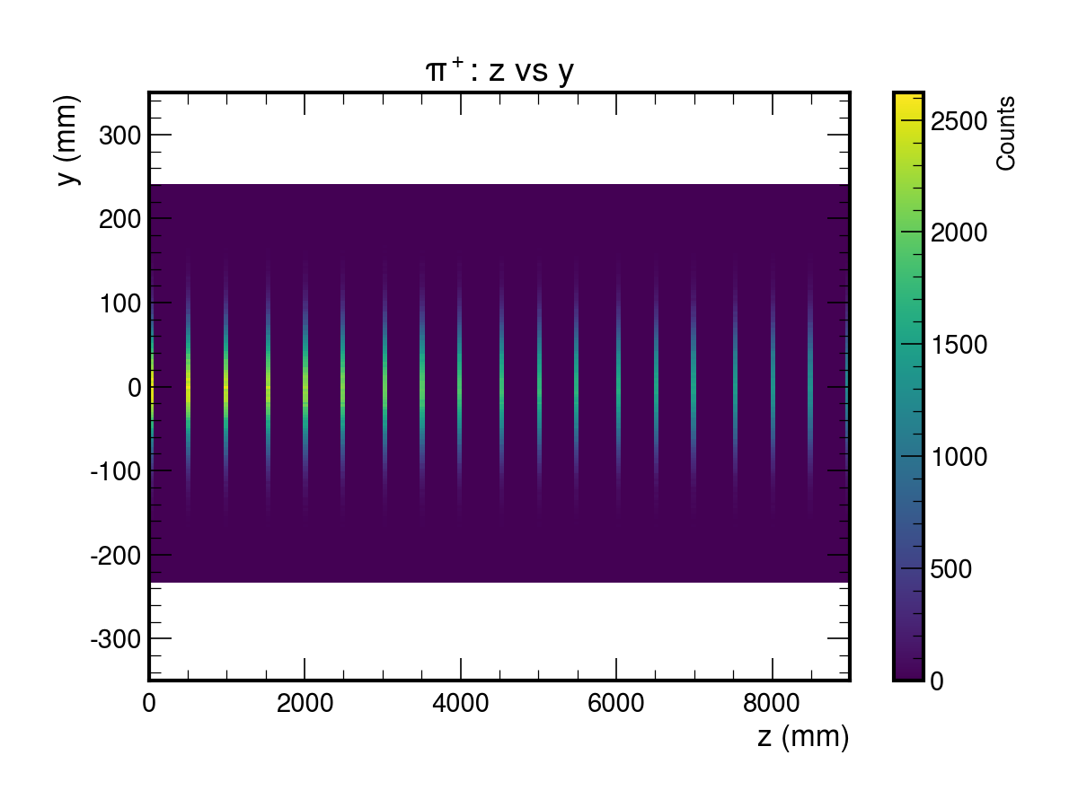
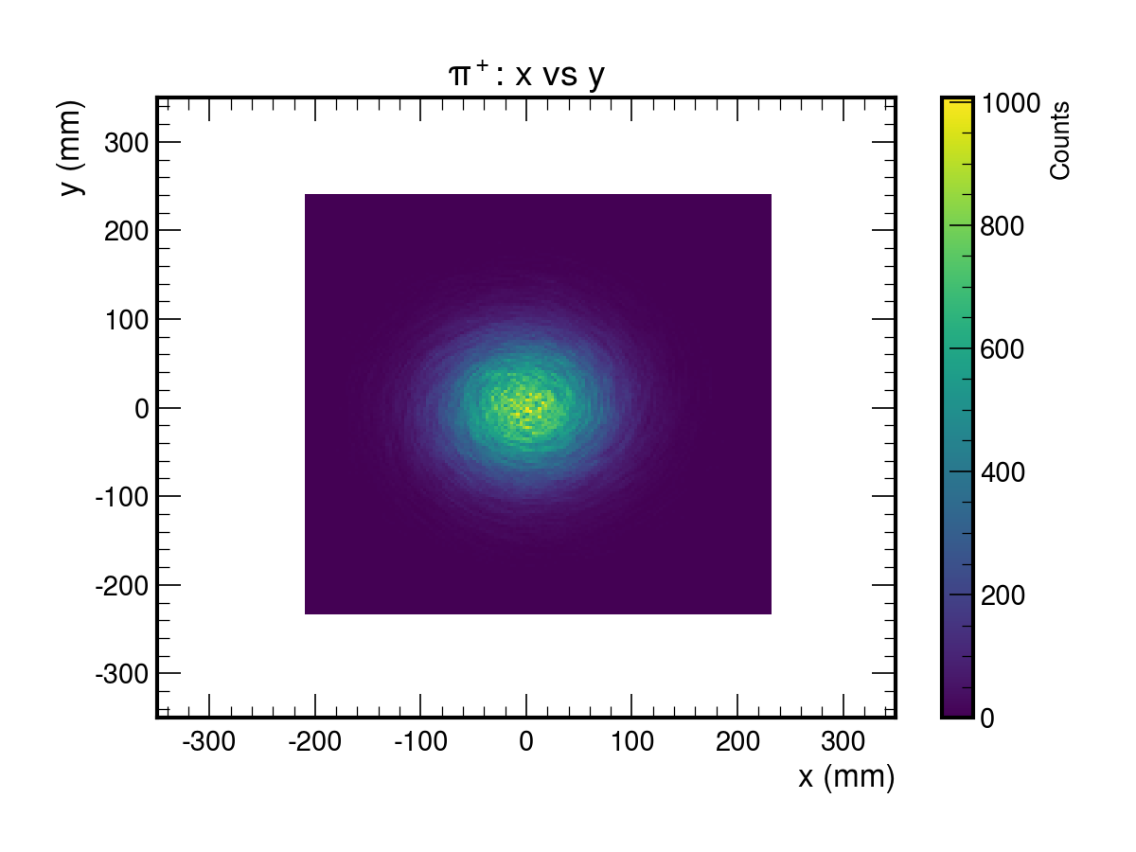
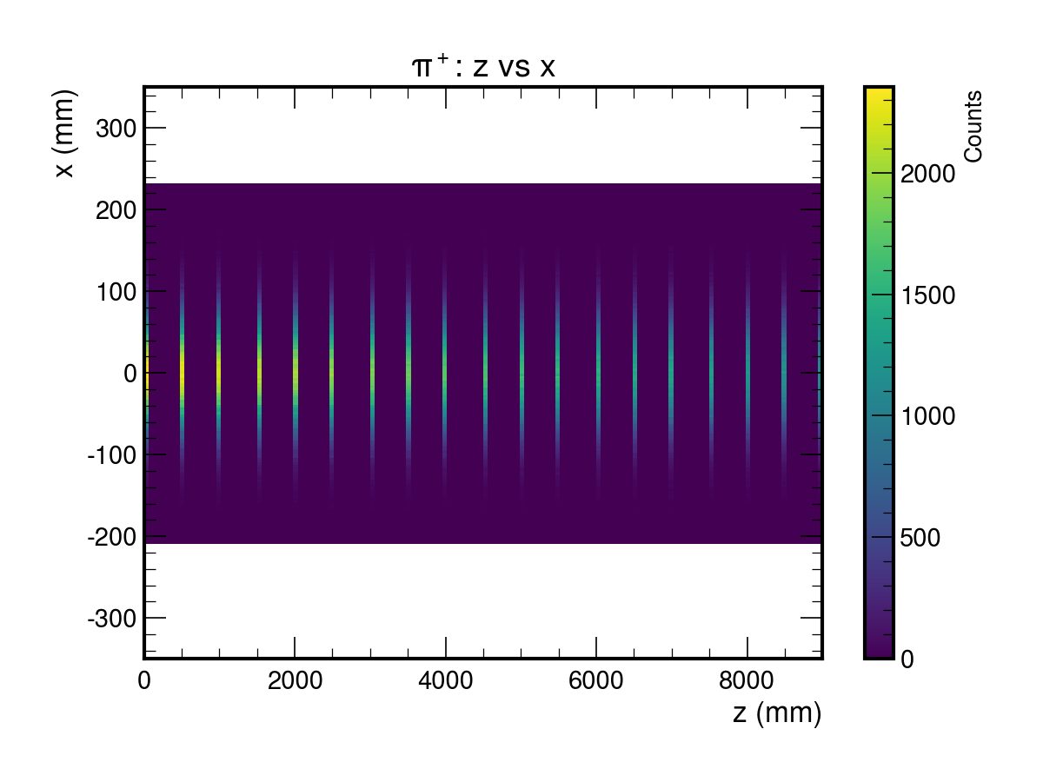
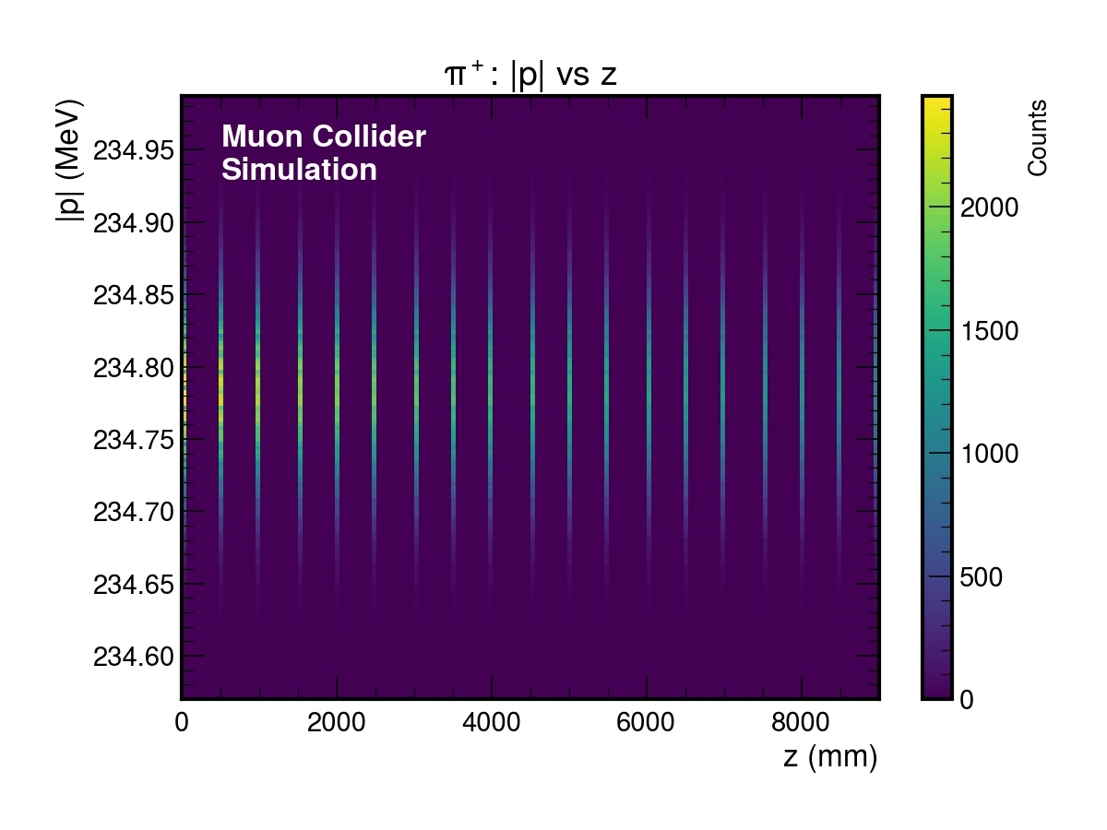
Pion Decay Channel

Slide 24
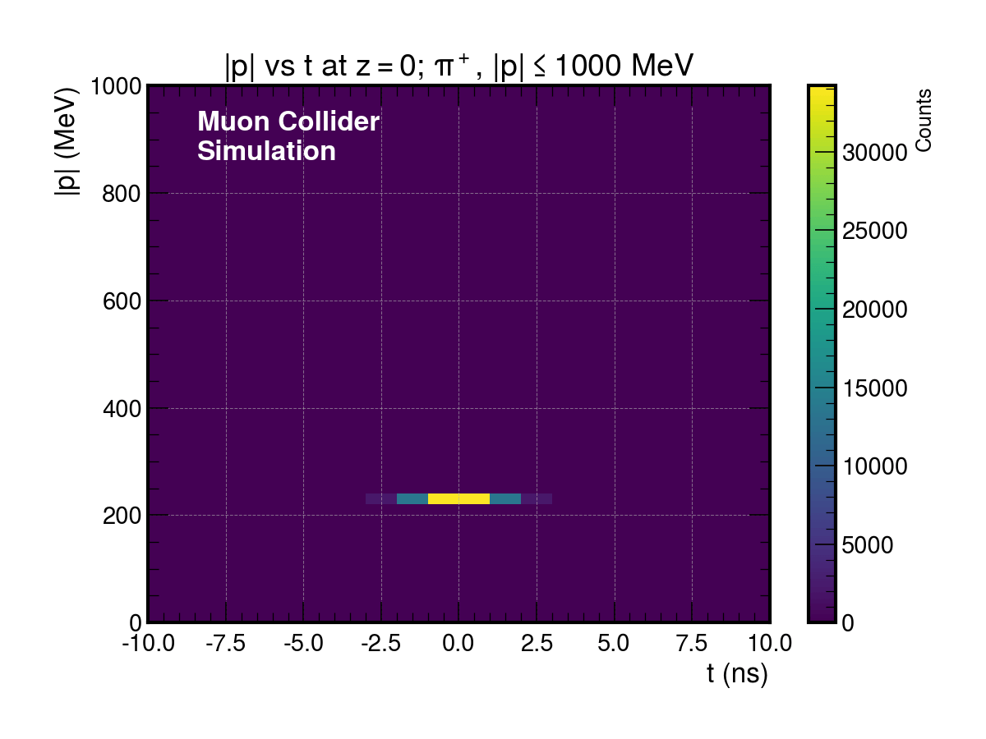
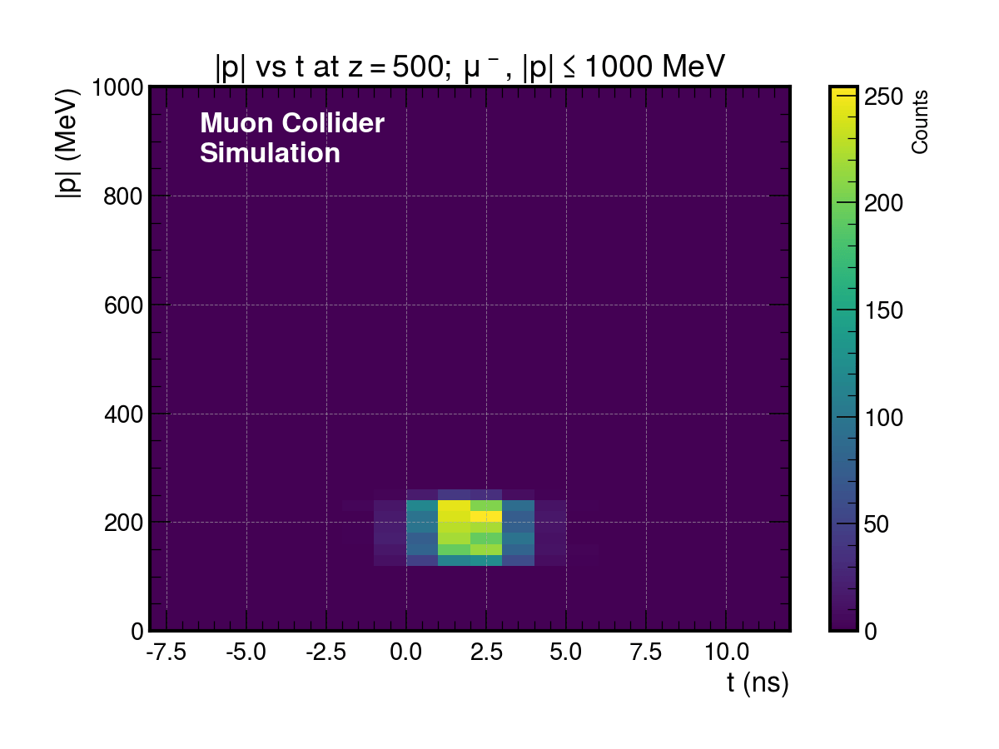
Pion Decay Channel

Slide 25
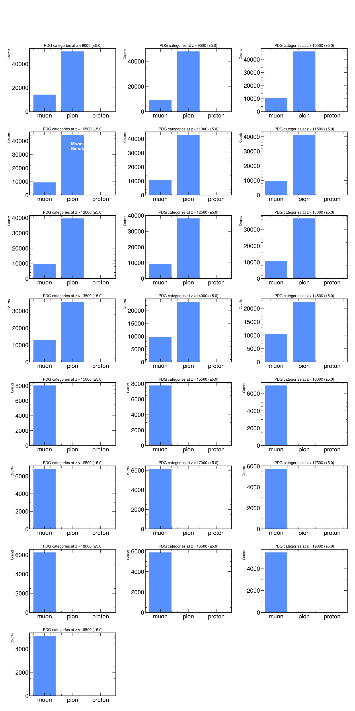
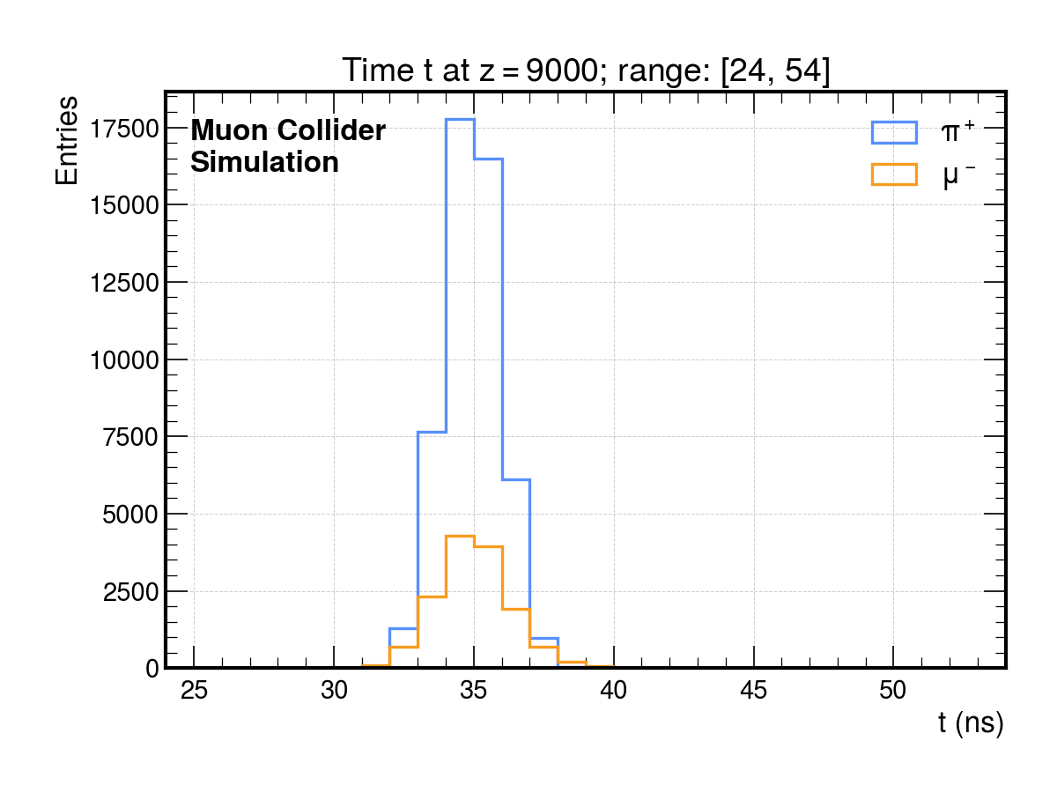
Chicane

Slide 26
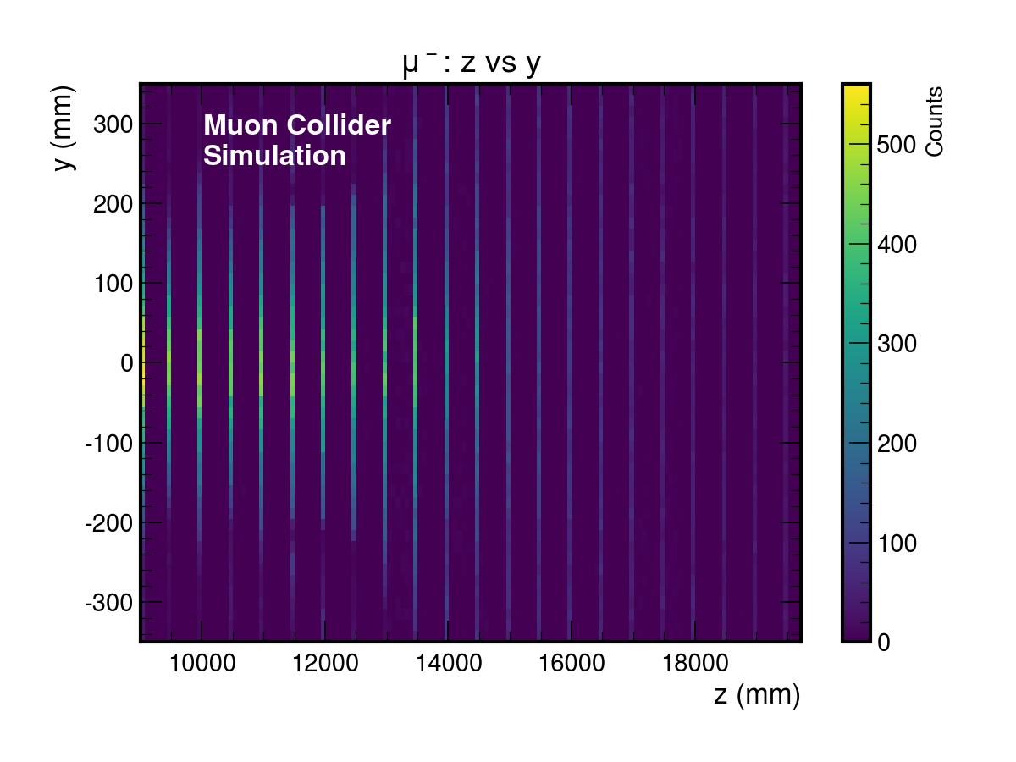



Chicane

Slide 27




Chicane

Slide 28


Chicane

Slide 29


Cooling Preparation

Slide 30

Cooling Preparation

Slide 31



Cooling Cell’s Coil

