Slide 1





Collider Ring
C. Accettura, C. Ahdida, D. Amorim, Ch. Carli, G. Lerner, E. Mactavish, J. Manczak, E. Metral, J. Osborn, Y. Robert, D. Schulte, M. Vanwelde
On behalf of the International Muon Collider Collaboration
Funded by the European Union (EU). Views and opinions expressed are however those of the author(s) only and do not necessarily reflect those of the EU or European Research Executive Agency (REA). Neither the EU nor the REA can be held responsible for them.
November 2025

Slide 2
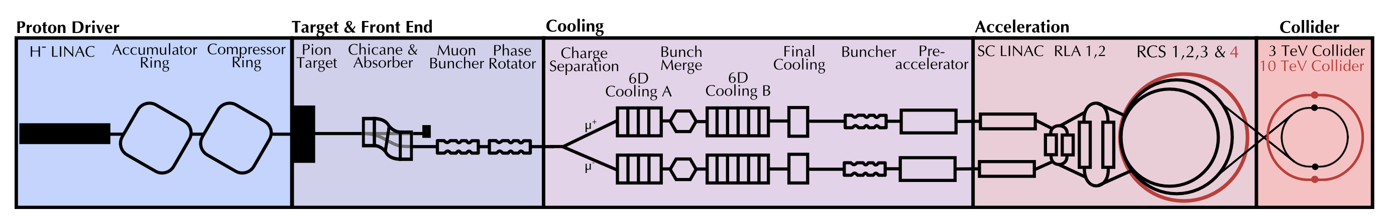
Muon Collider Concept
The main challenge is the short muon lifetime τ = γ x 2.2 μs
Protons produce pions which decay into muons which are captured
Ionisation cooling of muon in matter
Acceleration to collision energy
Short, intense proton bunch
Collision
2

Slide 3
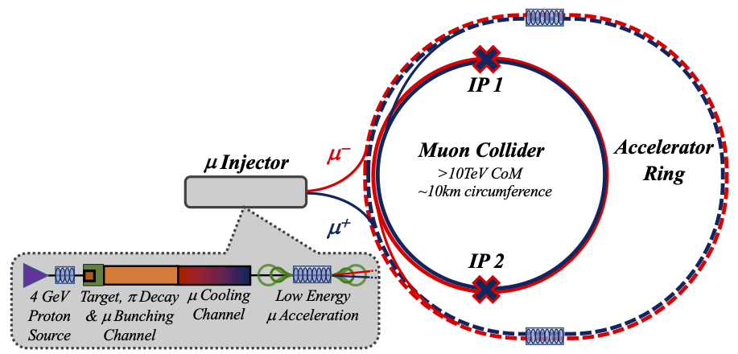
Key Challenges
0) Physics case
4) Drives the beam quality
MAP put much effort in design
optimise as much as possible
2) Beam-induced background
1) Dense neutrino flux
mitigated by mover system and site selection
3) Cost and power consumption limit energy reach
e.g. 35 km accelerator for 10 TeV, 10 km collider ring
Also impacts beam quality
3

Slide 4
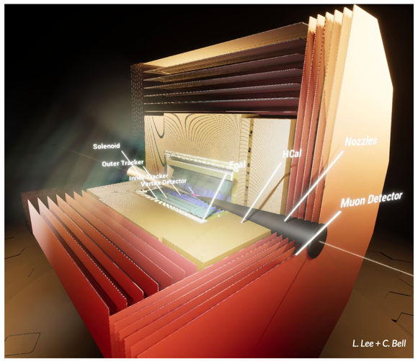
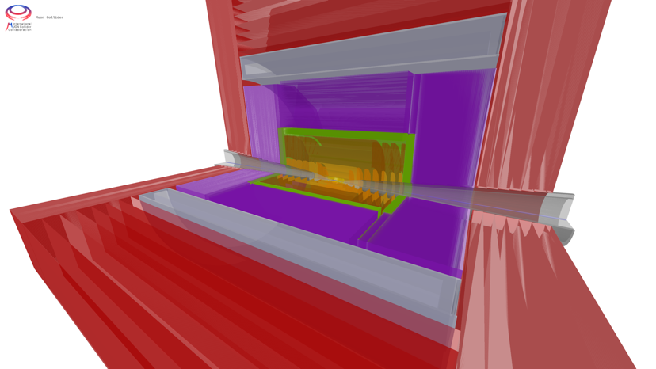
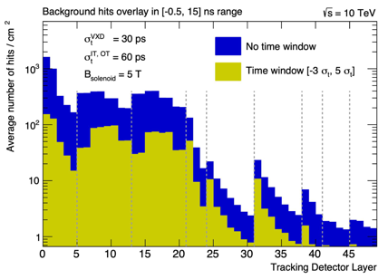
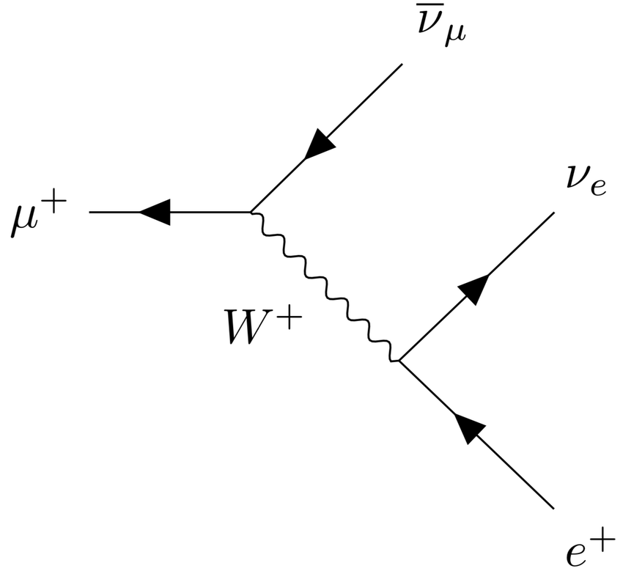
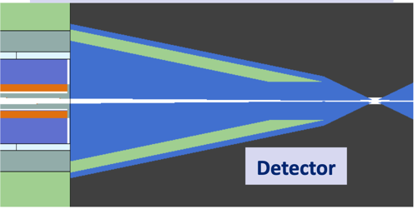
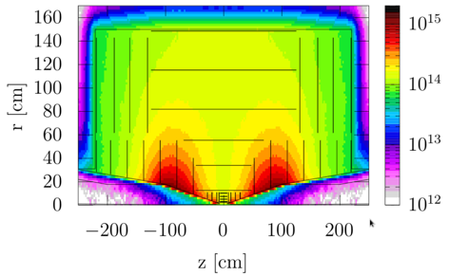
Physics and Detector Concepts
MUSIC
(MUon System for Interesting Collisions)
MAIA
(Muon Accelerator Instrumented Aperatus)
Challenges:
High-energy lepton detector requirements
Background from muon decay and beam-beam effects (BiB)
60,000 decays per m and bunch crossing
Achievements
Two detector concepts are being developed
Performance studies with GEANT
Detailed design and simulations of MDI and background suppression
Key conclusions:
Full simulations show good physics performance with near-term technology in spite of BiB
But important improvements are possible
Need strong R&D for optimization and integration
Proper investment crucial to enable exploitation of full muon collider potential in available time using new technologies, AI, and ML

Slide 5
Key Target Parameters
Param. | Unit | Site independent |  | CERN 2 tunnels |  | CERN 1 tunnel
Sqrt(s) | TeV | 3 | 10 | 3.2 | 7.6 | 3.2 | 7.6
L/IP | 10³⁴ cm⁻²s⁻¹ | 1.8 | 17.5 | 2 | 10 | 0.9 | 7.9
Int L | ab⁻¹ | 1 | 10 | 1 | 10 | 1 | 10
Accumulation time | years | 2+2.8 | 2+2.9 | 2+2.5 | 2+5 | 2+5.6 | 2+6.3
C | km | 4.5 | 11.4 | 4.8 | 8.7 | 11 | 11
B_{dipole} | T | 11 | 14 | 11 | 14 | 4.8 | 11
Collider dipole technology |  | Nb3Sn | HTS | Nb3Sn | HTS | NbTi | Nb3Sn or HTS
Accumulation time: Time to obtain the integrated luminosity with two IPs.
Ramp-up over the first three years 5%, 25%, 70% of nominal.
5

Slide 6
Muon Collider Luminosity Scaling
Fundamental limitation
Requires emittance preservation and advanced lattice design
Applies to MAP scheme
High beam power
High energy
Large energy acceptance in collider ring
Dense beam
High field in collider ring
Luminosity per power increases with energy
Provided technologies can be made available
Constant current for required luminosity scaling

Slide 7
Collider Ring Challenges
Neutrino flux mitigation
500 W/m loss from muon decay requires shielding
Magnet strength at large aperture
Lattice design with IP beta-function of 1.5-5 mm
Important energy spread (0.1% rms)
Maintain a short bunch length
Impedances
Beam-beam effects
Imperfections
Operational considerations
…

Slide 8
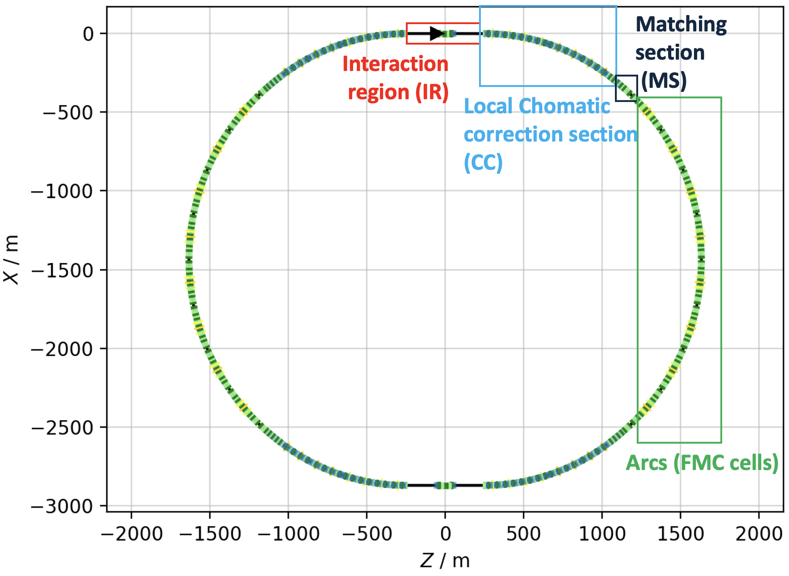
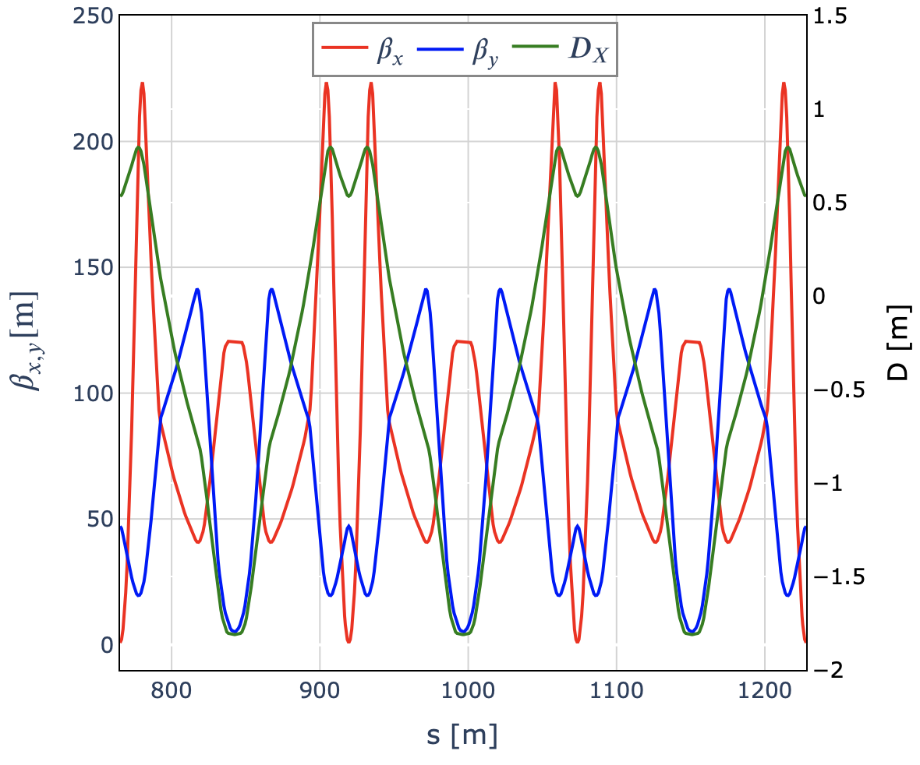
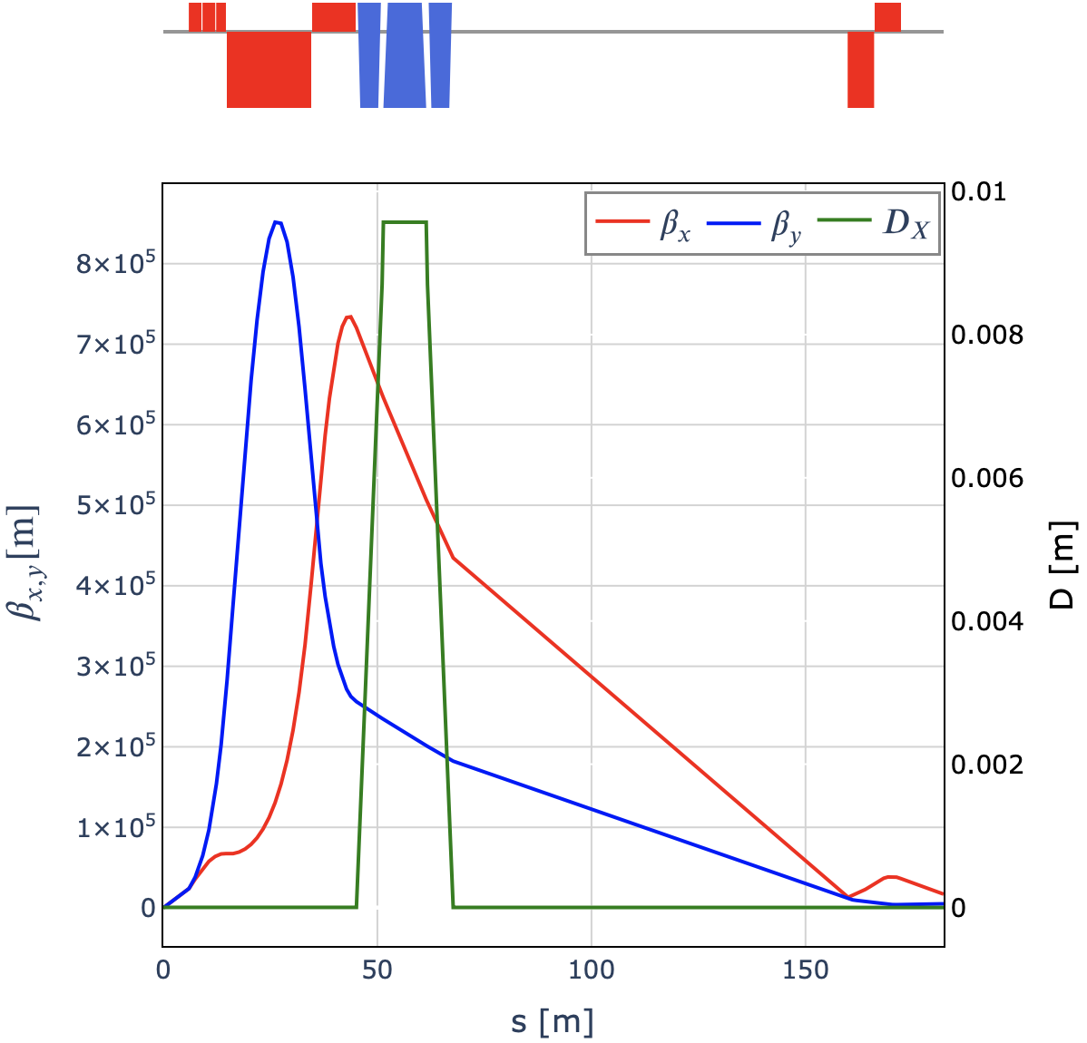
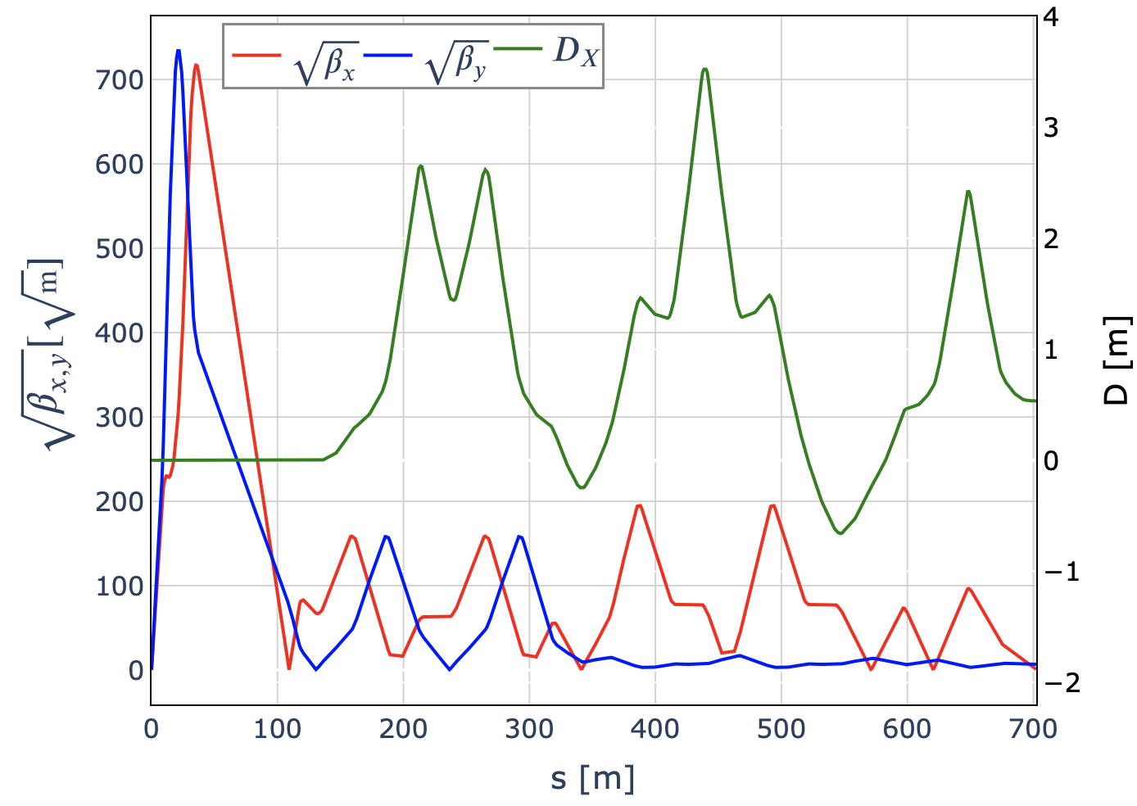
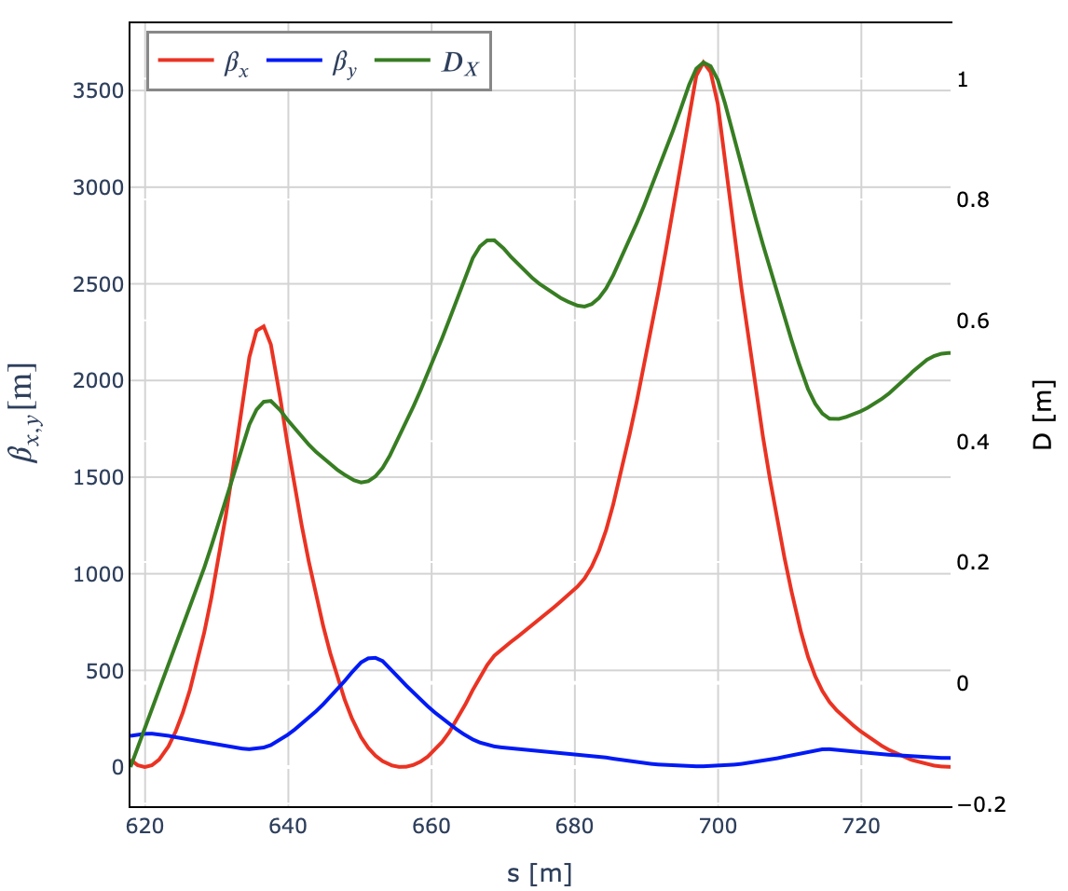

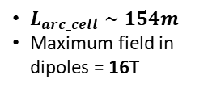
Overview of the Collider Ring Optics
FMC Arcs
Interaction Region (IR)
Chomatic correction section (CC)
Matching Section (MS)
$L_{arc_cell}∼154m$
Maximum field in dipoles = 16T
$L^{∗}=6m$
Chicane to reduce BIB
2 sextupole pairs to correct chromatic perturbations from FF triplets

Slide 9
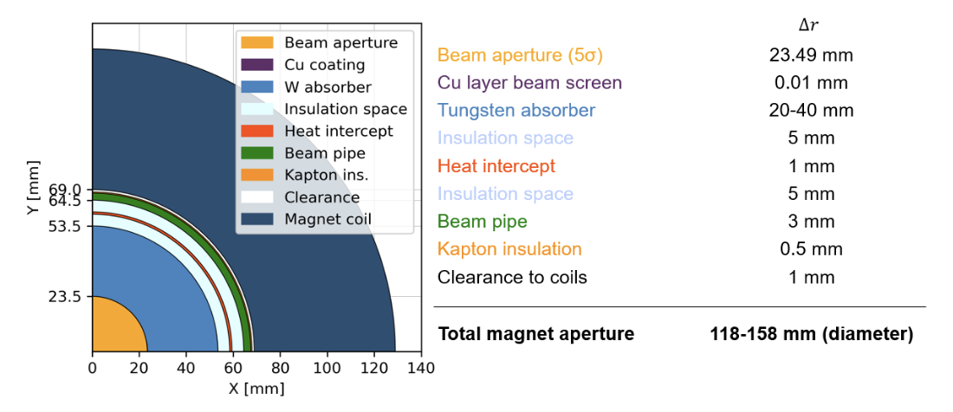
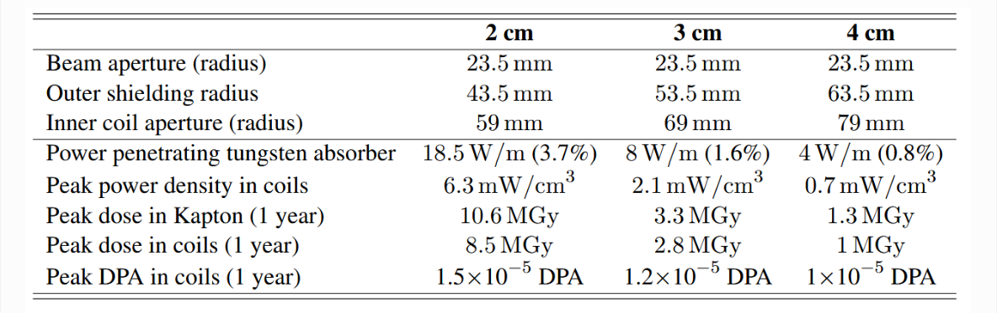
Aperture Requirements (Arcs)
A. Lechner et al.
Challenges:
500 W/m loss, magnet strength
Scales with average magnetic field, bunch charge and repetition rate
Key conclusions:
20 mm shielding seems marginal
30 mm appear acceptable for HTS at 10-20 K
40 mm is good for LTS
30 mm might be good enough for LTS with 5 T
Magnet Designs

Slide 10
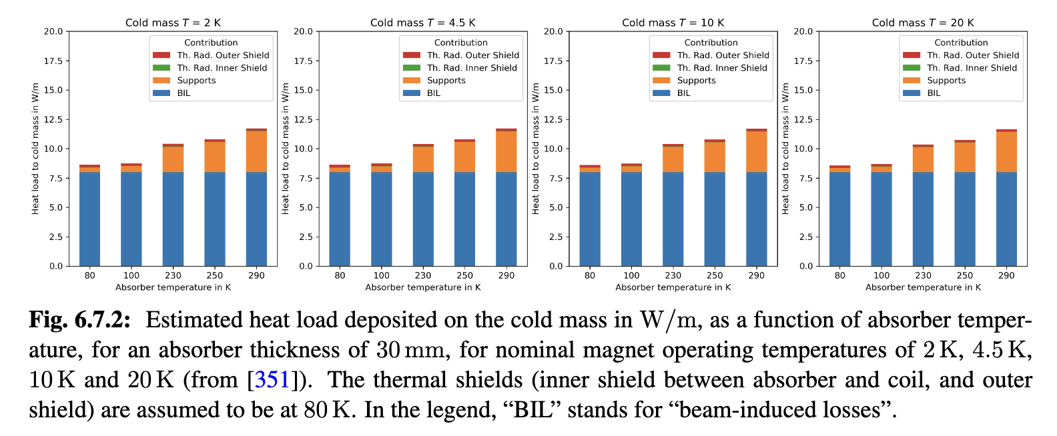
Note: Cryogenics
P. Borges de Sousa
Main power consumption required for cold mass cooling
Most of the heat load in the cold mass is from beam-induced losses

Slide 11
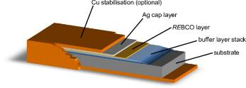
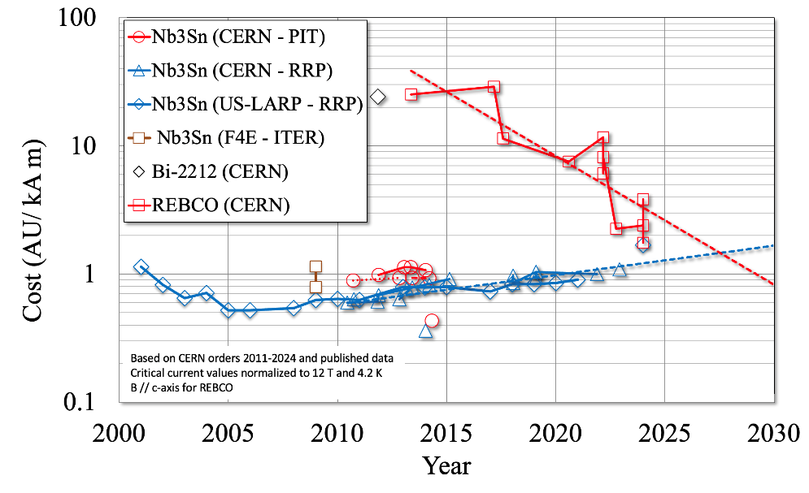
Note: HTS
Explore different HTS solutions
Much effort on REBCO
Some on iron-based HTS (China and some INFN effort)
Kabel challenges
Improvement of REBCO tapes with industry
Develop cables for accelerators
Magnet challenges
Dealing with high forces
Quench protection
Strong synergy with applications in society
Funsion reactors, power generators for windmills, motors, power transmission, medical applications, …
Spoiler:
Solenoids are already achieving high fields
No insulation required if magnets operate at fixed field
REBCO Tape

Slide 12
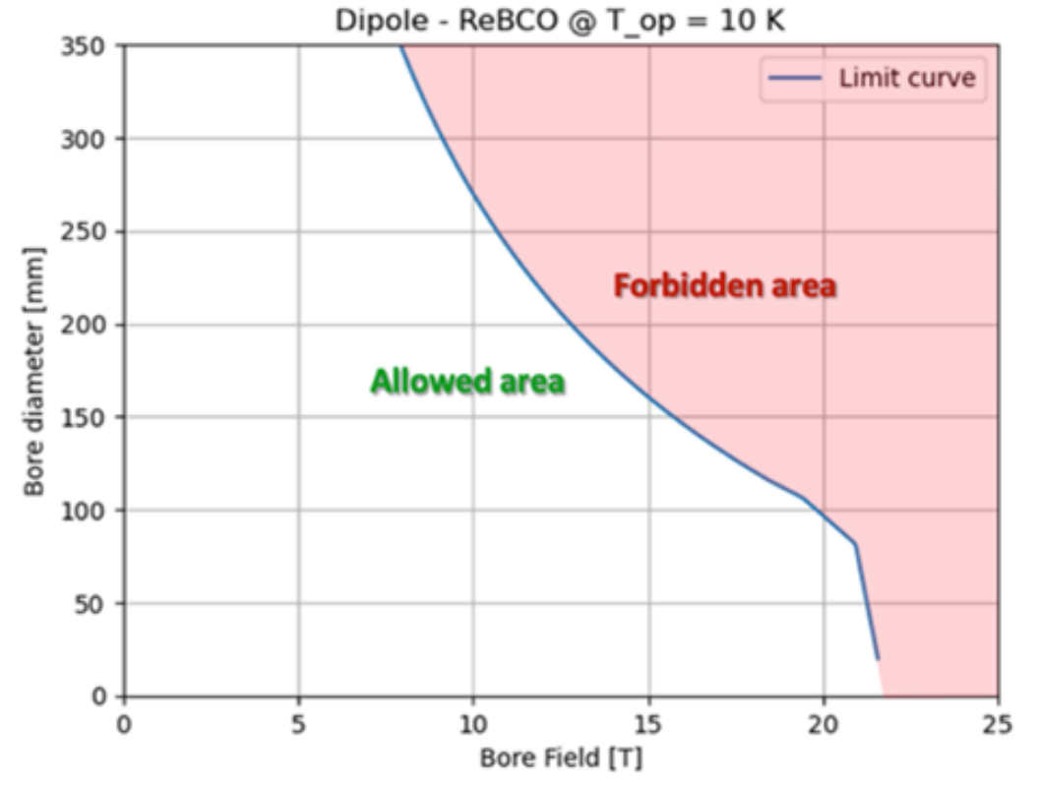
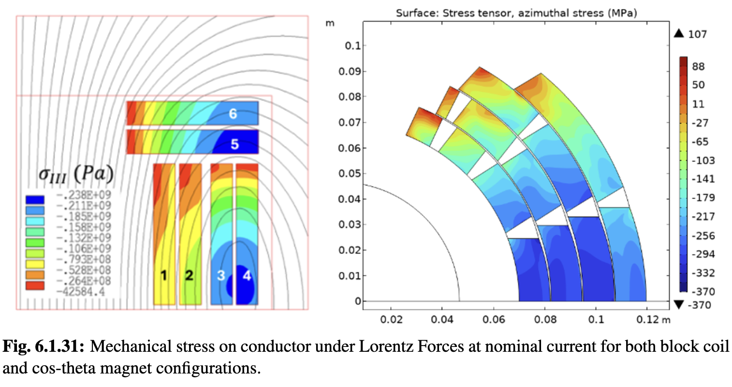
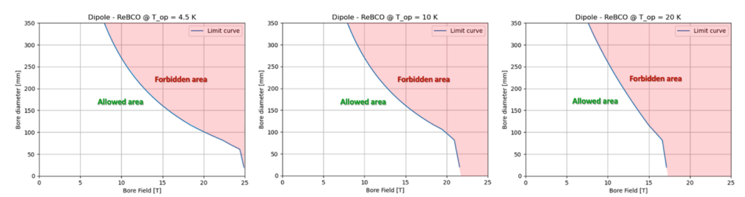
Magnetic Field Strength
Scans for different material, cost, apertures
Considering current limit and stress
For dipoles, quadrupoles and combined function magnets
L. Bottura et al.
Magnet Designs
Predict practical limits:
For 2050:
NbTi @ 4.5 K, 158 mm: 4.9 T
NbSn @ 4.5 K, 158 mm: 11 T
Beyond 2050:
HTS @ 20 K, 138 mm: 14 T
HTS @ 10 K, 138 mm maybe 16 T

Slide 13
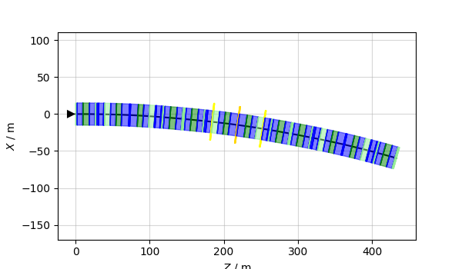
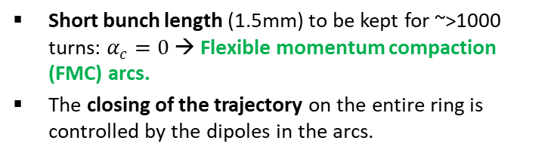
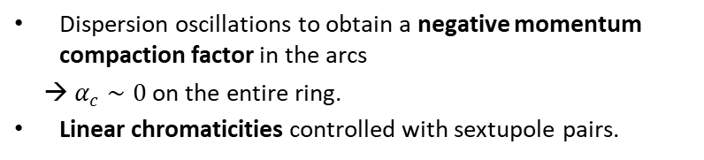
Collider Ring Arc Lattice
Short bunch length (1.5mm) to be kept for ~>1000 turns: $α_{c}=0$ → Flexible momentum compaction (FMC) arcs.
The closing of the trajectory on the entire ring is controlled by the dipoles in the arcs.
Note: for 10 TeV assume 16 T dipoles
Expect minor change when going to 14 T
Some combined function magnets slightly too strong
Not a priority study at this moment
Dispersion oscillations to obtain a negative momentum compaction factor in the arcs
→ $α_{c}∼0$ on the entire ring.
Linear chromaticities controlled with sextupole pairs.

Slide 14
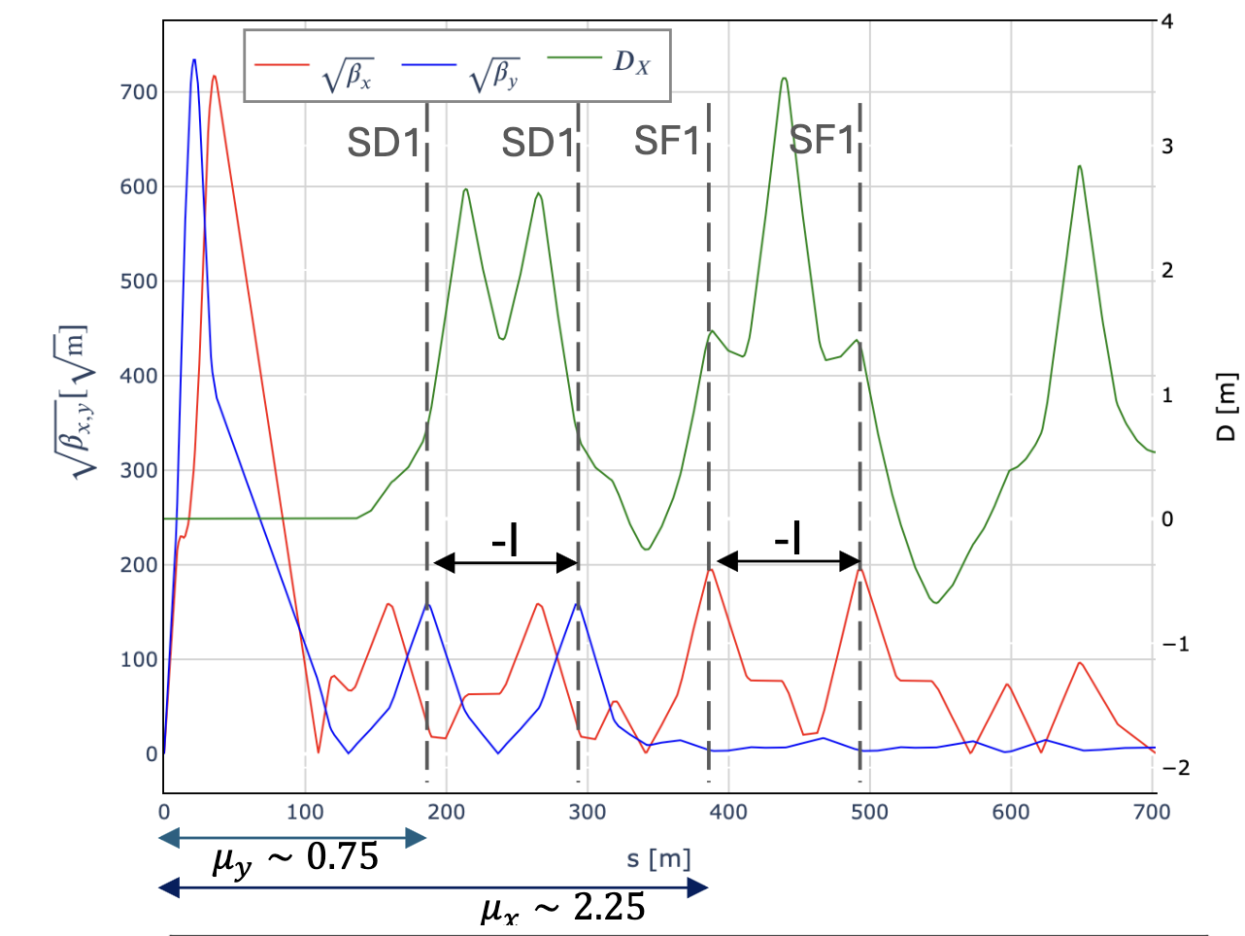
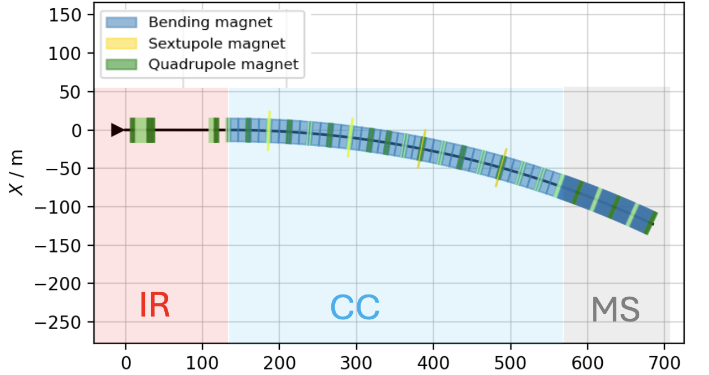
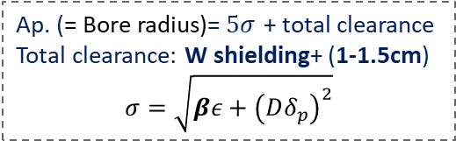
Interaction Region Lattice
Ap. (= Bore radius)=$5σ$ + total clearance
Total clearance: W shielding+ (1-1.5cm)
$$σ=\sqrt{βε+{\left(Dδ_{p}\right)}^{2}}$$

Slide 15
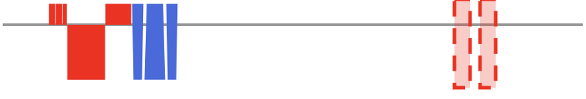
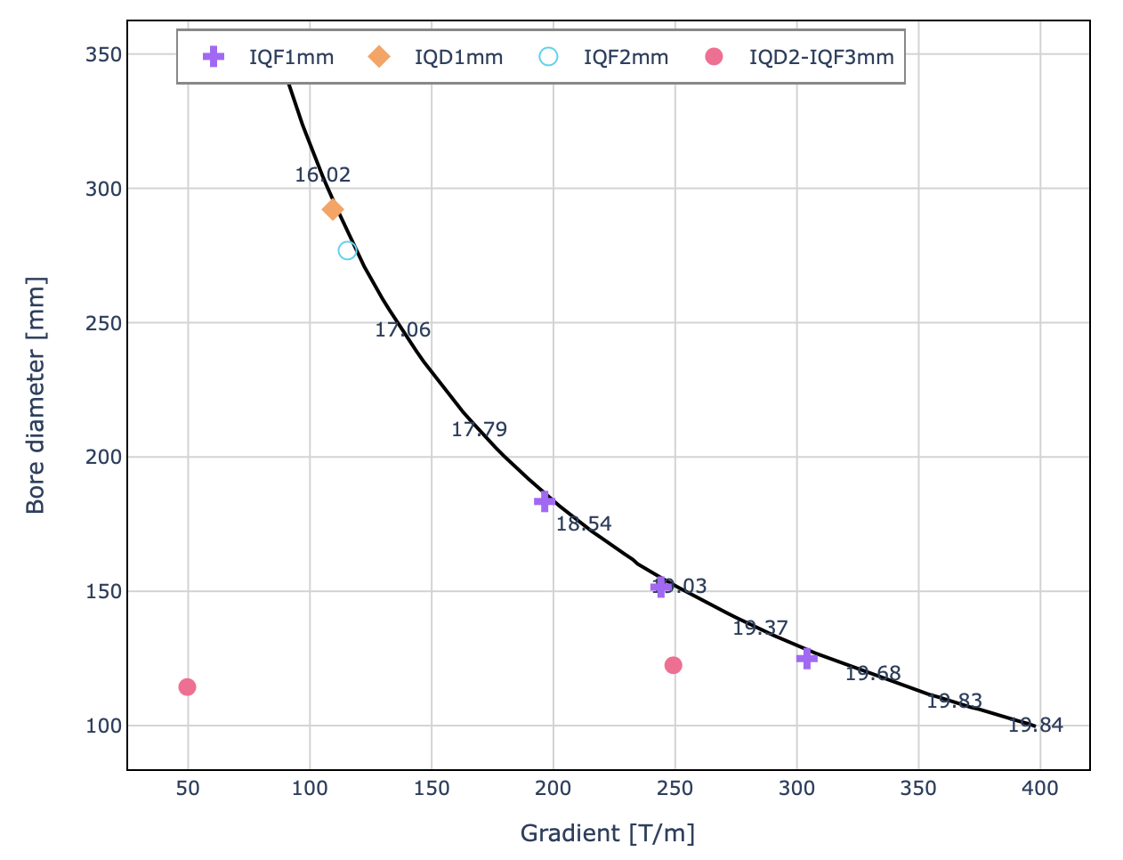
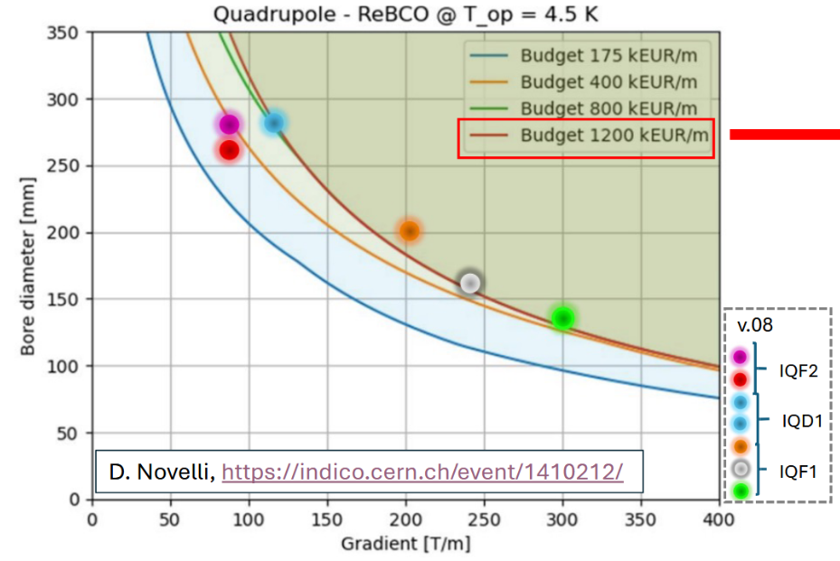
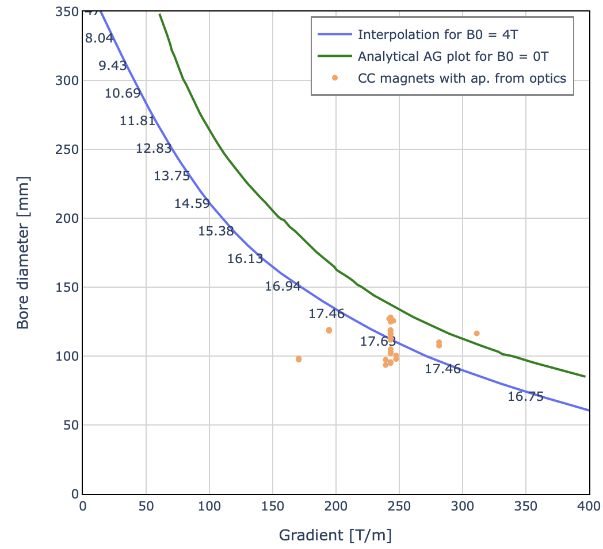
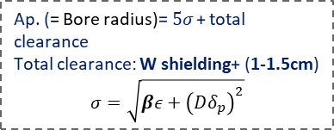

Final Focus Magnets
Magnet gradient is OK for 10 TeV with 4 cm space around beam aperture
Design was made for 20 T on aperture, slight modification required
At 7.6 TeV required gradients are lower for the same apertures and layout
Potentially do not reduce gradient that much and use relatively stronger focusing to reduce apertures and triplet length apertures
Magnets are expected to be OK for 7.6 TeV
$$T_{op}=4.5K$$
Ap. = $5σ+4cm$
L. Bottura et al.
Forbidden area
Allowed area
Ap. (= Bore radius)=$5σ$ + total clearance
Total clearance: W shielding+ (1-1.5cm)
$$σ=\sqrt{βε+{\left(Dδ_{p}\right)}^{2}}$$

Slide 16
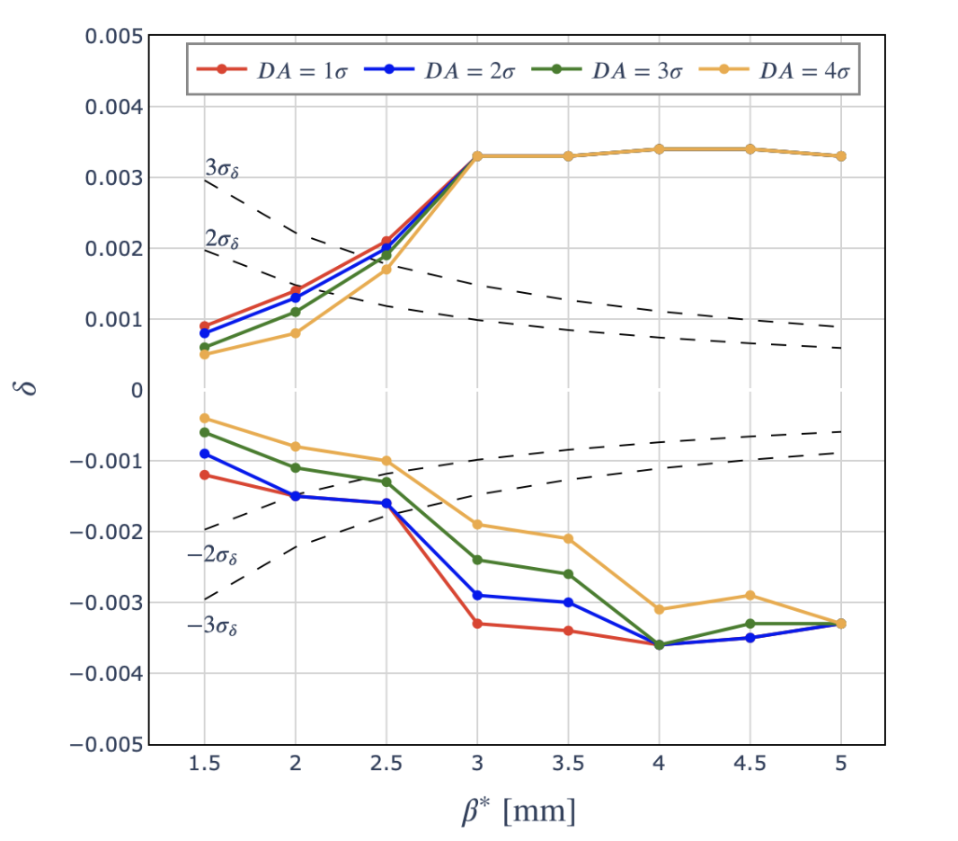
Collider Ring Performance
Dynamic aperture for 10 TeV is smaller than the target
More optimization is required (this is a tough challenge)
However, priority is neutrino flux mitigation
At 7.6 TeV have 2 mm beta-function
Increased energy acceptance
Find that longitudinal emittance could be smaller by up to a factor 3
May be marginally OK already now
Need a full start to end study

Slide 17
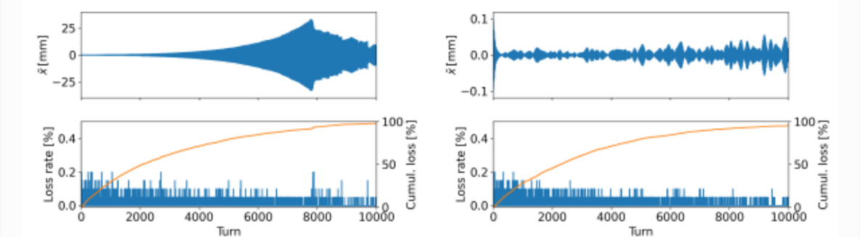
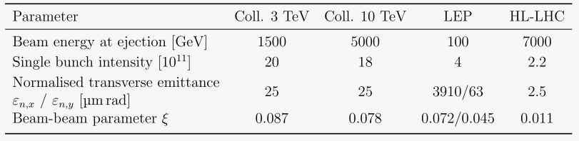
Collective Effects
Challenges:
Impedance of the beam pipe
Beam-beam effects
Impedance:
No longitudinal motion of particles in the beam
Slippage factor η = 0
Shield is coated with 10 um of copper
Room temperature assumed (worst case)
Feedback alone is not sufficient
Need to add Q’ = 2 to make beam stable
Relatively small compared to LHC (about 15)
Note: fast 20-turn damper would allow 16 mm all around the ring
Q’ = 0 and no damper
Q’ = 2 and 100-turn damper
Beam-beam effect:
Beam-beam parameter is ξ = 0.078 at injection
Instability can develop
A 20-turn transverse damper makes the beam stable

Slide 18
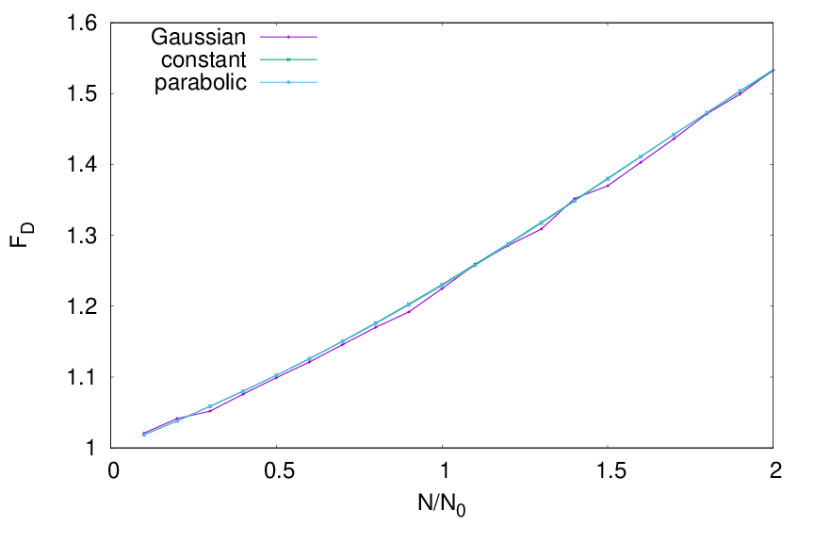
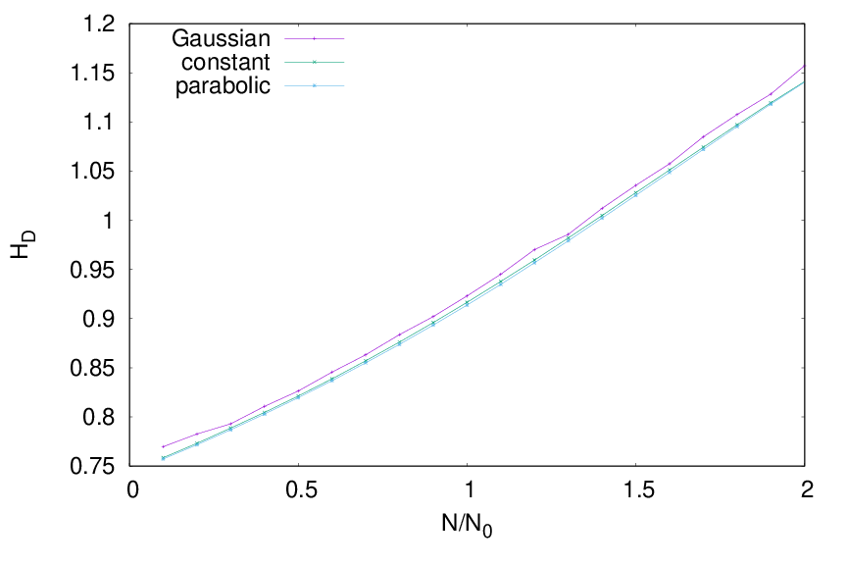
Pinch Effect
Hourglass effect reduces luminosity to about 76% of geometric value
Beam-beam effect increases the luminosity
but can generate additional background
Simulations with GUINEA-PIG for three different longitudinal profiles with 1.5 mm RMS bunch length yield similar results

Slide 19
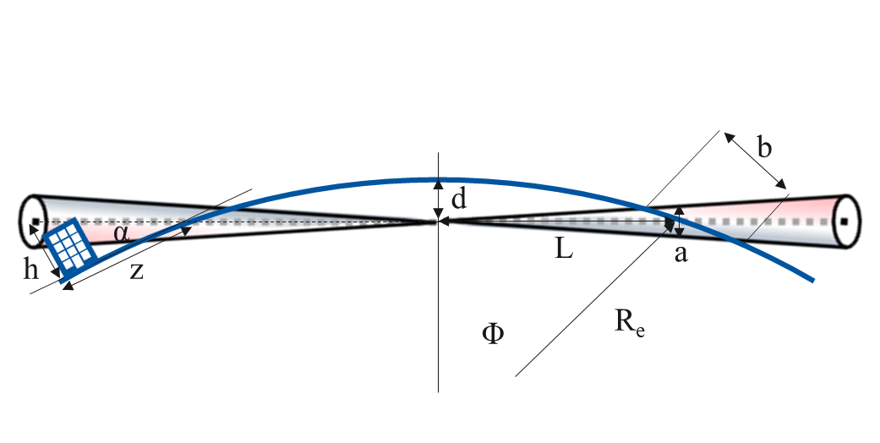
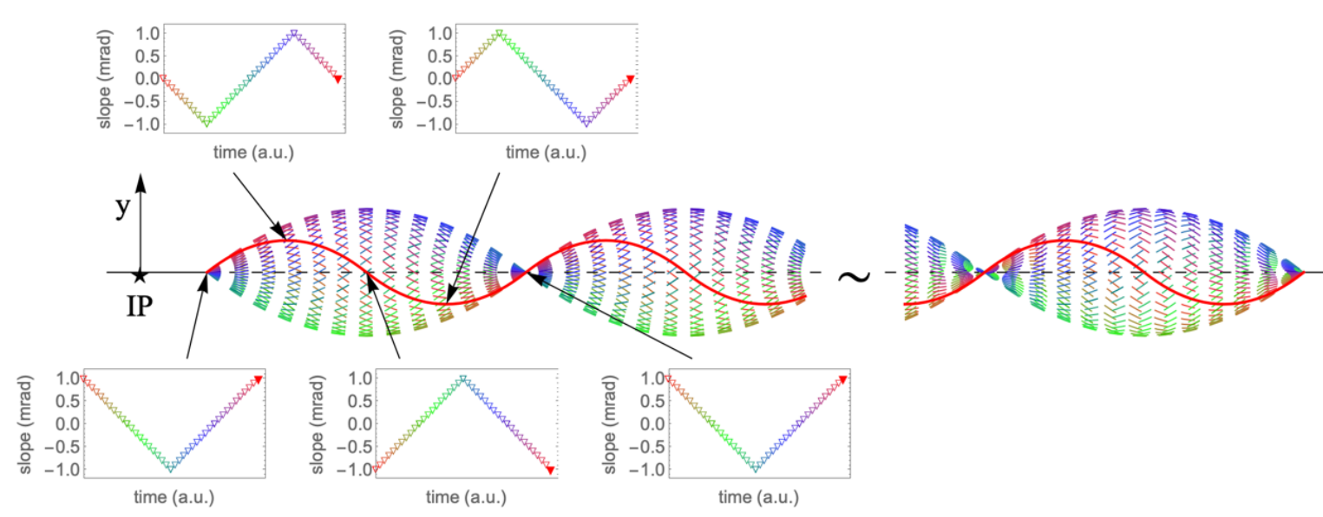
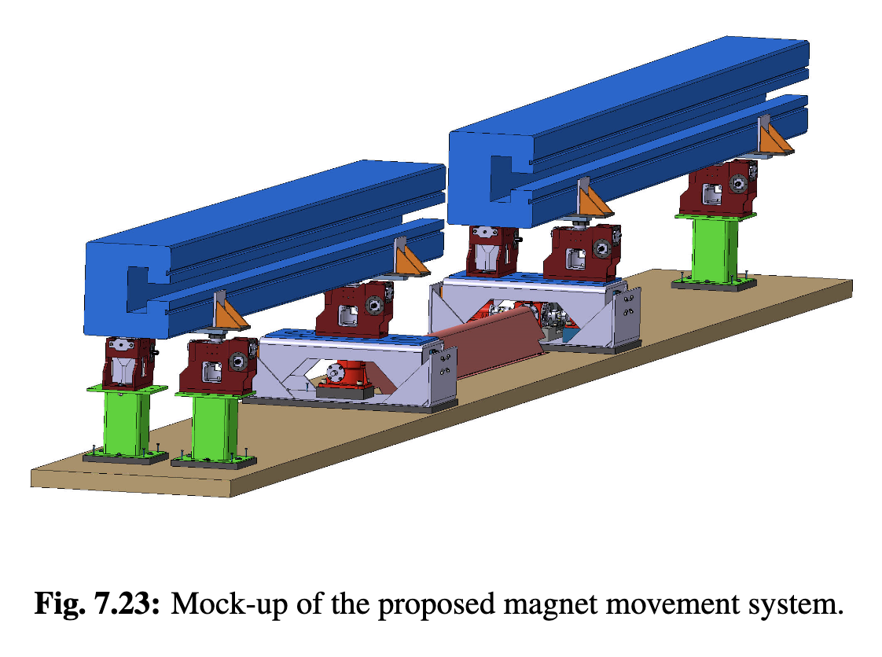
Neutrino Flux Mitigation
Challenge:
Can obtain neutrino flux inline with CERN strategy
Strategy:
Buy and fence the land in direction of the experimental insertions
Makes us robust for later additions in these insertions (inject, extraction, …)
Use mover system to mitigate flux from the arcs (VIPER: Vertical Incremental Periodic Excursion of the Ring)
Yields improvement by about two orders of magnitude
t₁
t₂
Arc mitigation concept
Vertical deformation with parabola segments
Move pattern forward in time, tentative assumption:
+/- 1m radian
Mover system design

Slide 20
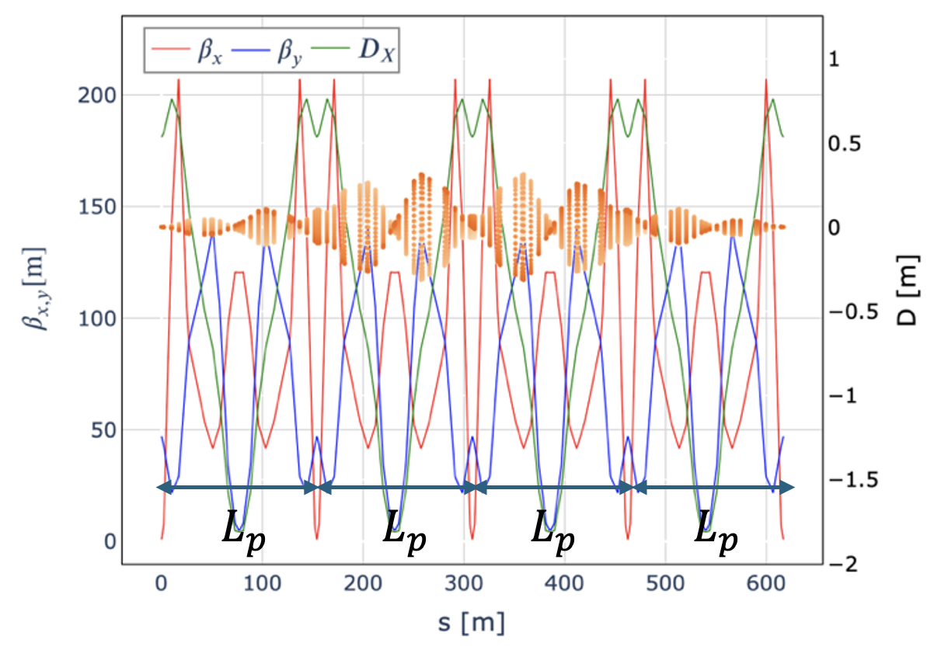
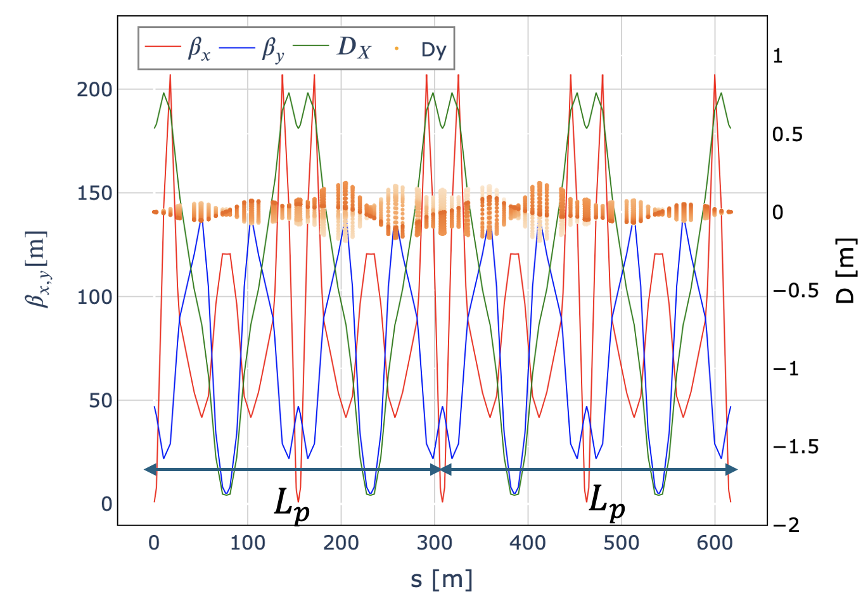
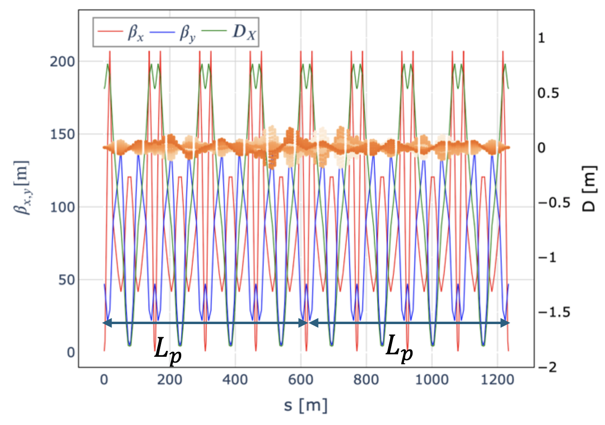


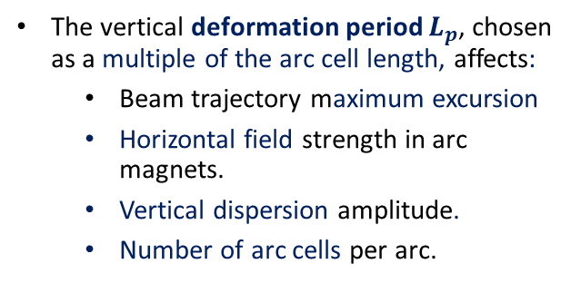
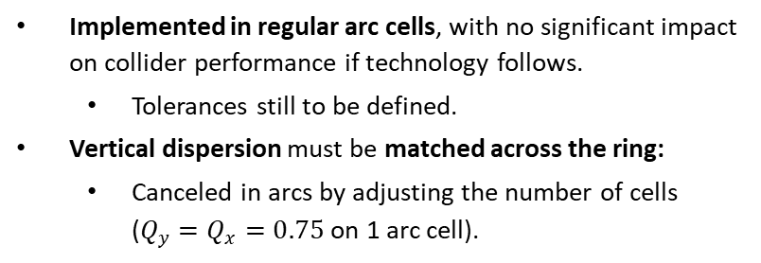

VIPER in the Regular Arcs
Implemented in regular arc cells, with no significant impact on collider performance if technology follows.
Tolerances still to be defined.
Vertical dispersion must be matched across the ring:
Canceled in arcs by adjusting the number of cells ($Q_{y}=Q_{x}=0.75$ on 1 arc cell).
The vertical deformation period $L_{p}$, chosen as a multiple of the arc cell length, affects:
Beam trajectory maximum excursion
Horizontal field strength in arc magnets.
Vertical dispersion amplitude.
Number of arc cells per arc.
$$L_{p}∼154m$$
$$L_{p}∼300m$$
$$L_{p}∼600m$$
Vertical dispersion for several deformation steps (scan $±$1 mrad)
Notes:
Vertical periodic machine deformation

Slide 21
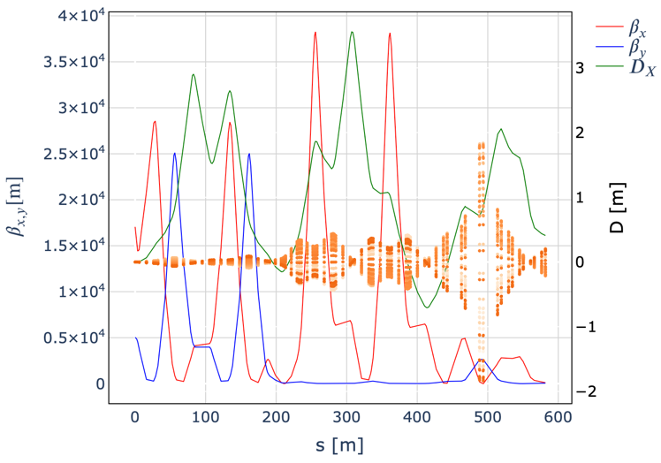
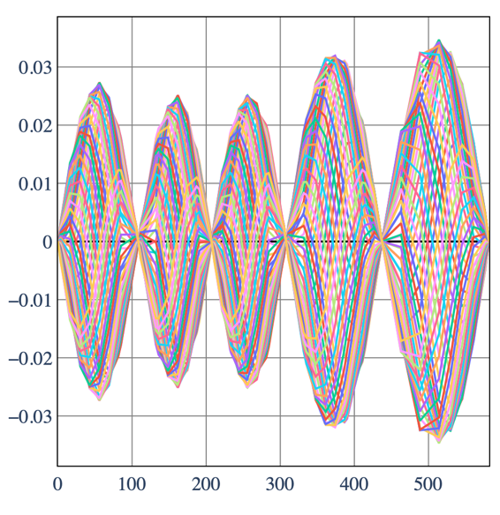
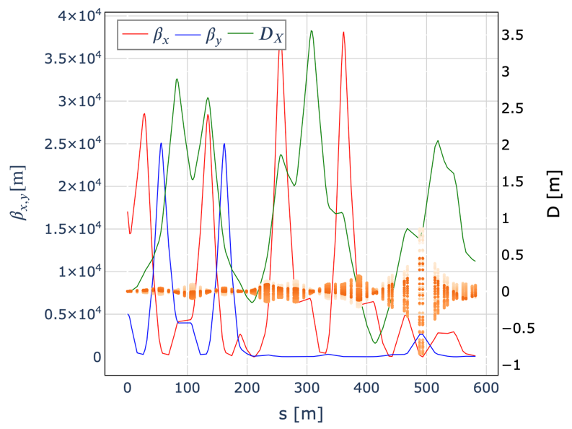





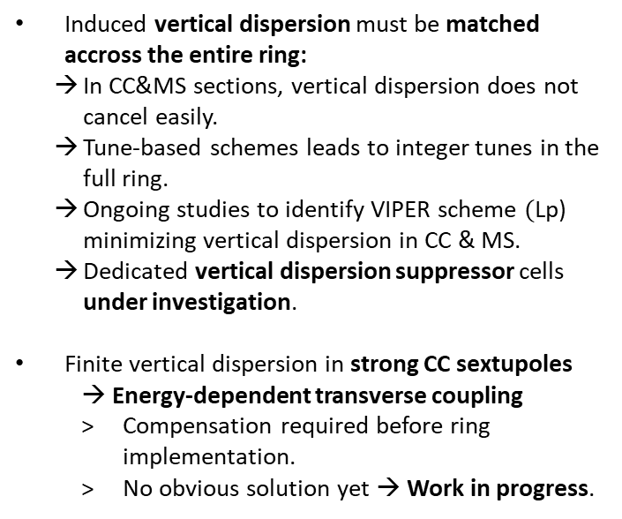

VIPER Feasibility in CC & MS
Residual vertical dispersion at MS end with one deformation period
Induced vertical dispersion must be matched accross the entire ring:
In CC&MS sections, vertical dispersion does not cancel easily.
Tune-based schemes leads to integer tunes in the full ring.
Ongoing studies to identify VIPER scheme $($Lp) minimizing vertical dispersion in CC & MS.
Dedicated vertical dispersion suppressor cells under investigation.
Finite vertical dispersion in strong CC sextupoles
→ Energy-dependent transverse coupling
Compensation required before ring implementation.
No obvious solution yet → Work in progress.
$$L_{p, CC\&MS}$$
Start of CC
5 deformation periods
$$L_{p, CC1}$$
$$L_{p, CC2}$$
$$L_{p, CC3}$$
$$L_{p, CC4}$$
$$L_{p, MS}$$
Notes:
Vertical periodic machine deformation
Le schema optimal sur la CC permet aussi d’avoir des excursin d’orbite pas trop grande → limitation des erreurs d’alignement?

Slide 22





Placement Studies
Achieved:
Detailed modelling using FLUKA
First good orientation found
Mover system concept
Civil engineering tool to determined best orientation of collider ring tunnel
J Osborn, Y. Robert,
E. MacTavish, A. Navascues Cornagoet al.
Exit points maps for interconnection regions from arcs
Effect from movers
Detector insertions:
Worst flux in fenced site in Jura is similar to sitting in an airplane
Corresponds to lowest class of surveilled area at CERN
Site study at CERN for experimental insertion

Slide 23






Radiation Protection Studies
FLUKA and RP studies
Most conservative geometrical scenario considered: exposure in underground cellar
Arcs:
At 7.6 TeV, regular arc is 0.5 x CERN goal in worst point
Adding 30 cm straights: 1 x CERN goal
People can live there
Consider horizontal mitigation, in particular if short straights are longer
Also identify limit of angular spread
Horizontal mitigation scheme to be further followed up
Dose distributions from Interconnection region with movers
Dose distributions from Bending region with movers
Side view
Cross-sectional view
Side view
Artifical boundary
Dose scales with energy squared
At 20 km the dose from 30 cm straight section and the bending region are approximately equivalent
5 TeV
5 TeV
Area for dose evaluation
Beam center

Slide 24
Further Mitigation
Need to push the magnet interconnect length down
MAP assumed 0.3 m
With 1 m would reach 2x CG
Could consider increasing vertical deflection
Need to explore the maximum in any case
Could consider similar system as in the vertical
Adds complexity and cost
Need two-dimensional scan
Simpler approach proposed by Christian
Change strength of alternating dipoles to create varying angles in interconnects
For 1 m interconnect and 5 m dipoles expect to need about 10% field strength to reach goal
To be verified
Other schemes could be considered
Dumping the beam early can help a bit
Dumping at 50%, means flux recution by factor two and 20% less luminosity

Slide 25




Site Specific Designs
Started studies for concrete site at CERN and Fermilab, looks very promising
CERN:
One RCS in SPS and two in LHC
Construct facility on CERN land
Adjusted parameters
(3.2 and 7.6 TeV, 10 TeV maybe possible)
Fermilab:
One RCS in Tevatron tunnel,
Three RCSs in one site-filler tunnel
J Osborn, Y. Robert,
E. MacTavish, A. Navascues Cornago

Slide 26
Conclusion
Key parameters are established
Required shielding of magnets in arcs
Achievable field level in magnets
Cooling scheme
Important lattice progress
Beta-functions can be achieved
Slight increase of energy acceptance still the aim
But expect to profit from reduced longitudinal emittance
Imperfection studies remain to be done
Have concept for neutrino flux mitigation
Appears to achieve goal
Mover system does not degrade beam in regular arcs
Are developing solution for experimental insertion
Studies indicate that collective effects are under control
Much more hard to work remains to be done but expect to succeed

Slide 27
Reserve

Slide 28


Collider Ring and Interaction Region
A preliminary cross section of the Collider Ring has been established based on an LHC cross section.
The Interaction Regions haven’t yet been designed.
An Interaction Region from the FCC housing a single detector has been used for the preliminary costing exercise as well as the affiliated shafts and surface sites.
Therefore, specific designs tailored to the Muon Collider Ring need to be developed, specifically, cavern and shaft sizes for the Interaction Region as well as any further areas necessary to accommodate the required services.

Slide 29

Surface Structures
Ensuring the surface structures are housed where possible on CERN owned land is of upmost importance.
Geographical studies will confirm surface placement of the injector complex and particularly, the surface experimental sites if not to be housed on CERN land. Ensuring these surface sites are in turn located on feasible plots of land.
The Neutrino Flux model, however, aims to find an optimal Collider Ring placement with the surface experimental sites housed on CERN land.

Slide 30


Long Term R&D
With the aim to begin Civil Construction in 2040.
Site specific technical designs, site preparation, an environmental impact study and all the corresponding procedures in preparation for construction need to be conducted.
As well as the preparation for civil engineering construction works, obtaining all required permits, preparation of technical documentation, tenders and commercial documents.

Slide 31
RF and High-Field HTS Development Strategy
For the RF development:
The key challenge is the normal conducting RF in the muon cooling section
Attempt to remain within state of the art for the other parts
This might change once the commitment to a muon collider becomes stronger
This is therefore a part of the muon cooling technology development
Had good discussions with the LDG RF panel
SLAC is investing into an RF test stand
Also efforts at INFN and in the UK
A clear Roadmap for the development of HTS magnets exists and funding needs to be secured
The LDG should play an important role
The HTS solenoid technology is of high importance for societal applications
We can profit from developments driven by society
We can contribute to society
We see that this is leading to additional support for R&D
The power converter for the fast-ramping magnets are of high relevance for society

Slide 32










Magnets
Achieved:
Systematic dipole/solenoid performance prediction (LTS and HTS)
Aperture, field, cost, stress, loadline, protection, …
HTS solenoid designs (6D cooling, final cooling, target)
Normal-conducting fast-pulsed dipoles (HTS as alternative)
Technically limited R&D timeline developed
MuCol HTS conductor
Operating current: 61 kA
Did adjust collider ring field
HTS final cooling solenoid mechanical design
REBCO, 20 K
First HTS winding tests
Target HTS solenoid
Key conclusions:
Design work is basically done
Opportunity to ramp up effort (engineering designs, building models, …)
With sufficient resources HTS solenoids and Nb₃Sn dipoles could be ready for decision in 10-15 years, consistent with implementation timeline
HTS dipoles likely take longer
HTS pancakes 4 mm tape
Normal-conducting RCS pulsed magnets
32

Slide 33






Collective Effects
Goal:
Identify collective effects intensity bottlenecks
Achieved:
Initial studies for proton complex
Assessed impedances (beam screen and RF cavities) in RCSs and collider ring
Studying counter-rotating beam impedance
Studies started on muon cooling
WEPM095
Key conclusions:
Impedances in RCSs and collider ring can be taken care of by design
Beam-beam can be handled by 20 turn feedback
Resistive wall in muon cooling is OK
Further key detailed studies: beam loading, longitudinal and transverse space charge in 6D cooling, impedance of cooling absorbers

Slide 34


R&D Plan Deliverables and Resources

Slide 35
R&D Plan Deliverables and Resources
Totals:
Duration 10 years
Accelerator: 300 MCHF material, 1800 FTEy
Detector: 20 MCHF material, 900 FTEy

Slide 36
European Accelerator R&D Roadmap
Reviews in Europe and the US found muon collider promising
Requires important innovation
European Strategy for Particle Physics Update (ESPPU) supported muon collider R&D in 2020
CERN Council charged Laboratory Directors Group (LDG) to develop Accelerator R&D Roadmap
Directors of institutes, e.g. INFN Frascati, PSI, DESY, RAL, CERN, …
LDG formed five panels, one on Muon Collider
Muon Collider panel developed an R&D Roadmap with the help of the global community until end of 2021
36
http://arxiv.org/abs/2201.07895

Slide 37


Collider Ring
Challenges:
500 W/m loss, magnet strength, lattice design with beta 1.5-5 mm, 0.1% beam energy spread
Achieved:
Magnet shielding design
Magnet performance model and conceptual designs
Cryogenics conceptual design
Lattice reaches target beta-functions but not yet full target energy acceptance
First studies of mover system impact on beam
Impedance is OK
Key conclusions:
Further improve energy acceptance, but OK with energy spread predicted in muon cooling
Mover system OK for beam in regular arcs
Address imperfections next

Slide 38
Collider Ring Arcs
Challenges:
500 W/m loss, magnet strength, lattice design with beta 1.5-5 mm, 0.1% beam energy spread
Achieved:
Magnet shielding design
Magnet performance model and conceptual designs
Cryogenics conceptual design
Lattice reaches target beta-functions but not yet full target energy acceptance
First studies of mover system impact on beam
Impedance is OK
Key conclusions:
Further improve energy acceptance, but OK with energy spread predicted in muon cooling
Mover system OK for beam in regular arcs
Address imperfections next

Slide 39
Collider Ring Arc Lattice
Challenges:
Achieving the small IP beta-function
Achieving the energy bandwidth
Maintain a short bunch length
Key conclusions:
Further improve energy acceptance, but OK with energy spread predicted in muon cooling
Mover system OK for beam in regular arcs
Address imperfections next

Slide 40

Collider Ring Lattice
Challenges:
Note:
Lattice designs assume 16 T dipoles
Our initial guess
Not yet excluded
Can scale ring performance
More important to study neutrino flux mitigation
Also imperfections and tuning
Key conclusions:
Further improve energy acceptance, but OK with energy spread predicted in muon cooling
Mover system OK for beam in regular arcs
Address imperfections next

Slide 41

Radiation Protection Studies
Achieved:
Detailed modelling using FLUKA
First good orientation found
Mover system concept
FLUKA and RP studies
Arcs:
At 7.6 TeV, regular arc is 0.5 x CERN goal in worst point
With 30 cm straights 1 x CERN goal
People can live there
Should consider horizontal mitigation, in particular if short straights are longer
Also identify limit of angular spread
Detector insertions:
Worst flux in fenced site in Jura is similar to sitting in an airplane
Corresponds to lowest class of surveilled area at CERN
Key conclusions:
Are close to a solution
More work to be done
Site study at CERN for experimental insertion

Slide 42




Overview of the Collider Ring - Magnets
FMC Arcs
Interaction Region (IR)
Magnetic field in combined-function magnets
$$T_{op}=4.5K$$
Ap. = $5σ+4cm$
Forbidden area
Allowed area
Chomatic correction section (CC)
IR quadrupoles meet magnet requirements
Ap. = $5σ+4cm$
Magnetic field slightly above constraints in several magnets, but seems possible to adjust collider design to satisfy magnet constraints for T = 10K.
Impedance considerations not taken into account.
Maximum field in dipoles = 16T
Ap. (= Bore radius)=$5σ$ + total clearance
Total clearance: W shielding+ (1-1.5cm)
$$σ=\sqrt{βε+{\left(Dδ_{p}\right)}^{2}}$$

