Slide 1
Muon Collider Front End and Cooling
J. Scott Berg
Brookhaven National Laboratory
June 29, 2026

Slide 2
Target and Initial Capture
Proton beam hits target, producing
pions (both charges, around 200 MeV)
which eventually decay to muons
Pions produced with a large angular
and energy spread but a relatively
small spot size
Target is in a high field solenoid
(15–20 T), which tapers down to a
lower field to capture a large angular
divergence

Slide 3
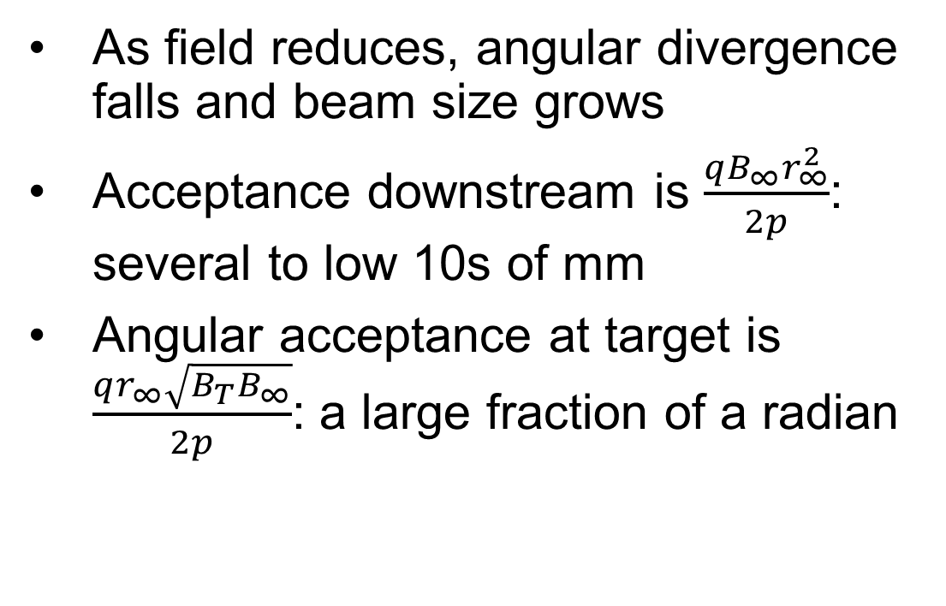
Target and Initial Capture
As field reduces, angular divergence falls and beam size grows
Acceptance downstream is $\frac{qB_{∞}r_{∞}^{2}}{2p}$: several to low 10s of mm
Angular acceptance at target is $\frac{qr_{∞}\sqrt{B_{T}B_{∞}}}{2p}$: a large fraction of a radian

Slide 4
Capture of Bunch Train
Beam develops a time-energy correlation as it travels down the beamline
RF cavities form bunches
Adjust RF
frequencies to give
bunches similar
energies
Works for both
muon signs

Slide 5
Ionization Cooling Physics
Pass through material, reduce energy, longitudinal and transverse momentum
  This is the non-conservative process that cools
Restore energy (longitudinal momentum) via an RF cavity without changing transverse momentum so we can repeat
Slope of energy loss w.r.t energy gives cooling/heating
  Positive slope is cooling

Slide 6
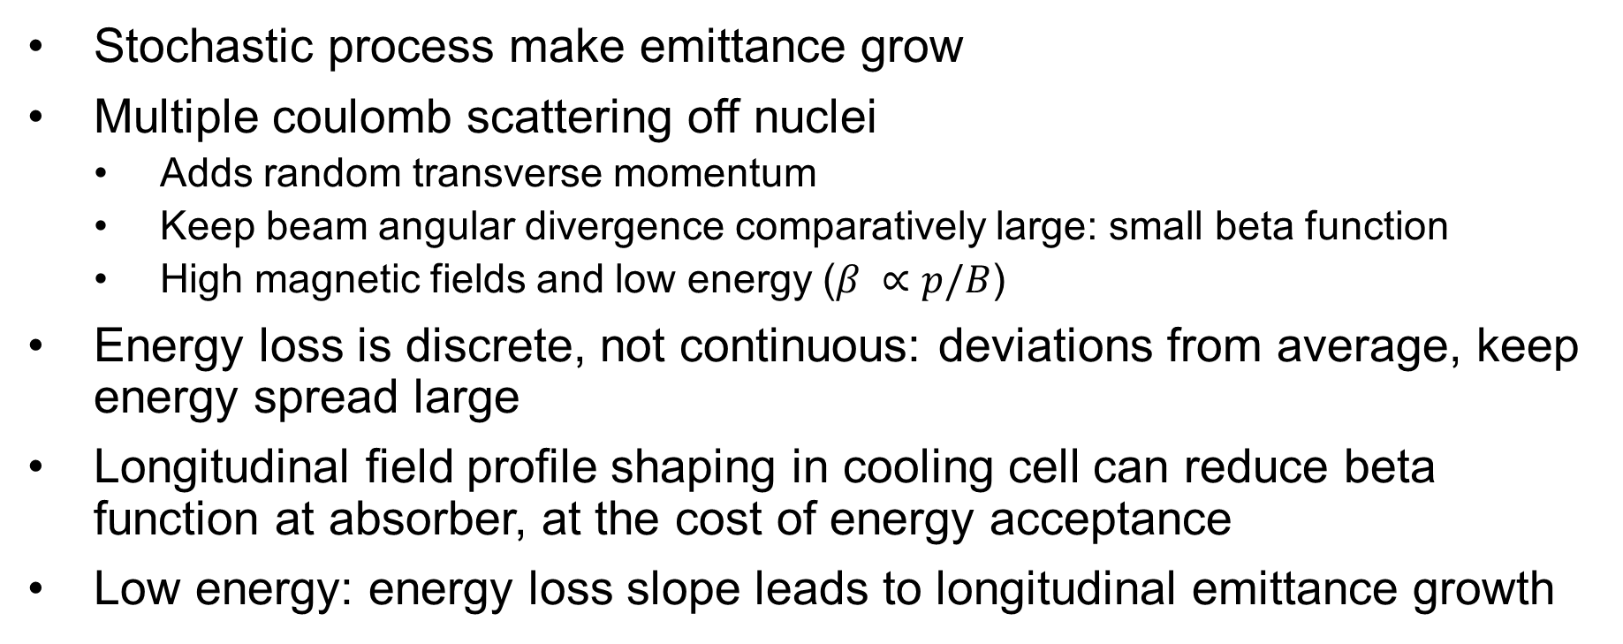
Ionization Cooling Physics
Stochastic process make emittance grow
Multiple coulomb scattering off nuclei
  Adds random transverse momentum
  Keep beam angular divergence comparatively large: small beta function
  High magnetic fields and low energy ($β ∝p/B$)
Energy loss is discrete, not continuous: deviations from average, keep energy spread large
Longitudinal field profile shaping in cooling cell can reduce beta function at absorber, at the cost of energy acceptance
Low energy: energy loss slope leads to longitudinal emittance growth

Slide 7
Ionization Cooling Physics
Fractional transverse emittance reduction is fractional momentum reduction
Give the lost energy back with RF cavities ($$$). Favors low energy to keep relative change high. Typically run just below minimum ionizing momentum (~ 200 MeV/c)
Achieve longitudinal emittance reduction by coupling longitudinal motion with transverse motion
  Transverse bending fields
  Absorbers with thickness depending varying linearly with transverse position

Slide 8
Cooling Overview
Capture and initial cooling: train of ~21 bunches
6-D rectilinear cooling
  Prepare for bunch merge
Combine 21 bunches into 1
6-D rectilinear cooling
Final cooling

Slide 9
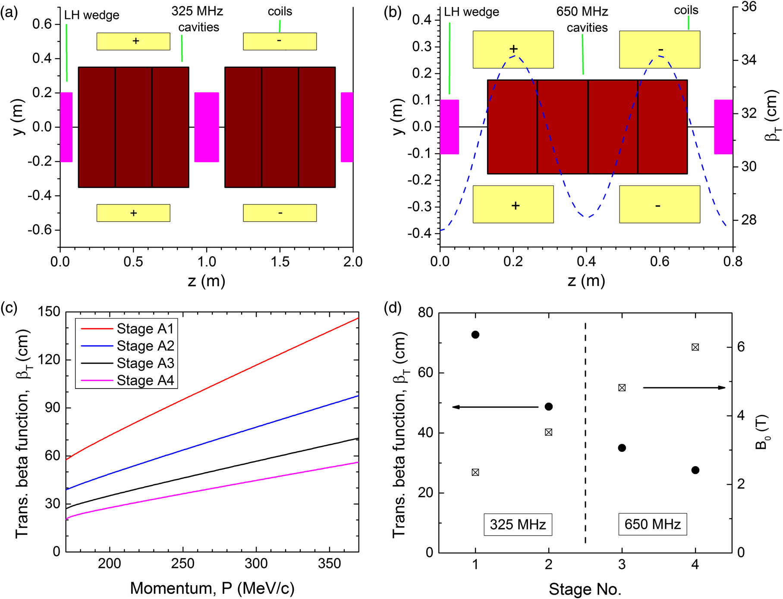
6-D Cooling of Bunch Train
Cool beam enough to merge
into one bunch
  Merge in longitudinal and
  transverse, so cool both
Absorbers alternating with
RF cavities, surrounded by
focusing solenoids
Solenoid field varies
longitudinally: lower beta
function than uniform solenoid

Slide 10
6-D Cooling of Bunch Train
As emittances reduce,
progressively modify cells
Reduce beta function
  Keep angular spread constant
  Higher magnetic fields
  Shorter cells
Increase RF frequency
  Keep energy spread high
Adiabatic

Slide 11
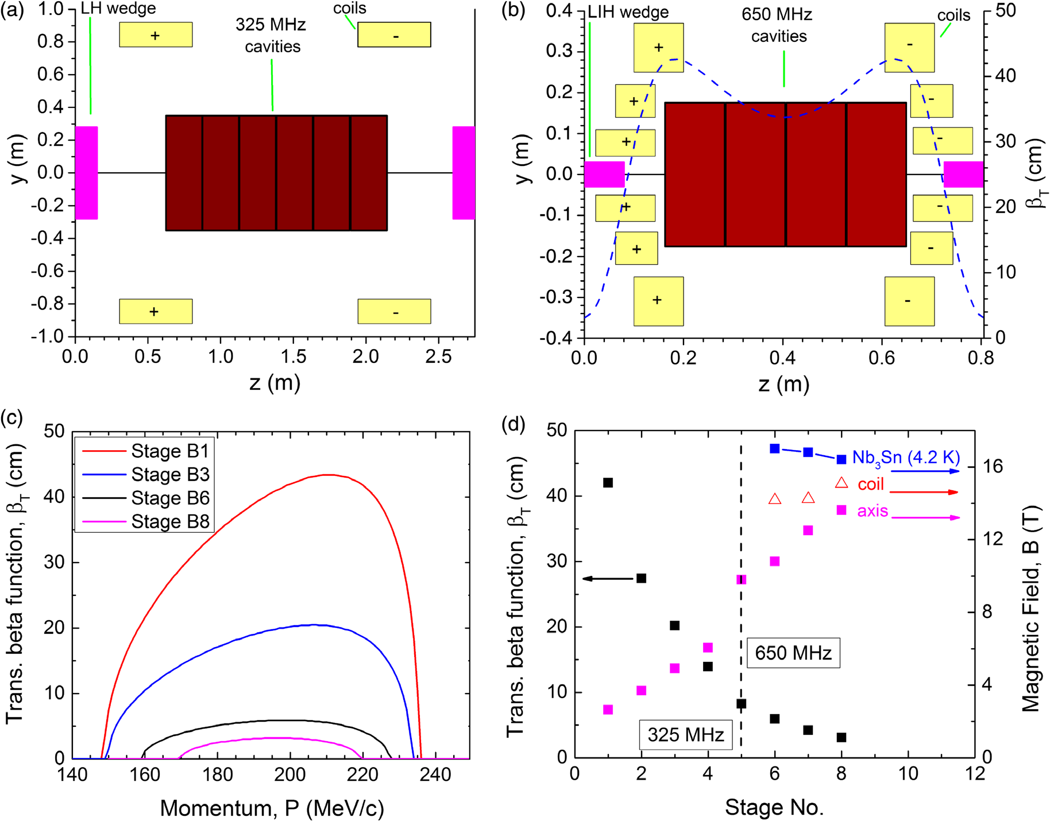
6-D Cooling of Merged Bunch
Get lowest transverse emittance possible
Lower beta functions than pre-merge
  Higher magnetic fields
  Stronger longitudinal variation of fields
  Reduced energy acceptance
Progressive changes in beta, field, length like before

Slide 12
6-D Cooling of Merged Bunch
Late stages very challenging
  High fields
  Proximity of magnets to each other and to RF cavities
Reaches a performance limit
  Achievable magnetic field
  Energy acceptance (energy straggling)
  Transverse acceptance falling faster than emittance
  Intensity-dependent effects

Slide 13
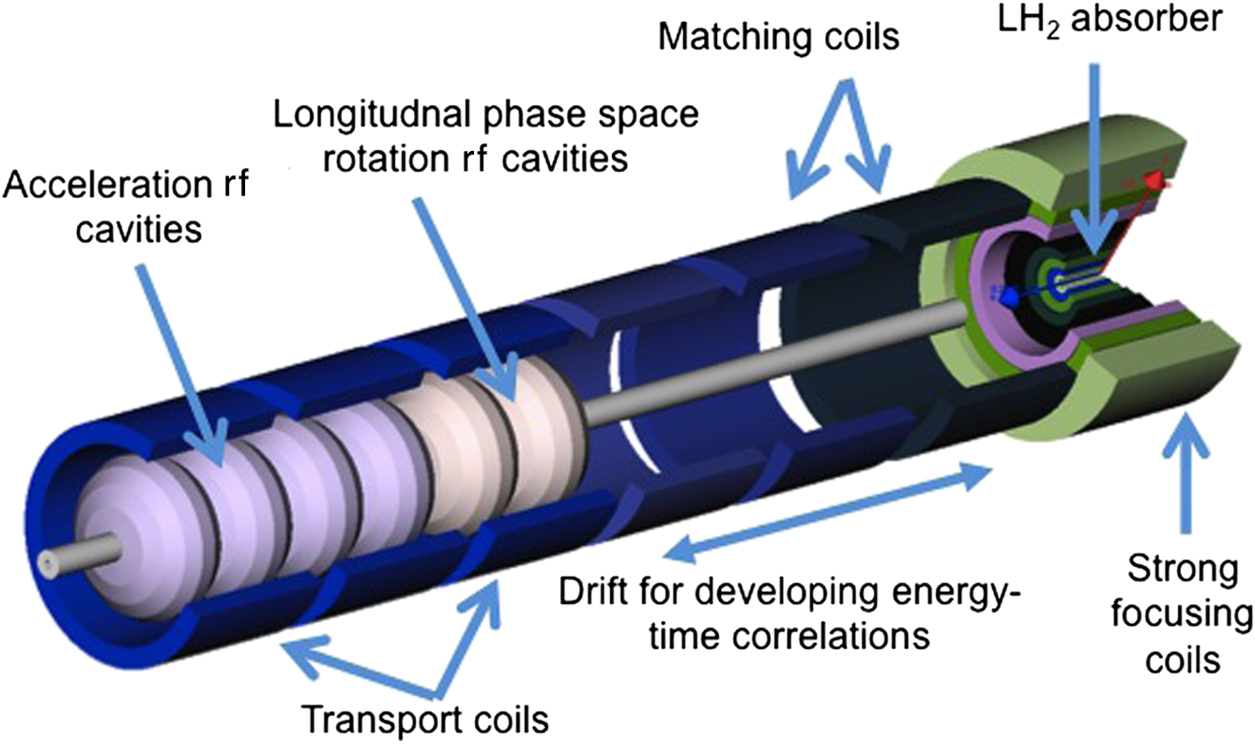
Final Cooling
Switch to cooling in a uniform, very high field
solenoid
Non-adiabatic: significant amount of cooling before
reacceleration
  Difficult beam dynamics
Allow energy to drop, solenoid effectively
stronger
  Longitudinal emittance growth from slope of
  Bethe-Bloch curve
Forced to lower RF frequencies

Slide 14
My Naïve, Possibly Wrong, View of Where AI would be Beneficial
Replace time-consuming calculations with a reasonably accurate model
Model/optimize a system with many parameters that have complex interdependencies
Need to generate training data from real calculations/simulations

Slide 15
Global Front End Optimization
Many pieces optimized individually assuming input from prior stage
  Proton bunch length, target parameters
  Target taper
  Selection chicane, absorber placement
  Decay drift
  Buncher, phase rotation (done separately, should be together)
Design of one stage depends on what it got sent from the previous and needs to send to the next
Everything needs to work together to get optimum for the system

Slide 16
Surrogate Model From Solenoid Layout to Cooling Performance
Parameters as input
  Magnets: solenoid and dipole geometry, current
  RF voltage
Output is relevant cooling performance
  Equilibrium emittance and acceptance
  Transmission
Beam characteristics (longitudinal and transverse beta functions)
Develop a surrogate model for that mapping
  Use the model to rapidly design a full channel, incorporating matching

