Slide 1
Machine Learning for
Muon Collider Target Design
Virtual prototyping and Design Optimization of Future Multi-Megawatt Target System
June 29, 2026
Katsuya Yonehara
USMCC AI/ML meeting

Slide 2
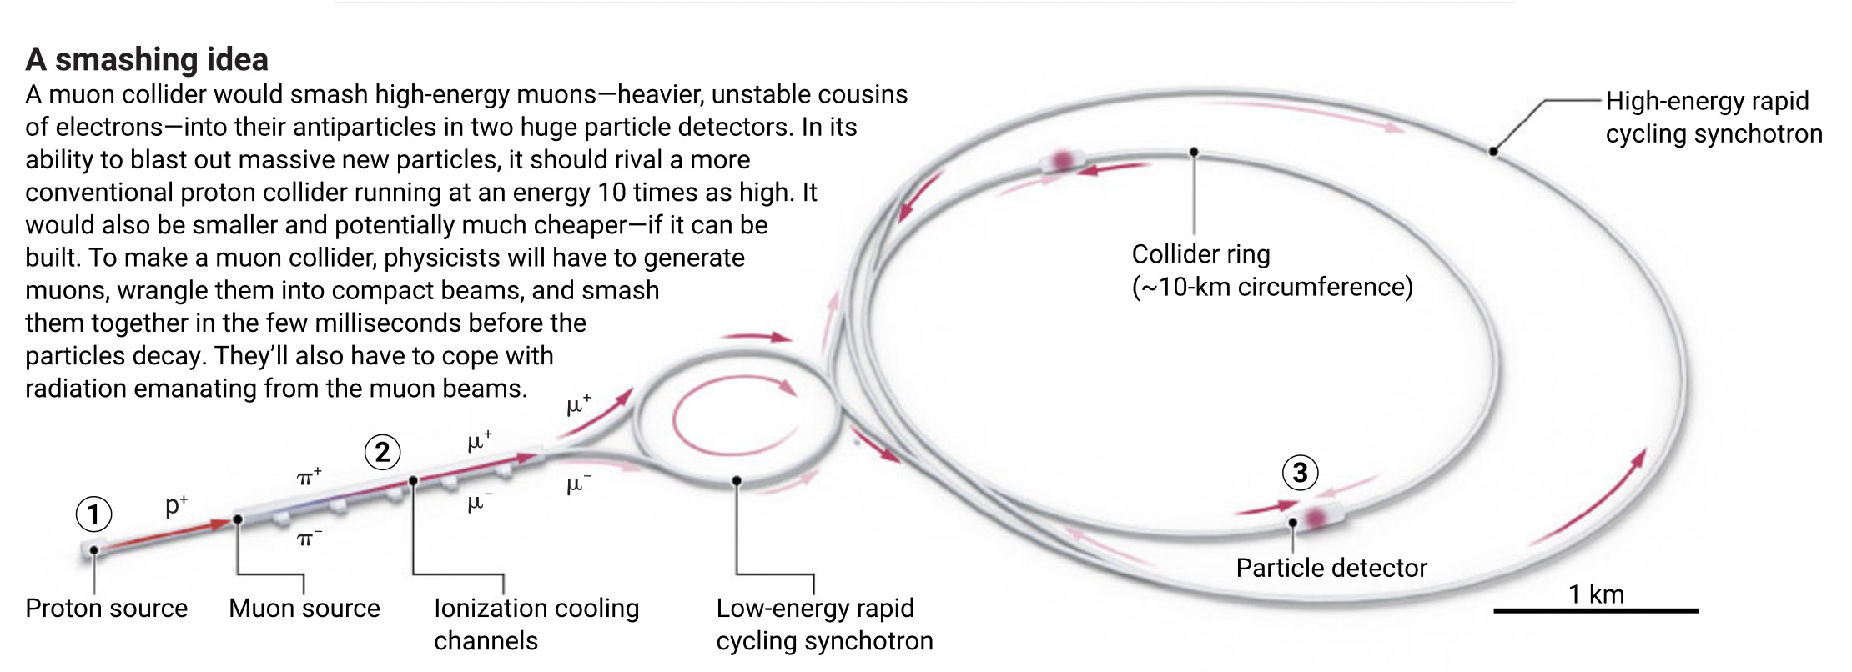
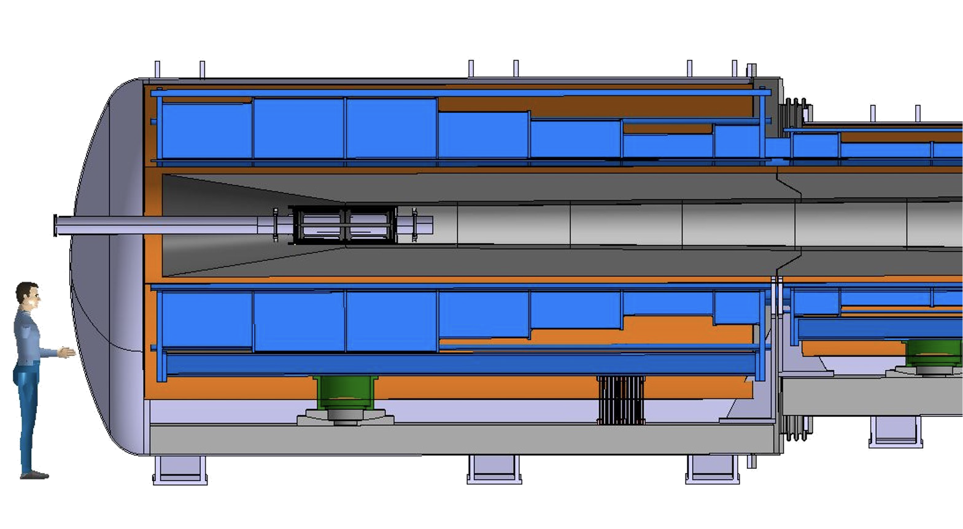
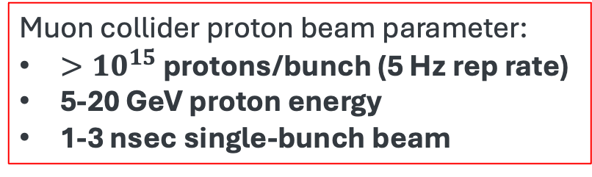
Layout of Muon Collider Accelerator Complex
Muon collider proton beam parameter:
$>{10}^{15}$ protons/bunch (5 Hz rep rate)
5-20 GeV proton energy
1-3 nsec single-bunch beam
Beam direction
No facility currently exists for full-scale experimental validation of the MC target system

Slide 3
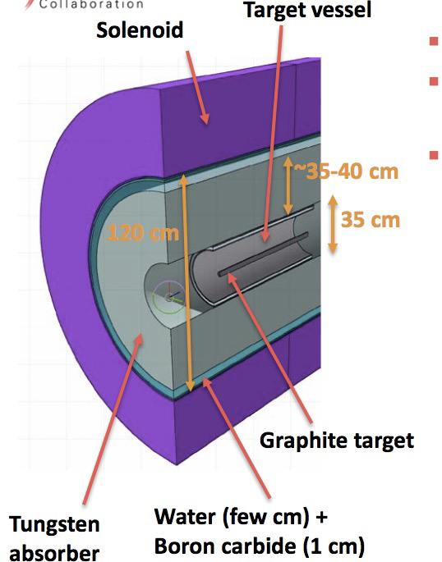
Conceptual Design of MC Target Station
Proposed by IMCC
Tungsten absorber
to reduce radiation load on the SC magnet
50-cm long graphite target
for pion production
20-T Superconducting solenoid
for pion capture
Tapered solenoid
for pion/muon transport and matching

Slide 4

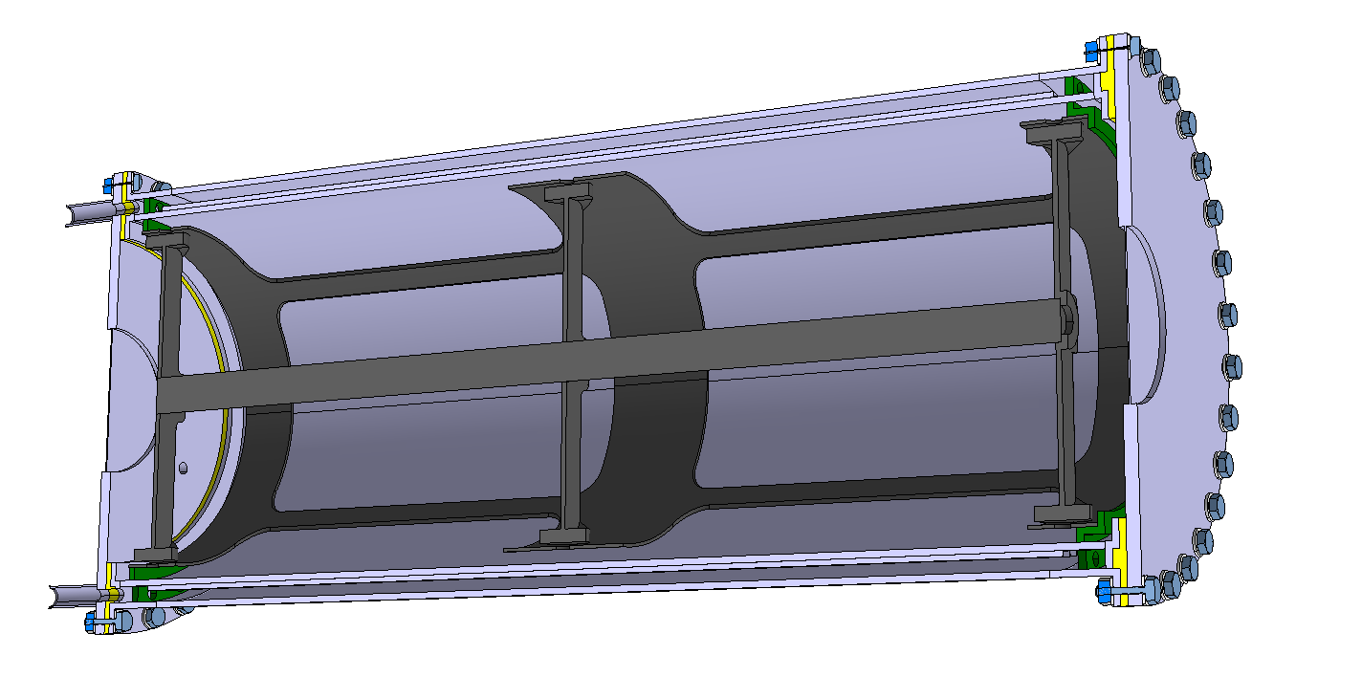
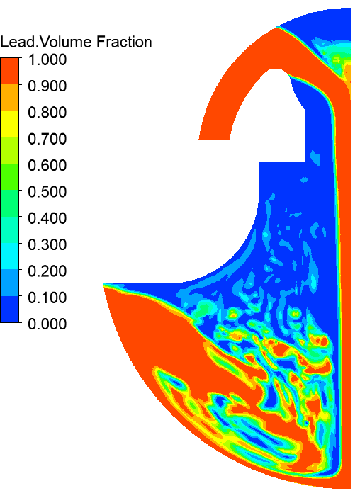
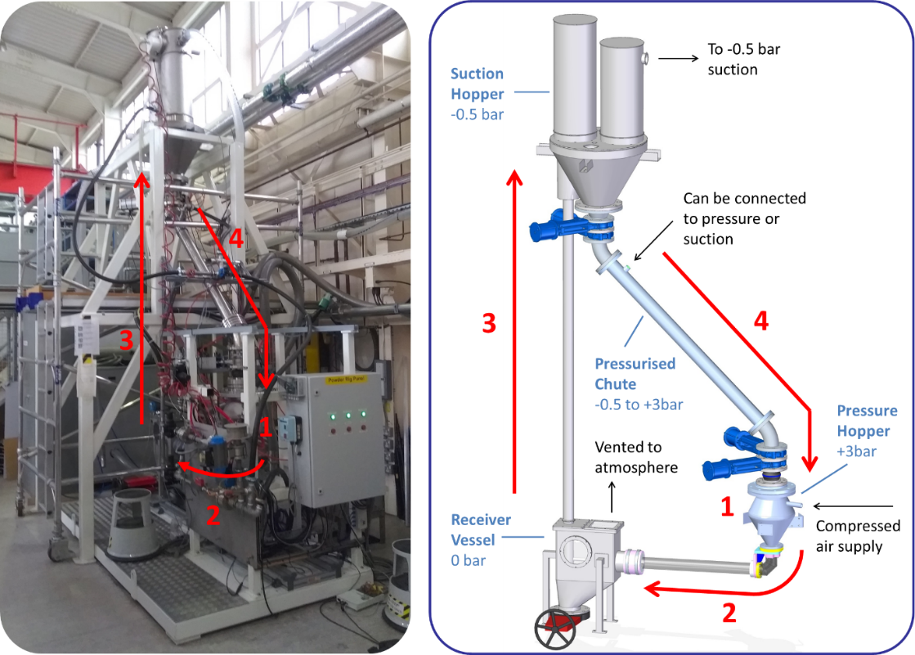
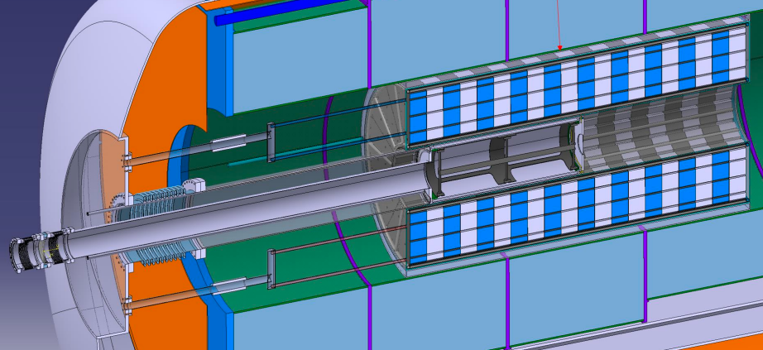
Candidate Target Concepts
R. Franqueira, NuFACT‘25
Multiple international collaborations are exploring complementary target concepts for future muon collider facilities
C-Target & target system
CERN
Liquid Pb Target
ENEA & CERN
Fluidized W-Target
RAL & Warwick Uni.
S. Cândido, R. F. Ximenes, M. Calviani, D. Calzolari, A. Lechner, F. Saura, J. Manczak, G. Lerner, C. Mucher
C. Carrelli, L. Tricarico, M. Tarantino, I.Di Piazza, P.C. Puviani, et al.
B. Suitters, C. Densham, J.J. Back, W. Bishop, D. Wilcox, et al.

Slide 5
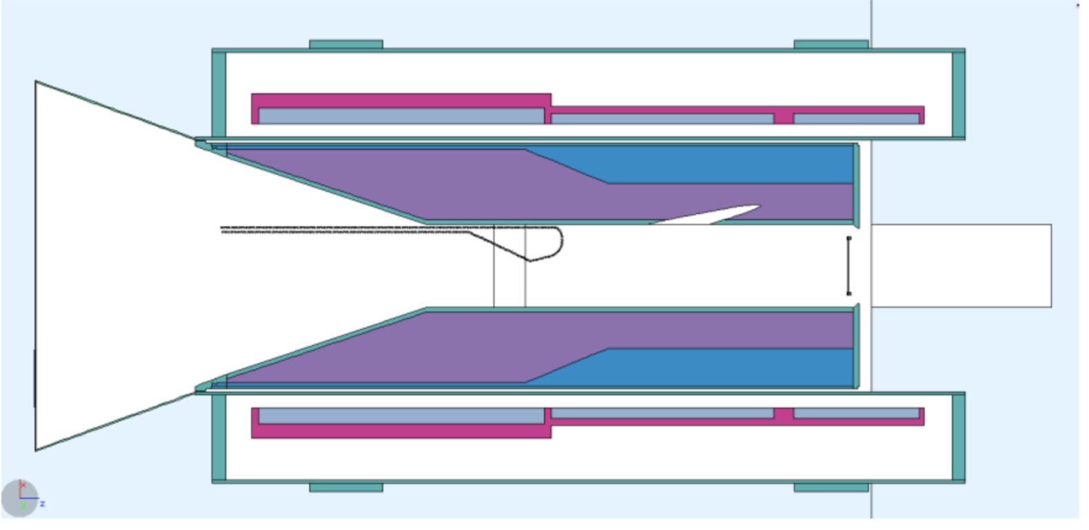
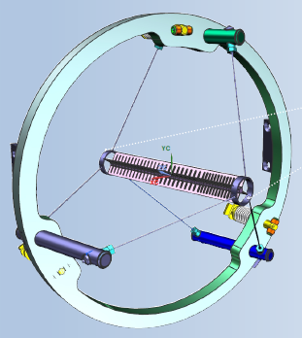
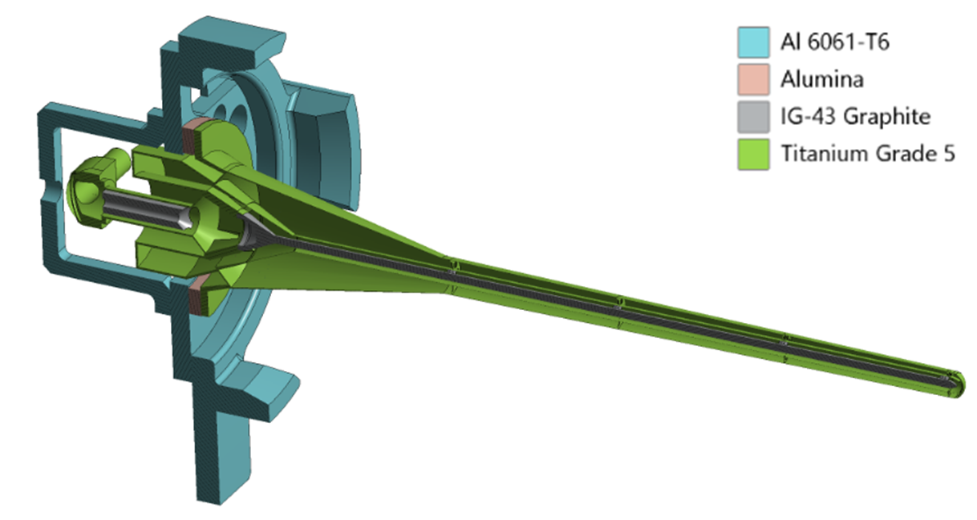
Evolution of HEP High-Power Targetry Challenges
X 2.5
MC Target concept
2-4MW in target at 8 GeV
120 GeV 2.4 MW LBNF Target
X 140
Candidate Mu2e-II Target core C, W, WC, SiC, etc, ~ 10 mm x 200 mm
100 kW in target at 800 MeV
Mu2e Target core Tungsten
6.3 mm x 220 m
700 W in target at 8 GeV
LBNF Target core Graphite
16 mm x 1.5 m
25kW in target at 120 GeV
Higher power density = Greater engineering and material challenges
p
Conveyor target
Mu2e target
High-Z w/o active cooling
Target in Solenoid magnet
LBNF graphite target
MW operations
Mu2e-II target system
High power operations
Notes:
Generation after generation, the beam power increase and the energy decrease, leading to more and more power density deposited in material.
The different targets are presented with the same scale so you can compare the size from one to another design.

Slide 6
Why is Machine Learning Crucial for Muon Collider Target Design?
No existing beam facility can reproduce the Muon Collider proton beam conditions required for full-scale target testing
Constructing and experimentally validating a dedicated Muon Collider target facility would be prohibitively expensive and involve substantial technical and financial risks
High-performance computing enables high-fidelity Multiphysics simulations, while ML accelerates design exploration, performance prediction, and optimization of target configurations
Muon Collider target design is an excellent use case for the Genesis Mission framework: combining HPC, high-fidelity multiphysics simulations, emulator, and AI-driven optimization

Slide 7
Potential ML Applications for MC Target Systems
Target design is inherently a multi-objective optimization problem
Materials
  Radiation damage prediction
  Material screening of novel target materials
  Inference of thermo-mechanical properties
  Uncertainty quantification for material performance
Design Optimization
  Optimize target material and geometry
  Optimize proton beam parameters and capture/transport magnet configurations
  Maximize pion/muon production
  Minimize energy deposition and thermal stress
Drew will present ML applications for the SNS target system.

Slide 8
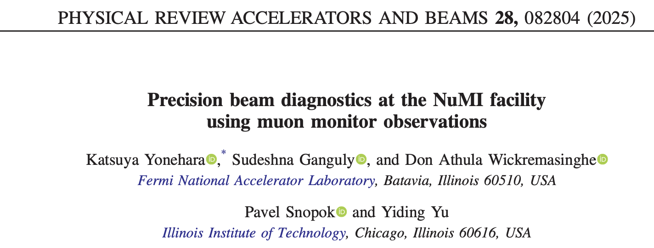
Potential Applications of ML for MC Target Systems
Demonstrated at the NuMI target system
Operational and Lifetime Applications
  Real-time prediction of target performance
  Emulator for beam-target monitoring & control
  Beam tuning, feedback, and autonomous control
  Real-time anomaly detection and fault diagnosis
  Predict remaining useful life of targets and capture magnets
  Reinforcement learning for autonomous operation and optimization
Machine Learning enables virtual prototyping, intelligent operation, and predictive lifetime management throughout the life cycle of Muon Collider Target Systems

Slide 9
Conclusion
Machine Learning, combined with HPC and high-fidelity multi-physics simulations, provides a practical framework for designing and optimizing future Muon Collider target systems
Benchmark simulations and experimental measurements remain essential for validating ML models and optimization results
Realizing this vision will require close collaboration among the target, accelerator, materials science, HPC, and AI communities, together with sustained investment in computing infrastructure, AI development, and experimental validation
  The Muon Collider target program is an ideal application for future DOE initiatives that integrate AI, HPC, and multi-physics simulations, such as the Genesis Mission vision

