Slide 1
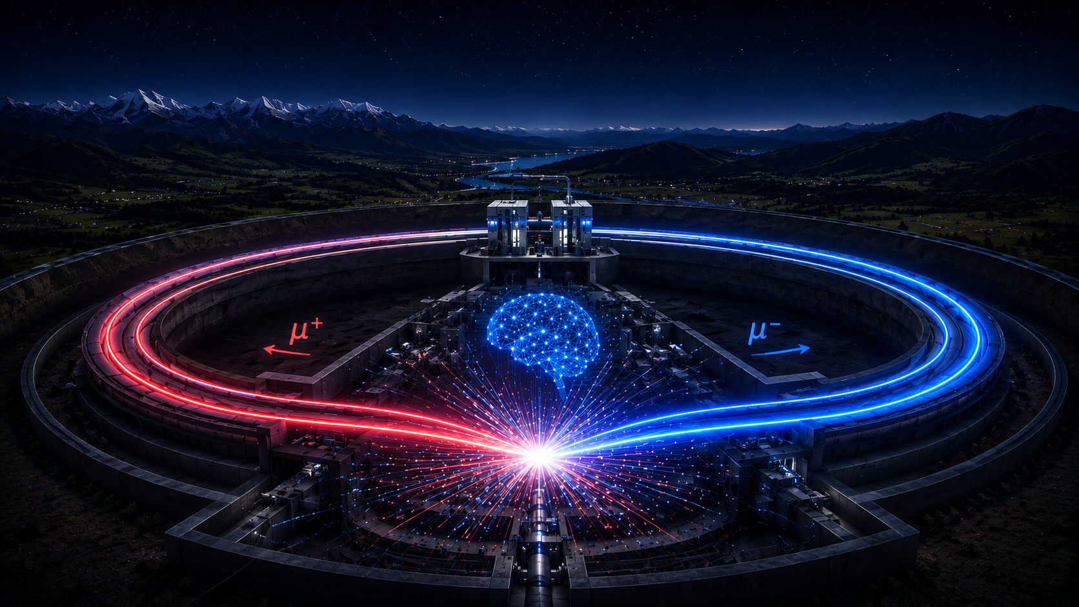

Example: Agents for Software
G. Watts (UW/Seattle)
2026-06-30

Slide 2
Classifying The Landscape
Models We Build Ourselves
Frontier Level Large Language Models
Event Selection & Classification
ML based Reconstruction
Generative Models for Simulation
Fast ML for Trigger
Calibration
Anomaly detection (operations, DQ, analysis)
Coding Agents/ Assistants, documentation
Agents
(AI-native)
We need to think about each category
Different resources, usage, rate of evolution, etc.
Different effects on the collaboration
Interactions with our current tools
Coding agents / LLMs
Information retrieval
Text review, summarization, writing
Agentic workflows
Tool-use
Physics Analysis Automation
Planning, Data Prep, Detectors, etc.

Slide 3
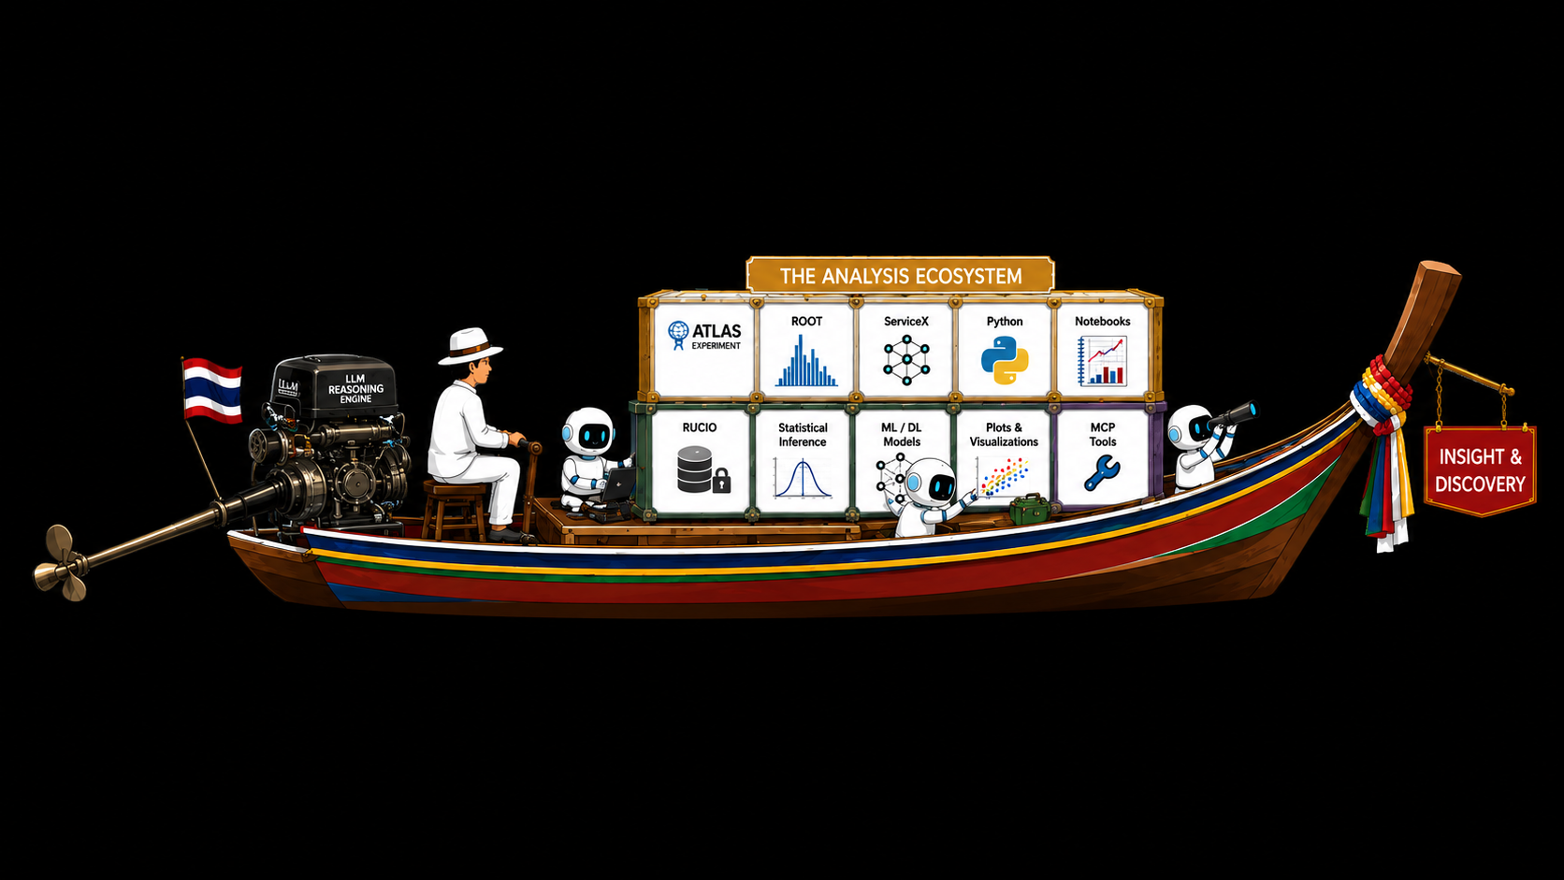
Anatomy Of An Agent
The LLM
The “Agent”

Slide 4

How Good Is The Engine?
What we want: a Plot!
Plot the
reconstructed top quark pair mass
in events
with one charged lepton
in the
rucio dataset <z-prime-mc-3000-gev>
What to plot: $m_{t\overline{t}}$
Final State Topology: semi-leptonic
In What Data: ATLAS Open Data
(actual rucio did here)

Slide 5


How Good Is The Engine?
What we want: a Plot!
What to plot: $m_{t\overline{t}}$
One top decays to all-jets
Second semi-leptonically
Event Selection Cuts
Deal with jet combinatorics
Deal with neutrino $p_{z}$ ambiguity
Final State Topology: semi-leptonic
In What Data: ATLAS Open Data
(actual rucio did here)

Slide 6
Hint Text
ServiceX
Different hint files for different workflows…
Different prompts for different tasks
Awkward Array
Prompt
Question
Large Language Model
Vector
Hist
Same for all questions
ATLAS xAOD Data

Slide 7
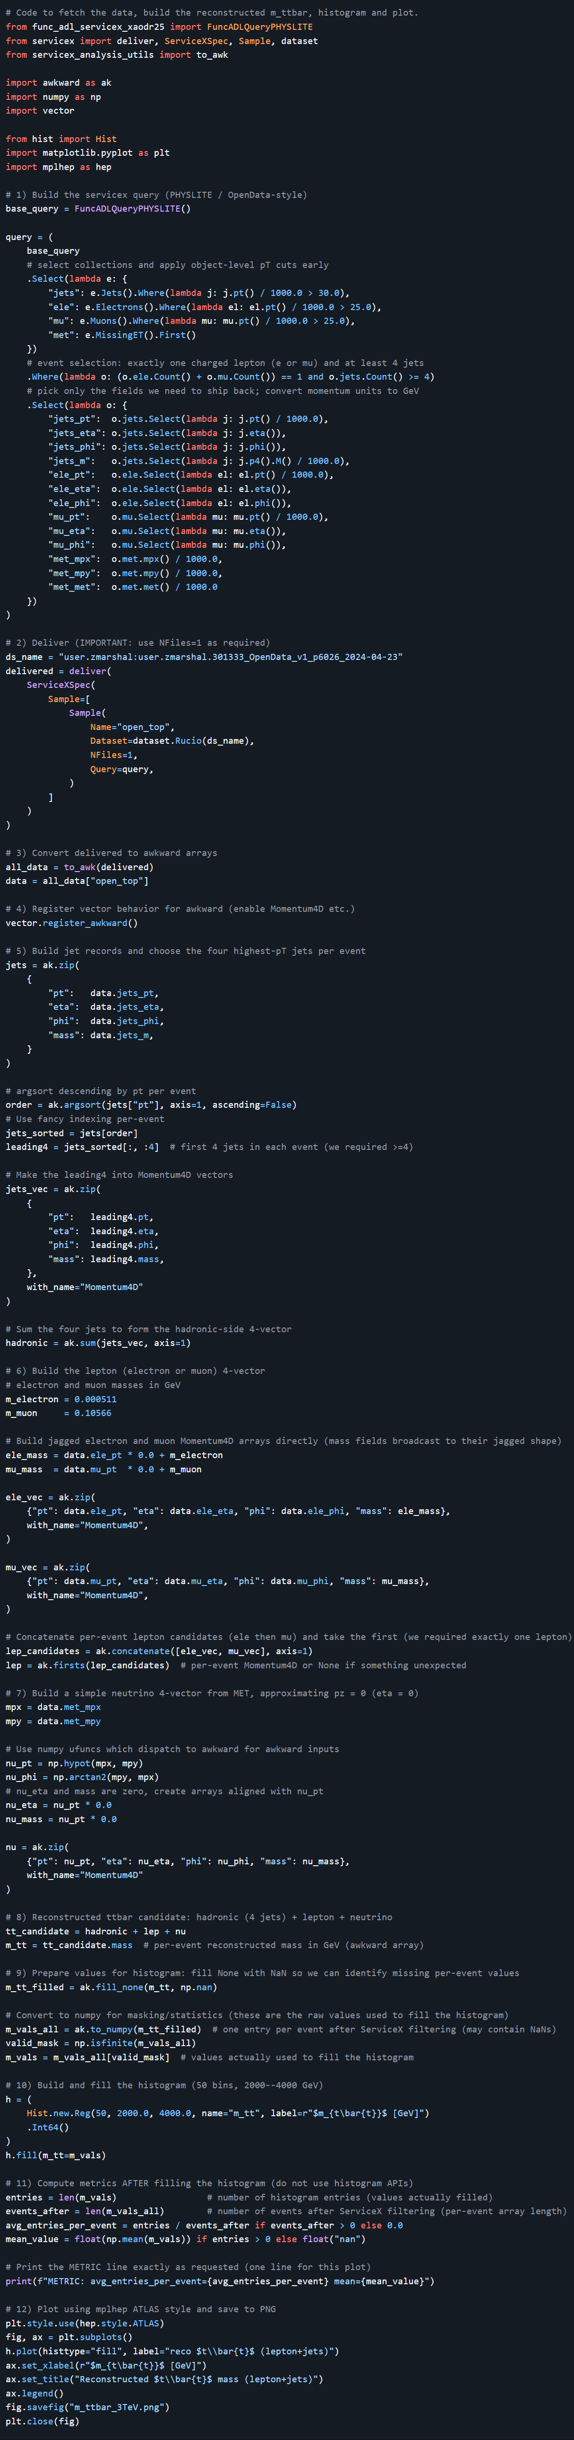
How Good Is The Engine?
Full Code Here

Slide 8
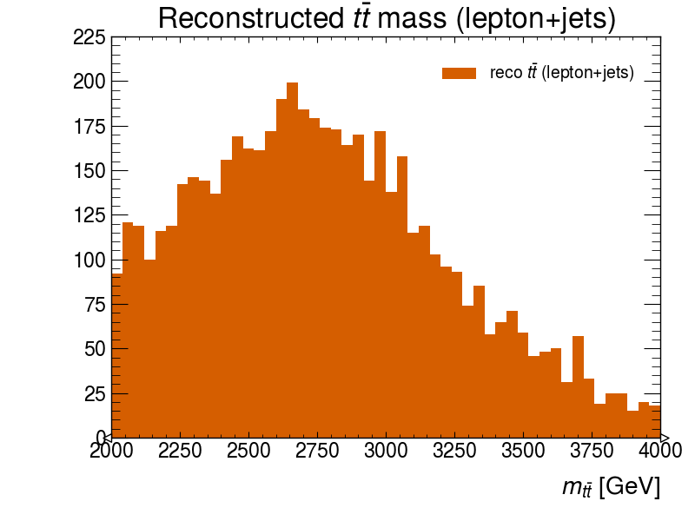
How Good Is The Engine?
Plot the reconstructed top quark pair mass in events with one charged lepton in the rucio dataset <z-prime-mc-3000-gev>

Slide 9
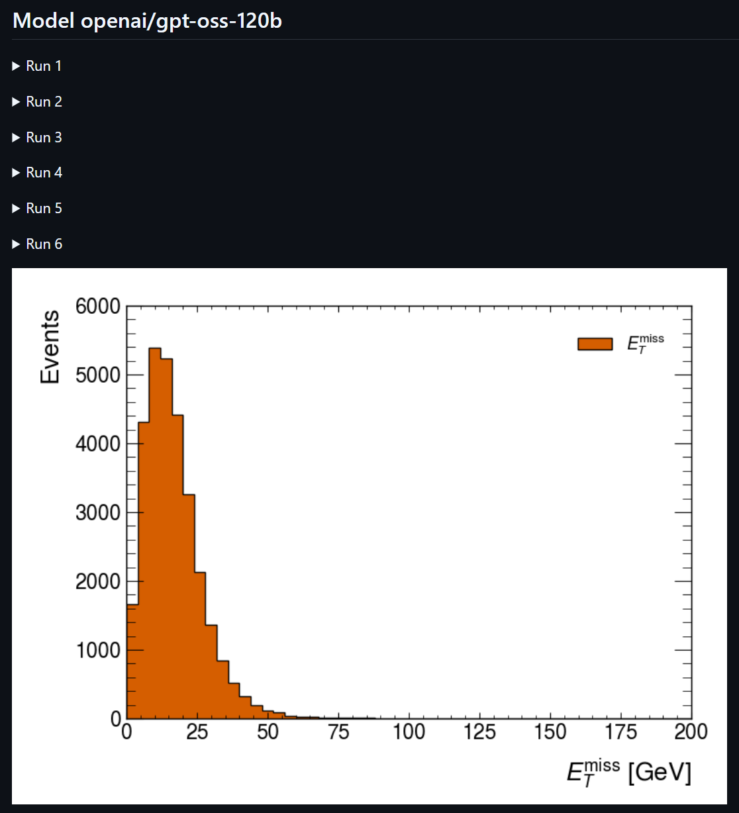
Prompt + Question + Hint files
“Agentic” Harness
Fix It Prompt is very similar to first prompt
  Includes old code
  stderr, stdout
Automatic Iterations are allowed up to some limit
LLM
Fix It Prompt + Question + Hint files + Previous Version of Code
Run Code
(in docker)
Took 6 tries on Q1!!!
Did Code Fail?
Y

Slide 10
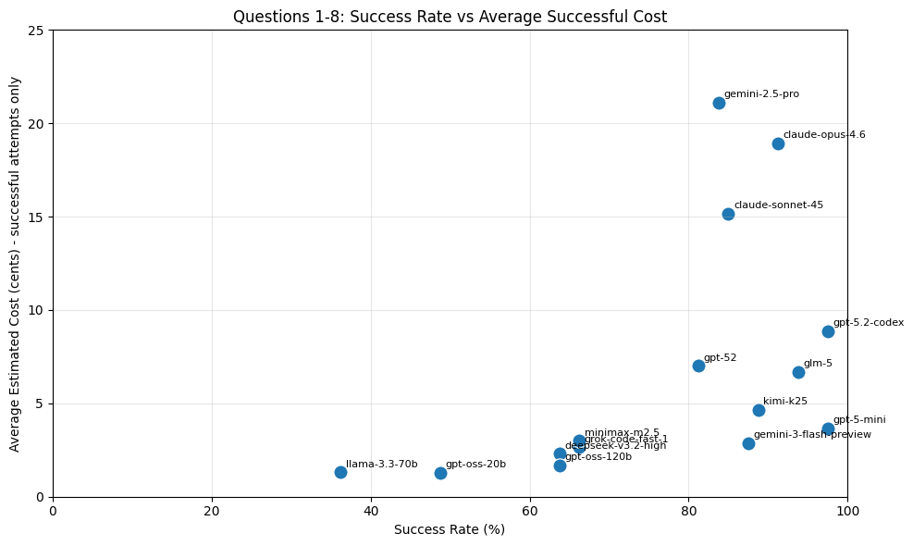
What Can Agents Do?
Full Information

Slide 11
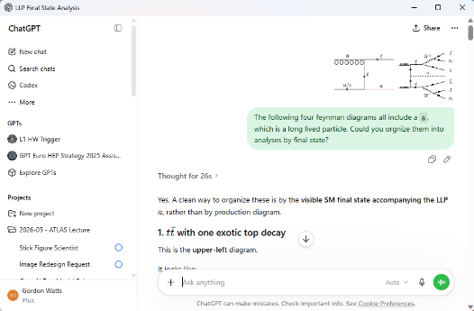
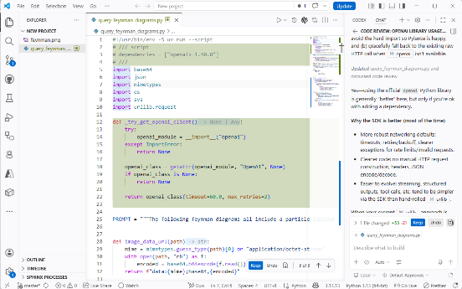
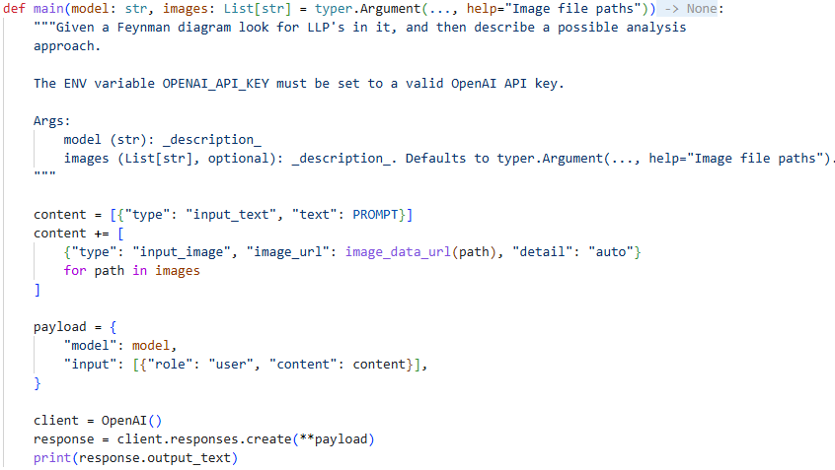
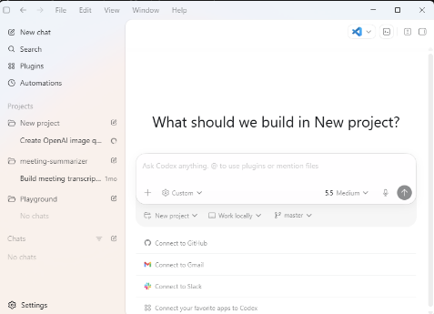
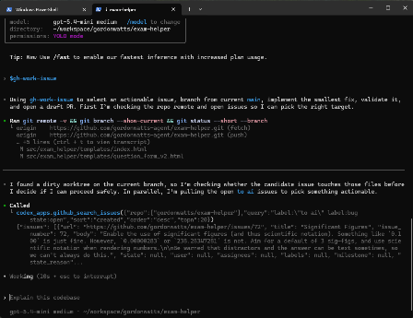
How Agents/LLM’s Are Currently Being Used…
Web/App Based Chat
IDE Integration (vscode)
Direct API access in Python
App Agentic Harness (codex/code)
CLI Agentic Harness (codex/code)

Slide 12
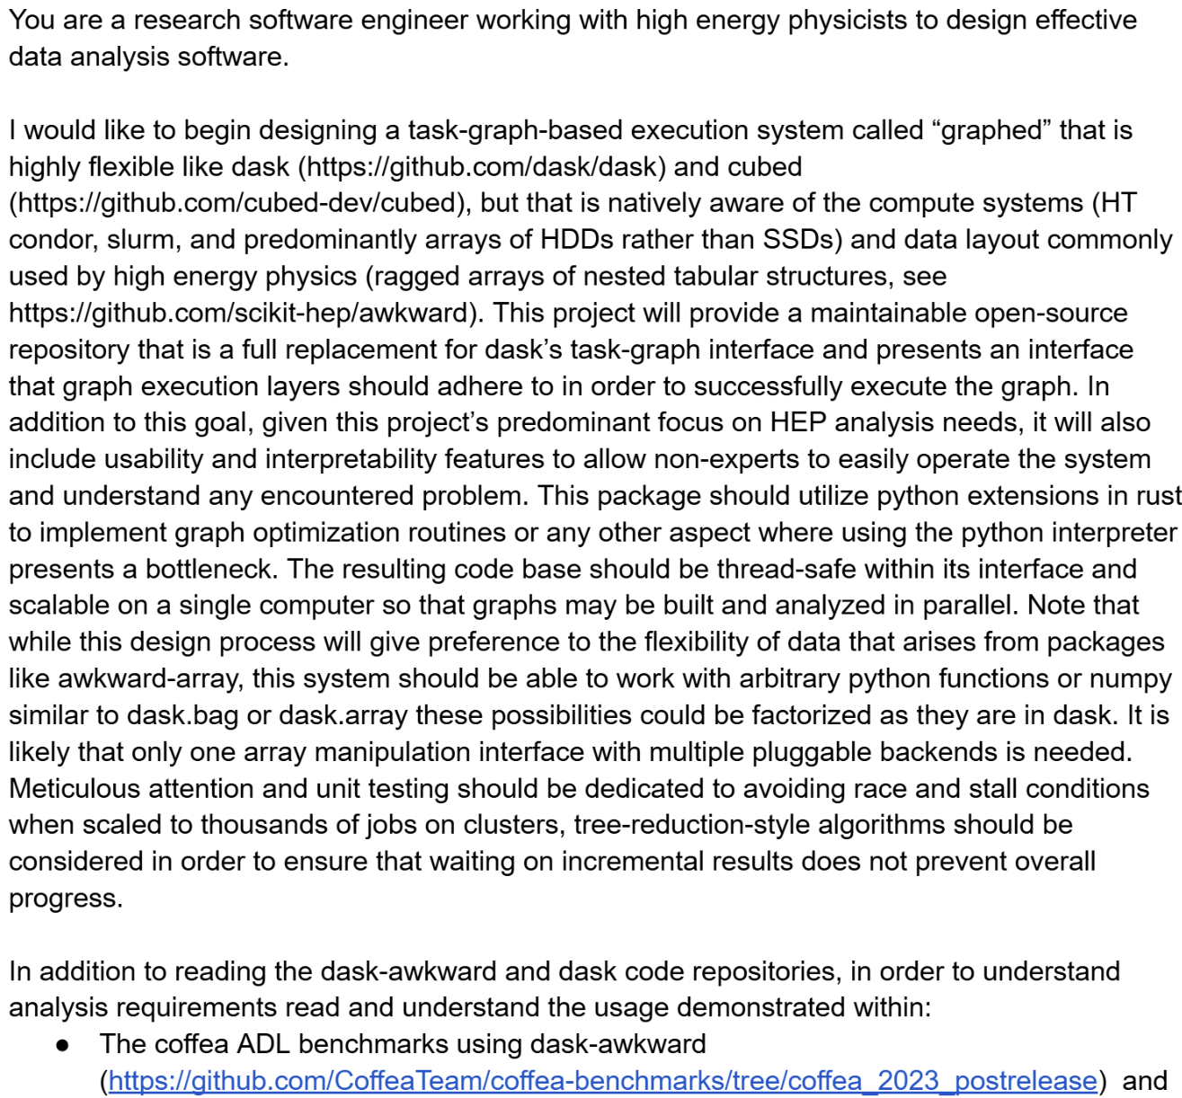
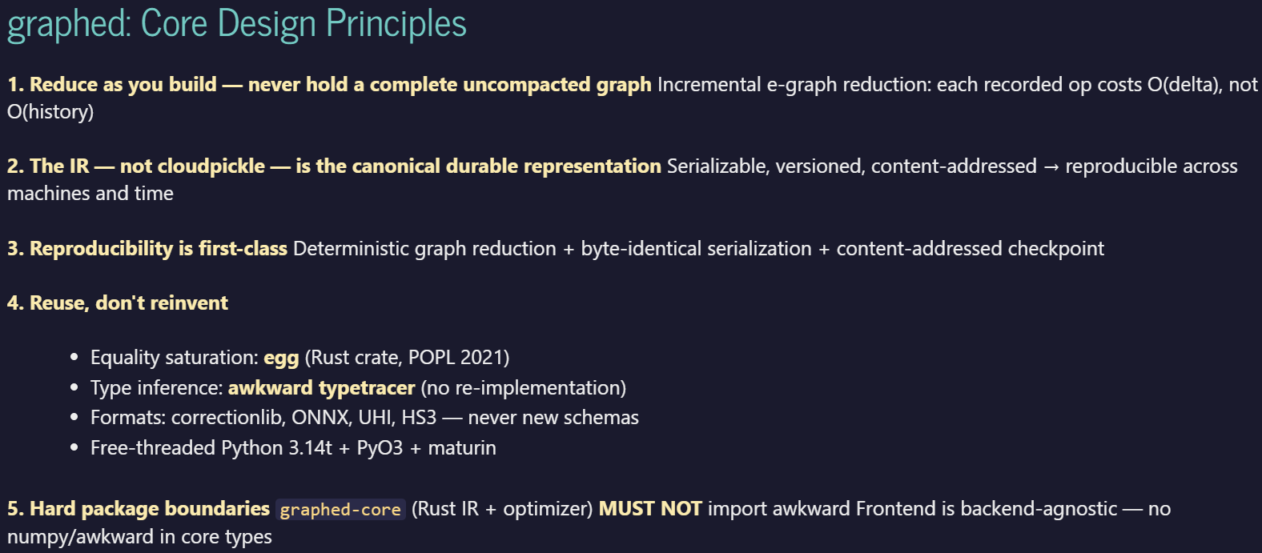
Where We Are Headed?
Lindsey Gray (Fermilab):
Needed an efficient way to build DAG
For scale of a full physics analysis w/systematics
Frustrated with Open-Source solutions
Wrote a 4-page description of what he wanted
Claude Code Delivered:
Used up a month’s of a $20 credit and cost an extra $90 USD
Generated a minimal functional product (needs further work) – outcome not decided…
Repo of the code (written with tests)
And then wrote a talk to describe its work
“Coding by spec”

Slide 13
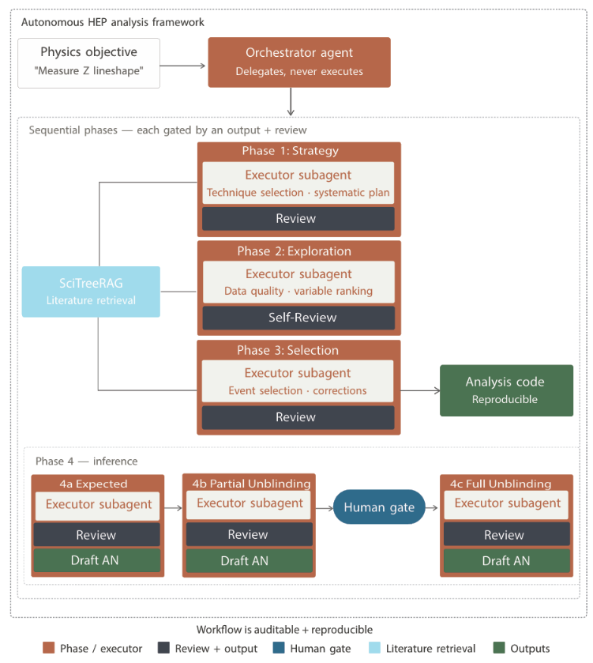
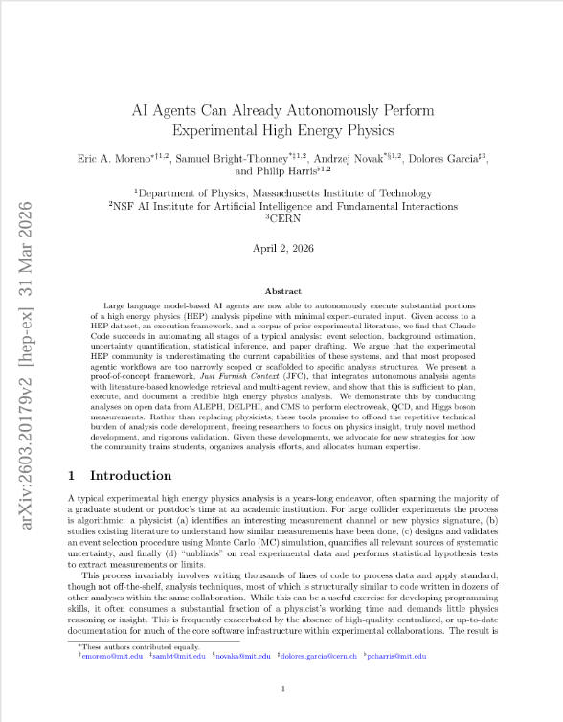
Could we do a physics analysis like this?
arxiv
The appendix of this paper as lengthy prompts describing ~8 different analyses…
The framework gets them done…
They aren’t publication quality yet…

Slide 14
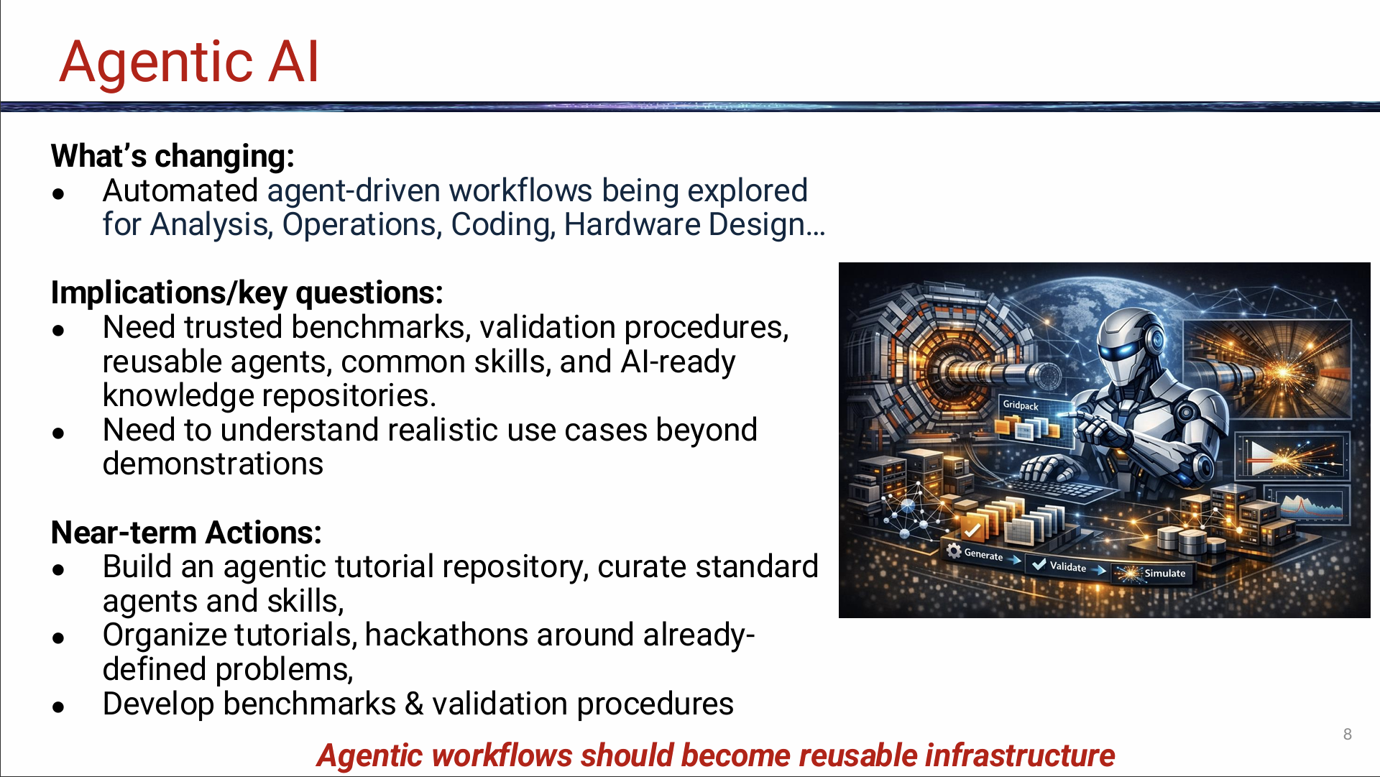
From Bose/Elmer talk this morning…

Slide 15
Making Agents More Powerful…
AI-ready
AI-native
Bridge between the more traditional world and Agents
Making interfaces and API’s easily consumable by LLMs
  LLM’s ask different questions than we code an API too
LLM’s do inject some randomness
  Important sequences should be encoded for use by a LLM.
Expose to a LLM via MCP or command line
Build facilities able to run agents in an experiment’s set environment
System designed from the ground up to work with LLMs.
Analysis System, Detector and Accelerator Aids (and maybe controls)
Requires trust, benchmarks
A lot more potential benefit…
… a lot more risk
Should help automate processes…
… even without Agents

Slide 16
Food For Thought…
LLM’s and Agents must now be taken seriously
Capable of contributing to:
  Complex software development
  Physics Analysis
  With the right guidance
Guidance
  This is where the real intellectual effort will be invested in the next year
  How do we put together will vary depending on the systems we are using
I have glossed over lots of issues
  How does this change a collaboration
  Access for all members of a collaboration
  Trust, Validation, etc.
There are technical solutions to address some of this
  Benchmarks
  Human in the loop
  Local LLM’s for the collaboration
  … But nothing makes them go away entirely
Join CLARIPHY slack (send almost anyone email), joinn #agent-analysis

