Slide 1
Muon Campus Introduction
Muon Collider Demonstrator
February 4, 2026
Jim Morgan

Slide 2
Muon Campus history
Originally the Antiproton Source
  Built 1983-1984, produced and stored antiprotons for the Tevatron collider
  Operated 1985-2011
  Primary beam energy 120 GeV (up to 80 kW), antiproton beam energy 8 GeV
  Target station at AP-0 used lithium lens for focusing
Conversion to the Muon Campus
  Planning and construction 2012-2016
  Reconfigured for the Mu2e Experiment, resonantly extracted 8 GeV protons
  Accumulator Ring decommissioned, many magnets used in new beamlines
  New extraction beamline added to transport beam to Mu2e (MC-2) Building
  Added g-2 Experiment to plan, added MC-1 Building to house Ring
  g-2 Experiment ran 2017-2023, Mu2e Experiment hasn’t received beam yet
Potential site for Muon Collider Demonstrator
  Existing infrastructure, including target station
  8 GeV proton beam from Recycler, possible future 800 MeV H- beam from Linac2 (PIP-II Linac)
Study – M1-M3 Optics
Study – Alternative M5 optics

Slide 3
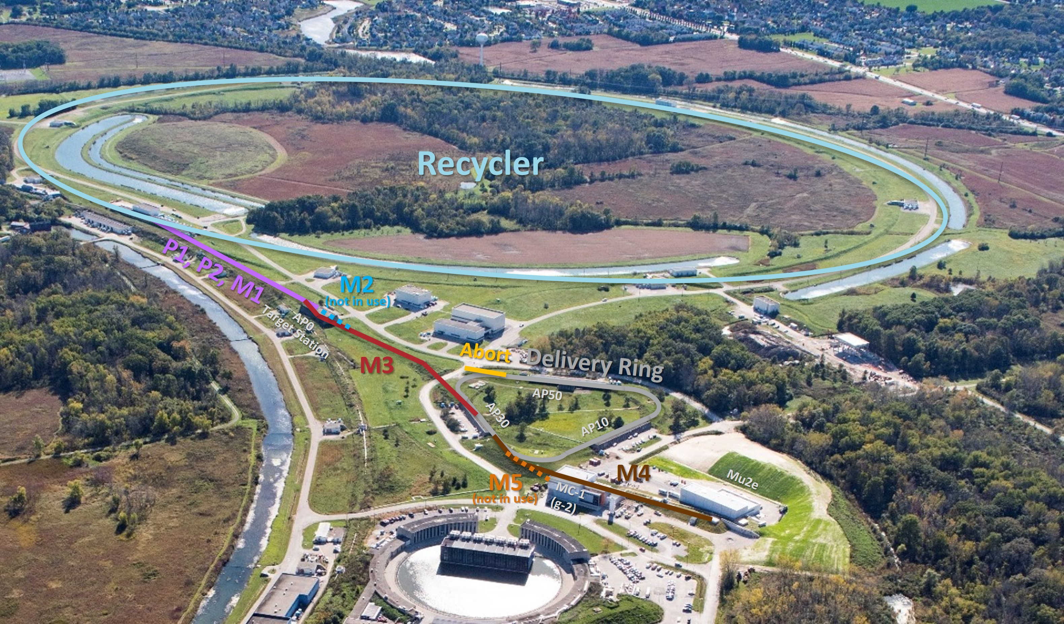
Muon Campus location and beamlines

Slide 4
The Antiproton Source (1985 – 2011)
  A 120 GeV proton beam (84 53 MHz bunches) from the Main Ring/Injector was transported to the Target Station via AP-1 every 2.2 seconds
An 8.89 GeV/c negative secondary beam traveled down AP-2 and was injected into the Debuncher Ring
8 GeV antiprotons were bunch rotated and stochastically cooled in the Debuncher Ring, then transferred to the Accumulator Ring via the D/A line
Antiprotons were accumulated over hours, then transferred to the Main Injector via the AP-3 and AP-1 lines
8 GeV protons could be “reverse injected” or sent in the reciprocal direction of the antiprotons for tune-up

Slide 5
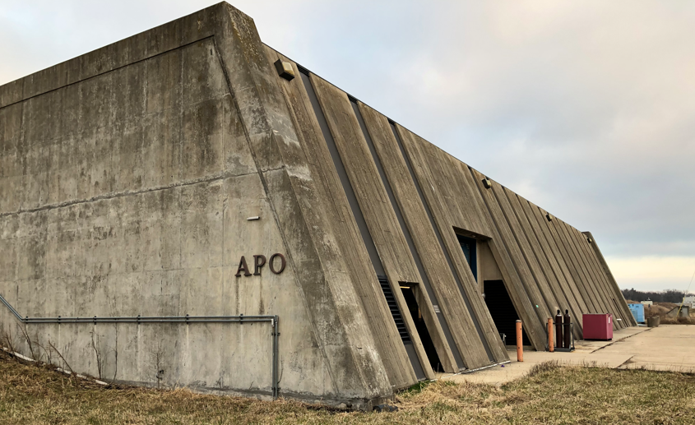
Antiproton Source (and Muon g-2) AP-0 Target Station

Slide 6
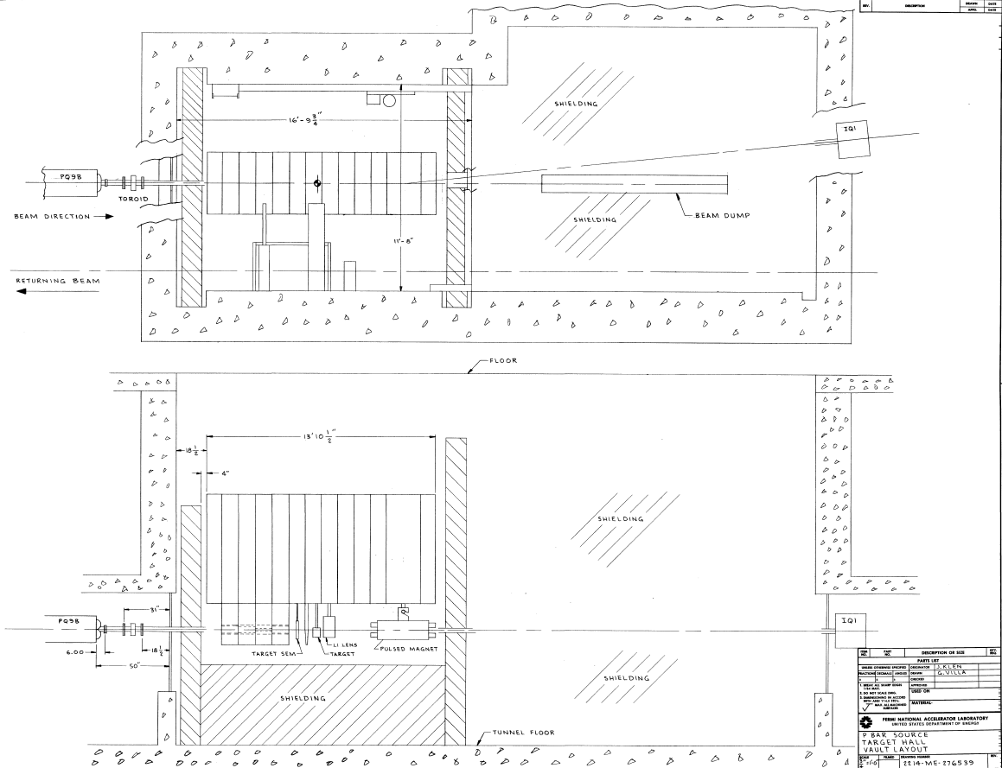
AP-0 Vault

Slide 7
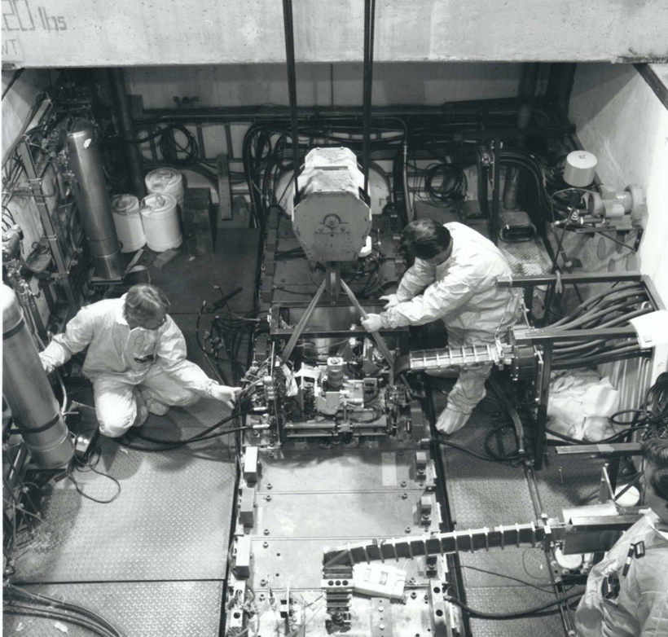
Technicians preparing to lift module from Vault

Slide 8
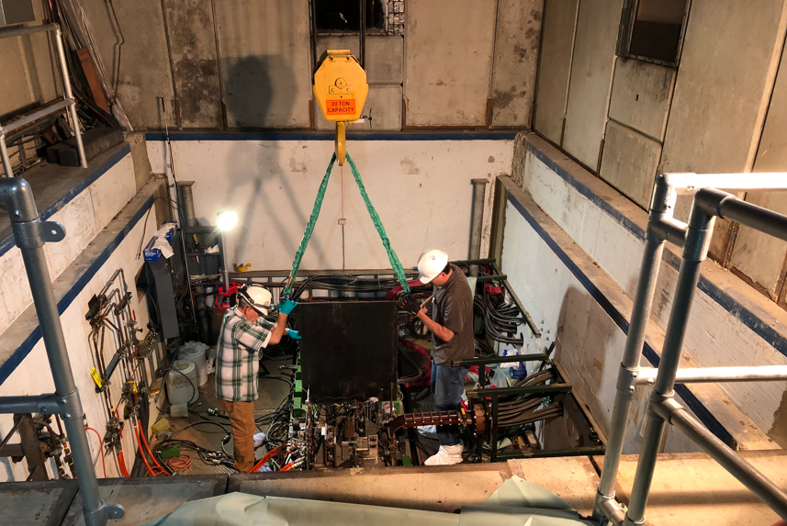
Technicians lifting filler plate from Vault

Slide 9
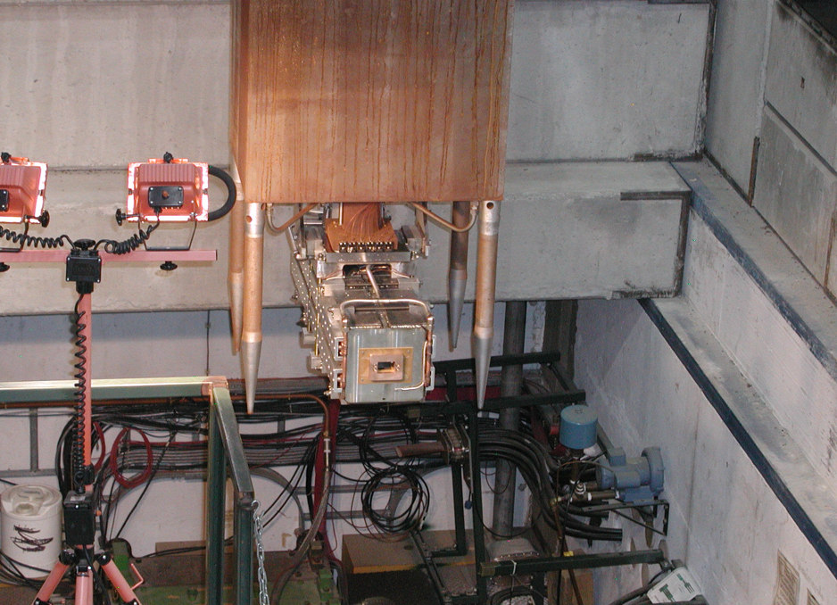
Pulsed magnet being lifted from Vault

Slide 10
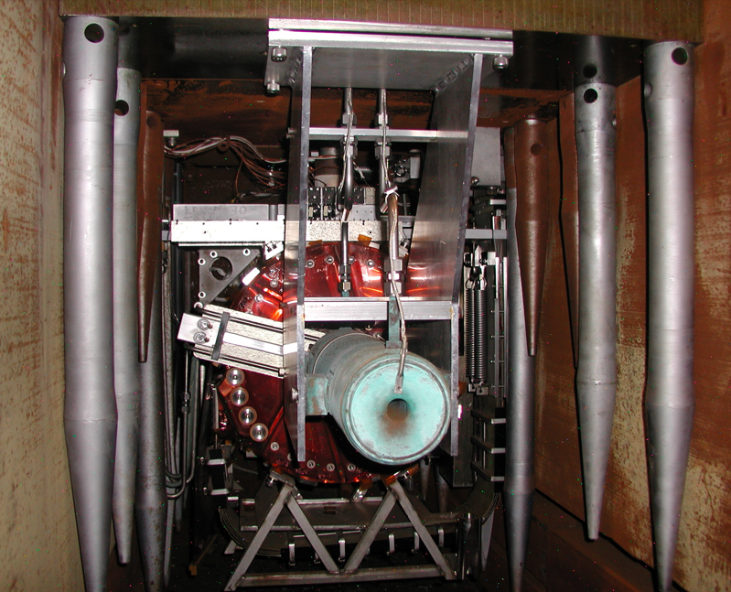
Looking upstream from Pulsed Magnet

Slide 11
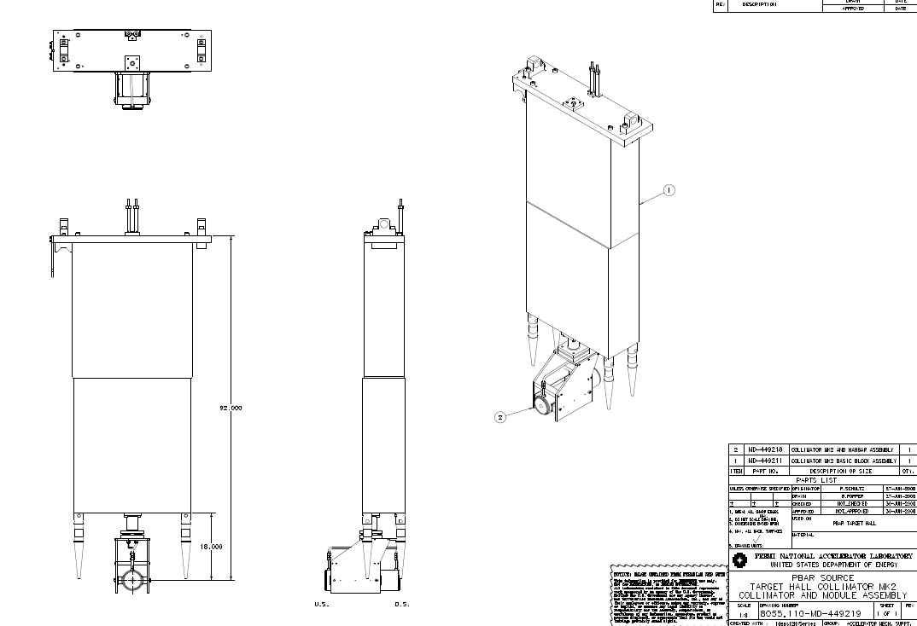
Collimator and module

Slide 12
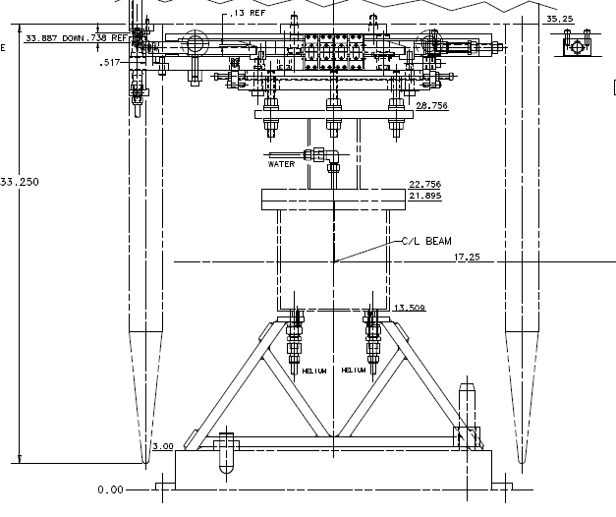
Example of device hanging from AP-0 module

Slide 13
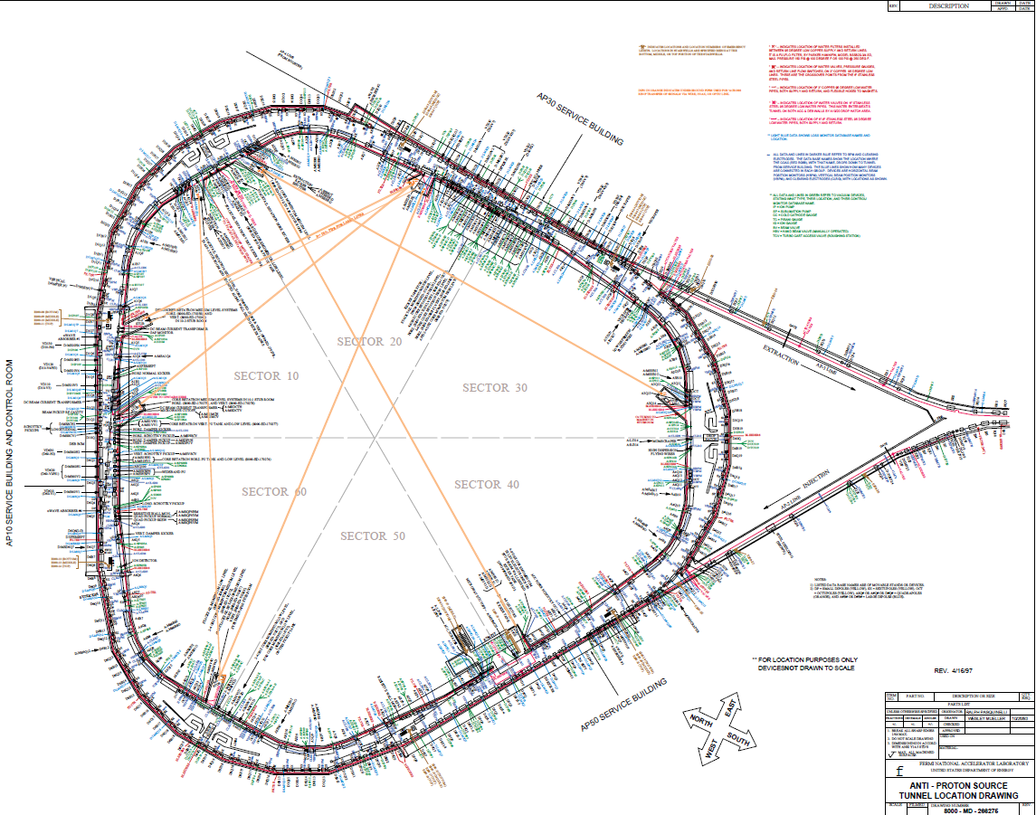
Antiproton Source Rings circa 1993

Slide 14
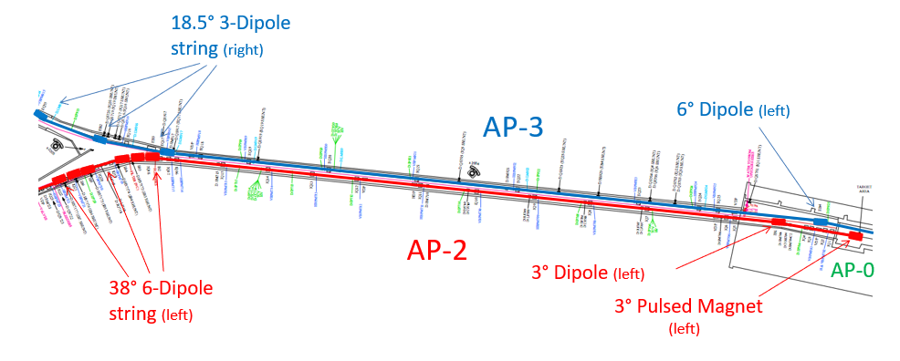
Antiproton Source AP-2 and AP-3 Lines

Slide 15
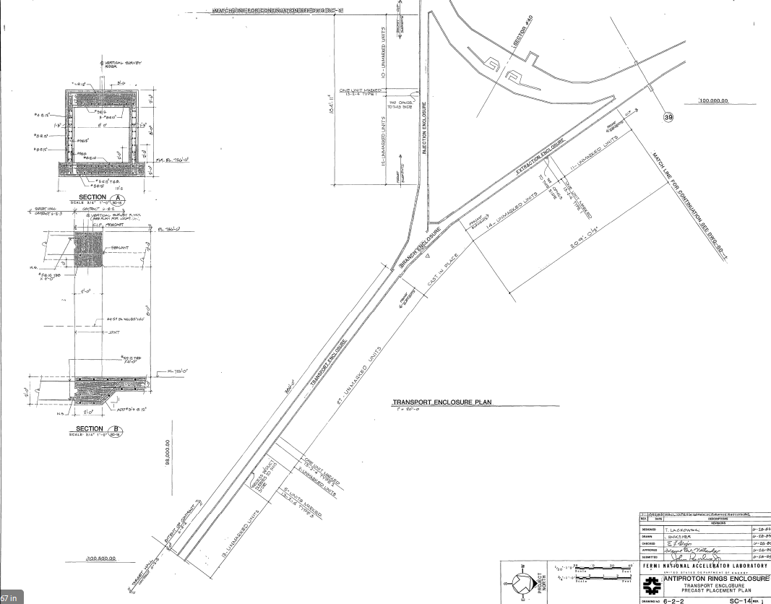
Transport Enclosure
Tunnel dimensions
8’ high x 8’ wide

Slide 16
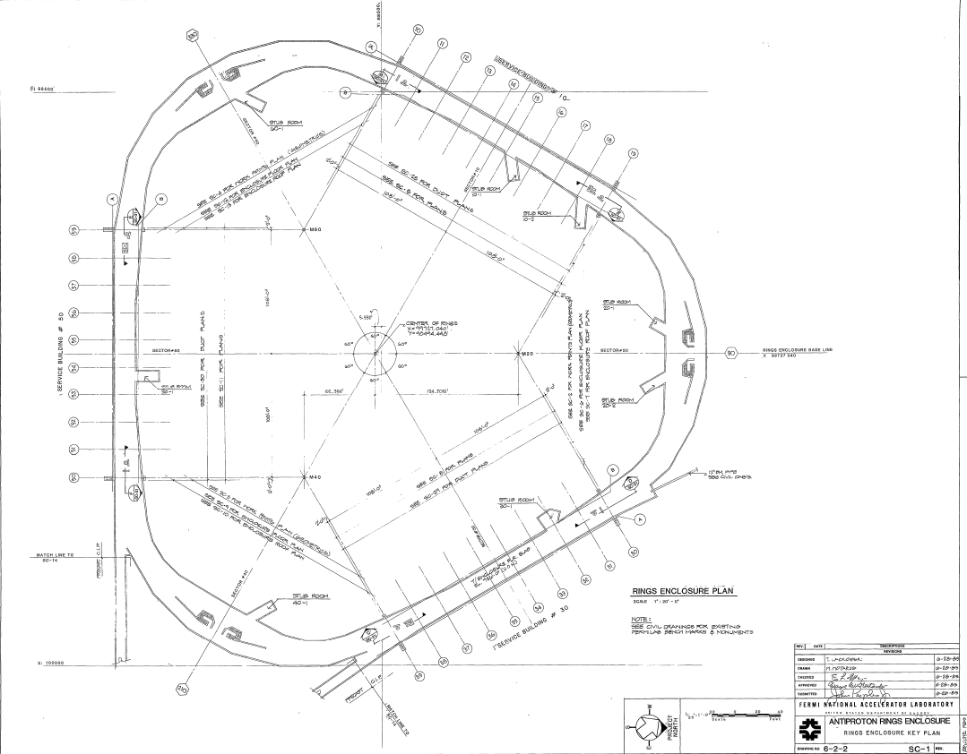
Ring Enclosure

Slide 17
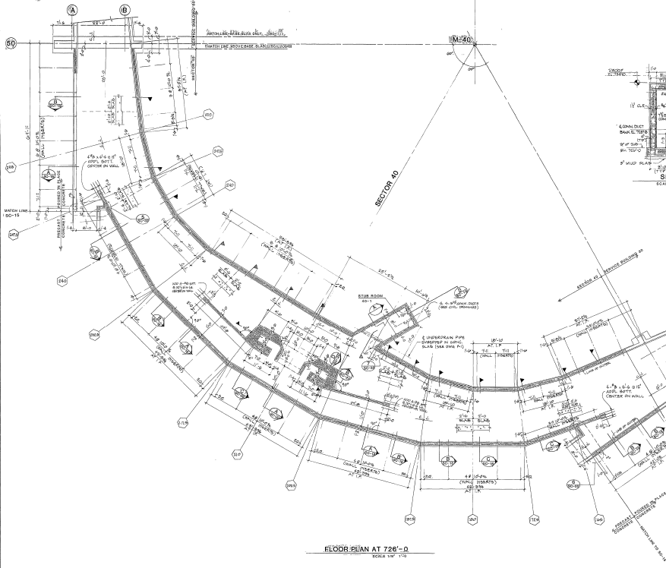
Ring Enclosure, typical arc section
Tunnel dimensions
Variable width 20’ – 35’
Height 8’

Slide 18
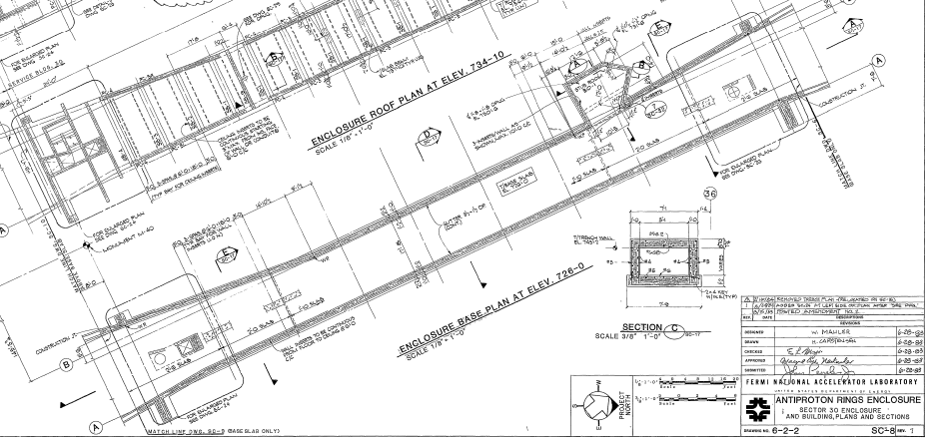
Ring Enclosure, typical straight section
Tunnel dimensions
Variable width 17’ – 25’
Height 8’

Slide 19
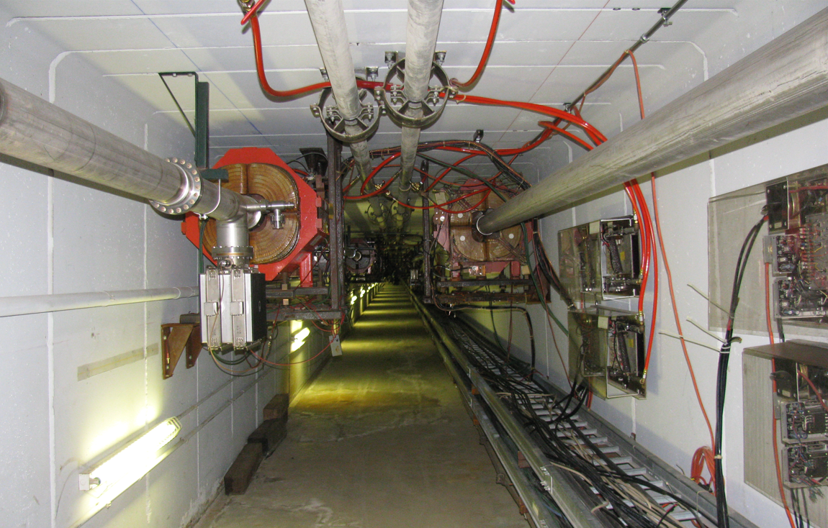
Antiproton Source AP-2 and AP-3 Lines

Slide 20
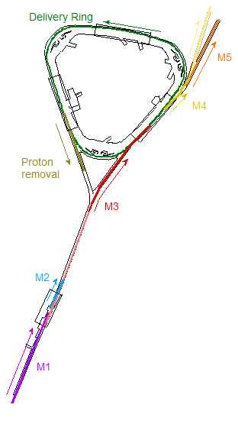
Muon g-2 mode
  An 8 GeV proton bunch, 120 ns long, was transported to the Target Station via the M1 Line at an average rate of 12 Hz, with 100 Hz bursts (16 bunches, 10 ms interval, repeated every 1.33 seconds, up to 15 kW beam power)
A 3.1 GeV/c Positive secondary beam traveled down the M2 and M3 Lines and was injected into the Delivery Ring in the 30 straight section
Some of the pions decayed into 3.1 GeV/c muons as they travel down M2 and M3
Muons circled the 550 meter Delivery Ring four times to separate protons from the muons
The Mu2e abort located in the 50 straight section was used to remove protons
3.09 GeV/c muons were then extracted into the M4 Line, then continued into the M5 Line and on to the g-2 Experiment at MC-1

Slide 21
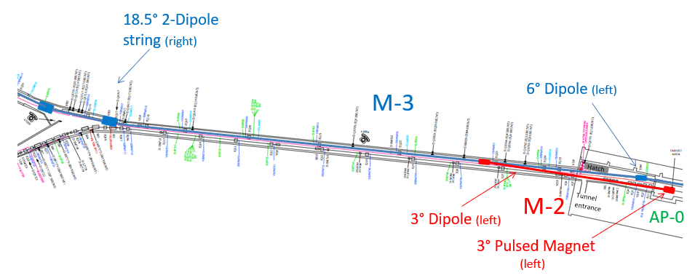
Muon Campus M2 and M3 Lines

Slide 22
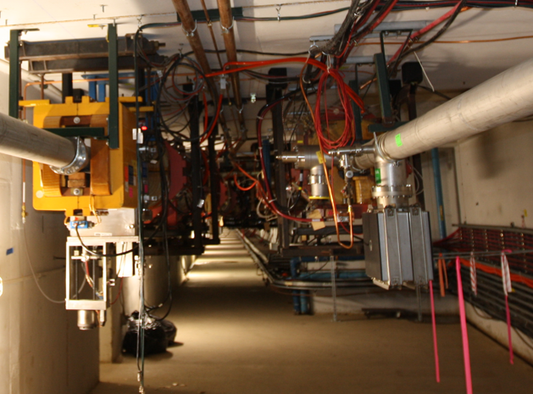
Muon Campus M2 and M3 Lines

Slide 23
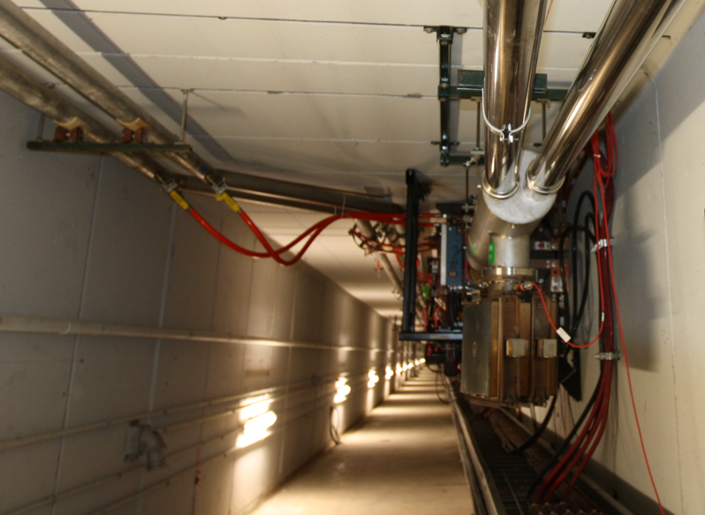
Muon Campus M2 and M3 Lines

Slide 24
Mu2e Mode
  An 8 GeV proton bunch, 120 ns long, is transported to the Delivery Ring via the M1 and M3 Lines(bypassing the Target Station) at an average rate of 6 Hz with 18 Hz bursts
The 8 GeV bunch is injected into the Delivery Ring in the 30 straight section
A 2.5 MHz RF system maintains the short bunch as it circulates in the Delivery Ring
The proton bunch is resonantly extracted over 40 ms into the M4 Line and transported 240 m to the Mu2e Experiment Production Solenoid, which contains a target
The remaining proton beam that is not resonantly extracted is aborted in the 50 straight section and transported to a dump

Slide 25
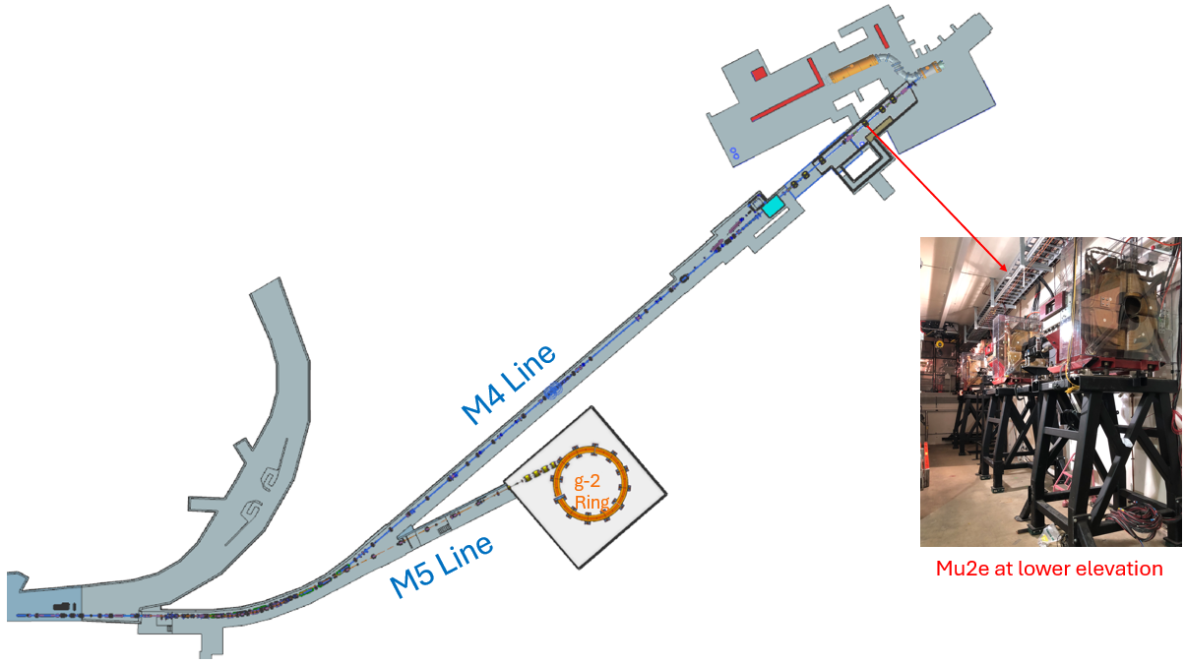
M4 Line to Mu2e

Slide 26
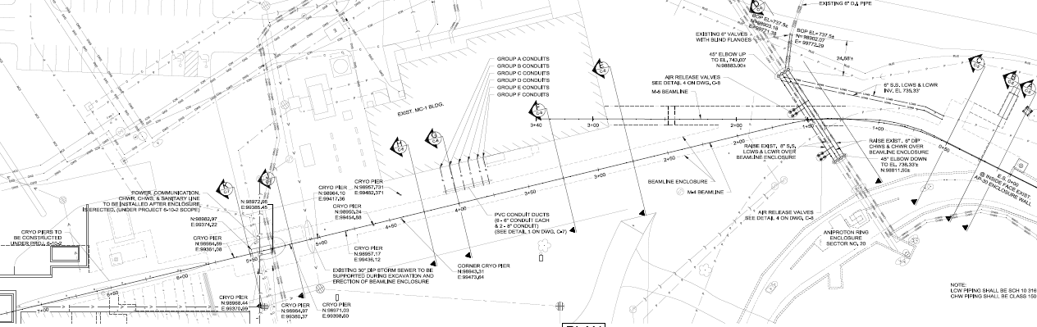
M4 Enclosure
Tunnel dimensions
Variable width 10’ or greater
Height 8’

Slide 27
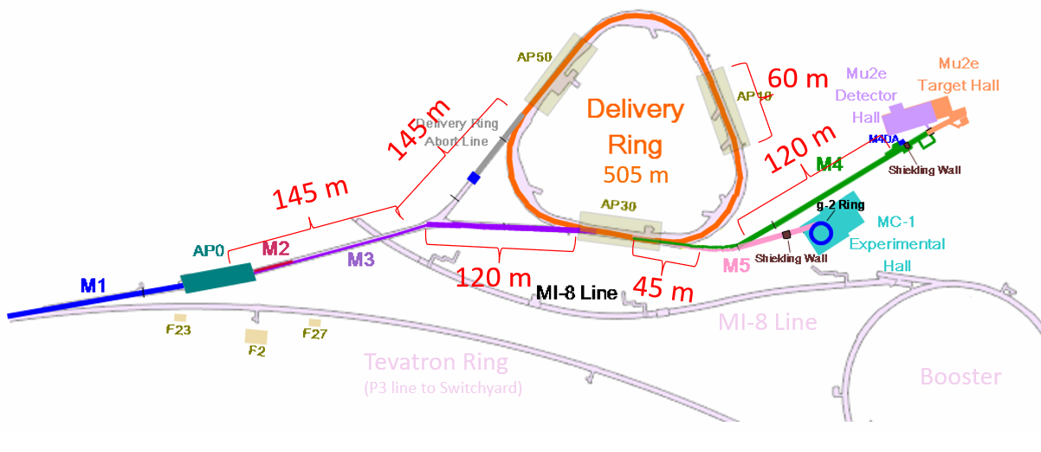
Muon Campus dimensions

Slide 28
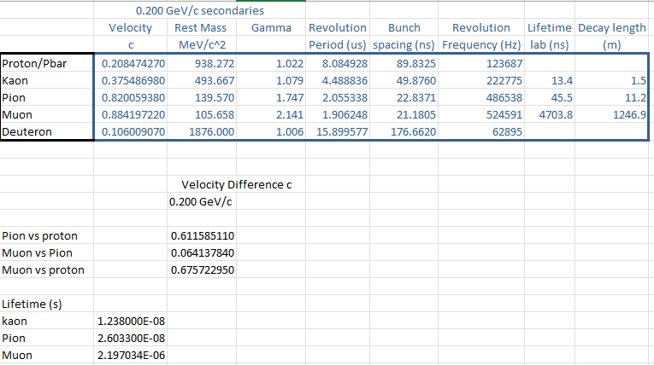
200 MeV/c muons

Slide 29
Muon Campus options using AP-0 Target Station
Single pass through extended M2 Line
  Follows path of old AP-2 Line, more than 100 m available for Demonstrator
  Alternatively, could shift Demonstrator to downstream of bend region
  Utilize AP-0 Target Station, but need to optimize focusing for 200 MeV beam
  Momentum spread from Target Station approximately +/- 10%
  Could be further reduced in bend section with momentum collimation
Circulating muons in the Delivery Ring or a new Ring in the same tunnel
  Delivery Ring has three large straight sections and three arcs with bending magnets
  Old Accumulator path had twelve mini-straights between dipoles
800 MeV beam from Linac2 (PIP-II)
  Stub in PIP-II Beam Transfer Line being built for possible use with Mu2e
  Would require a Target Station, even if a beamline is built for Mu2e
  Limited options for site of Target Station
Study – M1-M3 Optics
Study – Alternative M5 optics

Slide 30
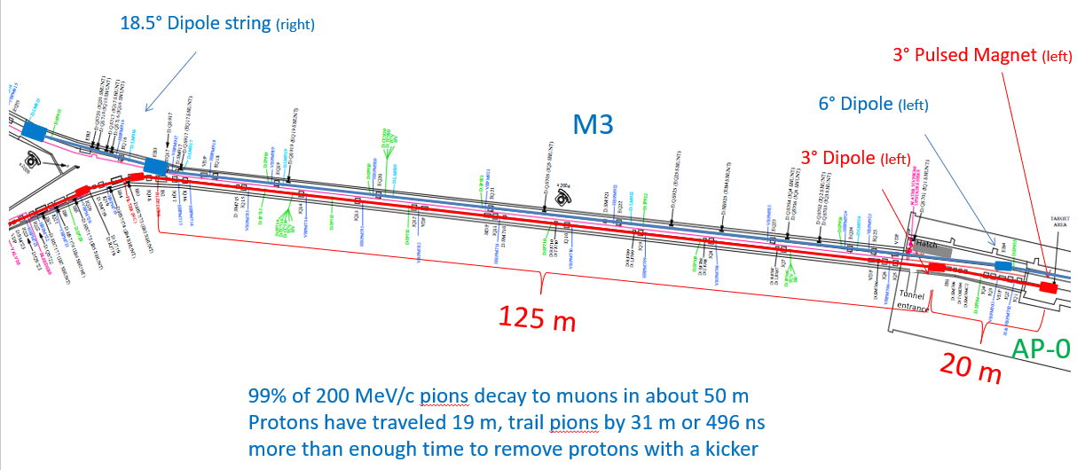
M2 Line extension

Slide 31
Delivery Ring (or new Ring) for Demonstrator
Accumulator
(decommissioned)
Delivery Ring

Slide 32
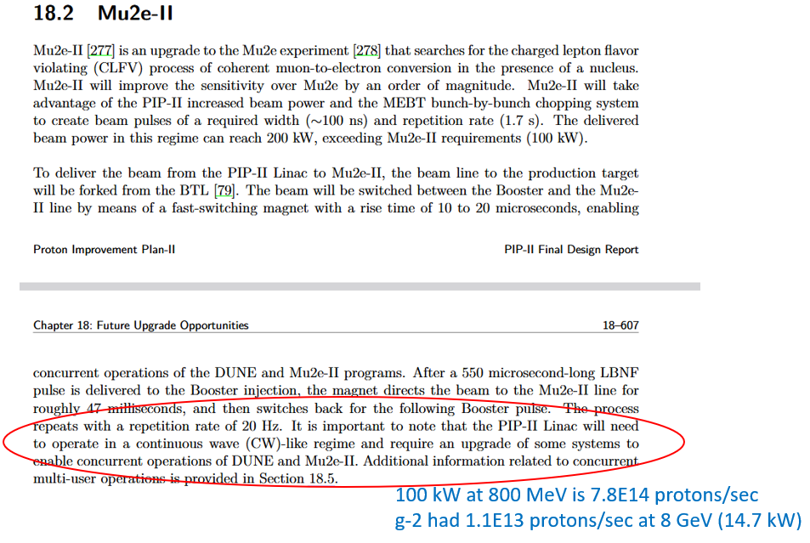
Linac2 (Pip-II) beam to the Muon Campus

Slide 33
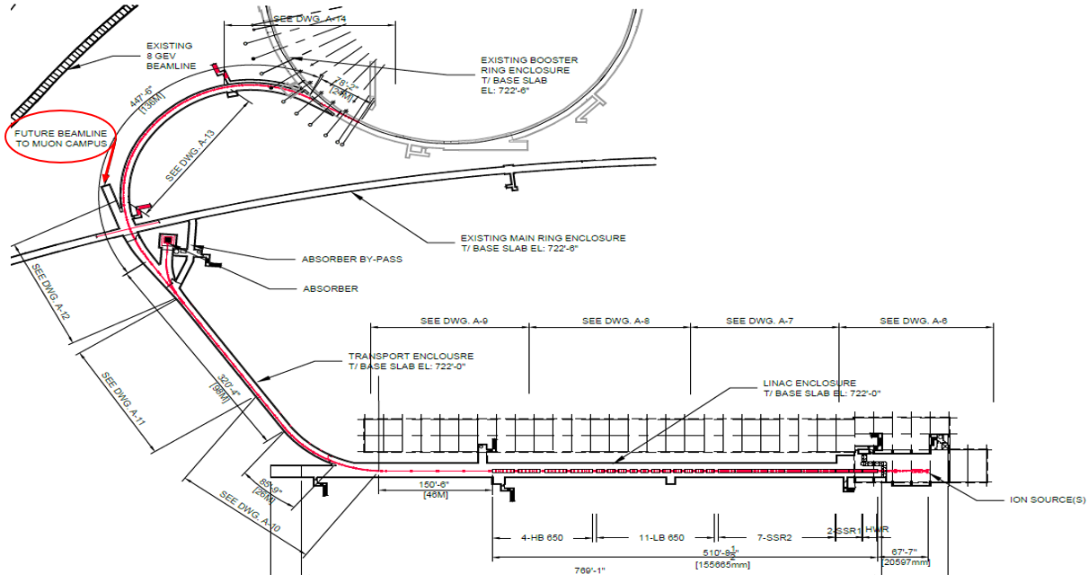
Linac2 (PIP-II) 800 MeV beamline stub for the Muon Campus

Slide 34
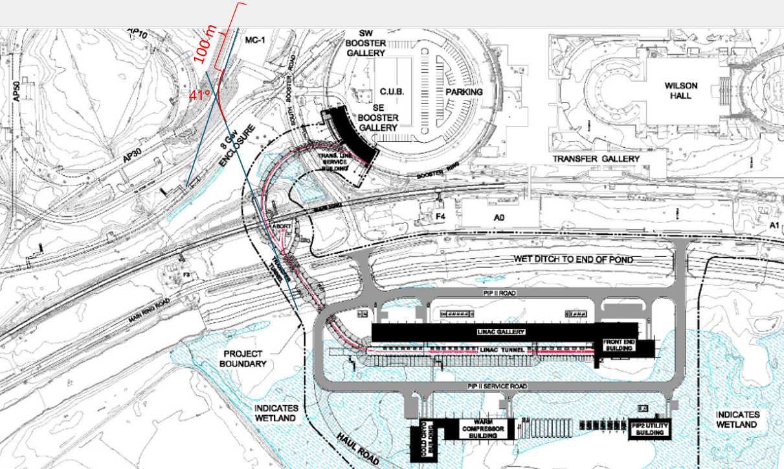
Linac2 (PIP-II) 800 MeV beam path to the Muon Campus
Target Station here?

Slide 35
Moving forward
Need to have better understanding of Demonstrator components
  Both single pass in a beamline or in Ring straight sections
  Existing tunnel geometry might constrain device dimensions
What are cryogenic needs?
  May be able to connect to existing MC-1 cryo system
  How much service building footprint is needed?
What are solenoid power supply needs
  Is there enough room in existing service buildings or are new buildings needed?
  In Delivery Ring, so tunnel side not available Monday and Tuesday
How does 200 MeV muon yield compare, 8 GeV versus 800 MeV primary beam?
Need focusing scheme for Target Station (horn?, solenoid?)
  Existing AP-0 lithium lens poorly suited for low momentum pions
  Existing Inconel 600 target may not be best choice either
  In general, make sure the AP-0 Target Station is suitable for the Demonstrator
Eventually need to work out optics for Demonstrator
  Optics match from Target Station to transport line
  Optics for Demonstrator
  Optics match between transport line (or Ring elements) and Demonstrator

