Slide 1
Fermilab Beamlines for Muon Cooling Demonstrator
Jeff Eldred
Feb 11, 2026

Slide 2
Program Planning Assumptions
We are looking for scenarios that are compatible with two operational modes.
1) LBNF + mu2e, with 1.05-1.2s MI ramp.
2) LBNF only with 0.65s MI ramp.
- Assume Switchyard slow-extraction program will also be running one cycle per supercycle, roughly 5s every minute for ~10% tax on LBNF.
- Unclear if SBN program will be running, but assume parasitic.
Based on Switchyard precedent, assume that muon cooling demonstrator may be allowed if the tax is less than 5%. My understanding is that this is not a statistics experiment, and therefore that should be achievable.
The bigger challenge is for siting to not interfere with operations.
The ACE PIU CDG estimates $2.6m for every 16m of transfer line, essentially regardless of bean energy. There may be a new test beam site, but not guaranteed.
2
J. Eldred | Muon Cooling Demonstrator Siting at Fermilab
2/9/2026

Slide 3
Updated List of Beamlines
Linac2 0.8 GeV H- ions -> 200 MeV/c muons
- chopped or unchopped micropulse.
- variable macropulse length.
- consider 2-GeV energy upgrade.
Booster 8-GeV protons -> 200 MeV/c muons
- variable number of bunches 1-81.
RR/MI 8-120 GeV protons -> 200 MeV/c muons
- option to slip-stack for x2 bunch charge.
- variable energy up to 120 GeV.
FAST/IOTA 200 MeV/c electrons
FAST/IOTA 70 MeV/c protons -> 200 MeV/c protons
- requires energy upgrade.
3
J. Eldred | Muon Cooling Demonstrator Siting at Fermilab
2/9/2026

Slide 4
Linac2 0.8 GeV H- Ions
0.55ms every 20Hz is used for PIP-II, the other 99% is available.
One bunch every four RF buckets at 650 MHz (i.e 6.15 ns), plus optional chopping.
Pathak simulations indicate bunch sigma from linac is as short at 7ps! After BTL it is more like 400ps sigma without RF buncher.
- If we need bunches <100ps sigma, we might need our own RF buncher.
Average current limited to 2mA on microsecond average, but bunch charge separately limited at RFQ to achieve 2mA with 45% beam chopped.
So we have two strategies:
- Up to ~0.77e8 H- every 6.15ns (i.e. unchopped).
- Or ~1.5e8 H- up to every 12.3ns (i.e. 50% chopped)
4
J. Eldred | Muon Cooling Demonstrator Siting at Fermilab
2/9/2026

Slide 5
Linac2 H- Ion Upgrades
CW operation requires a ~$13m upgrade, but I think we don’t need 1.6MW CW.
$2.6m for every 16m of transfer line
- H- bend limited to 20m at 0.8 GeV, so a 90-degree bend is $5.1m
- Transfer line estimate valid for all energies, not just linac by the way.
Cost to upgrade 2mA to 2.7mA estimated at ~$25m.
- bunch charge at 2mA might also be able to be increased in front end.
Cost for upgrade to 1GeV ~$43m, upgrade to 2GeV ~$413m.
- +$7.7m and +$33m respectively for a 90-degree bend.
Cost estimates from PIU CDG group in 2023, total project cost but +/- 50% margins
Booster-like AR scenarios are generally at least $100m or $0.5-1m / kW.
5
J. Eldred | Muon Cooling Demonstrator Siting at Fermilab
2/9/2026

Slide 6
Booster 8-GeV protons
Typical Booster batch is 81 bunches = 1.5 μs macropulse, but if desired than with PIP-II era chopping we can fill less than the entire ring.
- same charge per bunch (or slightly more), proportionately less batch charge.
PIP-II era intensity is 6.5e12 over 81 bunches = 8e10 p/bunch.
53 MHz RF in Booster, bunch length sigmas of 0.9-1.6ns (with bunch rotation).
up to 8e10 p, 0.9-1.6ns sigma long, every 18.8ns, for up to 1.5 μs.
Higher instantaneous current than Linac2 beam (35e6/ps vs 8.5e6/ps), and much much higher average current (42e8/ns vs 0.1e8/ns).
6
J. Eldred | Muon Cooling Demonstrator Siting at Fermilab
2/9/2026

Slide 7
Recycler / Main Inector 8-120 GeV protons
Same micropulse structure from Booster. Boxcar stacking allows for up to six batches consectively for 9 μs macropulse length.
Slip-stacking allows for x2 bunch charge to 16e10, using the 1.6 ns long sigmas, requires 0.1-0.15s (i.e 2-3 Booster ticks) to perform.
- PIP-II era slip-stacking uses 1680 Hz for RF manipulation. Technically if we are using only two partial Booster batches we can try to slip faster or slower, but its a good rate anyway.
Only RR is needed for 8-GeV, unless we accelerate in Main Injector. Bunch length sigma reduces to ~0.5ns after about 20 GeV in Main Injector.
up to 8e10 p, 0.9-1.6ns sigma long, every 18.8ns, for up to 9 μs (i.e. boxcar)
up to 16e10 p, 1.6ns sigma long, every 18.8ns, for up to 9 μs (i.e. slip-stacking)
(divide bunch length by 3 if accelerated to at least 20 GeV.)
7
J. Eldred | Muon Cooling Demonstrator Siting at Fermilab
2/9/2026

Slide 8
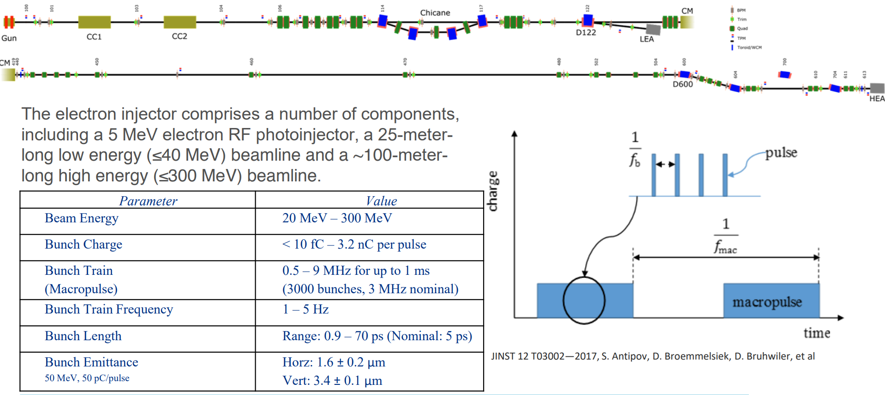
FAST/IOTA 250 MeV Electron Beamline
Broemmelsiek et al. 2017 article. Here 3.2nC = 2e10 electrons
up to 2e10 e, 5-70ps sigma long, every 333ns, for up to 160 μs demonstrated
8
J. Eldred | Muon Cooling Demonstrator Siting at Fermilab
2/9/2026

Slide 9
FAST/IOTA Proton Beamline
FAST/IOTA “IPI” proton injector was just commissioned, still verifying parameters.
In the meantime, Antipov 2017 design specs based on HINS operation.
FAST IPI: 2.5 MeV (70 MeV/c), need to be accelerated to 21 MeV (200 MeV/c).
Fermilab Linac1: 0.75 MeV out of RFQ, 10 MeV out of DTL1, 38 MeV out of DTL2
Fermilab Linac2: 2.1 MeV out of RFQ, 10 MeV out of HWR, 35 MeV out of SSR1.
Conclusion: 1-2 more RF cavities are needed over about 20-30m (bypass IOTA)
- Unclear if we could literally use the DTLs from Linac1 after Linac2 starts!
Design current is 8mA at 325MHz (i.e 3ns spacing). Worse case bunch length 0.4ns sigma. Bunch charge 1.5e8 protons per 3ns bucket.
- State of the art RFQ like SNS or ESS would achieve 1e9 protons.
up to 1.5e8 p, ~0.4ns sigma long, every 3ns, for up to 1.7 μs every 1 Hz
9
J. Eldred | Muon Cooling Demonstrator Siting at Fermilab
2/9/2026

Slide 10
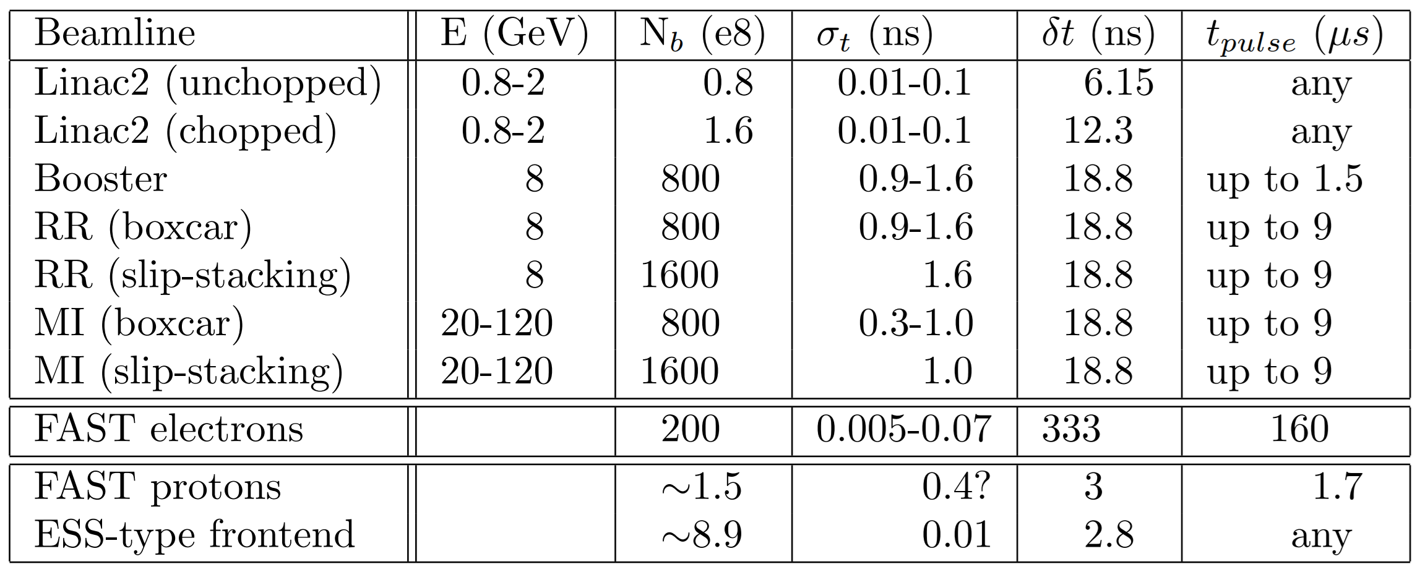
Summary Table
Going only on bunch charge, I’d say 8-GeV slip-stacked seems best but you tell me.
I also think we should strongly consider the FAST electron beamline for an initial phase of the demonstrator at least.
10
J. Eldred | Muon Cooling Demonstrator Siting at Fermilab
2/9/2026

Slide 11
11
11
Backup Slides
(Beamline/siting/operations interactions
from Nov 2024 Workshop)
11
J. Eldred | Muon Cooling Demonstrator Siting at Fermilab
2/9/2026
Notes:
11
11
11
11
11
11

Slide 12
Some Highlights of Fermilab Neutrino Program in P5 Report
2023 P5 Report Recommendations
R1b: “Highest Priority… The first phase of DUNE and PIP-II …”
R1d: “Highest Priority… NOvA, SBN, T2K and IceCube …”
R2b: “Plan and start…order of priority… A re-envisioned second phase of DUNE with an early implementation of an enhanced 2.1 MW beam—ACE-MIRT—a third far detector, and an upgraded near-detector complex as the definitive long-baseline neutrino oscillation experiment of its kind.”
R4g/R6/AR12: “Form…a strategic 20-year plan for the Fermilab accelerator complex within the next five years…consistent with the long-term vision of this report including neutrinos, flavor, and a 10 TeV pCM collider”
AR13: “Assess the booster synchrotron and related systems for reliability risks through the first decade of DUNE operation, and take measures to preemptively address these risks.”
12
J. Eldred | Muon Cooling Demonstrator Siting at Fermilab
2/9/2026

Slide 13
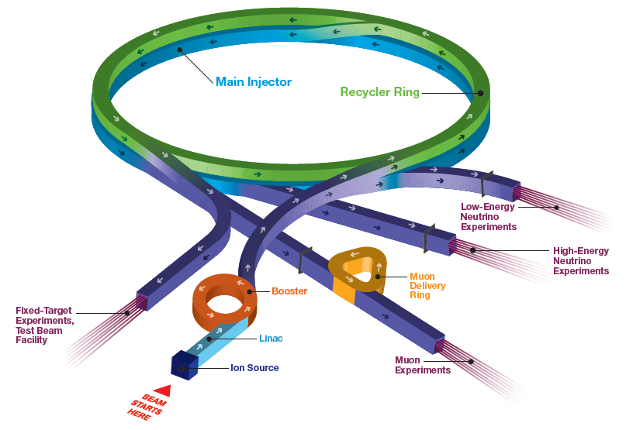
Accelerator Complex
Short Baseline Neutrino:
ICARUS, ANNIE, SBND
SwitchYard120:
test beam (FTBF),
SpinQuest
Long Baseline Neutrino:
NOvA
Muon Campus:
g-2 (completes this year), Mu2e (commissioning)
Irradiation Test Area (ITA) in Linac
13
J. Eldred | Muon Cooling Demonstrator Siting at Fermilab
2/9/2026

Slide 14
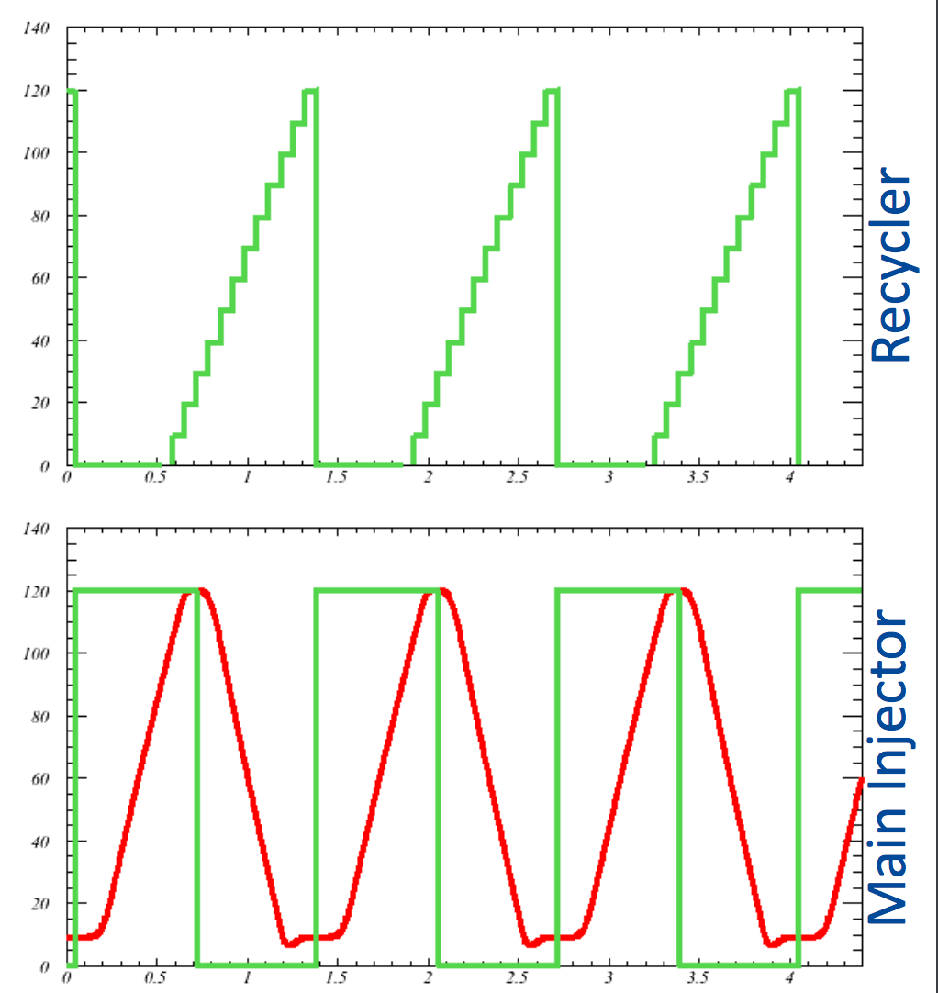

Introduction to Fermilab accelerators
$$\frac{1}{15Hz}=0.067 s$$
H⁻ linac (1970, 1993, 2012)
- 400 MeV linac ~20mA
Booster synchrotron (1970)
- H⁻ stripping injection (1978)
16 turns to ~4.7x10¹² p per pulse
- Ramp from 0.4 to 8 GeV at 15 Hz
Recycler (1998)
- 3.3 km permanent magnet 8 GeV ring
- Slip-stacking 12 Booster batches, ~56x10¹² p
- Also re-bunches beam for Muon Campus
Main Injector (1998)
8 to 120 GeV ramp, cycle time 1.2-1.4 s
1.33s cycle shown
14
J. Eldred | Muon Cooling Demonstrator Siting at Fermilab
2/9/2026

Slide 15
Accelerator Complex in PIP-II / LBNF era (pre ACE plan)
15
J. Eldred | Muon Cooling Demonstrator Siting at Fermilab
2/9/2026

Slide 16
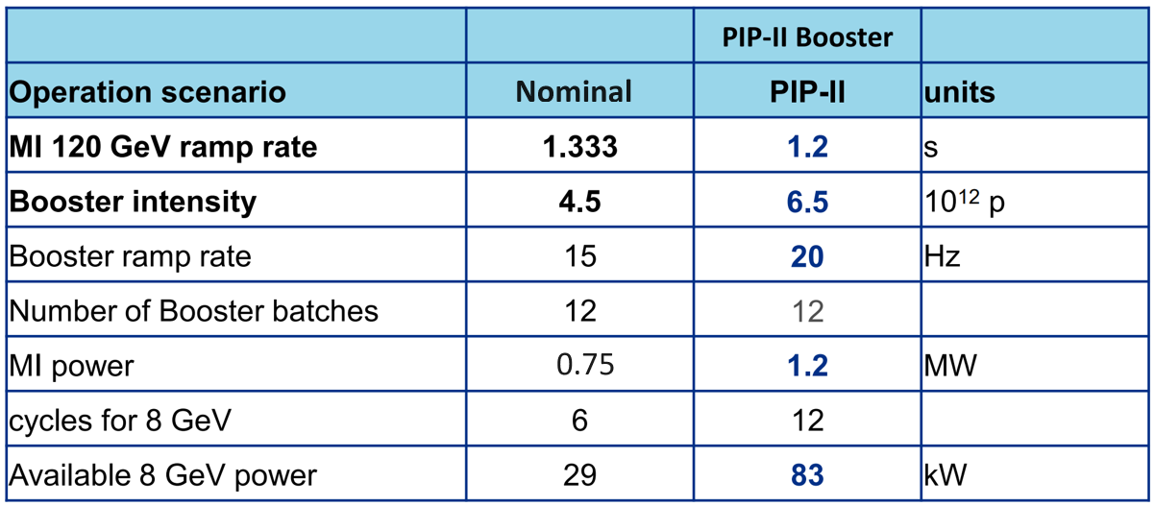
Accelerator Complex in PIP-II / LBNF era (pre ACE plan)
PIP-II Project provides
New SRF linac for injection into Booster at 800 MeV (present 400 MeV).
Booster cycle rate upgraded to 20 Hz from 15 Hz.
Increased proton beam intensity for 1.2 MW beam power from MI.
Demonstrated
1.067-1.133 s
4.7-4.9 e12
0.96 MW
16
J. Eldred | Muon Cooling Demonstrator Siting at Fermilab
2/9/2026

Slide 17
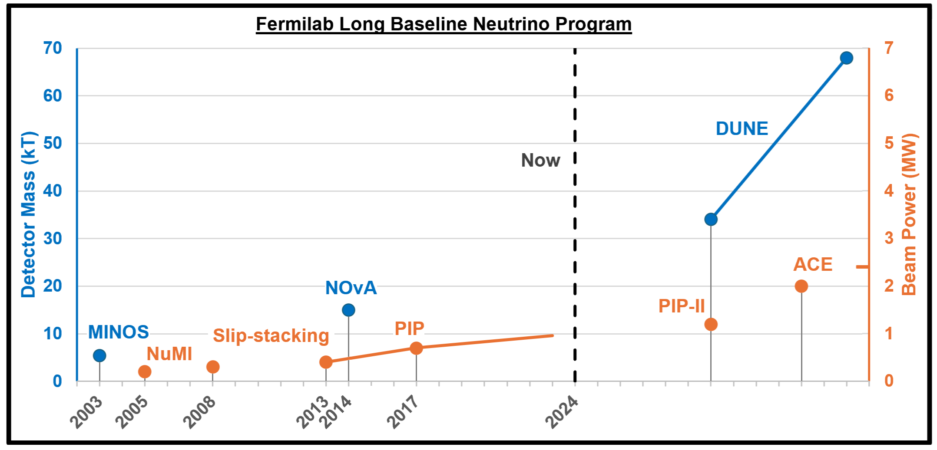
Past & Future Long Baseline Neutrino Program (with ACE)
PIP-II upgrade will provide proton power of 1.2 MW (at most 1.35 MW).
Upgrade to 2-2.4 MW will make best use of the full DUNE detector.
17
J. Eldred | Muon Cooling Demonstrator Siting at Fermilab
2/9/2026

Slide 18
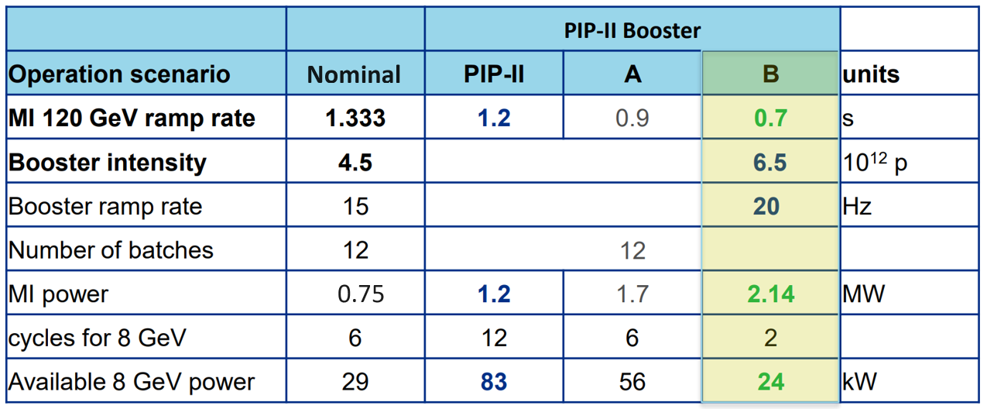
Accelerator Complex Evolution (ACE) Main Injector Ramp & Targetry (MIRT)
ACE-MIRT proposed to reduce Main Injector cycler to ~0.65s to increase beam power
- Requires x2 RF acceleration and x2 magnet power supplies
- Emphasis on reliability and infrastructure modernization upgraes.
18
J. Eldred | Muon Cooling Demonstrator Siting at Fermilab
2/9/2026

Slide 19
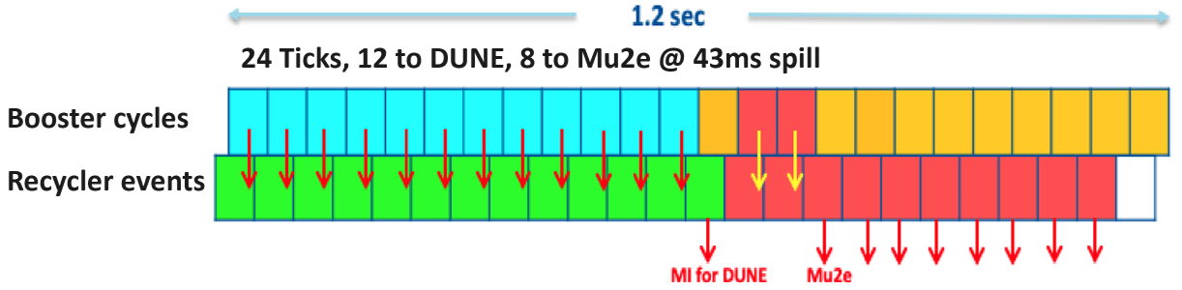
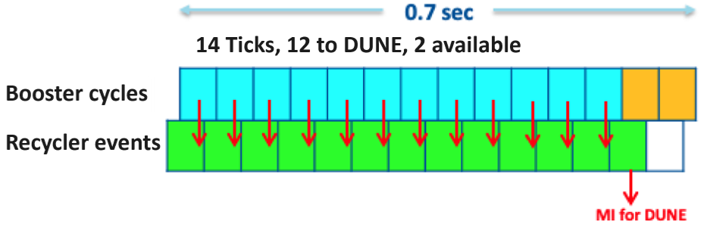
Impact of shortened cycle on other experiments
PIP-II Era
MI Cycle:
ACE-MIRT
MI Cycle:
19
J. Eldred | Muon Cooling Demonstrator Siting at Fermilab
2/9/2026

Slide 20
20
20
Muon Ionization Cooling Technology Demonstrator
Candidate Sites at Fermilab
20
J. Eldred | Muon Cooling Demonstrator Siting at Fermilab
2/9/2026
Notes:
20
20
20
20
20
20

Slide 21
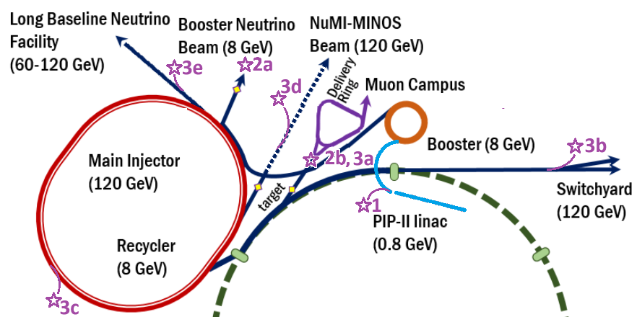
Demonstrator Candidate Sites
Candidiate Sites
1) 0.8-1.0 GeV H- from Linac
2) 8 GeV protons from the Booster
3) 8-120 GeV protons from the Main Injector
21
J. Eldred | Muon Cooling Demonstrator Siting at Fermilab
2/9/2026

Slide 22
Demonstrator Candidate Sites
1) 0.8-1.0 GeV H- particles from the PIP-II linac:
(1a) Greenfield site in the Tevatron field
(1b) Following the proposed mu2e-II line to muon campus.
2) 8 GeV protons from the Booster:
(2a) At the present day short-baseline neutrino
(2b) At present day muon campus site.
3) 8-120 GeV protons from the Main Injector:
(3a) Split off P1 Muon Campus line.
(3b) Split off P1 Meson line.
(3c) Split off MI Abort beamline.
(3d) At the present day NuMI beamline.
(3e) Split off LBNF beamline.
22
J. Eldred | Muon Cooling Demonstrator Siting at Fermilab
2/9/2026

Slide 23
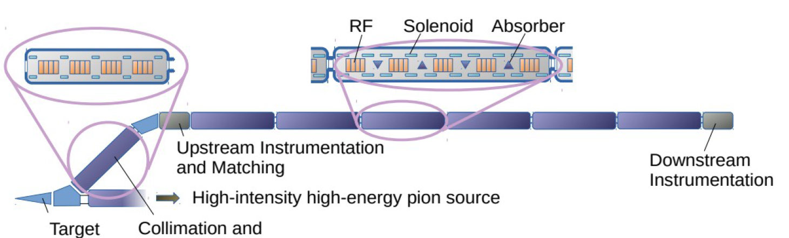
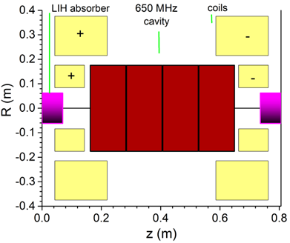
Muon Ionization Cooling Technology Demonstrator
Many cells
“A Demonstrator For Muon Ionisation Cooling” – C. Rogers (here
50m long, 7.2 T peak solenoid field, 704 MHz RF, LiH wedges
Evaluated for CERN PS (25 GeV) or SPS (450 GeV) beams.
23
J. Eldred | Muon Cooling Demonstrator Siting at Fermilab
2/9/2026

Slide 24
Site Considerations
Regardless of proton energy, we intend to capture 190-210 MeV/c muons.
- They would have different muon production yields and initial muon distributions.
- This will probably impact the target & capture system significiantly, but we will try to isolate the impact from ionization cooling demonstrator itself.
- We will also need to evaluate the impact on instrumentation and statistics.
Different beam powers and longitudinal structures available at different energies.
All sites will need infrastructure:
- 50m of straight tunnel space (after 1m dogleg), appropriate civil construction.
- Electrical power (magnets and HLRF) & cryogenics.
- Appropriate shielding, tritium mitigation, ODH.
Some opportunities to re-use existing infrastructure or to construct a multipurpose facility.
24
J. Eldred | Muon Cooling Demonstrator Siting at Fermilab
2/9/2026

Slide 25
Demonstrator Candidate Sites
Candidiate Sites
1) 0.8-1.0 GeV H- from Linac
2) 8 GeV protons from the Booster
3) 8-120 GeV protons from the Main Injector
25
J. Eldred | Muon Cooling Demonstrator Siting at Fermilab
2/9/2026

Slide 26
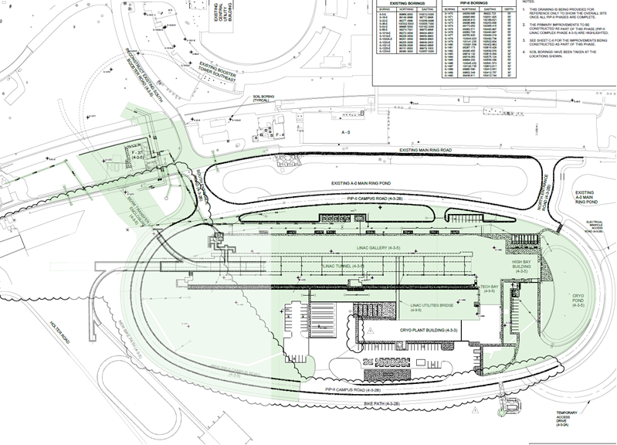
Proposed Facility at PIP-II Linac (from F2D2)
0.8-1 GeV CW beam
split off PIP-II linac.
Optional ring, MW dump.
26
J. Eldred | Muon Cooling Demonstrator Siting at Fermilab
2/9/2026

Slide 27
0.8-1.0 GeV H⁻ particles from PIP-II Linac
Excellent Proton Availability
CW operation of the PIP-II linac would supply 1.6 MW of beam power, only 1% of which is used for the Fermilab Booster – the rest is potentially available for experiment.
- Mu2e-II proposed targets challenging at 100 kW, we need less power or different target.
High-duty Macropulse Structure, 162.5 MHz Micropulse Structure
Beam arrives in ~1ns bunches arriving every 6-12ns averaging 2mA beam power.
Bunch-by-bunch chopping available to remove bunches further.
Greenfield Siting Near PIP-II
Abundant real-estate in the TeV field, proximity to PIP-II power/cryo.
Synergy with Other Proposed Programs
Proposed low-energy muon facility (muSR, muon HEP)
Proposed Fermilab Facility for Dark Discovery (F2D2) beam dump physics program
Proposed Co-location of 120-GeV test beam program.
Expect 0.8 GeV particles, but 1.0+ GeV scenarios can also be considered.
27
J. Eldred | Muon Cooling Demonstrator Siting at Fermilab
2/9/2026

Slide 28
Demonstrator Candidate Sites
Candidiate Sites
1) 0.8-1.0 GeV H- from Linac
2) 8 GeV protons from the Booster
3) 8-120 GeV protons from the Main Injector
28
J. Eldred | Muon Cooling Demonstrator Siting at Fermilab
2/9/2026

Slide 29
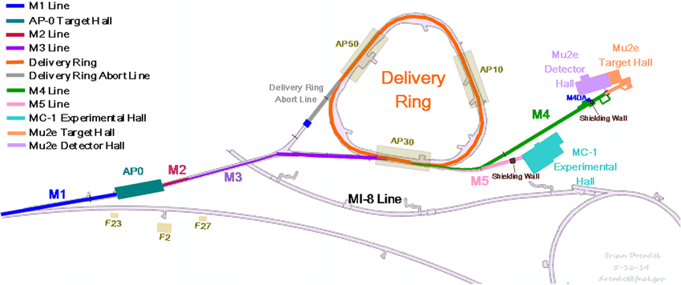
8-GeV p / 3-GeV μ Muon Campus Delivery Ring Site
29
J. Eldred | Muon Cooling Demonstrator Siting at Fermilab
2/9/2026

Slide 30
8 GeV protons from Fermilab Booster
Proton Energy Appropriate for Proton Driver
Fermilab proton driver scenarios envision ~8-GeV beams, so the muon production, capture, and selection systems are also being demonstrated (at much lower power of course.)
1.5us Macropulse, 53 MHz Micropulse Structure
81 bunches, each 1.2ns separated at 19ns intervals. 6.5e12 protons in 1.5us pulse.
Siting at Muon Campus M2/M3
Take advantage of existing tunnel, cryo, power. Transfer to the Muon Campus requires use of the Recycler, parasitic on LBNF program.
- A 7% reduction of LBNF 2.1 MW 120-GeV power for 10 kW at 8-GeV.
- one 1.5us pulse every 0.7s MI cycle.
- Option to manipulate beam in Recycler before muon campus.
Siting at Short-Baseline Neutrino Target Hall
Start after the end of SBN program
- No impact on LBNF, 1-2 pulses every 0.65-0.7s corresponds to 13-24 kW at 8-GeV.
30
J. Eldred | Muon Cooling Demonstrator Siting at Fermilab
2/9/2026

Slide 31
Demonstrator Candidate Sites
Candidiate Sites
1) 0.8-1.0 GeV H- from Linac
2) 8 GeV protons from the Booster
3) 8-120 GeV protons from the Main Injector
31
J. Eldred | Muon Cooling Demonstrator Siting at Fermilab
2/9/2026

Slide 32
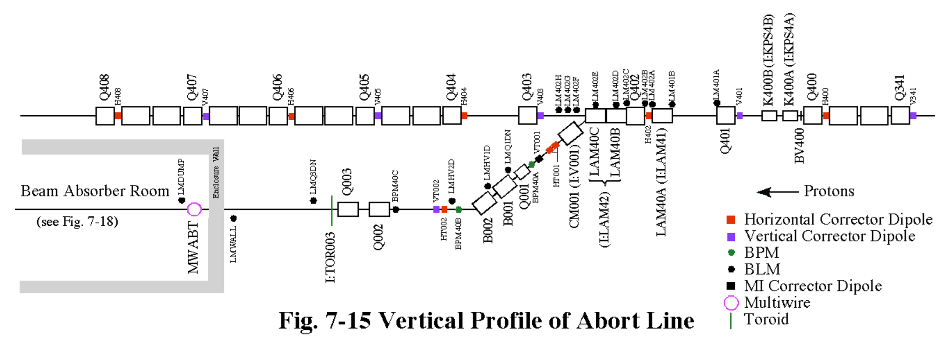
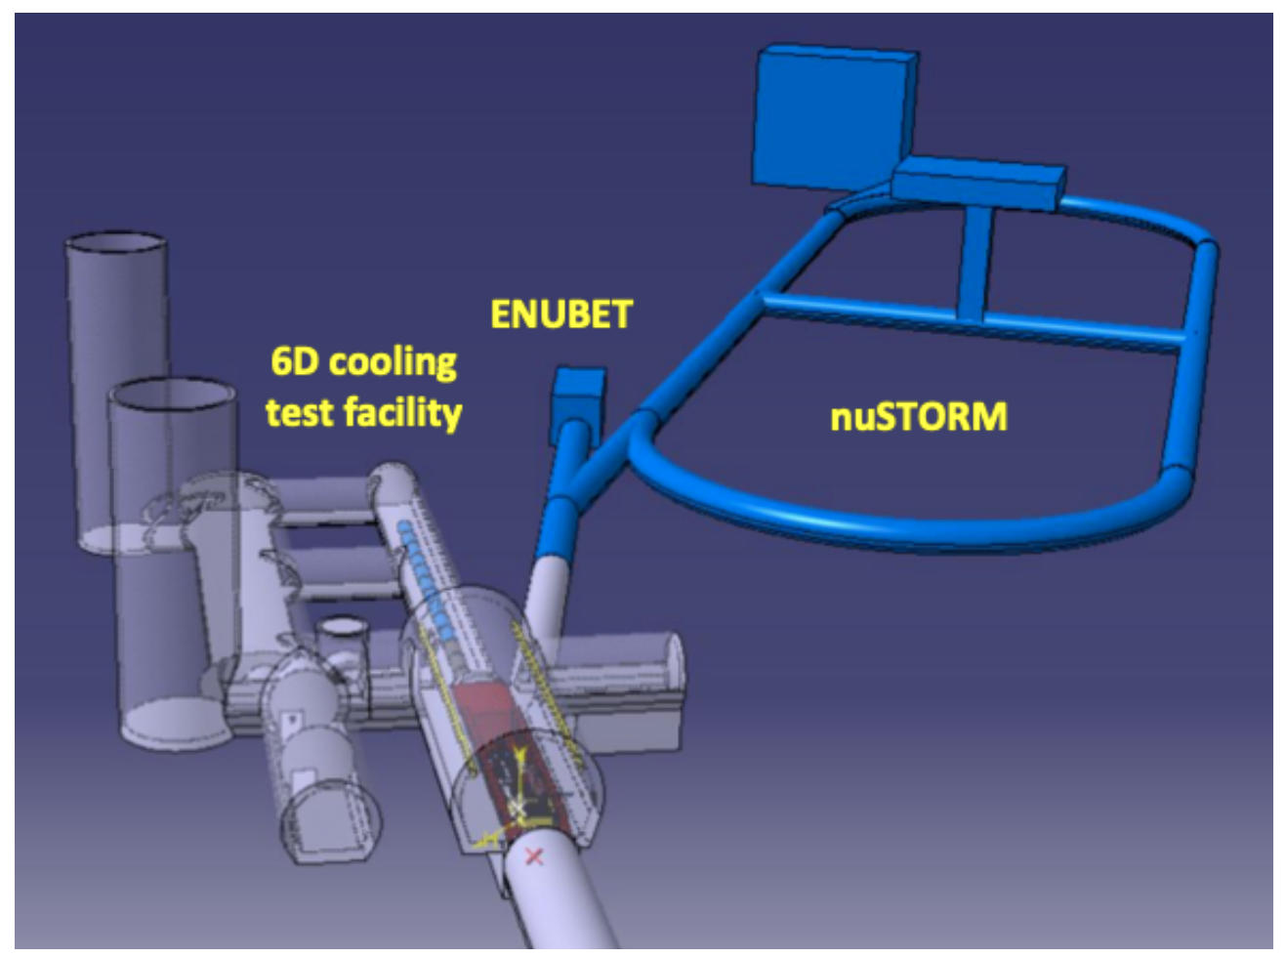
MI Abort / NuSTORM Site
MI-Abort + Dump
F. Esteban et. al.
NuSTORM Facility
at CERN
32
J. Eldred | Muon Cooling Demonstrator Siting at Fermilab
2/9/2026

Slide 33
8-120 GeV protons from Main Injector / Recycler Ring
Low-duty Factor Intense Proton Pulse
972 bunches, each 2ns separated at 19ns intervals. 78e12 protons in 9us pulse.
Direct Extraction from Main Injector
Multiple beamline options, depending on real estate and infrastructure needs.
- MI Abort line was the planned site for NuSTORM.
Operations is Parasitic on LBNF program
- A 5% reduction in 2.1 MW LBNF power corresponds to 105 kW at 120 GeV.
- one 9us pulse every 13s or so.
8-120 GeV Tuneable Energy
Proton energy can be set by Demonstrator needs, option to vary energies.
33
J. Eldred | Muon Cooling Demonstrator Siting at Fermilab
2/9/2026

Slide 34
Summary
P5 recommends that Fermilab prioritize DUNE/LBNF operations near-term, but also begin planning and preparations for a post-DUNE experimental program.
- Fermilab has a direct interest in establishing the feasibility of a Muon Collider.
Fermilab has opportunities at several energies for experimental programs to run alongside the DUNE/LBNF, and several candidate sites to host the program at each energy.
Operation at 8-GeV is the closest match to the proton driver case, and the siting opportunities initially appear to require the least beamline modifications.
Operation at 0.8 GeV could allow co-location synergies with other proposed physics programs.
Operation at 120 GeV enables higher power and higher energy.
34
J. Eldred | Muon Cooling Demonstrator Siting at Fermilab
2/9/2026

Slide 35
Some Other Muon Collider Topics at Fermilab
Fermilab expertise and facilities for RF and superconducting magnets.
- S. Gourlay talk magnets and S. Belomestnykh talk RF.
Fermilab expertise and facilities for targets, muon production, capture, and instrumentation.
- M. Hedges talk targets and mu2e program at Fermilab.
Muon Collider proton driver scenario for Fermilab. (IPAC24 paper)
Proposed proton bunch compression experiment at IOTA. (IPAC24 paper)
35
J. Eldred | Muon Cooling Demonstrator Siting at Fermilab
2/9/2026

