Slide 1
Lessons learnt from MICE
K. Long
March 2, 2026

Slide 2
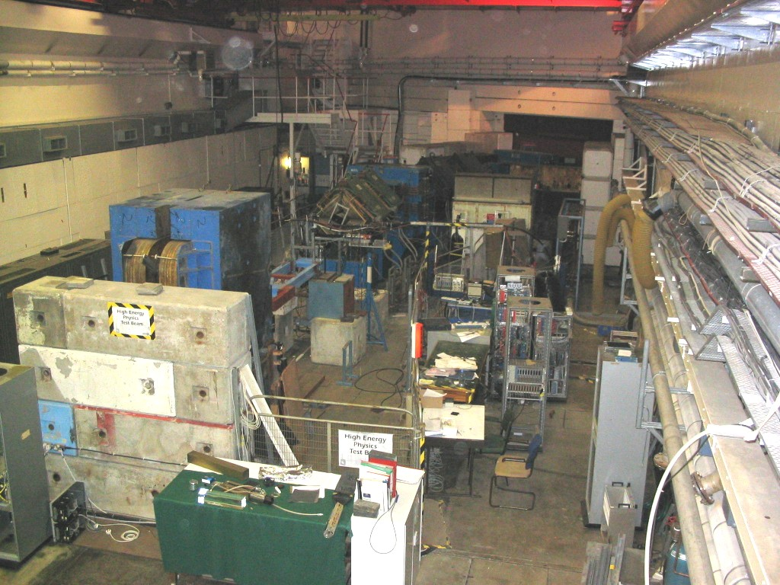

Slide 3
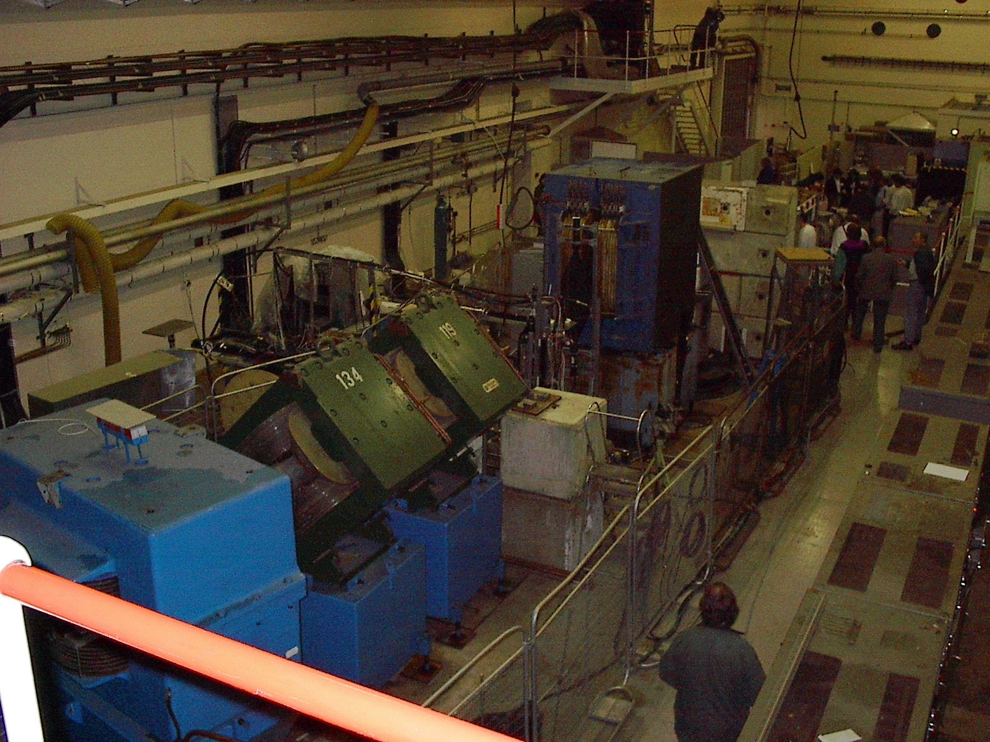

Slide 6
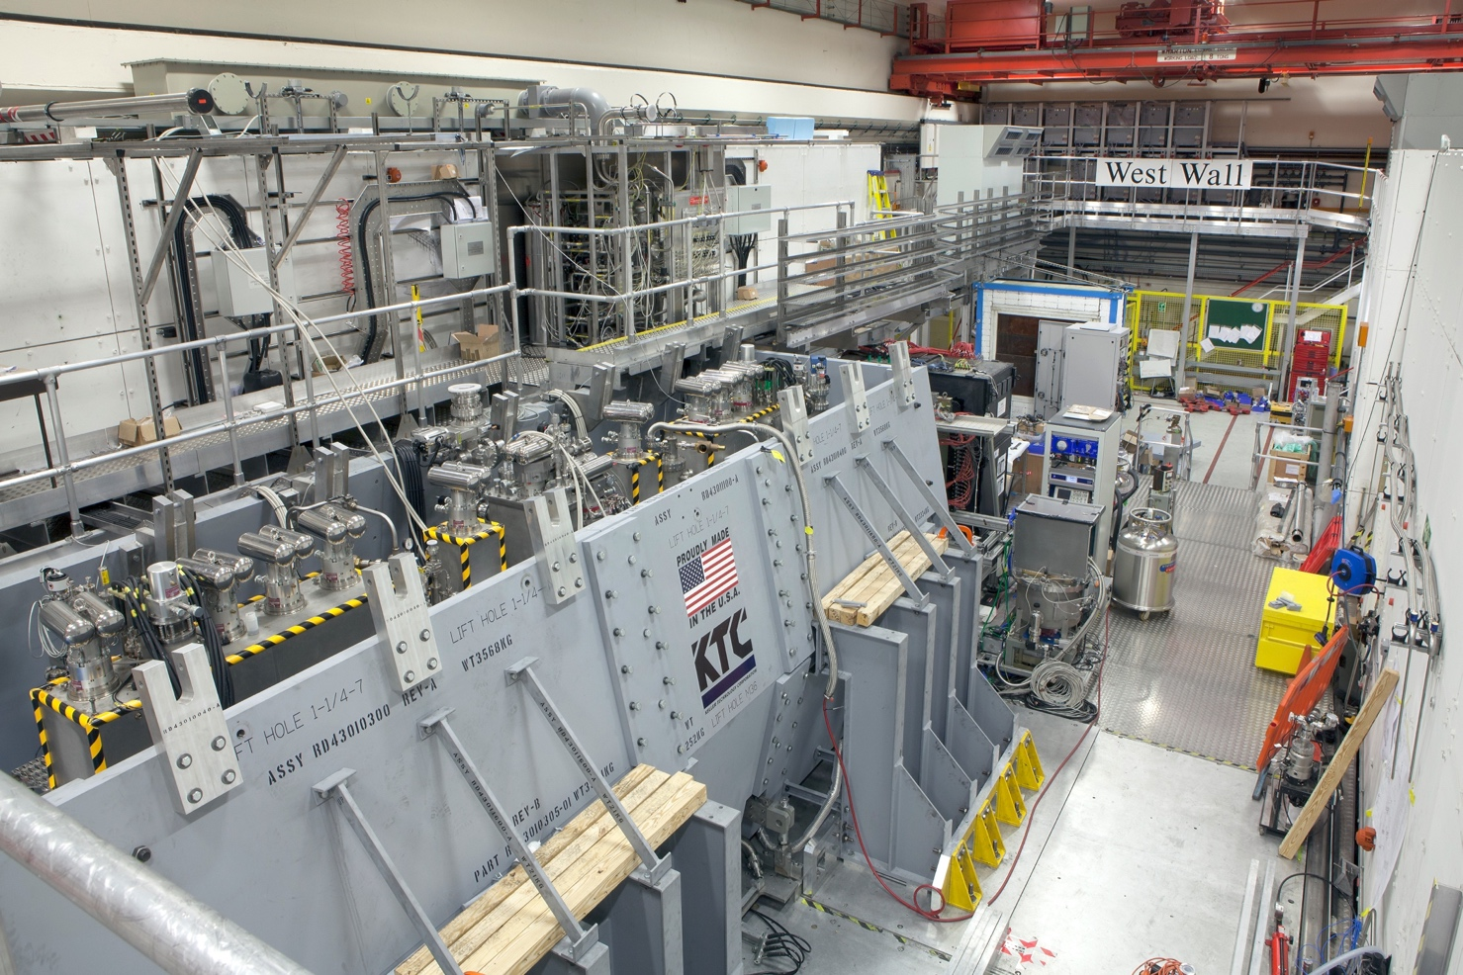
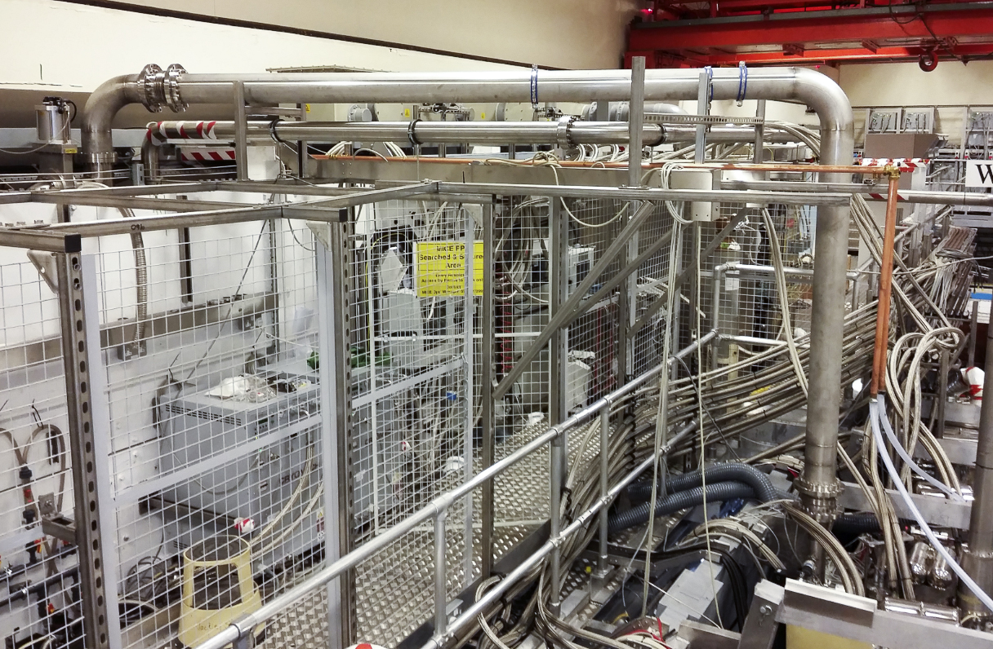

Slide 7
Liquid-hydrogen system
Final cool-down start: 13Sep18
Fill start: 17Sep18
Absorber full: 25Sep18
Stable operation

Slide 8
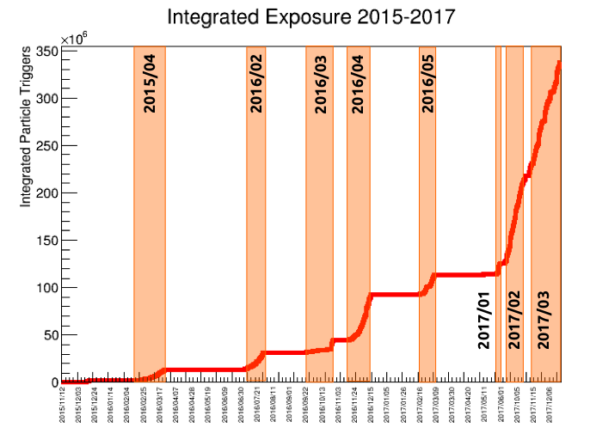

Slide 9
Evolution of Motivation 2003—2018

Slide 10
Muon Collider and Neutrino Factory

Slide 11
2003/04: Astbury panel/proposal
No lower bound on θ₁₃
Indirect constraints on Higgs mass:
LHC operations not yet started
Energy frontier beyond LHC under discussion
Ionization cooling required:
Neutrino Factory:
Discovery reach to <~ 4 x 10⁻⁶
Muon Collider:
Luminosity to deliver multi-TeV collisions

Slide 12
2012: annus mirabilis
New Higgs-like state at 125 GeV:
Clear programme @ LHC to test SM Higgs hypothesis
Daya Bay: θ₁₃ ~ 0.1 > 0:
Conceivable to discover CP-invariance violation
Neutrino Factory not required for next step in search for CP-invariance violation
ICHEP 2012: school-boy mean
[Risk noted in business case @ G/w 0]

Slide 13
Projected sensitivity to CPiV
LBNF/DUNE
J-PARC/Hyper-K
DUNE and Hyper-K alone:
5σ sensitivity over >50% of all values of δ_{CP} after 10 yrs
Combined—sensitivity enhanced

Slide 14
2018:
P5:
Neutrino programme:
LBNF/DUNE
LBND
Energy Frontier:
LHC and its upgrades
ILC
Looking beyond LHC @ DUNE/Hyper-K
EU Strategy update:
Muon Collider w/g:
Proton driven
LEMMA; e⁺e⁻ driven
MICE results important i/p to Strategy Update process

Slide 15
A brief history
Collaboration perspective

Slide 18
International review of MICE
Astbury Panel #1: 2002
Astbury Panel #2: 2003
Recommended full proposal be solicited
Among the recommendations:
Recommended approval of the proposal
Among the recommendations:

Slide 19
Astbury #2, Gateway 0, 1, 2/3
It did not prove to be possible to deliver:
RAL-based technical liaison in each critical sub-system; and
RAL-owned Technical Advisory Committee
KL comment: would have been of substantial benefit
Joint (CCLRC/PPARC) MICE Project Board: 2003/05
Oversaw MICE’s passage through Gateway Process:
UK approval process for Government procurement (analogous to US Critical Decision process)
Critical JMPB decisions:
Staged implementation:
Phase I: MICE to Step II
Phase II: MICE to Step VI
Air-cooled refrigerator to serve decay solenoid:
PSI solenoid requires high-pressure He gas at 10K; final expansion is done in the magnet
Consequence:
Superconducting magnets for MICE cooled using cryocoolers
Increased demands on design and execution of spectrometer, focusing and coupling magnets
KL comment:
Reduced risk and cost to UK; arguably allowing project to be approved
Increased risk and cost to collaborating institutes, in particular, the US

Slide 20
CMPB 2005/10
CCLRC (later Collaboration) MICE Project Board
Oversaw execution of Phase I project (to Step II); and
Preparation of Phase II (MICE to Step VI)
Collaboration management of project:
Through ‘Technical Coordinator’ (aka Project Manager); and
Technical Board (http://mice.iit.edu/tb/)
Evolution of schedule:
Delays in implementation of MICE Muon Beam
Controlled by 2008, but, arguably focus on MMB issues meant that scrutiny of other aspects of MICE project by collaboration and CMPB was not so rigorous/detailed

Slide 21
2010—
MICE Project Board constituted 2010:
Resource Loaded Schedule Review 2013—
Collaboration:
MICE International Project Office: 2013—
Some key dates:
Step I complete: 2010
Stray field identified as an issue: Mar 2012
SSU (SS2) delivered to RAL Aug 2013
PRY adopted as solution: Sep 2013
Focus-coil installed Oct 2013
SSD (SS1) delivered to RAL Oct 2013
SSU, SSD installed May, Jul 2014
PRY complete May 2015
Magnet commissioning start Jun 2015

Slide 22
Rebaseling
US P5 review: May 2014
Building for Discovery: Strategic Plan for U.S. Particle Physics in the Global Context
“Realign activities in accelerator R&D with the P5 strategic plan. Redirect muon collider R&D and consult with international partners on the early termination of the MICE muon cooling R&D facility.”
MuPAC: July 2014
From Office timeline summary:
MICE seen as interesting benchmarking but not key to US programme
DOE MAP/MICE review: August 2014:
Coupling coil removed from MICE cooling cell
MPB/RLSR: November 2014:
Formal rebaseline:
MICE programme will culminate in simplified cooling demonstration

Slide 23
Turning points
13th September 2015:
SSD M1 coil fails in training quench
26Oct15, 3/4Dec15: Magnet reviews (US/MAP):
Replacement or refurbishment of SSD
MPB/RLSR: 03/04 April 2016:
UK should seek to recover SSD with transfer of resource from US
STFC Cost to completion review: 26 April 2016:
Rejects UK SSD recovery plan
Recommends extended running in Step IV configuration and that collaboration be asked to submit a proposal for a cooling demonstration that could be performed with available equipment
MICE to STFC: May 2016:
STFC Executive Board: 26th May 2016:
Rejects SSD recovery plan; rejects reconfiguration of cooling demonstration
Approves extended operation of Step IV
Clearly a turning point: KL comments:
Magnet training: over-extended many of the staff involved:
Enhanced staffing essential for a future effort:
Personnel to execute training
Expert personnel: magnet, cryogenic and electrical to oversee and trouble-shoot
Failure of M1 coil in SSD:
Risk of such a failure could have been reduced:
Stronger support at RAL by DL electrical experts and FNAL electrical/magnet/quench-protection experts
Greater understanding of quench propagation in SS cold mass (2020 hindsight)
Better record keeping and/or greater trained electrical/electronic technical support during QD/QP set up
Enhanced QA/QC during magnet manufacture and possibly also intrinsic design issue(s)

Slide 24
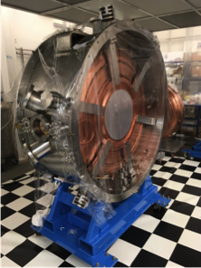
Observations
At the time the decision to cancel the cooling demonstration (with RF) was taken:
The two single-cavity modules were at an advanced stage of preparation
Prototype had delivered >20 MV/m and was ‘quiet’
The RF amplifier had delivered 1 MW into a dummy load in DL
New groups had joined the collaboration to contribute to the cooling demonstration:
China: IHEP Beijing, Sichuan
Korea: UNIST
Serbia: Belgrade, Novi Sad

Slide 25
Cost to completion
Asian and European:
Began, formally, in 2005 (cost of proposal preparation earlier)
Deliverables essentially on time, never on critical path
Spend continues to present day

Slide 26
Science and impact

Slide 27
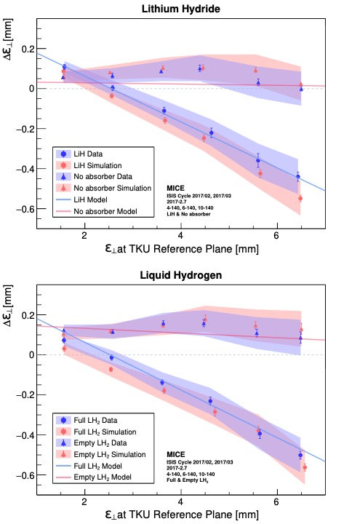
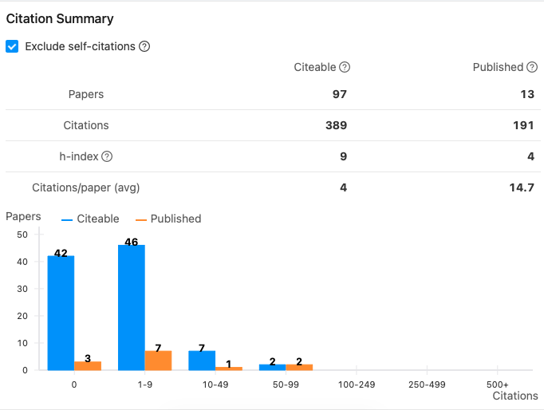
Publications

Slide 28
Education and training
‘First destination returns’
Significant accelerator project experience:
Lab and University;
Early-career researcher and senior staff(!)

Slide 29
Thoughts …

Slide 30
Benefit of muon beams
Energy frontier: big advantage over pp because fundamental fermion
Future study of the Higgs:
Line width; establish single resonance (?) in s-channel with μ⁺μ⁻
Couplings; requires > 1 TeV for complete, precise study

Slide 31
Lessons learnt …
… well … sound project management, etc. DOE labs good at this; so …
Consider, e.g., nuSTORM; development of FNAL muon complex for high-brightness beams …

