Slide 1






Muon Collider Ring Magnets
Seminar Series for the National Lab Muon Accelerator Study Group
S. Mariotto^{1,2}, B. Caiffi³, L. Alfonso³, A. Bersani³, L.Bottura⁴, S. Farinon³, F. Mariani^{2,5}, D. Novelli^{3,5}, A. Pampaloni^{3,5}, T. Salmi⁶
¹Università degli Studi di Milano
²INFN, LASA, Sezione di Milano
³INFN, Sezione di Genova
⁴CERN
⁵Università La Sapienza, Roma
⁶Tampere University
Funded by the European Union (EU). Views and opinions expressed are however those of the author only and do not necessarily reflect those of the EU or European Research Executive Agency (REA). Neither the EU nor the REA can be held responsible for them.

Slide 2
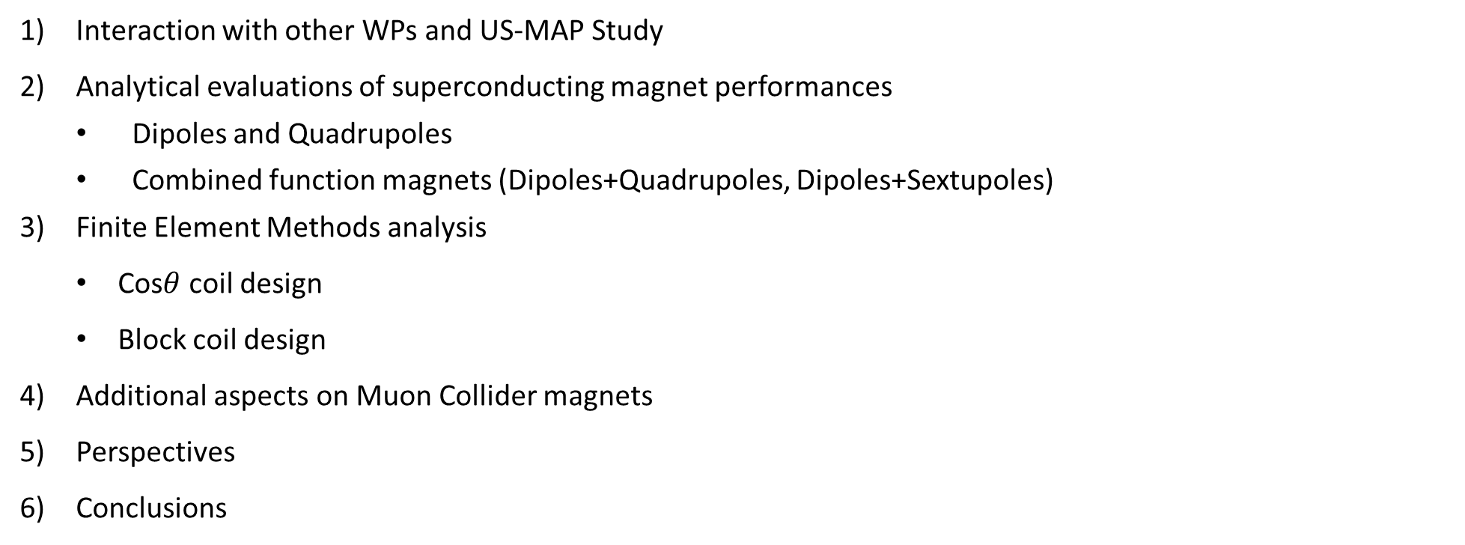
Outline
Interaction with other WPs and US-MAP Study
Analytical evaluations of superconducting magnet performances
  Dipoles and Quadrupoles
  Combined function magnets (Dipoles+Quadrupoles, Dipoles+Sextupoles)
Finite Element Methods analysis
  Cos$θ$ coil design
  Block coil design
Additional aspects on Muon Collider magnets
Perspectives
Conclusions

Slide 3
The Muon Collider Complex
IMCC (Internation Muon Collider Collaboration) aims at studying the feasibility of a 10 km, 10 TeV center of mass energy Muon Collider, as indicated by the European Strategy for Particle Physics.
Main driver for collider constraints: $μ d$ecays in 2.2 $μs$in rest frame
OUR GOAL
Analyze realistic technical design options for the development of superconducting magnets for the 10 TeV Muon Collider main ring
Identify technical challenges limiting magnet performance and propose innovative technologies to be further developed in the R&D phase following the ongoing feasibility study.
must be produced, cooled, accelerated and collided ASAP
decay products must be shielded to avoid damage
Minimized straight sections to avoid collimated neutrino flux

Slide 4
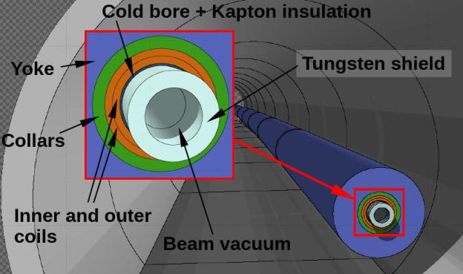
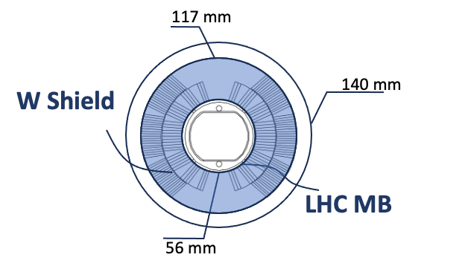
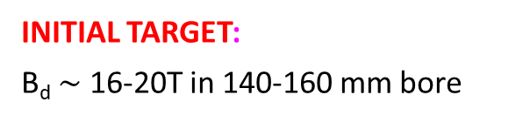
Magnets for the Collider Ring
Radial Build^{[1][2]}
High Magnetic Field (B): enables a more compact collider design
High Gradient (G): allows for a low β* to minimize beam emittance
Large Aperture: W shield to reduce the heat load caused by muon decay products
Combined Function Magnets: avoid straight sections to mitigate neutrino-induced radiation
INITIAL TARGET:
B_{d} $\sim$ 16-20T in 140-160 mm bore
~x3 LHC dipole apertures!
[1] P. Borges de Sousa https://indico.cern.ch/event/1250075/contributions/5357594/
[2] A. Lechner “Radiation shielding studies for superconducting magnets in multi-TeV muon colliders” IPAC24

Slide 5
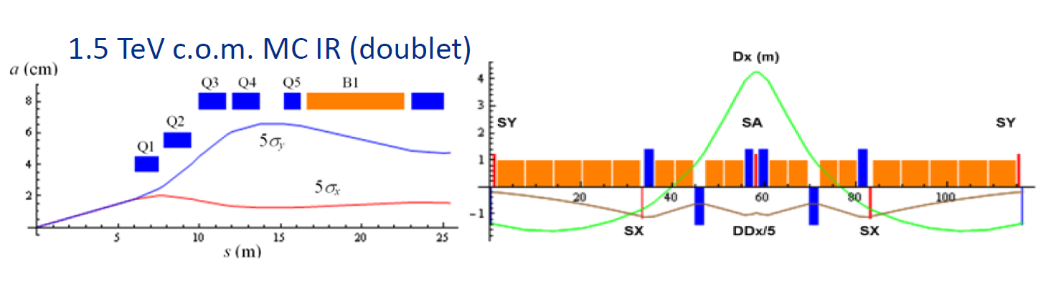
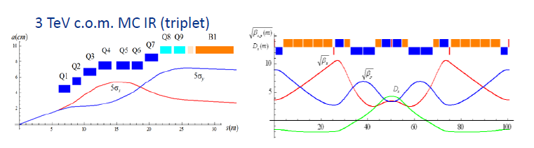
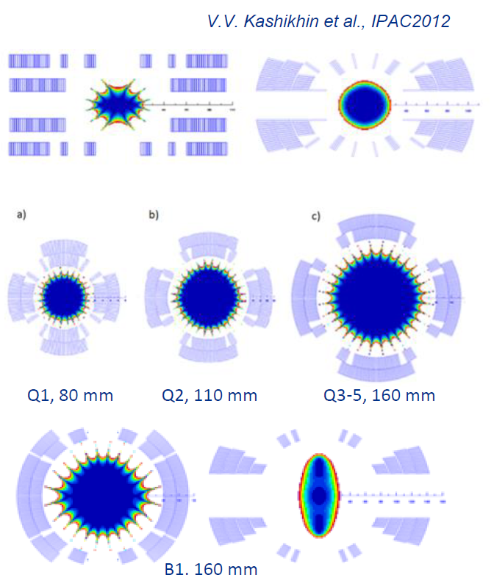
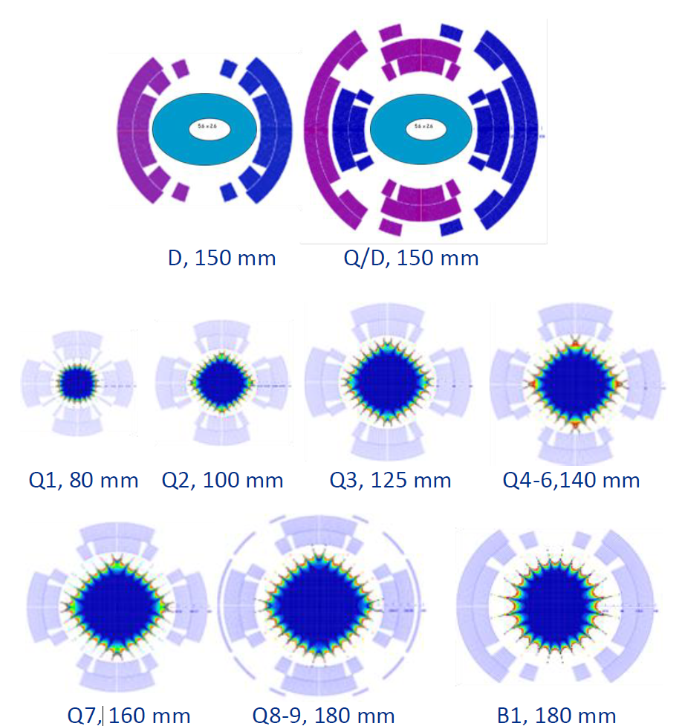
MC 1.5 TeV and 3 TeV from US-MAP
Overview
1.5 TeV Design
3 TeV Design
Nb3Sn magnets – baseline approach
Use of high Jc Nb3Sn strands and 40-42 Rutherford cables conductors
Targets:
  B_{d} = 10 T and G = 200 T/m for Q (1.5 TeV)
  Combined B_{d} = 8-9 T + G = 80 T/m (3 TeV)
Design approach: open midplane vs closed shell
Flat racetrack coils above bore aperture
Good field quality only in ~30% of coil aperture
Increase in coil size to compensate FQ
Mechanics requires mid-plane support
Extrapolation at 6 TeV from the 3 TeV design
Stress management solutions for large aperture
IR Magnets assumed to use HTS technology (20 T)
More on this topic:
Courtesy of A. Zlobin
https://indico.cern.ch/event/1147940/

Slide 6
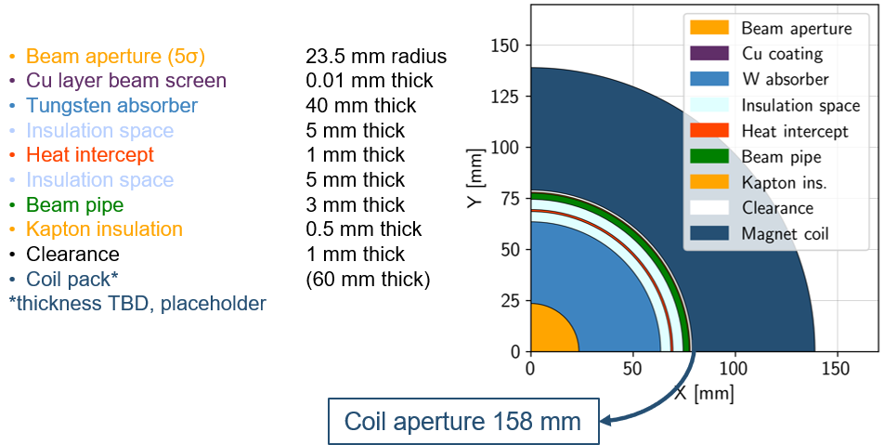
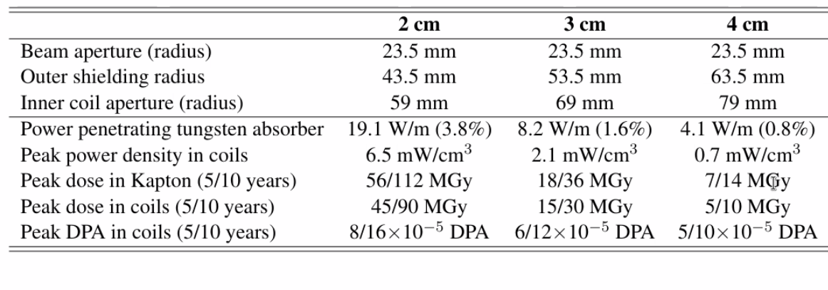
Interaction with other WPs
Courtesy of Patricia Borges de Sousa
https://indico.cern.ch/event/1250075/contributions/5357594/
Collection of requirement and constraints coming from other WP studies to select most challenging magnet configuration for technical design study:
Beam Lattice design:
  Magnet type / Field / Aperture
Cryogenic studies:
  Operating Temperature, Thermal Insulation thickness
Radiation heat loading/degradation
  Shielding thickness, Radiation heat load, radiation dose
Radial build
N.B bore_{magnet}= beam aperture (23.5 mm) + [Cu layer beam screen,+ Insulation space & heat intercept + beam pipe + Kapton insulation + clearence] (15.5 mm ) + W_{abs} (30-40 mm)
ARC Magnet Shielding assumption:
T_{op} < 10 K:
W_{abs} = 4 cm (P<5 W/m) / 160 mm aperture
T_{op} = 20 K:
W_{abs} =3 cm (P<10 W/m) / 140 mm aperture
Courtesy of Anton Lechner – IPAC24 Conference
https://cds.cern.ch/record/2912945

Slide 7
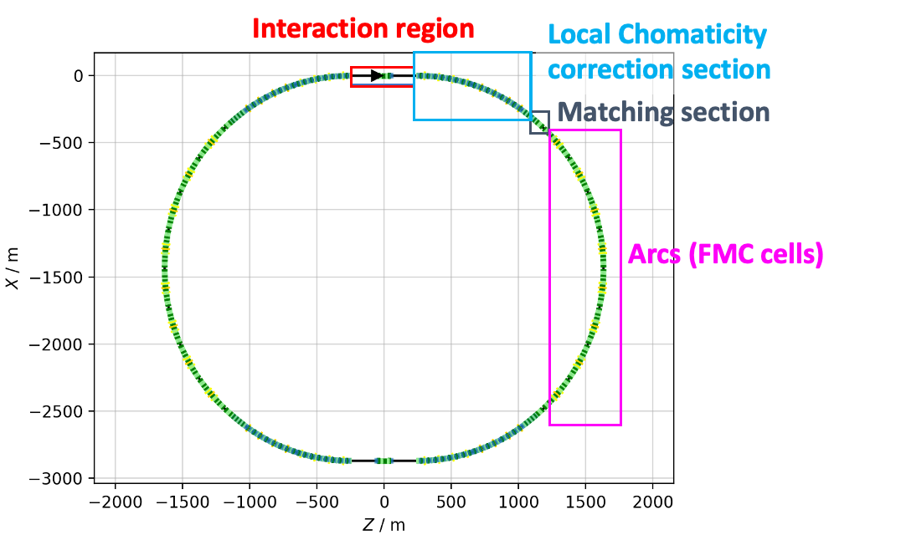

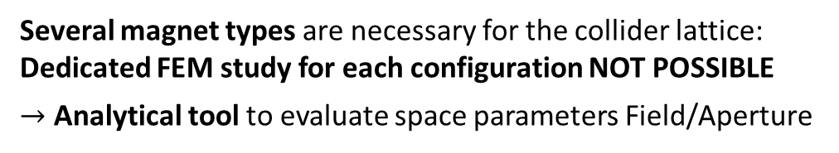
Different Magnet Options:
Specs from Beam Optic Studies
ARC[1]
Interaction region[2]
Dipole:
B_{d}=16 T in 138 mm bore aperture
Combined magnets:
B_{d}=8 T, G1=+-320 T/m bore in 130 mm bore aperture
Name | L [m] | Magnet aperture diameter [mm] | B[T]
IB2 | 6 | 320 | 8.1
IB1 | 10 | 320 | -9.7
IB3 | 6 | 320 | 8.1
Name | L [m] | Magnet aperture diameter [mm] | G [T/m]
IQF2 | 6 | 280 | 85.2
IQF2_1 | 6 | 266 | 85.2
IQD1 | 9 | 290 | -115.4
IQD1_1 | 9 | 290 | -115.4
IQF1B | 2 | 204 | 205.1
IQF1A | 3 | 172 | 241.8
IQF1 | 3 | 140 | 302.2
Courtesy of:
C. Carli, K.Skoufaris , M. Vanwelde
Chromatic Correction
Dipole[1]:
B_{d}=16 T in 138 mm bore aperture
Combined magnets:
B_{d}=4 T, G1=+-240 T/m in 170 mm bore aperture
B_{d}=4 T, G2=+-330 T/m² in 130 mm bore aperture
[1] K. Skoufaris et al. ``Update on collider optics design'', IMCC Annual Collaboration Meeting 2024 https://indico.cern.ch/event/1325963
[2] M. Vanwelde et al., `` Status of the 10 TeV center-of-mass collider lattice and IR design'', IMCC Detector and MDI workshop 2024 https://indico.cern.ch/event/1402725
Several magnet types are necessary for the collider lattice:
Dedicated FEM study for each configuration NOT POSSIBLE
$→$ Analytical tool to evaluate space parameters Field/Aperture

Slide 8
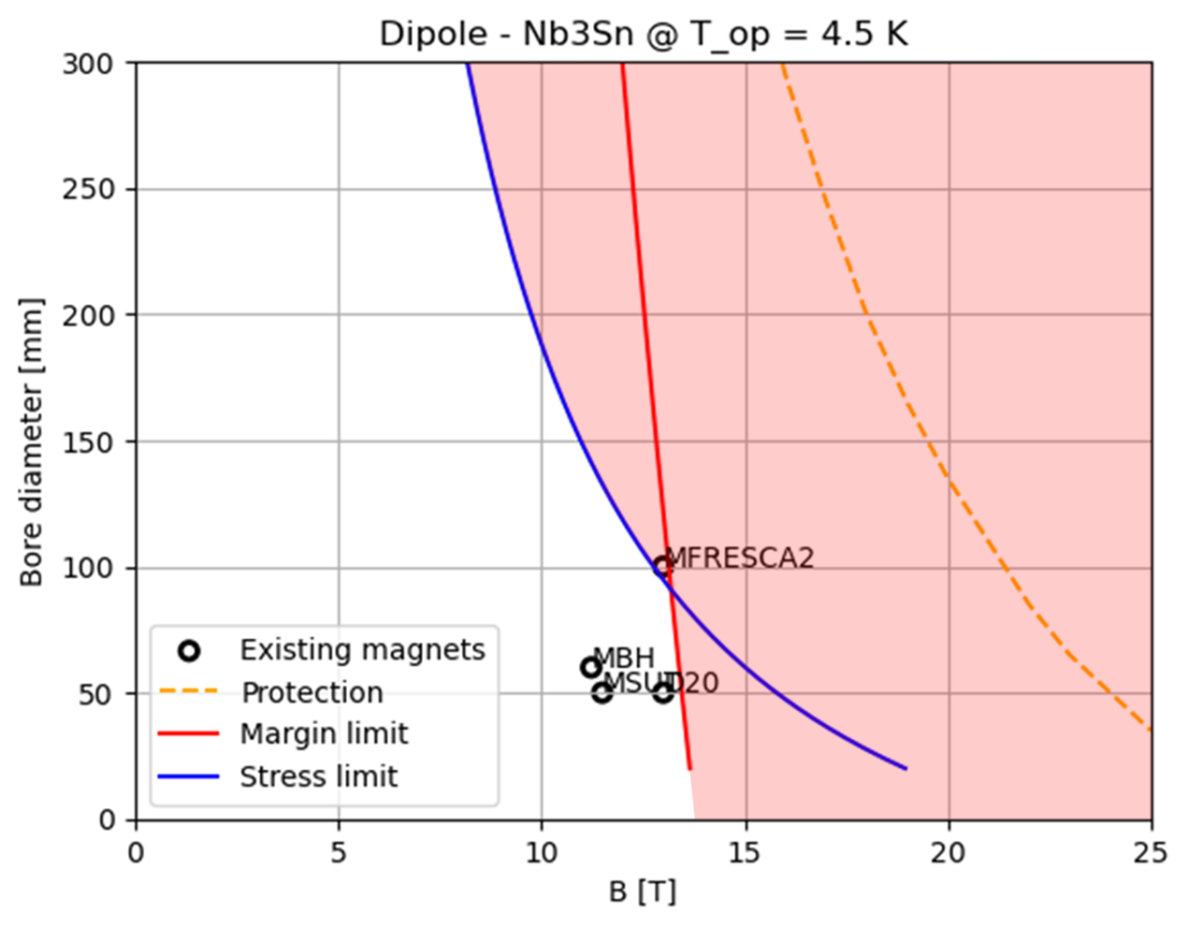
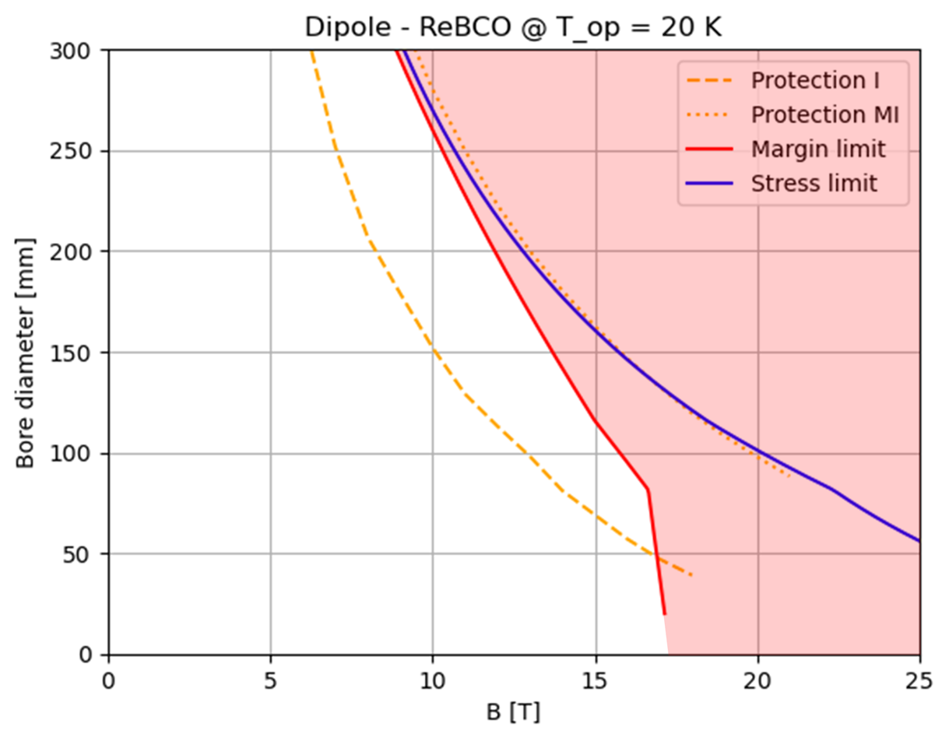
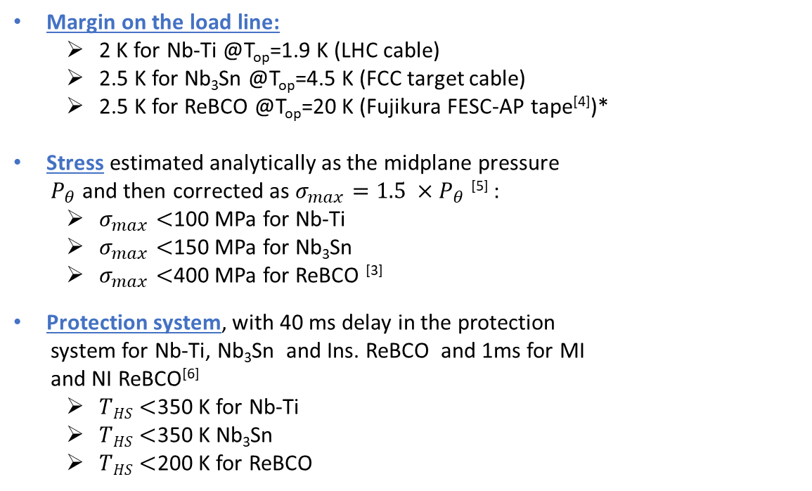
Upper Limit Definition
Semi-analytic innovative approach^{[1,2,3]} to define upper limits for the magnet performances at different temperatures and budgets, for different technology (Nb-Ti, Nb₃Sn, ReBCO) considering the following constraints:
Margin on the load line:
  2 K for Nb-Ti @T_{op}=1.9 K (LHC cable)
  2.5 K for Nb₃Sn @T_{op}=4.5 K (FCC target cable)
  2.5 K for ReBCO @T_{op}=20 K (Fujikura FESC-AP tape^{[4]})*
Stress estimated analytically as the midplane pressure
$P_{θ}$and then corrected as $σ_{max}={1.5 ×P}_{θ}$^{[5]} :
  $σ_{max}<$100 MPa for Nb-Ti
  $σ_{max}<$150 MPa for Nb₃Sn
  $σ_{max}<$400 MPa for ReBCO ^{[3]}
Protection system, with 40 ms delay in the protection
system for Nb-Ti, Nb₃Sn and Ins. ReBCO and 1ms for MI
and NI ReBCO^{[6]}
  $THS<$350 K for Nb-Ti
  $THS<$350 K Nb₃Sn
  $THS<$200 K for ReBCO
A (aperture) –B (magnetic field) plots
Dipole Nb₃Sn @ 4.5K ( Max cost=400 kEur/m)
Dipole ReBCO @ 20K
( Max cost=400 kEur/m)
* Margin given by the stability of the cryogenic system
[1] D. Novelli et al 10.1109/TASC.2024.3352526 (2024)
[2] D. Novelli et al., 10.1109/TASC.2024.3507744 (2025)
[3] D. Novelli, S. Farinon, : https://doi.org/10.15161/oar.it/143359
[4] Fujikura_Tape
[5] E Todesco et al , 10.1088/1361-6668/abdba4
[6] T. Salmi et al., 10.1109/TASC.2025.3540791

Slide 9
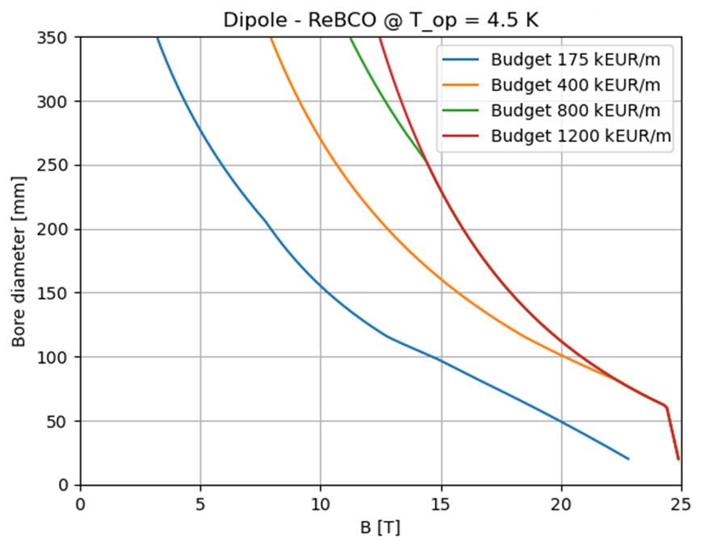
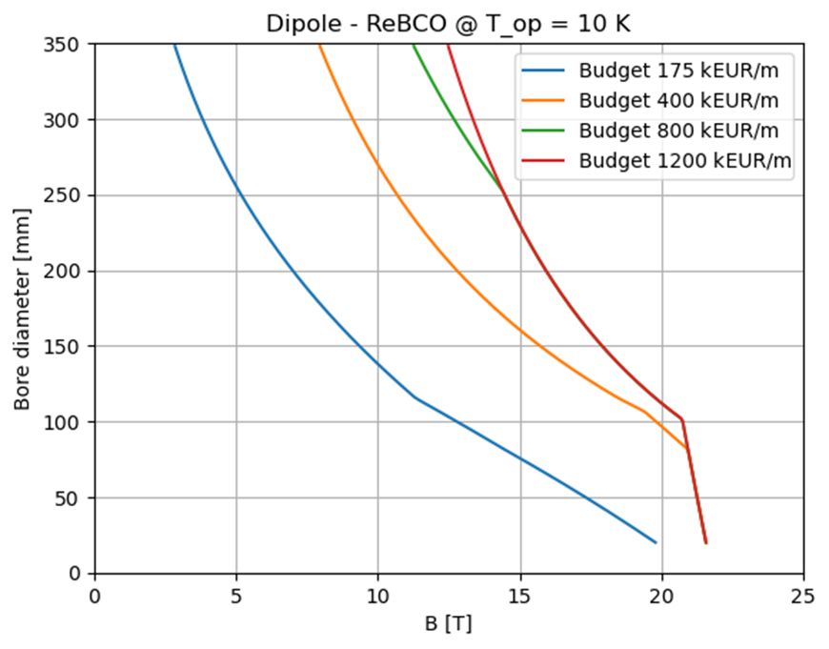
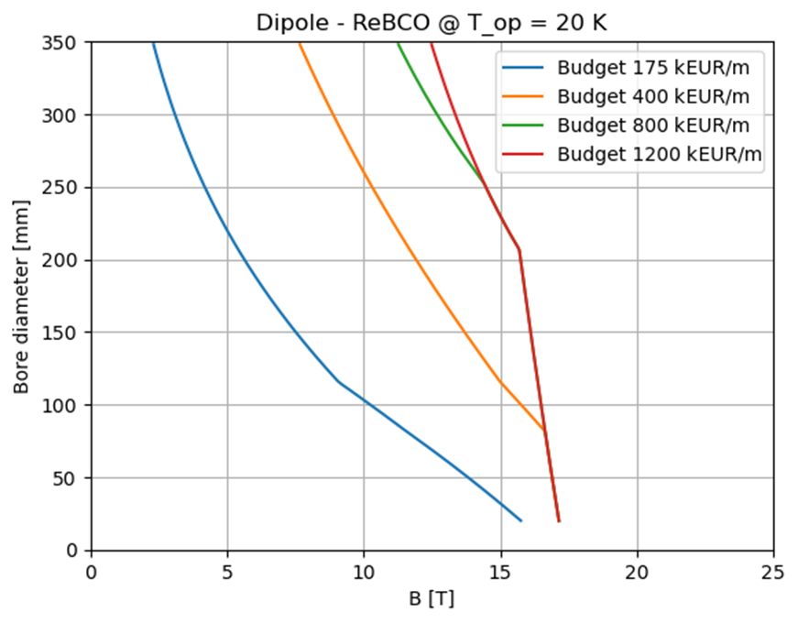
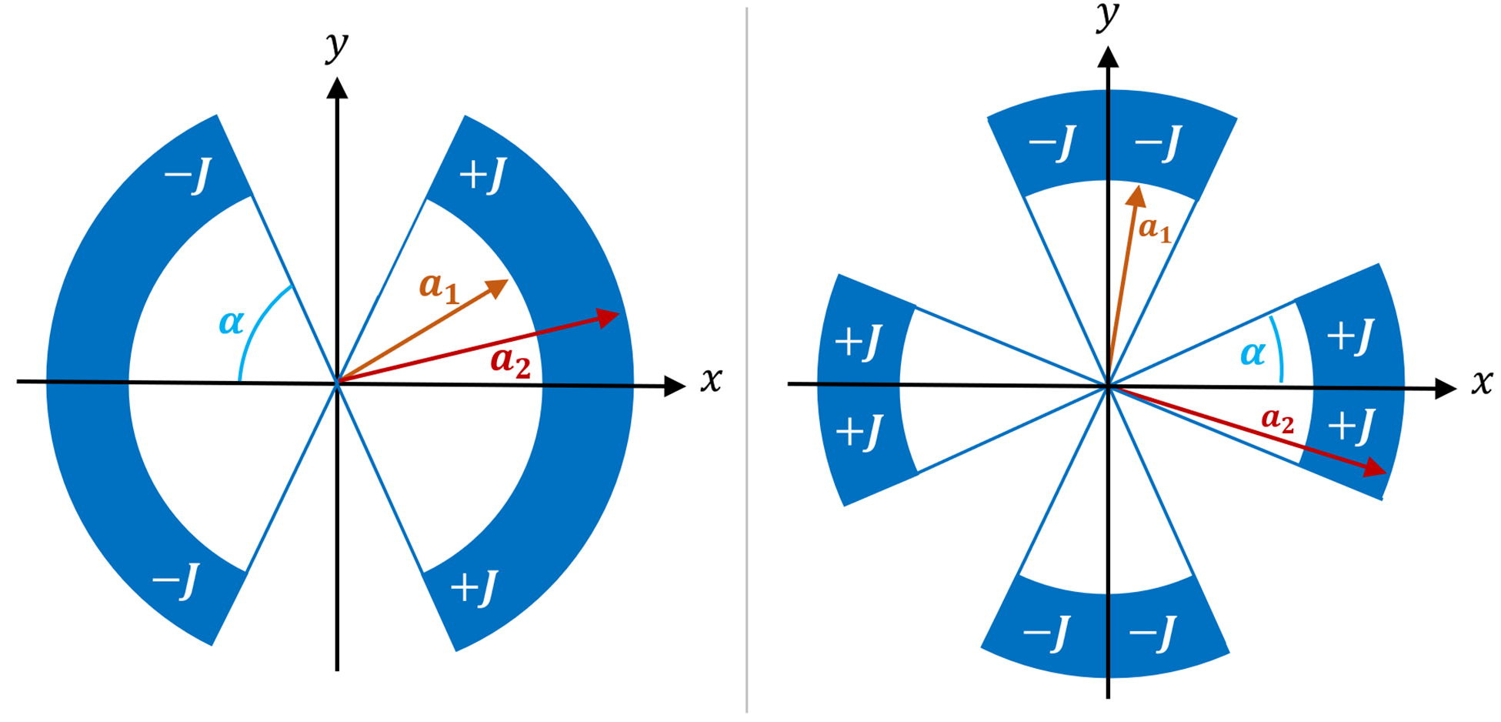



A-B plots
(Aperture)-(Field)
ReBCO @ 4.5K
ReBCO @ 10K
ReBCO @ 20K
IR [10T, 300 mm]
IR [10T, 300 mm]
IR [10T, 300 mm]
ARC [16T, 160 mm]
ARC [16T, 160 mm]
ARC [16T, 140 mm]
[14T, 140 mm]
Proposed design point
Sector coil approximation
[3]
$$C \left[\frac{kEUR}{m}\right]=C_{coil}+C_{ColdMass}+C_{CryoMagnet}$$
Summary of technical assumptions:
Single sector coil
Maximum allowed stress: 400 MPa
Fujikura Tape, Roebel cable
Non-insulated or Metal-insulated cable
$$B\left(w,J\right)=\frac{2μ_{0}J w sinα}{π}$$
($w=coil width )$
C_{ReBCO}=8013 EUR/kg (today’s prize)
C_{ReBCO}= 2671 EUR/kg (aspirational)

Slide 10
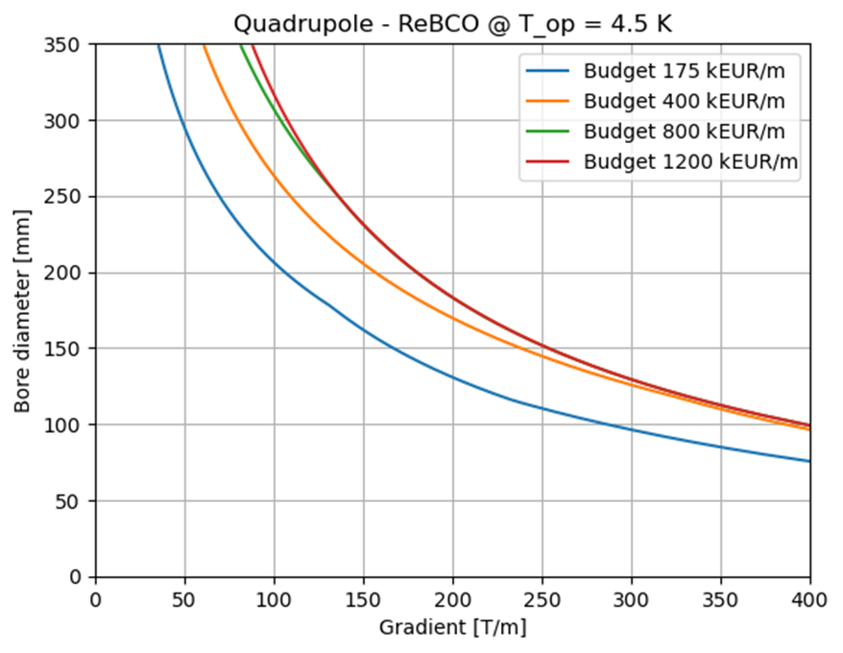
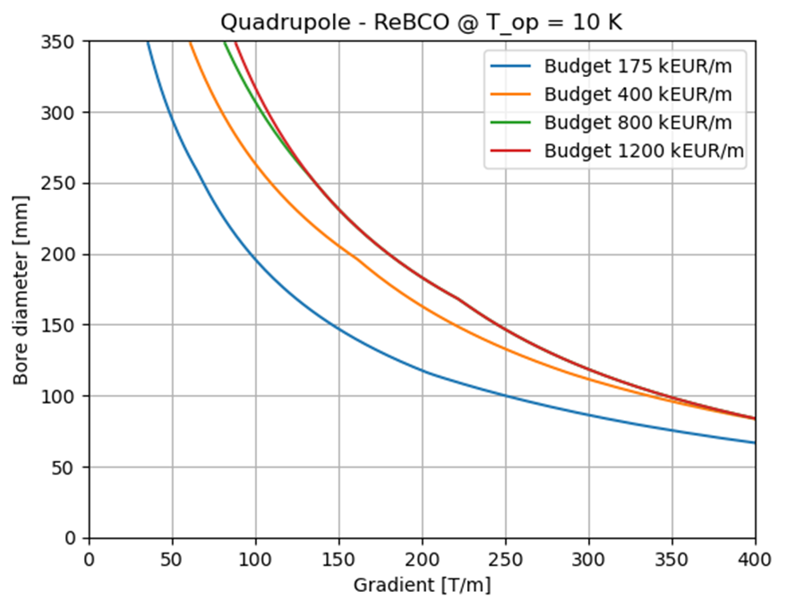
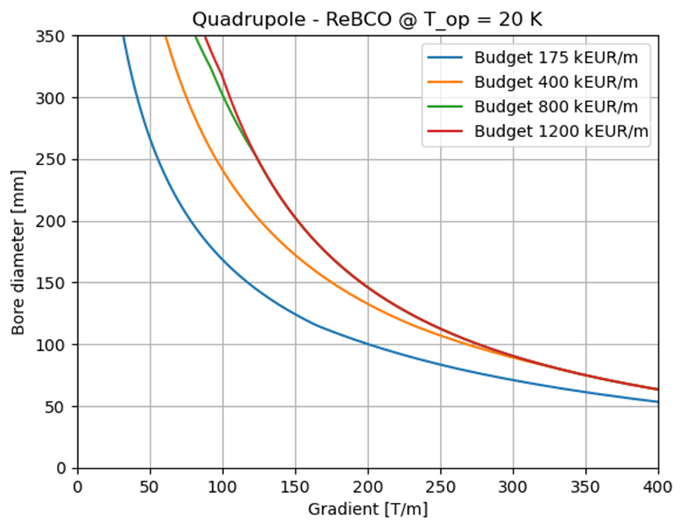



A-G plots
(Aperture)-(Gradient)
ReBCO @ 4.5K
ReBCO @ 10K
ReBCO @ 20K
IR [115T/m, 290 mm]
IR [115T/m, 290 mm]
IR [115T/m, 290 mm]
ARC [240T/m, 170 mm]
ARC [240T/m, 170 mm]
ARC [240T/m, 170 mm]
ARC [330T/m, 130 mm]
[300T/m, 140 mm]
Proposed design point
ARC [330T/m, 130 mm]
ARC [330T/m, 130 mm]
Sector coil approximation
[3]
$$C \left[\frac{kEUR}{m}\right]=C_{coil}+C_{ColdMass}+C_{CryoMagnet}$$
Summary of technical assumptions:
Single sector coil
Maximum allowed stress: 400 MPa
Fujikura Tape, Roebel cable
Non-insulated or Metal-insulated cable
$$G\left(w,J\right)=\frac{2μ_{0}J}{π}\ln\left(1+\frac{w}{a_{1}}\right)sin⁡(2α)$$
($w=coil width )$
C_{ReBCO}=8013 EUR/kg (today’s prize)
C_{ReBCO}= 2671 EUR/kg (aspirational)

Slide 11
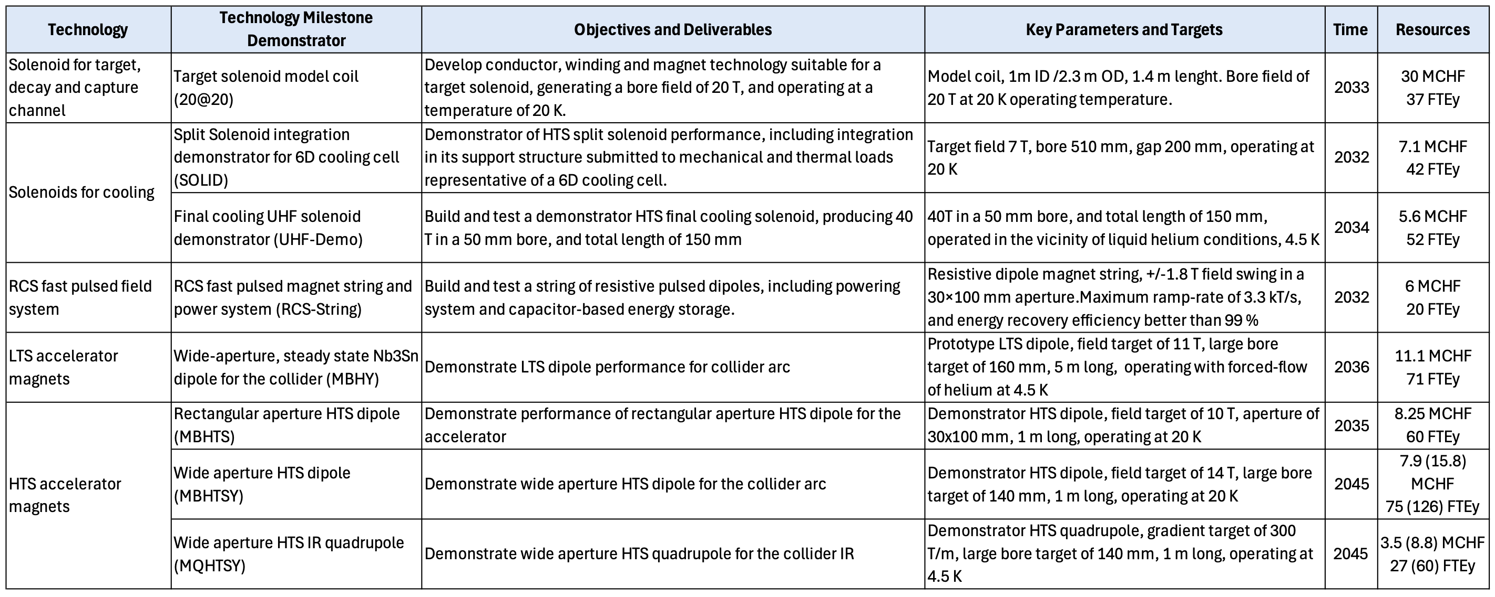

A-B and A-G Plots
Dipole- ReBCO @ 20K^{[1,2,3]}
Quadrupole - ReBCO @ 4.5K ^{[1,2,3]}
Summary of technical assumptions:
Single sector coil
Maximum allowed stress: 400 MPa
Fujikura Tape, Roebel cable
Non-insulated or Metal-insulated cable
Baseline for ARC dipoles: 20 K, 400 KEur/m
Baseline for IR quadrupoles: 4.5 K, 800 KEur/m
IR [10T, 300 mm]
IR [115T/m, 290 mm]
ARC [240T/m, 170 mm]
ARC [16T, 140 mm]
ARC [330T/m, 130 mm]
$$C \left[\frac{kEUR}{m}\right]=C_{coil}+C_{ColdMass}+C_{CryoMagnet}$$
[14T, 140 mm]
Proposed design point
[300T/m, 140 mm]
Proposed design point
C_{ReBCO}=8013 EUR/kg (today’s prize)
C_{ReBCO}= 2671 EUR/kg (aspirational)
Technology demonstrators corresponding to proposed design point identified as milestones in the supplementary report to the European Strategy for Particle Physics (arXiv:2504.21417)
[1] D. Novelli et al 10.1109/TASC.2024.3352526 (2024)
[2] D. Novelli et al., 10.1109/TASC.2024.3507744 (2025)
[3] B. Caiffi Collider ring magnets cost model, IMCC Annual Meeting

Slide 12
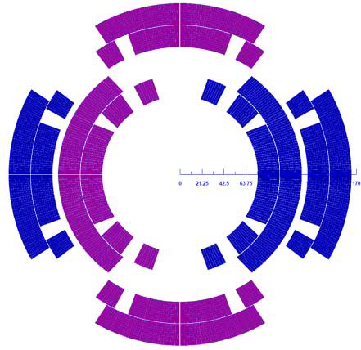
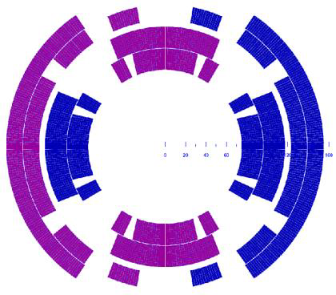
Combined function magnets
The straight path generates huge dose induced by the neutrino beams from muon decays
COMBINED FUNCTION
MAGNETS
Asymmetric
Nested
N.B. displacement x 100
T. Ogitsu
  Pros: Separate Powering Dipole/Quadrupole
  Inherit experience on Nb3Sn magnets for HiLumi and LARP-US development program
  Cons: Stress on Coil is critical (large forces where currents are opposite)
  Alignment between the two coils
  Two types of different coil to be produced (Higher Costs)
  Pros: Single type of coil
  Optimized margin and field quality
  Cons: Fixed Dipole/Quadrupole ratio
  Stress on the supporting structure is not balanced
  Magnet protection more difficult

Slide 13
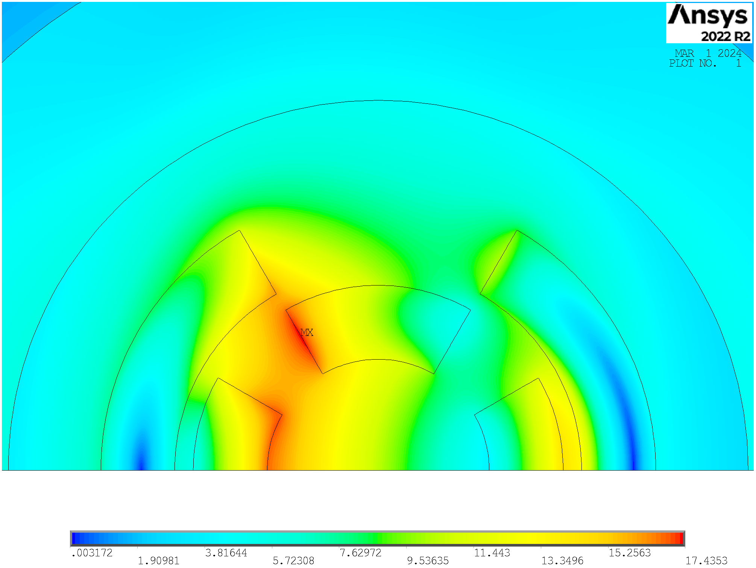
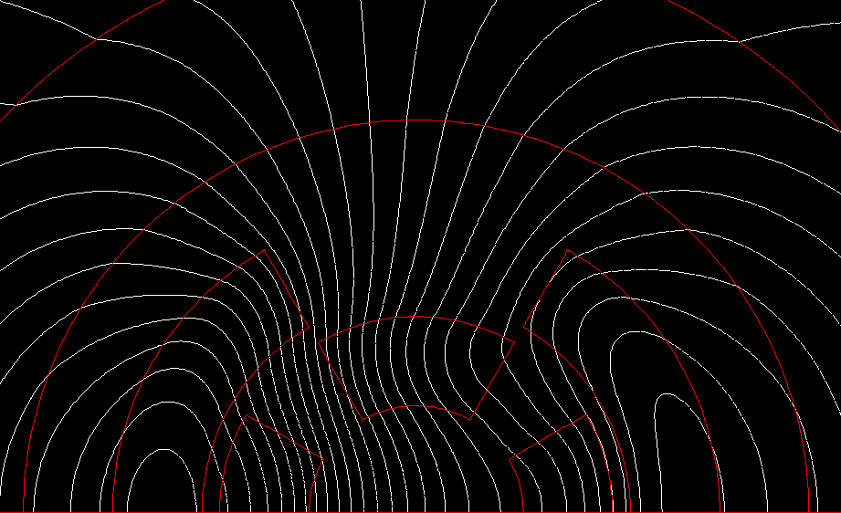
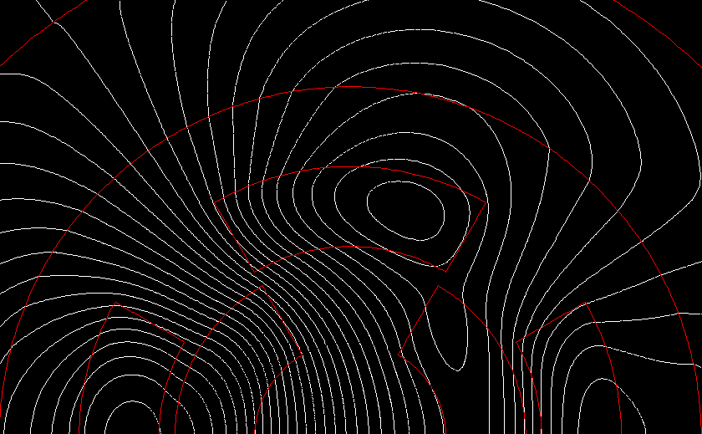
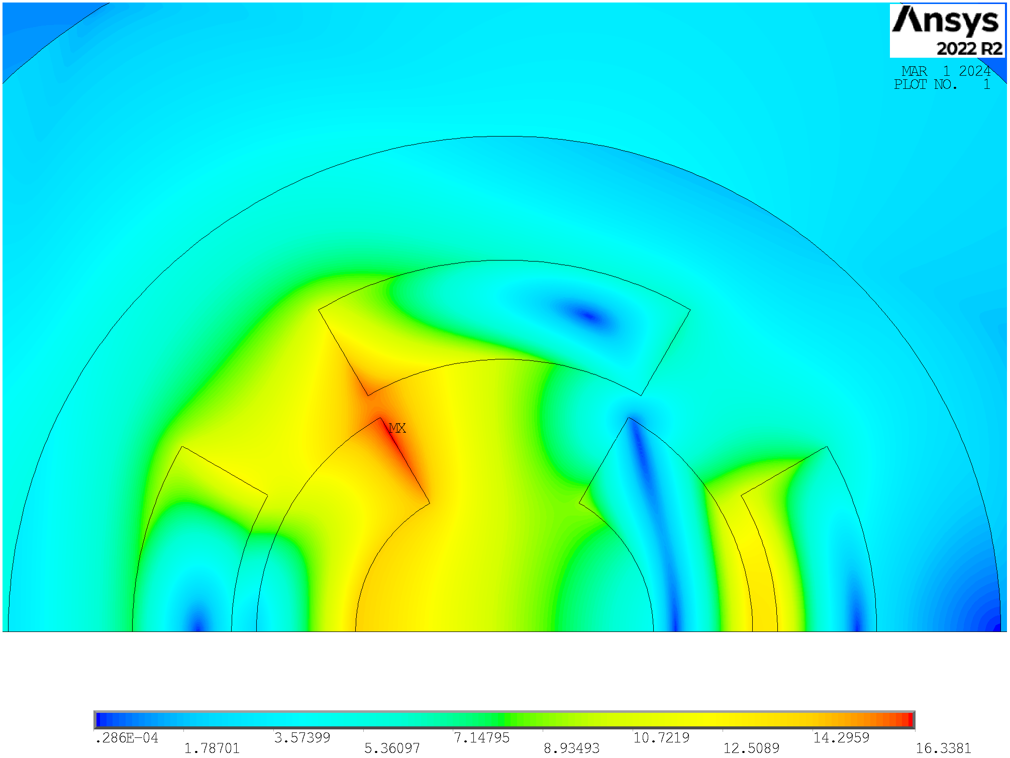
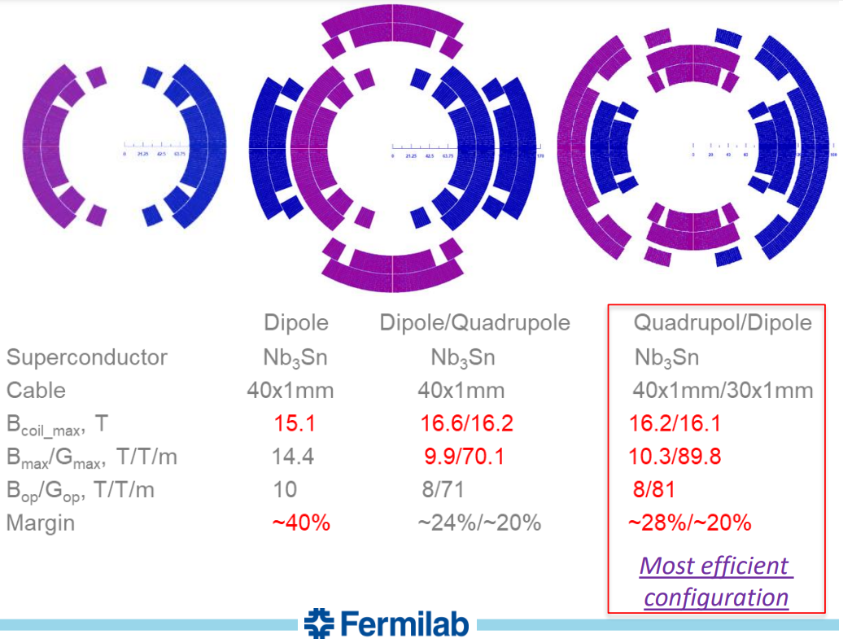
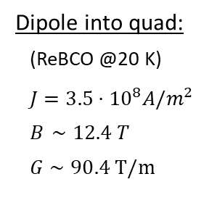
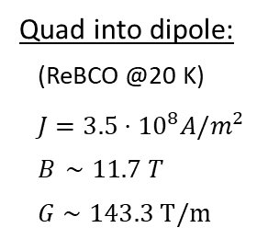
Which Type of Nested Solution?
Quad into dipole:
(ReBCO @20 K)
$J=3.5⋅{10}^{8}A/m^{2}$
$B_{ }∼11.7 T$
$G∼143.3 T/m$
Dipole into quad:
(ReBCO @20 K)
$J=3.5⋅{10}^{8}A/m^{2}$
$B_{ }∼12.4 T$
$G∼90.4 T/m$
N.B. displacement x 100
These two configurations are NOT realistic.
Arc:
Combined function magnets: B1, B1+B2 and B1+B3
B ≈ 8…16 T; G ≈ 320 T/m; G’ ≈ 7100 T/m²
Aperture ≈ 130 mm
Final focus:
Combined function magnets: B1, B2, B1+B2 , B1+B3
B ≈ 4…16 T; G ≈ 100…300 T/m; G’ ≈ 12000 T/m²
Aperture ≈ 120…300 mm
The quadrupole into dipole configuration is the most efficient one, in accordance with US-MAP. Additionally, for combined function magnets in the muon collider, quadrupoles are generally required to be stronger than dipoles.

Slide 14
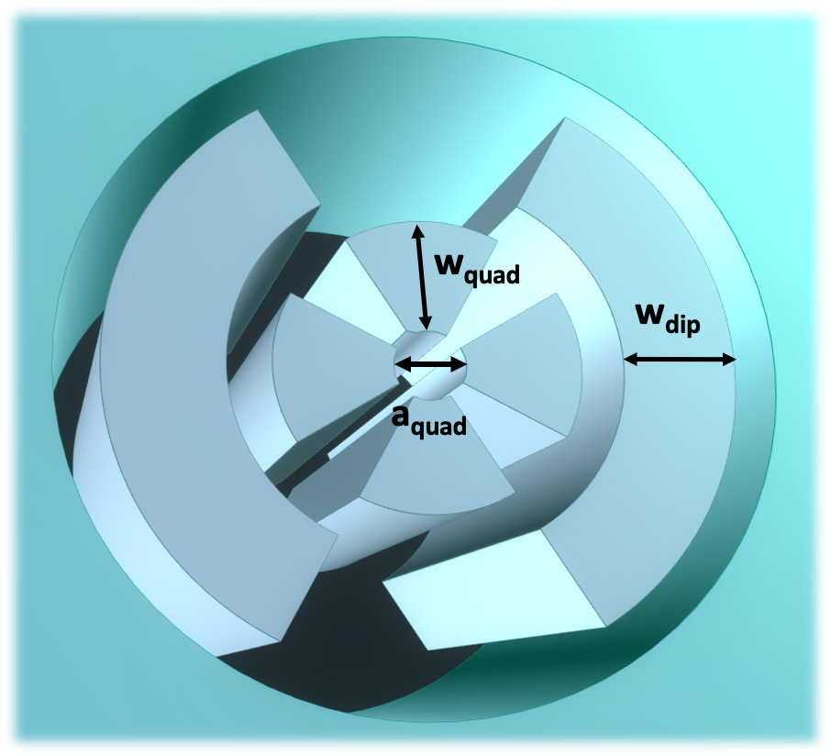
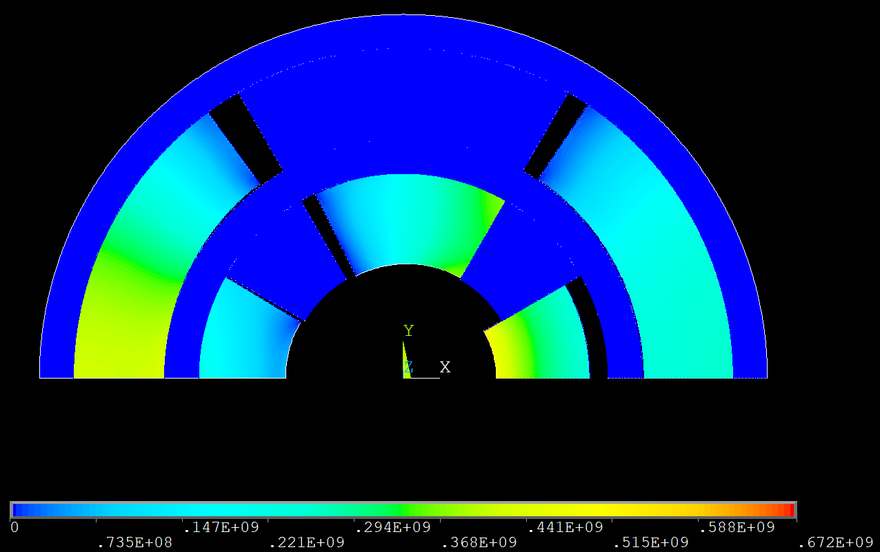
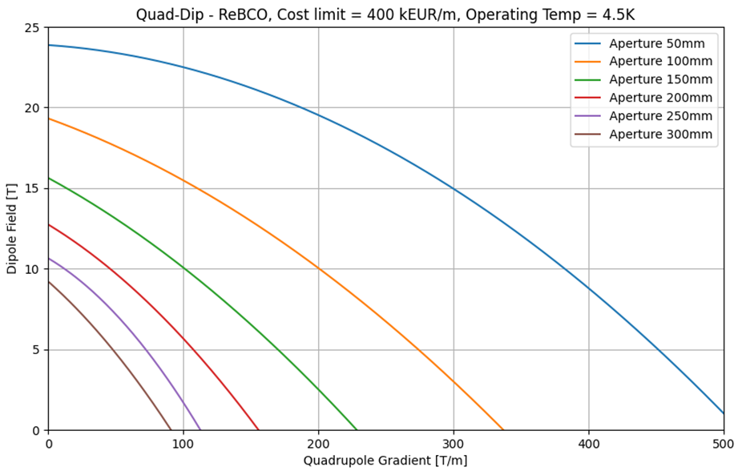
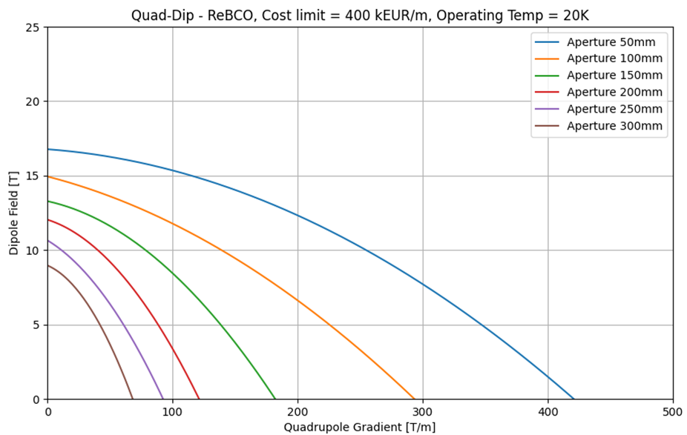
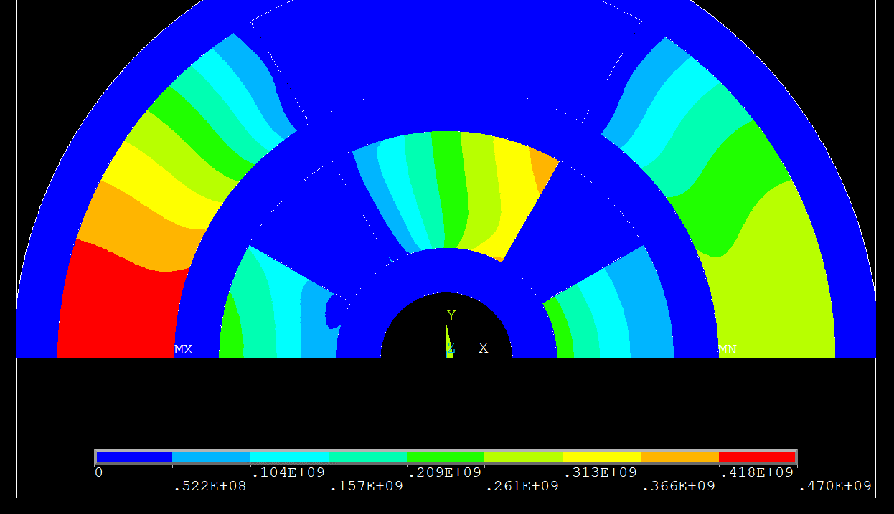
B-G plots for combined function magnets
Nested configuration with quadrupole (inside) + dipole (outside), sector coil approximation
E.M. optimization based on Python + ANSYS interface
Constraints on stress, margin on the loadline, protection and cost as in the AB-plots and AG plots
N.B. displacement x 100
ReBCO Cost limit =400 kEUR/m T_{op}=4.5K
Inward movement of the inner coil (quadrupole) -> must be intercept by the mechanical structure
From lattice design v0.7:
8 T, 100 T/m, aperture of 310 mm (FF)
8 T, 320 T/m, aperture of 130 mm (ARC)
4 T, 240 T/m, aperture of 170 mm (Corr.)
4 T, 330 T/m, aperture of 130 mm (Corr.)
Courtesy of Kyriacos Skoufaris
https://indico.cern.ch/event/1351046/
An inner infinite rigid structure was assumed in this simplified calculation. More realistic solution will be studied when a specific design will be decided
Courtesy of D.Novelli

Slide 15
B-G plots for combined function magnets
Nested configuration with quadrupole (inside) + dipole (outside), sector coil approximation
E.M. optimization based on Python + ANSYS interface
Constraints on stress, margin on the loadline, protection and cost as in the AB-plots and AG plots
N.B. displacement x 100
ReBCO Cost limit =400 kEUR/m T_{op}=20K
Inward movement of the inner coil (quadrupole) -> must be intercept by the mechanical structure
From lattice design v0.7:
8 T, 100 T/m, aperture of 310 mm (FF)
8 T, 320 T/m, aperture of 130 mm (ARC)
4 T, 240 T/m, aperture of 170 mm (Corr.)
4 T, 330 T/m, aperture of 130 mm (Corr.)
Courtesy of Kyriacos Skoufaris
https://indico.cern.ch/event/1351046/
An inner infinite rigid structure was assumed in this simplified calculation. More realistic solution will be studied when a specific design will be decided
Courtesy of D.Novelli

Slide 16
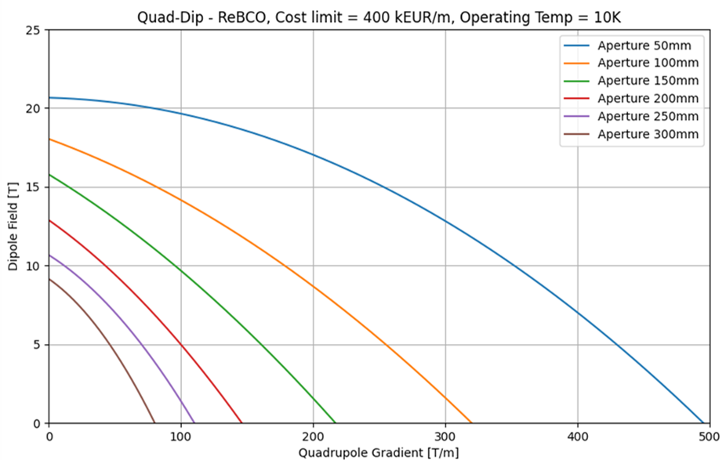
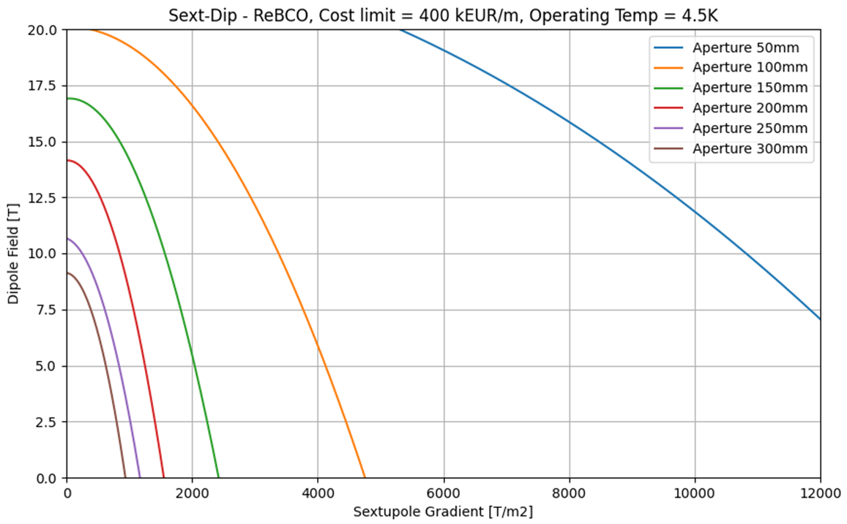
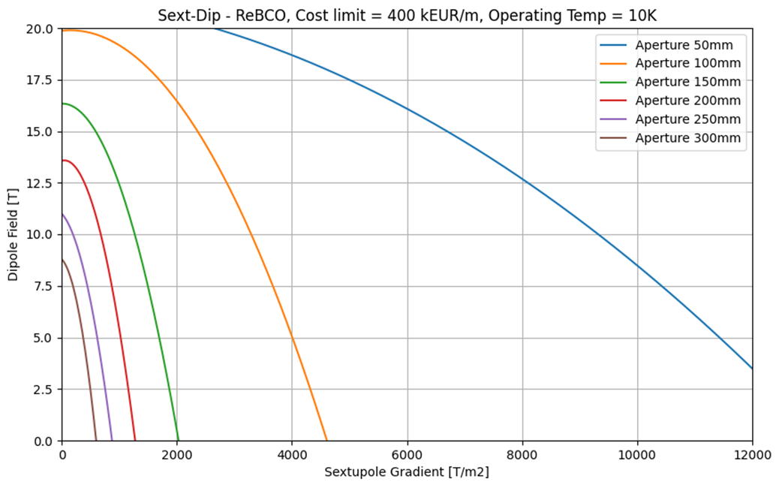
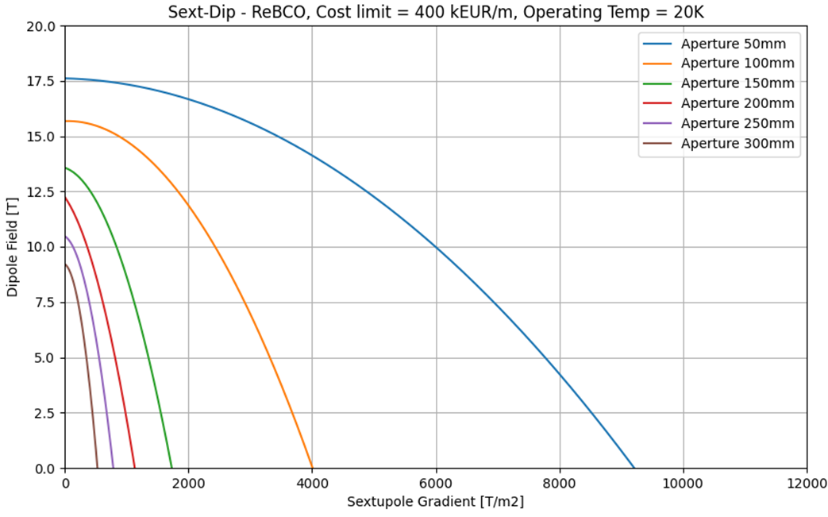
Summary of BG and BS with ReBCO

Slide 17

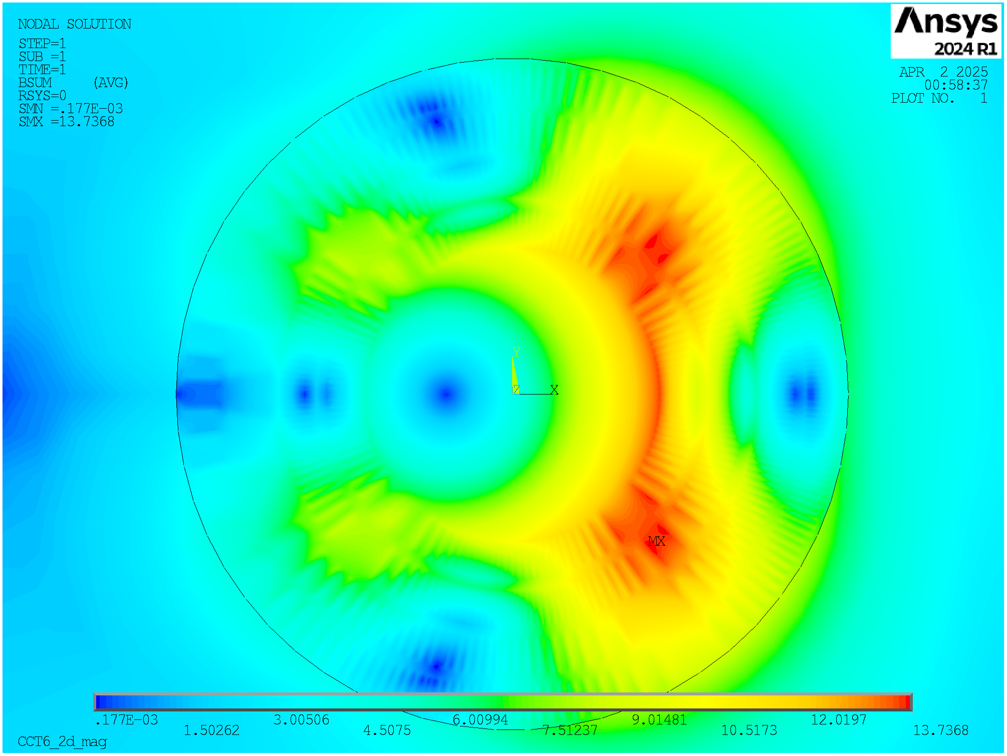
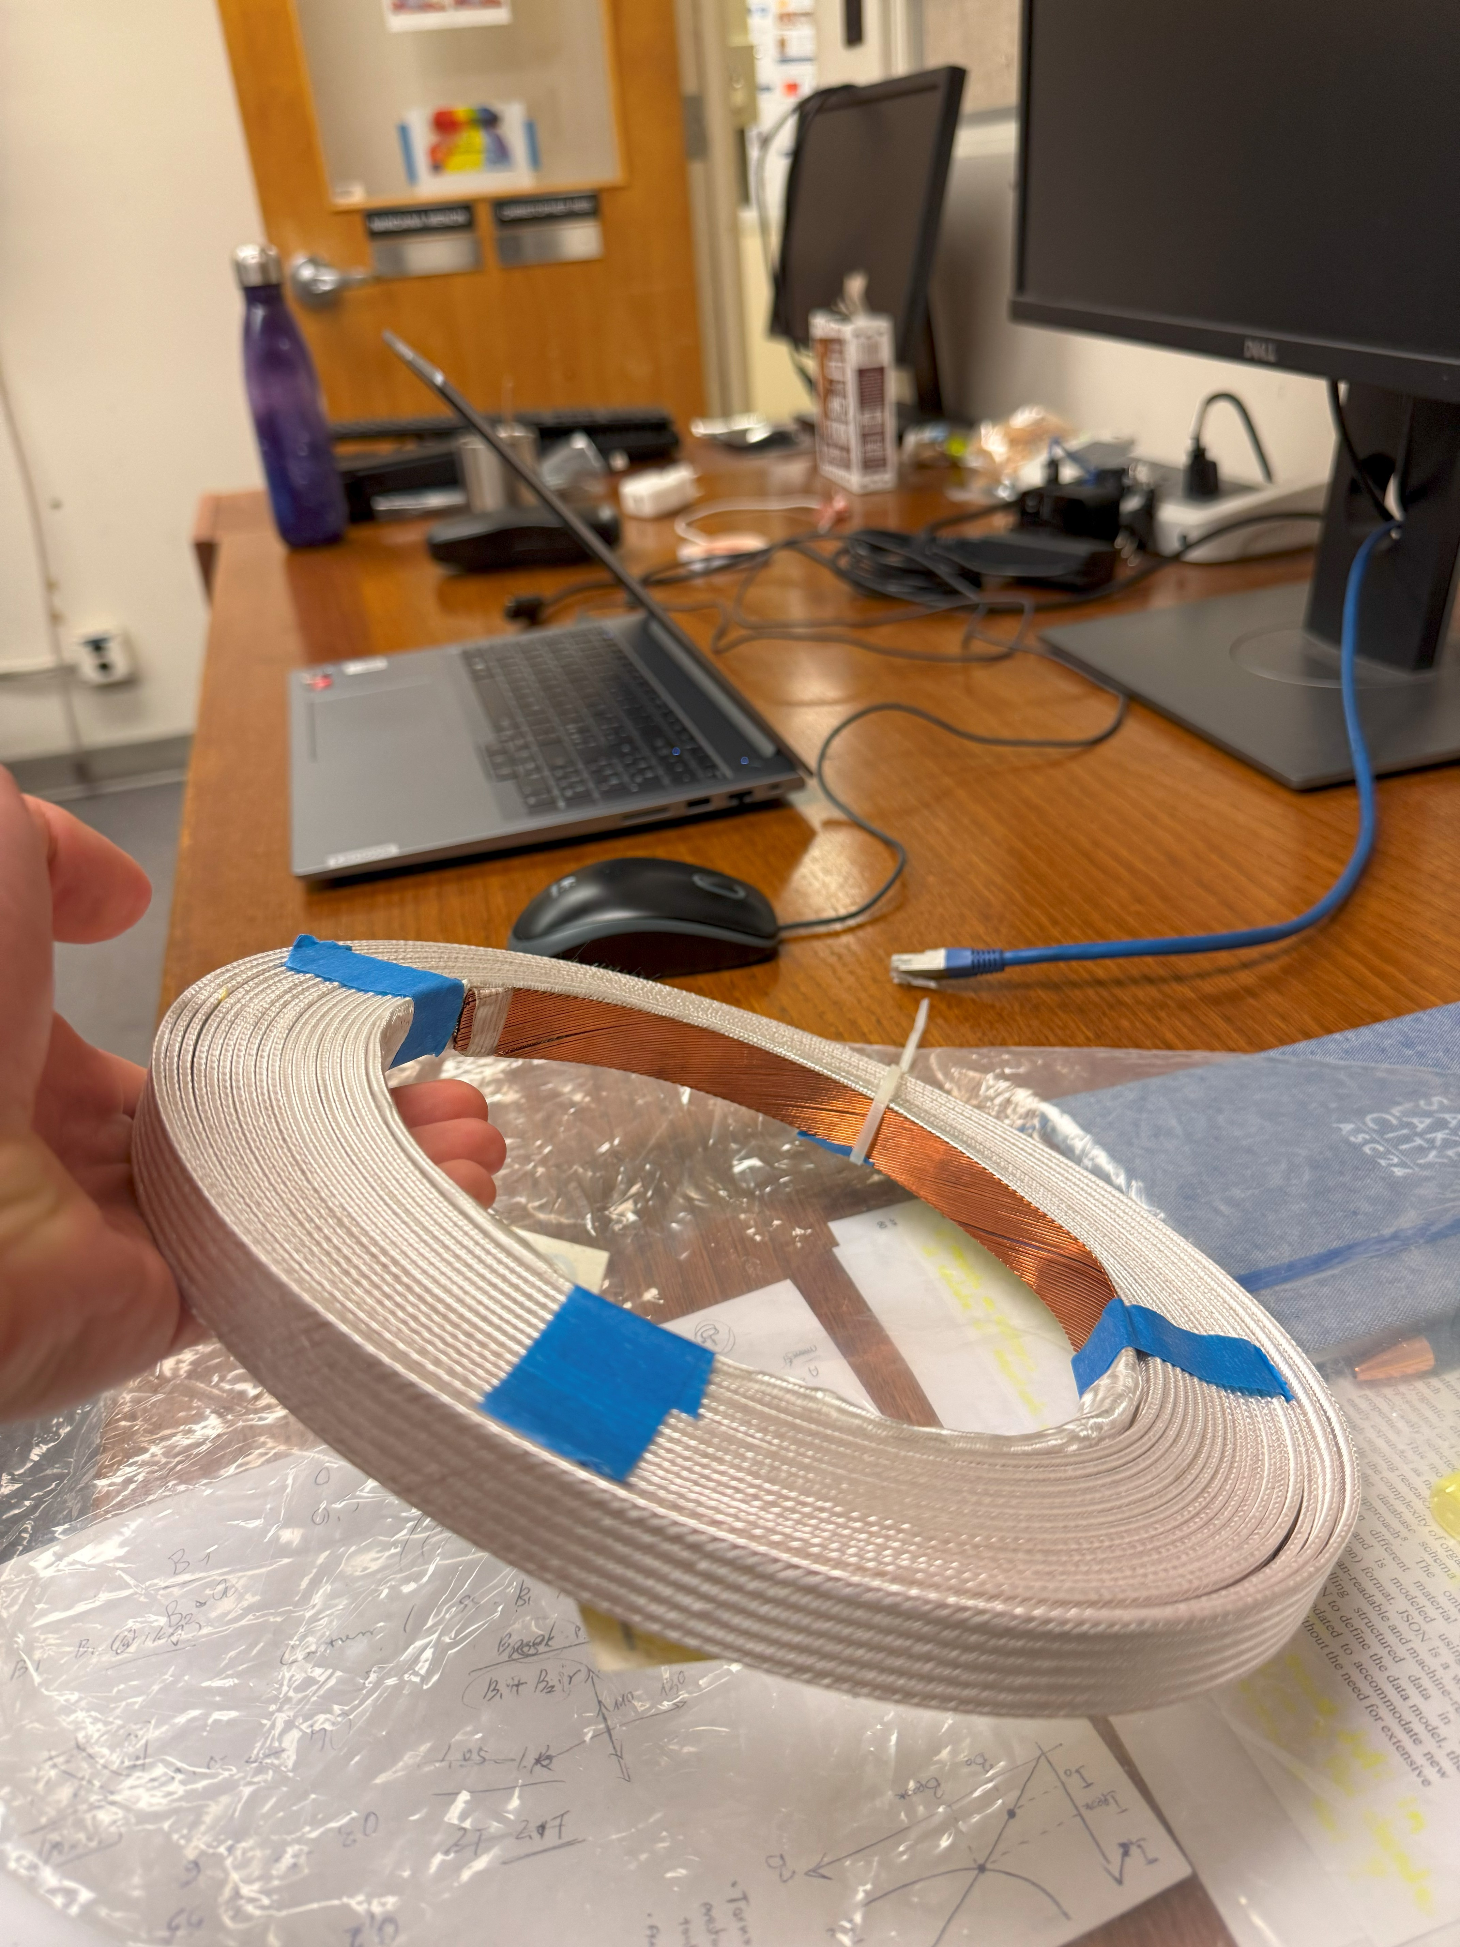
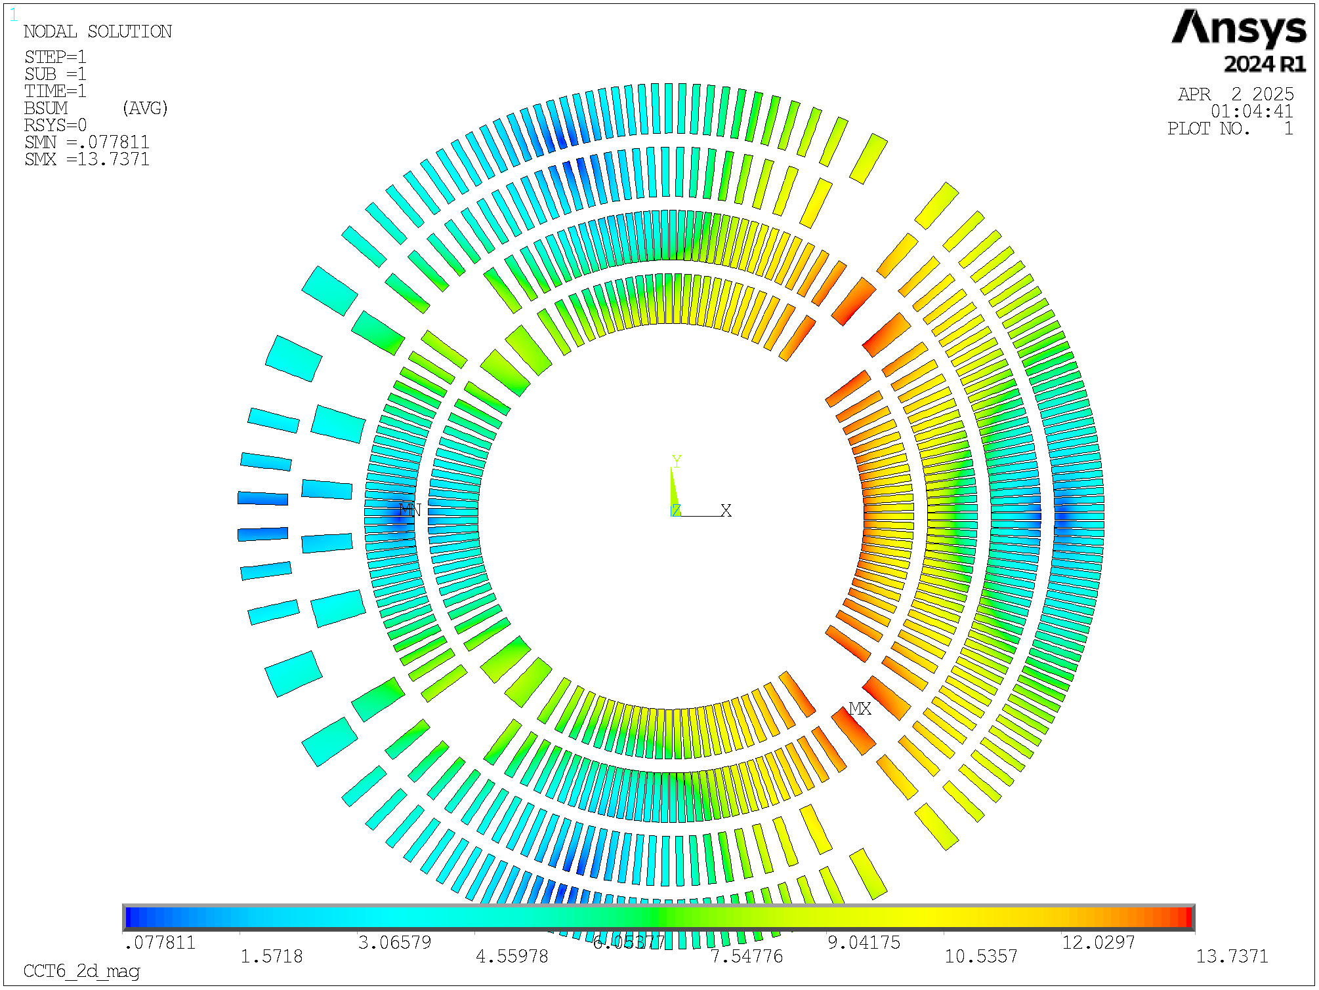
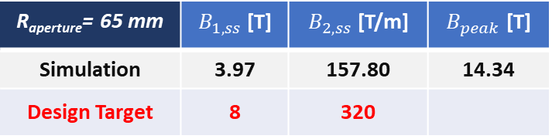
Practical studies
PhD. Program D. Novelli
Use of Nb₃Sn since lot of R&D is still required for HTS cables.
GOAL: Maximum performance achievable in combined-function quad+dip magnets?
Comparison with target of beam optics
R_{aperture}= 65 mm | $B_{1,ss}$ [T] | $B_{2,ss}$ [T/m] | $B_{peak}$ [T]
Simulation | 3.97 | 157.80 | 14.34
Design Target | 8 | 320
INTERNSHIP @ Berkeley Lab with P. Ferracin and L. Brouwer
Removing the constraint of having the quadrupole inside and the dipole outside, the study revealed that the best configuration is having a quadrupole inside and a combined function outside with B1[T] / (B2[T/m]*R_{aperture} ) = 1.4, that means with a stronger dipolar component.
With the technology available today and the design constraints, only up to half of the required performance can be achieved.
In this configuration,
we study a specific design:
4 layers, canted cos-theta (two double-pancakes):
  - first two layers = B2
  - last two layers = B1+B2
Nb₃Sn cable used for the MQXF magnets of HL-LHC.
Aperture of 130 mm.
Ansys model to evaluate the performance @ 4.2 K.
Winding test to prove the configuration feasibility
Layer 4
Dip+Quad
Layer 3
Layer 2
Quad
Layer 1
MQXF cable

Slide 18
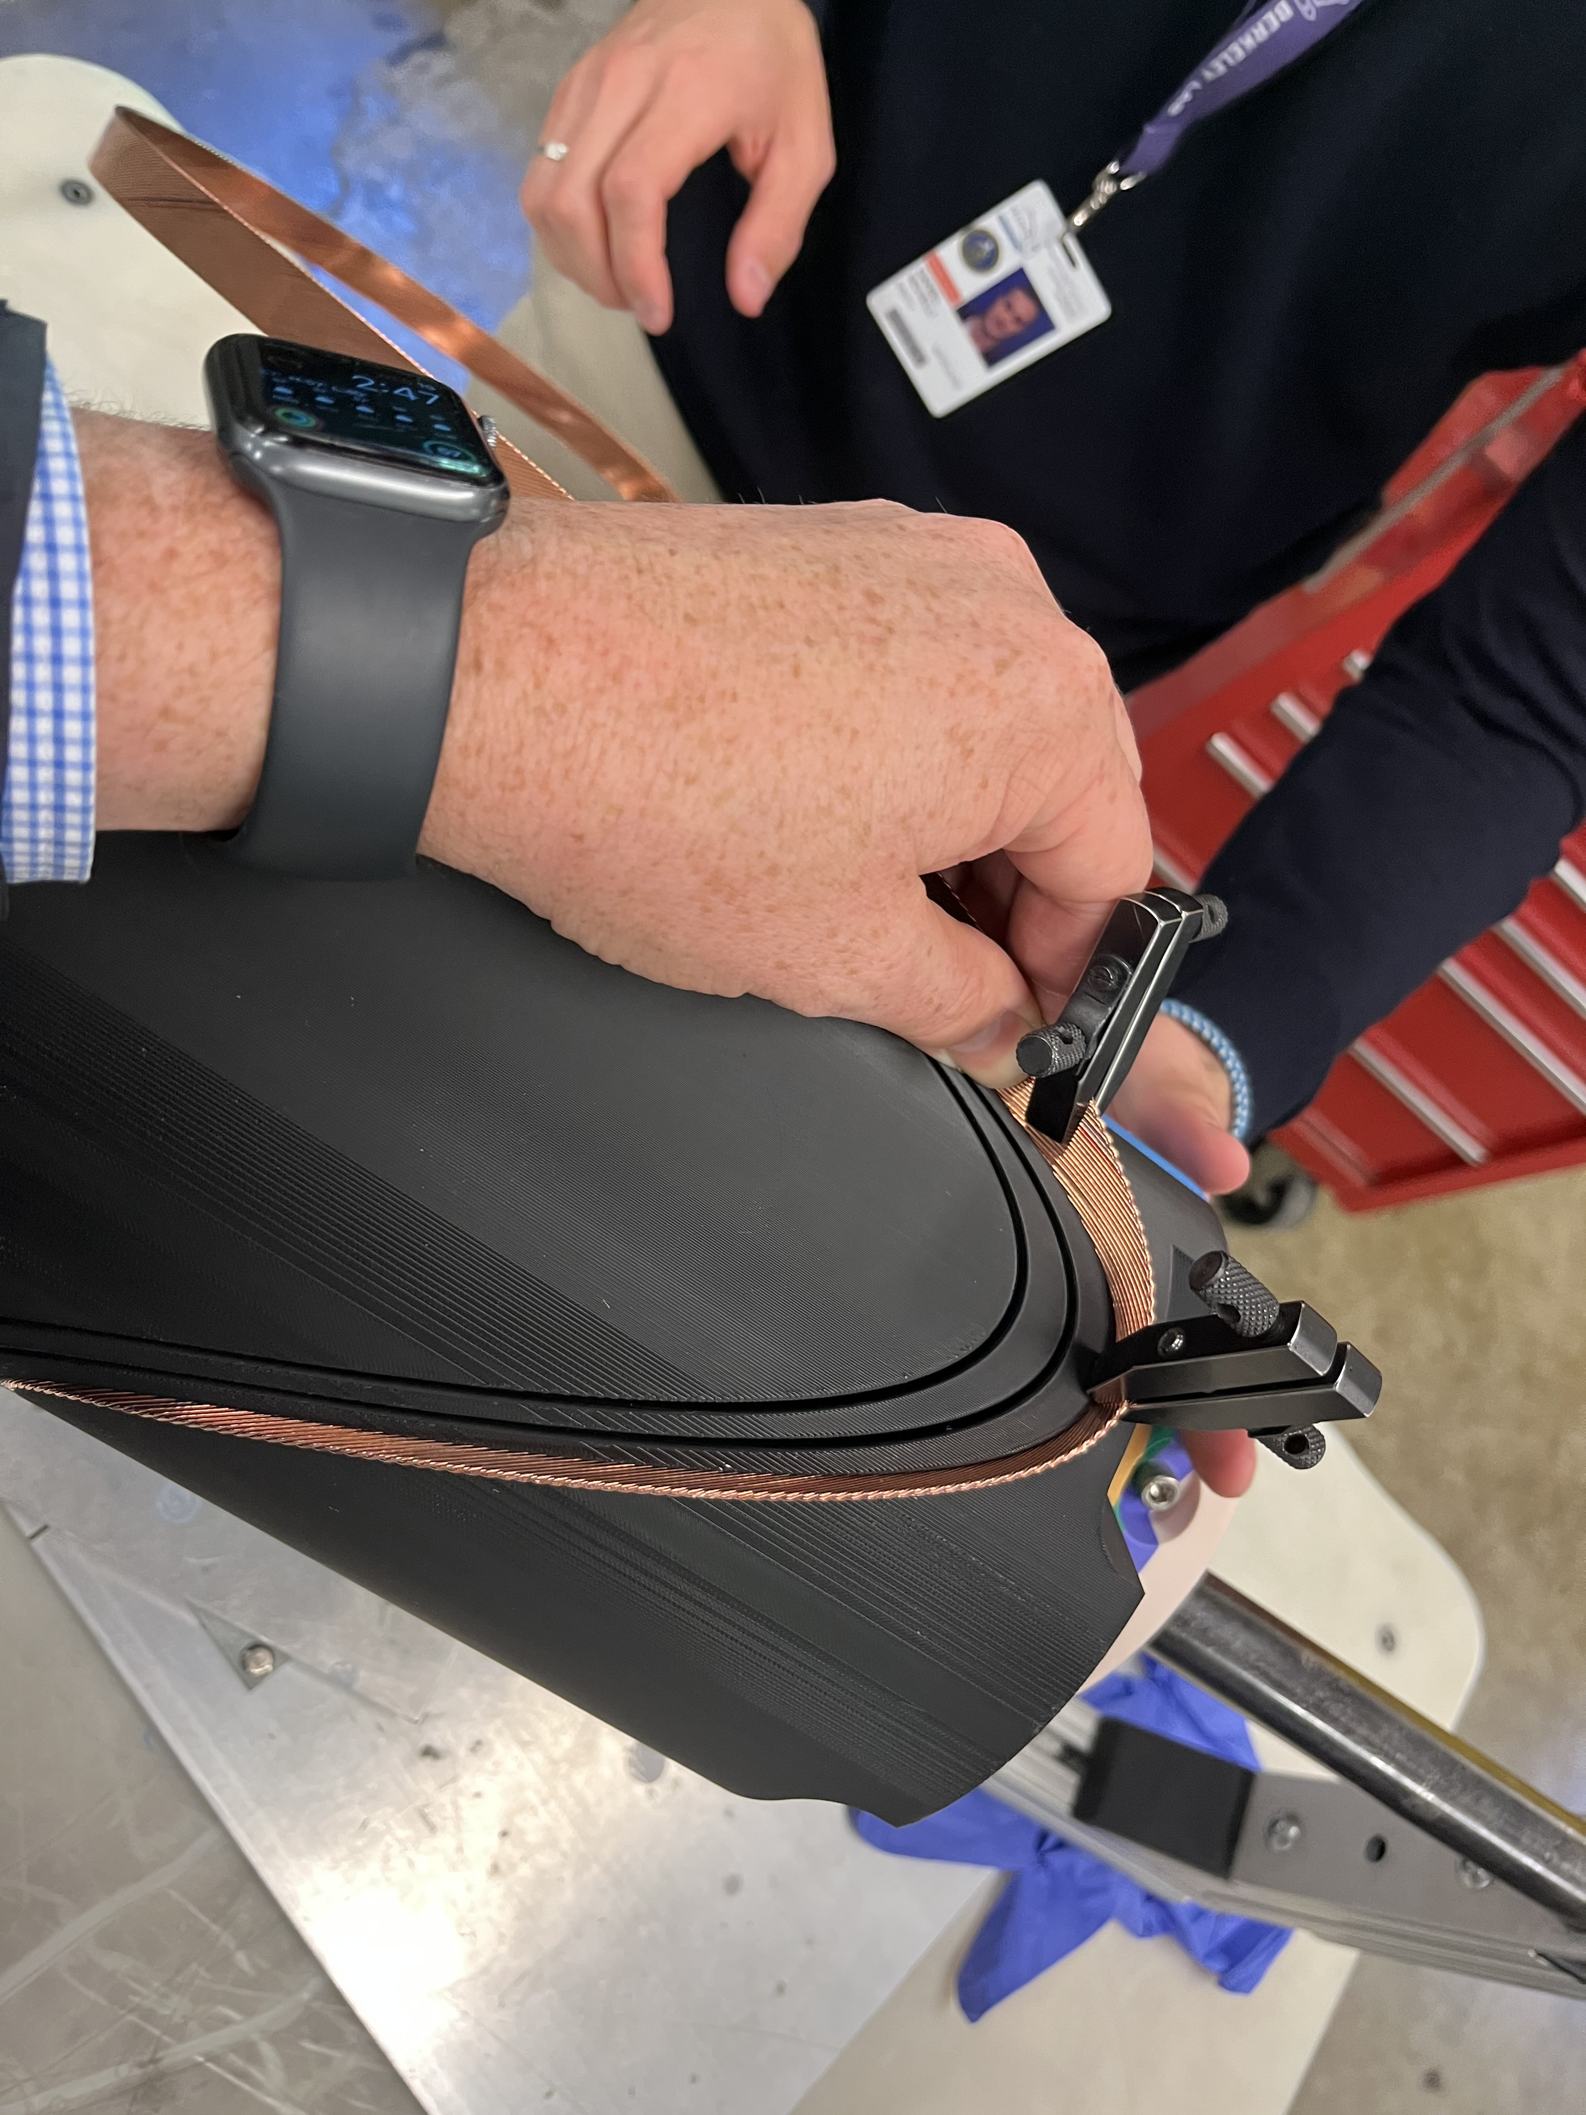
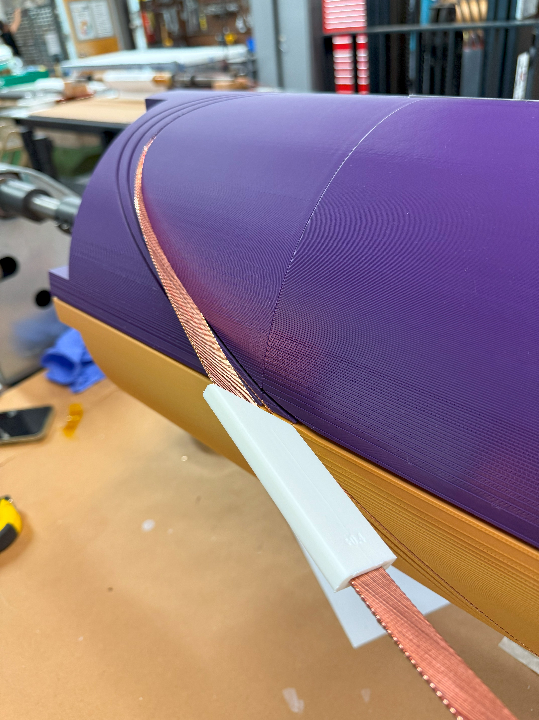
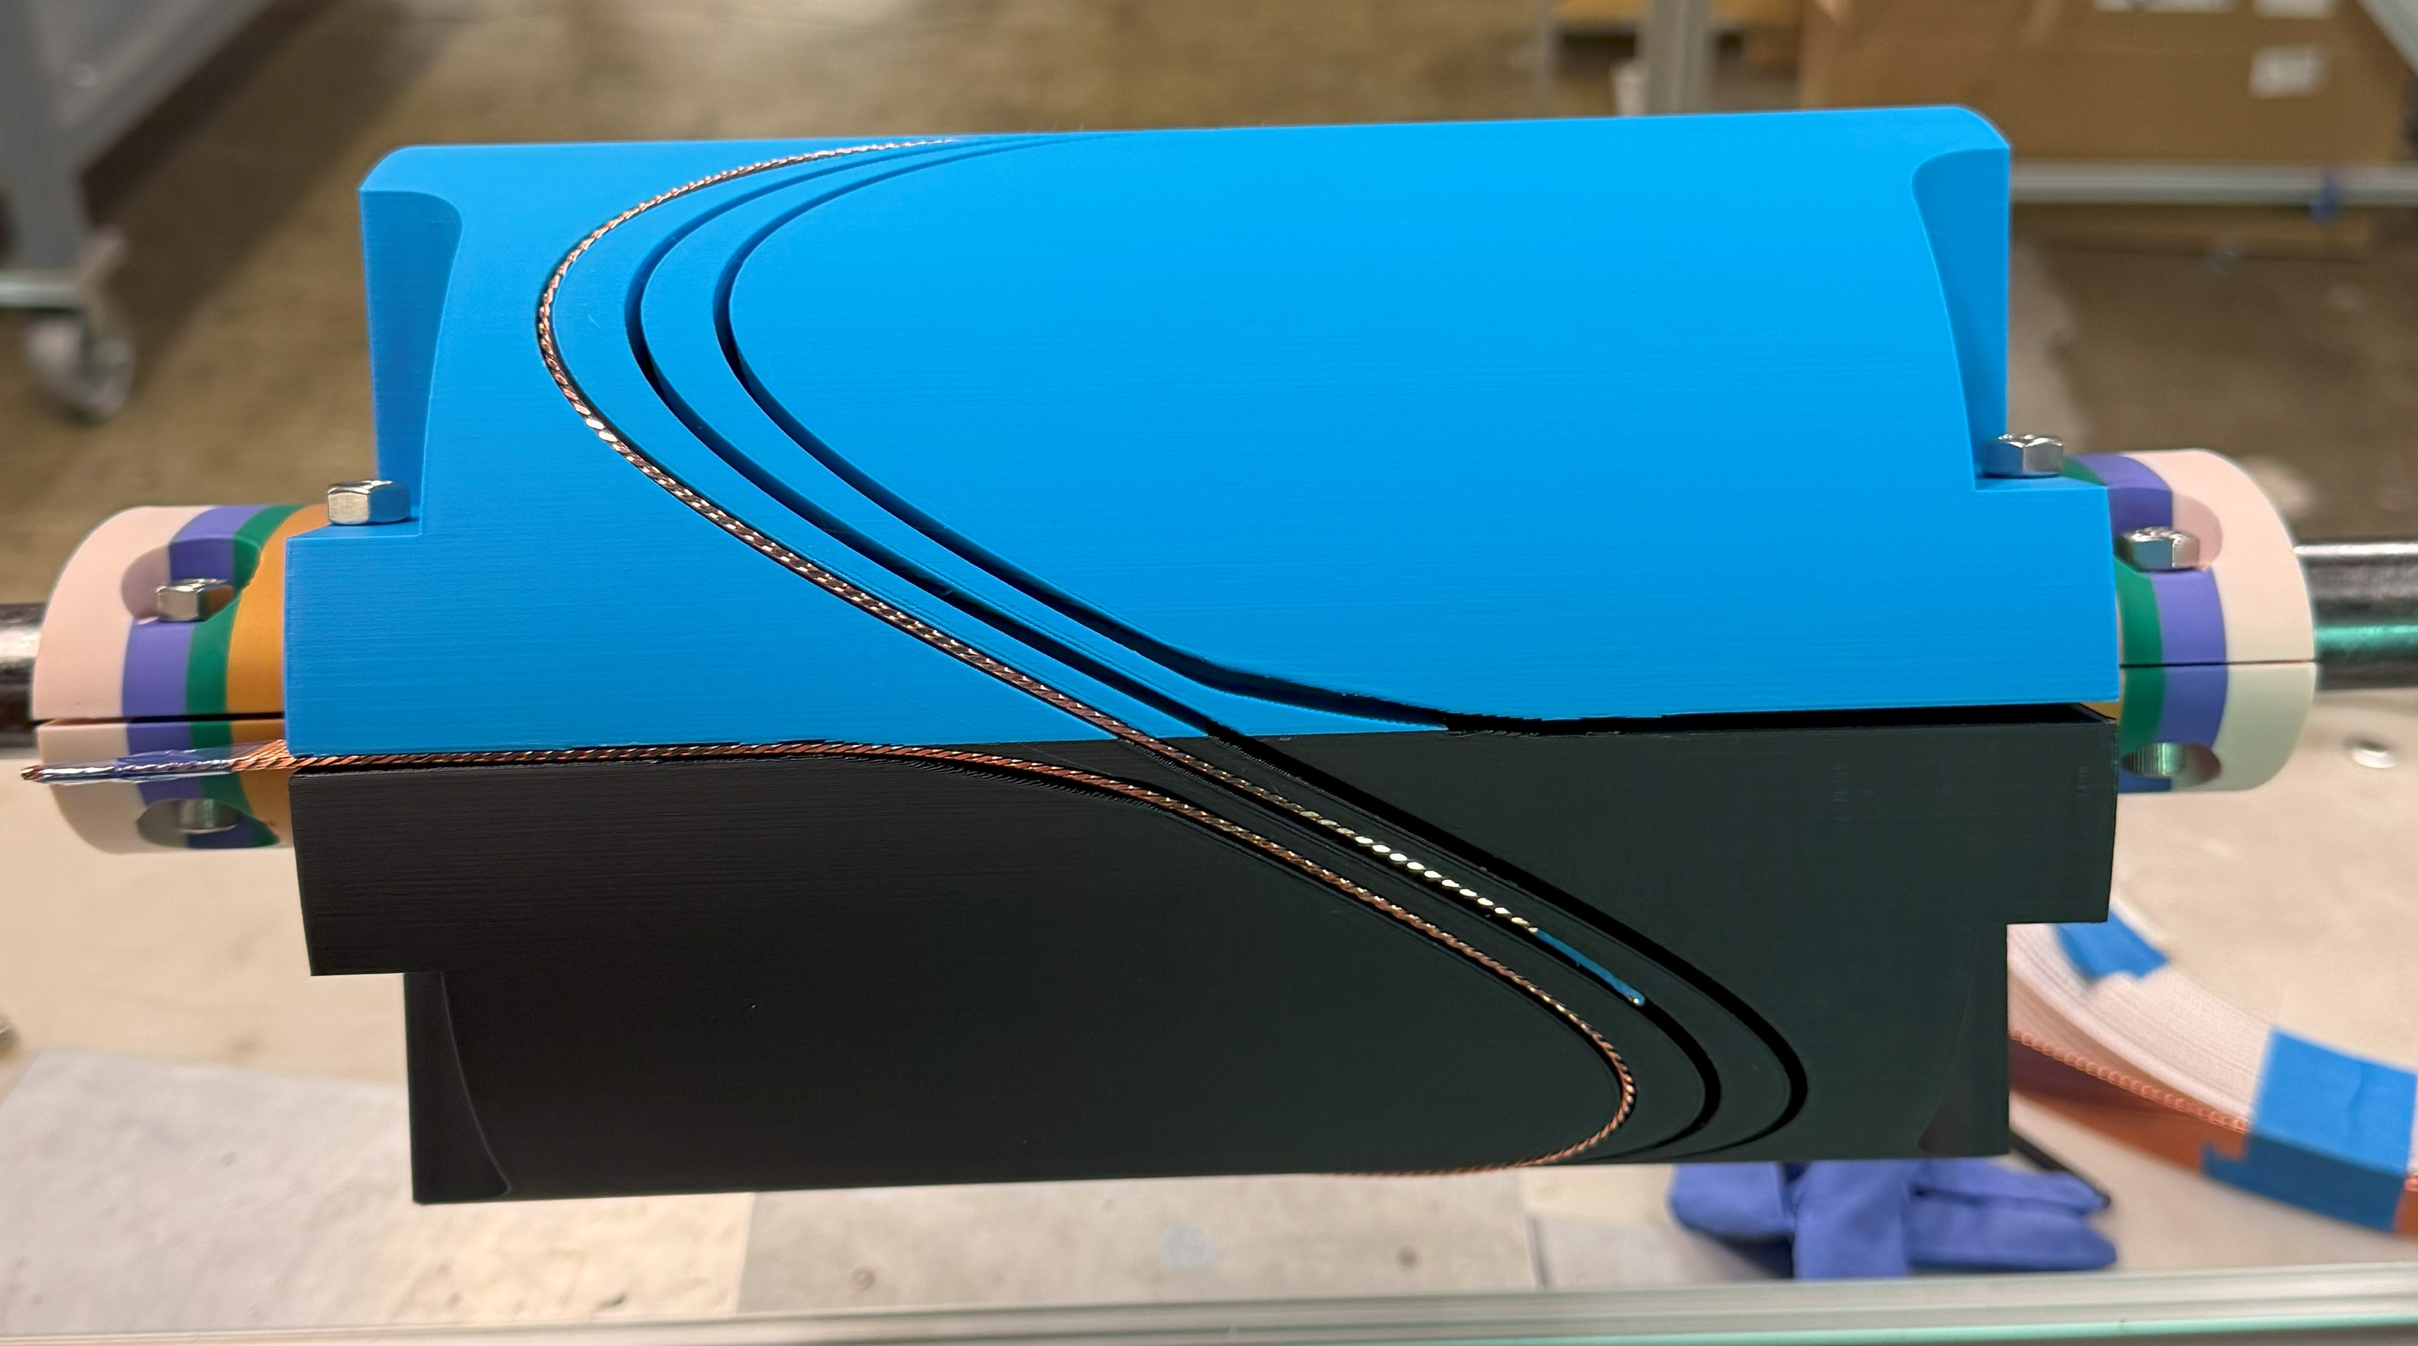
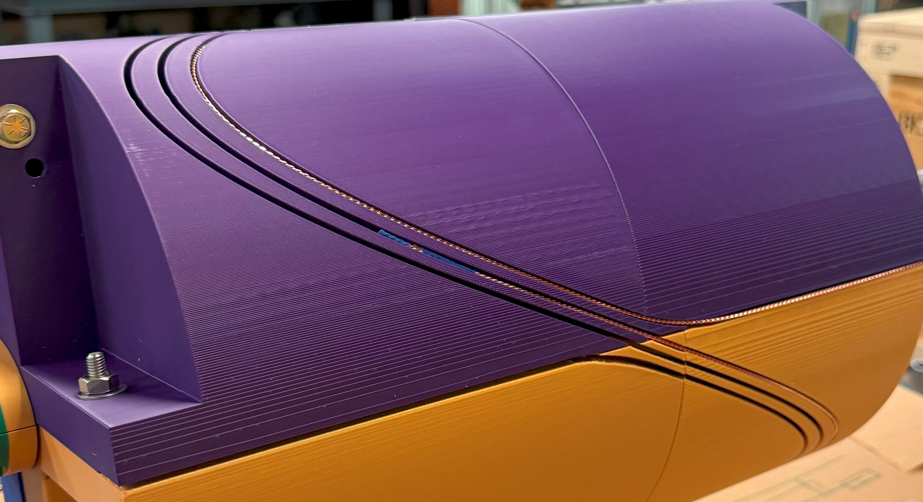
Feasibility Study
Layer 1, combined function
Layer 3, combined function
Analytical and
numerical study
3D model
Winding test
3D printing
The winding test was successfully executed.
The large aperture facilitate the winding process.
The winding was stopped after the first turn in order to save the cable for other tests, as each turn should be identical to the others.
Conclusion: the windability of this magnet has been proved for a CCT geometry.

Slide 19
Working Point for FEM Models
Courtesy of D. Novelli @ IMCC-2024
https://indico.cern.ch/event/1325963/contributions/5837724/
Up today NO final lattice performances have been defined for each of the collider sections: Arcs, CC, MS, IR
Use of our analytical evaluations for lattice iterations (now lattice version at v0.8)
Dipoles & Quadrupoles (IR): AB and AG plots (4.5 K)
Dipoles and CFM (Arcs, CC, MS) : AB and BG (10 K)
14 T/140 mm
Magnet Use in Lattice, M. Vanwelde, IMCC 2025
GOAL of FEM Models: evaluate real detailed magnet
parameters using credible assumption for on-going technology R&D !!!
Selection of interesting design configuration using A-B plots for the ARC DIPOLE collider magnets in parallel with phase space exploration
Main outcome from Analytical exploration:
Nb₃Sn limited by operating margin and Peak stress for B >14 T
HTS (ReBCO) limited by Cost and protection.
  Metal insulated (MI) or Not Insulated (NI) coils must be used.
FEM DESIGN
High Field considering
Large Bore HTS Dipoles

Slide 20
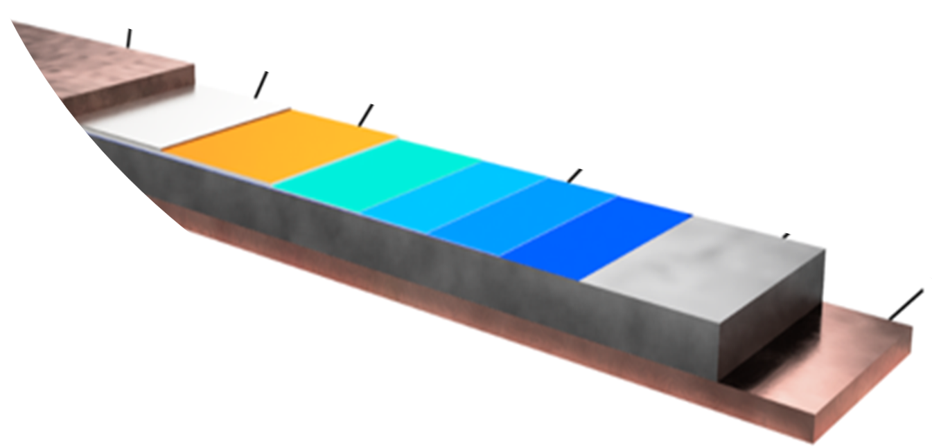



HTS Cable Assumptions
REBCO TAPE:
Fujikura FESC-AP tape
We want to use not twisted stacked tapes cable.
Twist and transposition not effective in reducing the AC losses for coated conductors [2], while increasing cost and complexity
20 um
Copper
Courtesy of S. Mariotto
2 um Silver
2.5 um REBCO
Buffer Layers
60 um
Hastelloy
[1] https://www.fujikura.co.uk/netalogue/pdfs/Fujikura%20Superconductor%20Guide.pdf
[2] D. Uglietti at al. “Non-twisted stacks of coated conductors for magnets: Analysis of inductance and AC losses“ https://doi.org/10.1016/j.cryogenics.2020.103118
20 um
Copper
2 tapes co-wounded with 50 $μm$ thick SS layer (x2)
Metal
$\frac{{\text{A}}_{\text{Cu}}}{{\text{A}}_{\text{SC}}}$ = 16.15
Copper
Substrate
SC layer
f_{f} = 0.018
[3]https://www.fujikura.co.uk/netalogue/pdfs/Fujikura%20Superconductor%20Guide.pdf

Slide 21







Electromagnetic Design: Block-coil layout
Courtesy of L. Alfonso @ IMCC-2025
https://indico.desy.de/event/45968/contributions/185355/
Block-coil advantages:
Most of the coil done with simple geometry winding (racetracks)
Stress management proposal implemented
Disadvantages:
Field quality optimization more difficult (not yet optimized)
Parameter | Value | U.M.
I_{OP} | 3515 | A
J_{ENG} | 542 | A/mm²
J_{COPPER} | 1820 | A/mm²
B₁ | 16 | T
B_{PEAK} | 18.1 | T
T_{OP} | 20 | K
B[T]
Iron Yoke
Coil Layout
$$B_{peak}$$
$$18.06 T$$
Stacked cable
Bore Aperture
Block-Coil
Parameter | Value | U.M.
∆T_{MARGIN} | 2.5±1% | K
Aperture | 140 | mm
E_{STORED}/V | 0.3 | J/mm³
E_{STORED}/L | 5.3¹ | MJ/m
L | 853¹ | mH/m
Harmonics¹ | Value
B3 | 0.16
b5 | -0.36
b7 | 0.02
Conductor Quantity
$$N_{tapes}$$ | 10720
Stacked cable
B[T]
0.24 2.19 4.13 6.09 8.03 9.98 11.93 13.88 15.83 18.06
¹HTS persistent current not considered

Slide 22





Electromagnetic Design: cos$θ$-coil layout
Costheta Advantages
Minimization of conductor quantity in coil cross-section
Better field quality optimization (here considering also HTS persistent current)
Costheta Disadvantages
Stress management (layer supports still to be implemented)
$B$[T]
Iron Yoke
Coil Layout
Bore Aperture
Parameter | Value | U.M.
∆T_{MARGIN} | 2.5±1% | K
Aperture | 140 | mm
E_{STORED}/V | 0.28 | J/mm³
E_{STORED}/L | 3.9 | MJ/m
L | 534 | mH/m
Harmonics¹ | Value
b3 | 4
b5 | 2
b7 | -2
Conductor Quantity
$$N_{tapes}$$ | 8272
Parameter | Value | U.M.
I_{OP} | 3633 | A
J_{ENG} | 565 | A/mm²
J_{COPPER} | 1897 | A/mm²
B₁ | 16 | T
B_{PEAK} | 18.1 | T
T_{OP} | 20 | K
Cos-Theta
Courtesy of F. Mariani @ IMCC-2025
https://indico.desy.de/event/45968/contributions/185356/
30% less than block coil
¹HTS persistent current effect considered

Slide 23



HTS Persistent Current Models
Courtesy of F. Mariani @ IMCC-2025
https://indico.desy.de/event/45968/contributions/185356/
Development of electromagnetic modelling for FAST persistent current simulation in HTS magnet cross-section:
Tape orientation optimization
Induced peak lorentz forces on conductor estimation
Analytical Model in MATLAB (Brandt) or FEM Model (COMSOL)
Compatible results on hysteretic losses
Losses Calculation | COMSOL | MATLAB
$$Q_{hyst}$$ | 22.5 | 22
Harmonic | COMSOL | MATLAB
b3 | 3 | 4
b5 | -7 | -0.2
b7 | -3 | -0.05
Harmonic content strongly affected by critical current saturation in tape cross-section

Slide 24





Preliminary Mechanical Analysis
Assumptions
First mechanical analysis goal: evaluations of stresses induced by energization to address if stress management solutions have to be considered and how.
Common assumptions for cos$θ$ and block-coil layouts:
Homogenized coils ($E_{coils}=174\text{1} GPa,ν_{coils}=0.3$)
Infinitely rigid structure
Frictionless contact between coils and structure
Layers bonded together
Only Lorentz forces (no forces for cooling contraction)
[1] C. Barth, G. Mondonico, and C. Senatore, “Electro-mechanical properties of ReBCO coated conductors from various industrial manufacturers at 77 K, self-field and 4.2 K, 19 T,” Superconductor Sci. Technol., vol. 28, no. 4, Feb. 2015, Art. no. 045011. [Online]. Available: https://dx.doi.org/10.1088/0953-2048/28/4/045011
[2] Superconductor Business Development Division Fujikura Ltd., “Introduction of Fujikura re-based high temperature superconductor,” Fujikura Global, Koto City, Tokyo, Japan, Tech. Rep., Jul. 2024. [Online]. Available: https://www.fujikura.co.jp/eng/products/newbusiness/
[3] H. Maeda and Y. Yanagisawa, "Recent Developments in High-Temperature Superconducting Magnet Technology (Review)," in IEEE Transactions on Applied Superconductivity, vol. 24, no. 3, pp. 1-12, June 2014, Art no. 4602412, doi: 10.1109/TASC.2013.2287707
Transverse Compressive Stress
> 400 MPa²
Transverse Tensile Stress
10-100 MPa³
Axial Compressive Stress
< 100 MPa²
Axial Tensile Stress
> 700 MPa³

Slide 25



Mechanical Design: Block-coil layout
ONLY EM Forces
Each block is surrounded by enclosed rib vertical and horizontal structural elements
0.3 mm clearance between coils and the structure
Block-coil stress values are below the maximum allowable limits
We need mechanical data from stack of tapes!!!
Parameter | Value | U.M.
σ_{X_MAX} | -216 | MPa
σ_{Y_MAX} | -56.9 | MPa
|σ_{XY_MAX}| | 2.86 | MPa

Slide 26













Mechanical Design: Cos$θ$
Assumptions for allowable stresses:
$∥$tape face$: σ_{max}=$-100 MPa
$⊥$ tape face: $σ_{max}=$- 400 MPa
Persistent Current
Distribution
Lorentz Forces
Azimuthal stress $σ_{θ}$
Radial stress $σ_{r}$
$$J/J_{c}$$
$f_{L}$ $[N/m^{3}]$
$σ$ (MPa)
Extrapolation of the lorentz forces considering effect of the persistent current evaluated using T-A Formulation (COMSOL)
$σ_{θ max}$= 17 Mpa
$σ_{θ min}$= -261 MPa
$σ_{r max}$= 22 Mpa
$σ_{r min}$= - 197 MPa
Radial compressive stress needs to be reduced!
Need to implement stress management solutions
  Implementation or ribs and spar around each coil block
ONLY EM Forces

Slide 27







Magnet Cost
[1] Bottura, L., and B. Bordini. "HTS Potential and Needs for Future Accelerator Magnets." arXiv preprint arXiv:2503.23048 (2025).
[2] Aspirational value (~1/3 of actual)
[3] Extrapolation from LHC experience
The model used to evaluate the total cost of the magnet considers three different contributions¹:
  Coil material and manufacturing
  Cold mass material and the manufacturing
  Cryogenics
$(8\text{k}\text{€/}\text{m}$) ³
$C_{coil}+C_{ColdMass}+C_{Cryogenics}$ = $C_{tot}$
$(9.9$ k€/m) ³
$(26.4$k€/m) ³
$${C_{coil}= C}_{SC}+C_{CoilManifacturing}$$
$${C_{ColdMass}=C}_{ColdMassMaterial}+C_{ColdMassManifacturing}$$
= $\frac{B}{B_{ref}}{C_{ColdMassMaterial}}_{ref}$
Parameter | Value | Unit
Cost_{Actual} | 8013 | kEUR/kg
Cost_{Aspirational} ² | 2671 | kEUR/kg
Density_{ReBCO} | 7800 | kg/m³
C_{Coil_Manufact} | 9.9 | kEUR/m
 | $Cosθ$ design [k€/m] | $Block$ design [k€/m]
$$C_{coil}$$ | 236.2 | 303
$$C_{ColdMass}$$ | 74.4 | 74
$$C_{Cryogenics}$$ | 8 | 8
$$C_{tot}$$ | 318.6 | 385
${C_{ColdMassMaterial}}_{ref}$ (k€/m) ($B_{ref}$= 8.33 T) | $C_{ColdMassMaterial}$ (k€/m)
$25$³ | $$48$$
Both magnet design presently satisfy the presently considered budget
Arc Cell budget available: 400 k€/m
IR Quadrupole budget available: 800 k€/m (needed to push performance)
*Cos$θ$ coil cost may vary after stress management implementation

Slide 28



IR Field Free drift
Parameter | LHC Drift | HL-LHC Drift
Magnetic to Mechanical Length | 137 mm | 350 mm
Cold Mass End | 170 mm | 317 mm
Cryostat+CWT | 478 mm | 962 mm
Flanges, valves, ecc | 1050 mm | 480 mm
Total | 1835 mm | 1934 mm
First IR magnet
Coil ends (175 mm) already challenging for REBCO
  Need to consider also asjusting for bore aperture, peak field ecc ecc
Optimization of Q1 connection box position between Q1 and Q2 saving up to 200 mm (Increase distance Q1-Q2 to be checked with beam dynamic lattice design)
If operating @ $T_{op}≥$ 4.5 K: NO NEED OF PHASE SEPARATOR (No LHe) saving up to 500 mm (assuming to optimize space for other components)
Cold Mass end covers: Flat Design vs Dished end
Main Message: Total of 1500 mm for MuCol
(1300 mm + 200 mm as a safety margin)
Courtesy of H. Prin

Slide 29






Magnet Connection Length
Coil heads on the connection side (CS)
Coil heads on the non connection side (NCS)
Recap from H. Prin presentation @ mmWG 13th June 2024:
Collection of superconducting magnet connection between two different cryostat and within the same cryostat interface.
LHC MB (NbTi, 1.9 K) 1200/1300 mm (LHC L_{d-d}=1.36 m)
  Coil Length - Magnetic Length = 236 mm
  CSpoolpiece corrector: 176 mm
  Magnet End Plate/Cold mass: 226.5 mm
MQXFa/b for the HL-LHC project (Nb3Sn, 1.9 K) Q2A/Q2B L= 2090 mm
  Coil Length - Magnetic Length = 109 mm
  CSpoolpiece corrector: NA
  Magnet End Plate/Cold mass: 228 mm
Splices
NbTi leads
Magnetic Filed
ML
Nb₃SN coil leads
ML
Mag. Length
FFML
L_{head/e}
L_{s/head}
Possible method to minimize FFML
Compact Coil ends (difficult for HTS/200mm typical value for Nb₃SN)
Reduction of cold mass head equipment (for example with $T_{op}$ = 20 K)
$$ΔL=−100/300 mm$$
$L_{FFML}>$ 1000/1200 mm
E. Todesco, "Optimizing the filling factor in high energy colliders"
Still to be implemented in lattice design V0.xx (up to now considering 30 mm)

Slide 30





Wobbling
Possible implementation of horizontal field (FOR DISCUSSION)
  External Steering Magnet outside of the main dipole/combined function magnet
    Integrated strength: $±$8.375 Tm
    Easier implementation and tunability
    Additional length between the magnet
REQUIREMENTS:
$B\sim 0.67 T$ for 100 m period and $±$25 mm
Tunable horizontal dipole field
  Magnet handling with additional coil (horizontal dipolar field)
    Already implemented in HL-LHC MCBXF (Ciemat)
      150 mm aperture magnet (2.1 T Vertical – 2.1 T Horizontal field)
      Main issue: TORQUE 147 kNm/m
        EXAMPLE: 16 T vertical – 0.67 T horizontal $→$ 350 kNm/m
      Difficult for 3 combined function magnets (HD-Q-VD)
  Fixed magnet position with additional coil
    Larger bore aperture/inner elliptical tungsten layout (horizontal thickness >vertical thickness)
Courtesy of F. Toral

Slide 31

Next Steps and Perspectives
Implementation of actual stress management solutions for Cos$θ$ magnet design
  Existing solutions already considered for hadron colliders within US-MDP program
Block Coil Design: analysis of persistent current effect on both EM and mechanical performances: use of both analytical models and FEM methods (T-A formulation)
Extended mechanical analysis (assembly, cooling down and magnet energization)
  No standard material properties available for MI stacked tape conductors
  Starting from already considered properties for muon collider high field solenoids and synergic programs already focusing on HTS magnets
  MAIN question for mechanical models: How can we shift from tape to coil equivalent properties?
Winding trials to evaluate coil end design with the considered cable and coil geometries

Slide 32
Conclusions
Development of innovative analytical approach for lattice design iteration and fast feedback
  Different configurations considered (Dipoles, Quadrupoles, CFMs)
FEM models for ARC large aperture high field HTS dipoles
  Presently developed to address technological challenges to be solved during the R&D phase of superconducting magnet development
Analytical/FEM models for persistent current analysis already implemented for costheta (to be extended also at block coil design)
Stress management design (block coil already implemented) must be further studied
  Extensions to full magnet cycle (assembly, cool-down, energization)
  Costheta magnet layout to be implemented
Input for lattice design given also for Field free region length and IR Field free drift space
  Not yet full lattice parameters: IR quadrupoles and CFMs not yet defined
Up to now we can only cover detailed analysis of ARC Dipoles
  IR quadrupole case study and CFMs have not been studied at with FEM models

Slide 33
Thank you for your attention!
Funded by the European Union (EU). Views and opinions expressed are however those of the author only and do not necessarily reflect those of the EU or European Research Executive Agency (REA). Neither the EU nor the REA can be held responsible for them.

Slide 34


Recommendations for ESPP
IMCC released a supplementary report to the European Strategy for Particle Physics (arXiv:2504.21417)
For the collider ring, the following staged options were reported:
10 TeV in a 10 km ring
  HTS magnets @ 20 K , 14 T -16 T in 140 mm aperture, TRL 3,4
3 TeV in a 5 km ring
  LTS Nb₃Sn magnets @ 4.5 K , 11 T in 160 mm aperture, TRL 6,7
6 TeV in a 10 km ring
  LTS Nb₃Sn magnets @ 4.5 K, 11 T in 160 mm aperture, TRL 6,7
3 TeV in a 10 km ring
  LTS NbTi magnets @ 4.5 K, 5 T in 160 mm aperture, TRL 7,8
Main challenges identified:
Reaching the desired field performance with HTS magnet technology
Development of suitable winding technology
Managing large forces and stresses
Quench protection of magnets with large store energy (~MJ) and energy density (260 J/cm³)
Cost and sustainability

