Slide 1




RCS power system and magnets
Seminar Series for the National Lab Muon Accelerator Study Group
F. Boattini¹, G. Brauchli², M. Gast³, D. Fazioli⁴,D. Moll⁵, M. Breschi⁴, D. Aguglia¹, P. Viarouge⁶
¹ CERN , ² UNR –Còrdoba (AR) , ³ KIT –Karlsruhe (DE), ⁴ UNIBO – Bologna (IT), ⁵ TUD-Darmstadt (DE), ⁶ UNILAVAL-Quebec (CA)

Slide 2
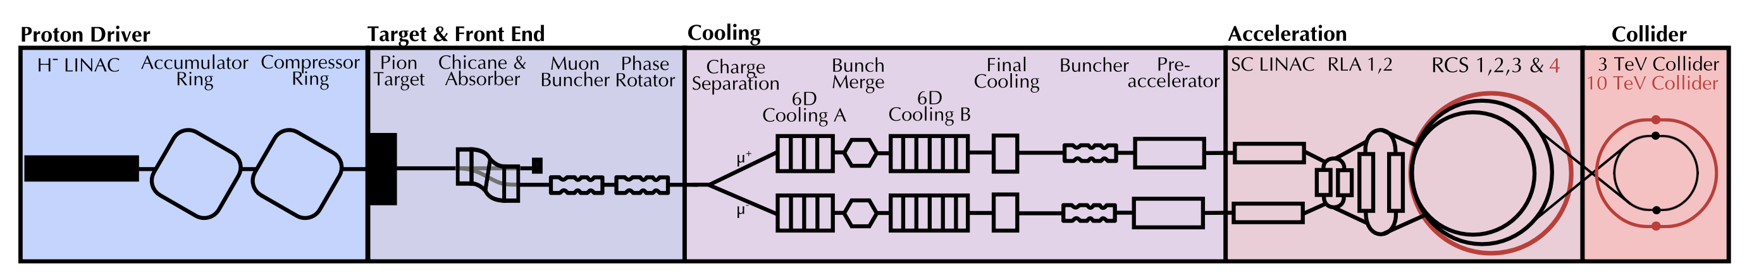
Outline
Context and key challenges (F. Boattini → CERN)
Powering system description CERN-UniBO (F. Boattini→ CERN)
Cost computation from IMCC 2025 annual meeting (F.Boattini→CERN)
Dipole magnets optimization UniBo (M. Breschi → UNIBO)
Quadrupole magnets optimization UniBo (M. Breschi→ UNIBO)
Transient FEM models Uni-Darmstadt (D. Moll→TUD)
Excel-Python design suite for Dipoles CERN-UniLaval-Uni-Darmstadt (D. Moll→TUD)
Dipole field quality estimation Uni-Darmstadt (D. Moll→TUD)
Next steps (F. Boattini → CERN)

Slide 3
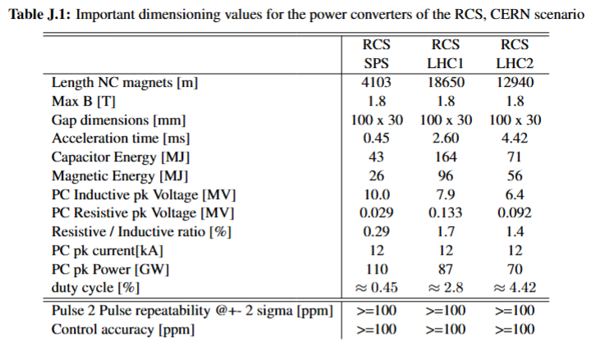
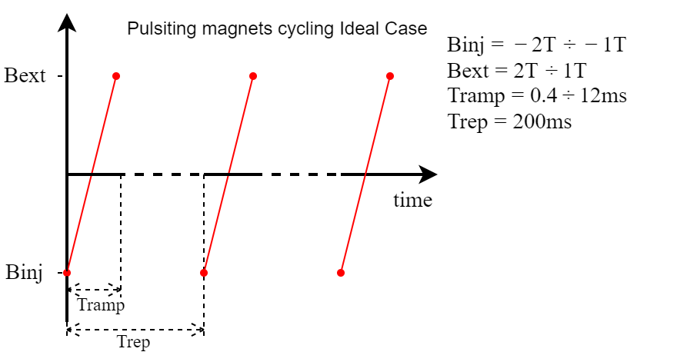
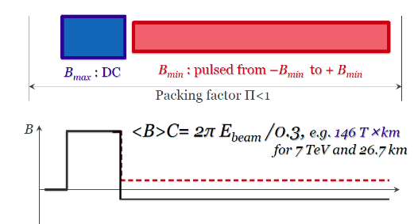
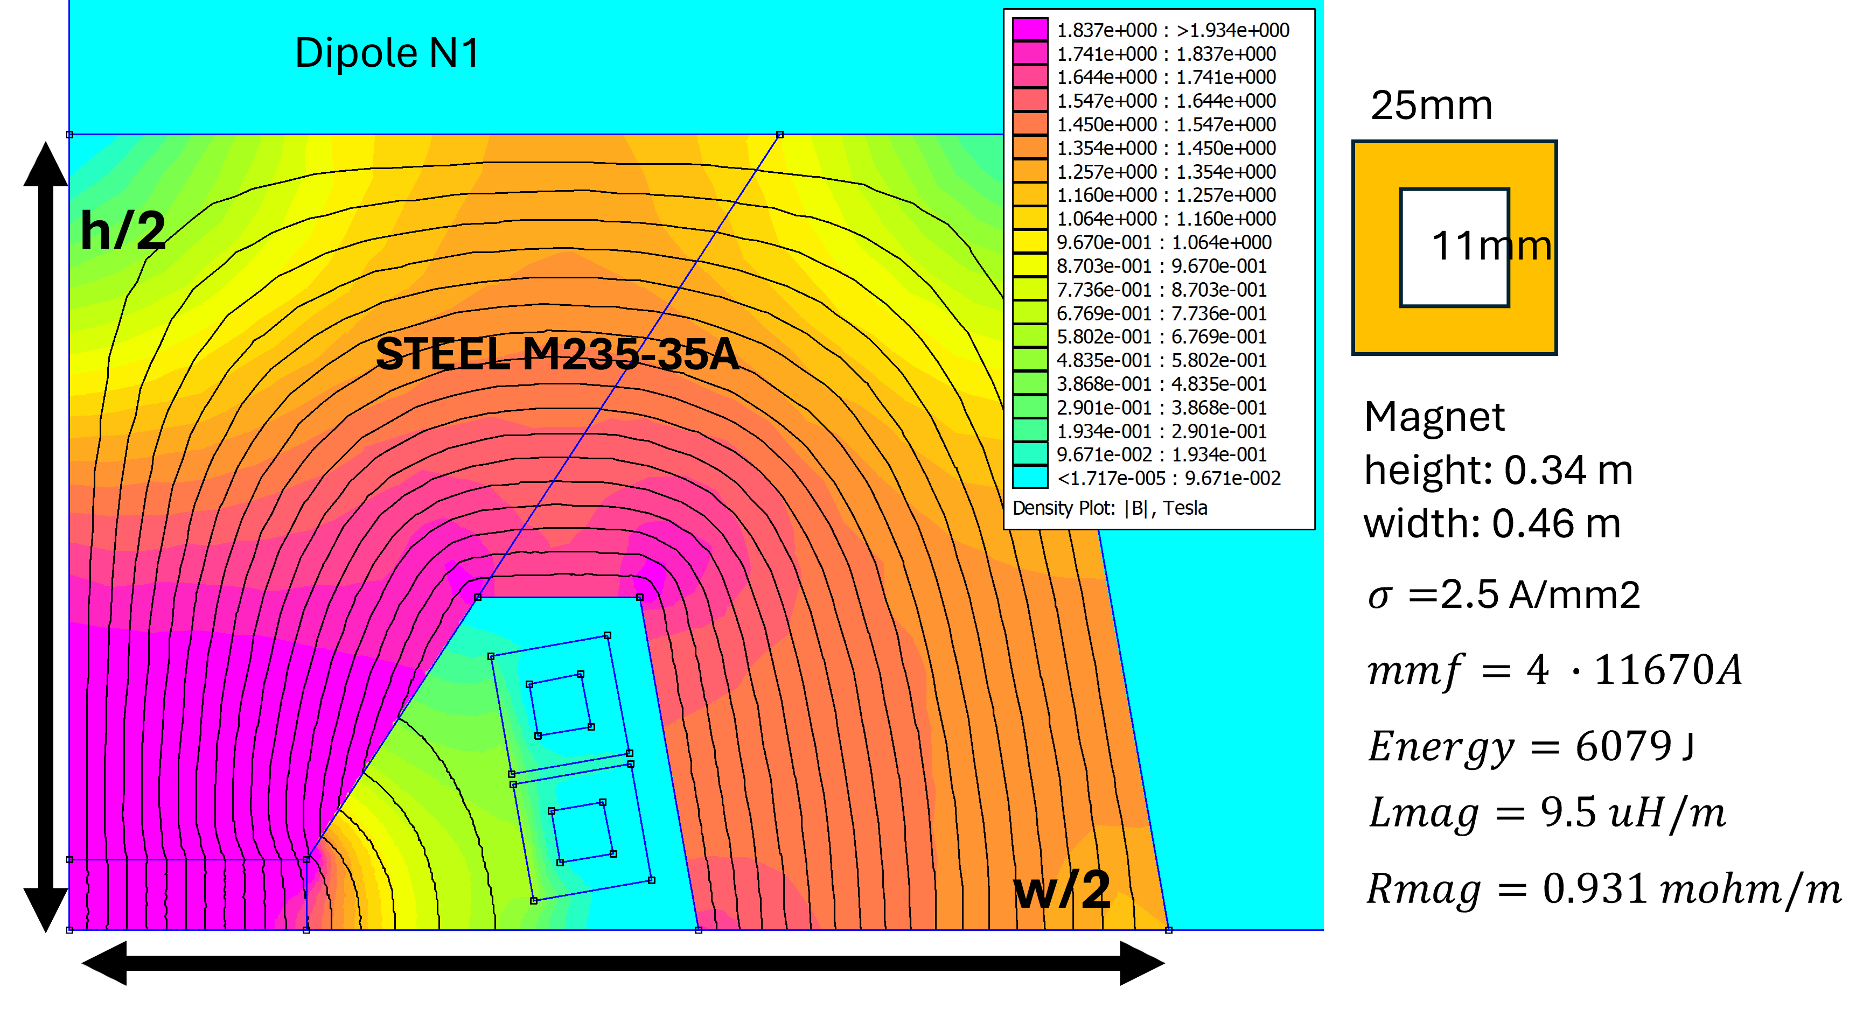
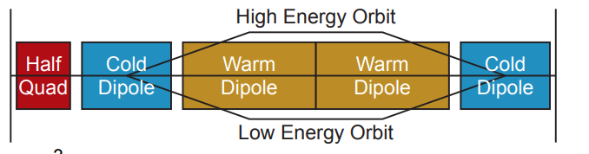
Context and key challenges
Quick ramp time; Low duty cycle
Some RCSs are hybrid.
Powering needs to be bipolar
Hybrid Rapid Cycling Synchrotron
High energy stored in the dipole magnets
Translates into high peak power

Slide 4

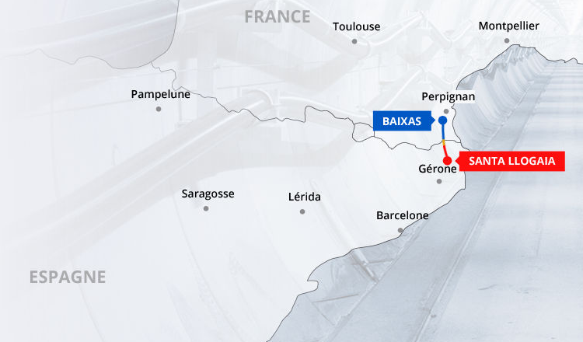
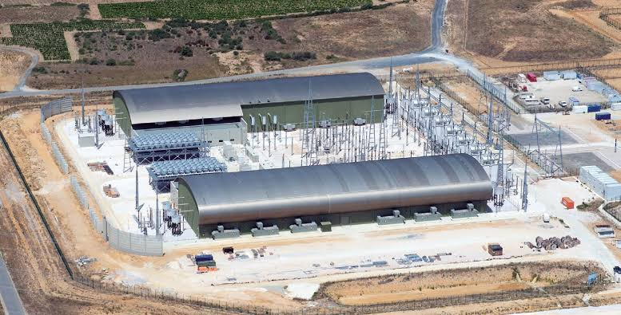
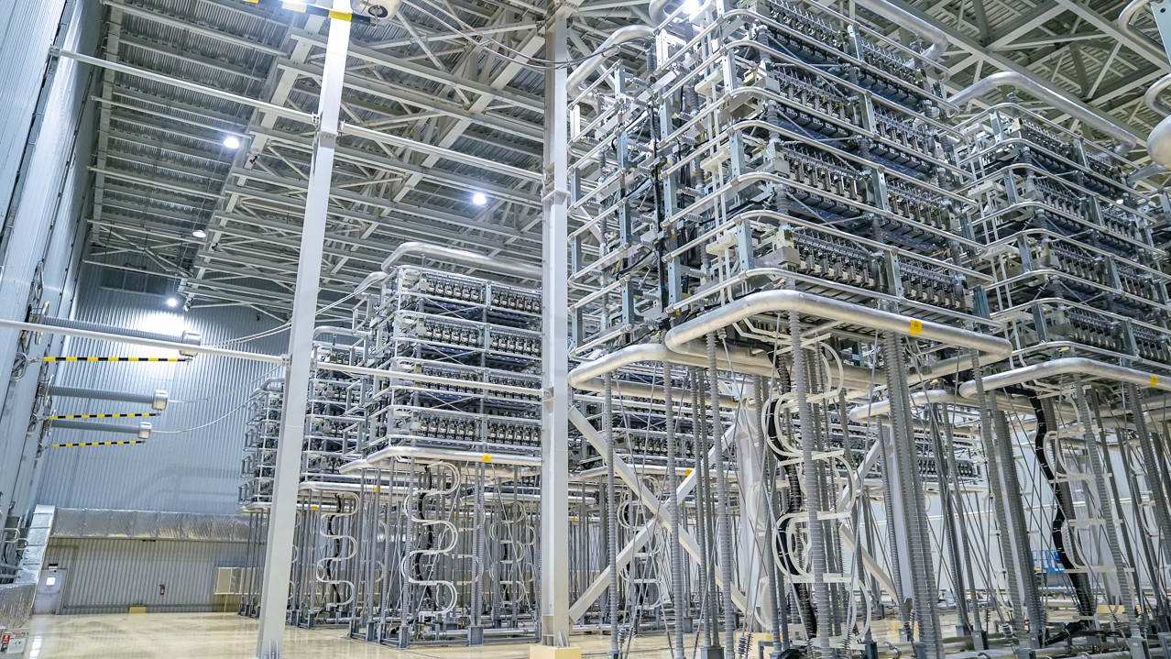
Context and key challenges: put some numbers
Consolidated Parameters:
https://www.overleaf.com/project/68b05258e0939d9219d30863
Results from POMARCS computations
(POwer & MAgnets for RCS, python suite)
Required peak power and voltages are huge
P_{pk}≈ 120 GW
V_{pk} ≈ 10 MV
I_{pk} ≈ 12 kA
P_{avg}≈ 0.48 MW
V_{rms} ≈ 0.68 MV
I_{rms} ≈ 0.47 kA
HVDC line between Spain – France 640 kVdc – 2GW

Slide 5
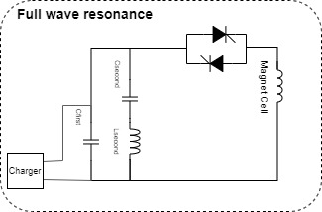
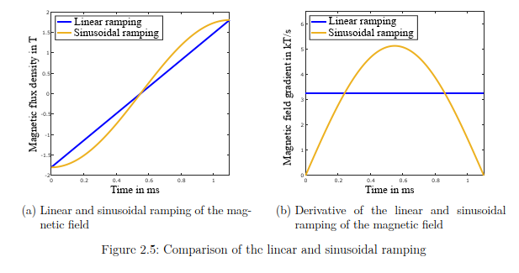
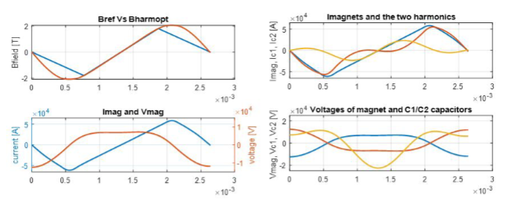
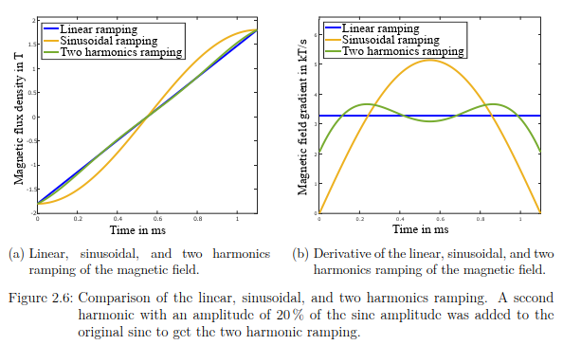
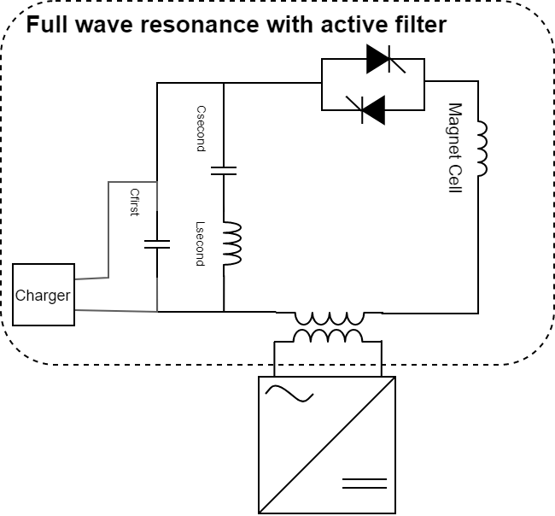
Powering system description: full wave resonance
Use of resonant power systems
Sinus resonance requires much higher RF power
Two harmonics resonance
Energy is almost entirely recovered
An active filter is added to allow controllability
“cheap”
“expensive”
“very expensive”

Slide 6
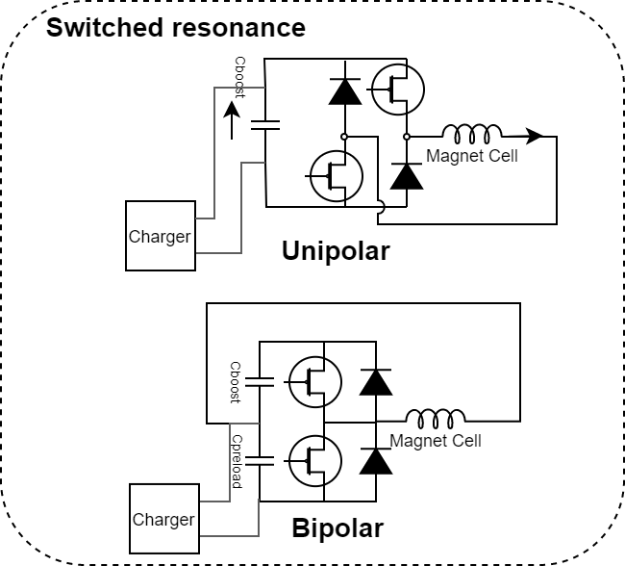
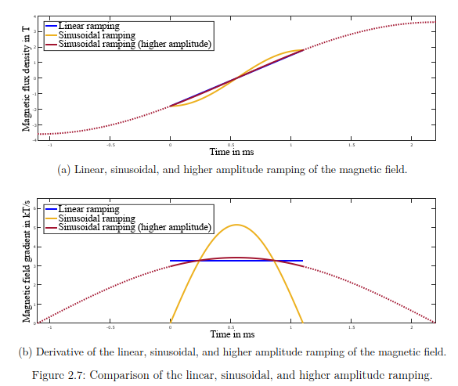
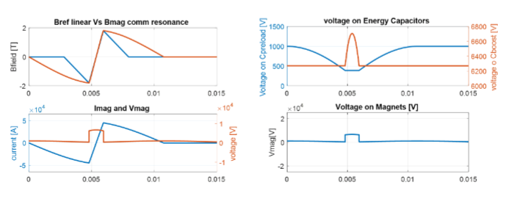
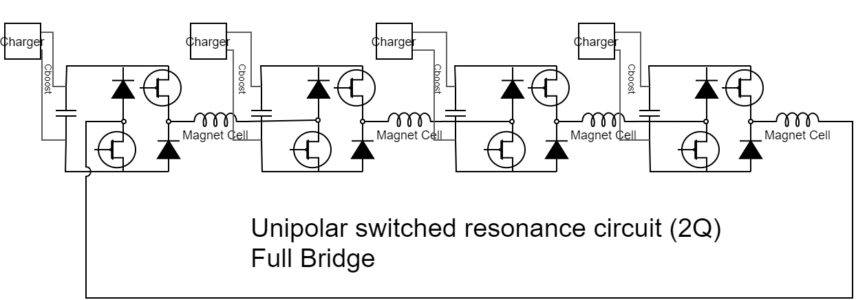
Powering system description: switched resonance
Higher amplitude resonance exploits linear portion of the resonance.
“cheap”
“expensive”
“very expensive”
No additional HW needed for controllability. Power cells can be connected in series

Slide 7
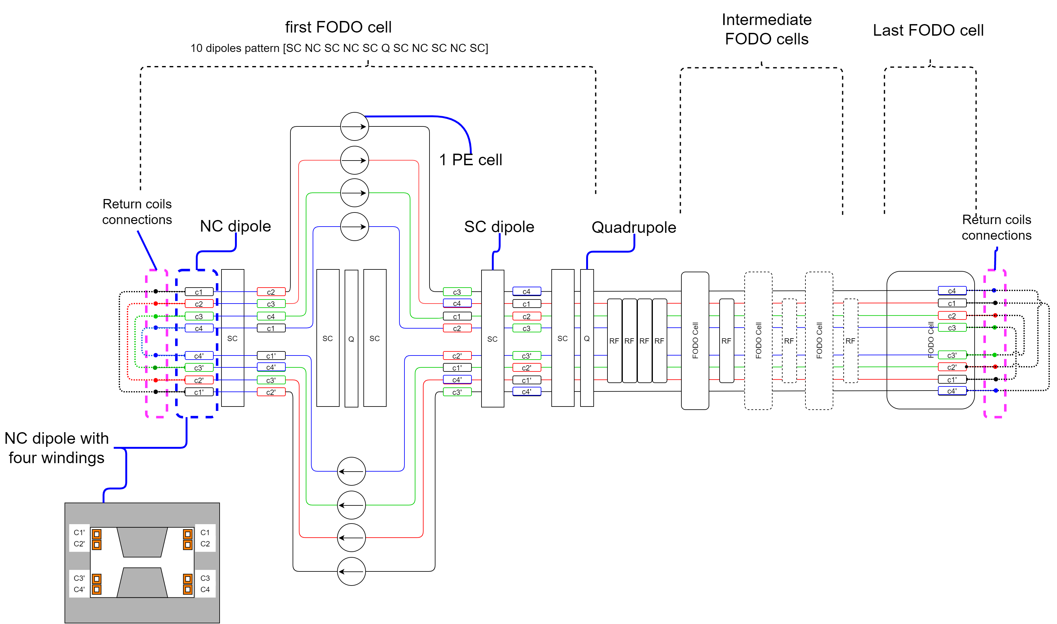
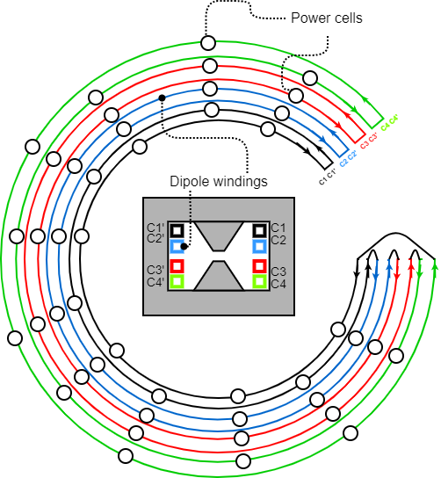
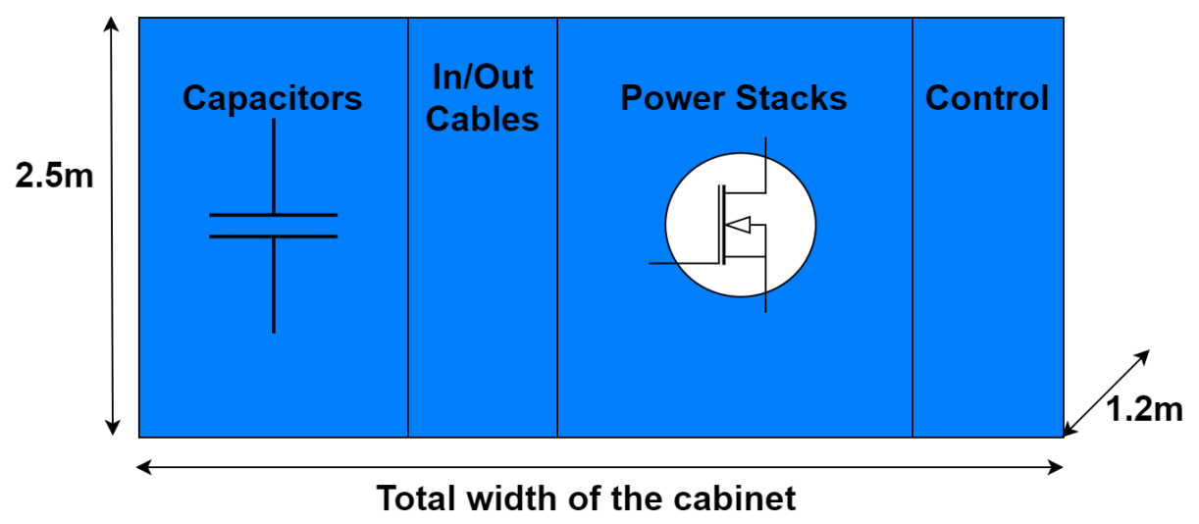
Powering system description: connection
Full RCS with power cells distributed along it and a single circuit connection
Beginning
End
Eight conductors going around the accelerator. No return path inside magnets except the first and last one

Slide 8

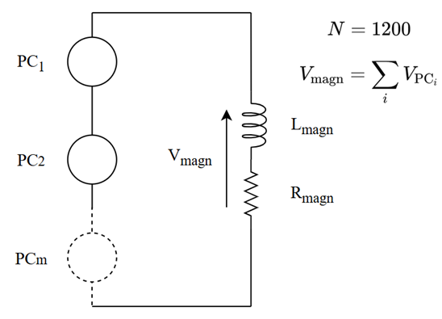
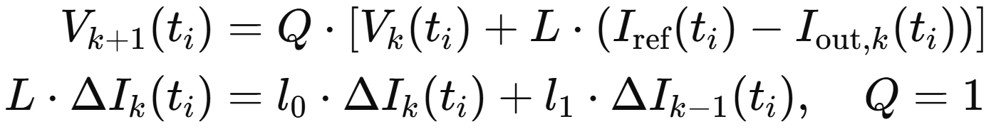
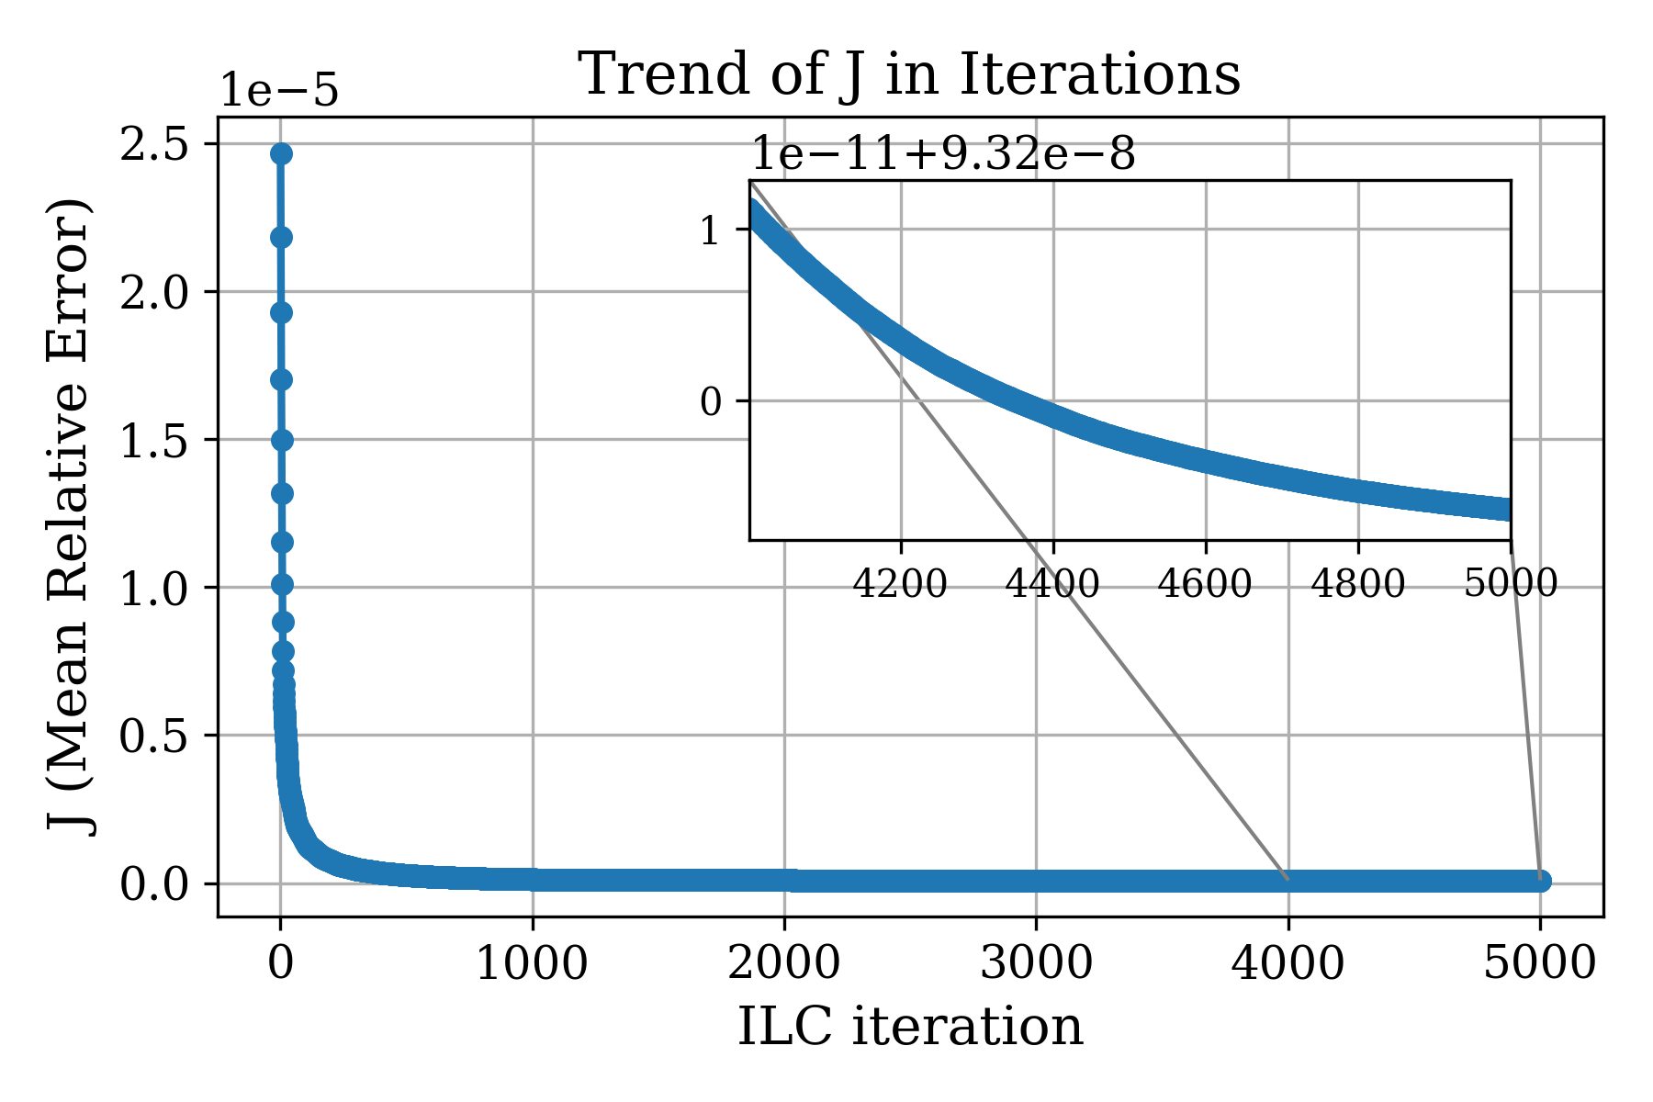
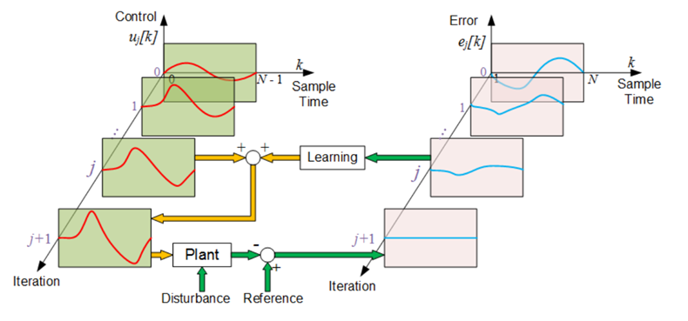
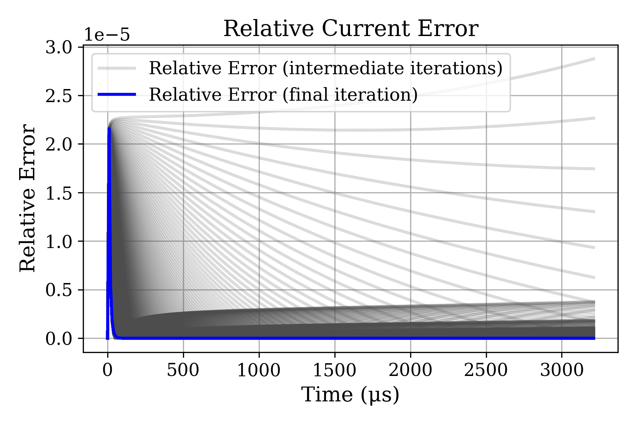
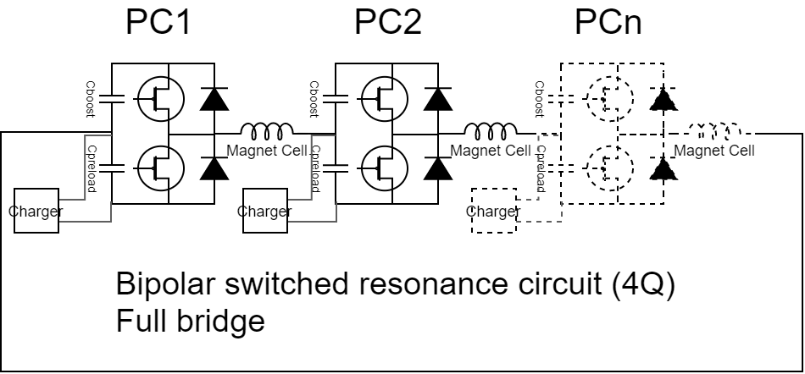
Powering system description: the control
We need to demonstrate that we can control the current / field shapes with a reasonably accuracy with the resonance only approach.
Control strategy
System schematization
Pulse to Pulse improvement
Play with IGBTs switching times to shape the pulse

Slide 9
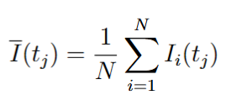

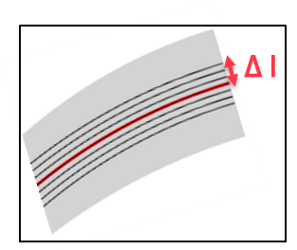

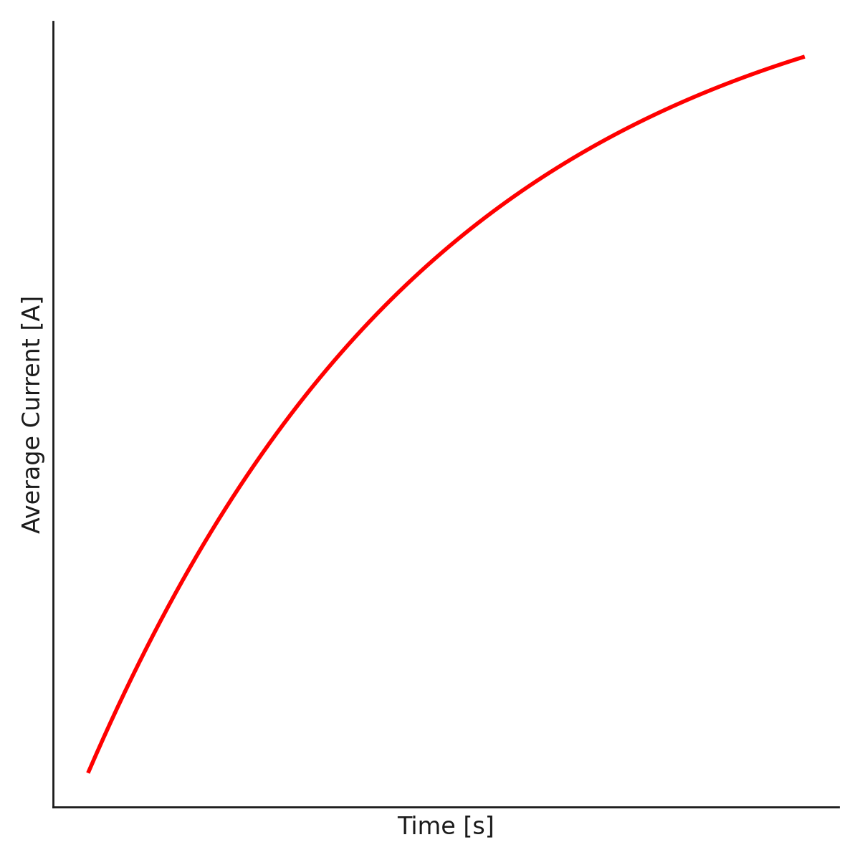


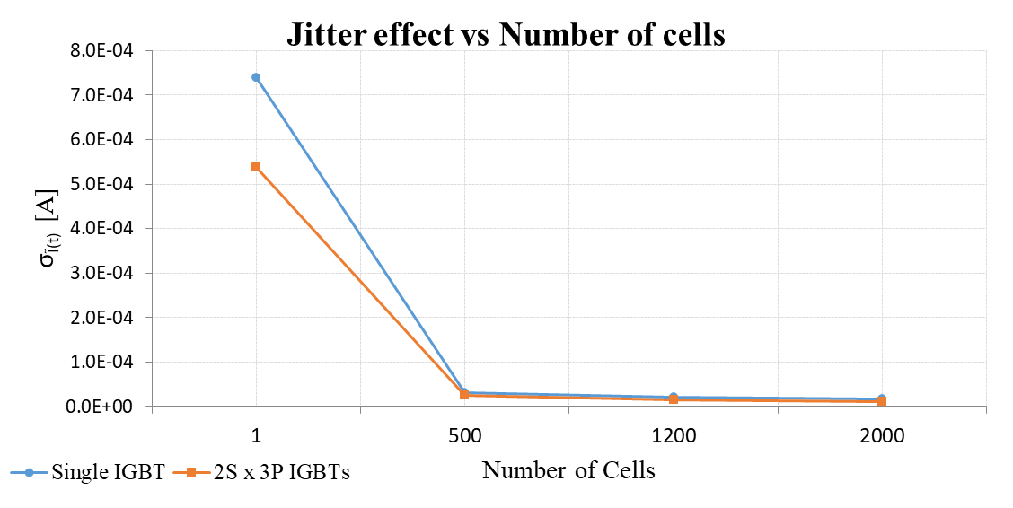
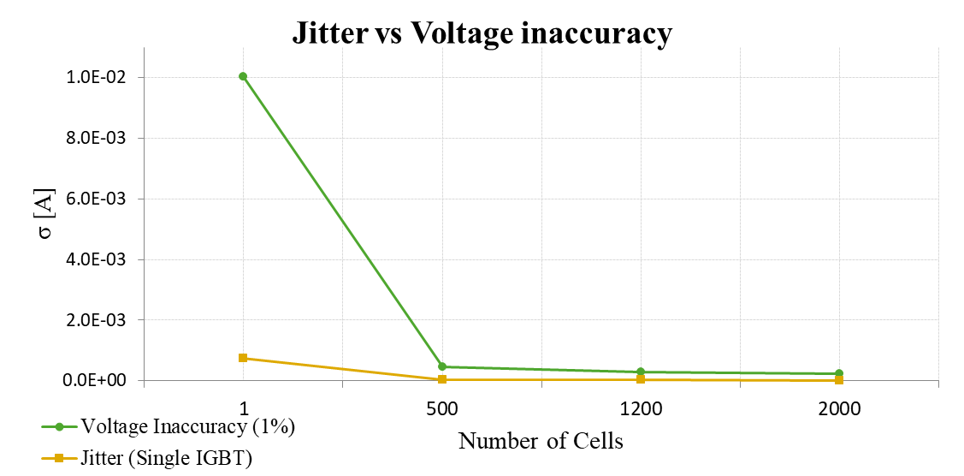
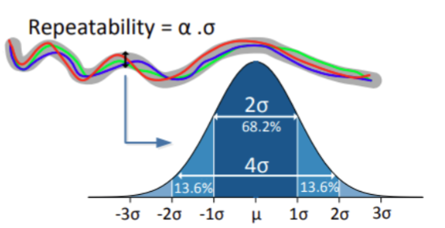
Powering system description: the control
The pulse-to-pulse control can work up to the limit imposed by the intrinsic repeatability of the system.
Repeatability
is a statistical variable characterized by a dispersion
Assume we want to have 95% of the times the ramp within a boundary of +-100ppm then α =2 and ασ_{max} <100ppm.
σ_{max} must therefore be <50ppm
Normal distribution is assumed
Jitter of IGBTs
DC voltage inaccuracy Vs IGBTs jitter
Number of cells is always beneficial to reduce dispersion

Slide 10
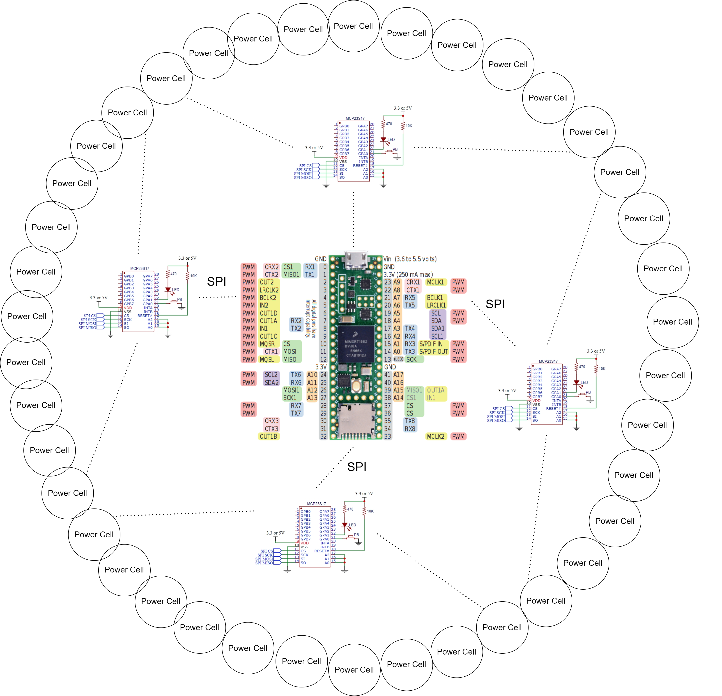
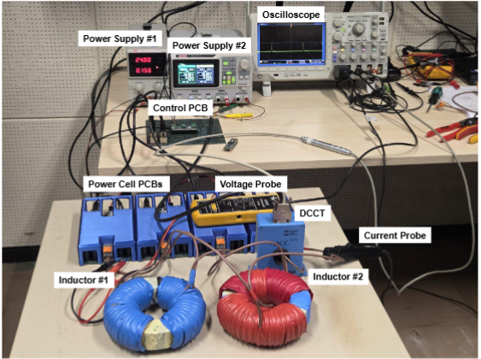
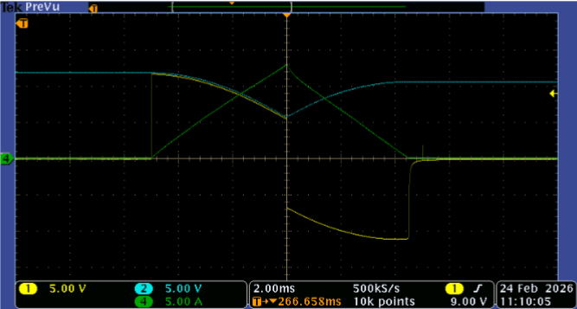
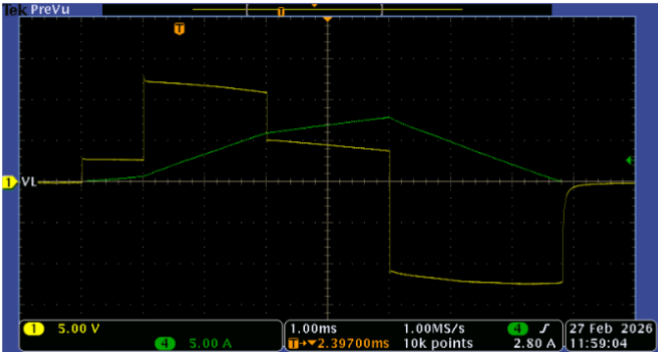
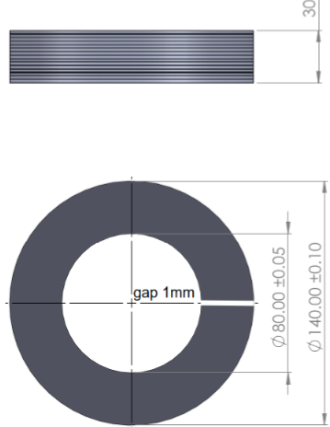
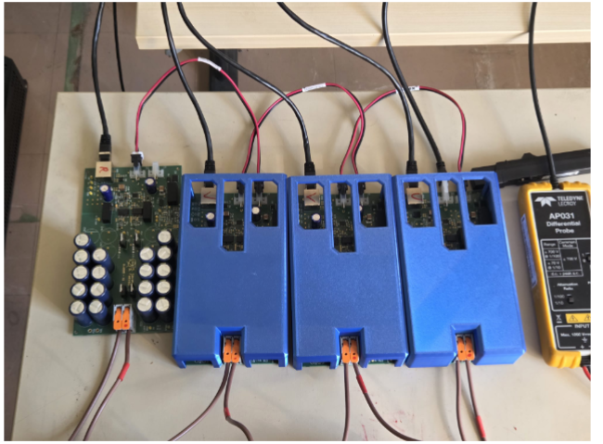
Laboratory view
Powering system description: small scale tests
A factor of x1000 in currents and in voltage for testing the control approach: 40 cells PCB
Laboratory view
Current pulse and DC voltage recovery
Resonance with four PC in series
Dummy loads 0.35mm sheets
Power cells

Slide 11
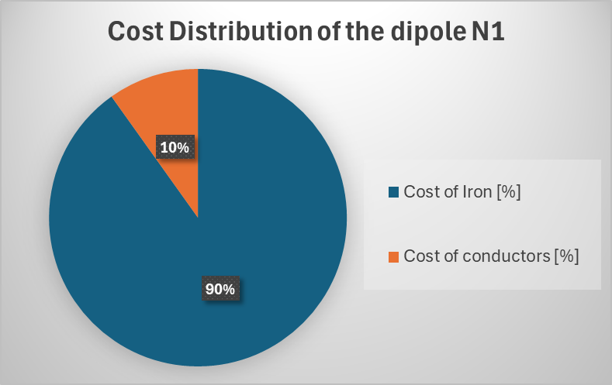
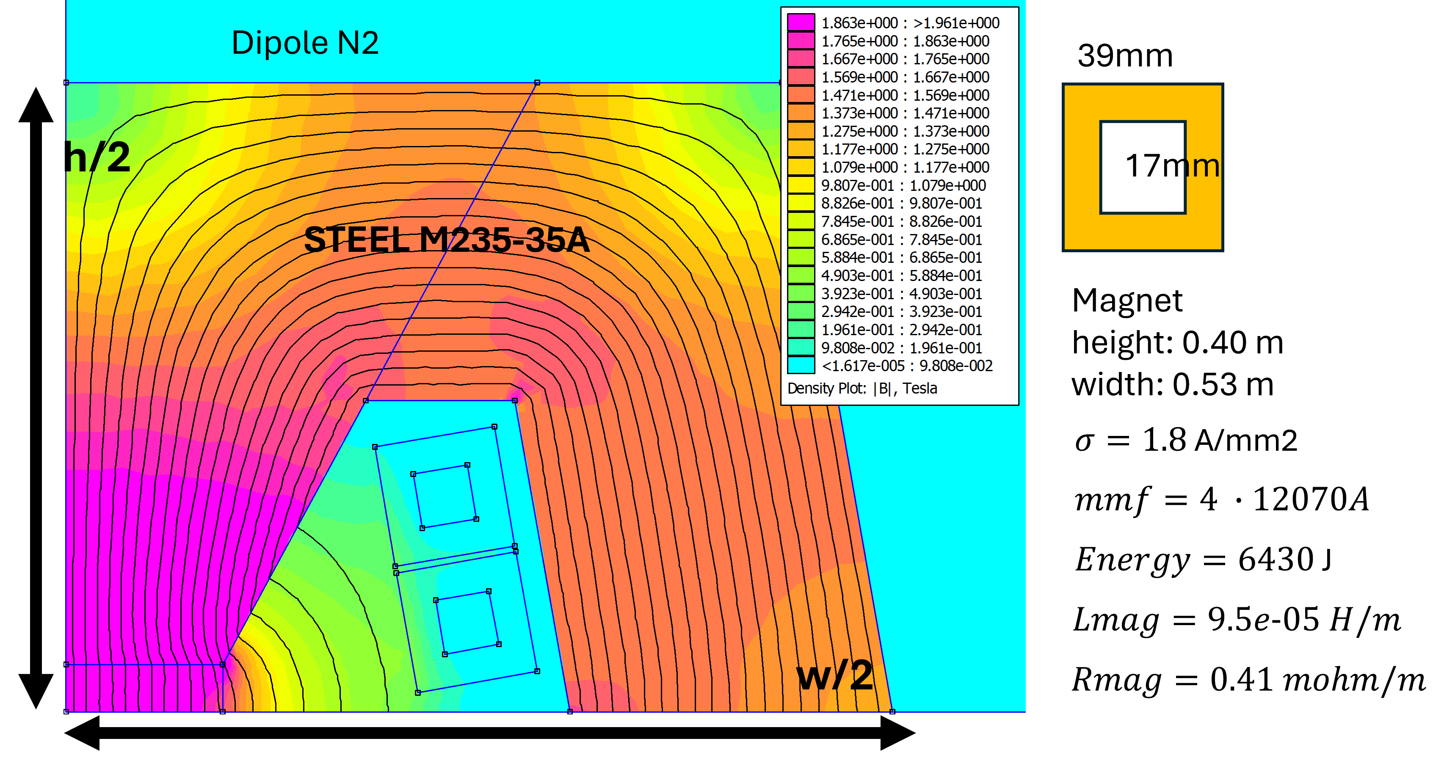
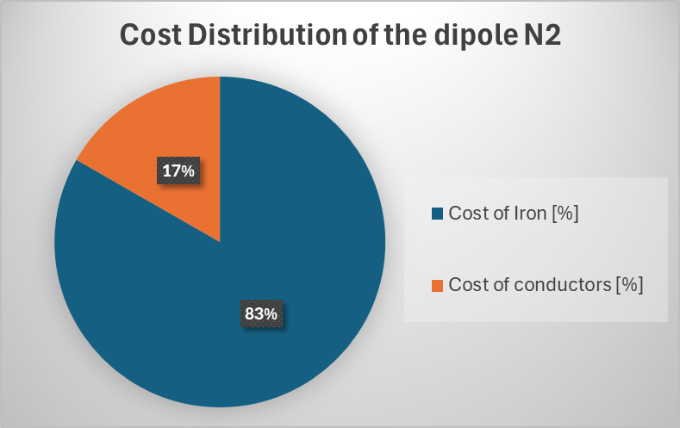
Cost computation: results from the IMCC 2025 annual meeting
 | Magnet cost x meter [kEu/m] | total NC length [m] | Cost NC magnet [MEu] | N Pecells | Cost Pecell [kEu] | Cost of the PC [Meu] | Total losses [MW] / [kW/m]
RCS1-CERN | 19.55 | 4103 | 80 | 1000 | 316 | 361 | 1.0 / 0.25
RCS2_CERN | 27.1 | 18650 | 505 | 1340 | 246 | 329 | 13.2 / 0.71
HCS3_CERN | 27.1 | 12940 | 351 | 1000 | 561 | 561 | 15.7 / 1.21
Total |  |  | 936 |  |  | 1251 | 29.9 / 2.17
RMS current increases
preliminary
Compact high losses design →
Iron weight [kg/m]: 980; Iron costs [Eur/m]: 17’627
Copper weight [kg/m]:37; Copper costs [Eur/m]: 1927
Total cost weigth x meter [kg/m]: 1017;
Total cost Magnet x meter [Eur/m]: 19’553
Bigger high losses design →
Iron weight [kg/m]: 1250; Iron costs [Eur/m]: 22’573
Copper weight [kg/m]:85; Copper costs [Eur/m]: 4532
Total weigth x meter [kg/m]: 1335;
Total cost Magnet x meter [Eur/m]: 27’105

Slide 12
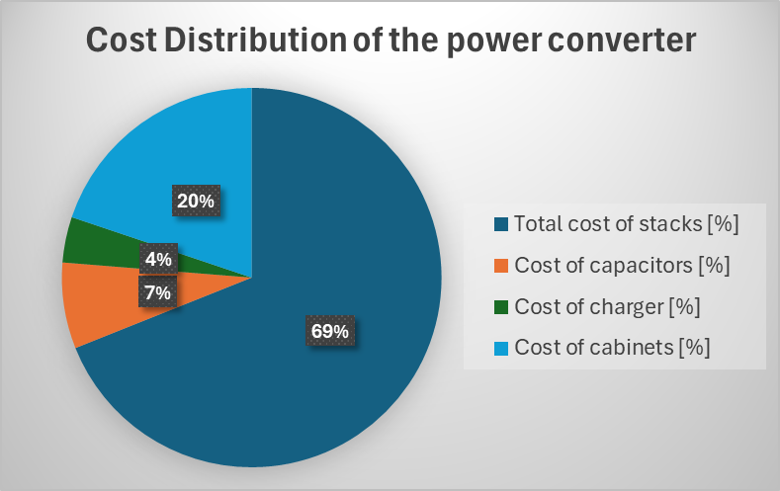
Cost computation: results from the IMCC 2025 annual meeting
 | Magnet cost x meter [kEu/m] | total NC length [m] | Cost NC magnet [MEu] | N Pecells | Cost Pecell [kEu] | Cost of the PC [Meu] | Total losses [MW] / [kW/m]
RCS1-CERN | 19.55 | 4103 | 80 | 1000 | 316 | 361 | 1.0 / 0.25
RCS2_CERN | 27.1 | 18650 | 505 | 1340 | 246 | 329 | 13.2 / 0.71
HCS3_CERN | 27.1 | 12940 | 351 | 1000 | 561 | 561 | 15.7 / 1.21
Total |  |  | 936 |  |  | 1251 | 29.9 / 2.17
RMS current increases
Preliminary
Number of stacks: 15
Total cost of stacks [Eu]: 390’285
Cost of capacitors [Eu]: 41’508
Cost of charger [Eur]: 22’000
Cost of cabinets [Eu]: 112’320

