Slide 1




RCS power system and magnets Seminar Series for the National Lab Muon Accelerator Study Group
F. Boattini¹, G. Brauchli², M. Gast³, D. Fazioli⁴,D. Moll⁵, M. Breschi⁴, D. Aguglia¹, P. Viarouge⁶
¹ CERN , ² UNR –Còrdoba (AR) , ³ KIT –Karlsruhe (DE), ⁴ UNIBO – Bologna (IT), ⁵ TUD-Darmstadt (DE), ⁶ UNILAVAL-Quebec (CA)

Slide 2

Outline
Dipole magnets optimization
Quadrupole magnets optimization

Slide 3
Dipole magnets optimization
Magnet specifications: 1) Magnetic field in the aperture 1.8 T 2) Good field region (30 mm * 100 mm) 3) 1 ms ramp from −1.8 to + 1.8 T
Various magnet configurations available in the literature were analyzed with a FEM model and a design optimization procedure
Comparison made in terms of stored magnetic energy (relevant for the power supply system), electrodynamic losses (relevant for operation and environmental costs) and field quality

Slide 4
Design of fast-ramped resistive dipoles for the RCS accelerator
In this study 3 main configurations were analyzed: H-type magnet, Windowframe magnet, Hourglass magnet (from the US study)
J. S. Berg, H. Witte, “Pulsed synchrotrons for very rapi acceleration”, AIP Conference Proceedings 1777, 100002 (2016)
H-type magnet
Hourglass magnet
Windowframe magnet

Slide 5
Design of fast-ramped resistive dipoles for the RCS accelerator
H-type magnet

Slide 6
Design of fast-ramped resistive dipoles for the RCS accelerator
Hourglass magnet

Slide 7
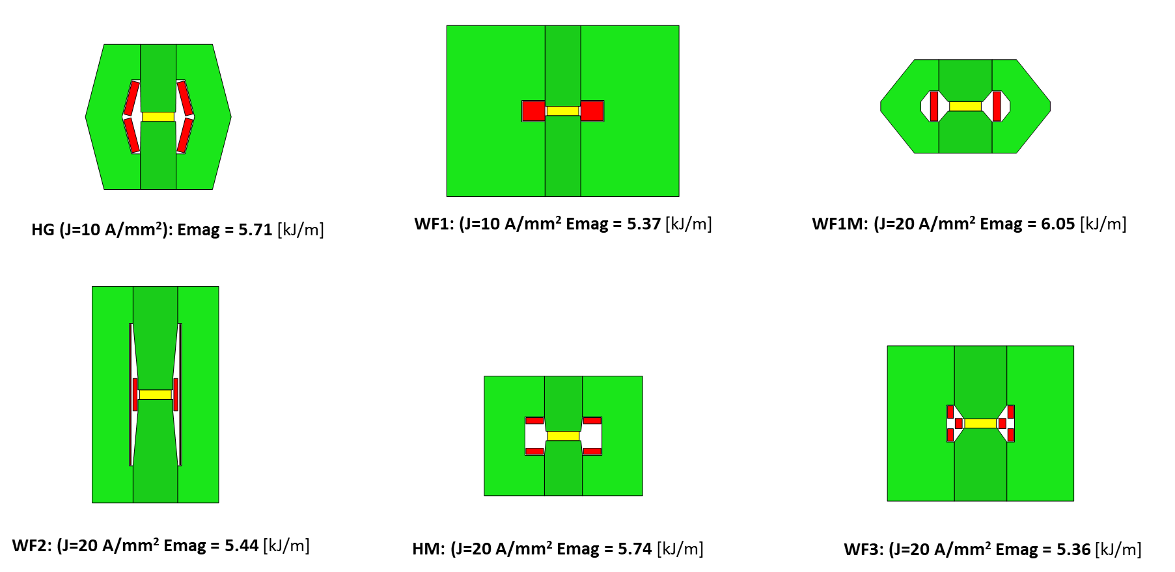
Design of fast-ramped resistive dipoles for the RCS accelerator
Selected configurations (low energy and losses)

Slide 8
Design of fast-ramped resistive dipoles for the RCS accelerator
M. Breschi, et al., “Comparative Analysis of Resistive Dipole Accelerator Magnets for a Muon Collider”, IEEE Trans. Appl. Supercond., vol. 34, n. 5, Art. No. 4003305, 2024

Slide 9
Magnetic circuit model of the H-type magnet
To reduce the computation time wrt the FEM model, an equivalent circuit model of the H-type magnet was developed
The circuit was solved with mesh analysis

Slide 10
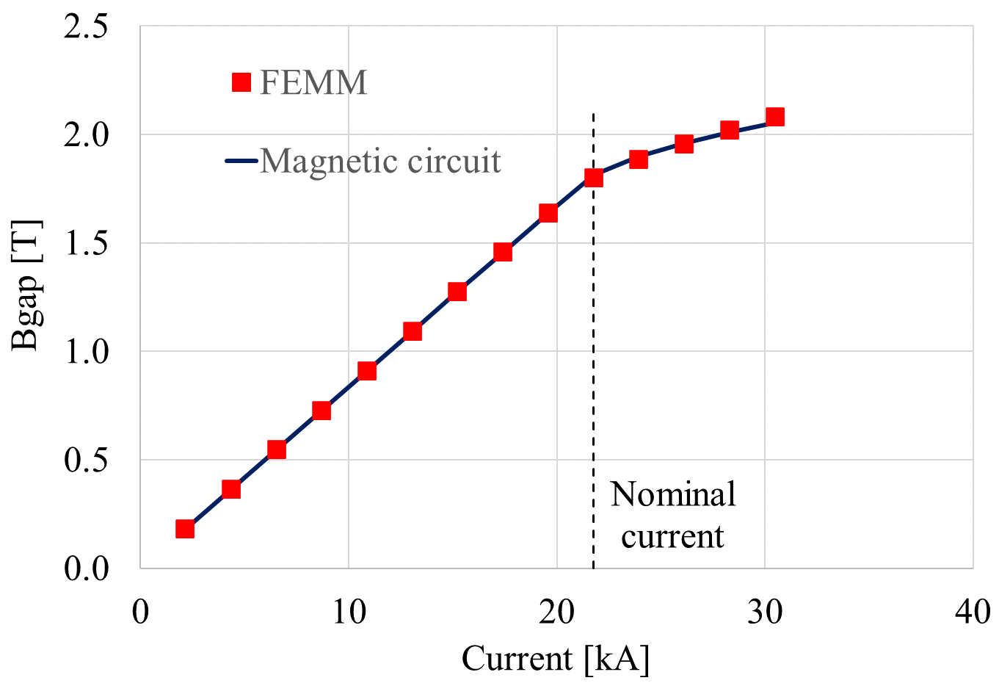
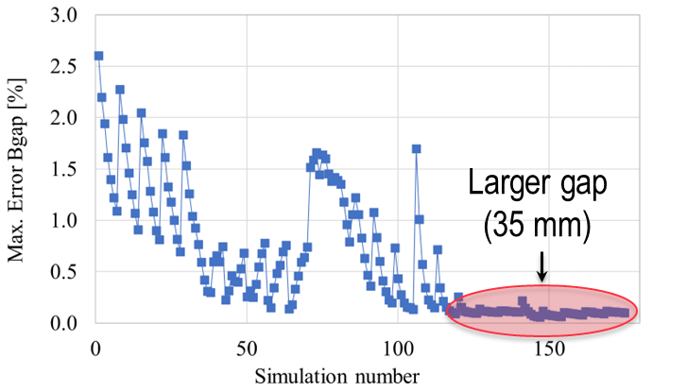
Magnetic circuit model of the H-type magnet
The field in the gap and the total flux linked to the winding were computed with the magnetic circuit and the 2D FEM model (FEMM)
Good agreement over 175 different configurations
Parametric study
 | Min. (mm) | Max (mm) | Number of values
Gap width | 80 | 120 | 5
Gap height | 25 | 35 | 5
Coil width | 39.5 | 69.5 | 7
Field

Slide 11
Outline
Design of fast-ramped resistive dipoles for the RCS accelerator
Quadrupole magnets optimization

Slide 12
Analyzed quadrupole configurations (1/3)
Main requirements for the quadrupole magnets design
Field gradient about 30 T/m, but higher gradients also desirable
Magnetic field homogeneity within 10 x 10⁻⁴ in the good field region
Fast Ramps in the order of 1 ms
Main objectives of the design
Limit the magnetic stored energy (crucial design specification for the supplied power)
Limit the total losses (iron + copper)

Slide 13
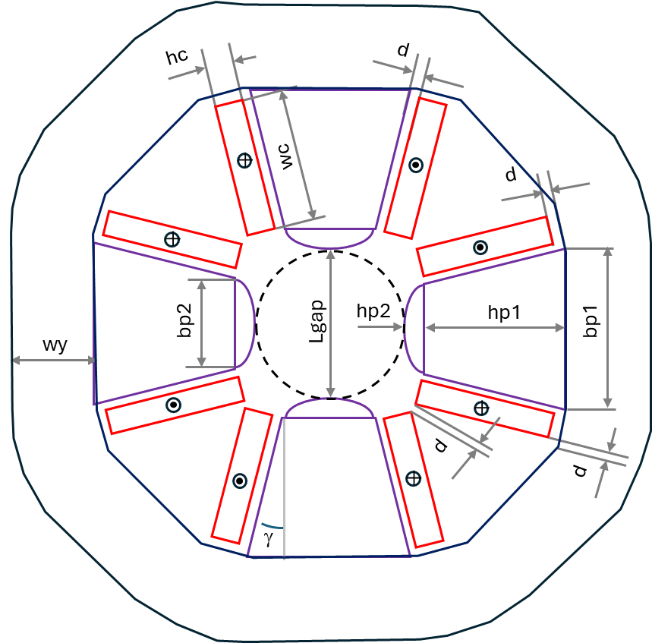
Analyzed quadrupole configurations (2/3)
Conductor
Conductors parallel to the yoke for Cu loss reduction (8 bars)
Conductors parallel to the poles, with reduction of the leakage flux (8 bars)
Yoke with shaved corners to reduce Fe losses
Conductor
Magnetic poles
(M235 – 35a)
Magnetic poles
Quadrupole magnet for a rapid cycling synchrotron, H. Witte, J. S. Berg, Brookhaven National Laboratory, Upton, NY, USA, Proceedings of IPAC2015, Richmond, VA, USA
Ferromagnetic yoke
Ferromagnetic yoke
(M235 – 35a)
MAP Configuration #1
Configuration #2

Slide 14
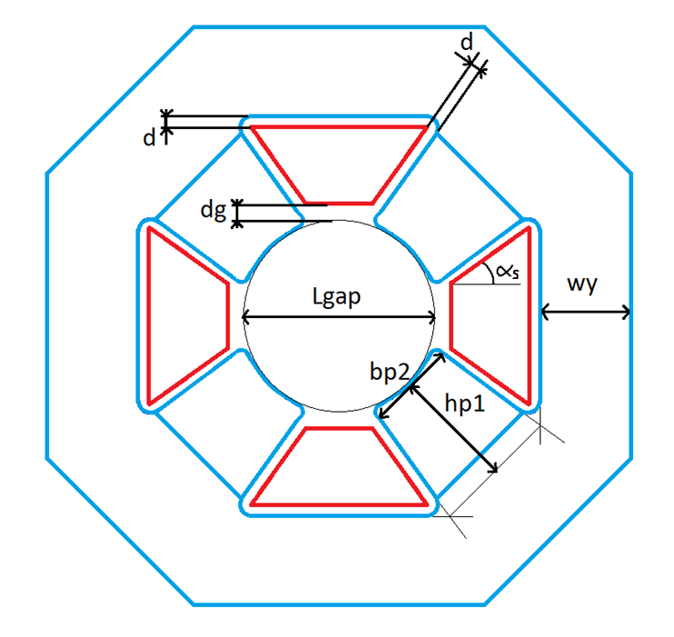
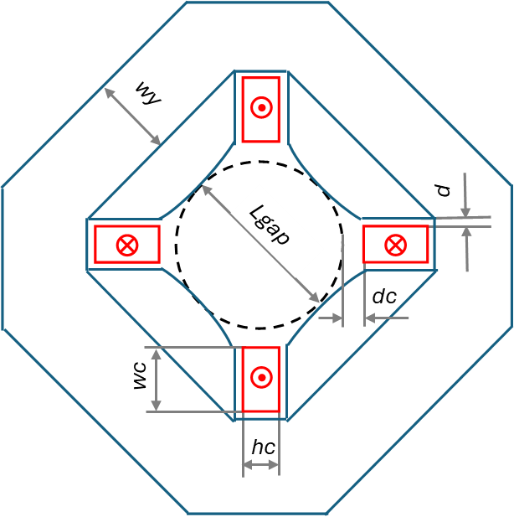
Analyzed quadrupole configurations (3/3)
Conductors parallel to the poles to reduce the leakage flux (4 bars)
Conductors with trapezoidal shape to fill the empty spaces between poles
Conductor
Conductor
Magnetic poles
Poles shaping tangential to the air gap region to reduce magnetic energy
Magnetic poles
Ferromagnetic yoke
Configuration #3
Ferromagnetic yoke
Configuration #4

Slide 15
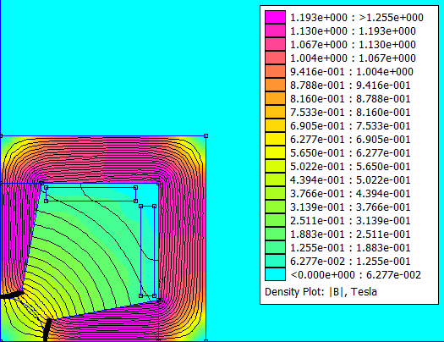
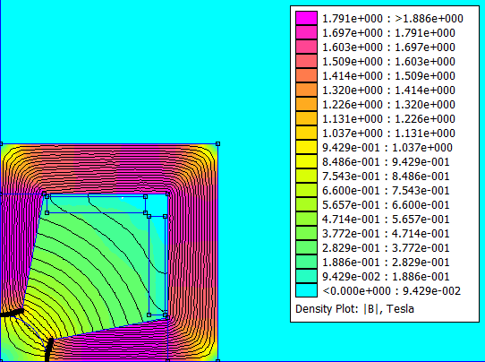
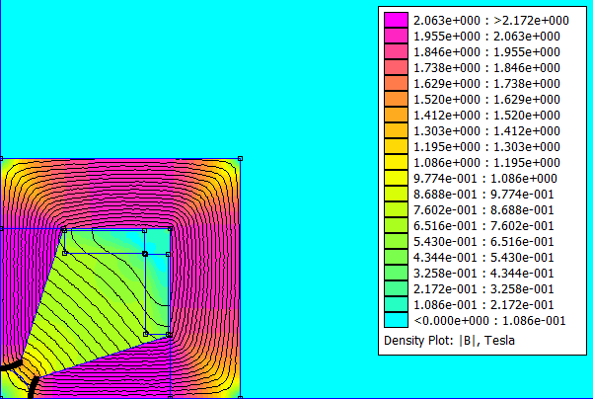
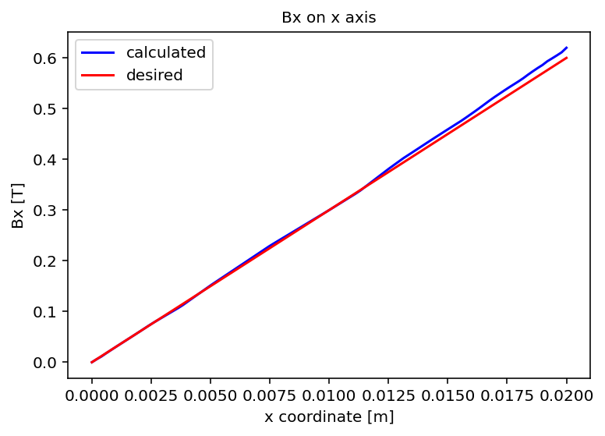
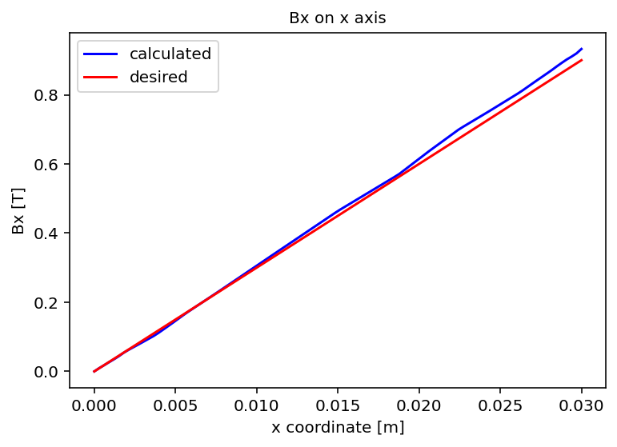
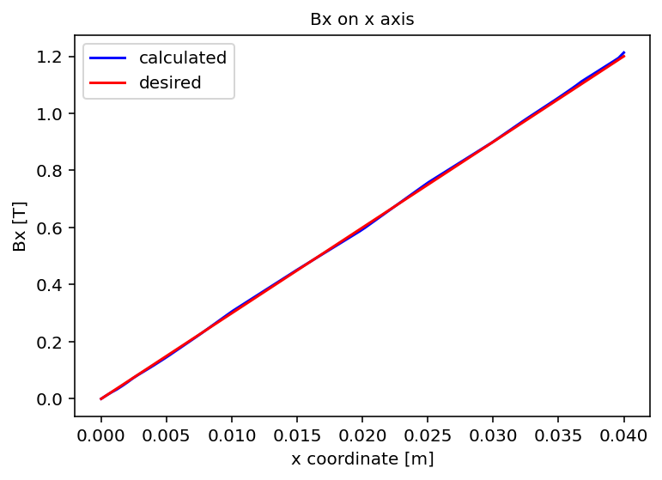
Field map and results of Configuration #1
Field gradient set to 30 T/m, Jc set to 20 A/mm²
Lgap = 40 mm
Em = 443 J/m
Lgap = 60 mm
Em = 2416 J/m
Lgap = 80 mm
Em = 26053 J/m
Bpeak = 1.19 T
Bpeak = 1.79 T
Bpeak = 2.06 T

Slide 16
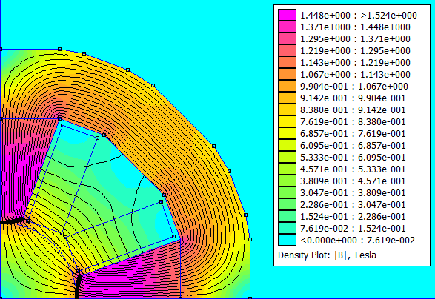
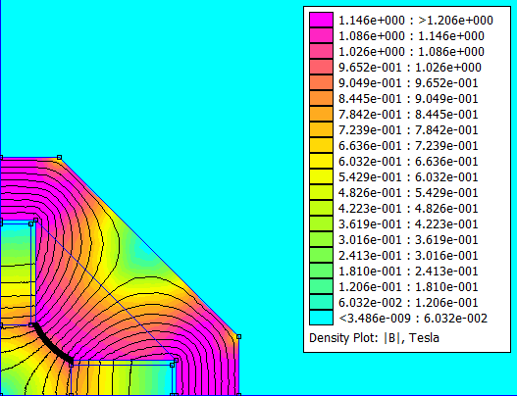
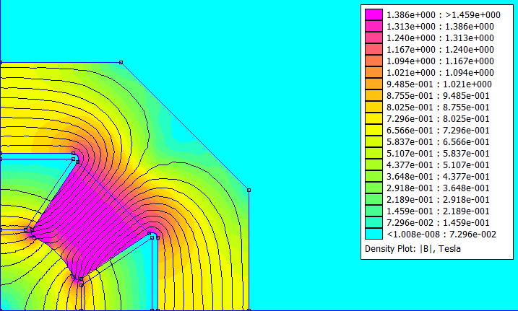
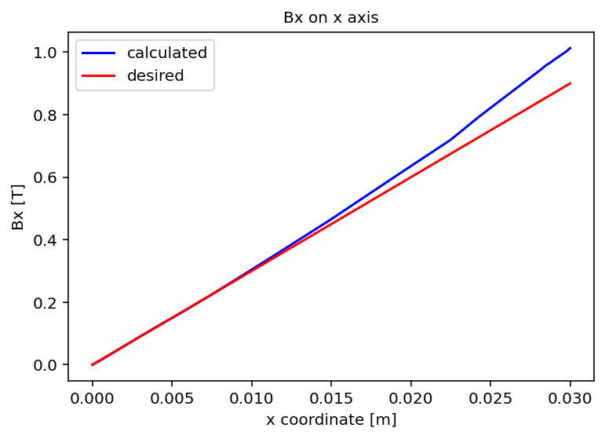
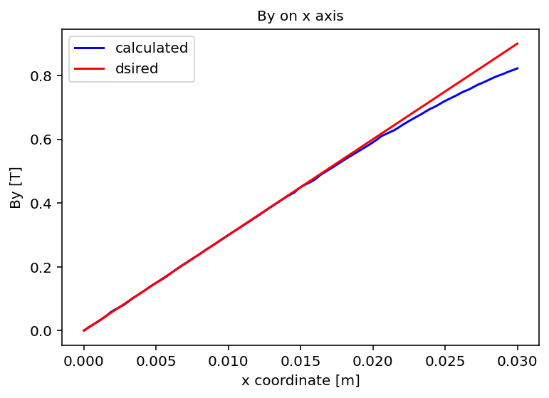
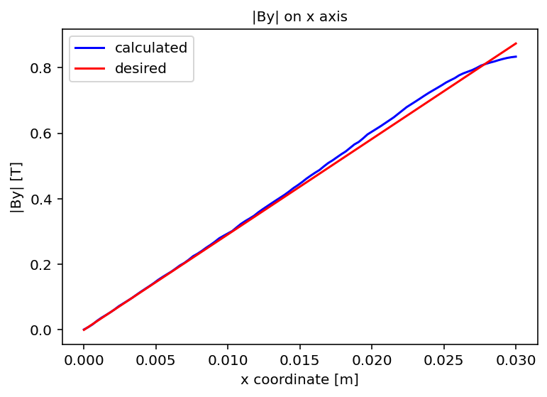
Results of Configurations #2, #3, #4
Field gradient set to 30 T/m, Lgap set to 60 mm
Em = 1052 J/m
Em = 1110 J/m
Em = 831 J/m
#2 Bpeak = 1.45 T
#3 Bpeak = 1.15 T
#4 Bpeak = 1.39 T

Slide 17
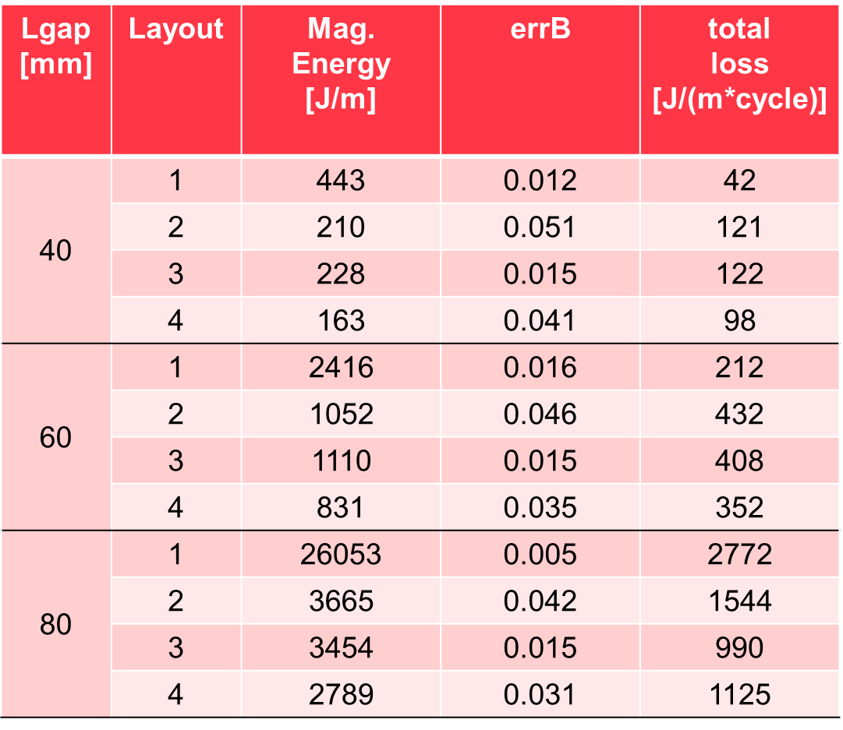
Comparison of the different configurations
Field gradient set to 30 T/m
Configuration #1 is the best in terms of total losses, due to the conductor placement
Configuration #4 exhibits the lowest magnetic energy, due to the small air region outside of the good field area
Configuration #3 exhibits a good tradeoff between losses, magnetic energy and field error and was selected for further studies

Slide 18
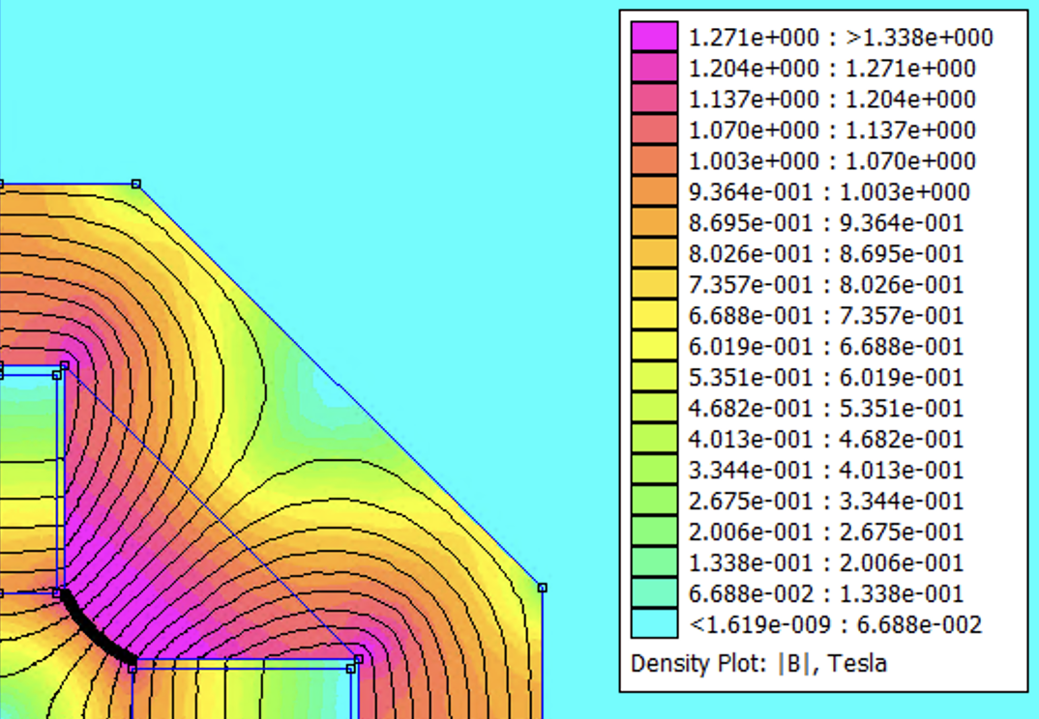

Study of higher gradients for Configuration #3
Lgap set to 60 mm, Jc set to 20 A/mm²
$gradB=35 T/m$
gradB [T/m] | errB | Mag. Energy [J/m] | total Loss [ J/m/cycle]
30 | 0.015 | 1108 | 407
35 | 0.016 | 1637 | 554
40 | 0.015 | 2318 | 731
The magnetic energy of the 40 T/m quadrupole seems too high, but 35 T/m seems reachable
For comparison, the magnetic energy of the dipoles is about 5 kJ/m

Slide 19
Conclusions for the quadrupole studies
Four different configurations of resistive quadrupole magnets were optimized for three values of the air gap diameter.
All optimized configurations achieve the specified field gradient of 30 T/m. Even a higher gradient, up to 35 T/m is attainable without exceedingly high energy and losses.
The most suitable configuration in terms of losses is #1 (MAP), in terms of magnetic energy #4 and a tradeoff of loss, magnetic energy and field quality is found for #3.
Further investigations are required to reduce the field error.

