Slide 1

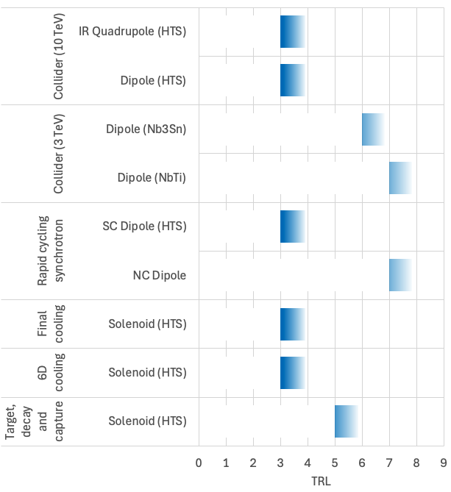
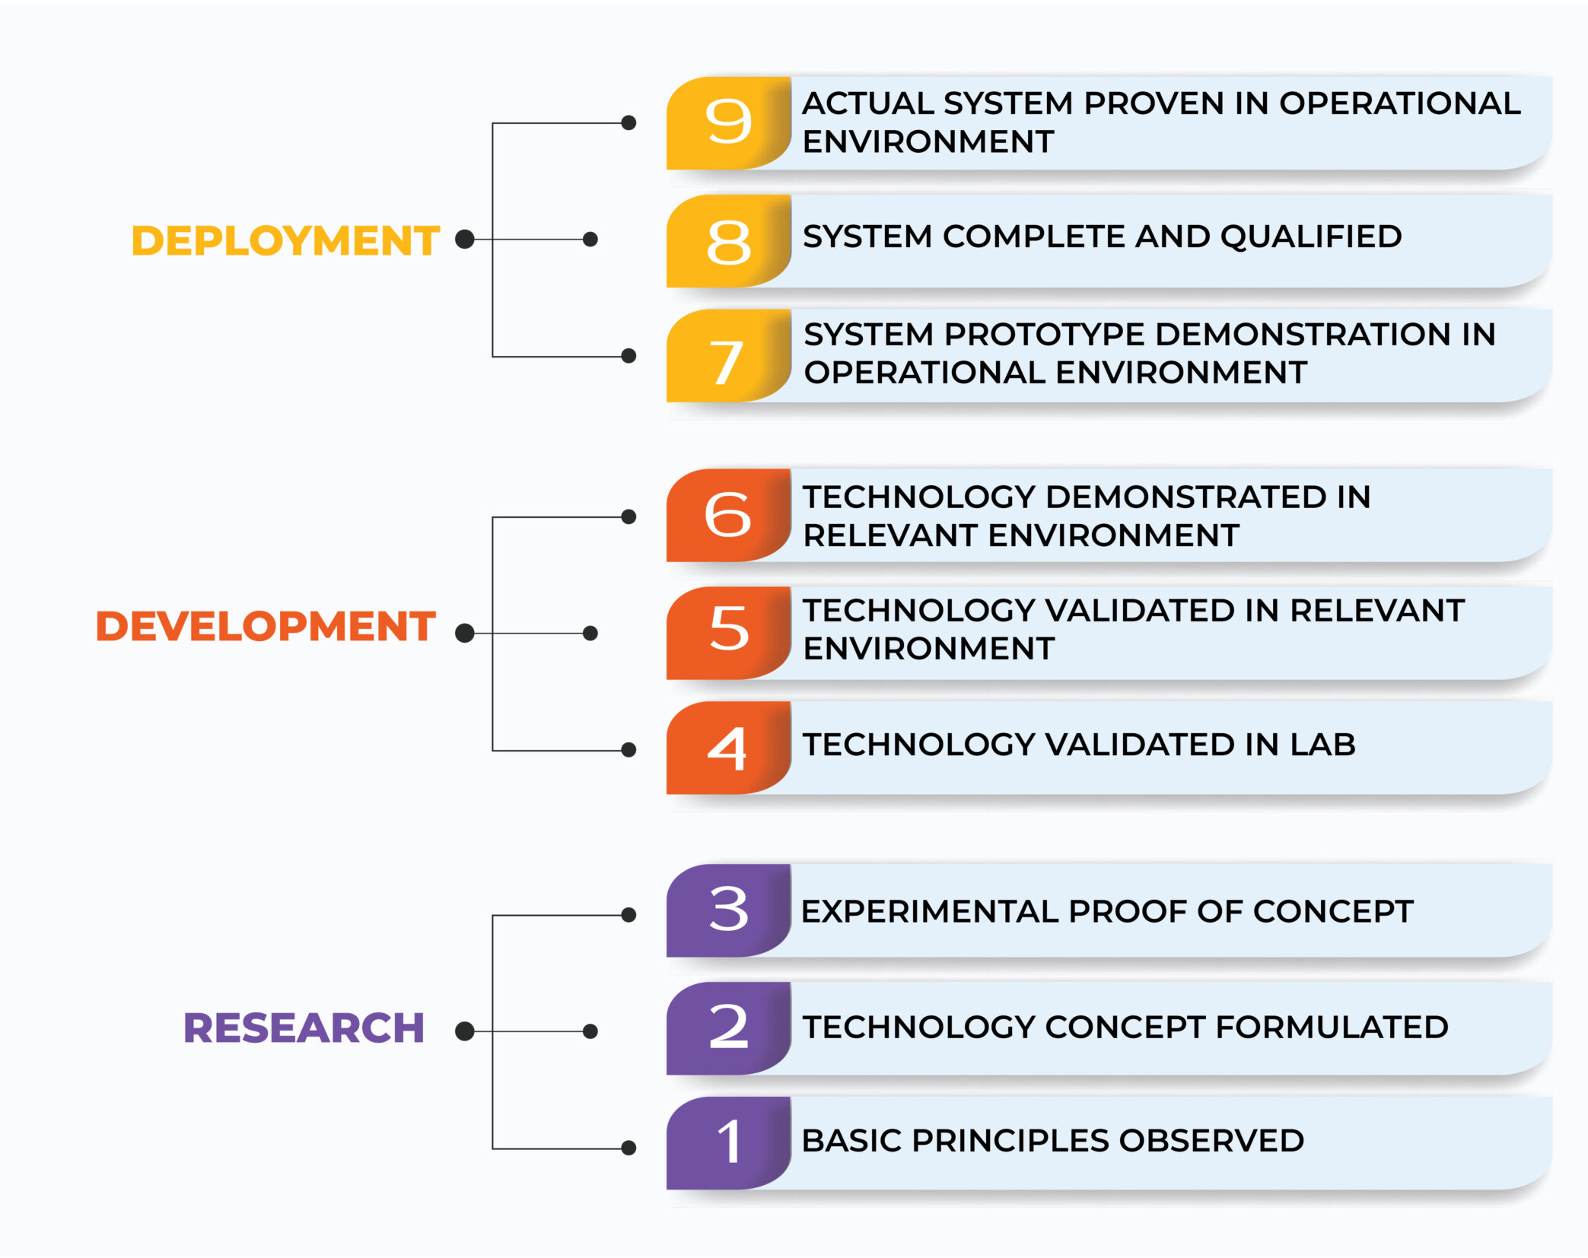
Technology Readiness (courtesy of Luca Bottura)
Fast Powering system
Resonating PC + hundreds of connected cells + p2p control. Altogether is totally new. Not sure it’ll work as needed!
Courtesy of L. Bottura

Slide 2
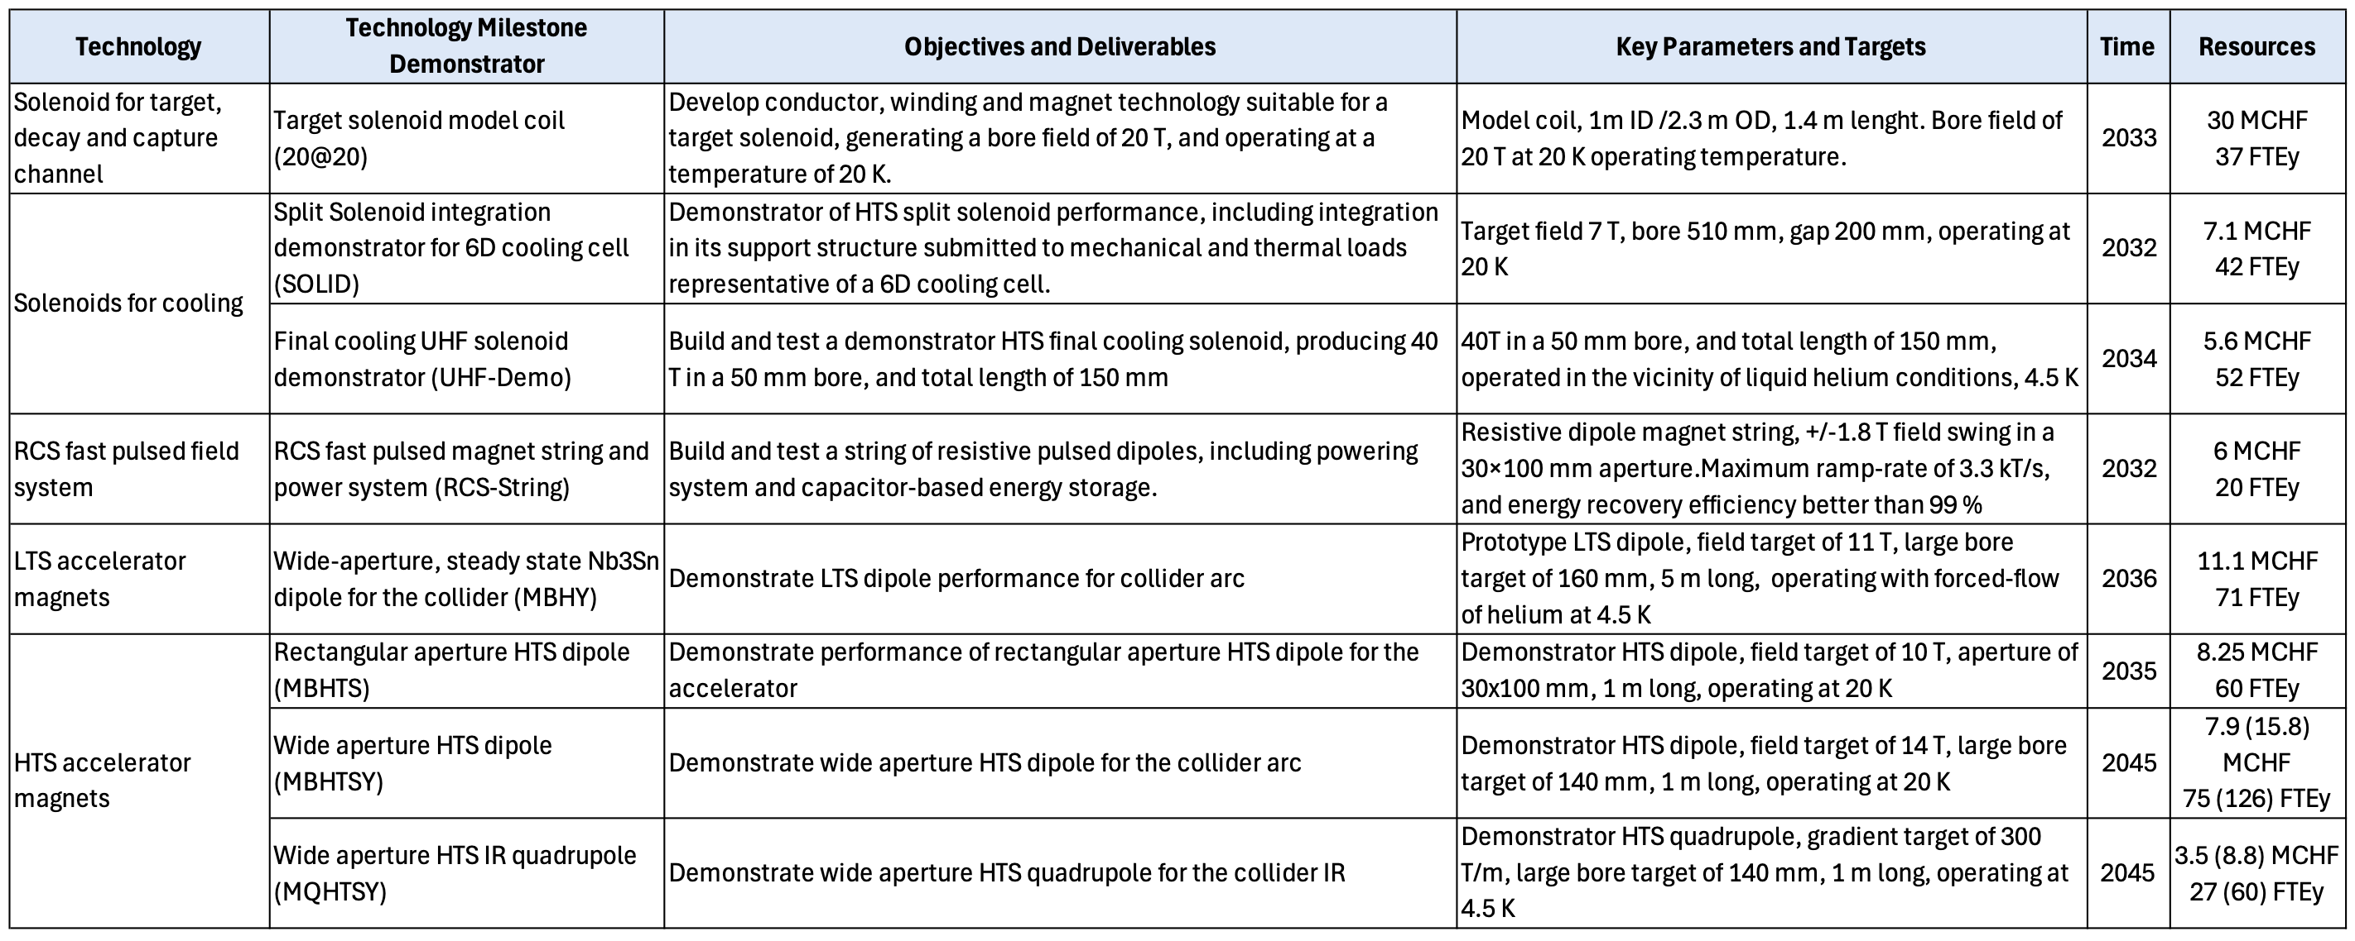
R&D Plan
Included in the package presented by Luca.
Detailed in the following
Courtesy of L. Bottura

Slide 3
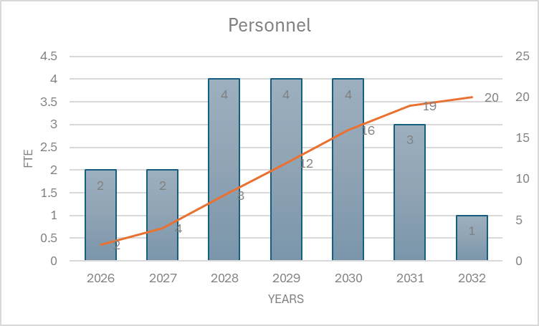
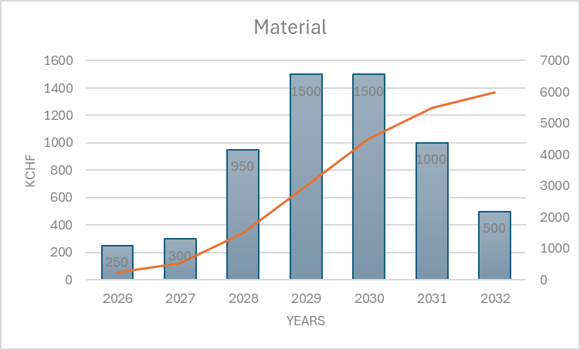
R&D Plan – Resources
As diffused so far…. Uncertain for the very next years
2026-27 are probably still more supervised students than staff

Slide 4
R&D Plan-activities
Easy
Reduced scale ”PCB size” string test
  Test control principle and limits;
  Measure the magnetic field in the chamber.
  Magnetic material characterization for losses → AK steel Int.
Realization of a full size IP00 power stack
  Exploit the limits in peak commutated current → Hitachi CH/Infineon DE may be interested
  Verify the jitter typical values.
  Refine cost model.
Full scale, reduced quantities string test
  Dipole + Quadrupoles proto realization and analysis
  Real scale current/voltage testing
  Real scale B measurement in chamber
  Cost model refining
Supervised students
PHD + STAFF
STAFF
must find a testing area. Not available in EPC presently
Hard

Slide 5
R&D Plan-timeline
Reduced scale ”PCB size” string test
  Test control principle and limits;
  Measure the magnetic field in the chamber.
  Magnetic material characterization for losses → AK steel Int.
Realization of a full size IP00 power stack
  Exploit the limits in peak commutated current → Hitachi CH/Infineon DE may be interested
  Verify the jitter typical values.
  Refine cost model.
Full scale, reduced quantities string test
  Dipole + Quadrupoles proto realization and analysis
  Real scale current/voltage testing
  Real scale B measurement in chamber
  Cost model refining
Supervised students
2026-2027
PHD + STAFF
2027-2029
STAFF
must find a testing area. Not available in EPC presently
2030-2033

Slide 6
summary
Technical solution for RCS powering proposed and analyzed in simulation. Modular systems with hundreds of basic power cells exists supporting the concept. However, they are quite different and cannot be taken as examples.
Preliminary design of dipole and quadrupole magnets highlighted possible problems with field quality inside the vacuum chamber. Reduced scale small model will help understanding.
Magnet losses in small scale sample will help assessing the models.
Construction magnet experts required particularly for the third phase.
Next steps for us is build and test…

