Slide 1
Accelerating Muons
J. Scott Berg
Brookhaven National Laboratory
Seminar, National Lab Muon Collider Accelerator Study Group
December 1, 2025

Slide 2
Outline
Overview
Initial acceleration
Low-energy acceleration
  Linac
  RLAs
Pulsed synchrotrons to high energy
  Design considerations
  Pulsed magnets
  Alternative: FFAs
R&D topics

Slide 3
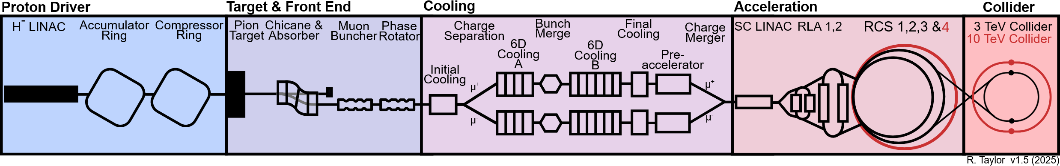
Muon Collider Facility Overview
Proton driver creating high-power proton beam
Front end: create pions at target, capture muons, form bunch train
Cooling: reduce emittance, combine into one bunch
Acceleration: increase energy
Collider ring

Slide 4
Muon Acceleration Overview
After final cooling, muons have a kinetic energy 3–4 MeV
The physics goal of 10 TeV “pCoM” means we need to accelerate to 5 TeV
Accelerating muons is qualitatively different from accelerating other particles because
  Muons are decaying so we need to accelerate quickly
  A relatively large longitudinal emittance (25 meV·s)
  A high charge per bunch (2 10¹²)
  Two bunch charges circulating simultaneously in the same beamline

Slide 5
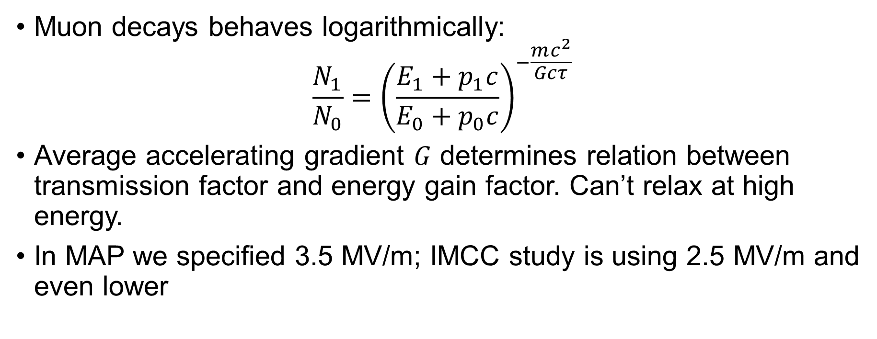
Muon Decay in Acceleration
Muon decays behaves logarithmically:
$\frac{N_{1}}{N_{0}}={\left(\frac{E_{1}+p_{1}c}{E_{0}+p_{0}c}\right)}^{−\frac{mc^{2}}{Gcτ}}$
Average accelerating gradient $G$ determines relation between transmission factor and energy gain factor. Can’t relax at high energy.
In MAP we specified 3.5 MV/m; IMCC study is using 2.5 MV/m and even lower

Slide 6
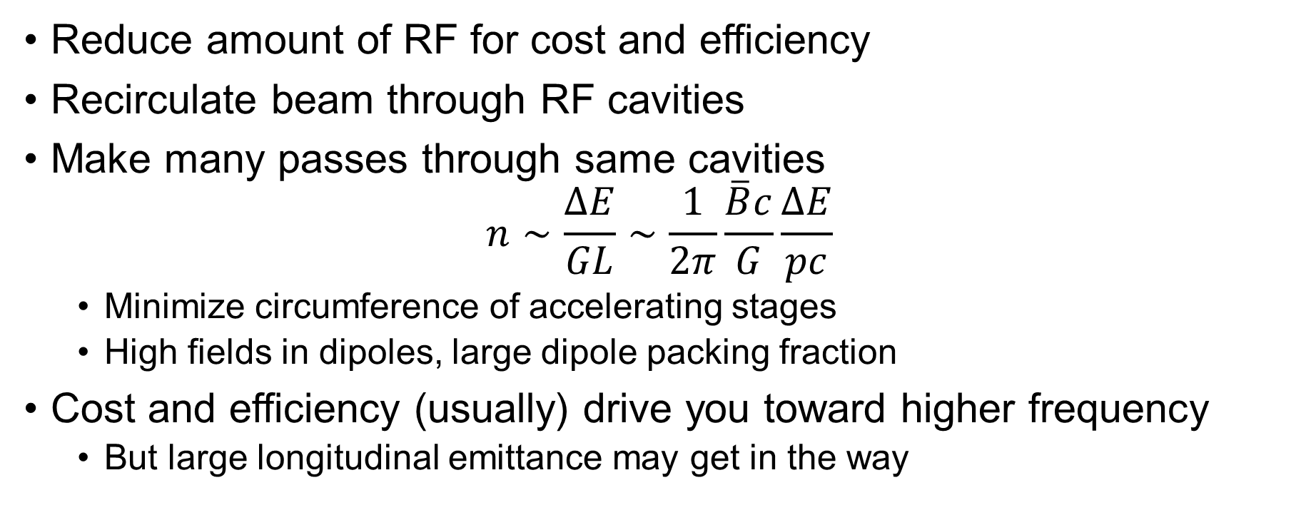
RF Cavities
Reduce amount of RF for cost and efficiency
Recirculate beam through RF cavities
Make many passes through same cavities
$n∼\frac{ΔE}{GL}∼\frac{1}{2π}\frac{\overline{B}c}{G}\frac{ΔE}{pc}$
  Minimize circumference of accelerating stages
  High fields in dipoles, large dipole packing fraction
Cost and efficiency (usually) drive you toward higher frequency
  But large longitudinal emittance may get in the way

Slide 7
Outline of the Acceleration Process
Initial acceleration from 3–4 MeV in a linac
  Impractical to recirculate with a reasonable average gradient
Once the beam size and energy spread have reduced sufficiently, accelerate in a CEBAF-like recirculaing accelerator
  Make a few passes through RF

Slide 8
Outline of the Acceleration Process
Once the orbit period becomes long enough, switch to using ramped magnets
  Enables 10s of passes through the RF

Slide 9
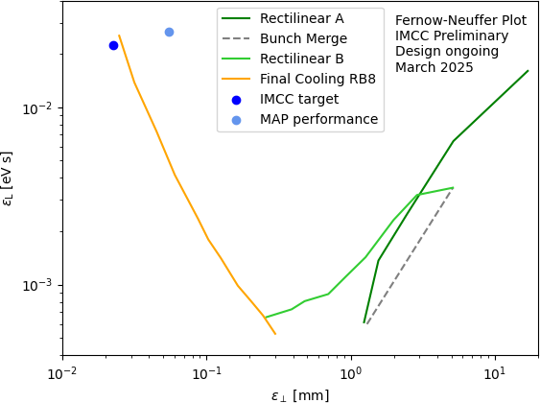
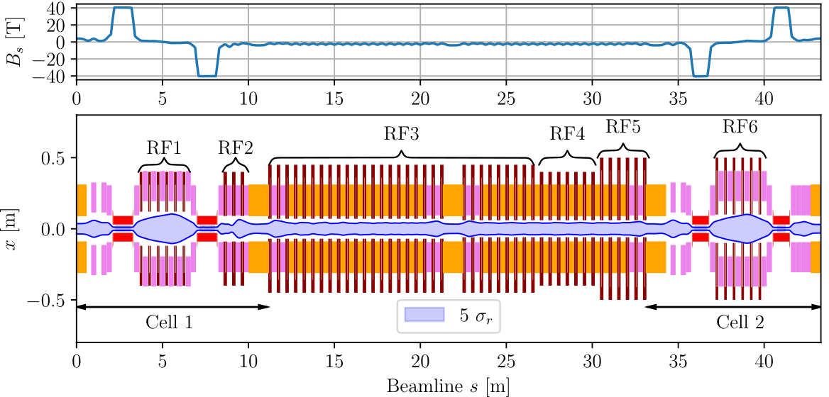
Ionization Cooling
Rectilinear cooling with bunch train
Bunch merge
Rectilinear cooling with single bunch
Final cooling: exchange transverse/longitudinal

Slide 10
Final Cooling Lattice, Re-Acceleration
Absorbers in high field solenoids
RF between to manipulate beam and re-accelerate
RF operates in much lower solenoid fields
Can reaccelerate with this:
  No high field solenoids and
  matching
  RF manipulations should be
  simpler/shorter

Slide 11
Final Cooling Lattice, Re-Acceleration
Parameters from last stage of final cooling:
  11 ns RMS bunch length
  8 MHz RF
Basic concept is to use accelerating RF used by final cooling
  Switch to higher frequencies and higher gradients as quickly as possible
  Will be accelerating well off-crest
  Early accelerating gradients will be well below 1 MV/m
    What kinds of gradients can be achieved with low-frequency RF or induction linacs?
  Estimate >30% decay before one can use higher gradient RF (~100 MHz?)
Lower longitudinal emittance from cooling would help!

Slide 12
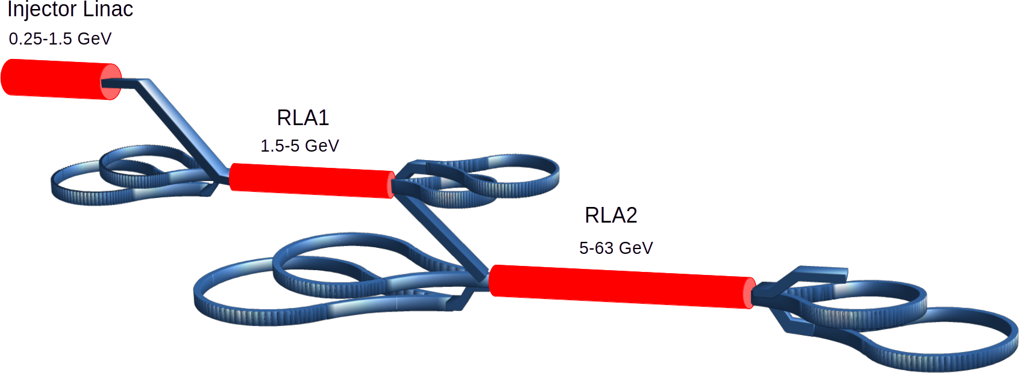
Low-Energy Acceleration
Once we’ve reached ~250 MeV KE
Possible to start using higher gradient SCRF
MAP layout: SC linac and two RLAs, reaching 63 GeV
Initial challenge: large longitudinal emittance
  Quick estimate says 350 MHz
  SCRF won’t work until at least
  about 500 MeV, so forced to use
  lower frequencies
IMCC work: primarily A. Aksoy

Slide 13
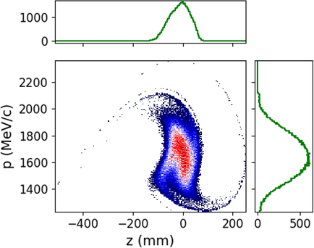
IMCC Design: Linac
Start with 88 MHz RF (probably warm?)
  Also use 176 MHz to manipulate bunch, control emittance
At about 750 MeV, compress bunch and go into 352 MHz linac
  Again, include 88/176 MHz RF to control longitudinal distribution
Significant longitudinal distortion by the end
  Lower frequency would be better
Average accelerating gradient 1.25 MV/m

Slide 14
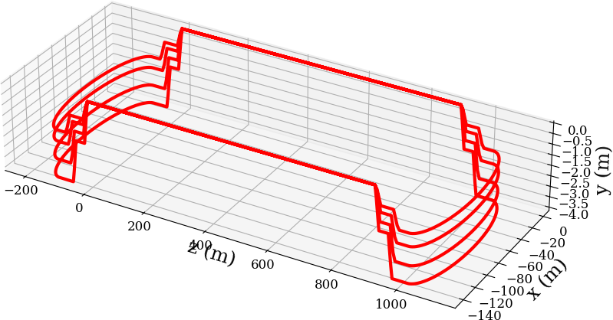
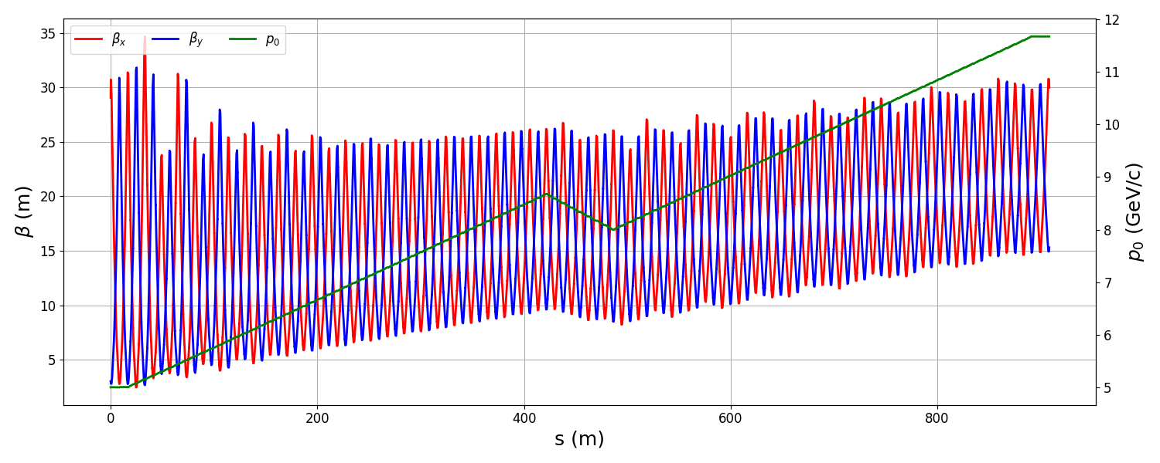
IMCC Design: RLA2
Switched to racetrack configuration, vertical separation
Arcs: second-order achromat due to energy spread
352 MHz RF, with 1056 MHz harmonic
to manage longitudinal distribution

Slide 15
IMCC Design: RLA2
Have full start to end simulation
Good average accelerating gradient, ~5 MV/m
In MAP we assumed using stored energy only
  Replacing RF power would require a few MW into an input coupler
  1056 MHz stored energy will drop much faster than 352 MHz
  Does it make sense to run lower gradient and lower loaded Q (cold or warm)?
Can’t just keep adding turns: orbit separation issues in the switchyard.

Slide 16
Pulsed Synchrotrons to High Energy
Once acceleration time is long enough, can ramp magnets like in a synchrotron
Pulsed magnets need to be iron-dominated to change fields on a ms time scale
Iron dipoles will be limited to a bend field of 1.75 T
  2.0 T if you use Fe-Co, but cobalt might be a radiation problem
With only iron dipoles, could only accelerate to 1.3 TeV on the Fermilab site
  Not even accounting for quadrupoles, RF, etc.
Need to get a higher average bend field

Slide 17
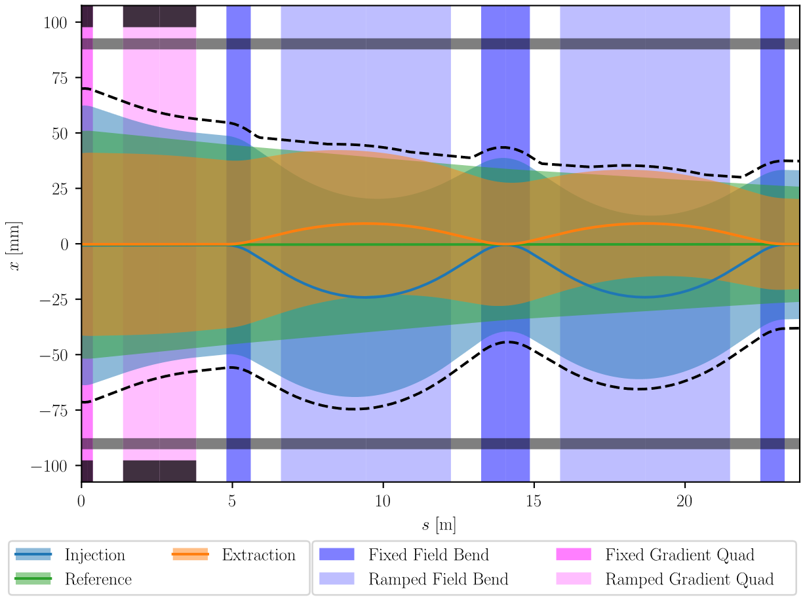
Hybrid Dipoles
Need higher average bend field with changing magnetic field
Mix constant field superconducting magnets with iron magnets that bend backward at low energy and forward at high energy
More SC magnet: higher energy; more iron magnet: more range

Slide 18
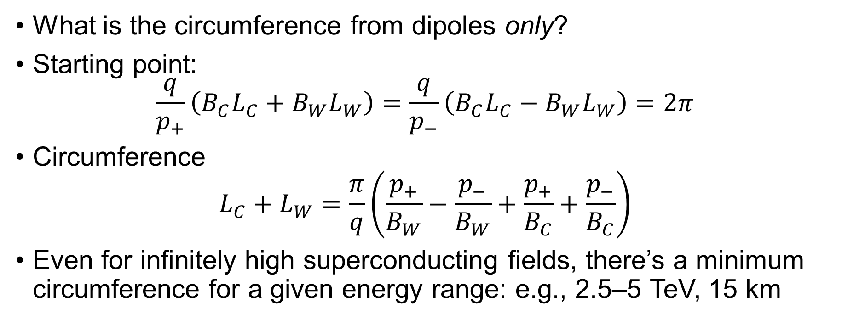
Dipole Field and Circumference
What is the circumference from dipoles only?
Starting point:
$\frac{q}{p_{+}}\left(B_{C}L_{C}+B_{W}L_{W}\right)=\frac{q}{p_{−}}\left(B_{C}L_{C}−B_{W}L_{W}\right)=2π$
Circumference
$L_{C}+L_{W}=\frac{π}{q}\left(\frac{p_{+}}{B_{W}}−\frac{p_{−}}{B_{W}}+\frac{p_{+}}{B_{C}}+\frac{p_{−}}{B_{C}}\right)$
Even for infinitely high superconducting fields, there’s a minimum circumference for a given energy range: e.g., 2.5–5 TeV, 15 km

Slide 19
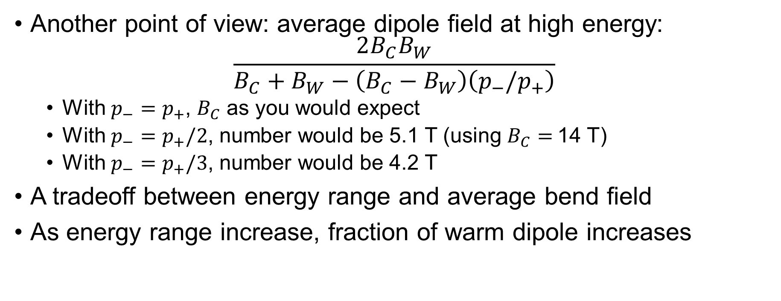
Dipole Field and Circumference
Another point of view: average dipole field at high energy:
$\frac{2B_{C}B_{W}}{B_{C}+B_{W}−\left(B_{C}−B_{W}\right)\left(p_{−}/p_{+}\right)}$
  With $p_{−}=p_{+}$, $B_{C}$ as you would expect
  With $p_{−}=p_{+}/2$, number would be 5.1 T (using $B_{C}=$14 T)
  With $p_{−}=p_{+}/3$, number would be 4.2 T
A tradeoff between energy range and average bend field
As energy range increase, fraction of warm dipole increases

Slide 20
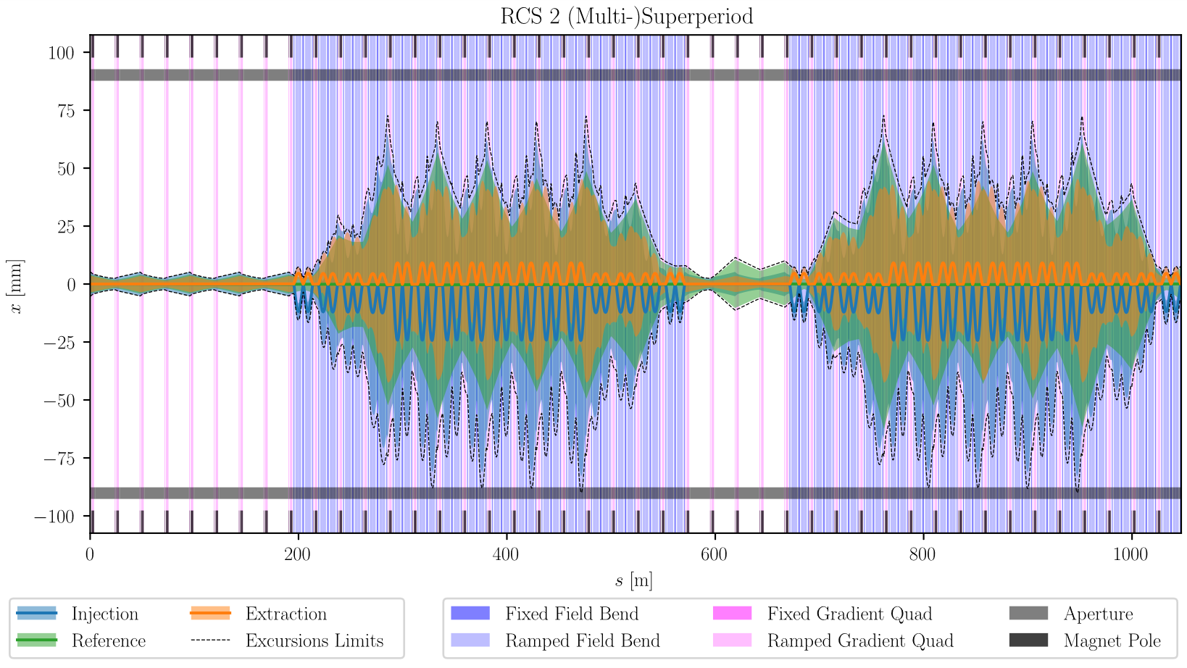
Pulsed Synchrotrons: Overview
Several rings, accelerating in stages from 63 GeV to 5 TeV
Each ring has a number of RF stations evenly distributed around the ring
Between the RF stations are FODO
arcs with dispersion suppressors on the
ends

Slide 21
Pulsed Synchrotron: Design Approach
Two different approaches have been taken
US (Kyle Capobianco-Hogan and myself): bottom-up approach
  Use Tevatron and Fermilab site boundary circumferences as guidance
  Starting with 63 GeV and working up in energy, design lattices with realistic elements, find the best energy reach
  I will talk mostly about these designs
IMCC (several people)
  Start with high level parameters and design lattices to reach those goals
  Have done early simulations based on high-level parameters (longitudinal dynamics, collective effects)
  They’re putting together detailed designs for their lattices

Slide 22
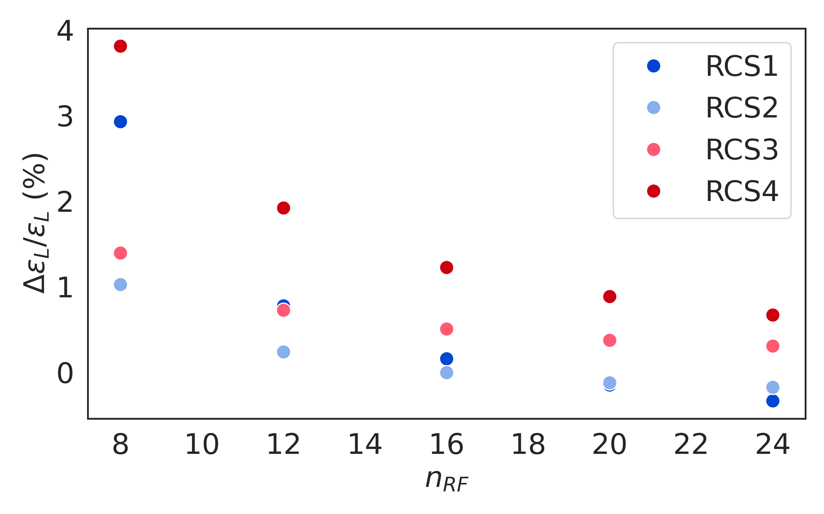
Number of RF Stations
Large amount of energy gain at each RF station
Discretization of energy gain creates issues
Large synchrotron phase advance per station
  Ring synchrotron tune ~1
  Synchrotron tune per RF station needs to be below ~0.15
Magnets ramp continuously, energy mismatched to magnet field
These effects push us to more RF stations
But dipole packing fraction worse with more stations

Slide 23
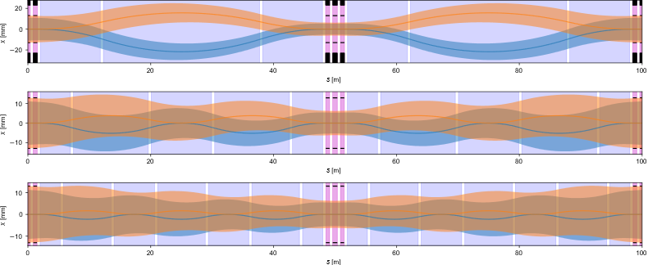
Subdividing Dipoles
Hybird dipoles lead to large orbit excursions in dipoles
  More stored energy in pulsed magnets, power supply cost
  Larger apertures in superconducting magnets
  Larger beam pipes or repeated aperture changes (impedance)
Can have more switches
between fixed and ramped
  Reduces aperture
  Cost is lower dipole packing
  fraction

Slide 24
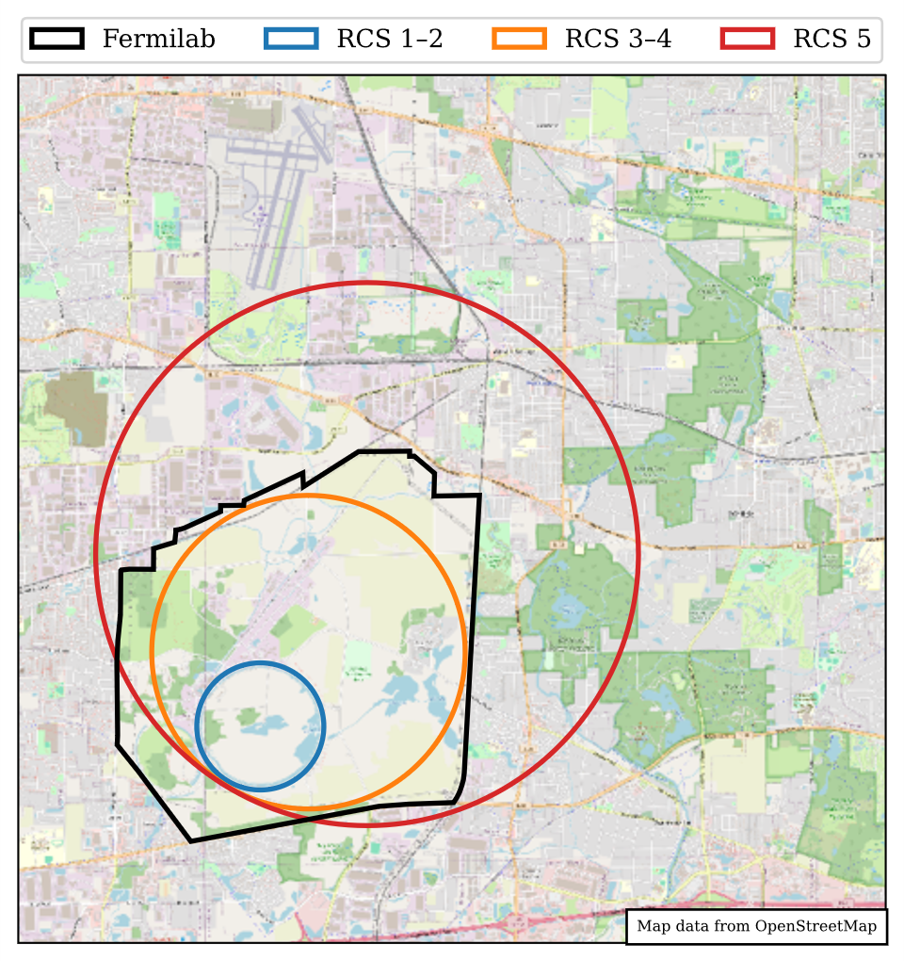
Fermilab Site Example
 | RCS1 | RCS2 | RCS3 | RCS4 | RCS5
Injection Energy (TeV) | 0.063 | 0.174 | 0.454 | 1.54 | 3.46
Extraction Energy (TeV) | 0.174 | 0.454 | 1.54 | 3.46 | 5.00
Circumfernce (km) | 6.28 | 6.28 | 15.5 | 15.5 | 26.8
Superperiods | 12 | 12 | 12 | 6 | 6
Ramped Bend (%) | 33.1 | 26.4 | 42.0 | 45.1 | 51.1
Fixed Bend (%) | N/A | 7.5 | 9.6 | 20.5 | 21.5
Quad (%) | 57.9 | 11.0 | 8.1 | 4.1 | 3.4
Average Accel. Gradient (MV/m) | 2.5 | 2.0 | 2.0 | 1.0 | 1.0
Turns | 7 | 22 | 35 | 75 | 85
Acceleration Time (ms) | 0.15 | 0.47 | 1.81 | 3.90 | 7.64

Slide 25
Notes on Design
IMCC design uses 4 rings, have an equivalent for the Fermilab site
  Fourth ring is off-site, much larger circumference
Use hybrid quadrupoles as well to improve packing fraction
Note low dipole packing fractions
Reduce gradient at high energies to get higher on-site energy
Impact of energy-field mismatch needs to be checked in simulation
Need a longitudinal matching scenario
  Want to do most of the matching in the later part of acceleration

Slide 26
Pulsed Synchrotron Simulation Studies
IMCC has done extensive simulation studies
  Longitudinal dynamics
  Collective effects (including counter-rotating bunches)
Our goal is to finalize our designs, then work with our IMCC collaborators to begin simulations
  Feed back on design parameters, particularly with regard to longitudinal
  Check the impact of energy/field mismatch
  Longitudinal matching through the chain

Slide 27
Pulsed Magnets
We need magnet fields to go from either their minimum field or full field negative to full field positive, sometimes in less than 1 ms
Only one test demonstrating ramping a magnet at this rate to high field (Summers, 2012)
  No detailed prediction and analysis of the experiment from simulations
  Note loss: 15%/cycle

Slide 28
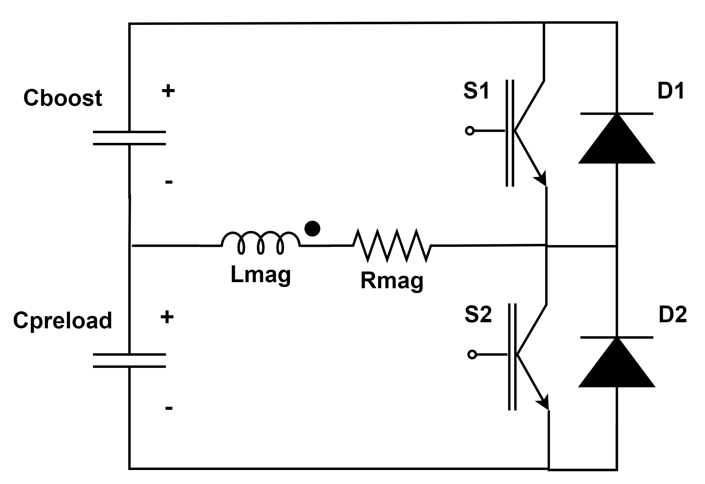
Pulsed Magnet Power Supply
Large amount of stored energy in pulsed magnets
Energy must be transferred in ms timescales
10s of MJ stored energy, 10s of GW peak power
Efficiency extremely important
Need a ramp nearly linear with time,
well-controlled
CERN has done significant work, have a design
with preload and boost capacitors to get nearly
linear ramp

Slide 29
Pulsed Magnets: Prototyping Program
Measure iron response in detail at high ramp rates and fields
Build a small scale prototype
  Designed for low losses as for a production model
  Small to make power supply manageable
  Measurements of voltage, current, field for varying ramp rates and fields
  Goal is to ensure we understand the magnet response
Build a prototype power supply for a full size magnet
Drive a full size magnet with the power supply

Slide 30
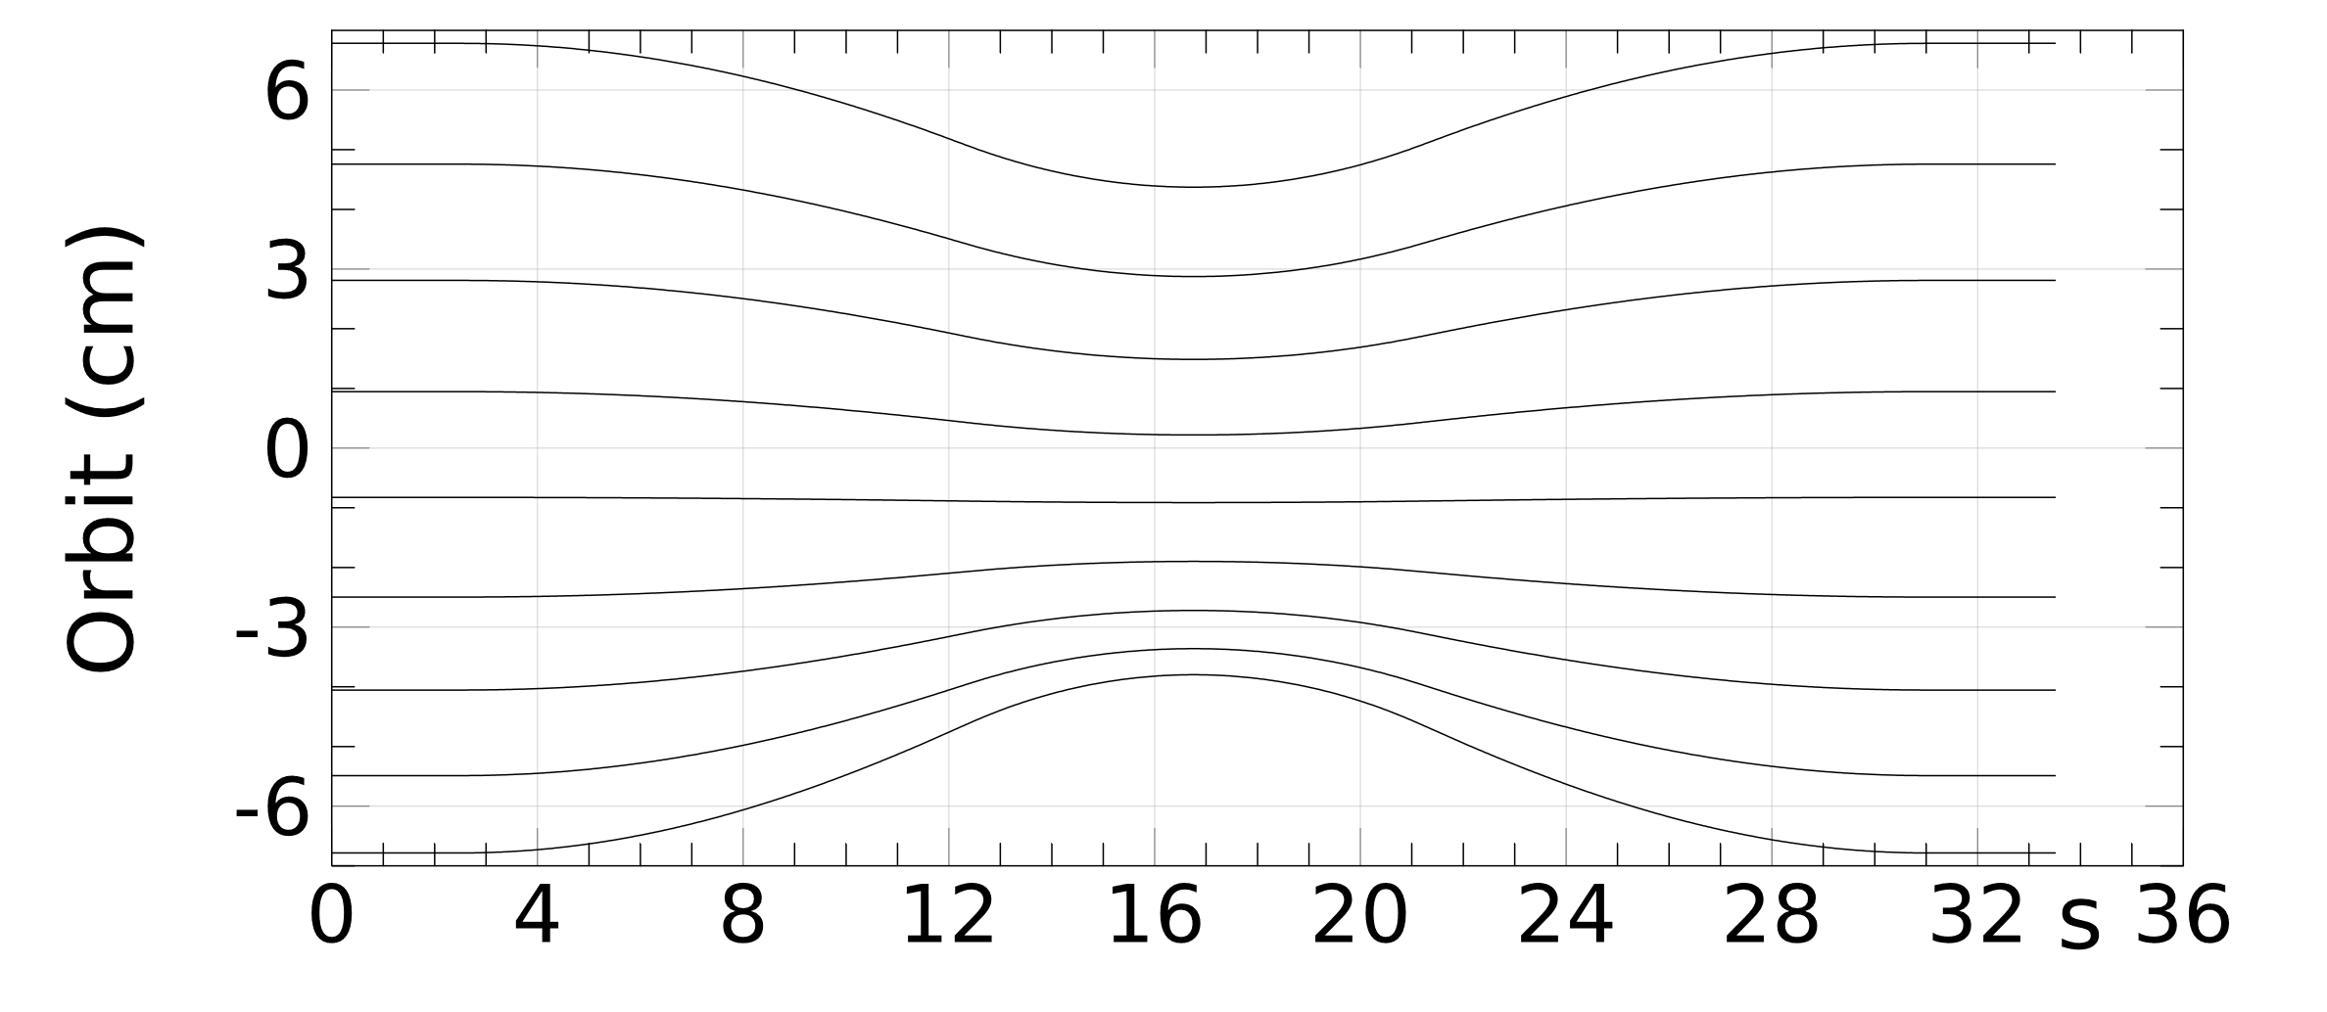
What is an FFA
Fixed Field Alternating gradient accelerator
Large energy range (e.g., factor of 2) in a single beamline
Magnet fields do not vary with time
Alternating gradient focusing in compact cells for small orbit excursion
Motivation for muon acceleration:
superconducting-only solution that
will scale with magnet technology;
overcome the limited field in iron

Slide 31
What is an FFA
A single cell is duplicated around the ring
Each cell has a long drift that can contain an RF cavity
  Also used for injection/extraction/etc.
For muons: accelerate both signs, requires reflection symmetry for consistent injection/extraction
An FDF triplet with a long RF
straight is the simplest solution

Slide 32
Existing FFA Studies
Early studies looked at FFAs for low energy acceleration
  Costs generally ended up similar to RLAs, no strong motivation
Study of FFA to 5 TeV
  Motivation: energy reach scales with superconducting magnet field
  Size for a given energy similar to pulsed synchrotron
  Injection and extraction (septum) were a problem
Vertical FFA (UK)
  Motivation: orbit period independent of energy
  Designs had very large apertures: RF problem
  Magnets are complex to build

Slide 33
R&D Topics
Once final cooling scenario becomes better settled, need to work out an early acceleration scenario
  Note that lower longitudinal emittance out of cooling will greatly help all acceleration stages and the collider ring
Continued work on low-energy acceleration designs
  Continue the lattice design effort
  Can we get away without third harmonic? Beam loading. Lower RF gradient might help here.

Slide 34
R&D Topics
Finalized detailed lattice designs for pulsed synchrotrons
Simulations on the Fermilab site specific designs
  Single-particle simulations
    Verify we have sufficient bucket area
    Do we have enough RF stations?
    Check effect of energy/field mismatch on transverse dynamics
    Construct a longitudinal matching scenario
    Update designs if needed
  Collective effects
    Beam loading and longitudinal wakes, counter rotating
    Transverse wakes: do we need sextupoles?

Slide 35
R&D Topics
Check neutrino radiation from straights in pulsed synchrotrons
Can we get to higher energies or more compact designs with FFAs?
  Injection/extraction septum: get longer drifts with an oval design?
  Use FFA-like techniques with pulsed magnets: best of both worlds?
Hardware R&D program for pulsed magnets
Revisit low-energy acceleration breakpoints
  Based on physics breakpoints from long ago that probably don’t apply

Slide 36
Summary
We have a good idea of how we would accelerate muons to 5 TeV
  There are plenty of challenges in the details, important to have complete, realistic designs and to simulate them “end-to-end.”
To reach our highest energies likely requires pulsed magnets that operate in a new regime. All indications are that it should work, but prototyping is needed.
The IMCC has made extensive progress beyond the MAP work
  I’ve only touched on a fraction of what they’ve done in this talk
  US collaboration with them will be essential

