Slide 1
Solenoids for the Muon Collider
March 23, 2026
K. Badgley

Slide 2
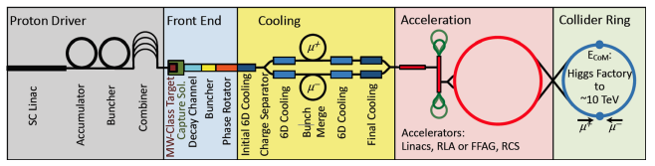
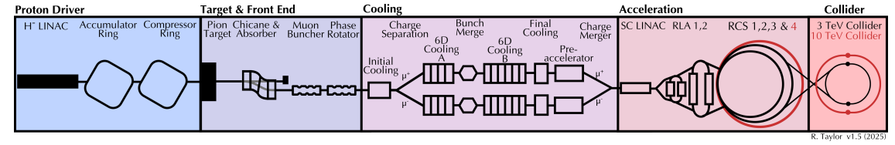
Solenoid Locations

Slide 3
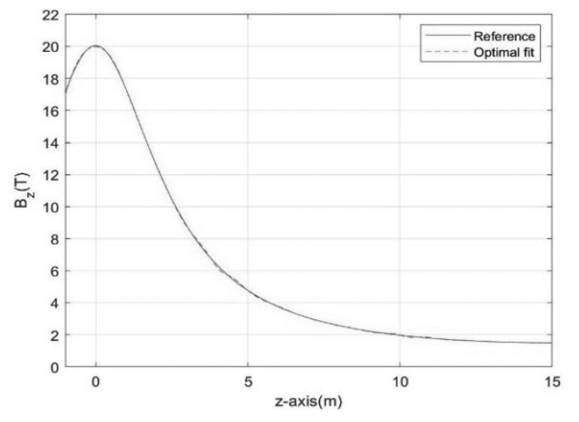
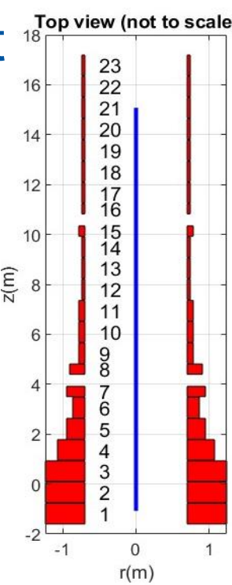
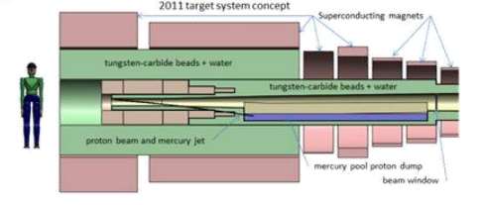
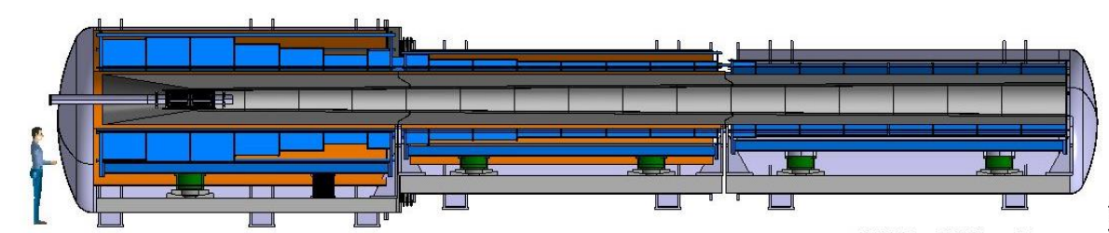
Target, Capture, Decay
Evolution of MAP design to IMCC design
Resistive hybrid to full HTS
Increased solenoids spacing for support structure
Increase bore shielding
Simplify power supply-all coils at the same current
Solenoids covered in Luca Bottura’s talk
https://indico.muoncollider.us/event/26/

Slide 4
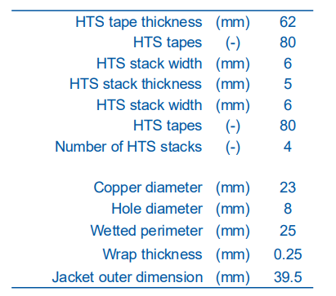
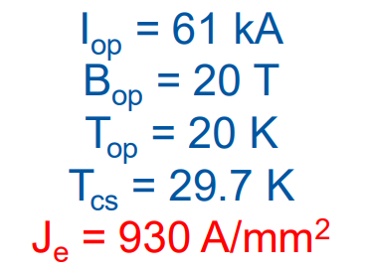
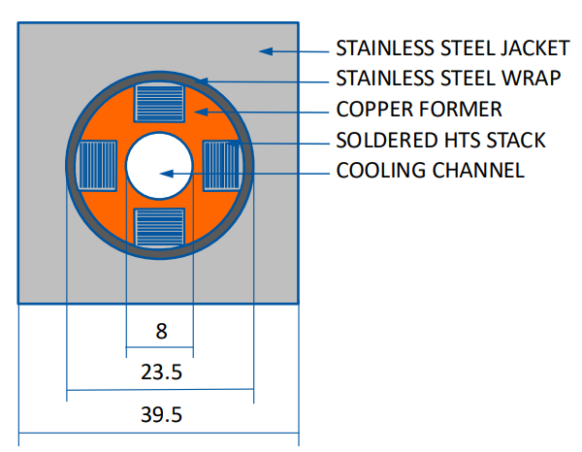
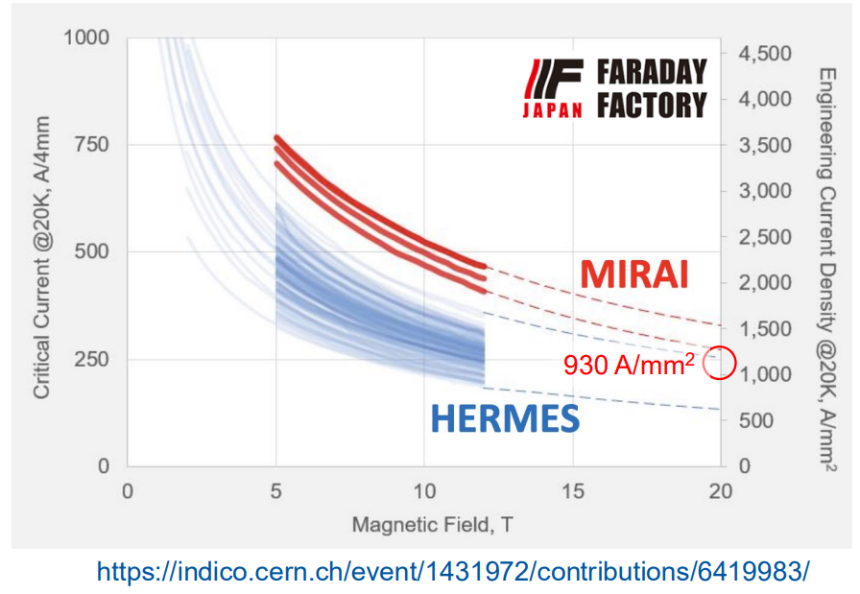
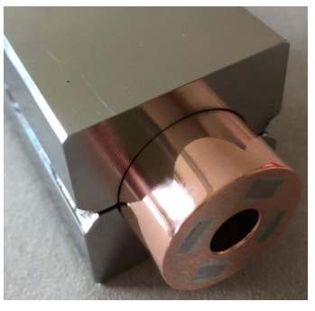
Target, Capture, Decay
Solenoids covered in Luca Bottura’s talk
https://indico.muoncollider.us/event/26/
Coil beyond state of the art

Slide 5
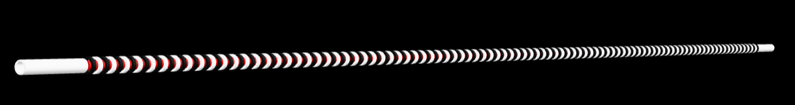
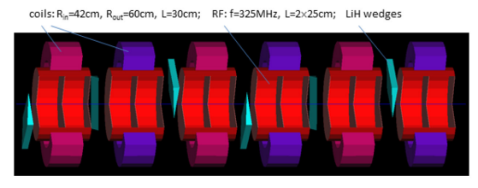
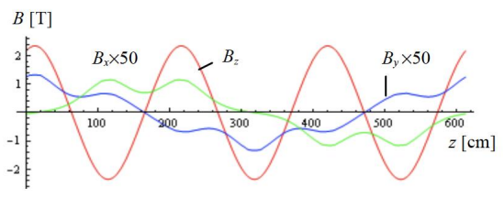
Initial cooling*
C. Riggall, 2025
Helical FOFO (HFOFO)
Alternating polarity, tilted solenoids (periodic rotations in x and z, pitch and roll) to generate rotating dipole
30 periods with 6 solenoids per period
Modest magnetic fields, current density <100 A/mm²
Can be achieved with current technology
Example of one period
D. Neuffer, 2016

Slide 6
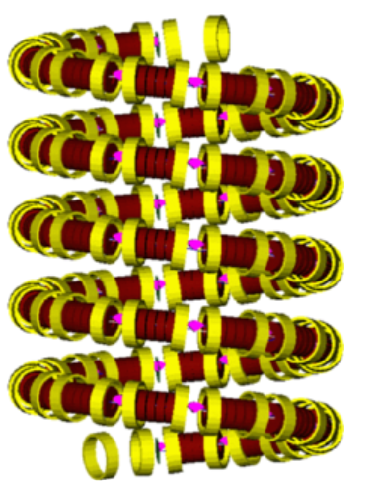
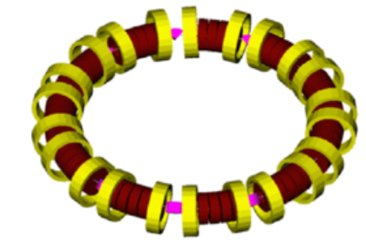

6D Cooling Schemes Considered
Ring
Guggenheim helix
Rectilinear
Not pictured- Helical

Slide 7
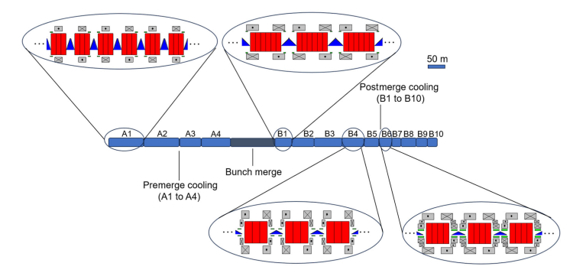
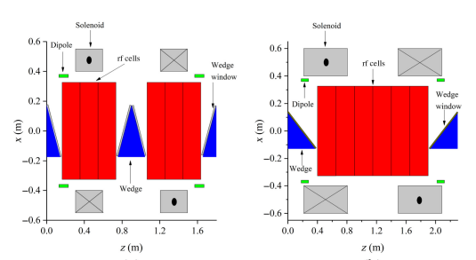
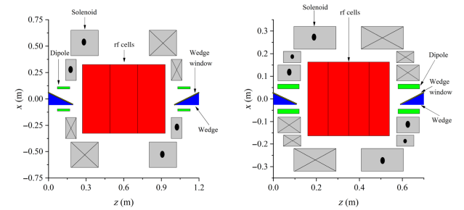
6D Cooling
Solenoids with superimposed dipole
MAP used titled solenoids
IMCC solenoids with separate dipoles
Two lattices: pre-merge (A), post-merge (B)
A 4 stages
B 10 stages (IMCC variant with shorter 8 stage)
Each stage has ~100 cells
At least three current designs, more in progress
Large forces (tens of MN) due to alternating field direction and nearby coils
R. Zhu, 2025
A1 cell
B1 cell
B4 cell
B6 cell

Slide 8
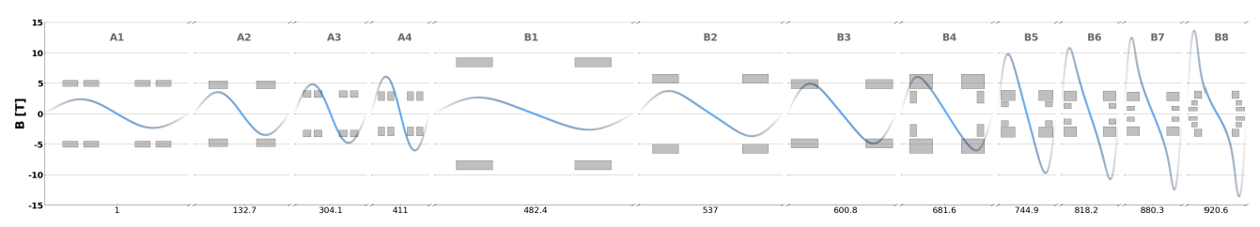
6D Cooling
Fields ~sinusoidal
Axis field from 2-17 T
Bore radius 70-600 mm
Over 25 unique solenoids
Two branches, one for each sign
One charge branch requires ~3,000 magnets, so a total of ~6,000 solenoids!

Slide 9
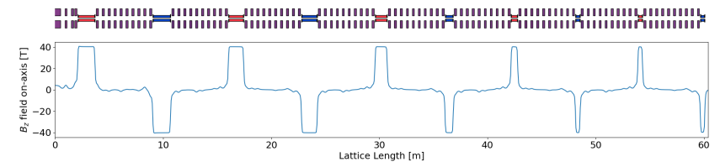
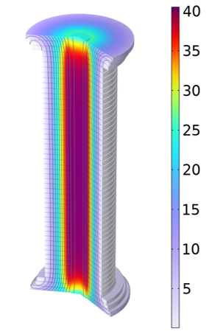
Final Cooling
https://arxiv.org/pdf/2510.27437
MAP
At least 3 lattice designs at present, depending on 6D cooling choice
IMCC- beam after 6D cooling stage 8 and after stage 10
MAP design 10 alternating high field solenoids separated by 10 lower field solenoids
Required field up to ~43 T
Current density ~632 A/mm²
60 mm
730 mm
*B. Bordini et al., "Conceptual Design of a ReBCO Non/Metal-Insulated Ultra-High Field Solenoid for the Muon Collider," in IEEE Transactions on Applied Superconductivity, 2024

Slide 10
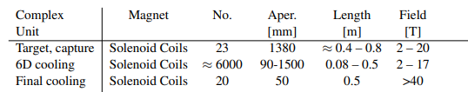
Beyond State-of-the-Art
Field vs Bore of Superconducting Solenoids
MC Final Cooling
MagLab 40 T
LTS = Low Temperature Superconductors (NbTi, Nb₃Sn)
HTS = High Temperature Superconductors (REBCo, Bi-2223, Bi-2212)
State-of-the-Art
MC Target, decay, & capture 20 K
MC 6D Cooling
Plot from Mark Bird with minor modifications

Slide 11
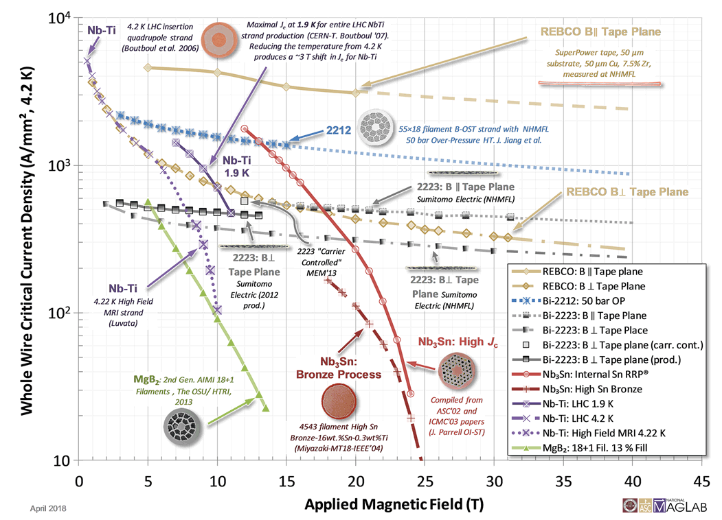

Slide 12
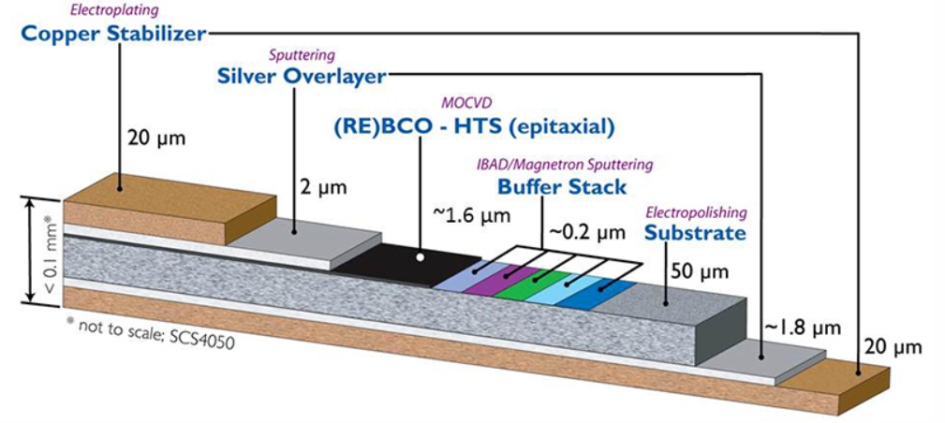
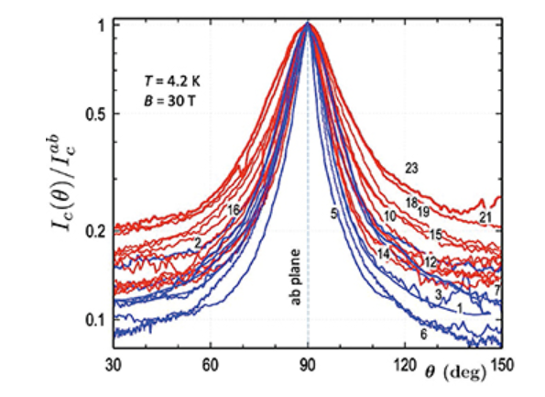
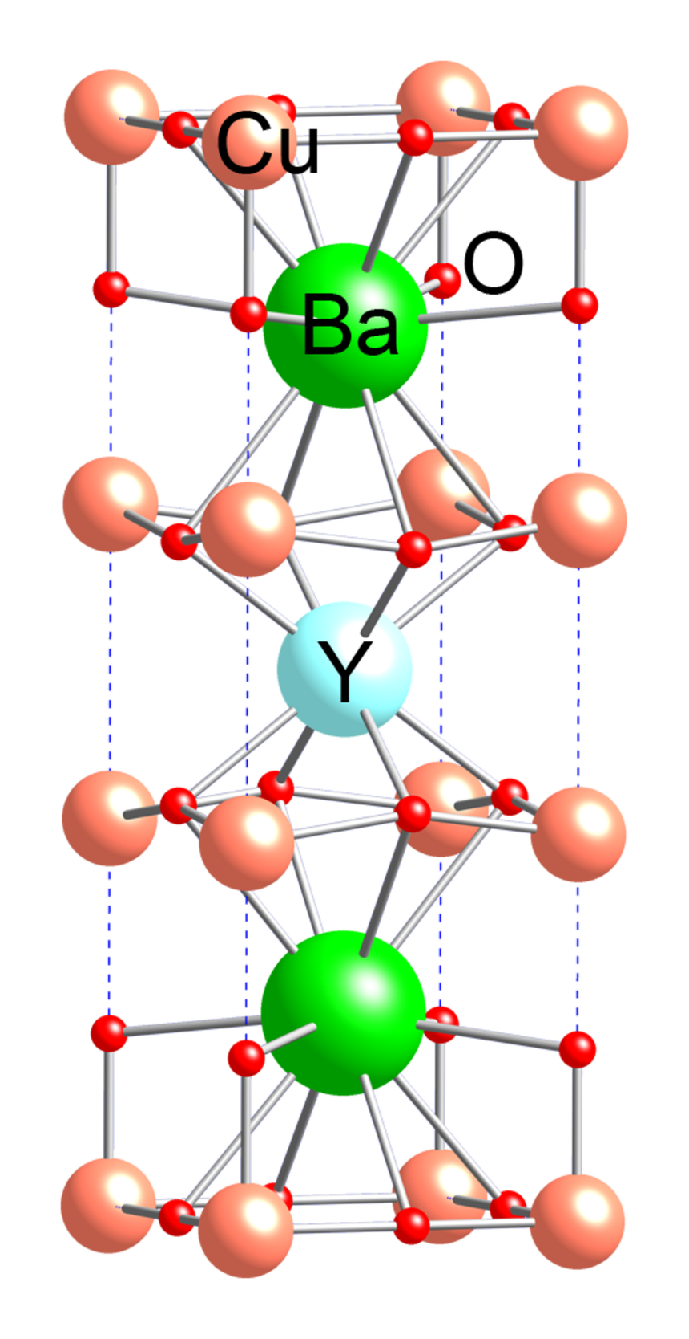
REBCO-Structure
www.superpower-inc.com
Rare-earth Barium Copper Oxide
yttrium, lanthanum, samarium, neodymium, gadolinium and europium
Fabrication
Physical vapor deposition- pulsed laser, sputtering, molecular beam epitaxy,…
Chemical vapor deposition- Metal-organic chemical vapor deposition, plasma enhanced
Atomic layer deposition
a-b plane of crystal structure ~ along plane of tape
Critical current density is highly anisotropic, depends on B field orientation to crystal structure
Design winding to minimize perpendicular field?
c
b
J Jaroszynski et al 2022 Supercond. Sci. Technol. 35 095009
a

Slide 13
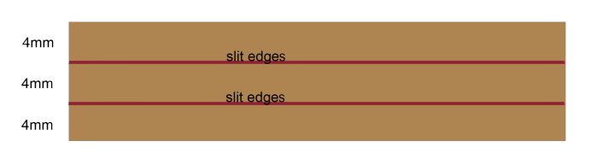
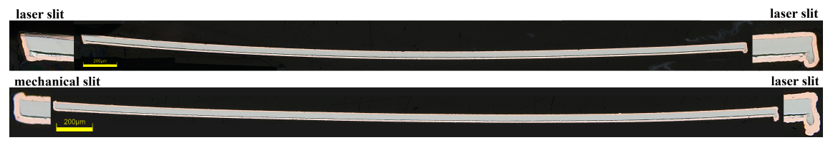
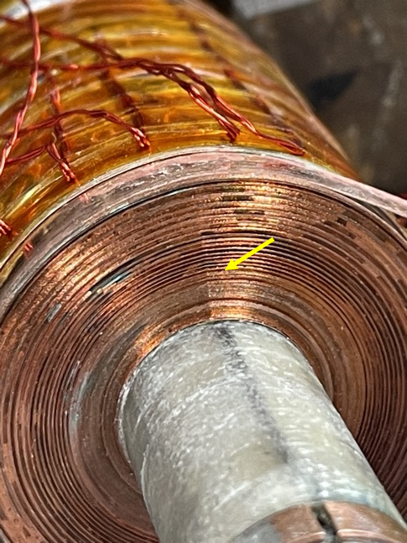
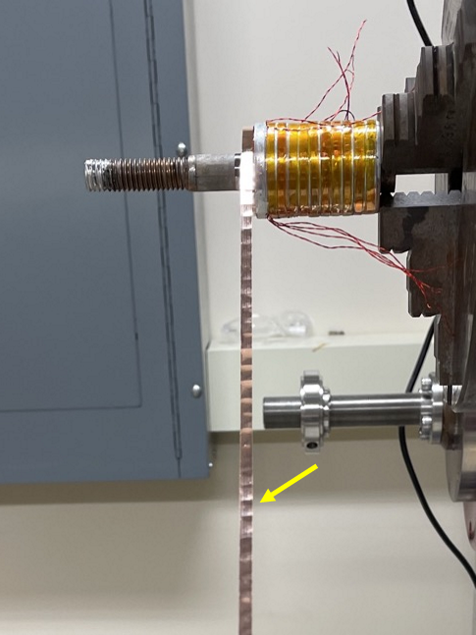
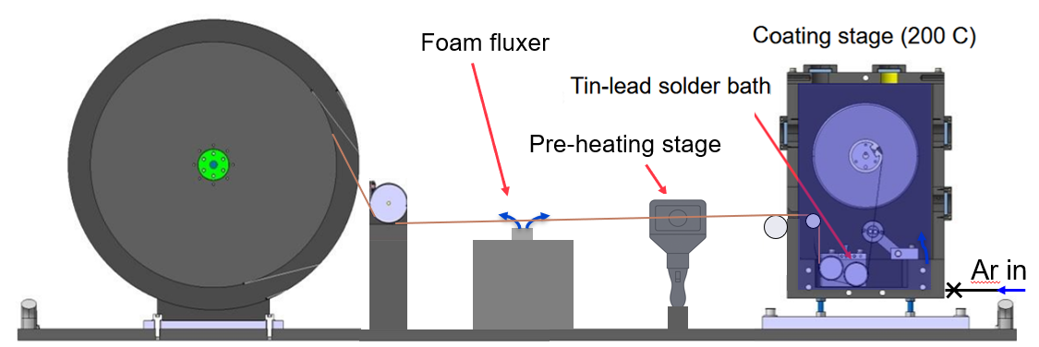
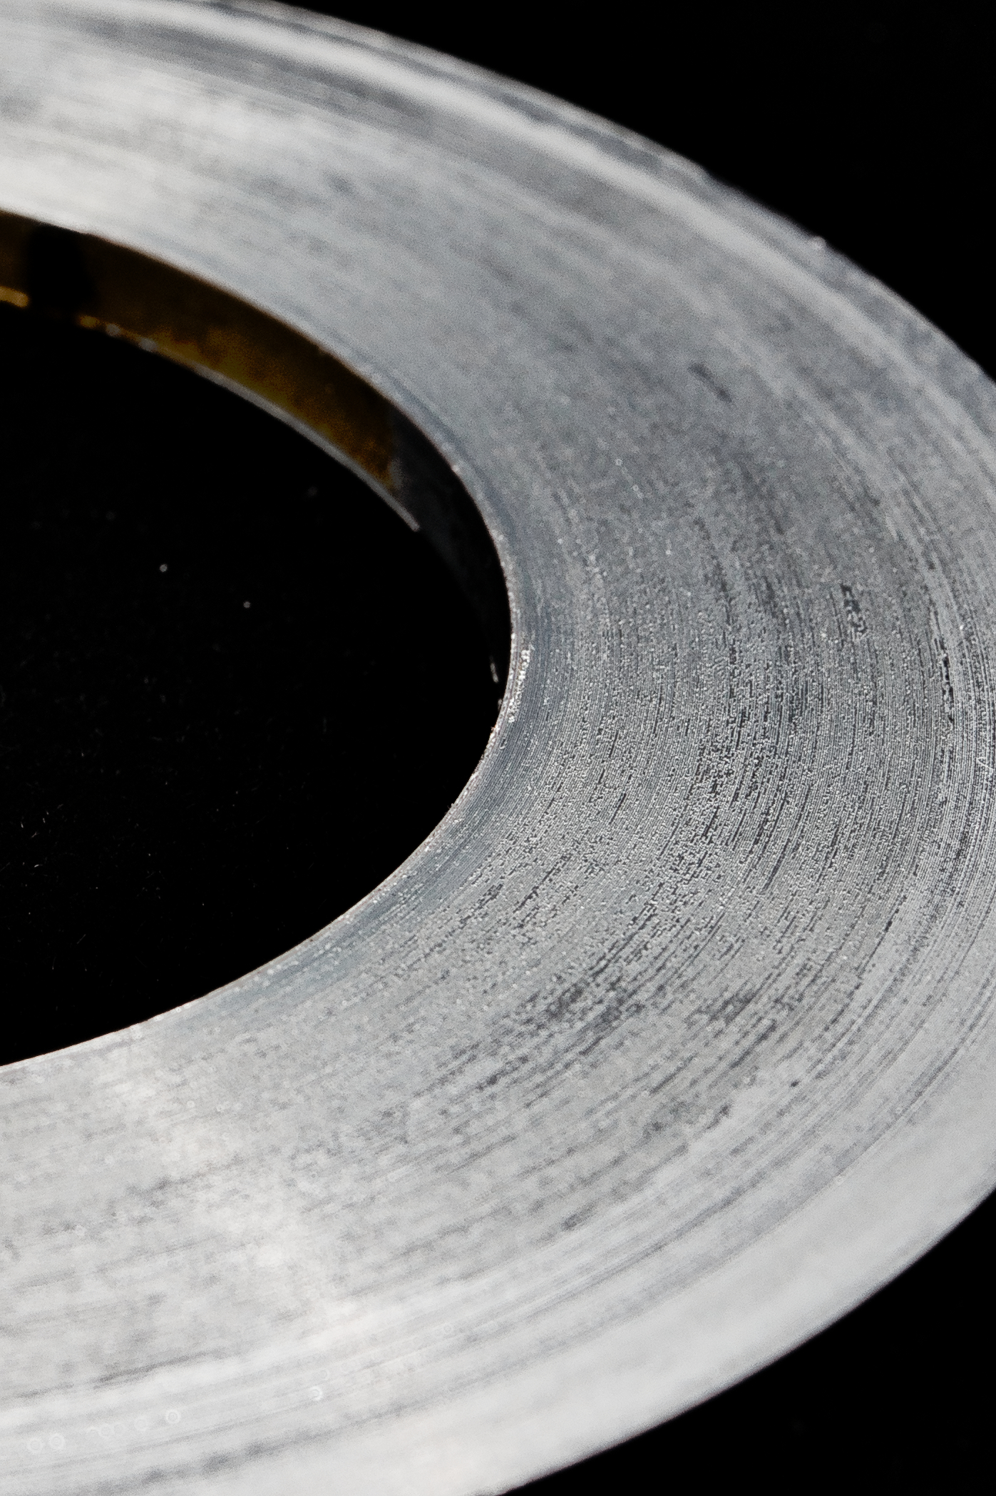
REBCO- Fabrication and Winding
Formed as wide tape and mechanically or laser slit to desired width, leads to non-uniformity in thickness at the edges
Non-uniform thickness creates voids in winding, voids lead to kinks and non-uniform turn-to-turn resistance
M. Small 2021
300 turns
J. Bang 2025 Little Big Coil
R. Unterrainer 2025

Slide 14
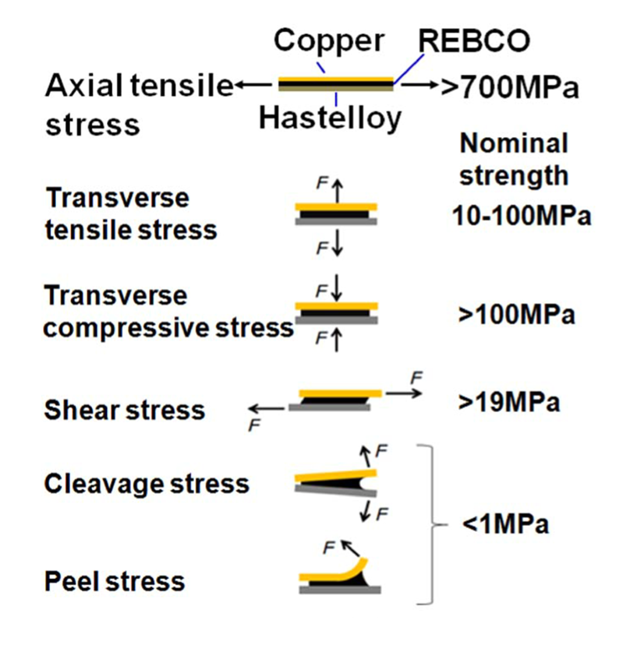
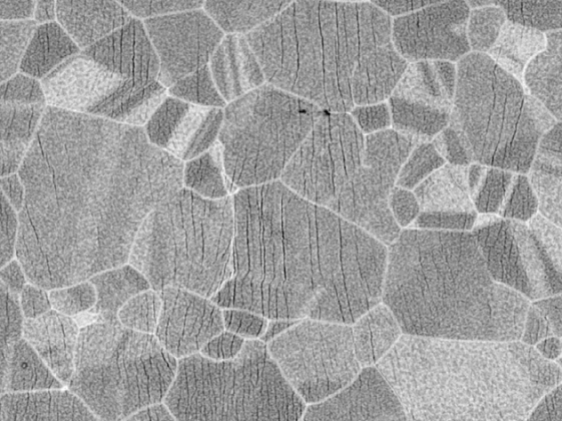
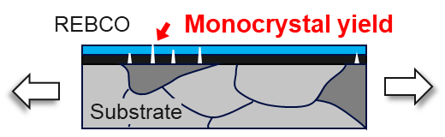
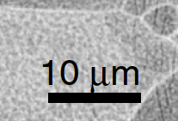
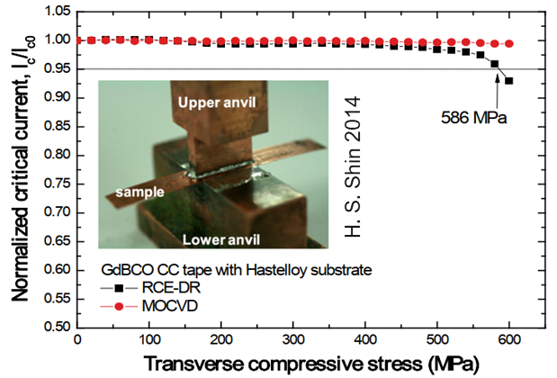
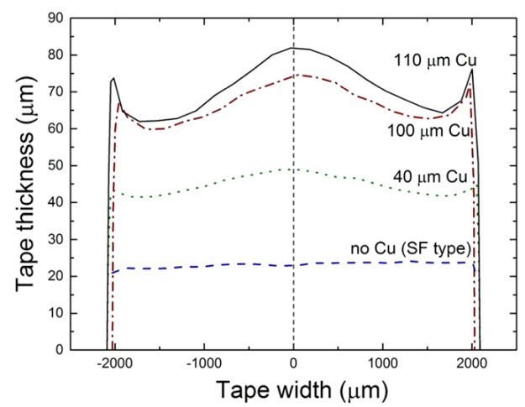
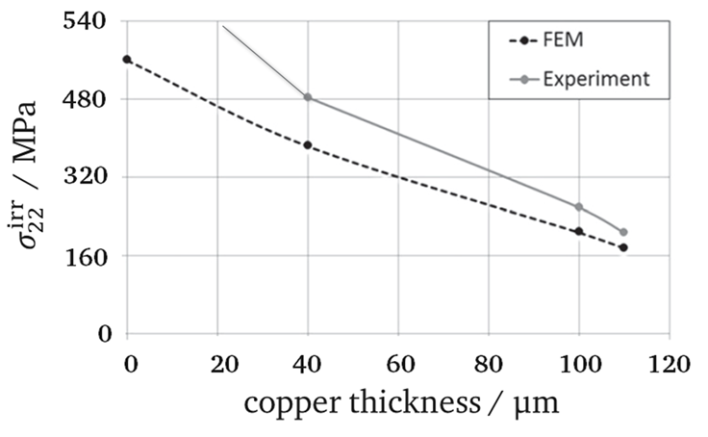
REBCO-Mechanical Limits
Longitudinal driven by plastic deformation of substrate causing cracking in REBCO
Transverse compression driven by stress concentration
Loading direction
Grains of Hastelloy
M. Sugano et al 2005 Supercond. Sci. Technol. 18 S344
Maeda et al. 2014
Limits bend radius
Several images taken from G. Vernassa’s talk Performance Limitations of UHF REBCO Solenoids

Slide 15
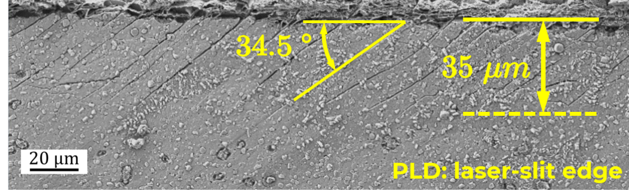
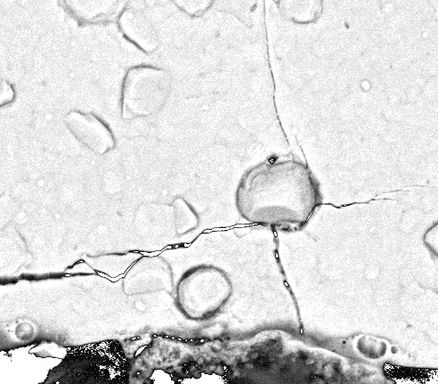
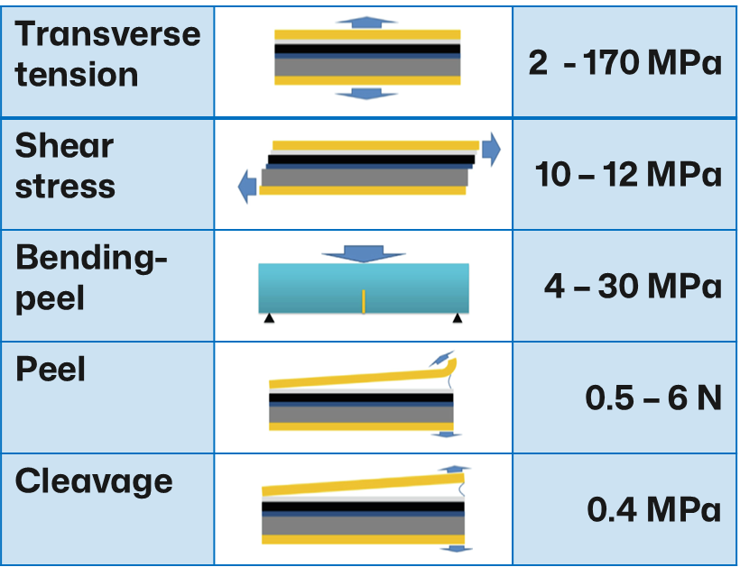
REBCO-Mechanical Limits
Cracks at slit edges
Layered structure vulnerable to delamination
Delamination driven by local defects
Cracks, delamination nucleation sites, inclusions…
Need non-destructive method of characterizing tapes
Stress concentration at crystallites
Slit edge side
Slit edge side
Ag
Ag
Mixed crack./delam.
EuBCO
Delamination
EuBCO
Y₂O₃
MgO
MgO
Y₂O₃
Al₂O₃
Adapted from P. Gao et al., Supercond. 2023
Al₂O₃
Hastelloy® C-276
1 μm
Hastelloy® C-276
2.5 μm
Several images taken from G. Vernassa’s talk Performance Limitations of UHF REBCO Solenoids

Slide 16

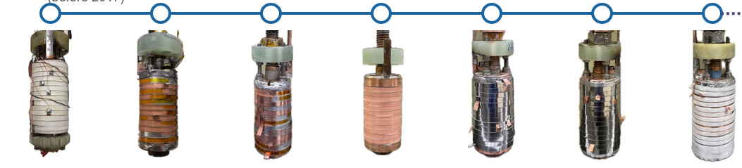
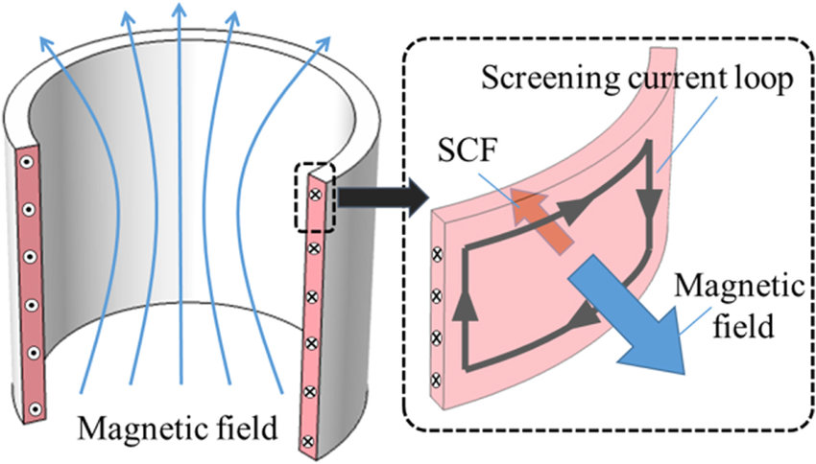
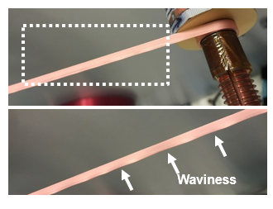
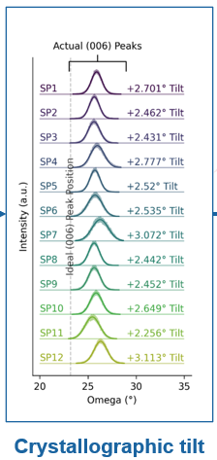
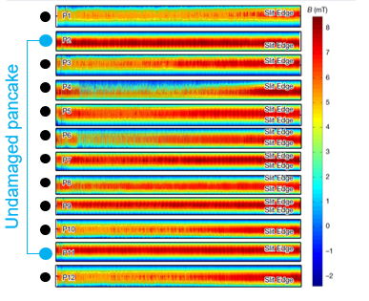
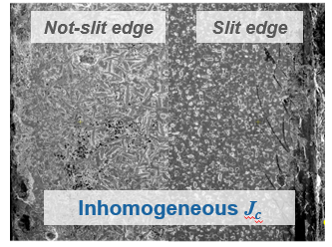
Screening Currents – Little Big Coil Program
12 NI pancakes in 31 T background field
Stress from screening current caused plastic deformation
Orientation of slit edge appeared to play a role
Result of crystal tilt and non-uniform Jc instead
M. Wang, 2019
J. Bang, 2025

Slide 17
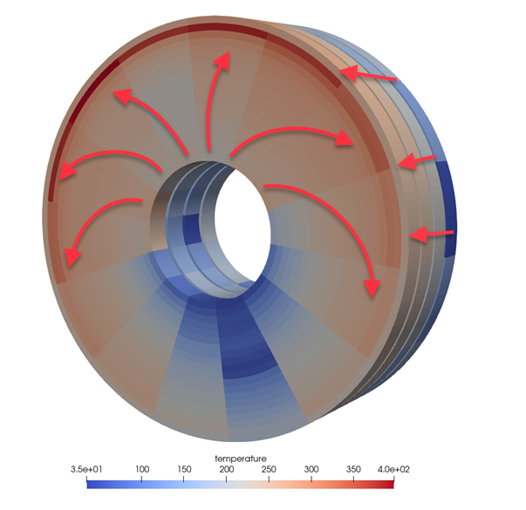
REBCO – Additional R&D Areas
YateStar measurement of critical current at 77K of SuperPower tape
Non-uniform critical current across width of tape
Use multiple tapes in parallel
Quench protection
Slow normal zone propagation ~cm/s
Non-insulated vs insulated
Low resistance splice method
Radiation damage
Need to match simulation to experiments
Couple electromagnetic and mechanical simulations
Screening currents change inductance
Test larger coils
Cooling, powering, quench protection
…
Paul Yu
T. Mulder

Slide 18



Coil Test Facilities
Commercial Facilities
Commonwealth Fusion, GA ITER central solenoid,…
Refurbish MICE/Mu2e cryostat at Fermilab

Slide 19

High Field Solenoids added to MDP
US Magnet Development Program recognized the need for high field solenoid R&D – added Area II: High Field Solenoids for HEP
“This is a new Area within MDP, and the goal is to leverage synergies with the NHMFL and Fusion applications to rapidly develop solenoid technologies tailored to HEP needs.”

Slide 20

Concluding Remarks
HTS very promising for Muon Collider Magnets, but still a considerable amount of R&D required
Conductor fabrication/characterization, magnet design, winding techniques, splice/ joint methods, mechanical structure, quench protection, cooling schemes….!
Interest from Fusion driving down cost
Muon collider magnet designs maturing
Iteration needed between HTS R&D and lattice
Number of 6D cooling solenoid types should be reduced
Facility needed for testing larger/coupled coils

